Slide 1
Circuit Diagram of the Common Quad Hybrid for the RD53 readout chip
(first draft for discussion)
Acknowledgment: Aleksandra Dimitrievska, LBL
Reference Document: “The RD53A Integrated Circuit”, CERN-RD53-PUB-17-001 V 3.42, 15/09/2018

Slide 2
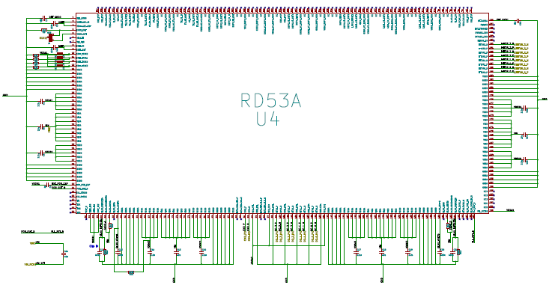
RD53A Integrated Symbol
Circuit with a whole ASIC symbol offers better “human reading” format,
while a distributed symbol is beneficial for a multi-level design. Although
the design style is a personal choice, both approaches can still complement
each other. An engineer is therefore advised to prepare two diagrams.

Slide 3
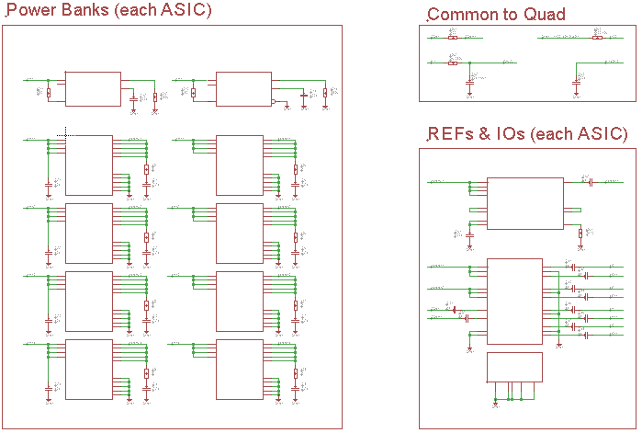
RD53A Distributed Symbol

Slide 4
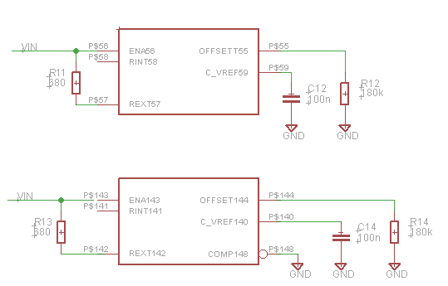
Power Shunts
Vin = Iin x Rext / 1000 + V offset
V offset = 2 x 2uA x 180k = 0.7V
(1.4V @ 1A supply current)
Total current per ASIC
with 2 shunts = 2A
Compensation for ceramic output
blocking capacitors with low ESR

Slide 5
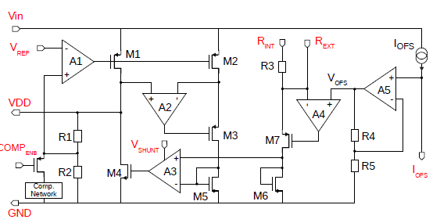
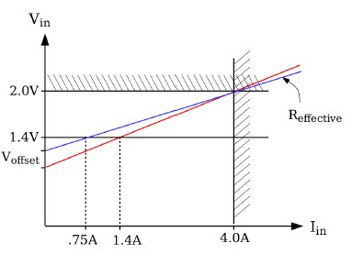
Power Shunts
V offset should be approx.
Vin / 2. It is needed to set an
operating point of analogue
circuitry between “Vin” and “GND”.
Another purpose of the Offset
Voltage is to reduce the slope of
“Vin” vs “Iin” behaviour, to make “Vin” less dependent on supply
current variation.

Slide 6
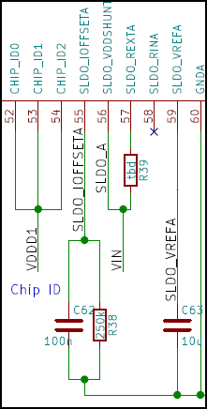
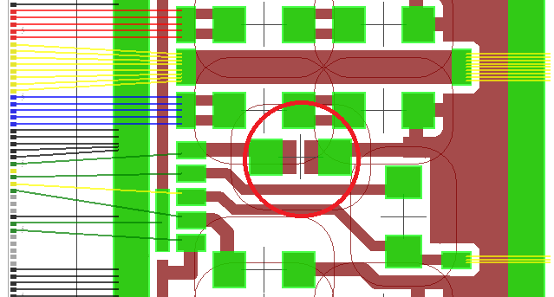
Power Shunts
Minimum value of the noise filter capacitor for the offset voltage is
yet to be tested. Parasitic capacitance of the real estate could be exploited to reduce the number of discrete components, otherwise SMD resistor and capacitor could be stack up (glued prior reflow)
to establish parallel RC circuit
V offset setting resistor = 180k

Slide 7
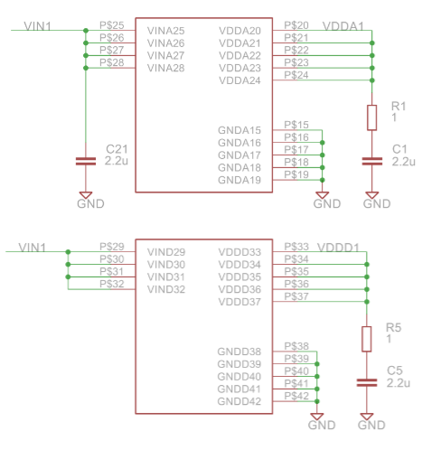
LDO Power Banks
This structure repeats 4 times
Resistor to override low ESR of ceramic capacitor for stable LDO operation.
If confirmed to be redundant,
this resistor could be removed
from the flex to reduce its mass.
Targeting AEC-Q200 parts for the power train (good value for money as compared to military grade components), the value
of 0402 size capacitor is limited
to 2.2uF – to be confirmed if this is good enough.

Slide 8
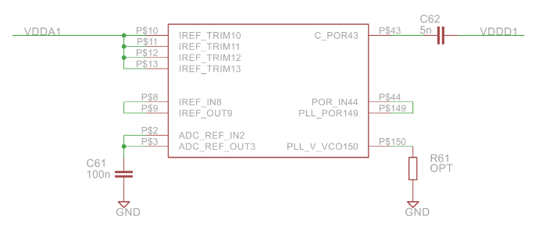
Power-On reset and References
Optional wire bond connections to trim the global reference current
Reference current
loop needs NO
blocking capacitor
“Power-On” mono-flop will
reset PLL circuit
Reference voltage loop will benefit
from the blocking capacitor
Resistor to reduce VCO frequency
(PLL in reset) to extend reset time.
It is impractical to tailor ASIC settings when it comes to detector production.
Quality control and device selection should replace the need of reference
trimming and forcing by external circuits. All reference loops could then
be done internally (with access for the purpose of monitoring and noise cut),
to save real estate and labour cost.

Slide 9
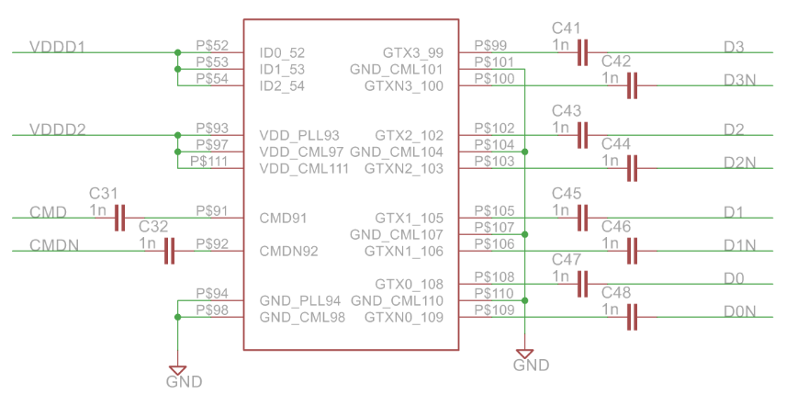
I/O Block
AC-coupling of command line is individual for each ASIC, assuming the latter is equipped with a fail-safe circuitry (irrelevant for DC-balanced transfer at 640 Mbps).
C0G capacitors
with 50V rating
& 1% tolerance
By convention, AC-coupling of data is implemented at frontend. They may later move to Data Aggregator Chip (once available) to reduce flex mass.

Slide 10
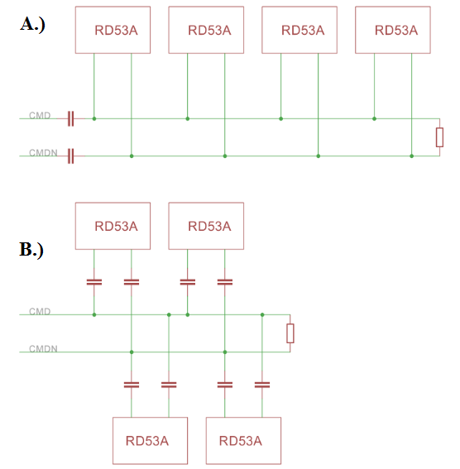
Command Distribution Tree
Circuit B.) is currently implemented, offering proper termination for CMD transmission line. Capacitors will be redundant with Data Aggregator Chip.
They however make each chip immune
against bus jamming in a multi-drop scheme in case of ASIC power failures
(ESD protection circuit may pull LVDS beyond acceptable common mode range)

Slide 11
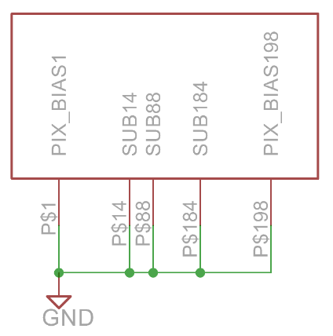
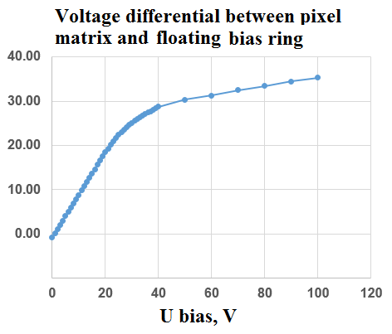
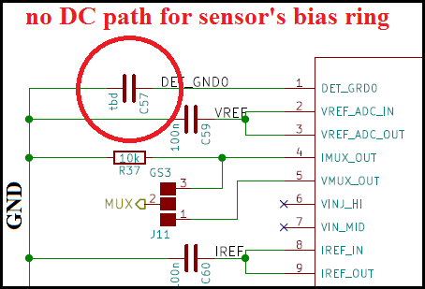
Substrate and Ground Connections
Return bias current of the Pixel Sensor
flows through the front-end circuitry of the RD53A chip. There is an additional path for return current through sensor’s
bias ring connected to the chip. The latter if left floating, will experience a built-up
“punch-through” voltage in order of 30V
violating CMOS absolute max. rating.

Slide 12
Common Circuits
NTC thermistors as a part of Detector Control System, can
be floating or referenced to the
local ground of each Quad Pixel Module in a serial-power chain.
HV return is mixed with LV supply current in a serially powered scheme. There is no dedicated pin for sensor’s bias return current.
The latter reduces the number
of cables but requires PSPP chip
in the DCS.
Resistor value is limited to 1k to cope with 10nA/pixel leakage current for irradiated sensors. Resistor size must be 0805 (0.1W) or 1206 (0.25W).
Note: PSPP V.3 operates with NTC referenced to the power
rail (conceptual mistake), that
requires floating thermistors.
HV noise filter could move to the bus tape to save real estate on the flex.

Slide 13
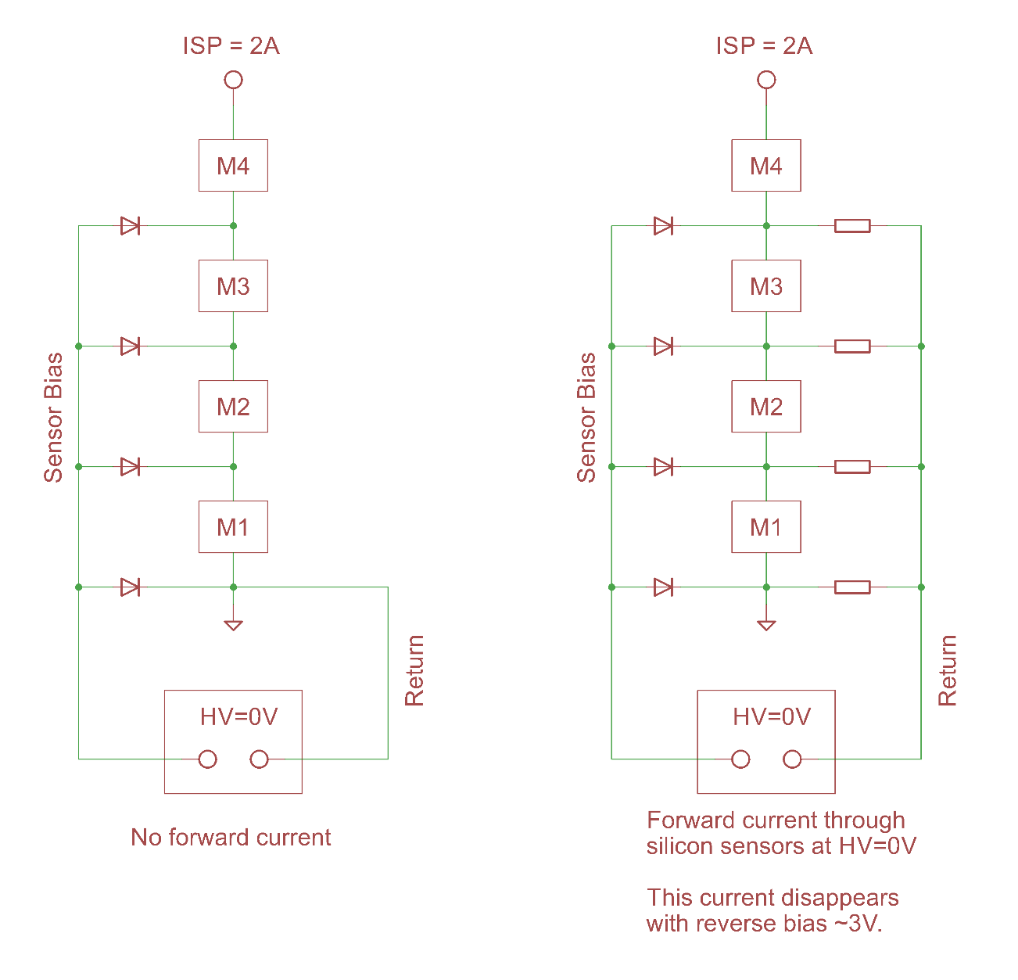
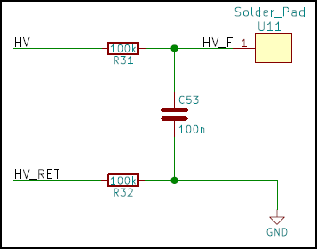
Forward Current Problem
A.) HV return of each
sensor is mixed with
LV supply current
(preferred scheme).
B.) HV return of each
sensor is distributed
by resistor network.
A.) B.)
The latter shows forward current through silicon sensors under certain conditions, see next page.

Slide 14
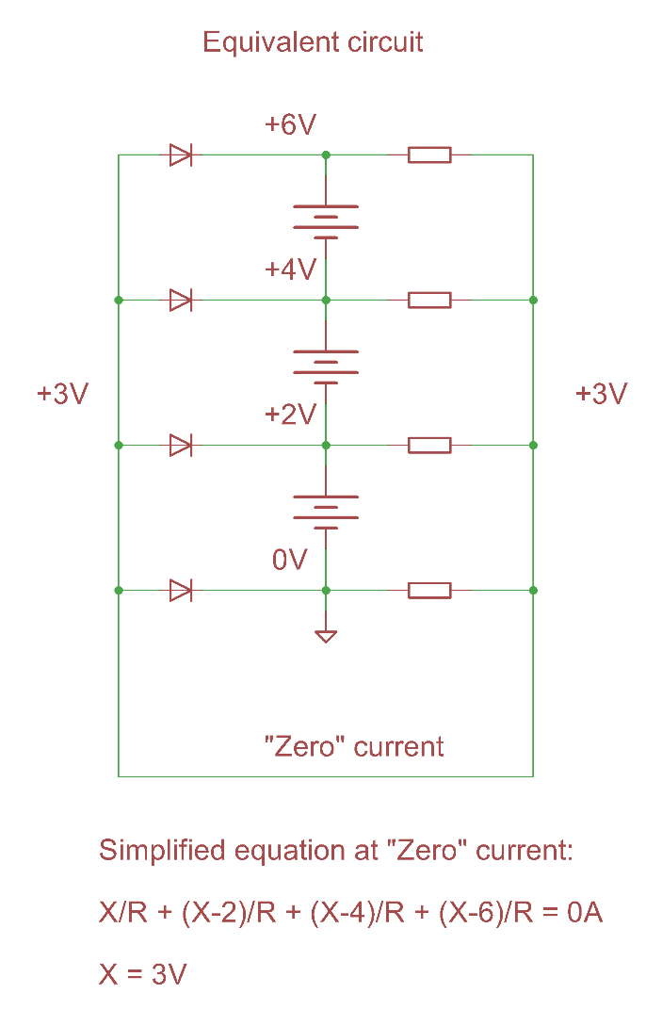
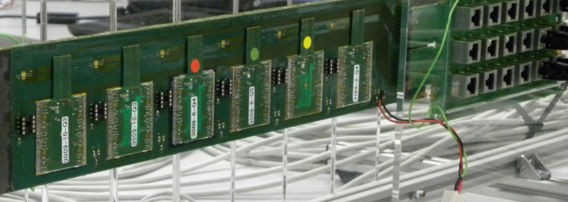
Forward Current Problem
B.)
If the chain of serially-powered pixel modules is
ON but there is no bias voltage applied to their silicon sensors yet (option “B” for HV return), a large forward current is registered through the
number of sensors down the chain.
LV=shunted; HV = shunted; Current = -0.9 uA
LV=ON (2.2A) HV = shunted; Current = +13.0 uA
LV=ON HV = 1V bias; Current = -1.3 uA
LV=ON HV = full bias; Current = -2.2 uA

Slide 15
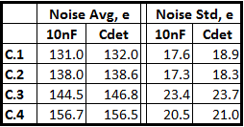
Noise Floor without HV filter
FE-I4B Quad Pixel Module
(stand-alone operation)
FE-I4B Quad Pixel Module
(in a serially-powered chain)
Supply current = 2A
Bias Voltage = 100V
Tuning:
Target threshold = 1000e
Calibration charge = 8000e
Time over Threshold = 11
Measurements in progress with capacitors being removed one by one from all Quad Modules.
As mentioned earlier, RC filter
for sensor’s bias voltage could
be shared by several modules.
Filter components will move to
the bus tape or even patch panel
Average Threshold and ToT and their dispersion
do not change after removing HV filter capacitor

Slide 16
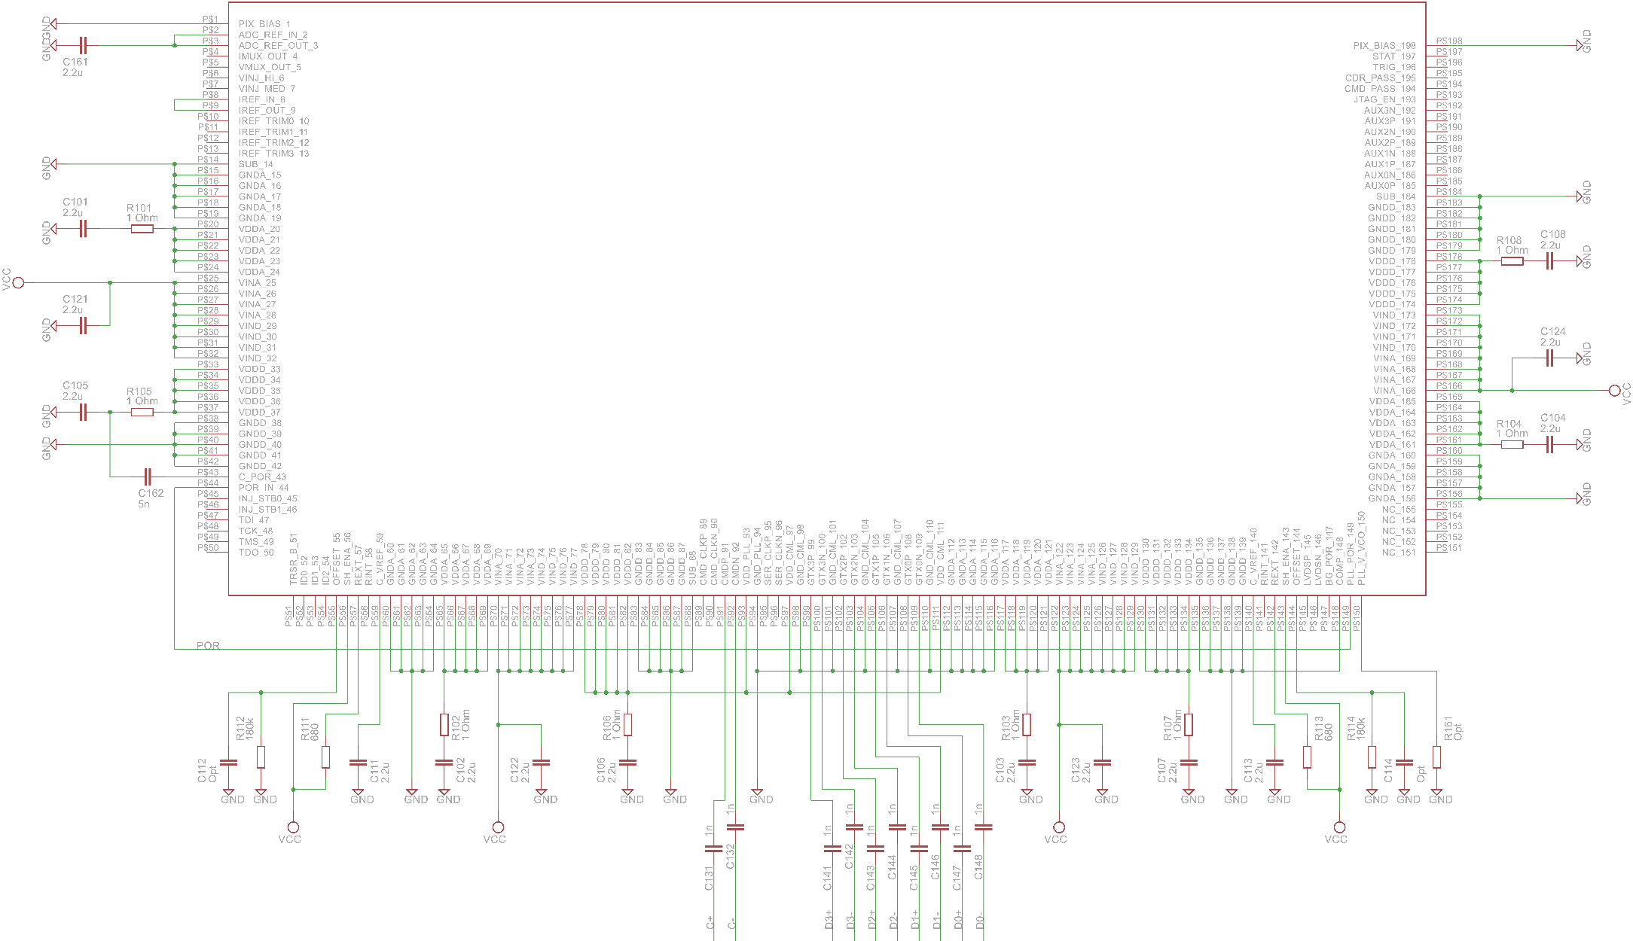
New Circuit Diagram (1 ASIC)

Slide 17
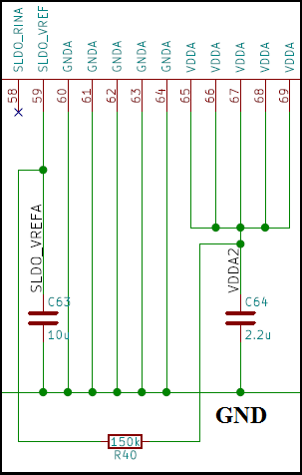
Open Questions
1.) Overriding VREFA using regulated output is a positive feedback (VDDA = 2x VREFA) with a risk of clamp or oscillations
2.) Use of 10uF capacitors in 0402 package
with (typical) 4V rating:
a.) I have registered a short circuit in this
component at 2V after a few minutes
of operation. Rigorous QC/QA needed.
b.) Tolerance of X7R components is +/-20%
c.) Capacitor value is a function of voltage,
temperature and time (!) – they do age.
d.) Radiation effects to be studied for
different manufacturers and batches.

Slide 18
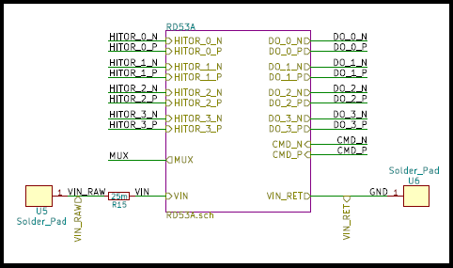
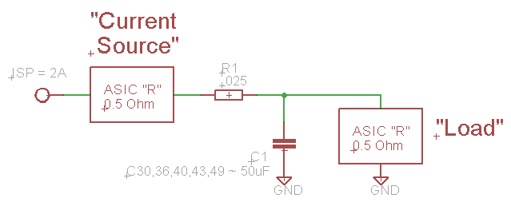
Open Questions
3.) 25 mOhm resistor per ASIC needs 1206 size for 2A current
to dissipate 0.1W without overheating – very bulky solution (!)
4.) Does SLDO need 50uF capacitor
at its input (C30+C36+C40+C43+C49)
for stability, OR can it operate with
a smaller capacitor value ? This will
depend on the bus tape inductance.
The purpose of this resistor in the power chain
is unclear (it does not contribute to RC circuit)

Slide 19
Summary, Suggestions
1. Reference voltage and current loops probably don’t need two ASIC
pads (“In” and “Out”). This circuit could stay inside ASIC with one
pad made available for monitoring / connecting blocking capacitor.
This will save real estate on the flex and reduce the risk of wire bond
failures (58u x 86u pads allow for a single bonding attempt by wedge).
2. New ASIC will benefit from a buffered pad to source voltage equal to
the one of the front-end (DC-coupled pixel matrix). Sensor’s bias ring
should be referenced to this potential instead of just tying it to ground.
3. Integrated ADC will benefit from extra pads to monitor outside voltages
(drop across shunt = input voltage, drop across NTC = temperature).
Integrated thermistors monitor temperature in different parts of the
chip while an external component (NTC) is still needed to measure
temperature of the silicon sensor.
4. HV filter can placed on the bus tape to be shared by several modules.
5. I can submit Flex prototype on FR4 to check tolerances on components
A couple of bare ASICs would be very helpful to make progress.

