Slide 1
Studies of Quad Pixel Module assembly using paper laminate
Ilya Tsurin
Liverpool University

Slide 2
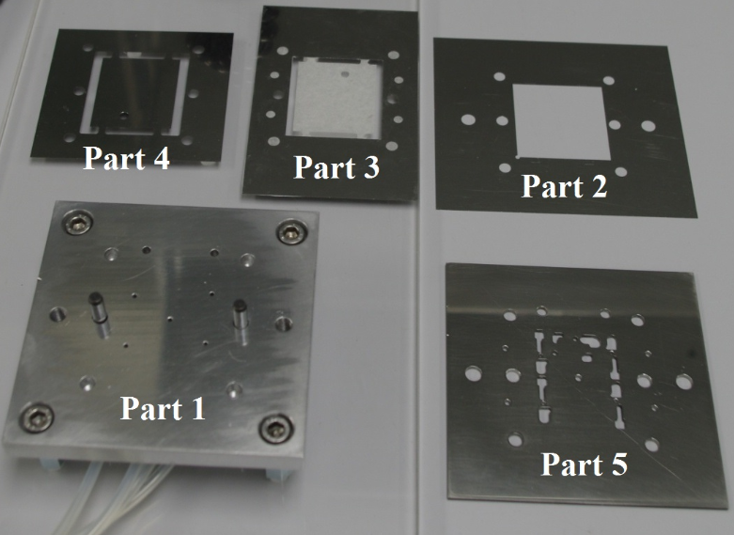
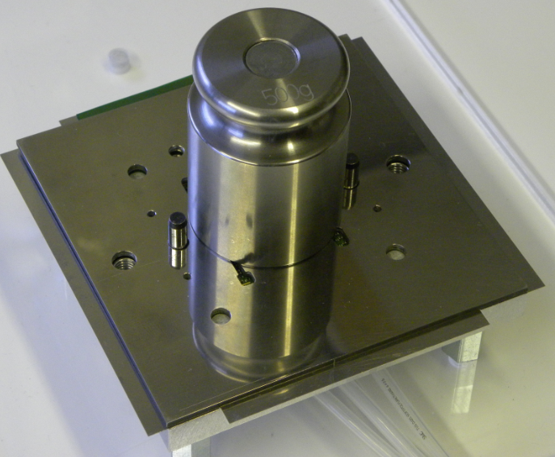
Gluing Jig V.1
Materials:
Aluminium, stainless steel
Production:
Workshop, industry
Assembly Method:
http://hep.ph.liv.ac.uk/~tsurin/POOL/ATLAS/Pixel/Jig/gluing_atlas_note.pdf

Slide 3
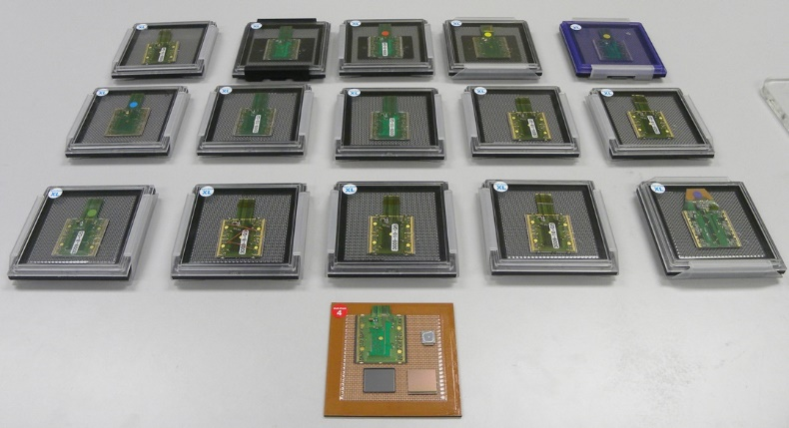
Progress up to date

Slide 4
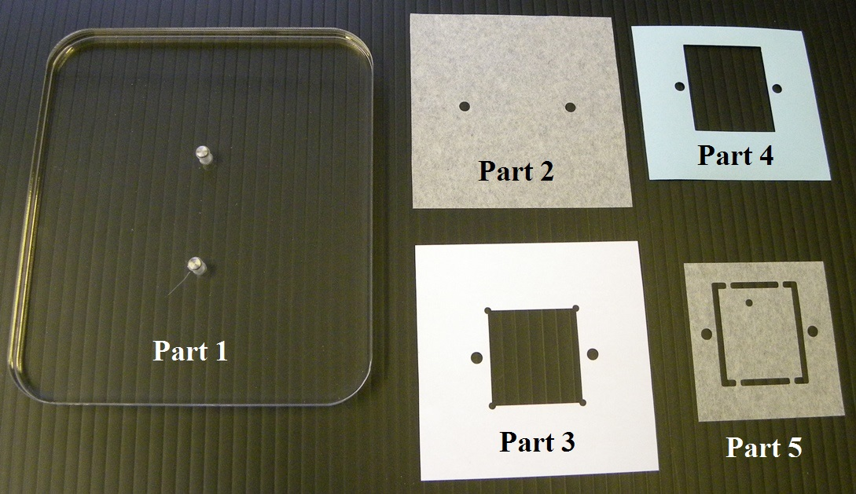
Gluing Jig V2
Materials: Procurement of parts:
Perspex/Plywood (!), Paper DIY (Silhouette cutting machine)

Slide 5
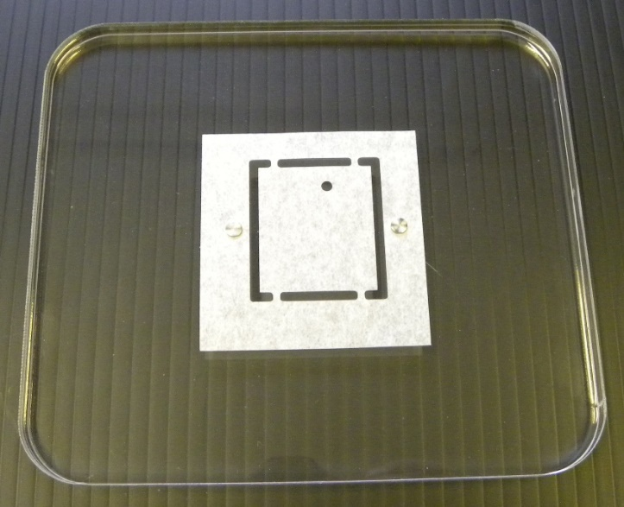
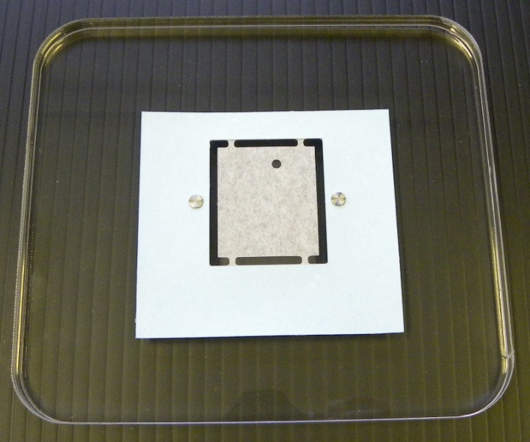
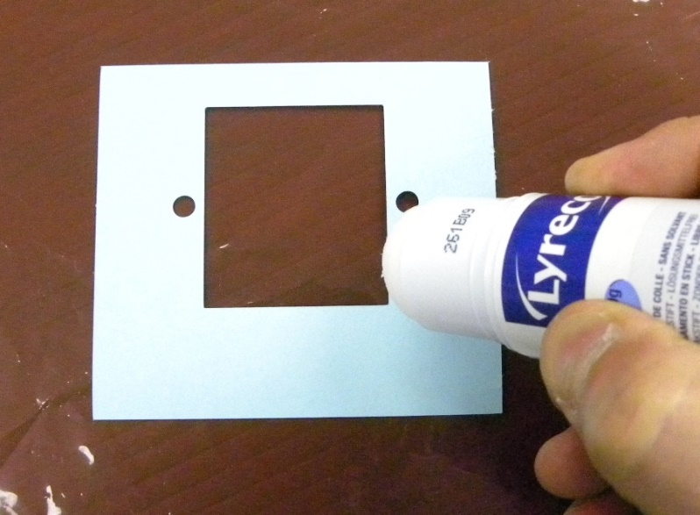
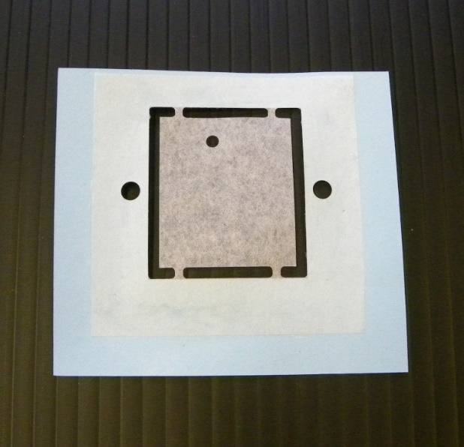
Preparation (offline)
A.)
C.)
B.)
D.)

Slide 6
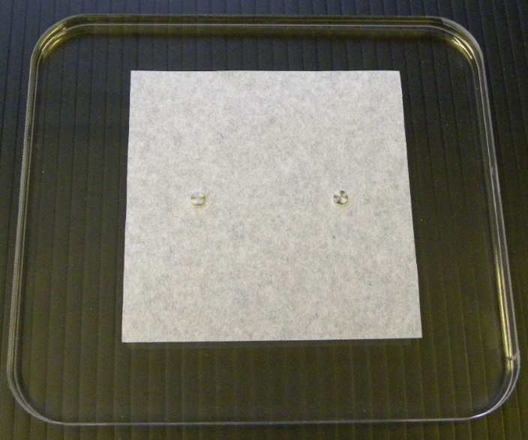
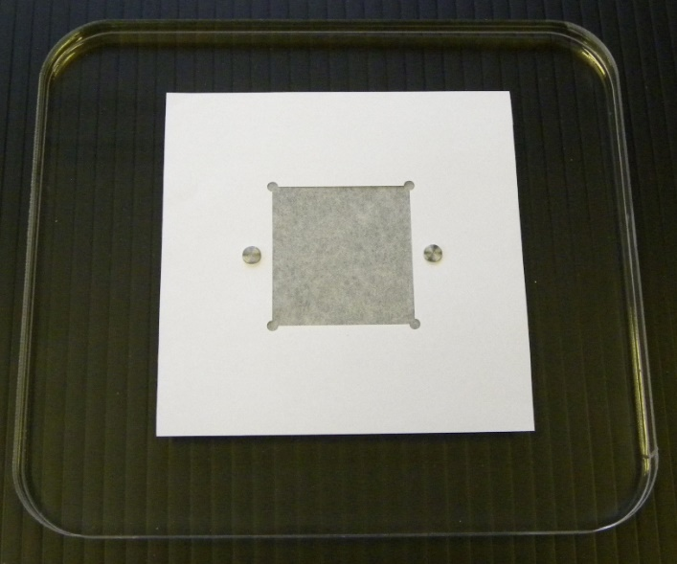
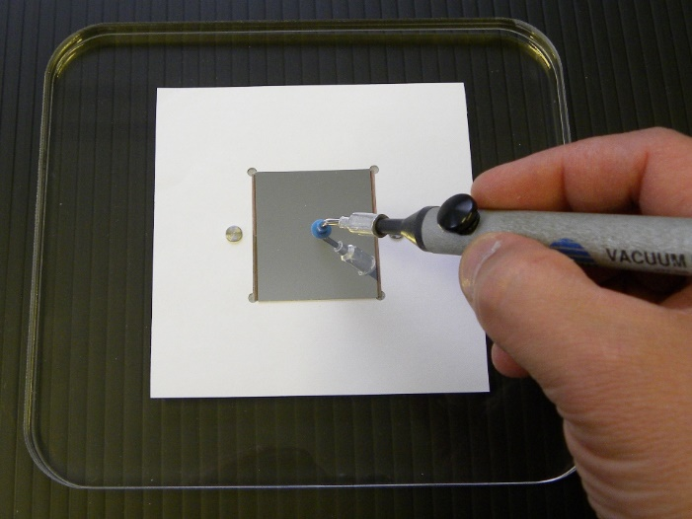
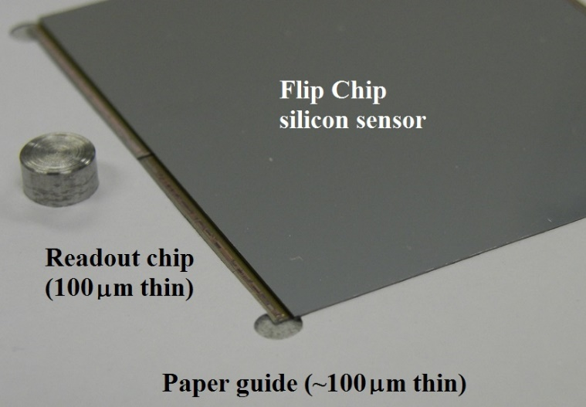
Assembly Step 1
A.)
C.)
B.)
D.)

Slide 7
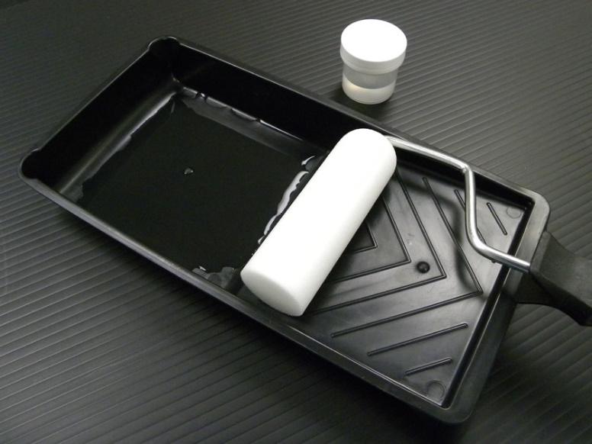
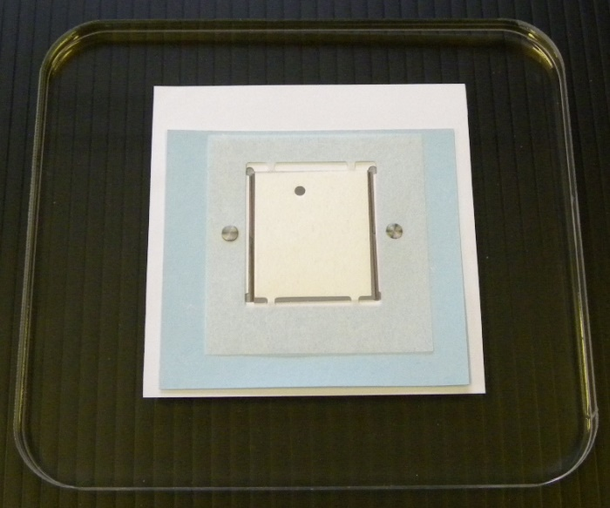
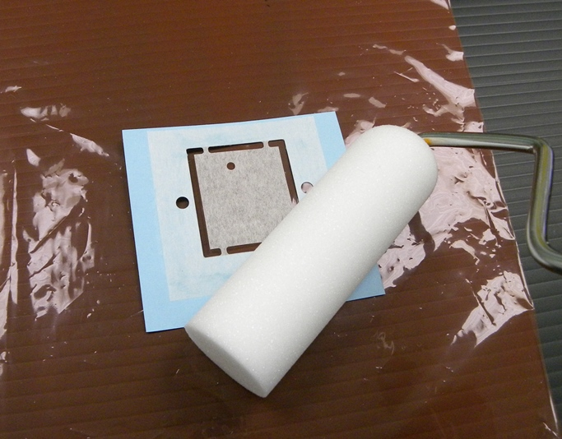
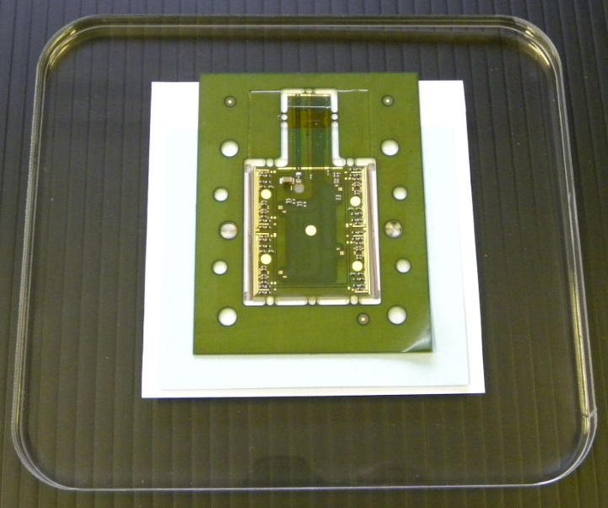
Assembly Step 2
A.)
C.)
B.)
D.)

Slide 8
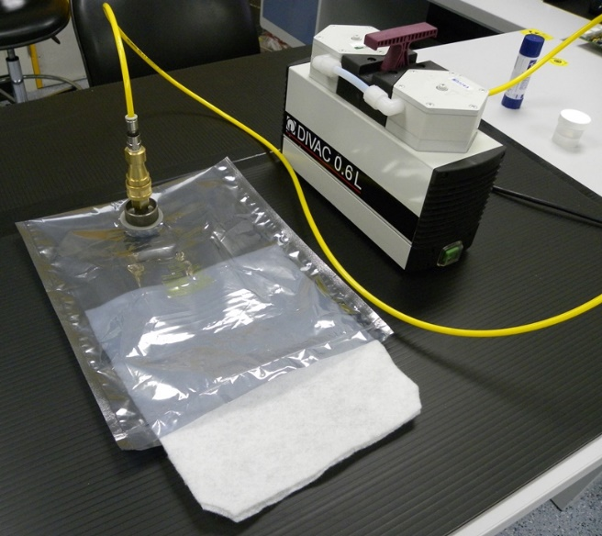
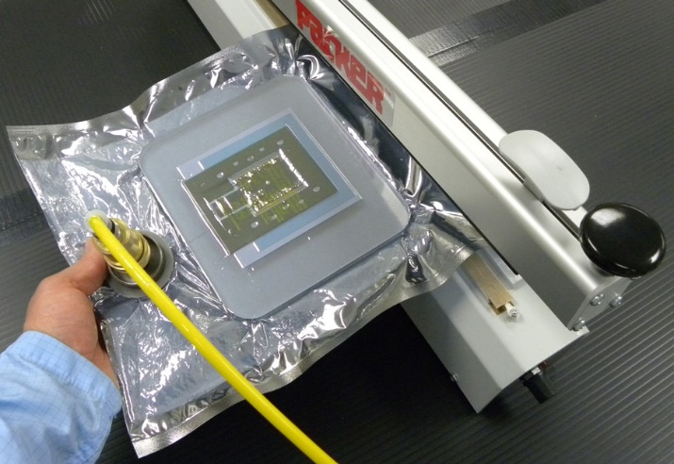
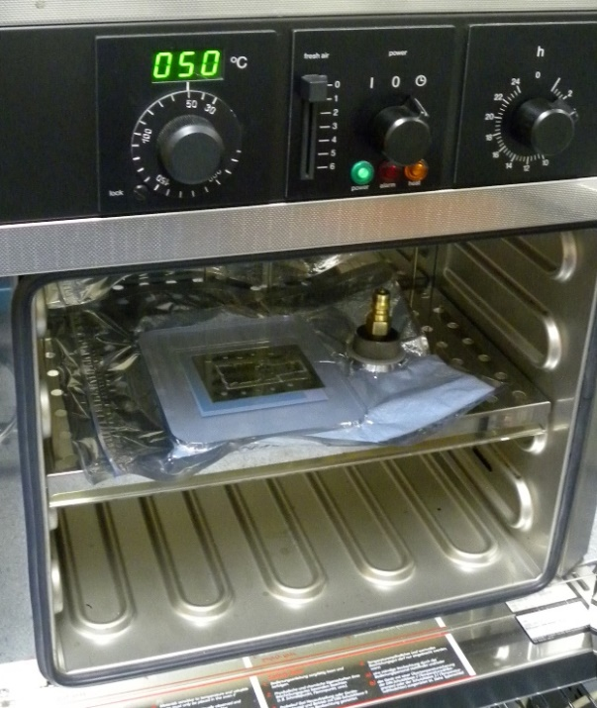
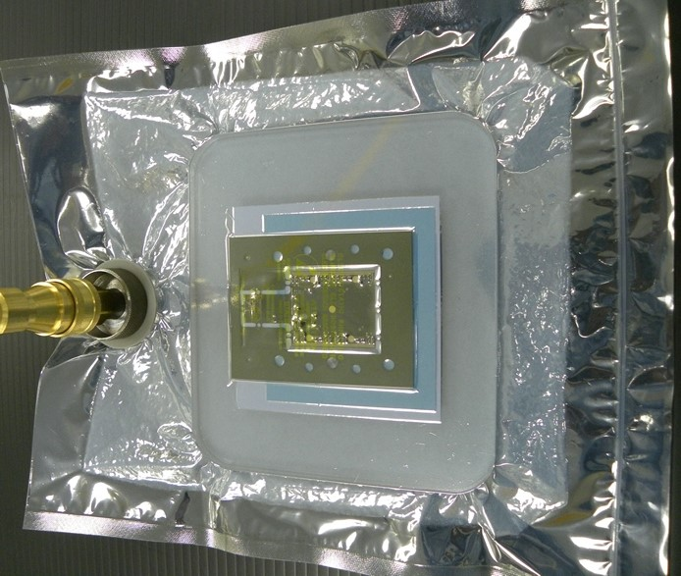
Assembly Step 3
A.)
C.)
B.)
D.)

Slide 9
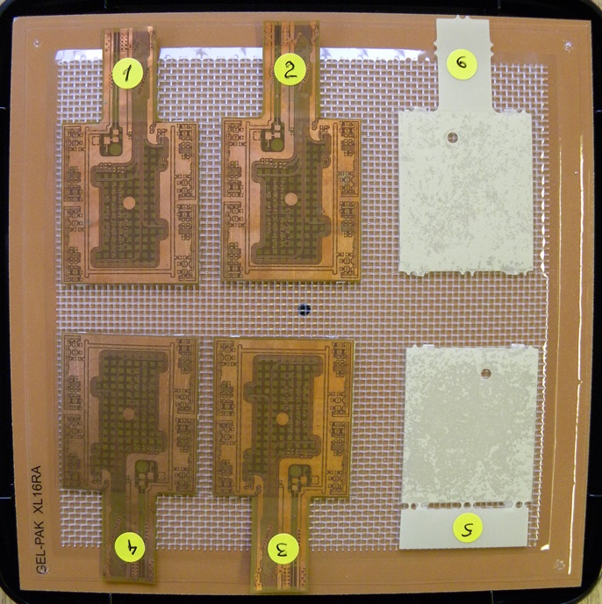
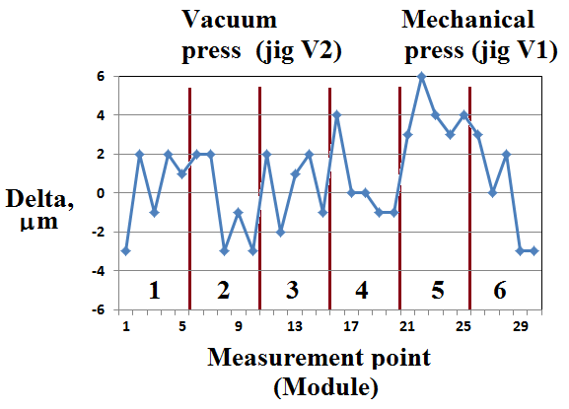
Module Planarity
Mock-up modules:
Glass + real PCB
Delta (um) is the difference of measured thickness (at 5 points on each module) and all constituents: paper, PCB and glass

Slide 10
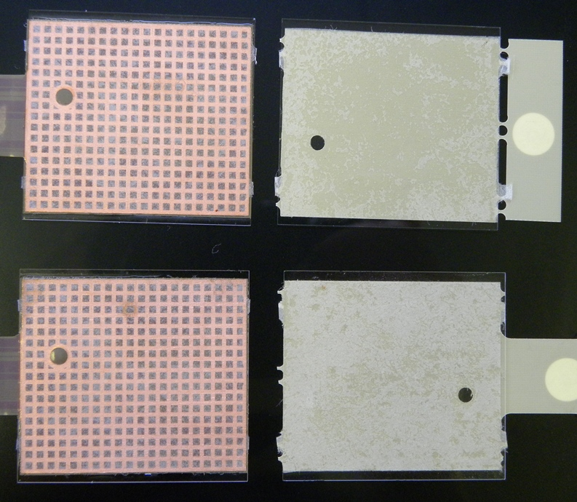
Air traps
1st ever
sample
Vacuum
Press (jig V2)
Mechanical Press (jig V2)
Jessica’s
sample
Not obvious from this picture but all new samples (jig v2) show absolutely no air.
Vacuum does the job !

Slide 11
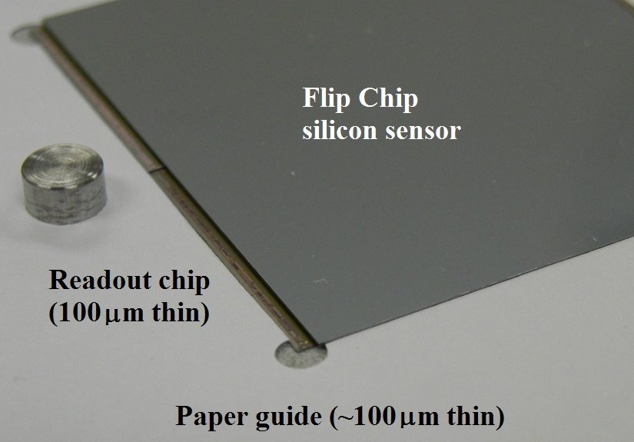
Stress to Sensors
Sensor edge overhanging ASIC gives rise to stressing silicon by vacuum membrane
Solutions: 1.) Appropriate thickness of paper frame to support sensor edges
2.) Additional paper frame around sensor to shape vacuum membrane
Tested with several cycles on bare 200um thin quad sensor:
I(V) and C(V) don’t change without those measures !

Slide 12
ICP Sodium Assay
Amplitude C6-99 paper: 200ppm sodium (Data spec)
Encapsulation properties of laminates:
Samples: 4cm x 1cm strips soaked in 40 ml. of water at 20deg. C for 24 hours
De-ionised water for background measurement (not detected)
1x C6-99 paper strip 9 ppb (~200ppm w.r.t. sorbency)
3x C6-99 paper strips 24 ppb (~200ppm w.r.t. sorbency)
1 kapton strip (2 samples), both not detected
1 kapton strip with Araldite 2011 only (2 samples), both not detected
1 kapton strip with C6-99 paper impregnated with Araldite (2 samples)
sample 1: 5 ppb / sample 2: 6 ppb
1.) Ion extraction before use (laundry :-)
2.) Evaluate different adhesive and laminates / synthetic mesh

Slide 13
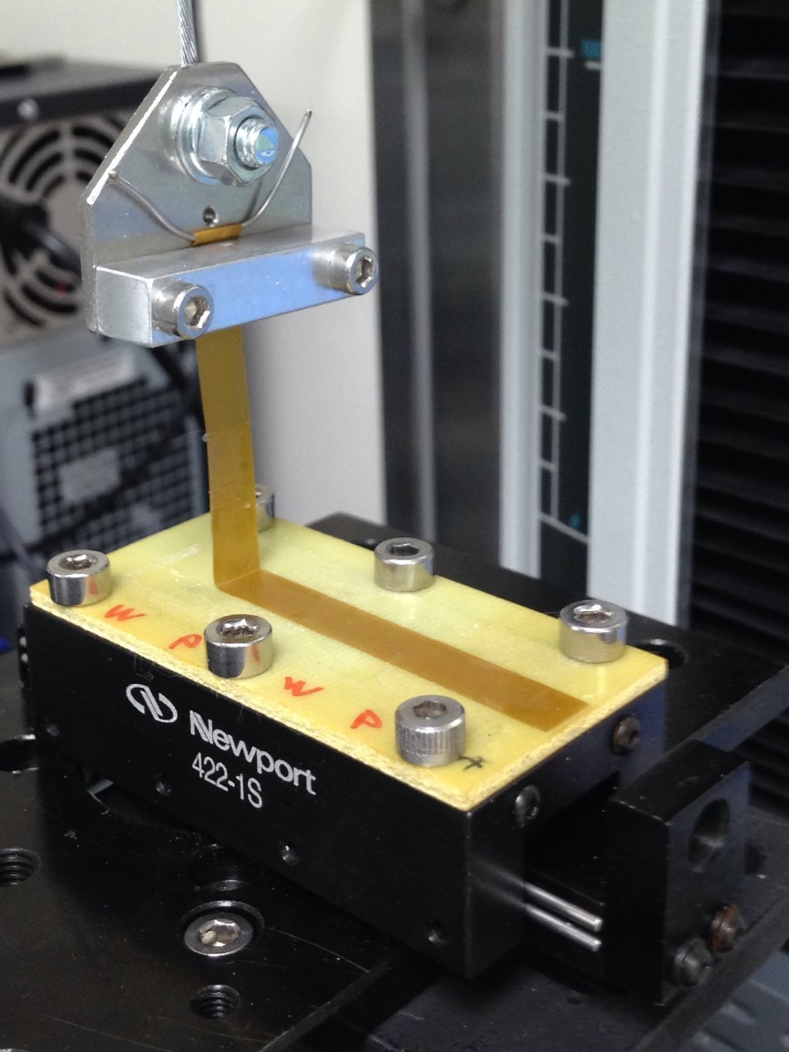
90 degree peel Adhesion Test
90 degrees pull test
Sample is mounted on a linear stage to self-establish 90 degrees angle
- Uniform force to characterise
bond along entire sample length
Conventional strip width of 1cm
to normalise strength reading
No-load reading for slack correction
180 degrees pull test could be
considered

Slide 14
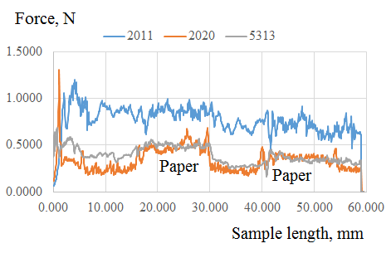
Comparing Glue Types
Samples: 1cm wide strip of DuPont Pyralux AP (50u polyimide) free of copper,
abraded with P1200 sandpaper (not needed, thought),
glued to aluminium (non-soaking) substrate with paper laminate
and cured at room temperature using vacuum former.
Legend:
“2011” – Araldite 2011
(RS stock Nr 388-8948)
“2020” Araldite 2020
(RS stock Nr 332-1754)
“5313” – Epolite FH-5313
(sourced from Andover US)

Slide 15
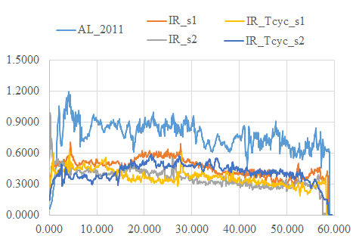
Irradiation and Thermal cycling
Samples: 1cm wide strip of DuPont Pyralux AP (50u polyimide) free of copper,
abraded with P1200 sandpaper glued with Araldite 2011 to FR4 base
with paper laminate and cured at room temperature using vacuum former,
irradiated by 60 MeV protons to 1e14 /cm2 and T-cycled 10 times
between -40C and +50C
Legend:
“AL_2011” reference
“IR_s1” – irradiated sample 1
“IR_s2” – irradiated sample 2
“IR_s1_Tcyc_s1” – irradiated
and T-cycled sample 3
“IR_s1_Tcyc_s2” – irradiated
and T-cycled sample 4

Slide 16
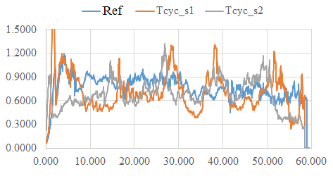
Thermal cycling only
Samples: same as before, kapton strips feature edge wetting resulting in “spiky” readings
Legend:
“Ref” reference
“Tcyc_s1” – irradiated
and T-cycled sample 1
“Tcyc_s2” – irradiated
and T-cycled sample 2

Slide 17
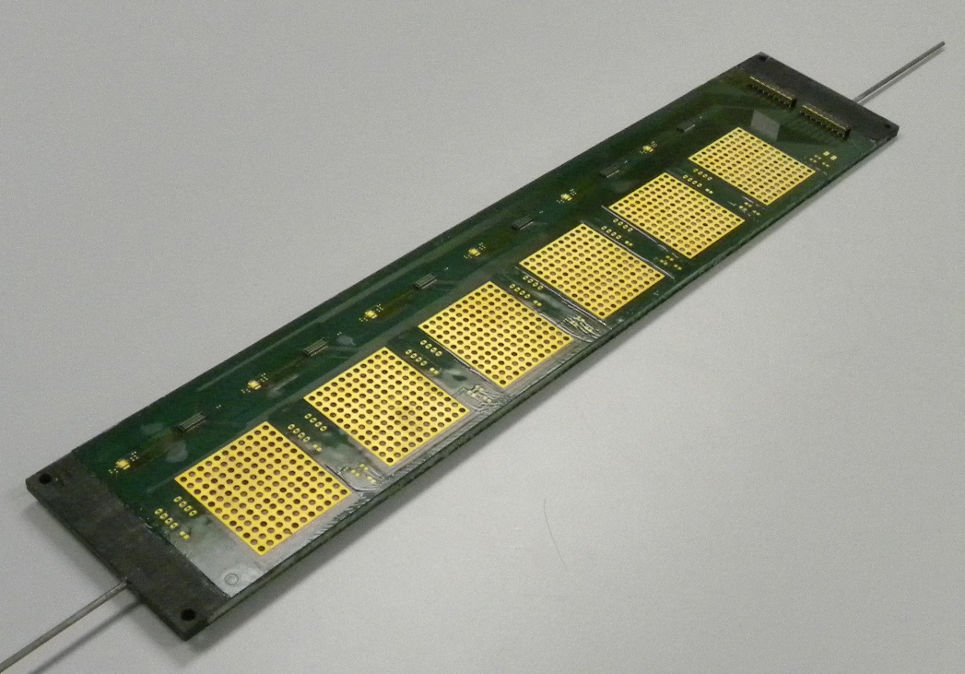
Technology Transfer
Low mass stave prototype for system tests
Flex bus tape (PCB) glued to carbon fibre plate using paper laminate

Slide 18
Summary
Affordable and easy to set up method for module assembly.
Easy solution for high temperature epoxy curing.
Trade-offs (moderate sodium, stresses) solved.
Araldite 2011 (epoxy adhesive for polyimide) is a good choice.
Slow thermal cycling does not change properties of the bond.
Bond strength reduces significantly already after small dose.

Slide 19
More Data available
Pull test for high temperature epoxy curing
Improvements to bond using backside copper mesh
Thermal stresses in real modules assembled with paper
laminate vs. bare glue, measured by strain gauges
Evidence of delamination after thermal cycling
(paper laminate vs. bare glue)
Peeling of PCB glued with laminate
Peeling of PCB glued with bare adhesive

