Slide 1
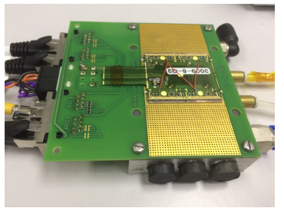
Present Jig
Used for wire bonding and testing modules
Too expensive for storing modules
Unsuitable for module transport
Connector restrains module movement in XY
Module immobilised in
Z by vacuum, could be modified for shipment
Heat sink / Peltier cooling
Water cooling

Slide 2
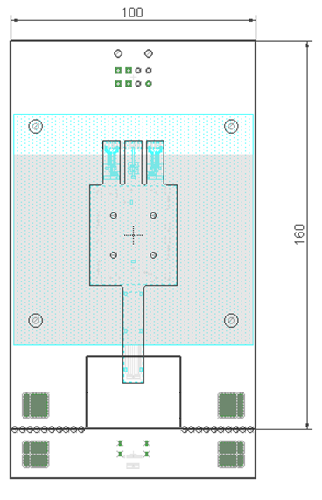
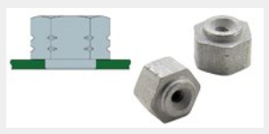
New Jig Baseboard
Jig for Bonding / Measurement/ Irradiation / Storage / Transport
Top and bottom copper plates connected
by array of vias for convective or stimulated
cooling
Vacuum nozzles
SMT nut
Commercially
available
Base: PCB in EuroCard format with
a snap-out part for cost reduction

Slide 3
New Jig Baseboard
Molex 4.2 mm pitch connector for LV and HV
50way 0.5mm pitch ZIF connector, one for
3 tabs. This connector will restrain module
in XY and feed LV and HV to the module
through exposed edge contacts (thermode
pads).
Opening to access Hirose BM14 connector
This snap-out board with mating Hirose connector and Micro-HDMI will be flipped and soldered through array of vias

Slide 4
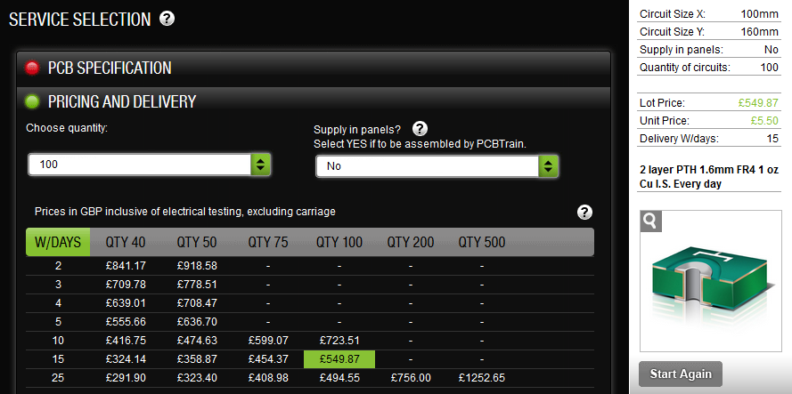
PCB Quote
It is only GBP 2.5 / card (!),
additional charge for population of 4 connectors will apply

Slide 5
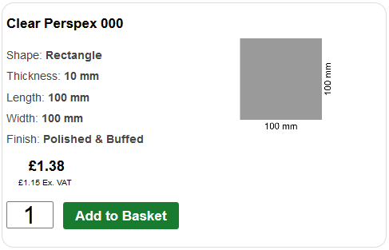
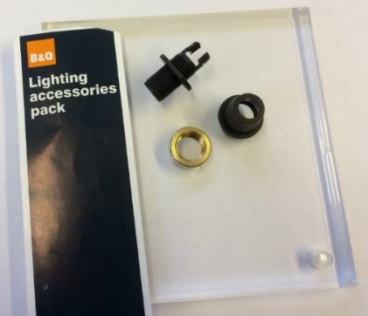
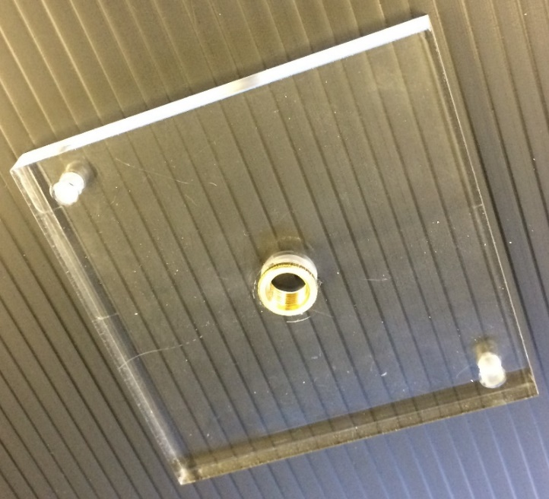
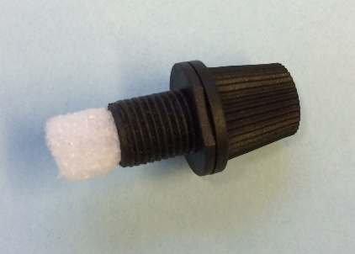
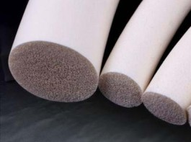
ESD Perspex Lid
Quote is given for ordinary Perspex,
antistatic Perspex AC-300 or AC 405 is 3x expensiver.
Padded finger
to restrain module in Z
B&Q lightning kit
Safe design:
finger inserted after placing the lid, so it never gets in the way of bond wires
Guiding holes for safe
placement of the lid on
top of carrier PCB
Silicone sponge cord

Slide 6
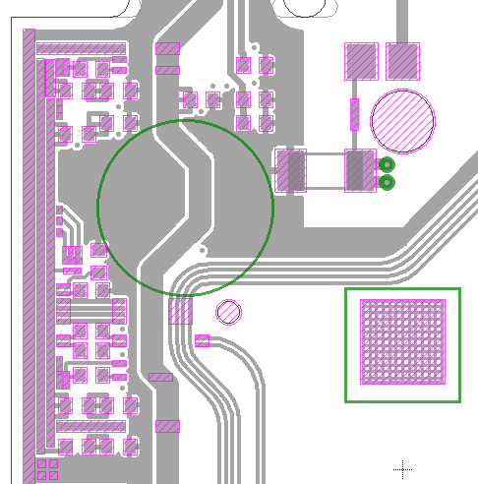
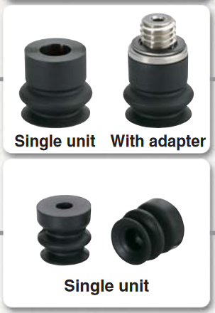
Suction Caps as Fingers
Bellow Suction Cap
available from RS in
2, 4, 5, 6mm… dia.
Suction Caps (to restrain module in Z) could be height adjusted by grub screws
to match SMT spacer nuts

Slide 7
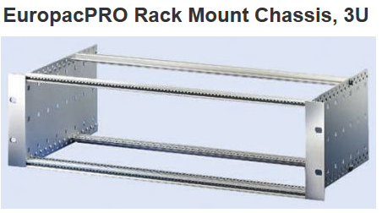
Storage and Transport solutions
Summary
2 Part design (PCB and Perspex Lid)
Cost of ALL components around 10 Pounds per jig

