Slide 1
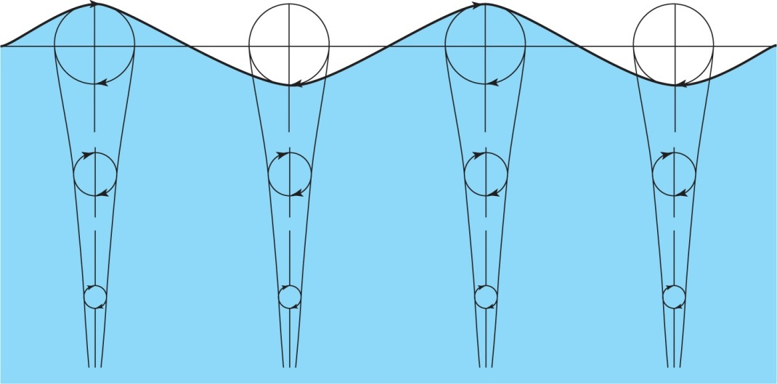
WAVE ENERGY
Waves on the sea are mainly caused by the wind. Streamlines of air are closer over the crests so pressure is reduced (Bernoulli) and the amplitude increases
Motion decays exponentially
with depth with ~80% of the
waves energy within λ/4.
is typically 100m in the
ocean and in deep water the
particles follow circular
trajectories as shown above
Consider a frame of reference moving with the wave velocity c so that the profile remains unchanged with time.

Slide 2
Since atmospheric pressure at the surface is constant Bernoulli’s equation gives
½ u_{c}² + gh = ½ u_{t}² + 0 (6.1)
where u_{c} and u_{t} are the particle velocities at crest and trough and h is the difference in height between crest and trough
If r is the radius of the orbit and τ the period then we can substitute
u_{c} = 2πr/τ –c, u_{t} = - 2πr/τ -c, h = 2r, λ = cτ
Substituting in (6.1) we obtain
(2πrc/λ–c)² – (- 2πrc/λ -c)² + 4gr = 8πrc²/λ + 4gr =0 so
c = [gλ/2π]^{1/2} = [g/k]^{1/2} (6.2)
Note that these waves are dispersive and the Group Velocity is
c_{g} = dω/dk = d(kc) /dk = d[gk]^{1/2} /dk
∴ c_{g} = ½ [g/k]^{1/2} = ½ [gλ/2π]^{1/2} = ½ c (6.3)

Slide 3
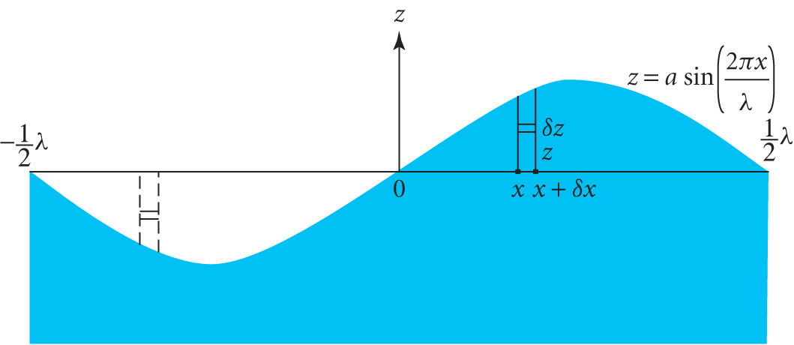
ENERGY IN A SURFACE WAVE
Consider a unit width of
wave with surface profile
z = a sin[2πx/λ]
(time dependence is not
required for this derivation)
Consider the gain in potential energy of an elemental mass δm = ρδxδz of fluid moving from –z to z δV = δmg(2z)
δV = 2ρgz δx δz

Slide 4
Assuming equipartition of energy the time averaged kinetic energy is equal to the time averaged potential energy, so that over the whole wavelength the total energy is E = ½ ρga²λ or
E = ½ ρga² (6.4)
per unit length in the x direction and per unit width
The power per unit width P = product E x c_{g}
P = ½ ρga² x ½ [gλ/2π]^{1/2} = ¼ ρga²[gλ/2π]^{1/2} (6.5)
Example.
Estimate the power per unit width of wave-front for a wave amplitude a = 1m and a wavelength of 100m
P= ¼ ρga²[gλ/2π]^{1/2}
≈ ¼ x 10³ x 10 x 1² x {(10 x 10²)/(2 x 3.14)}^{1/2} ≈ 32 kWm⁻¹
In mid ocean conditions the typical power per metre width of a wave-front is 30 – 70 kW m⁻¹

Slide 5
WAVE POWER DEVICES
Historically the first patent dates from 1799 but interest revived in the oil crisis in the early 1970s
Many inventions but most were impractical
Concerns about capital costs and storm damage
Interest declined in 1980s but revived in 1990s with 2nd generation wave power devices
Key issues are
Survivability in violent storms
Vulnerability of moving parts to sea water
Capital cost of construction
Operational costs of maintenance and repair
Cost of connection to the electricity grid
Various types of wave power devices are under study

Slide 6
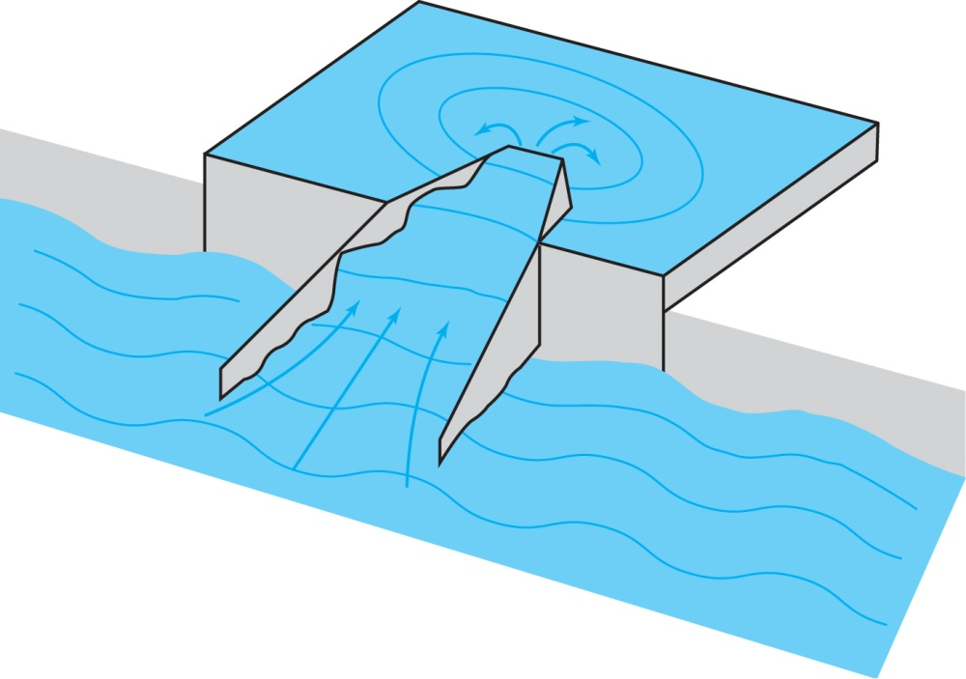
SPILL-OVER DEVICES
TAPCHAN ( TAPered CHANnel) is a Norwegian system in which sea waves are focussed in a tapered channel on the shoreline
Tapering increases the amplitude
and forces water to rise up a ramp
and spill over a wall into a
reservoir 3-5m above sea level
The potential energy is tapped
using a low head Kaplan turbine
No moving parts apart from the
turbine and easy connection to the grid
Relatively low power and limited to sites with a deep water shoreline and a low tidal range of < 1m
WAVE DRAGON is a floating offshore version with an inlet span of ~ 200m to generate ~ 4 MW

Slide 7
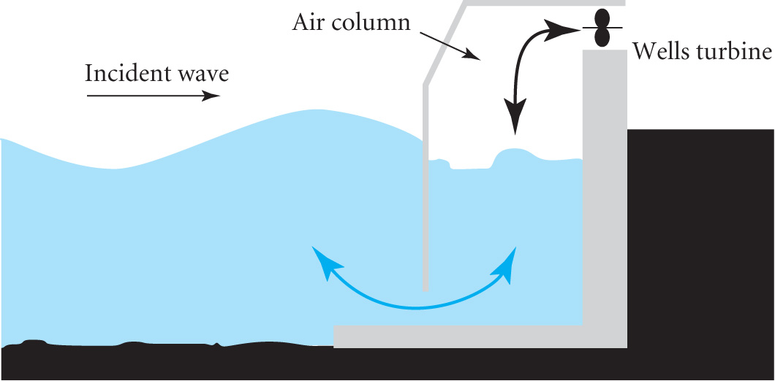
OSCILLATING WATER COLUMNS
The oscillating water column (OWC) uses an air turbine housed in a duct well above the water surface
The base is open to the sea so
that incident waves force the
column to oscillate vertically
The air above moves in phase
with the surface of the water
The speed of the air is enhanced by making the cross section of the duct << that of the column
A Wells Turbine has the property that it spins in the same direction irrespective of the direction of the airflow!
Unlike conventional blades, the blades in a Wells turbine are symmetrical about the direction of motion

Slide 8
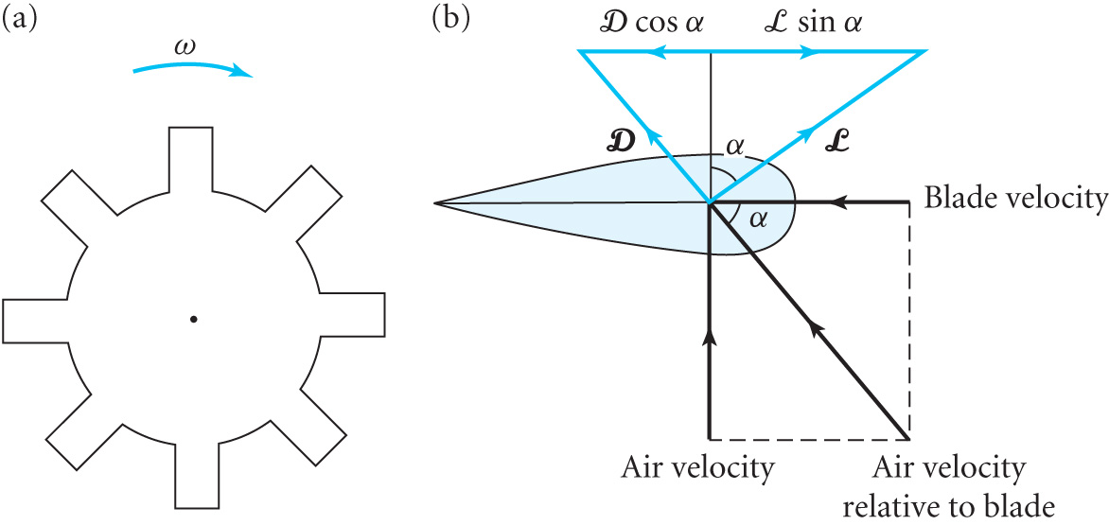
Relative to the blade the
airflow is at a non-zero
angle of attack α.
Plan View Blade’s frame of reference
The net force on the blade in the direction of motion is F = L sinα – D cosα (6.6) where L and D are the lift and drag forces
Diagram shows that the net force is independent of direction of airflow
Operational efficiency is ~ 80% but
At low air speeds the turbine absorbs power from the generator to maintain steady rotational speed
At high air speeds motion becomes turbulent reducing the net force on the blade and the efficiency

Slide 9
Two designs of shore based OWCs are the Limpet (UK) and Osprey (UK) generating 0.5 and 1.5 MW respectively
A 0.5MW OWC scheme is being prototyped in Australia using a 40m wide parabolic wave reflector to focus waves onto a 10m wide shoreline OWC
Capital cost 30% higher but 300% increase in output
Japan has a large floating OWC, the Mighty Whale, generating 110kW but its primary role is as a wave breaker to produce calm water for fisheries etc

Slide 10
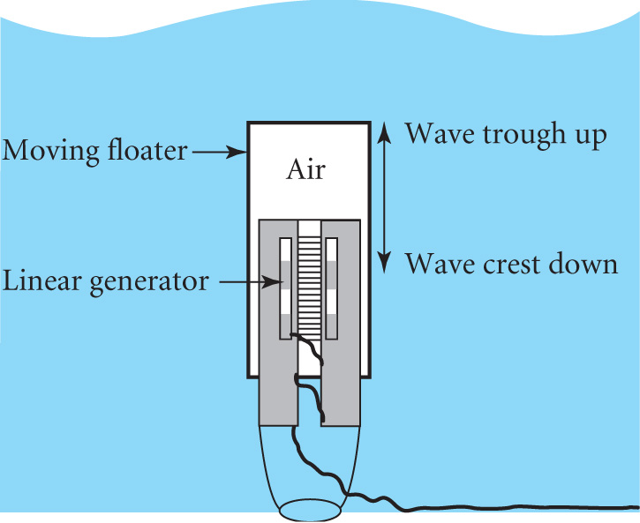
SUBMERGED DEVICES
These devices are impervious to rough seas
They exploit the change in pressure as
the wave passes >6m overhead
The example shown is the
Archimedes Wave Swing (AWS)
The ‘floater’ is an air filled chamber
9.5m diameter and 33m long which
oscillates vertically energising a
linear generator tethered to the sea bed
Extracts 50% of wave power irrespective of direction, a ‘point absorber’
Simple, easy replacement and cost effective in terms of power per kg steel
Pilot project in Portugal has 3 AWS producing 8MW
A full system could have up to 6 per km. The global potential is ~ 300GW

Slide 11
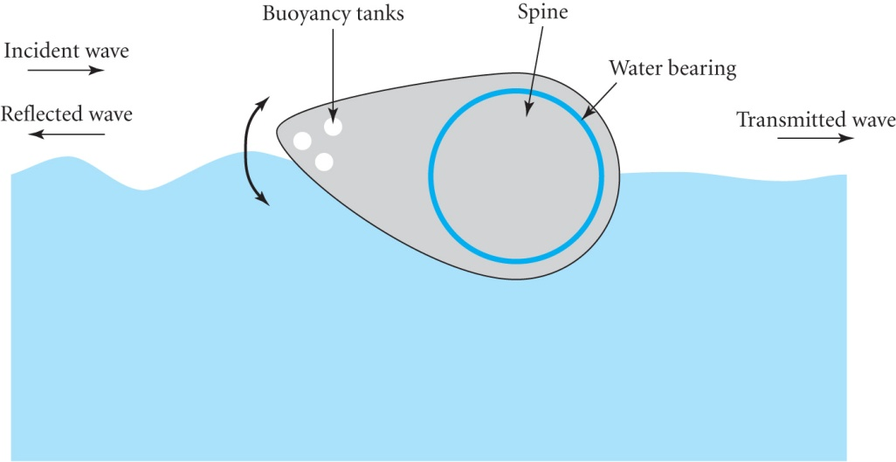
FLOATING DEVICES
Early 1970’s gave us the SALTER DUCK
The surface profile was chosen to
follow the circular trajectories of
water particles minimising
reflection and transmission and
achieving ~90% efficiency in
ideal conditions
A complete system would be a string of ducks several km long
A central spine 14m in diameter used the relative motion to generate power.
Designed for use in the Atlantic but never got beyond small scale trials due to lack of funding in the 1980s

Slide 12
A more recent alternative is the PELAMIS
Several cylindrical hinged sections pointed towards the wave
Segments rock back and forth. Relative motion activates hydraulic rams that pump high pressure oil through hydraulic motors to drive generators
A 3 segment version is 130m long and 3.5m in diameter and generates 750 kW
Combination of great length and small cross section provides good protection for large amplitude waves
3 devices are due to be installed off Portugal
30 machines per sq km would generate ~ 30MW
To avoid interference the devices need spacing of 60-90m

Slide 13
IMPACT ON ENVIRONMENT AND PROSPECTS
No greenhouse gases but shore based sites could affect scenic beauty and produce noise pollution
Global potential is very large ~ 1-10TW
The DTI (2001) estimated ~ 6GW around the UK
Main issues are capital cost, competitiveness and survivability
Regarded as high risk technology
Shore based schemes have reduced risk but less power
Every 50 years in the Atlantic there is a wave with 10 times the average amplitude so devices must withstand 100 times average wave energy
Wave frequency is ~ 0.2Hz so a cost effective solution to transform to 50-60Hz is required
In the long term wave power may provide ~ 15% of total demand

