Slide 1
HYDROPOWER
Hydropower taps into the natural cycle of
Solar heat➔sea water evaporation➔rainfall➔rivers➔sea
It is an established technology delivering ~20% of global electric production
By far the largest source of renewable energy
Energy of water is either potential (reservoirs) or kinetic (rivers). In both cases large water turbines are needed.
Tidal energy exploits bulk motion of water and requires low-head water turbines
Wave power is a huge and largely untapped resource
Ocean waves transport 30 – 70 kW of power per metre width
Need technologies to survive violent sea conditions
Best sites are between 40º and 60º latitudes on western coastlines above and below the equator

Slide 2
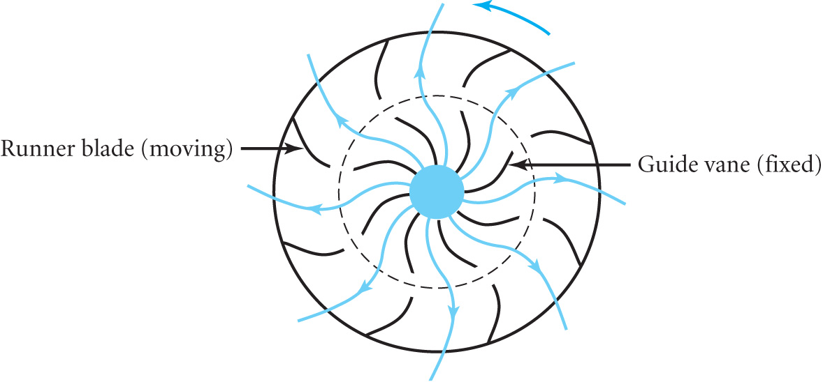
Waterwheels have been in use since ancient times
Early examples were of the
undershot design (a)
Later the overshot design (b)
with shaped blades were much more efficient
In 1832 the Fourneyron Turbine was invented, efficiencies > 80%
A fully submerged vertical axis
device with fixed guide vanes
directing water outwards through
gaps between the moving runner
blades
Modern water turbines are typically > 90% efficient

Slide 3
Economic advantages include
Low operating costs, minimal impact on atmosphere, quick response to demand and long plant life although the capital cost is high and there is a very long payback period
There are serious environmental and social issues
Displacement of population and impact on sedimentation, water quality, fish and flooding
Mountainous countries like Norway and Iceland are virtually self sufficient in hydropower
When resources are less abundant it is mainly used to satisfy peak load demand.
The following tables summarise the current world situation

Slide 4
INSTALLED HYDROPOWER
Country | Hydroelectric capacity in 2005 (GW)
USA | 80
Canada | 67
China | 65
Brazil | 58
Norway | 28
Japan | 27
WORLD TOTAL | 700
LARGEST SITES FOR HYDROPOWER
Country | Site | Hydroelectric capacity (GW)
China | Three Gorges | 18.2
Brazil/Paraguay | Itaipu | 12.6
Venezuela | Guri | 10.3
USA | Grand Coulee | 6.9
Russia | Sayano-Shushenk | 6.4
Russia | Krasnoyarsk | 6.0

Slide 5
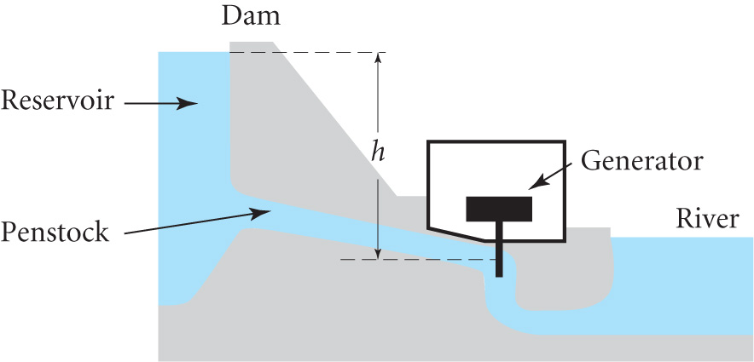
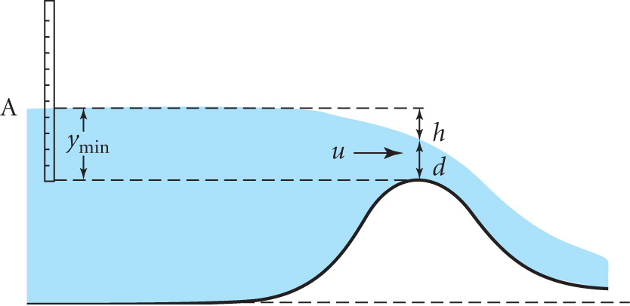
POWER OUTPUT FROM A DAM
Consider a turbine operating with a head of water h
Power P = η ρ g h Q (4.1)
where η is the efficiency of
converting the potential energy and
Q is the volume flowing s⁻¹
Q may be measured by using an
artificial barrier called a weir
The stream is diverted and the
presence of the weir causes the
level of water upstream to rise
Upstream at A the velocity is u_{A} while at the weir the velocity is u
The pressure on the surface is constant atmospheric pressure

Slide 6
Ignoring any vertical component for a broad-crested weir the flow per unit width is Q ≈ u d
Bernoulli’s equation ½ u² – gh ≈ ½ u_{A}²
For large h u_{A}² << u² and so u ≈ (2gh)^{1/2}
Hence d ≈ Q / (2gh)^{1/2}
The vertical distance from the undisturbed level at A to the top of the weir is y = d + h = Q / (2gh)^{1/2} + h
Note that there is a minimum value for y obtained by setting dy/dh = 0. This corresponds to minimising the PE increase
dy/dh = - Q / (8gh³)^{1/2} +1 = 0 so h = (Q²/8g)^{1/3}
Hence y_{min} = Q / (2g (Q²/8g)^{1/3})^{1/2} + (Q²/8g)^{1/3}
= Q / (g^{2/3} Q^{2/3})^{1/2} + (Q²/8g)^{1/3} = Q^{2/3} / g^{1/3} + (Q²/8g)^{1/3} = 3/2 (Q²/g)^{1/3}
∴ Flow rate Q = g^{1/2}(2/3 y_{min})^{3/2} Francis Formula (4.2)

Slide 7
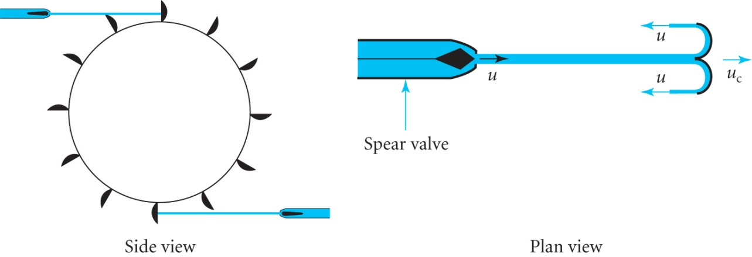
WATER TURBINES
In a waterwheel the force on the blades is due to the pressure difference as the water is almost stationary
In water turbines the water is fast moving and the turbine extracts kinetic energy
Two main designs, impulse turbines and reaction turbines
The Pelton wheel is an example of an impulse turbine in which the blades rotate in air apart from when being hit by a high speed jet.
Pelton shaped the cups so that
the direction of the splash
was opposite the jet whose
speed was controlled by the
spear valve
Let u be the velocity of the jet and u_{C} the velocity of the cup
Total change in the velocity of the jet relative to the cup is 2 (u- u_{C})

Slide 8
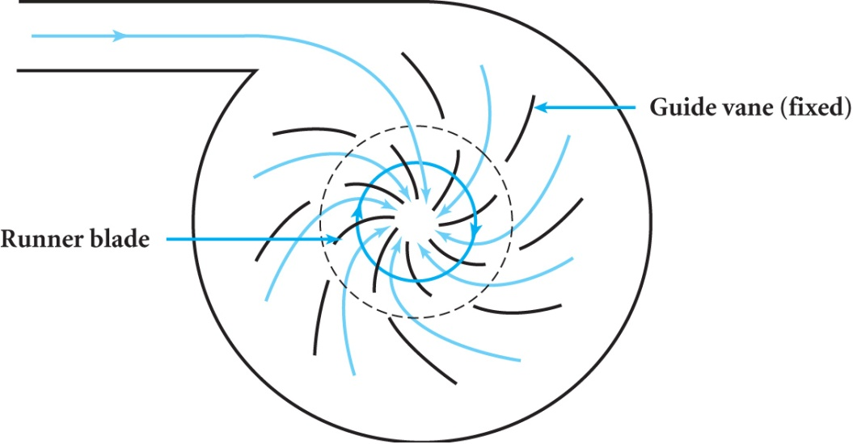
Force on cup F = 2ρQ(u – u_{C}) where ρQ is the mass of water striking the cup per second
Power P = F u_{C} = 2ρQ(u – u_{C}) u_{C}
To obtain the maximum power dP / d u_{C} =0
Hence u_{C} = ½ u and P_{max} = ½ ρQu² (4.3)
i.e the maximum power output is equal to the kinetic energy incident per second
As in the Fourneyron turbine
modern Reaction Turbines
use fixed guide vanes to direct
water between the blades of a
runner mounted on a rotating
wheel. The direction of flow is inwards (in the Fourneyron the outward flow caused problems in changing the flow)

Slide 9
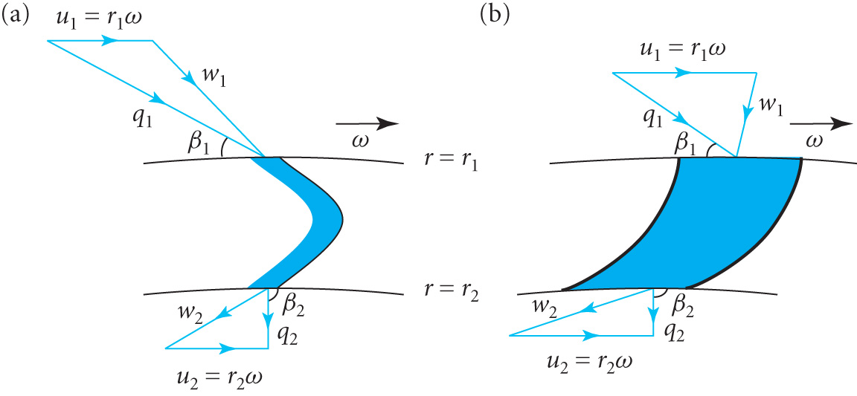
Reaction turbines are fully immersed in water and the thrust on the blades is due to a combination of impulse and reaction forces
The most common designs are the Francis turbine (runner is a spiral annulus) and the Kaplan turbine (runner is propeller shaped)
Velocity diagrams for
An impulse turbine
A reaction turbine
u, q and w define the
velocities of the runner
blades, fluid and the relative velocity of the fluid to the blade
The thrust for a reaction turbine can be analysed using Bernoulli’s equation. It is a combination of impulsive and reaction forces. If labels 1 and 2 indicate input and output we have:-
p₁/ρ + ½ q₁²= p₂/ρ + ½ q₂² + E where E is the energy per unit mass of water transferred to the runner

Slide 10
Consider two extreme cases
q₁ = q₂ i.e. ‘pure reaction’ then E = (p₁ – p₂ )/ ρ
p₁ = p₂ i.e. ‘pure impulsive’ then E = ½ ( q₁² – q₂²)
Define the degree of reaction
R = (p₁ – p₂ )/ ρ E = 1 - ( q₁² – q₂²)/2E (4.4)
Euler’s turbine eqn. (3.8)
P = ω Qρ (r₁q₁ cosβ₁ -r₂q₂ cosβ₂)
P = Qρ (u₁q₁ cosβ₁ -u₂q₂ cosβ₂) = Qρ E ; E is energy per unit mass i.e. E = u₁q₁ cosβ₁ -u₂q₂ cosβ₂ (4.5)
The power available from a head of water h is
P = η ρ g h Q (4.1)
Equating the two we define the hydraulic efficiency as
η = Qρ (u₁q₁ cosβ₁ -u₂q₂ cosβ₂) / ρ g h Q
so η = (u₁q₁ cosβ₁ -u₂q₂ cosβ₂) / g h (4.6)
Maximum efficiency when β₂= π/2 is η_{max} = u₁q₁ cosβ₁ / g h
i.e when the fluid exits in the radial direction

Slide 11
Example: A reaction turbine has equal areas at entrance of the stator and runner and at the runner exit. Water enters the stator radially with velocity q₀ = 2 ms⁻¹ and leaves at an angle β₁ = 10⁰ with velocity q₁ = 10 ms⁻¹. The velocity of the runner at r = r₁ is u₁ tangentially such that the relative velocity of the water w₁ is radial. On leaving the runner the absolute velocity q₂ is radial. If the head h = 11m calculate the degree of reaction and the hydraulic efficiency
Let A be the common areas at the entrance etc.
Flow rate = q₀A = w₁A = q₂A therefore q₀ = w₁ = q₂
Energy transfer per unit mass E = u₁q₁ cosβ₁ -u₂q₂ cosβ₂ (4.5)
Since the direction of q₂ is radial β₂ = π / 2.
Putting q₁ cos β₁ = u₁ (since w₁ is radial) then E = u₁² .
Now q₁² = u₁²+w₁² = u₁²+q₂² since w₁ and q₂ are equal and radial
Degree of reaction R = 1 – (q₁² – q₂²)/2E = 1 - u₁² / 2u₁² = ½
Hydraulic efficiency η = u₁q₁ cosβ₁ / g h ≈ 0.9

Slide 12
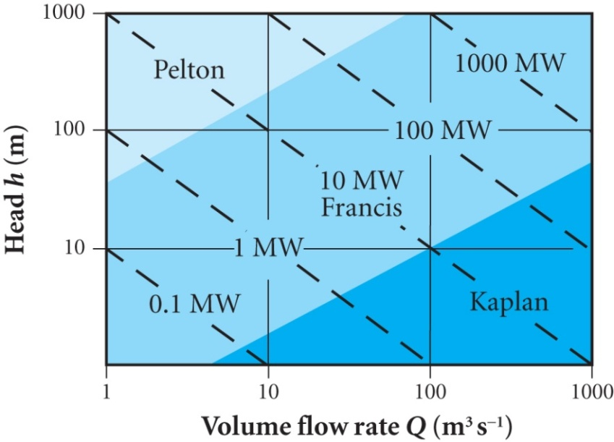
Choice of water turbine
Choice depends on head of water h and flow rate Q available
Impulse turbines are suited to large h
and low Q e.g. fast mountain streams
Kaplan turbines are suited to low h ,
large Q sites e.g. run-of-river sites
Francis turbines are preferred for
large h, large Q sites e.g.dams
Impact and Prospects of hydropower
Positive issues for hydropower include: no greenhouse gases, long lifetime and minimal maintenance and operation costs
Negative issues include: relocation of 30M-60M people worldwide, only 1% chance of a dam collapsing but catastrophic consequences, large capital cost, availability of sites, impact on environment
Future developments are patchy depending on the above issues and comparative economics with other power sources

