Slide 1
FUSION REACTORS
INTRODUCTION
Examples of fusion reactions
D + D ➔ T + p + 4.0 MeV
D + D ➔ ³He + n + 3.3 MeV
D + T ➔ α + n + 17.6 MeV
D + ³He ➔ α + p + 18.3 MeV
Release of energy because heavier nuclei are more tightly bound (especially α-particles)
ADVANTAGES OF FUSION OVER FISSION
1000 times as much energy resources from fusion fuels as from fission fuels
Fusion involves less toxic radioactive substances (e.g. T_{1/2} = 12 yrs for ³H(T), Emax for β- ~ 20 keV, T_{1/2}(biological) ~days
However neutron flux induces radioactivity in the structure
Small amount of fuel used– can’t go super critical

Slide 2
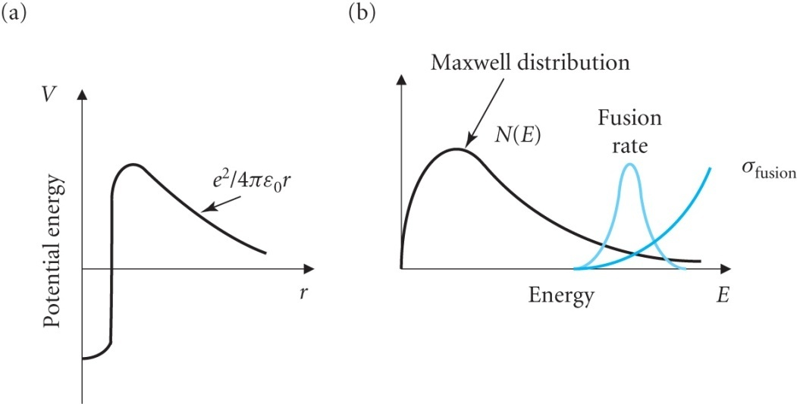
ACHIEVEMENT OF FUSION IN PRACTICE
D-T most promising ➔ biggest σ
Resonance occurs in D-T at E ~100 keV but not in D-D
Note that the Coulomb Barrier inhibits
fusion at small values of T_{D}
V(r) = Z₁ Z₂ e² / 4πε₀r (Z₁ = Z₂ = 1)
The value of V when r = 1.3 (2^{1/3} + 3^{1/3}) ~ 4 fm is 360 keV,
below which the nuclei must tunnel though the barrier
Thus σ ➔ 0 as T_{D} ➔ 0
Remember σ_{F} for fission can reach 600 barns which is
much larger than the above

Slide 3
HOW TO ACHIEVE FUSION
NAÏVE APPROACH
Accelerate D to 100 keV and bombard T gas target at S.T.P.
N = 6 10²⁵ atoms (so nuclei) m⁻³
λ = 1 / Nσ = 1 /(6 10²⁵ x 5 10⁻²⁸) ~ 30m
BUT D nuclei lose energy by ionisation in the T gas
For 100 keV D, range ~ 1mm
Probability of interaction in range R =
Average energy liberated per D is
(10⁻³ / 30) x 17.6 MeV = 0.6 keV
Since incident energy is 100 keV this gives an efficiency of 0.6 % !
THERMONUCLEAR APPROACH
Much more promising – D,T gas is heated to a temperature T given by E ~ kT ~ 100 keV
Energy will not be lost because of atomic collisions (Maxwell-Boltzmann distribution) so effectively R ➔ infinity

Slide 4
In this case fusion occurs and the heat generated leads to the process maintaining itself
Note that the useful heat is generated by α-particle collisions which remove ~ 1/5 of the total K.E. of 17.6 MeV
~ 4/5 of the total K.E. goes to the neutron
However if the reactor is surrounded by a Lithium blanket more tritium can be produced from neutron interactions
n + ⁶Li (7% of natural Li) ➔ T + α + 4.8 MeV
n + ⁷Li (93% of natural Li) ➔ T + α + n – 2.5 MeV
High grade Li reserves have energy content ~ reserves of U, Th
Additional Li is available from low grade ores and the sea. At present the main source of T is from fission reactors [D is plentiful ~ 0.02% of natural H]

Slide 5
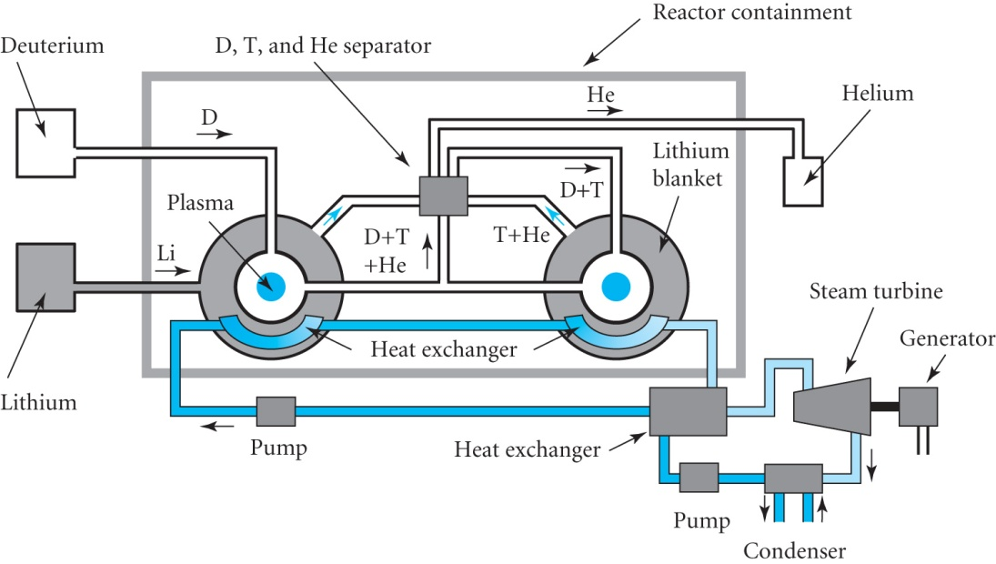
IDEALISED REACTOR
Power generated ~ few MW days /g Li
Look at energy balance. Let :-
P_{T} = thermal power output
P_{E} = η_{T}P_{T} ➔ electrical power outout
η_{T} is the efficiency for this process (~ 0.35 – 0.5)
P_{C} = ε P_{E} ➔ Power utilised for re-injection into the reactor

Slide 6
P_{I} = η_{I} P_{C} ➔ actual injected power to sustain reaction
Allows for efficiency for converting power to form required for re-injection
P_{P} = (1-ε) P_{E} ➔ Plant output power
Define AMPLIFICATION FACTOR
A = P_{T} / P_{I}
A = P_{T} / (η_{I} ε η_{T} P_{T}) = 1 / (η_{I} ε η_{T}) (25.1)
For P_{P} ≥ 0 and ε ≤ 1
Then A ≥ 1 / (η_{I} η_{T}) ~ 3 optimistically

Slide 7
EXAMPLE: What is the energy released when 100 kg of deuterium and 150 kg of tritium are consumed in 1 year in a fusion reactor? If the reactor’s thermal plant is 35% efficient, find the average continuous electrical power output over the year.
No. D atoms = 100 / (2 * 1.66 10⁻²⁷) = 3.01 10²⁸
No. T atoms = 150 / (3 * 1.66 10⁻²⁷) = 3.01 10²⁸
Energy release E = 3.01 10²⁸ x 17.6 10⁶ = 5.30 10³⁵ eV
= 5.30 10³⁵ x 1.6 10⁻¹⁹ = 8.48 10¹⁶ J
Continuous power produced P = εE / t
P = 0.35 x 8.48 10¹⁶ / (3600 x 24 x 365.25) = 0.94 GW

Slide 8
CONDITIONS FOR FUSION
For a practical fusion reactor two conditions have to be satisfied
D-T system has to be at a temperature such that the kinetic energies of the nuclei overcome the Coulomb repulsion
The system must be confined long enough to ensure that an adequate number of fusion reactions occurs
The temperature condition requires
E ~ kT ~ 100 keV so T ~ 10⁹ K
Care must be taken that the hot fuel does not melt the container
In fact somewhat lower temperatures will give rise to the condition when energy gained balances energy lost
Note the energy for molecular dissociation
D₂ ➔ D + D – 4.5 eV
and the energy for ionisation of the atom
D ➔ D⁺ + e⁻ - 13.6 eV
These energies are much smaller than kT in the reactor so that the
D and T gases are fully ionised forming a PLASMA

Slide 9
ENERGY PRODUCTION IN A PLASMA
Assume n/2 D and n/2 T nuclei / unit vol.
Reaction rate in volume dV = φ σ N dV where N = n/2 and φ = v n / 2 and v = relative velocity of the D, T nuclei.
∴Reaction Rate / unit vol. = n² σ v / 4 (25.2)
For a given gas temperature
Plasma behaves like a gas with a Maxwell-Boltzmann distribution of velocities
σ = f ( T_{D-T} ➔ Kinetic energy)
= f* (v ➔ velocity)
= f** ( T ➔ temperature)
Replace σ v by
averaging over the distribution
of velocities appropriate for temperature T

Slide 10
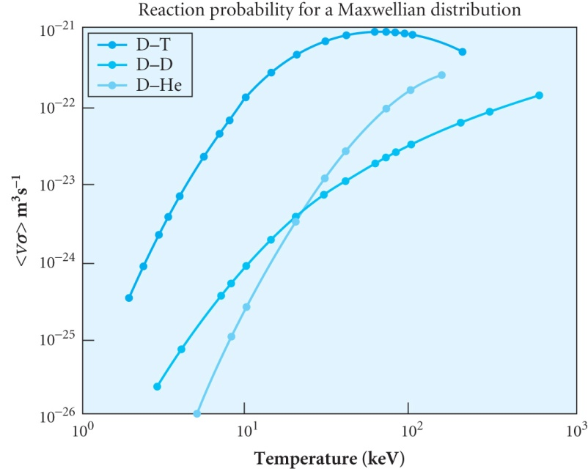
∴Power generated / unit vol. by fusion
is given by (25.3)
where Q_{F} = T_{α} + T_{n}
T_{α} = K.E. of α =1/5 x 17.6=3.5 MeV
T_{n} =K.E. of n =4/5 x 17.6=14.1 MeV
α provides useful energy directly to the plasma
n provides energy from the (n, ⁶Li) reactions in the blanket which is removed by the coolant
The temperature dependence of the averaged σ v product is known empirically yielding the following expression where the temperature T is measured in eV ( i.e.T K ➔ kT in eV to substitute into the formula)
(25.4)

Slide 11
ENERGY LOSSES
In addition to the usual heat leakage other sources arise because charged particles give off radiation whenever they are accelerated. Two types:
BREMSSTRAHLUNG
Acceleration caused by Coulomb force between two charged particles
e.g. e⁻ + D⁺ or e⁻ + T⁺ ( of less importance are e⁻ + e⁻ or D⁺ + D⁺ )
Power radiated goes as
Radiation is in X-ray region and is the most
important energy loss
2. SYNCHROTRON RADIATION
Acceleration due to motion of charged particles in a circle
➔Radiation in infra-red and microwave region
➔ much softer and easily absorbed ➔ much less important

Slide 12
BREAK EVEN TEMPERATURES
For T = 4 keV ➔ T ~ 5 x 10⁷ K D-T
For T = 40 keV ➔ T ~ 4 x 10⁸ K D-D
The most difficult problem in fusion technology is holding the plasma together sufficiently long for most of the particles to make a reaction.
What is the required criterion of performance?

