Slide 1
REACTOR OPERATIONS
LAYOUT OF A
REACTOR PLAN
The loading system allows U rods to be replaced
Pumps circulate fluids
THERMODYNAMICS
Maximum possible efficiency is η_{MAX} = 1 – T₂ / T₁
For FOSSIL fuel plants T₁ ~ 840K and T₂ ~ 300K
➔ η_{MAX} ~ 64%
In practice η ~ 40%

Slide 2
Limitations on increasing T₁ hence efficiency) are
Cannot burn fossil fuel at much above 840K
Steam pressure at 840K is 160 bar (atmospheres)
In NUCLEAR REACTORS there is in principle no such limit on T₁ BUT there are practical considerations
Melting or weakening of containment vessel
Melting or weakening of fuel rods
UO₂ is better than U [T_{MAX}=933K]
Corrosion

Slide 3
FEATURES OF REAL SYSTEMS
MAGNOX - Oldest in UK
Name arises from magnesium alloy cladding of fuel elements (low σ_{A})
Uses natural U, graphite moderator, CO₂ coolant
T₁ limited to 798K when CO₂ oxidises Magnox
Usually Core T ~ 683K ➔ steam T ~ 667K , η_{MAX} ~ 53%
In practice η ~ 31%
A.G.R. - ADVANCED GAS COOLED REACTOR
Uses enriched(2.3% ²³⁵U) UO₂, graphite moderator, CO₂ coolant, stainless steel cladding
Coolant Temperature ~ 938K at 40 bar
Steam Temperature ~ 838K at 160 bar
~ Same efficiency as fossil fuel plant

Slide 4
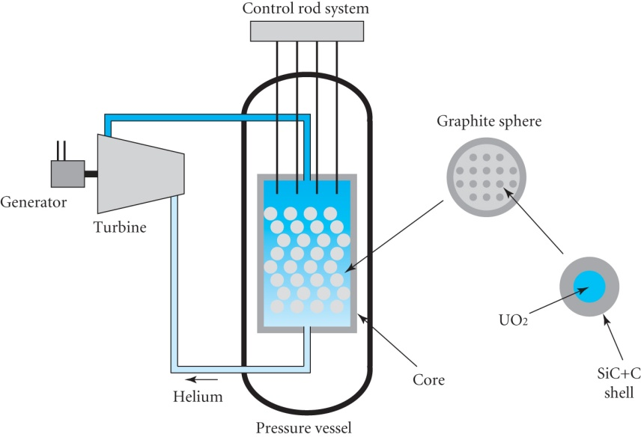
A very high temperature helium cooled graphite moderated reactor (HTGR) operates at a temperature of 1000ºC
Considerably higher than water cooled reactors (~300ºC) or liquid metal cooled reactors (~600ºC)
Fuel is in the form of small
spheres of mixed fissile and
fertile material in thin carbon
and silicon carbide shells
Fuel is enriched to 8%
A Pebble Bed Reactor
High temperature ensures
the annealing of radiation damage in the graphite
A strong negative temperature coefficient of reactivity
Main safety concern is to avoid air contact with hot graphite

Slide 5
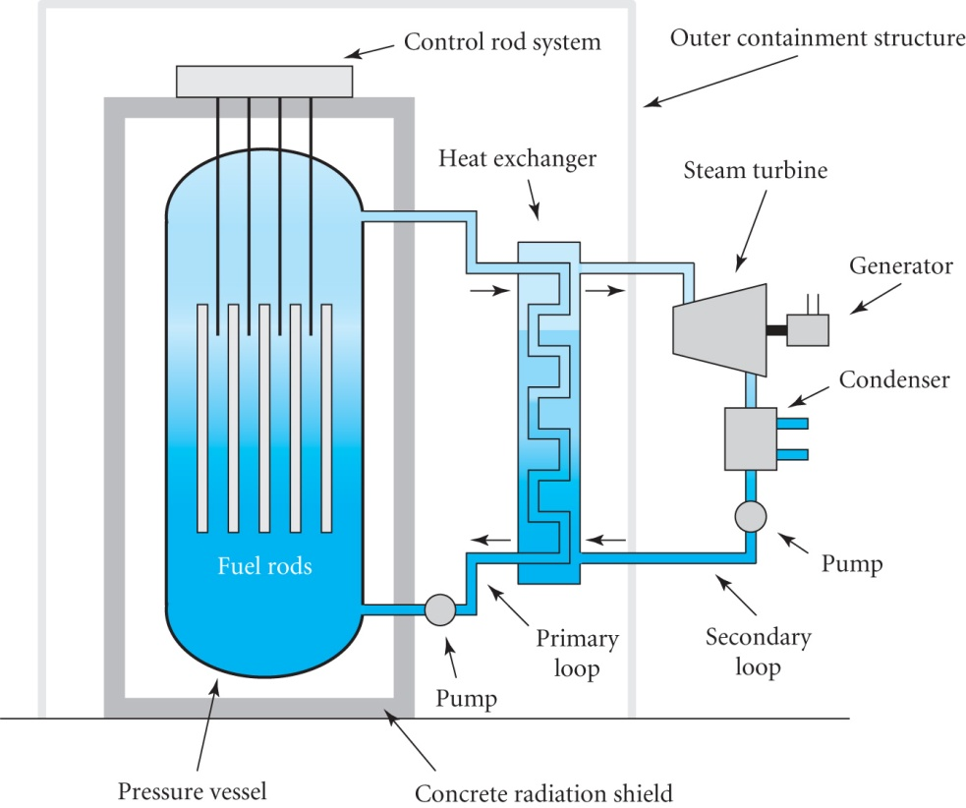
P.W.R. - PRESSURISED WATER REACTOR
Uses enriched(2.5% ²³⁵U) UO₂ ,
in ZIRCALOY cladding, water
moderator and coolant
Limitation of T₁ ~ 647K, critical
temperature of water in practice.
Core temperature ~ 573K at a
very high coolant pressure
~150 bar
ADVANTAGE of P.W.R. is that the core size is much smaller than for graphite moderated reactors
By far the most popular design in commission today
Efficiency ~ 32%
Other reactor systems are shown in the following table

Slide 6
SYSTEM | FUEL (% ²³⁵U) CLADDING | MODERATOR | COOLANT | TEMP. K
CANDU (Canadian) | Nat. UO₂ Zircaloy | D₂O | D₂O | 573
SGHWR (Steam Gen. Heavy Water Reactor) | UO₂ (2.3%) Zircaloy | D₂O (Uses less than CANDU) | H₂O | 573
BWR (Boiling Water) | UO₂ (2.5%) Zircaloy | H₂O | H₂O | 573 ½ P of P.W.R.
HTGR (High Temp. Gas Cooled) | UO₂ or UC₂ (>2.5%) Graphite | C | He | 1023 - 1273 High efficiency
FAST (Breeder) | UO₂ or PuO₂ (25% - 50%) | NONE | Na | 873
RMBK (Russian – Chernobyl) | UO₂ (2 - 2.4%) | C | H₂O | 573 Graphite at 973

Slide 7
NEGATIVE FEEDBACK EFFECTS
It is desirable to design reactors such that an increase in power automatically produces negative feedback to ensure safety
One example is the Negative Temperature Coefficient
An increase of temperature causes Doppler Broadening of the ²³⁸U resonances leading to increased absorption
For PWRs and BWRs a Negative Void Coefficient is desirable
Increased boiling creates more bubbles and decreases the moderator to fuel ratio leading to
Increased leakage (a -ve effect)
Increased capture in ²³⁸U (a -ve effect)
Increased energy for neutrons ➔ σ_{F} falls (a -ve effect)
Thermal utilisation factor increases (a +ve effect)
Western reactors are designed to include these safety features

Slide 8
OPERATING CHARACTERISTICS
DEFINITIONS
Introduce EXCESS REACTIVITY δk = k – 1
(Remember k is the reproduction constant)
Also introduce REACTIVITY ρ = (k – 1) / k
Since k ~ 1 δk ~ ρ
CONTROL SYSTEMS – Three Functions
Introduce small changes in ρ for start up, control of power and shutdown
Absorb built in excess reactivity and compensate for fuel burn up and poisoning
Emergency shut down
For 1 fast changes of ρ are required, slow will do for 2 and ultra fast changes are needed for 3

Slide 9
These control systems can be a mixture of manual and automatic
For 3. The system must be automatic and fail safe
PRINCIPLE OF A CONTROL SYSTEM
MONITOR - Measures neutron flux in BF₃ ionisation chamber
COMPARATOR - Compares flux with set of standard values
CONTROL SYSTEM - Depends on specific reactor type

Slide 10
1. GAS COOLED
Uses control rods with large σ_{A} for neutrons
e.g. cadmium or boron loaded steel
2. P.W.R. , B.W.R.
Uses control rods
OR add a neutron absorber (e.g. boric acid) to the coolant
OR ratio of D₂O / H₂O
OR add a reactor poison (see later) such as Gd₂O₃ of Er₂O₃ to the fuel rods. These initially absorb neutrons but the absorption decreases as they (and the ²³⁵U) are burnt up. This technique extends the time between refuelling for submarine reactors to 10 years
3. FAST REACTOR
Move groups of fuel elements in and out of core
(Boron has small σ_{A} for fast neutrons )

Slide 11
REACTOR KINETICS
The study of the response of a reactor to a change in k is known as REACTOR KINETICS
DEFINE the PROMPT NEUTRON LIFETIME :
= mean value of time taken from birth of prompt neutron to its absorption in reactor
= average slowing down time + average diffusion time so :-
For thermal neutrons (23.1)

Slide 12
Detailed calculations show that
Recall reactor equation (21.8)
For an INFINITE REACTOR Φ does not change with x,y,z so that

Slide 13
=
Note that the flux Φ changes exponentially with time t
Φ = Φ₀ exp[+t / T] with T = / (k∞ – 1) (23.2)
The argument is positive
Hence the flux will change rapidly with time if the neutron lifetime is short.
If k is changed from 1.000 to 1.001 the neutron flux and hence power will increase by a factor e in 1 second
since T = 10⁻³ / 10⁻³
In 10 seconds the power will change by a factor e¹⁰ ~ 22000!!

