Slide 1
TYPES OF REACTOR
THERMAL REACTORS are the simplest and most proven of reactor types. Others are under development
FAST REACTORS
‘Fast’ refers to the speed of the neutrons
Using the table of cross-sections (Lecture 17)we can evaluate η (Fuel Utilisation Factor) from σ_{f} and σ_{C} for a reactor fuelled by 50% ²³⁵U and 50% ²³⁸U ( average ν_{AV} ~ 2.5 for both)
T_{n} MeV | σ_{f} (barns) | σ_{C} (barns) | η= ν_{AV} x σ_{f} / σ_{A}
2 | .5(.6+1.3) ~ 0.9 | .5(.2+0) ~ 0.1 | 2.3
0.3 | .5(0+1.3) ~ 0.6 | .5(.2+0) ~ 0.1 | 2.1
0.001 | .5(0+8) ~ 4 | .5(4+3) ~ 3.5 | 1.4

Slide 2
Note that η > 1.3 even for neutrons slowing below 1 MeV
A CHAIN REACTION CAN BE MAINTAINED WITH HIGHLY ENRICHED FUEL
Prototype fast reactor at Dounray and first production model at Le Bouget
NOTES
A moderator is not required for these reactors
Good heat transfer properties needed (Liquid metals e.g Na)
A NEUTRON REFLECTOR is required
Expensive to build and highly enriched fuel is also expensive (Takes power!)
Only worth considering because fast reactors can be used as the BREEDERS of new fuel
e.g. ²³³U and ²³⁹ Pu

Slide 3
BREEDER REACTORS
Consider the capture of neutrons in ²³⁸U which dominates the cross-section for
T_{n} < 0.1 MeV
γ β− β−
n + ²³⁸U --> ²³⁹U* -->²³⁹U -->²³⁹Np -->²³⁹Pu
T_{1/2}=23min T_{1/2}=2.3days
₉₄²³⁹Pu has T_{1/2}= 2.4 10⁴ yrs and, like ²³⁵U, is FISSILE
Also if natural thorium captures neutrons
γ β− β−
n + ²³²Th --> ²³³Th* -->²³³Th -->²³³Pa -->²³³U
T_{1/2}=22min T_{1/2}=27days
₉₂²³³U is also FISSILE with thermal neutrons
Hence it is possible to breed fissile material in reactors

Slide 4
Some ²³⁹Pu is produced in ALL thermal reactors containing ²³⁸U
The ²³⁹Pu then becomes part of the fissile fuel
the most neutron efficient reactors produce the most ²³⁹Pu by this method
If the fuel rods are taken out of the reactor before the ²³⁵U has been used up, the ²³⁹Pu can be CHEMICALLY separated from the U and the fission products in a REPROCESSING PLANT.
The ²³⁹Pu can then be used for making nuclear weapons
Hence the reason for international inspection of nuclear power plants under the auspices of the IAEA

Slide 5
If the fuel rods are retained in the reactor for maximum ²³⁵U (and ²³⁹Pu) burn up the residual ²³⁹Pu is contaminated by ²⁴⁰Pu
γ
n + ²³⁹Pu --> ²⁴⁰Pu* --> ²⁴⁰Pu
T_{1/2}=6540 yrs
Chemical separated Pu would not then be suitable for weapons manufacture but it could still be used again in reactors
To breed more fuel than is used up more than one neutron must be captured by ²³⁸U for every ²³⁵U fission
THE BREEDING RATIO B
B is the number of new fissile atoms produced in a reactor per atom of existing fuel consumed by fission + neutron capture

Slide 6
THE BREEDER CYCLE IS :-
For a sustained reaction η = 1 + B + C + L
Typically C + L ~ 0.2 so if B>1 then η ≥ 2.2
Clearly B>1 is required for net fuel production
The table in 2.5 shows η>2.2 for fast neutrons only
Fast reactors can be used for breeding
η can be increased if more highly enriched fuel is used (with ²³⁵U or ²³⁹Pu increasing average ν from 2.5 to 2.9 say)
An improvement is also achieved by fission by fast neutrons in ²³⁸U or ²³²Th blanket

Slide 7
GEOMETRY OF A BREEDING REACTOR
When sufficient ²³⁹Pu has been produced it can be extracted
TIMESCALE FOR BREEDING
Consider a fast breeder with 2 tonnes of ²³⁹Pu, 20 tonnes of ²³⁸U, operating at 1000 MW
Consumption of Pu = mass of Pu atom x power / energy per fission

Slide 8
If B = 1.2 then we gain 0.2 x 0.39 ~ 0.08 tonnes / year
This generates fuel for a second reactor (i.e. 2 tonnes) in 2 /0.08 years = 25 years!!
Concern about the Earth’s fuel reserves ➔ interest in Breeder Reactors
UN statistics (1984 excluding Eastern Europe, USSR and China)
FUEL COAL EQUIVALENT
IN 10⁹ TONNES
COAL 1520
OIL 140
GAS 115
URANIUM 146
(No breeding, 2% burn up)
URANIUM 7300
(Breeding, 100% burn up)
Rough numbers depending on what it is considered economic to recover

Slide 9
Schematic of a FAST REACTOR
Extra radiation hazards
Continuous energy distribution of n
n+²³Na➔²⁴Na➔²⁴Mg*➔²⁴Mg+ γγ
β⁻ T_{1/2} ~ 15 hours

Slide 10
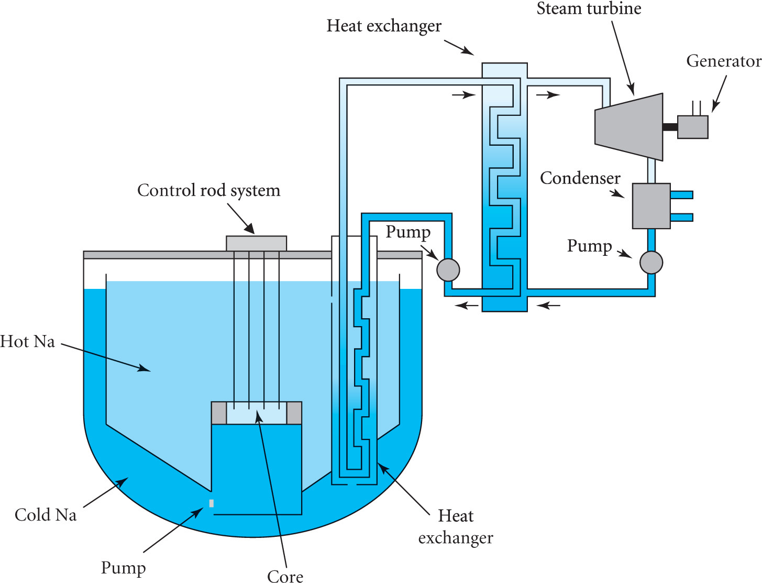
A pool type sodium cooled fast reactor

Slide 11
EXAMPLE:- A fast breeder reactor operates with a plutonium fuel. Plutonium emits on average 3.0 neutrons per fission and the neutron fission and absorption cross sections are σ_{f} = 1.8b and σ_{A} = 2.15b respectively. Determine a value for η. Assuming that the neutron losses are 20% in total calculate the value of B. The breeder reactor operates at a rating of 500 MW per tonne of fuel. Calculate the neutron flux and the consumption of plutonium fuel per year (You may assume that 200MeV is released per fission). Hence calculate the ‘doubling time’, i.e. the time needed to double the amount of fuel.

Slide 12
For plutonium η = 3.0 x 1.8 /2.15 = 2.51
So B = 2.51 – 1 – 0.2 = 1.31
The reaction rate is given by R = Nσ_{f} φ where N is the total number of plutonium atoms
In 1 tonne of plutonium N = 1000 /( 239 x 1.66 10⁻²⁷) = 2.52 10²⁷
Number of fissions per second = R = 500 x 10⁶ /(200 x 1.6 10⁻¹³) = 1.56 10¹⁹ s⁻¹
So 1.56 10¹⁹ = 2.52 10²⁷ x 1.8 10⁻²⁸ x φ
∴ φ = 3.44 10¹⁹ neutrons m⁻²s⁻¹
The rate of consumption of the original fuel is R_{Pu}= Nσ_{A} φ
∴ R_{Pu}= 2.52 10²⁷ x 2.15 10⁻²⁸ x 3.44 10¹⁹ = 1.86 10¹⁹ atoms / s
Or 1.86 10¹⁹ x 1.66 10⁻²⁷ x 239 = 7.38 10⁻⁶ kg s⁻¹ or 233 kg / year
The rate of production of excess fuel is 0.31 x 233 kg / year
so the doubling time is T_{D} = 1000 / (0.31 x 233) = 13.8 years

