Slide 1
NEUTRONS AND THEIR INTERACTIONS
Discovered by Chadwick in 1932 from reaction
⁹Be₅ + α ➔ ¹²C₆ + n + 5.75 MeV (Q value)
Neutrons do not occur as free particles as they undergo β decay
T_{1/2} = 10.6 min
Neutrons can be produced using a mixture of radium and beryllium
²³⁶Ra ➔ ²³²Rn + α then α + ⁹Be➔ ¹²C + n
1g of Ra + few g of Be produces ~ 10⁷ neutrons / s
INTERACTIONS OF NEUTRONS
Neutrons are uncharged so do not experience Coulomb repulsion.
Can interact with nuclei at thermal energies with kT ~ 1/40 eV
Interacting at low energies is important since
σ(low energy) >> σ(high energy)
There are two principle modes of interaction between neutrons and nuclei

Slide 2
ELASTIC SCATTERING σ_{S}
This is an important mechanism for slowing down neutrons --- MODERATION
The initial energy goes into the recoil energy of X + slower neutrons
COMPOUND NUCLEUS FORMATION
A neutron is absorbed by the target nucleus leaving the ‘compound nucleus’ in an excited state
After formation of the compound nucleus several things can happen
a) INELASTIC SCATTERING σ_{i}

Slide 3
b) RADIATIVE CAPTURE σ_{c}
EMISSION OF LIGHT CHARGED PARTICLES σ_{R}
d) FISSION σ_{F}
TOTAL CROSS SECTION σ_{T} = σ_{i} + σ_{C} + σ_{R} + σ_{F} + σ_{S} (16.1)
ABSORPTION CROSS SECTION (neutrons removed from flux)
σ_{A} = σ_{C} + σ_{R} + σ_{F} (16.2)
All σs depend on the neutron’s kinetic energy
σ_{R} is usually small and we will ignore it

Slide 4
The plots below sketch the behaviour of the neutron capture cross section
in ²³⁸U and the neutron induced fission cross section in ²³⁵U

Slide 5
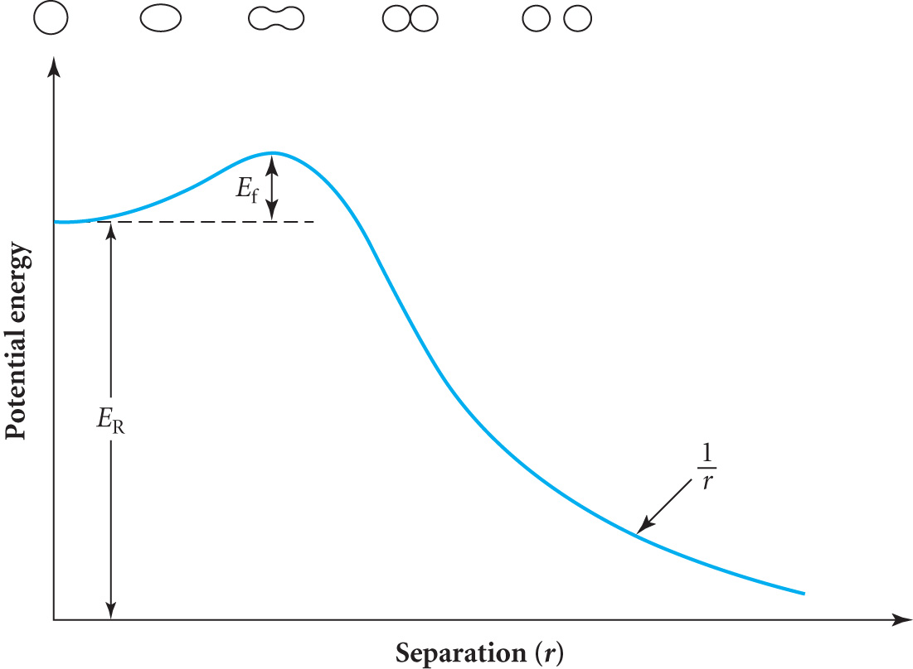
FISSION
Q = [M(A,Z) – M(A₁,Z₁) - M(A₂,Z₂) ] c²
Energetically favoured since δ(A/2) > δ(A)
Spherical shape gives lowest energy configuration ( LIQUID DROP)
Energy is required to deform the nucleus increasing the surface
area until Coulomb forces can complete the split
The extra energy needed to do this is called the
FISSION BARRIER or ACTIVATION ENERGY E_{f}

Slide 6
SPONTANEOUS FISSION
Consider the possible fission of ²³⁸₉₂U into 2 identical nuclei ¹¹⁹₄₆Pd
For uranium & palladium δ ~ 7.6 MeV & ~8.5 MeV / nucleon
∴ Q ~-238 x 7.6 – (-2 x119 x 8.5) = 214 MeV
Is this a possible decay mode?
The diagram has zero potential
corresponding to the final state.
As in alpha decay the Coulomb
Barrier (height E_{C}) prevents
immediate decay since Q < E_{C}(~250 MeV)
It is necessary to supply energy to deform the nucleus which increases the
dominant surface energy term while initially reducing the Coulomb term.
Hence a strong restoring force initially prevents fission until at a certain
separation the relative strengths reverse as the charges separate further and
fission occurs.

Slide 7
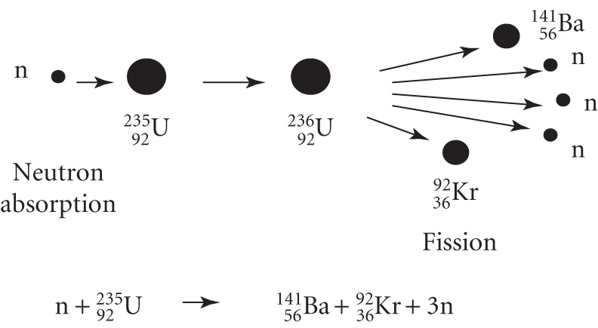
NEUTRON INDUCED FISSION
In this case the compound nucleus
is formed in an excited state as the
absorbed neutron has contributed
its binding energy |B_{n} |
Consider ²³⁶₉₂U formed as a compound nucleus by the capture of a slow neutron by ²³⁵₉₂U
M(²³⁵U) = 235.043933 u & M(n) = 1.008665 u so
Sum = 236.052598 u compared with M(²³⁶U) = 236.045733 u
ΔM = + 0.006865 u ≅ + 6.5 MeV
²³⁶U is formed excited with energy E_{x} = |B_{n} | = 6.5 MeV
For ²³⁶U E_{f} = 5.9 MeV
E_{x} > E_{f} so fission is possible with thermal neutrons in this case (K.E. of neutrons T_{n} ~ 1/40 eV)

Slide 8
In general if | B_{n} | < E_{f} then neutrons require Kinetic Energy T_{n} to induce fission
i.e. T_{n} + |B_{n} | > E_{f}
e.g. ²³⁸U for example where T_{n} > 1 MeV is required
The difference between the two compound nuclei is because of nucleon pairing energy
|B_{n} even-even | > |B_{n} even-odd |
So |B_{n} ²³⁶U | > |B_{n} ²³⁹U | and neutron K.E. is required to fission ²³⁹U
SPONTANEOUS FISSION occurs with small probability by tunnelling through the barrier
e.g. For ²³⁸U in the absence of α decay
T_{1/2} ~ 10¹⁵ years

Slide 9
Example: Calculate the fission thresholds for the reactions 1) n + ²³²Th➔²³³Th*➔fission and 2) n + ²³⁹Pu➔²⁴⁰Pu*➔fission
Masses : ²³²Th (232.038050 u) ²³³Th (233.041577 u)
²³⁹Pu (239.052157 u) ²⁴⁰Pu (240.053807 u)
n (1.008665 u)
1) Excitation for ²³³Th is = (232.038050 + 1.008665 - 233.041577)
= 5.138 10⁻³ u ≡ 4.8 MeV
Activation energy E_{f} = 6.7 MeV so threshold energy = 1.9 MeV
2) Excitation for ²⁴⁰Pu is = (239.052157+1.008665- 240.053807)
= 7.02 10⁻³ u ≡ 6.53 MeV
Activation energy E_{f} = 6.3 MeV so there is no threshold energy

Slide 10
FISSION BARRIERS AND NEUTRON BINDING ENERGIES
REACTION NEUTRON + | COMPOUND NUCLEUS | E_{f} MeV | B_{n} MeV | T_{n} MeV FOR FISSION
²³²Th | ²³³Th* | 6.7 | 4.8 | ~ 1.9
²³³U | ²³⁴U* | 5.85 | 6.8 | 0
²³⁵U | ²³⁶U* | 5.9 | 6.5 | 0
²³⁸U | ²³⁹U* | 5.8 | 4.8 | ~ 1.0
²³⁹Pu | ²⁴⁰Pu* | 6.3 | 6.5 | 0
TABLE 1
Only for Z >90 is E_{f} small enough for low energy neutrons to induce fission
The important naturally occurring fissionable nuclei
are ²³²Th, ²³⁵U (0.7% natural U) ,and ²³⁸U (99.3% natural U)
For A>250 E_{f} →0 and spontaneous fission becomes a probable decay mode

Slide 11
ENERGY RELEASE
Approximately 200 MeV is released in fission of a heavy nucleus :
MeV
K.E. of fission fragments 165 ± 5
Prompt γ-ray energy 7 ± 1
K.E. of fission neutrons 5 ± 0.5
– rays from fission products 7 ± 1
γ– rays from fission products 6 ± 1
Neutrinos from fission products 10 TOTAL ~ 200
MASS DISTRIBUTION OF FISSION FRAGMENTS
In low energy fission processes there is a
wide distribution of nuclear masses
Produced, with equal fragmentation
disfavoured by a factor of ~ 600
Distribution is symmetric with peaks
at A=95 and A=140

Slide 12
Assume fission from a nucleus at rest
Conservation of momentum
Conservation of Energy
(16.3)
So when the fission has a heavy fragment and a lighter fragment it is the lighter fragment that takes most of the kinetic energy

Slide 13
NEUTRON EMISSION
On average 2.1 neutrons are emitted in Th fission, 2.5 in U fission and 2.9 in Pu fission
Values increase by 0.05 per MeV as T_{n} of the neutron increases
Most of these are PROMPT neutrons emitted at the moment of fission
Some DELAYED neutrons (0.65% for ²³⁵U) are emitted following the β- decay of the fission product
THESE ARE VERY IMPORTANT FOR REACTOR CONTROL
e.g. For ⁸⁷Br 2% of the β- decays populate a state in ⁸⁷Kr which is so highly excited (~8 MeV) that neutron emission is a likely decay mode
Only appears after the β- decay with an apparent half life T_{1/2} = 54.5s

Slide 14
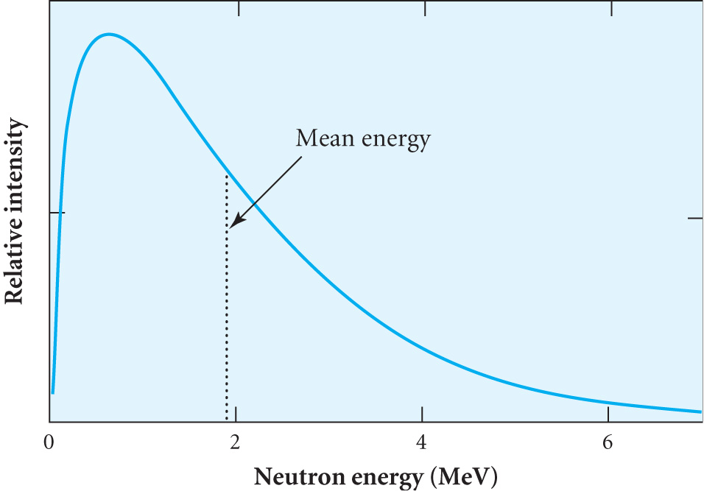
Some examples of delayed neutrons
FISSION NEUTRON ENERGY SPECTRUM

