Slide 1
BASICS OF NUCLEAR PHYSICS

Slide 2
UNITS
Length Femtometres or Fermi
1 fm = 10⁻¹⁵ m
Mass Atomic Mass Unit (a.m.u. or u)
1 u = 1/12 mass of ¹²C Atom = 1.66043 x 10⁻²⁷ kg
(approx. mass of n or p)
In nuclear physics masses are usually quoted in units of MeV/c²
Since E = m₀c² rest mass m₀ = E / c²
1 eV = 1.6021 x 10⁻¹⁹ J
Masses are measured in units of MeV / c² (1 MeV = 10⁶ eV)
Example
1 u = 1.66043 x 10⁻²⁷ x (2.99792 x 10⁸)² J = 1.49232 x 10⁻¹⁰ J
1 MeV = (1.6021 x 10⁻¹⁹ x 10⁶ ) J
1 u = 1.49232 x 10⁻¹⁰ / 1.6021 x 10⁻¹³
= 931.477 MeV / c²

Slide 3
Nuclear Binding Energy
Diagram shows the potential experienced by a proton in the nucleus
Attractive nuclear forces
Repulsive coulomb forces (not seen by
the neutrons)
The BINDING ENERGY of a nucleon is the energy required to release it from the nucleus

Slide 4
The total binding energy of the nucleus
B.E. = (Zm_{p} + Nm_{n} – M) c²
= sum of masses of constituents – mass
of nucleus
The quantity in brackets is also known as the MASS DEFECT Δ
e.g.for ¹⁶O
Δ =0.137 u ➔ B.E. = 128 MeV.
B.E. of nucleons in nuclei >> B.E. of electrons in atoms
Easier to measure mass of atoms
For Hydrogen m_{H} = m_{p} + m_{e}
For an atom M_{A}= M_{nuc} + Zm_{e}
Δ = Ζm_{H} + Νm_{n} − M_{A}
ignoring the B.E. of the electrons
Binding energy / nucleon δ = Δ / A
For ¹⁶O δ ~ 128/16 ~ 8 MeV

Slide 5
SEMI-EMPIRICAL MASS FORMULA
The mass of a nucleus may be approximately represented by the following formula
a_{V}, a_{S}, a_{C}, a_{SYM} are numerical coefficients
The terms represent:-
Volume term ~ number of nucleons
Surface term: Correction for surface nuclei
which have lower binding energies
Coulomb term: Correction for electrostatic
potential energy
Symmetry term favouring Z = N.
Pairing term favouring even values of N and Z
For Z and N even : ρ = +a_{P}A^{-3/4}
For A odd : ρ = 0
For Z and N odd : ρ = -a_{P}A^{-3/4}

Slide 6
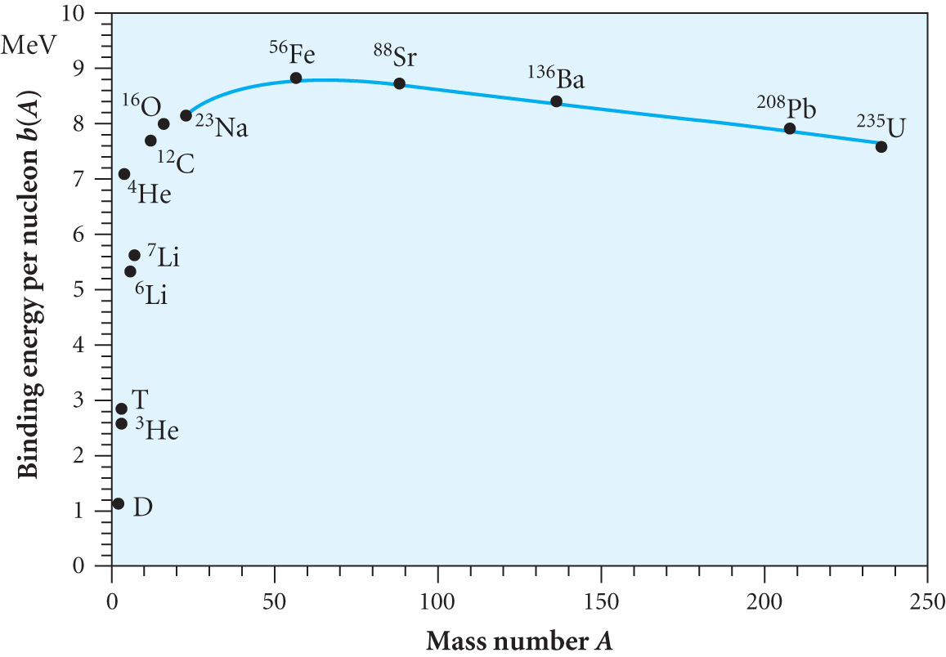
A few nuclei, e.g. α, ¹²C, ¹⁶O are extra stable
δ is larger than for adjacent nuclei
Most strongly bound nuclei have A ~ 60 – 80
Nuclear reactions can release energy if they yield more
stable nuclei
Fusion of low A nuclei or
Fission of large A nuclei

Slide 7
HISTORY OF FISSION AND FUSION
The source of the Sun’s power was a mystery until Eddington proposed the fusion of hydrogen to helium in 1920
Fission was observed shortly after Chadwick’s discovery of the neutron with the explanation coming from Meitner and Frisch in 1939.
In 1942 Fermi and Szilard demonstrated a controlled chain reaction. The first prototype nuclear power station was in 1956
1 tonne of uranium delivers the equivalent energy of 20,000 tonnes of coal
The average concentration of uranium in the Earth’s crust is 2.8 ppm. Granite has 4ppm
Known reserves are ~ 3.3 Mt ( corresponding to ~ 50 years at present consumption)
An estimated additional 10.7 Mt is recoverable

Slide 8
NUCLEAR REACTIONS
A schematic picture of a nuclear reaction is
Written as A(a,b)B* for a binary reaction
FUSION
Nuclei join to make a more stable nucleus e.g.. d + d ➔ t + p or d(d,p)t
δ➔ 1.12 , 1.12 ➔ 2.83, 0 MeV
Energy released = 3 x 2.83 – 4 x 1.12 = 4.02 MeV
FISSION
Excited nucleus B* divides into two fragments to make more stable nuclei
e.g.. n + ²³⁵U ➔ ₅₇¹⁴⁷La + ₃₅⁸⁷Br +n+n
δ➔ 7.6 8.5 8.5
Energy released = 235 x (8.5-7.6) ~ 200 MeV

Slide 9
CONSERVATION LAWS
Reactions of the form
A + B ➔ C + D + E …
Must obey momentum and energy conservation
Energy Conservation
Relativistically total energy E = m_{o}c²/(1-(v/c)²)^{1/2}
Expand (1-(v/c)²)^{1/2} to give E = m_{o}c² + (1/2) m_{o}v² + ….
= rest energy + kinetic energy
For reaction above
E_{A} + E_{B} = E_{C} + E_{A} + E_{E}
i.e M_{A}c² + T_{A} + M_{B}c² +T_{B} =
M_{C}c² + T_{C}+ M_{D}c² + T_{D} + M_{E}c² +T_{E} (14.1)
Where M_{A}, M_{B} etc are REST MASSES

Slide 10
Define QVALUE of the reaction as
Q = ( Initial Rest Mass – Final Rest Mass) x c²
= (M_{A}+ M_{B} - M_{C} - M_{D} - M_{E}) c²
= (T_{C}+ T_{D} + T_{E} - T_{A}- T_{B} ) (14.2)
E.g.
n + ₅¹⁰B ➔ ₃⁷Li + α OR ¹⁰B(n,α)⁷Li
A B C D
M_{A}+ M_{B} = 11.02161 u
M_{C} + M_{D} = 11.01861 u
Q = (11.02161-11.01861) x 931 = + 2.79 MeV
N.B. Q > 0 (Exothermic reaction)
Q < 0 (Endothermic reaction)

Slide 11
Momentum Conservation
P_{A} + P_{B} = P_{C} + P_{D} + P_{E} (14.3)
Often only 2 massive nuclei are formed so momenta of other products (e.g. neutrons) can be ignored and
P_{A} + P_{B} = P_{C} + P_{D}
In the laboratory frame B is often at rest so P_{B} = 0 then
P_{A} = P_{C} + P_{D}
Resolving components
P_{A} = P_{C} cos θ + P_{D} cos φ and
0 = P_{C} sin θ - P_{D} sin φ

Slide 12
For v << c
T = Mv²/2 and P = Mv so T = P² / 2M
so Q = P_{C}² / 2M_{C} + P_{D}² / 2M_{D} - P_{A}² / 2M_{A} (14.4)
E.g. for reaction n + ₅¹⁰B ➔ ₃⁷Li + α
Q > 0 (p 9) so reaction can proceed with T_{n} ~ 0 and P_{n} ~ 0
₅¹⁰B is at rest (in control rod!)
P_{Li} = - P_{α}
Q = P_{Li}² / 2M_{Li} + P_{α}² / 2M_{α}
= P_{Li}² (1/ 2M_{Li} +1 / 2M_{α} )
= P_{Li}² ((M_{Li} + M_{α} ) / (2 M_{Li} M_{α} ) )
So T _{Li} = P_{Li}² / 2M_{Li} = Q M_{α} / (M_{Li} + M_{α} ) (14.5)
= Q A_{α} / (A_{Li} + A_{α} ) = 2.79 x 4/11
T _{Li} = 1.01 MeV
And T _{α} = 2.79 x 7/11 = 1.78 MeV

Slide 13
Example: ²¹²Po decays to ²⁰⁸Pb (ground state) emitting an 8.784 MeV α. Calculate the recoil energy of ²⁰⁸Pb and the mass of ²¹²Po. [M_{α} = 4.002603u, M_{Pb} = 207.976636u ]
We can use equation (14.5)
T_{Pb} = Q M_{α} / (M_{Pb} + M_{α} ) and T_{α} = Q M_{Pb} / (M_{Pb} + M_{α} )
So 8.784 = Q x 208/(208+4)
Hence Q = 8.9529 MeV
Then the recoil energy of the lead is
T_{Pb} = 8.9529 x 4 / (208+4) = 0.169 MeV
From (14.2) Q = 8.9529 MeV = 8.9529 / 931.44 u = M_{Po} – M_{α} - M_{Pb}
So M_{Po} = 0.009619 + 4.002603 + 207.976636 u
M_{Po} = 211.988858 u

