Slide 1
BIOMASS
Plants derive energy primarily from photosysnthesis
CO₂ + H₂O + hν ➔ O₂ +[CH₂O Carbohydrate] (1)
Animals eat plants and the whole of animal and plant material is known as the BIOMASS
The attraction is that this is carbon neutral because of (1)
The products of (1) are ~ 5 eV per carbon atom higher in energy corresponding to ~16 MJ kg⁻¹ for pure carbohydrates
In the field ~ 1/5 radiation falls on the leaves and only 1/3 of this in the growing season. ~ 50% of the spectrum can be absorbed but green light is reflected so overall ~ 12% of the radiation is absorbed of which ~ 60% generates biomass
The efficiency of the biochemical processes is ~ 33% leading to an overall efficiency of ~ (0.12)(0.33)(0.2)(0.6) ~ 0.5%.
For annual solar energy of 1000 kWh m⁻² the available energy for biomass production is ~180 GJ ha⁻¹ (1ha = 10⁴ m²) which at 16 MJ kg⁻¹ leads to a carbohydrate biomass of ~ 10t ha⁻¹ y⁻¹ and an energy yield of ~ 5 kW ha⁻¹

Slide 2
BIOMASS POTENTIAL AND USE
Mass of plants and animals produced ~ 4 10¹¹ t y⁻¹ containing ~ 1.5 10¹¹ t of carbon
Average of ~ 7.5 MJ kg⁻¹ is stored in this biomass making an annual total of ~ 3 10²¹ J or many times the global power usage
~ 50% is used in sustaining plants leaving a potential 50TW
Of this 0.5 TW is used for food and 1.6 TW (5 10¹⁹ Jy⁻¹)as biofuel
~70% for cooking / heating providing ~ 1/3 of energy in developing countries
Open fires are only ~5% efficient so scope for efficient ovens
Residue from cereal production has energy content of 15-20 10¹⁸J but only a small fraction is used for energy production
Biomass energy production
Main sources are waste (agricultural, municipal) and energy crops
Utilization is by either anaerobic digestion, combustion and gasification or liquid biofuels

Slide 3
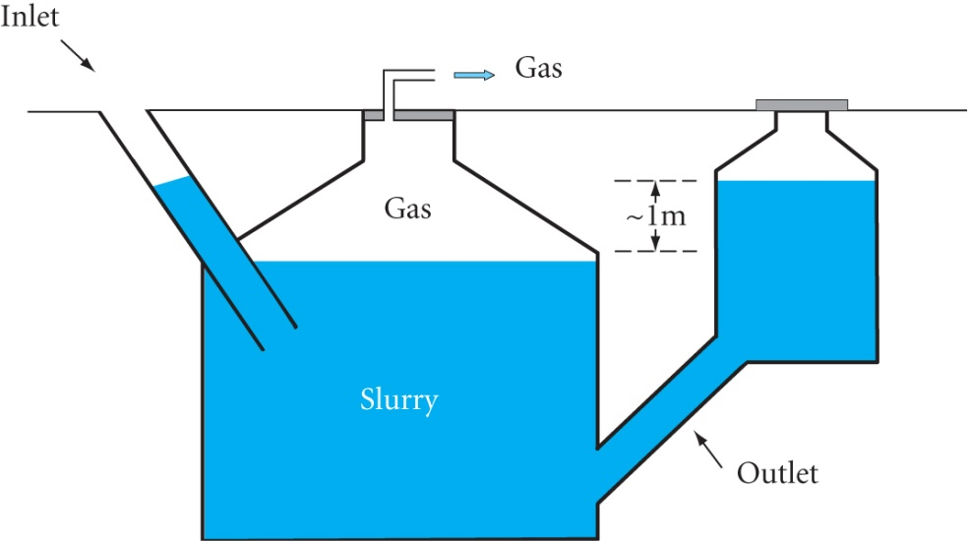
Anaerobic digestion
Decomposition by bacteria in the absence of air
eg. in compost heaps, marshes and cows (who produce ~ 3% of CH₄)
Produces 65% CH₄ and 35% CO₂ : calorific value 17 – 25 MJ m⁻³
Compared to aerobic conversion that produces residue, CO₂ and H₂O
Conversion efficiency is typically 40-60%.
A Chinese fixed dome digestor is shown below
The technology for large scale digestion is
well advanced
Potential from sludges and waste water in
EU is 2.5 GWy rising to ~12.5 GWy if
agricultural and municipal solid waste
(MSW) is included
In municipal waste digestors the organic fraction needs to be separated out which can be costly

Slide 4
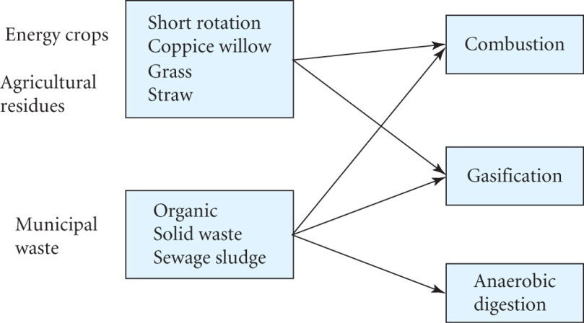
Combustion and gasification
Gasification has the potential estimated to supply 10-15% of energy needed in UK and Europe
Can be produced by combustion as well as anaerobic digestion
eg. Production of coal gas by heating coal in the presence of steam
Producer gas is similarly obtained by burning biomass in a reduced air supply to give a mixture of CO, H₂, CO₂, CH₄ + oils
Low calorific value 4.2 – 5.0 MJ m⁻³ (STP) but low emissions
Total conversion efficiency can be 60-70%
Each kg of air-dried biomass yields ~2.5m³ of gas or ~ 12 MJ kg⁻¹
A UK study identified two main biomass energy chains
Short rotation coppice willow has the
potential to provide ~9% of UK electricity by
2020 but large scale plant construction rates
limit this to ~1%

Slide 5
The 9% figure requires 10⁶ hectares (100km by 100km) planted compared to 18 10⁶ hectares of agricultural land
On this scale the cost would be competitive at 3p/kWh
Potential of +5% from smaller scale technologies
Miscanthus (Asian elephant grass) and straw could provide up to 12% by 2020 but are slightly more expensive
Total potential is ~13% saving 19 10⁶ tonnes of CO₂ compared to standard gas power stations CCGT
Similarly a ~15% contribution to electricity in OECD countries could come from biomass from forestry and farming by 2010
Assumes using ¼ of agricultural residues and assigning 5% of crop, farm and woodland area (75 10⁶ ha) to growing woody biomass sufficient to provide 200 GW of power
Households generate ~1 tonne of waste per year and burning it is a useful way of disposing of it compared to landfill sites
Processing is often needed before it can be used as a fuel
Not carbon neutral as 20-40% is derived from fossil fuels
Typical energy content is ~ 10 MJ /kg

Slide 6
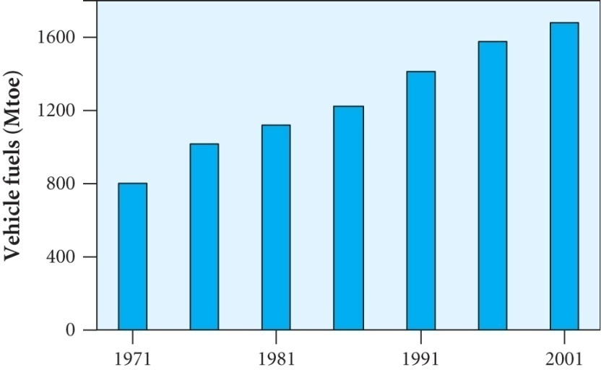
Liquid biofuels
In 2004 ~ 40 x 10⁹ litres of biofuel (mainly ethanol) were produced
Biomass is the only renewable source of carbon-based fuels and chemicals
Net savings in CO₂ emissions compared to petroleum based fuels
Provides energy security and economic development for a country
In 2001 1.6 Gtoe (giga tonnes oil
equivalent) of fuel were used for
transport (close to ¼ of world energy
consumption)
The trend is increasing
There are two important liquid biofuels
Bioethanol derived from sugar containing plants
Biodiesel derived from oil containing plants

Slide 7
Biethanol from fermentation of biomass
Uses sources of soluble sugar or starch:- sugar cane or corn
Vehicles can run on petroleum with ~ 20% ethanol mixture
In total the ~1.5 x 10¹⁰ litres produced / year is ~ 2.5% of petroleum used / year in the USA
Sugar from plants can be fermented by yeast or bacteria
C₆H₁₂O₆ ➔2 C₂H₅OH + 2 CO₂ + 0.4 MJ kg⁻¹
As heat released is so small nearly all the energy stored in the sugar is stored in the alcohol
Heat of combustion of ethanol is 30.5 MJ kg⁻¹ compared to
15.6 MJ kg⁻¹ for glucose and ~ 45 MJ kg⁻¹ for gasoline
Estimate the heat of combustion H_{C} by assuming all the carbon and hydrogen is burnt in terms of C,H & O, the fractions by weight in the fuel
Assume that the oxygen in the fuel combines with hydrogen

Slide 8
Reactions are C + O₂ ➔CO₂ + 32.8 MJ kg⁻¹ C and
2H + ½O₂ ➔ H₂O + 142.9 MJ kg⁻¹ H
where C, H and O are the fractions by weight in ethanol
H_{C} = 32.8 (C) + 142.9 (H – O/8) MJ kg⁻¹ (13.1)
The subtraction allows for the fact that the oxygen is already chemically bound in the fuel and 1 atom of oxygen combines with two of hydrogen
Example: For C₂H₅OH C = 24/46, H = 6/46, O = 16/46
So H_{C} = 32.8 (24/46) + 142.9 (6/46 – 2/46) MJ kg⁻¹
= 29.5 MJ kg⁻¹
An important quantity is the fossil replacement ratio (FER)
FER = energy supplied to customer / fossil energy used
Sugarcane ➔ ethanol FER = 8
Corn ➔ ethanol FER ~ 1.2 – 1.4
Switch grass is a possible source of cellulose that can be grown in areas unsuitable for food crops

Slide 9
Enzyme hydrolysis is being actively pursued (Gives FER ~ 4.6)
Typical values
for FERs and
yields
Biodiesel from plant oils
Production is growing. 2003 global production was 1.5 x 10⁹ litres
Vegetable oil + Methanol using potassium or sodium hydroxide as a catalyst produces biodiesel + glycerin
Resultant FER is ~ 3.2 (FER for diesel / petrol is ~ 0.83)
Diesels will run on vegetable oil but transesterification reduces the viscosity
Diesel engines have a higher compression ratio than petrol engines leading to higher temperatures and better efficiency (~40% cf 30%)
ETHANOL
Feedstock | FER | Plant (t/ha) | t/ha | Gallons / acre
Corn | 1.34 | 9 | 2.4 | 320
Switch | 3 - 5 | 12 | 3 | 400
Sugarcane | 8 | 10 | 5 | 650

Slide 10
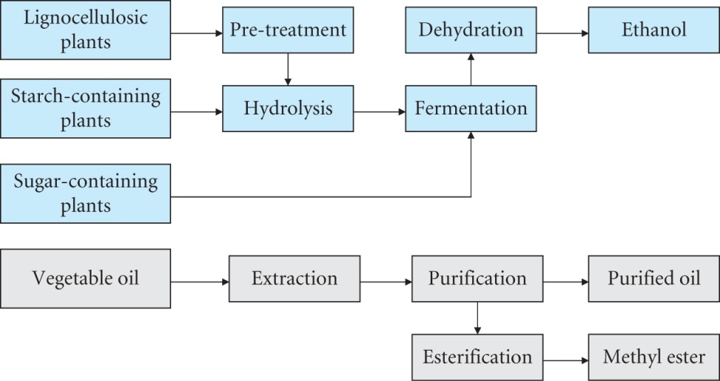
The main processes in making
biofuel are shown
The area of land needed is an
important parameter
Liquid biofuel yields
Biodiesel comes from rapeseed in the EU annual yield ~1.3t ha⁻¹
Jatropha plant and palm oil are available in the tropics with annual yields of 2.3 -3 and 4 – 6 t ha⁻¹respectively
Example 7.4 in Andrews and Jelley estimates that the annual US consumption of petrol could be replaced with biodiesel produced from 0.63 x 10⁶ km² of palm trees and reduce the carbon emission from 0.37 to 0.1 Gt displacing 0.27t carbon per year

Slide 11
POTENTIAL OF BIOMASS
In 2020 up to15% of the projected electricity demand in EU could be met by biomass combustion and gasification
Since the cost of transporting biomass is high (low energy density) small bioplants can utilise locally produced feedstock
Currently forestry residues in US produce over 6 GW of power plant
Liquid biofuels can be cost-effective with high oil prices
Land area requirements make it unlikely to exceed ~ 20% of fossil fuels
EU has a target that 5.75% of all fuel for petrol and diesel engines must be from renewable sources –
Rapeseed provides ~ 80% of the biodiesel feedstock
This target will require more land and rapeseed is a relatively expensive crop
Imported fuel may be needed

Slide 12
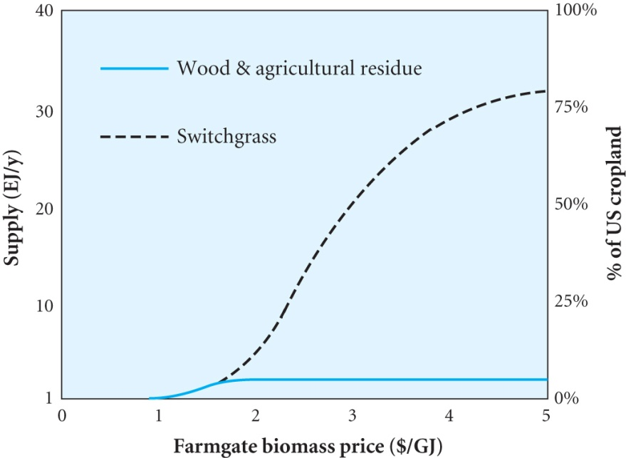
The relative energy densities of bioethanol and biodiesel are 66% and 90% respectively (petrol and diesel are 100%)
The potential of the biomass supply in US
Note the % of crop land required
The total primary energy consumption
in 2003 was 104 EJ ( Exa or 10¹⁸) for
comparison
Biomass has the potential to provide 10-20% of primary energy in developed countries and more in developing countries
Liquid biofuels can help to reduce the dependence on fossil fuels, particularly in aviation where ~ 5% of CO₂ emissions occur
Potential contribution to global energy needs appears to be limited to 20-30%

