Slide 1
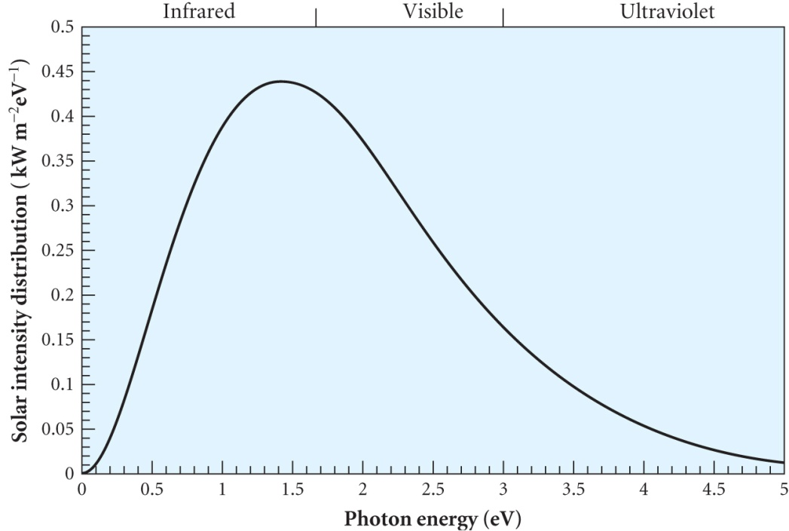
SOLAR ENERGY
The average solar power incident on earth is ~ 1kW m⁻² or 10⁵TW
Current world power needed is
~15 TW, ~ 11% from biomass
and ~85% from fossil fuels, both
of which are a consequence of
photosynthesis.
Photovoltaic cells have an
efficiency ~ 15% cf ~ 0.2 - 2% for biomass
AM0 = 1.36 kW m⁻² is the intensity on the atmosphere which is reduced to AM1.5 = 1 kW m⁻² incident on the surface at 48º to the vertical
Absorption in the atmosphere is mainly below photon energies
<~ 1.7 eV in the infrared
Typically ~ 30% of sunlight is diffuse
Variations in intensity depending on location and cloud cover

Slide 2
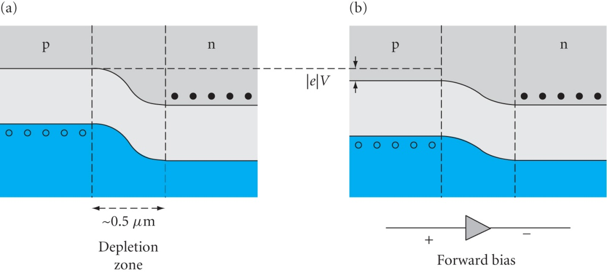
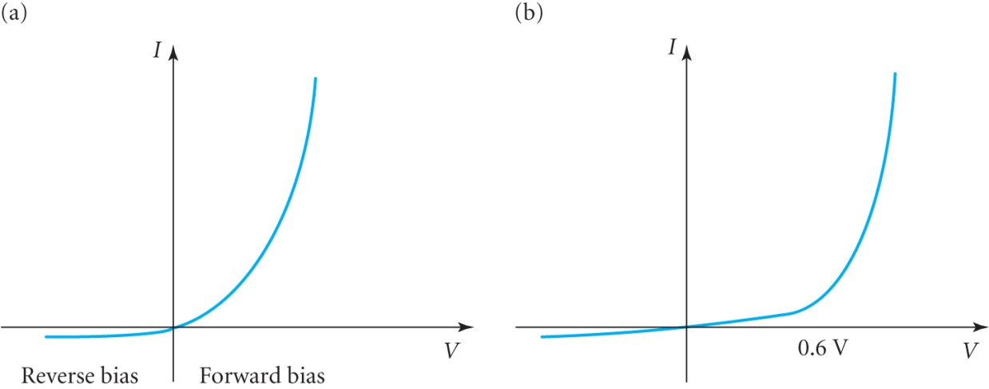
P-N JUNCTION CHARACTERISTICS
A p-n junction is manufactured by doping a silicon wafer
The resulting energy diagram shows how the device is non linear with forward and
reverse characteristics
depending on the polarity
of the applied voltage
When unbiased there is
~0.6V across the depletion
region
The forward current in a p-n
junction is given by
I = I_{S}{exp(V/V_{T})-1} (10.1)
I_{S} is the saturation current and
V_{T} ≡ kT/ e ≈ 0.026V
at room temperature
Ideal diode Actual behaviour

Slide 3
SOLAR PHOTOCELLS
A photocell is basically an unbiased p-n junction exposed to light
Photons can be absorbed by the photoelectric effect in which an electron absorbs the photon’s energy and creates an electron – hole pair
Need photons with energy > band gap energy E_{gap}, >1.1 eV in silicon corresponding to a wavelength of ~1.1 μm
The built in field in the depletion region sweeps electrons to the n-side and holes to the p-side creating a reverse current I_{L}
The photocell current I_{C} is given by
I_{C} = I_{L} - I_{S}{exp(V/V_{T})-1} = I_{L} - I_{S}{exp(I_{C}R/V_{T})-1} (10.2)
where I_{C} creates the forward bias V = I_{C}R where
R is the resistive load on the photocell
R
This forward bias gives rise to the second term (10.2) in the opposite direction to the light induced current I_{L}

Slide 4
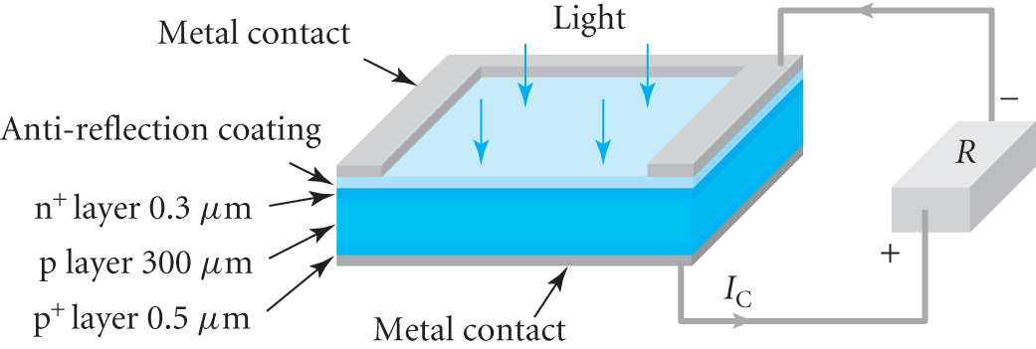
A cell consists of a p-n junction with metal electrodes
The top electrode is in narrow strips to allow illumination
A highly doped n⁺ layer
reduces the series resistance.
A highly doped p⁺ layer
minimizes surface
recombination at the rear contact by reducing the electron
concentration in this region.
An anti-reflective coating is included
When R=∞ , I_{C} = 0 and the open circuit voltage is given by
V_{OC}= V_{T} ln(1 + I_{L}/I_{S}) ≈ V_{T} ln( I_{L}/I_{S} ) since I_{L}>>I_{S} (10.3)
When R = 0, V=0 and the short circuit current I_{SC} = I_{L}
For a finite resistance R, I_{C} generates power
P_{C} = I_{C} V = I_{C} ²R (10.4)

Slide 5
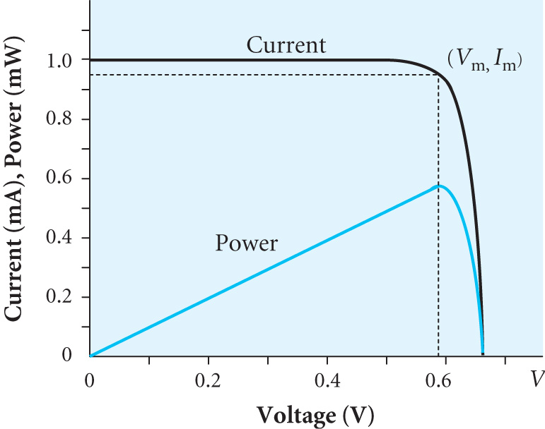
The maximum voltage V_{OC} must be less than the band gap
As V increases P_{C} increases until V is
slightly less than V_{OC}
If I_{SC} = 1 mA (= I_{L} ) & I_{S}= 10⁻¹⁴ A then
(10.3) ➔ V_{OC} =0.66V
From (10.2) & (10.4) we can calculate
I_{C} for a given V and then P_{C} as shown
At the maximum power point P_{m} = 0.55 mW, V_{m} = 0.58V and I_{m} = 0.95 mA . Note that I_{m} & V_{m} are close to I_{SC} and V_{OC}
The fill factor is defined as FF = P_{m} /(I_{SC}V_{OC}) (10.5)
FF is useful for quality control, typically in range 0.75 – 0.85
V (V) | 0.10 | 0.30 | 0.50 | 0.55 | 0.58 | 0.60 | 0.62 | 0.64 | 0.66
I (mA) | 1.0 | 1.0 | 1.0 | 0.98 | 0.95 | 0.89 | 0.77 | 0.51 | 0.0
P (mW) | 0.1 | 0.3 | 0.5 | 0.54 | 0.55 | 0.53 | 0.48 | 0.33 | 0.0

Slide 6
EXAMPLE:- A photocell has I_{S}=2 10⁻¹² A, I_{SC} = 30 mA and an area of 1cm². Find P_{m}, FF and the conversion efficiency of the cell. What resistance is required across the cell to give maximum output?
From (10.3) using V_{T} = 0.026V and I_{L}≈ I_{SC} we get V_{OC} = 0.61 V
Calculating I from (10.2) and P from (10.4) produces the table
Peak power P_{m} = 15.2mW when V_{m} = 0.53V and I_{m} = 28.6 mA
From (10.5) FF = P_{m} / I_{SC}V_{OC} = 0.0152 / (0.030 x 0.61) or 83%
Approximately 100 mW cm⁻² of solar radiation falls on this cell so
its efficiency is ~ 15%
The resistance for maximum output is
R = V_{m} / I_{m} = 0.53 / 0.286 = 18.5Ω
V (V) | 0.5 | 0.52 | 0.53 | 0.54 | 0.56
I (mA) | 29.6 | 29.0 | 28.6 | 27.9 | 25.5
P (mW) | 14.8 | 15.1 | 15.2 | 15.1 | 14.3

Slide 7
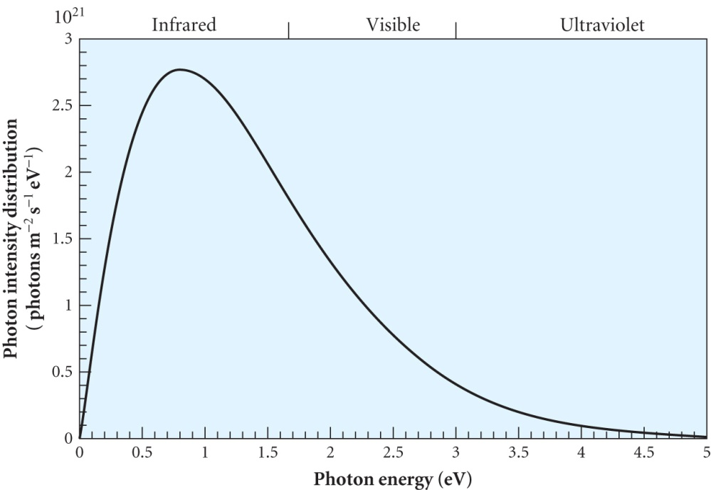
EFFICIENCY OF SOLAR CELLS
Conversion efficiency is defined as the ratio of P_{m} to incident solar power AM1.5 close to 100 mW cm⁻²
Factors effecting efficiency are:-
23% of photons have E < 1.1 eV
Only 1.1 eV of the energy of any
higher energy photons is required
to produce power so only 47% of
the incident energy contributes to
the power with 30% going to heat.
Hence 47% is the limiting value of efficiency for a solar cell
Of course the 1.1 eV simply produces the electron-hole pair while the useful power produced is | e | V_{m} . The ratio
| e | V_{m} / E_{gap} ~ 0.65 which is another significant reduction
Finally ~10% of the electron-hole pairs recombine before collection

Slide 8
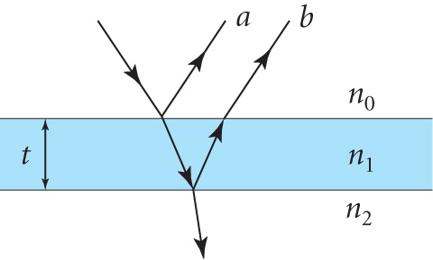
Reflection is potentially a 40% loss but this is reduced by an anti-reflection coating of ¼ wavelength material
Reflection coefficient from silicon without
a coating is ρ = (n₀-n₂)² / (n₀+n₂)²
Silicon refractive index averages to ~ 3.5
so ρ ~ 40%
Introducing a ¼ λ coating with refractive
index n₁ given by n₁² = n₀ n₂ reduces the value to ρ ~ 6% and multiple
coatings can reduce this to 1% and other small losses amount to ~3%
Multiplying these factors η_{C} ≈ 0.47 x 0.65 x 0.9 x 0.96 ≈ 26%
Decreasing E_{gap} increases the photocurrent (reduces 23% factor) but decreases V_{m} since |e |V_{OC} < E_{gap}
The optimum value is E_{gap} =1.4 eV
GaAs and CdTe have band gaps close to this

Slide 9
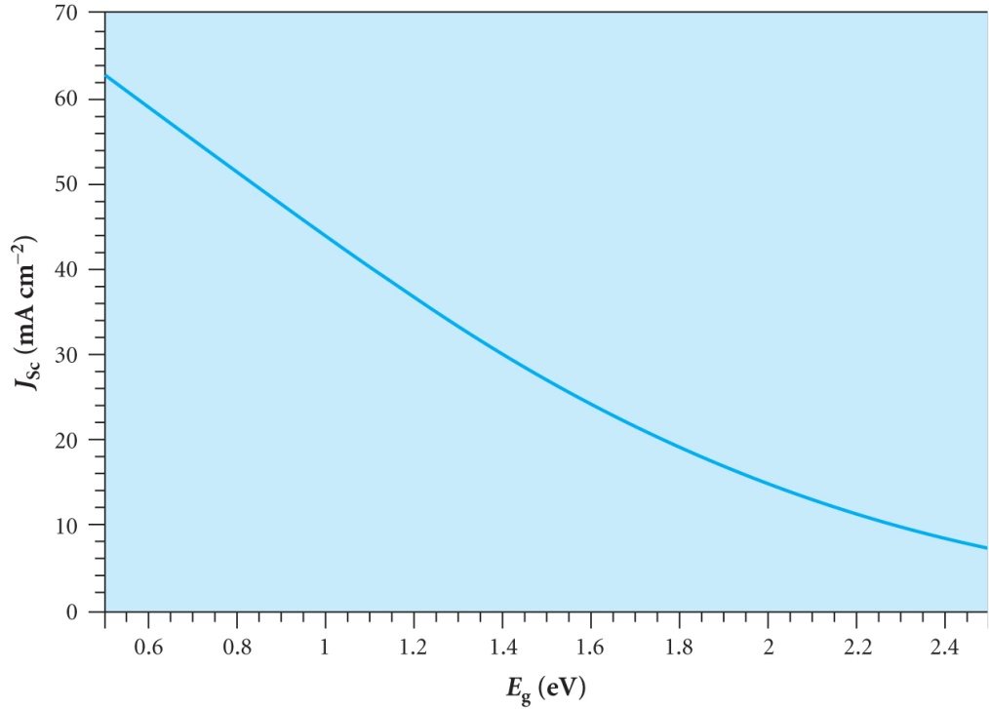
Dependence of the short circuit
current density j_{SC} on E_{gap} is shown
Approximately
j_{SC} ≈ A – B V_{g} mA cm⁻² (10.6)
A = 80 mA cm⁻², B = 34 mA V⁻¹
and V_{g} = E_{gap} / |e |
Also V_{OC} ≈ V_{g} – 0.46 V (10.7)
(Details in derivation 6.2 in text book)
Max. power P_{m} ≈ FF(A – B V_{g} )(V_{g} – 0.46 ) mW cm⁻² (10.8)
Assuming the fill factor stays constant this has a maximum when V_{g} = A/(2B) +0.23 ≈ 1.4 V
For a silicon cell with E_{gap} = 1.1eV and FF = 0.8
then (10.8) gives P_{m} ~ 25 mA cm⁻²
The following table gives examples for different types of cell

Slide 10
sc - single crystal
mc – multicrystalline
single – single junction
multi – multiple junctions
 |  | Efficiency % for cell area
Material | Band gap eV | ~ 1 cm² | ~ 1 m²
GaAs | 1.4 | ~24
GaAs (multi) | 1.8 – 0.7 | ~34
Si (sc) | 1.1 | ~24
Si (mc) | 1.1 | ~20 | ~13
a-Si(single) | ~1.7 | ~12 | ~7
a-Si(multi) | ~1.7 – 1.3 | ~13 | ~10
CdTe | 1.5 | ~16 | ~8
CuIn_{1-x}Ga_{x}Se₂ | ~1.2 | ~19 | ~12

Slide 11
EXAMPLE:- A 4cm² GaAs solar cell has I_{S} = 4 10⁻¹⁵ mA. I_{SC} = 127 mA under AM1.5 solar radiation. What is the conversion efficiency under normal and 100 x normal illumination? (Assume I_{L} ≈ I_{SC})
From (10.3) V_{OC} = V_{T} ln(I_{SC} / I_{S} ) = 0.026 ln(127/ 4 10⁻¹⁵)
V_{OC} = 0.988V
Need to obtain approximations for the V_{m} and I_{m}. Start by maximising P = I V where I is given by (10.2)
I_{C} = I_{L} - I_{S}{exp(V/V_{T})-1} so P = V[I_{L} - I_{S}{exp(V/V_{T})-1}]
Max. power when dP/dV =0
So [I_{L} - I_{S}{exp(V/V_{T})-1}]-(V/V_{T}) I_{S}exp(V/V_{T})=0
(1 + V/V_{T}) exp(V/V_{T}) = (I_{L} / I_{S} + 1) or approximately
(V_{OC}/V_{T}) exp(V_{m}/V_{T}) = I_{L} / I_{S}= exp(V_{OC}/V_{T}) (10.9)
Taking logs ln(V_{OC}/V_{T}) + V_{m}/V_{T} = V_{OC}/V_{T}
Writing x_{OC} = V_{T}/V_{OC} we get V_{m} =V_{OC}{1+ x_{OC} ln(x_{OC})} (10.10)

Slide 12
Then from (10.2) I_{m} = I_{L} - I_{S}{exp(V_{m}/V_{T})-1} and I_{L} ≈ I_{SC}
Using (10.9) I_{m} = I_{SC} - I_{S}{ (I_{L} / I_{S})(V_{T}/V_{OC})-1} ≈ I_{SC} (1- V_{T}/V_{OC})
I_{m} ≈ I_{SC} ( 1 – x_{OC}) (10.10)
FF = P_{m} / I_{SC}V_{OC} = {1+ x_{OC} ln(x_{OC})} ( 1 – x_{OC}) (10.11)
V_{T} ~ 0.026V so x_{OC} = 0.0263 leading to
V_{m} = 0.988{1+0.0263 x ln(0.0263)} = 0.89 V
I_{m} = 127(1 – 0.0263) = 124 mA
P_{m} = 0.89 x 124 = 110 mW
Under 100 x illumination V_{OC} increases as I_{SC} is 100x larger
V_{OC} = 0.026 ln(12700/ 4 10¹⁵) = 1.108 V and new values:-
x_{OC} = 0.0235, V_{m} = 1.01 V, I_{m} = 12.4A , P_{m}= 12.5W
At Am1.5 the solar power on the cell = 4 x 100 mW = 400 mW
Conversion efficiency = 110 / 400 = 28%
At x100 illumination the ratio is 12.5 / 40 = 31% ( 10% increase)

