Slide 1
PHYSICS OF ENERGY SOURCES
Dr J N Jackson and Dr J Coleman
Oliver Lodge Laboratory
jnj@hep.ph.liv.ac.uk, coleman@hep.ph.liv.ac.uk

Slide 2
TOPICS
Introduction
Renewable sources
Basic physics required, thermodynamics, fluid dynamics
Hydropower, wave power and tidal power
Wind power
Solar power
Biomass
Nuclear Power
Basics of nuclear physics
Principles, theory and operations of fission reactors
Progress with nuclear fusion
Radiation issues
Energy and society

Slide 3
RECOMMENDED TEXTS
1. Energy Science, principles, technologies and impact
Andrews and Jelley, Oxford University Press,
ISBN 978-0-19-928112-1
2. Nuclear Physics, Principles and Applications
Lilley, Wiley ISBN 0-471-97936-8
FURTHER READING
1. Physics of the Environment
Brinkman, Imperial College Press, ISBN 9-781848-161801
2. The Elements of Nuclear Power
Bennett and Thompson, Longman

Slide 4
INTRODUCTION
Historically mankind has gradually made increasing use of natural resources
Starting with the invention of fire
In the last two centuries we have learned how to convert heat into electricity
In a relatively short time we have significantly depleted the fossil fuel reserves of the planet
The resulting emission of CO₂ and other products of combustion is now having a noticeable effect on the climate
The world population and the demand for energy are both increasing
This course will examine the physical principles leading to the technological options currently open to us in seeking a solution to these problems

Slide 5
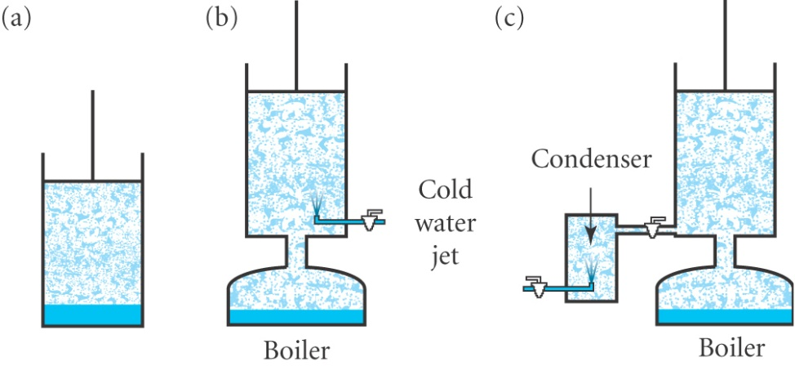
SOME HISTORY
Harnessing energy has been a continuing challenge leading to advances in scientific understanding and engineering
Water devices
Archimedes screw, water wheels , Fourneyron Turbine
Steam engines
Hero’s engine, Papin, Savery(1690),
Newcomen, Watt(1769),
Parsons Turbine(1884)
Thermodynamics and the Carnot cycle(1824)
Electricity
Discoveries of Oersted, Ampere, Faraday
1st Power station 1881 , DC, Edison
AC system, Westinghouse
1st hydroelectric station, Niagara, 1895
Nuclear Power from late1950s

Slide 6
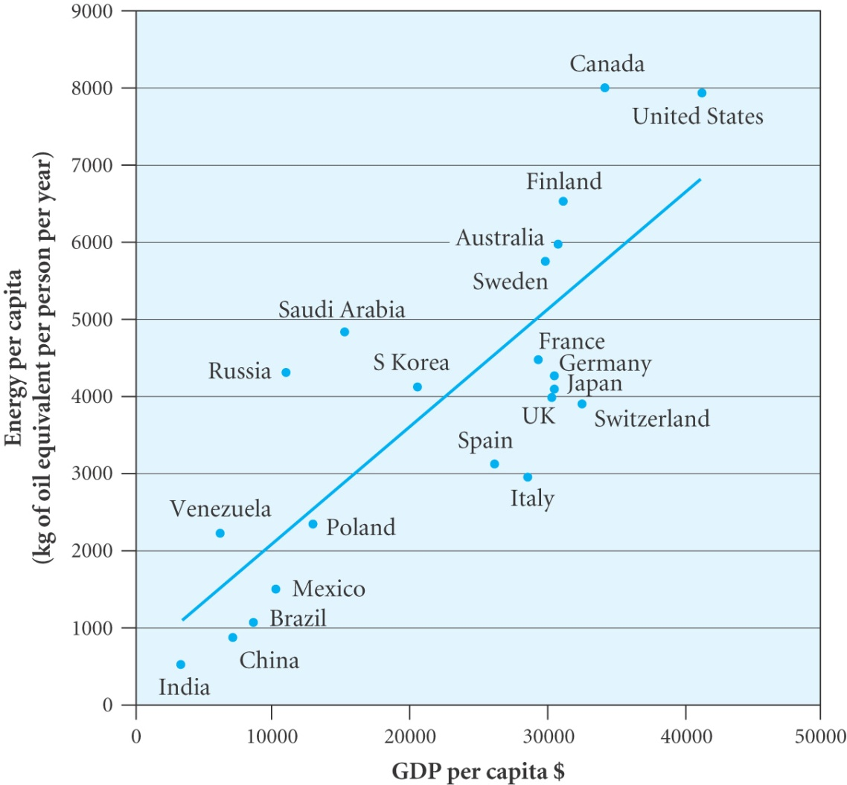
GLOBAL ENERGY TRENDS
There is a strong correlation between standard of living, as measured by GDP / capita and energy consumption per capita
A large spread between different highly developed countries
Scope for reducing
consumption via
improving efficiency
and changing lifestyle

Slide 7
It is natural for the less well developed countries to increase their GDP and population thus increasing energy consumption
The population in developed countries will stay ~ constant and hopefully efficiencies will be achieved
 | Population (x10⁹) | Power per capita (kW) | Total power consumption(TW)
1992
Developed countries | 1.2 | 7.5 | 9.0
Less developed countries | 4.1 | 1.1 | 4.5
Total | 5.3 |  | 13.5
2025
Developed countries | 1.4 | 3.8 | 5.3
Less developed countries | 6.8 | 2.2 | 15.0
Total | 8.2 |  | 20.3

Slide 8
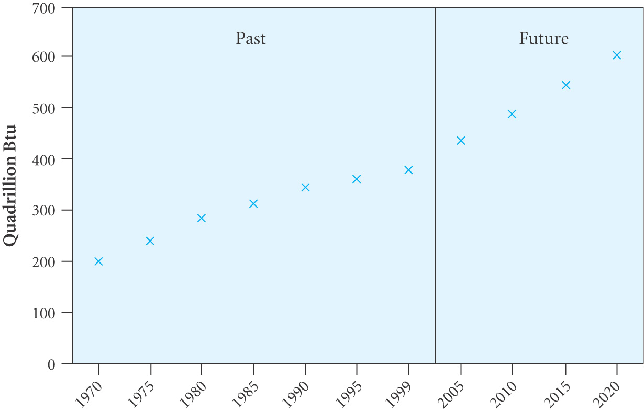
World energy consumption 1970 – 2020
Oil, coal and gas provided 86% of all energy consumption in 2003
Oil, gas and coal resources expected to last for 40/70/250 years respectively

Slide 9
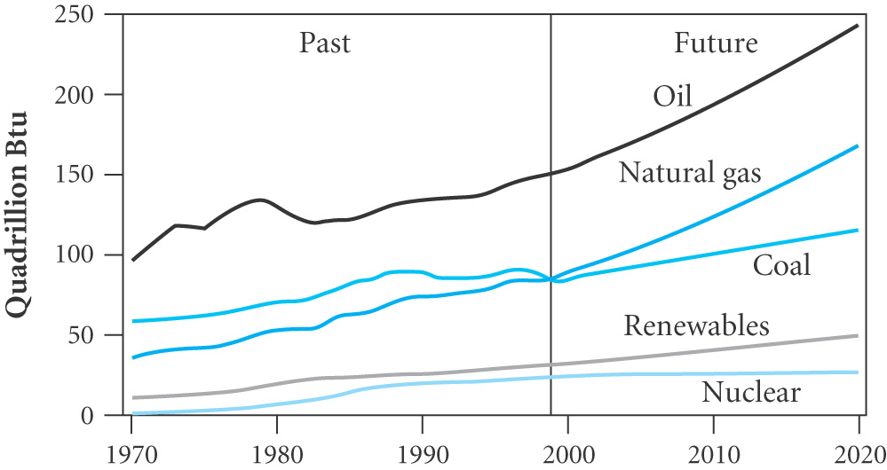
Primary fuel shares (% of total) assuming no change in reliance on fossil fuels
 | 2000 | 2010 | 2020
Oil | 39.2 | 36.4 | 34.4
Gas | 23.0 | 23.8 | 25.5
Coal | 23.8 | 25.3 | 26.1
Nuclear | 6.5 | 5.7 | 5.4
Renewables | 7.6 | 8.9 | 8.7

Slide 10
GLOBAL WARMING
THE GREENHOUSE EFFECT
The main greenhouse gases are water vapour and CO₂ which absorb infrared radiation
If the atmosphere was transparent to all radiations the Sun would heat the surface until it reached -19ºC at which point the incoming and outgoing radiation rates would balance
The atmosphere is mainly transparent to the Sun’s radiation which is mainly in the visible region but will absorb infrared
The energy radiated back from the surface at near room temperature is mainly infrared.
The atmosphere absorbs infrared and heats up
It then radiates both out into space and also back to earth
Hence the surface temperature rises by about 35ºC until the incoming and outgoing radiation are in equilibrium

Slide 11
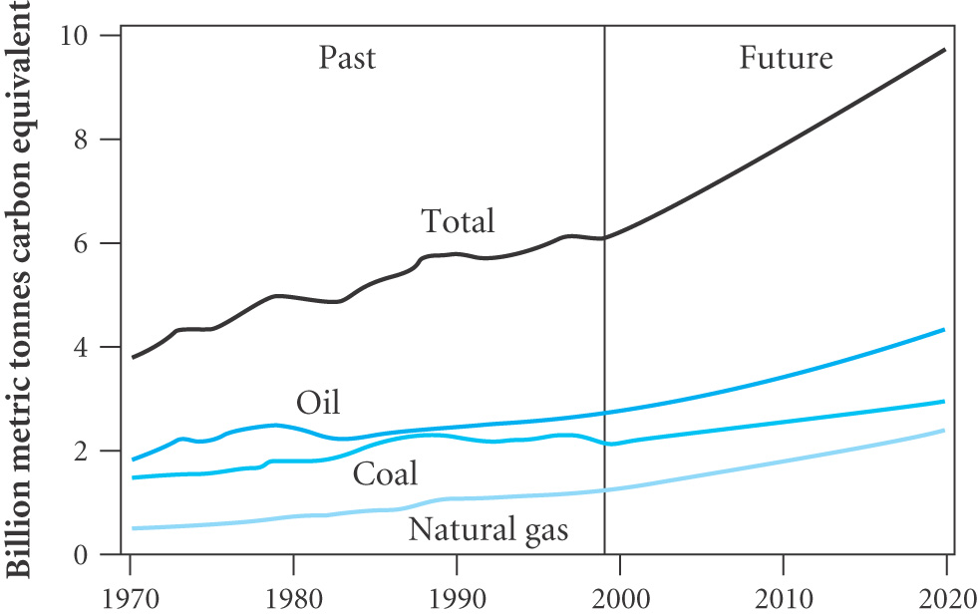
The burning of fossil fuels has added to the CO₂ in the atmosphere
Growth in CO₂ emission
by fuel type
CO₂ emissions
(life cycle analysis)
Source | CO₂ emission kg per kWh
Wood (without replanting) | 1.5
Coal | 0.8 – 1.05
Natural gas (combined cycle) | 0.43
Nuclear power | 0.006
Photovoltaic | 0.06 – 0.15
Hydroelectric | 0.004
Wind power | 0.003 – 0.022

Slide 12
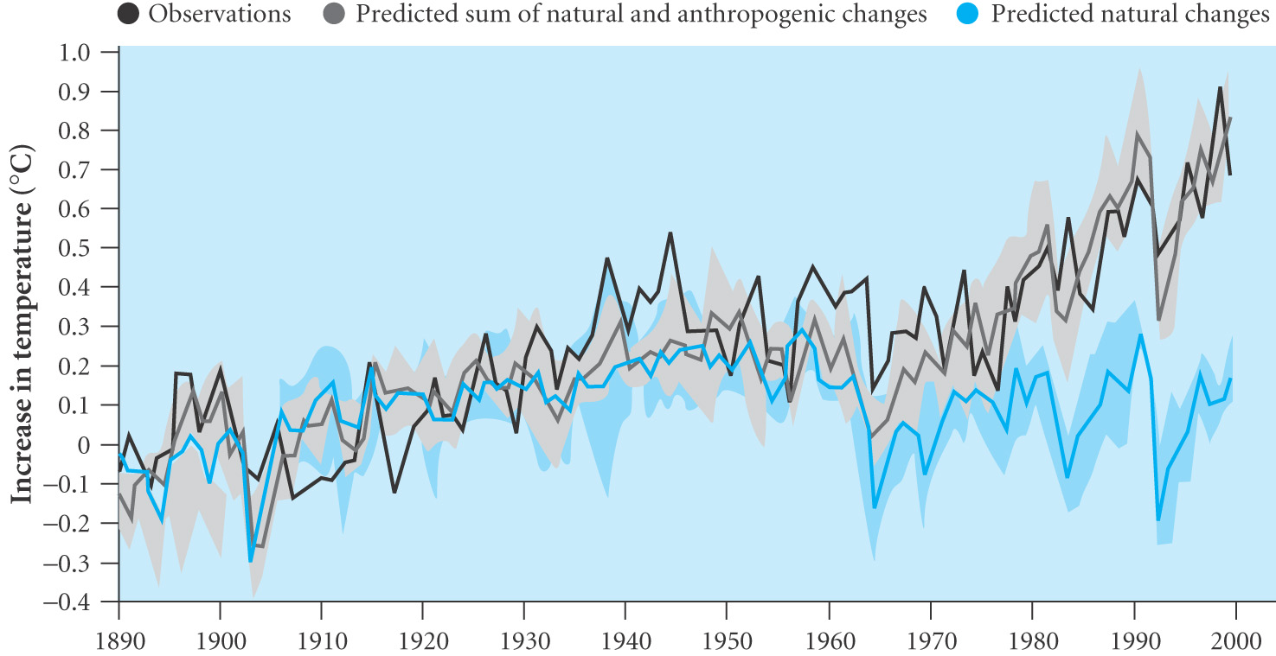
Over the 20th century the average global temperature rose by 0.6 ± 0.2ºC and the prediction of the IPCC is that there will be a rise of 1.4 - 5.8ºC between 1990 and 2100 if nothing is done
The steep rise since 1970 is termed Global Warming and is thought to be due to ANTHROPOGENIC emissions (CO₂, methane, CFCs etc)

Slide 13
Global warming is expected to become more pronounced in the coming decades
The effect on weather systems, ocean currents and sea levels could be devastating
Hence the need for international agreements to:
Increase the efficiency of energy use
Reduce dependence of fossil fuels
Develop schemes to reduce CO₂ emission from fossil fuels
Develop alternative sources of power
In this course we will review the various technologies for power production

Slide 14
NON SI UNITS
Quantity | Unit | Definition | SI Equivalent
Energy | calorie | Heat 1 g H₂O by 1ºC | 4.2 J
Energy | Btu | Heat 1 lb H₂O by 1º F | 1.055 kJ or 0.293 kWh
Energy | barrel | 42 US gallons, 0.136 tonnes | 159 litres
Fuel equivalence | 1 tonne oil | 1.5 tonnes hard coal 3 tonnes lignite | 12000 kW h
Power | 1 horsepower | 550 ft lb per second | 0.746 kW

Slide 15
EXAMPLE
Assuming that the volumes of the Greenland and Antarctic ice caps are 2.85 10⁶ km³ and 2.57 10⁷ km³ respectively and that the radius of the Earth is 6378 km with 70% of the surface covered by sea, estimate the rise in sea level if both icecaps melt completely
Total volume of ice V = (2.85 10⁶ + 2.57 10⁷⁾ km³ = 28.6 10¹⁵ m³
Surface area = 0.7 x 4 π r² = 358 10¹² m²
Ignoring the difference in densities of ice and water for this estimate the rise in sea level would be
h = 28.6 10¹⁵ / 358 10¹² ≈ 80 m

