Slide 1
Higgs Searches on ATLAS and Tracking & Software Development
19th February 2015
DESY CMS Interview
Notes:
Hello everyone. My name is Carl Gwilliam and I am going to talk about my recent work on ATLAS
I’ll start with a brief overview of my career so far:

Slide 2
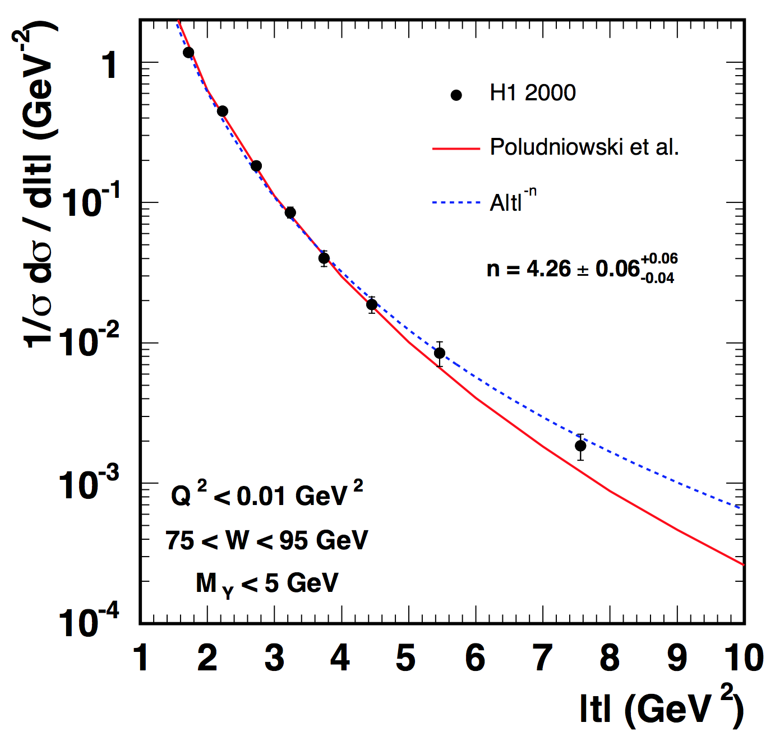

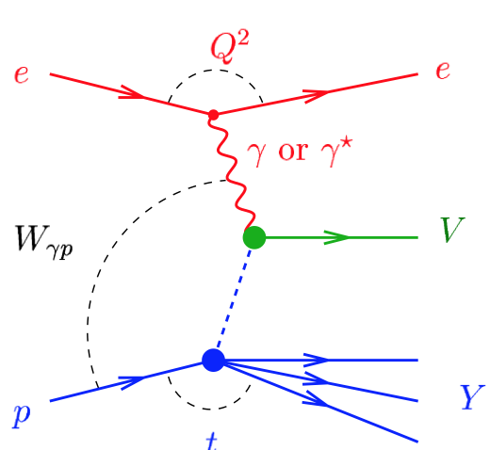



Career Overview
Ph.D. in High Energy Physics on H1 at Manchester University (2002-06)
  Measurement of diffractive photoproduction of ρ mesion at
  large momentum transfer
    First H1 measurement in this regime
  Monitored forward muon DQ
  Forward detector on-call expert
  Spent 2 years based here at DESY
ρ
Research Associate on ATLAS at Liverpool University (2006-Present)
  Higgs Physics
  ATLAS Tracking + Software
Notes:
I studied for a PhD in HEP at the University of Manchester, where I measured the diffractive photoproduction of rho mesons at large momentum transfer, t, (where pQCD models can be applied) for the first time on H1.
The plot here shows the differential cross-section as a function of t compared to the pQCD model prediction. I also measured the cross-section as a function of the SDMEs for this process, which showed that pQCD were not able explain the observed spin structure.

Slide 3
Searches for the SM Higgs and Beyond
Notes:
So, starting with the search for the Higgs boson …
1 MINUTE

Slide 4
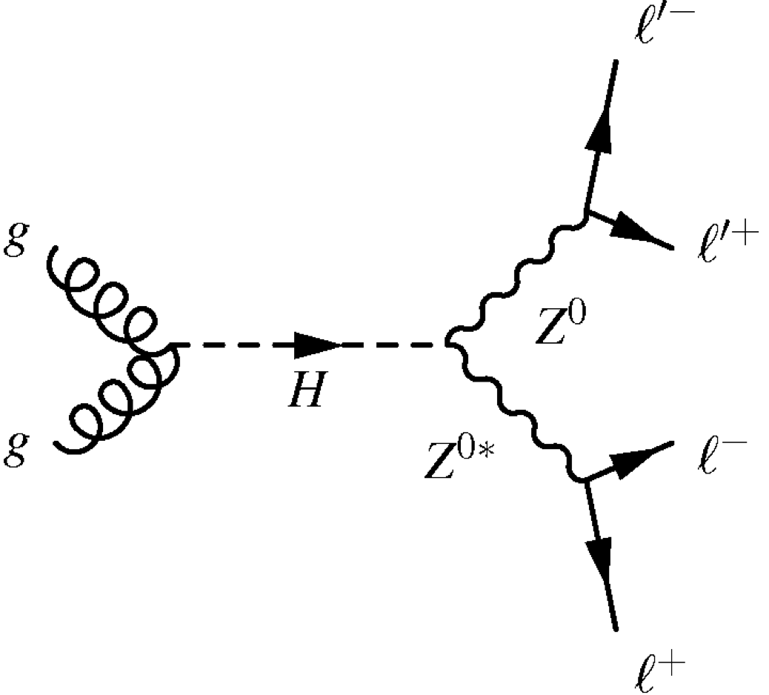
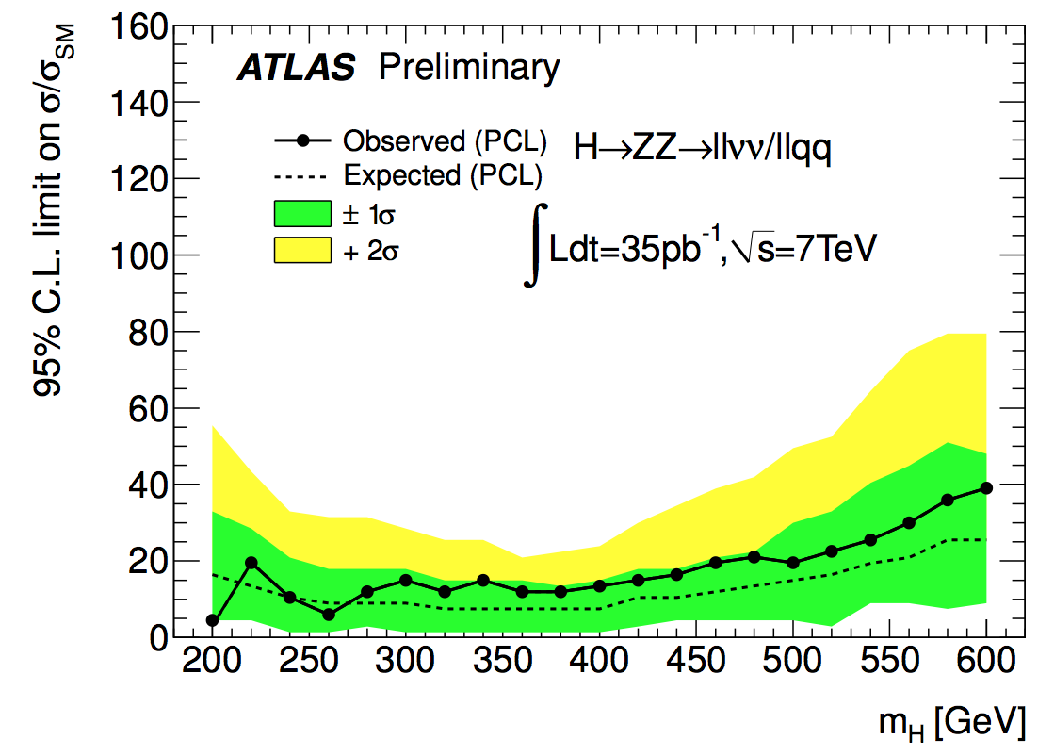
Focusing in on the Higgs
h
A major goal of the LHC was to find the Higgs
  But which mass range to search in?
Investigated the potential to search for Higgs bosons in early data using previously unconsidered h → ZZ decay modes
  Demonstrated better sensitivity at high-m_{h} than explored channels
  Allowed to investigate a mass range not accessible at previous colliders
First LHC result with 35 pb⁻¹
  One of the first LHC searches
Led 7 TeV h→ZZ→llqq search
  Performed all aspects of analysis
  Lead to me being editor for two letters in PLB
Excluded large high-m_{h} range
  Pinpointed where to look for SM Higgs
Notes:
I came to Liverpool prior to data-taking and one of the first things I did was to investigate the potential to search for Higgs bosons in early data using previously unconsidered H → ZZ decay modes where one Z decays leptonically and the other to jets or neutrinos

Slide 5
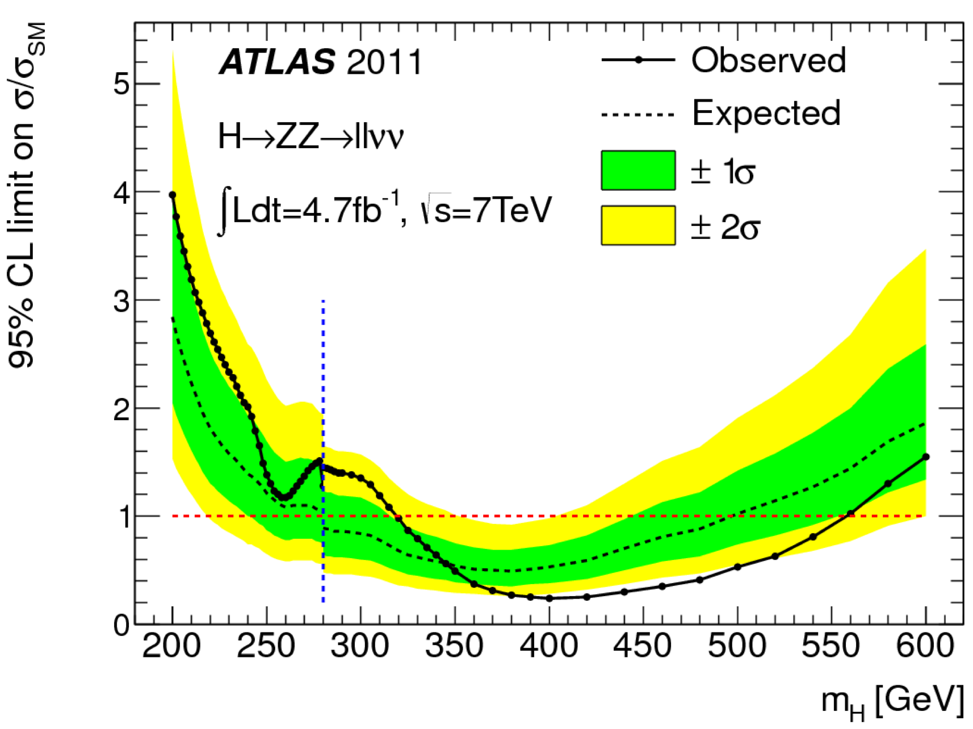
Focusing in on the Higgs
h
A major goal of the LHC was to find the Higgs
  But which mass range to search in?
Investigated the potential to search for Higgs bosons in early data using previously unconsidered h → ZZ decay modes
  Demonstrated better sensitivity at high-m_{h} than explored channels
  Allowed to investigate a mass range not accessible at previous colliders
First LHC result with 35 pb⁻¹
  One of the first LHC searches
Led 7 TeV h→ZZ→llqq search
  Performed all aspects of analysis
  Lead to me being editor for two letters in PLB
Excluded
Excluded large high-m_{h} range
  Pinpointed where to look for SM Higgs
Notes:
I lead the H->ZZ->llqq analysis with the full 7 TeV data, where I was involved in all aspects of the experimental analysis (selection optimization, background modeling and extracting results)
I was an editor (which in ATLAS is usually the lead author of an analysis) of two letters published in PLB on these results

Slide 6
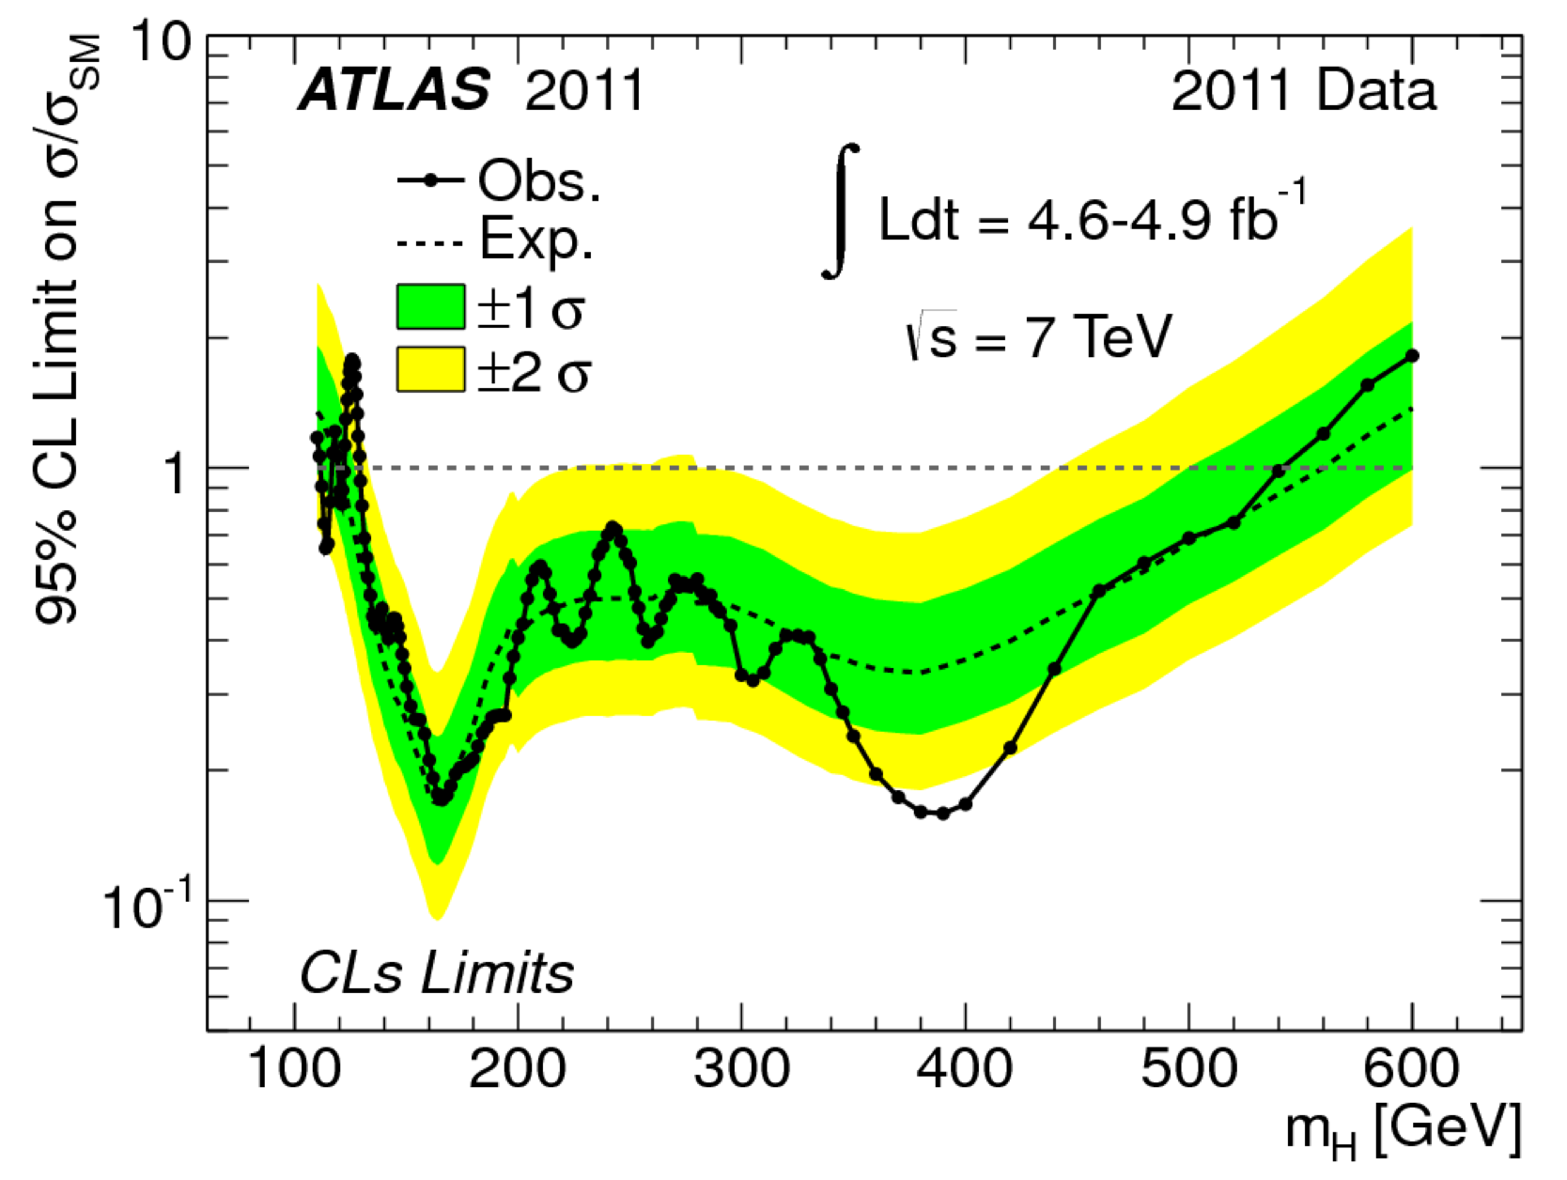
Focusing in on the Higgs
h
A major goal of the LHC was to find the Higgs
  But which mass range to search in?
Investigated the potential to search for Higgs bosons in early data using previously unconsidered h → ZZ decay modes
  Demonstrated better sensitivity at high-m_{h} than explored channels
  Allowed to investigate a mass range not accessible at previous colliders
First LHC result with 35 pb⁻¹
  One of the first LHC searches
Led 7 TeV h→ZZ→llqq search
  Performed all aspects of analysis
  Lead to me being editor for two letters in PLB
Excluded
Excluded large high-m_{h} range
  Pinpointed where to look for SM Higgs
m_{H} ≈ 125 GeV
Notes:
These channels were able to exclude a very large range of heavy Higgs masses (point to diagram)
As can be seen here where we show the x-section relative to the SM as a function of Higgs mass, with the red region being excluded
As such, when combined with other search channels (change overlay) they pinpointed where to look for the Higgs
At the same time we started to see hints of an excess in the diboson channels (mainly H->ZZ and H -> γγ) …

Slide 7
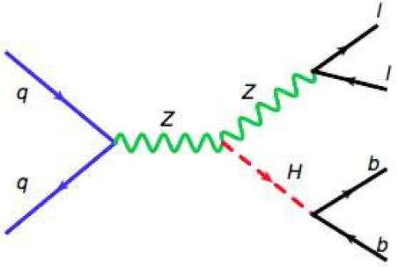
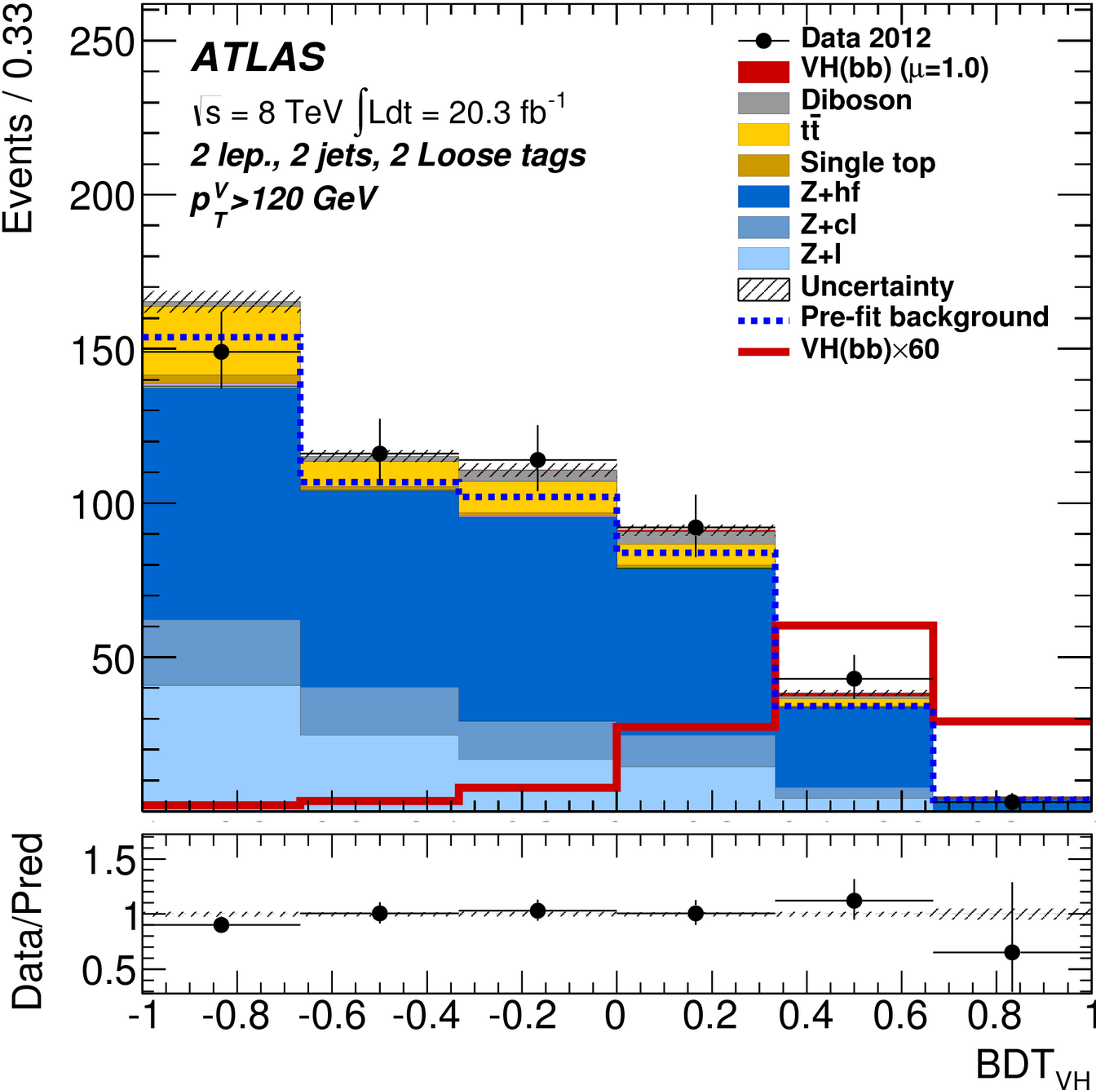
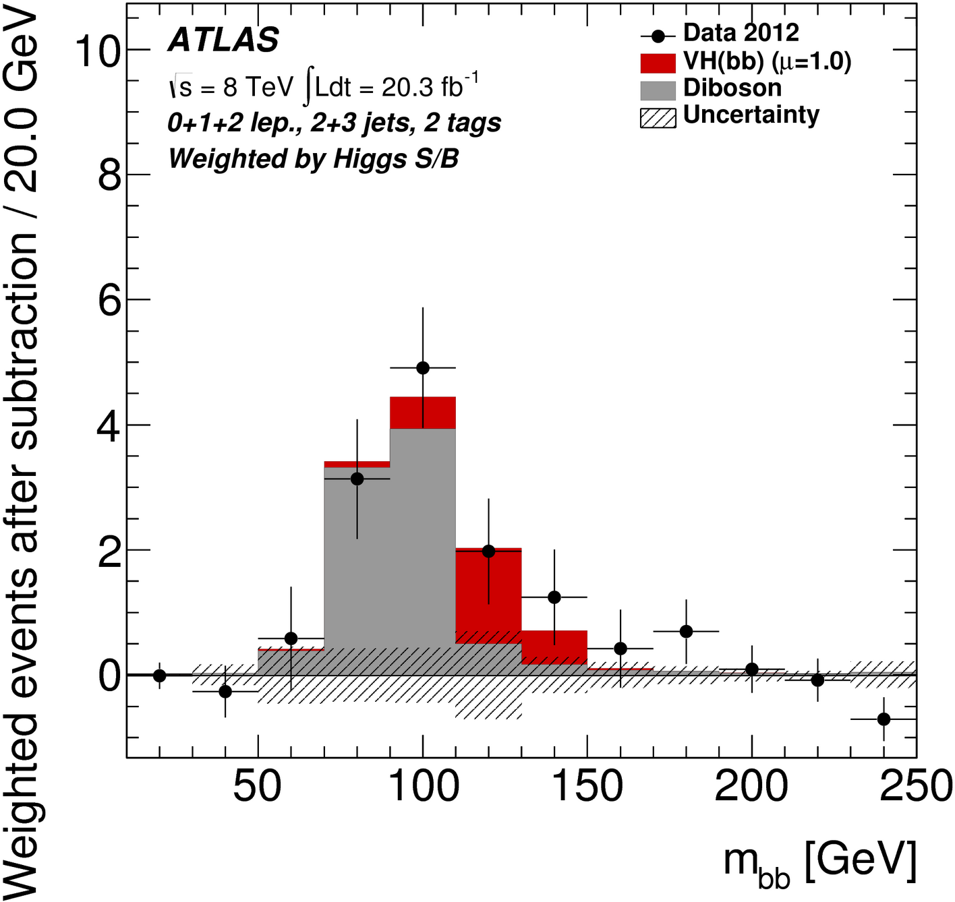
Fermionic h→ bb Search
“In conclusion, the extraction of a signal from H → bb decays in the WH channel will be very difficult at the LHC, even under the most optimistic assumptions for the b-tagging performance and calibration of the shape and magnitude of the various background sources from the data it- self.”
In parallel, I searched for h→bb in a similar final state
Predicted to be dominant low-m_{h} decay
  I performed a pre-data study showing Vh channel sensitivity significantly above TDR
Main analyser of Zh → llbb search
  Lead to 7 TeV PLB paper and first
  8 TeV preliminary public result
  Best expected sensitivity in this channel
I developed a method to determine the flavour composition of the background from data, reducing uncertainty
  Extract fraction of Z + light/c/b from combined fit to b-tagging discriminant
ATLAS UK Higgs Convenor (2011-13)
Significance 2.6σ (exp)
1.4σ (obs)
Notes:
I was the main analyser of the Zh->llbb channel (Point to diagram) for the published 7 TeV result and performed the first analysis at 8 TeV leading to a preliminary public result for EPS 2013
This plot (point to diagram) shows the reconstructed Higgs mass (mbb) for the full run-1 results after subtracting the non-diboson backgrounds with the contribution from SM dibosons and expected Higgs signal shown
This analysis has the best expected sensitivity in this channel, being 2.6σ, although we were somewhat unlucky since the observed significance is 1.4σ
Although it is not yet sensitive enough to show a clear H signal it will be an important measurement channel in run-2 LHC with boosted jet techniques playing an important role at the higher CoM energy

Slide 8
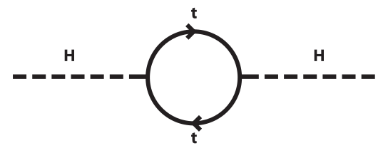



Extended Higgs Sector
Following the Higgs discovery, the main question was: is it the SM Higgs boson or is there new physics in the EWSB sector?
  Is the Higgs boson really a fundamental scalar or could it be composite?
  Why is Higgs boson light (“Hierarchy Problem”)?
  Are there further Higgs bosons?
Many BSM models (e.g. SUSY) predict extensions to the Higgs Mechanism
  E.g. 2HDM → 5 Higgs Bosons: h, H, A, H±
Based on my experience in lepton + jets final states, I developed several BSM Higgs searches
  Able to probe new Higgs-sector physics from many angles and efficiently search for a range of scenarios up to TeV masses
H±
A
?
H
Notes:
For example SUSY and generic 2HDMs predicts …
It is important to try to search for all new possibilities and based on my experience in the lepton+jets final state, I developed several BSM Higgs searches

Slide 9

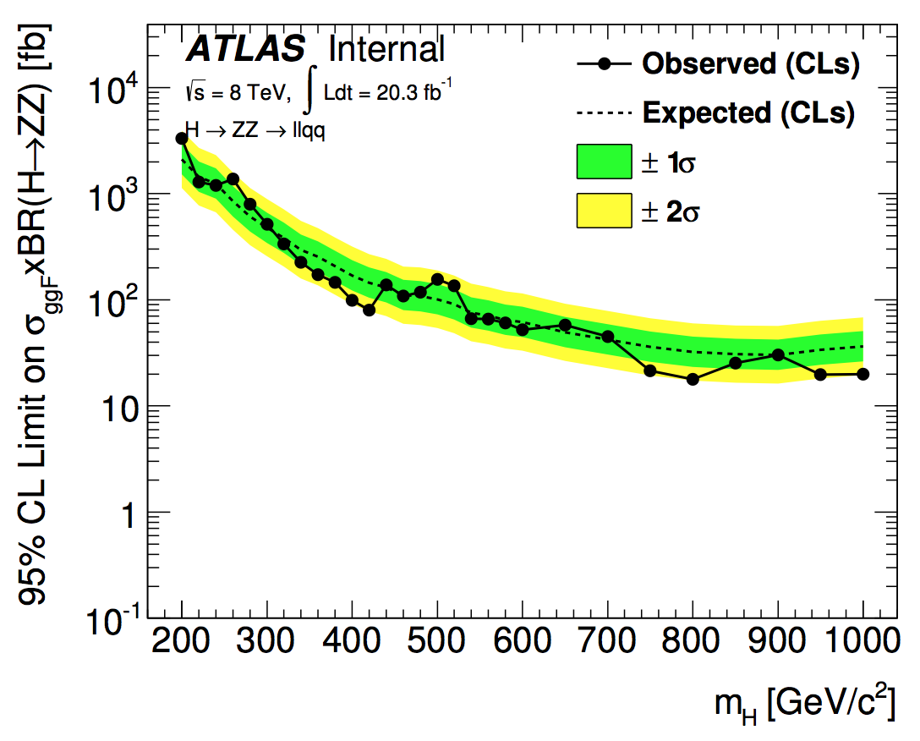
Additional Heavy Higgs Bosons?
H
Work In Progress
Heavy CP-even H → ZZ
  Main analyser for H→ZZ→llqq/bb
    Introduced boosted-jet topology
    for very high masses (~1 TeV)
  Led statistical interpretation
    Model-independent limit
    EW singlet, 2HDM
  Editor for combined BSM H->ZZ paper (4 channels) in preparation
A
H±
H
H±
VBF H± → WZ -> llqq
  Established previously unexplored charged Higgs search channel
    Predicted in H triplet models
  Led analysis and model interpretation
  Editor of paper to be submitted to PRL shortly
Notes:
This is an extension of the analysis that helped to rule out early Higgs mass phase space
Now it allows to search up to Higher mass, aided by including a boosted-jet topology where both quarks are reconstructed in the same jet, which I introduced
This is quite challenging since it involves taking into account production in 3 different modes, ggF, VBF and bbH, which vary over the model phase space, as well as the natural width of the resonance that can become large and lead to interference with the SM ZZ continuum background
I played a major role in combining the results of four H->ZZ channels in different final states and am editor for a combined H->ZZ paper in preparation

Slide 10
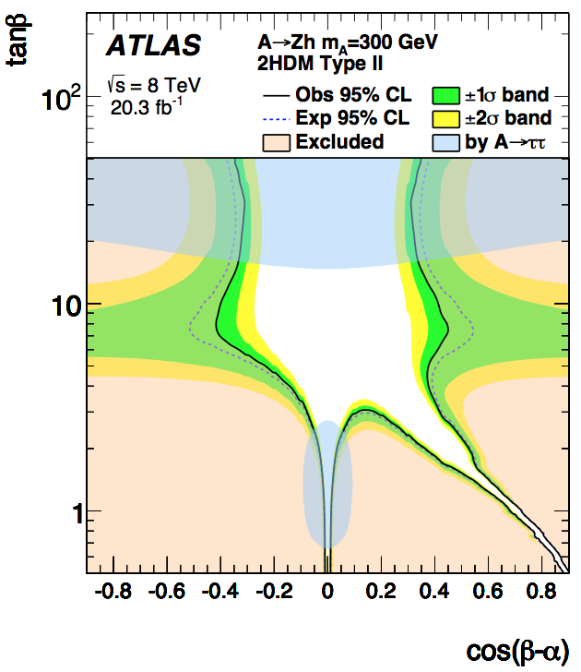

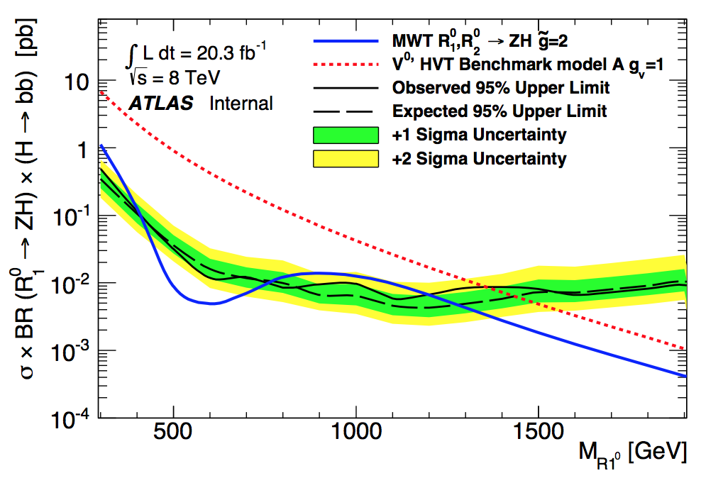
Vh Resonances?
A
CP-odd A → Zh
  Developed first analysis in most sensitive
  A → Zh → llbb final state
  Excludes a wide range of 2HDM space
  Paper submitted to PLB earlier this week
Alternative EWSB models (e.g. composite H) introduce a new strong interaction that dynamically breaks the symmetry
I contributed to searches for predicted resonances decaying to Vh
  Will provide exclusion in terms of simplified Lagrangian and Minimum Walking TC limits
  Paper to be submitted to PLB shortly
SM-like h
In Progress
Currently BSM H → Diboson Coordinator
and invited to be ATLAS BSM Higgs Convenor from April 2015
Notes:
As well as model-independent limits, this excluded a wide range of 2HDM parameter space
- Explain plot
Alternative dynamical models of EWSB, which can solve the hierarchy problem, instead introduce a new strong interaction (a la QCD)
- An example is composite Higgs models, were spontaneous breaking of a higher energy symmetry by the strong dynamics leads to the Higgs as a pNGB with additional heavier vector resonances
This plot shows the cross-section times BR for a neutral resonance decaying to Zh, compared to a benchmark model involving an extended SM gauge sector (red) and MWTC (blue)

Slide 11
ATLAS Inner Detector Tracker and Software Development
Notes:
I’ll now move on to my work on the ATLAS Inner Detector tracker and software development …
9 MINUTES

Slide 12
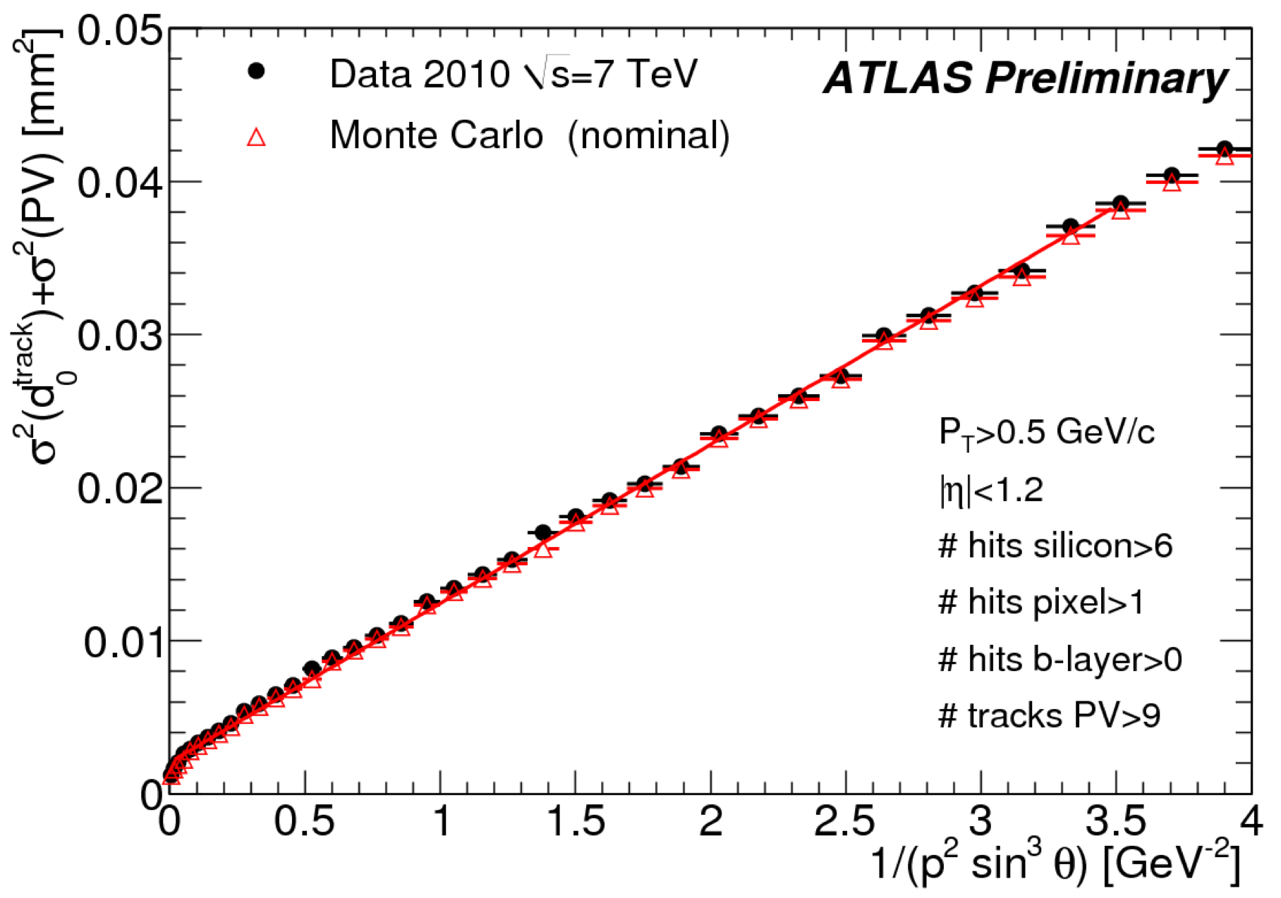
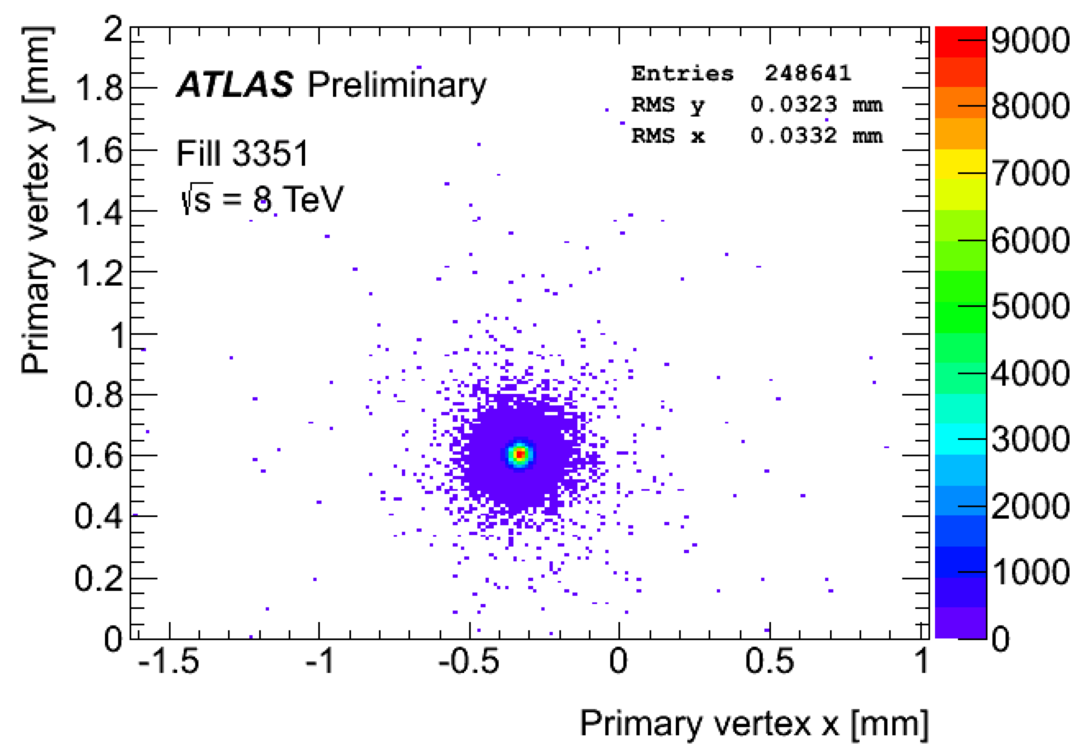
ATLAS Tracking Software
Studied effect of alignment and MS on IP resolution in first data → b-tagging input
I wrote the SCT cluster reconstruction algorithm and interface to detector conditions database
ID Release Coordinator (2009-10)
  Responsible for commissioning ID
  software with first LHC data
ATLAS Beamspot Convenor (2010-11)
  Coordinated crucial feedback to LHC
  and input to ATLAS reconstruction
  Responsible for offline luminous region parameter measurement
    μm precision within 48 hours of data
Notes:
I wrote the cluster reconstruction algorithm, responsible for combining hits on channels in the SCT, and the interface to allow the reconstruction software to access the detector conditions (such as dead modules)
Here (point to plot) is an example of a study I preformed with first data which shows the track IP resolution vs 1p²sin³θ which give information on the effect of alignment (point to slope) and MS (point to intercept) on the IP resolution
The plot shows the PV position in X and Y clearly displaying the luminous region or beamspot

Slide 13
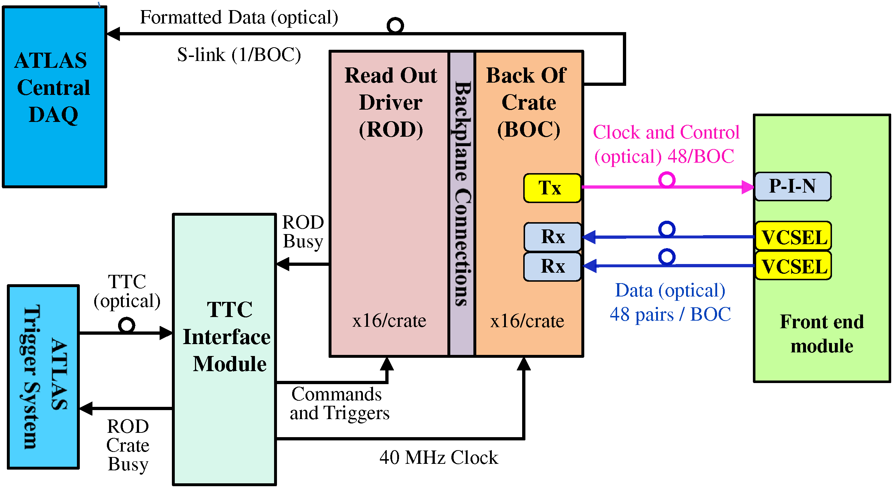
ATLAS SCT DAQ
Significant contribution to upgrade of SCT DAQ during LS1
I rewrote the DAQ configuration DB and the access to it
  Successfully commissioned during 2014 cosmic milestone run
  Resulted in a faster configuration time
I contributed to the installation of the expanded run-2 DAQ and implemented the new RODs & optical fibre mapping in DAQ SW
  Necessary to cope with higher run-2 LHC rate
Notes:
During the current LHC shutdown, I made a significant contribution to the upgrade and commissioning the SCT data-acquisition system, outlined here
I rewrote the DAQ configuration DB, which keeps track of the DAQ status, and the access to it (point to diagram)
Change overlay before “I contributed to …”

Slide 14
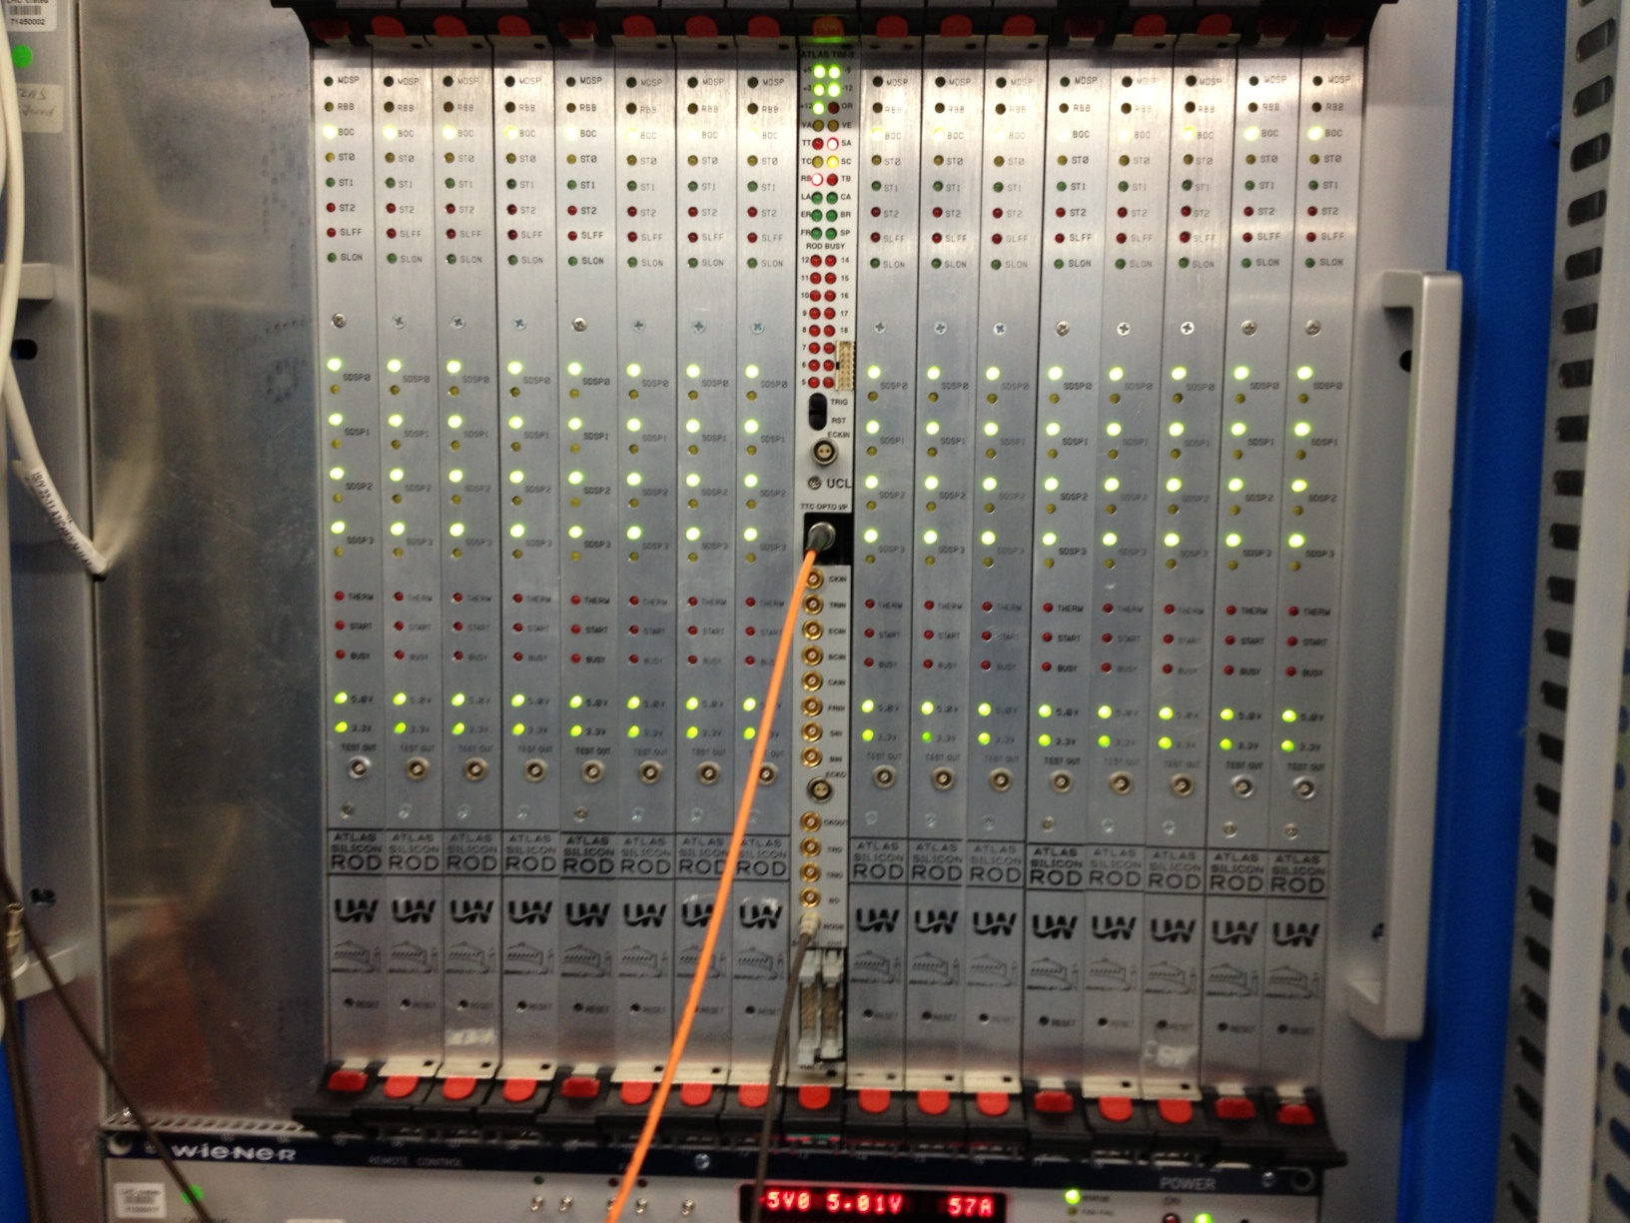
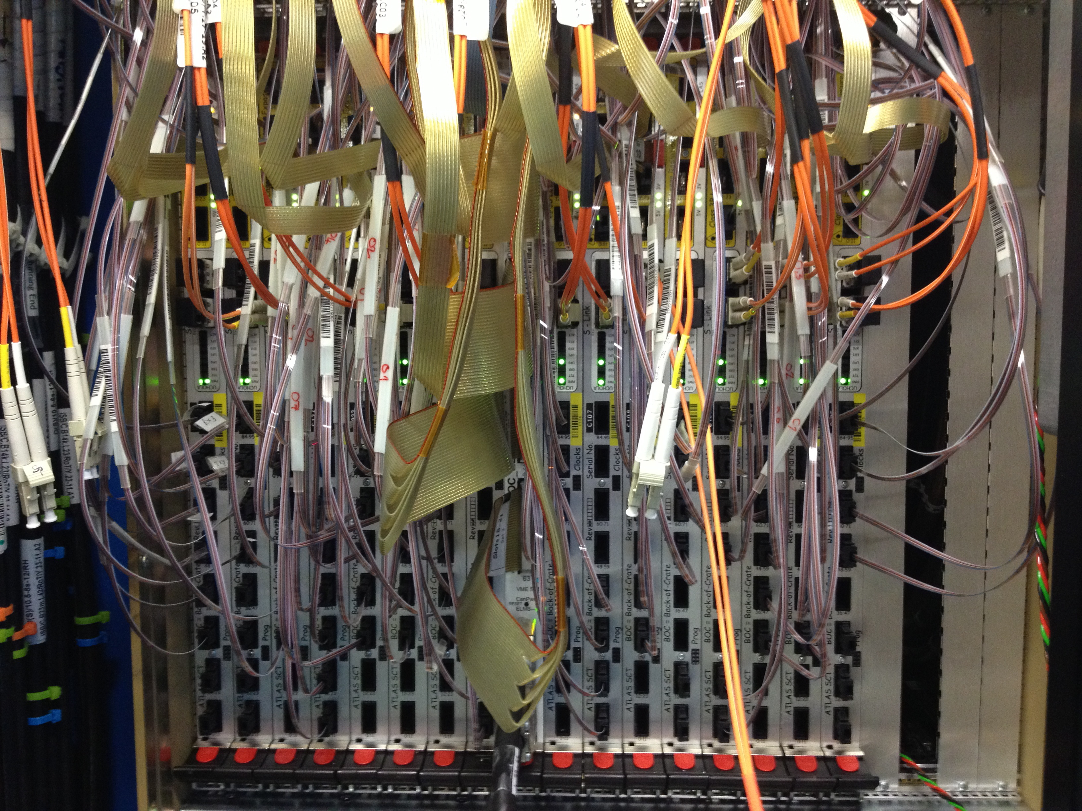
ATLAS SCT DAQ
Significant contribution to upgrade of SCT DAQ during LS1
I rewrote the DAQ configuration DB and the access to it
  Successfully commissioned during 2014 cosmic milestone run
  Resulted in a faster configuration time
I contributed to the installation of the expanded run-2 DAQ and implemented the new RODs & optical fibre mapping in DAQ SW
  Necessary to cope with higher run-2 LHC rate
Newly expanded DAQ (front)
Newly expanded DAQ (back)
Notes:
In order to cope with the increased rate of interactions expected at run-2 LHC it was necessary to expand the DAQ by inserting more read out drivers, shown here in a front and back view of one of the SCT DAQ crates
I contributed to the installation of the new RODs in the ATLAS pit, which involved a significant amount of rerouting optical fibres. I then implemented the additional RODs and new optical fibre mapping into the DAQ software
Change overlay

Slide 15
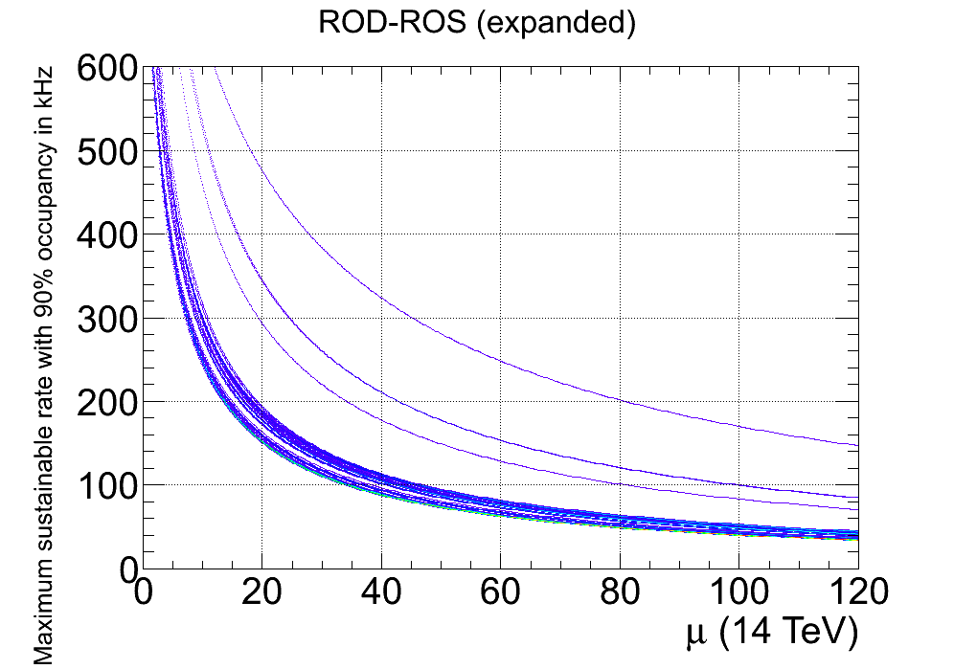
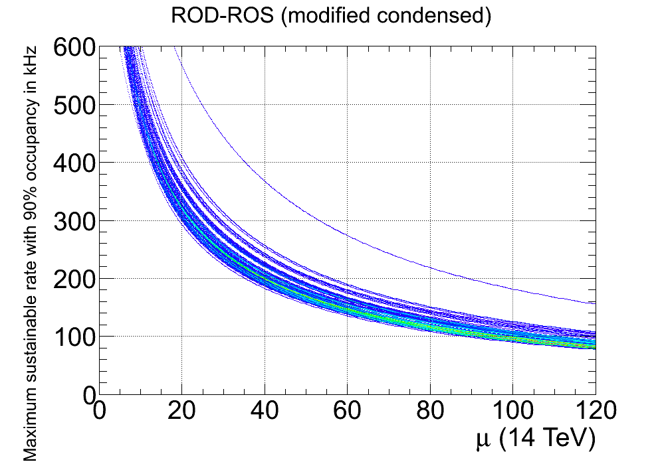
ATLAS SCT DAQ
Significant contribution to upgrade of SCT DAQ during LS1
I rewrote the DAQ configuration DB and the access to it
  Successfully commissioned during 2014 cosmic milestone run
  Resulted in a faster configuration time
I contributed to the installation of the expanded run-2 DAQ and implemented the new RODs & optical fibre mapping in DAQ SW
  Necessary to cope with higher run-2 LHC rate
Maximum sustainable rate (kHz)
Maximum sustainable rate (kHz)
μ ≈ 33
μ ≈ 87
ROD Fibre Mapping
Notes:
Since the readout is now spread over more components the sustainable total rate versus number of interactions has gone up meaning that instead of being limited to ~30 interaction at 100 KHz (point to diagram) we can now go up to ~90 (point to diagram), which is sufficient for run 2 data-taking

Slide 16


ATLAS Physics Validation
New SW Cache
Physics Validation Convenor 2013 −
  Responsible for ensuring the physics performance of the ATLAS simulation and reconstruction SW
Developed new framework to automate and centralise validation procedure
  Resulting in ≈ 2x faster turn around time
Currently leading the validation of the simulation and reconstruction for new
ATLAS run 2 geometry
  E.g. new Insertable b-layer
  Essential to ensure readiness for run 2 data
Test Job
Validation Sample
Histogram Production
Reference
Web Display
Book-keeping
Check Results
Notes:
Once a new SW cache is created with the changes, a validation sample, consisting of a series of physics processes, is submitted to the production system and standard histograms are then made automatically from these, which are compared to a good reference. A web display is then produced allowing validation contacts to check the changes to see if the results are as expected
I played a major role in validating the output of the new ATLAS EDM and I am currently ..
Try to find example difference

Slide 17
Future Direction
Notes:
I’ll finally move on to talk about my future plans …
14 MINUTES

Slide 18
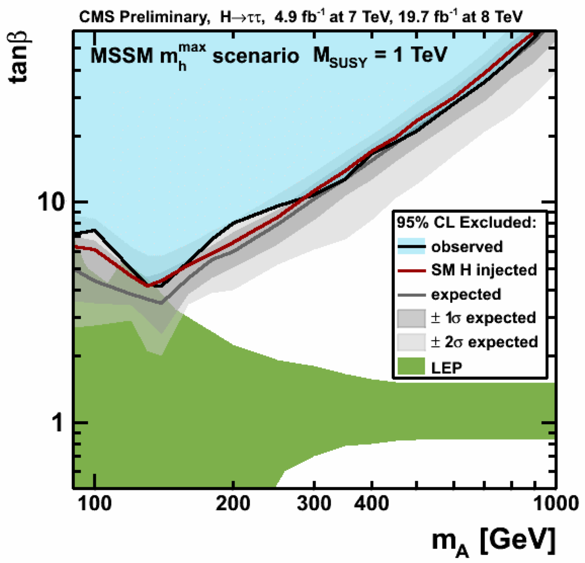
BSM Higgs in CMS
The start of the 13 TeV LHC opens an unexplored energy regime
  High-mass BSM Higgs searches may offer one of the first opportunities
  to discover new physics with the intial data
My BSM Higgs experience will allow me to contribute to and develop CMS Higgs searches right from the start
  Statistical analysis and model-interpretations
  Tracking and b-tagging
    b-tagging in boosted jets (high m)
    bbH production (high tanβ)
I will work to probe the remaining BSM
Higgs parameter space
  Requires a combination of several channels
I held several ATLAS leadership roles & aim to achieve the same on CMS
?
Notes:
My BSM Higgs experience, in particular in statistical analysis and interpretations within many BSM H models, will allow me to contribute to and develop CMS Higgs searches right from the start
For example, my knowledge of track reconstruction and b-jet identification algorithms can be utilized to develop methods for b-tagging in boosted jets, which will help for resonance searches at high mass and studying/optimizing selection for bbH production, which is important at high tanβ (where the coupling to the 3rd generation is enhanced)
I will work to probe the remaining BSM Higgs phase space, an example of which can be seen in the white region in this plot of the CMS H->ττ results. This will require a combination of several channels. For example A->Zh up to m_{H} < m_{t} and A/H -> tt or H->hh above this.
I have held several ATLAS leadership roles and have a track record of efficiently searching for new Higgs physics from several angles and in first data. I aim to achieve the same on CMS

Slide 19
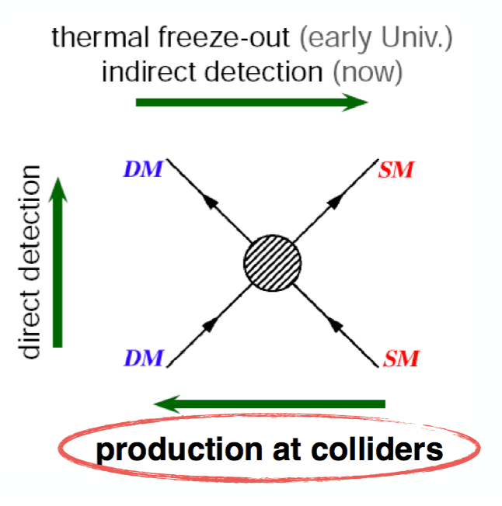
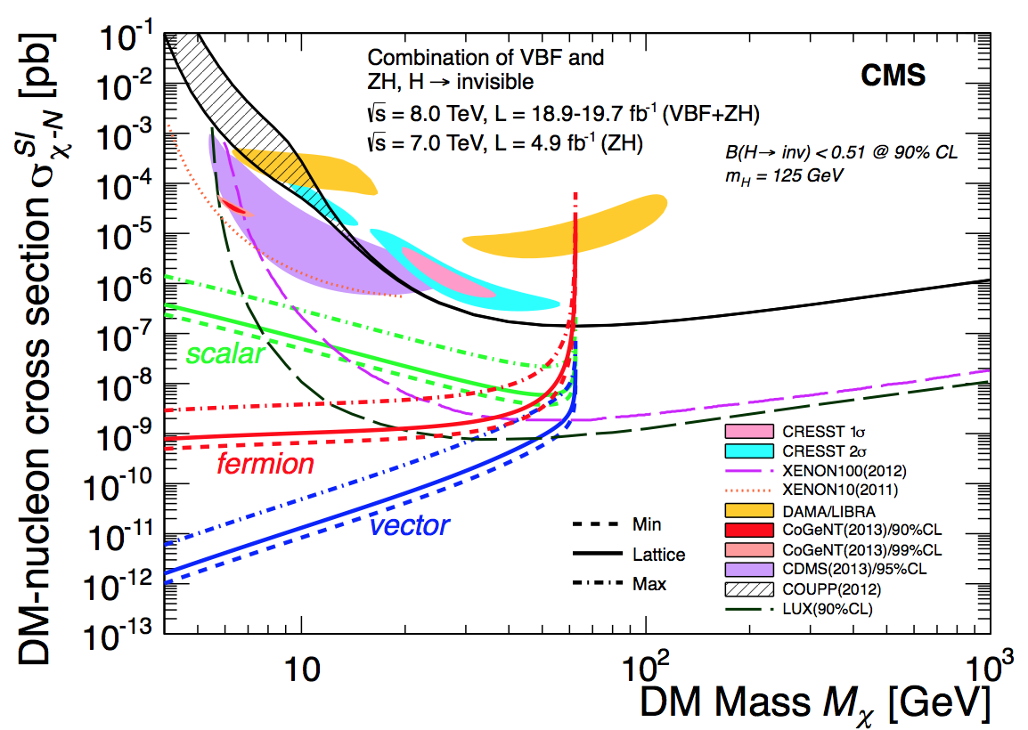
Higgs as a DM Probe
The nature of Dark Matter is one of the major open questions
  Assuming DM gets mass from EWSB it should couple to the Higgs → ideal search channel
I am exited to build on my experience in b-jet analyses to search for DM in the bb + MET channel once sufficient run 2 data is collected
Low mass: Zh → bbχχ
  Complementary to direct detection
High mass: Mono-h with h→bb
  Predicted as most sensitive channel
In the longer term there are many exciting possibilities:
  Precision h coupling measurements
  Higgs self coupling via e.g hh → bbττ
  at HL-LHC
Notes:
Change overlay before “low mass …”

Slide 20
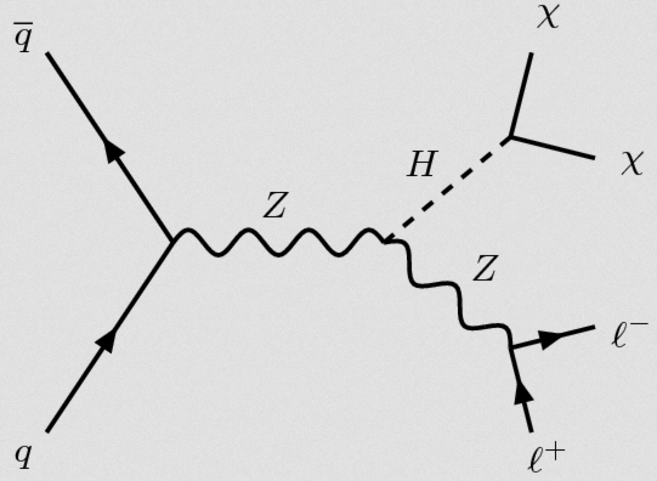
Higgs as a DM Probe
The nature of Dark Matter is one of the major open questions
  Assuming DM gets mass from EWSB it should couple to the Higgs → ideal search channel
I am exited to build on my experience in b-jet analyses to search for DM in the bb + MET channel once sufficient run 2 data is collected
Low mass: Zh → bbχχ
  Complementary to direct detection
High mass: Mono-h with h→bb
  Predicted as most sensitive channel
In the longer term there are many exciting possibilities:
  Precision h coupling measurements
  Higgs self coupling via e.g hh → bbττ
  at HL-LHC
Notes:
The plot (point to diagram) shows the CMS limit on DM-nulceon cross-section in this channel, compared to direct detection.
The collider limits are more sensitive than the direct detection results in the low mH region
Change overlay before “high mass …”

Slide 21
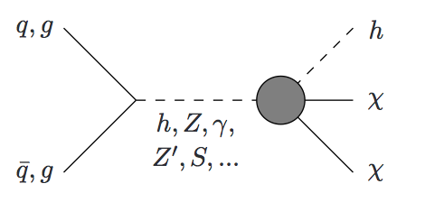
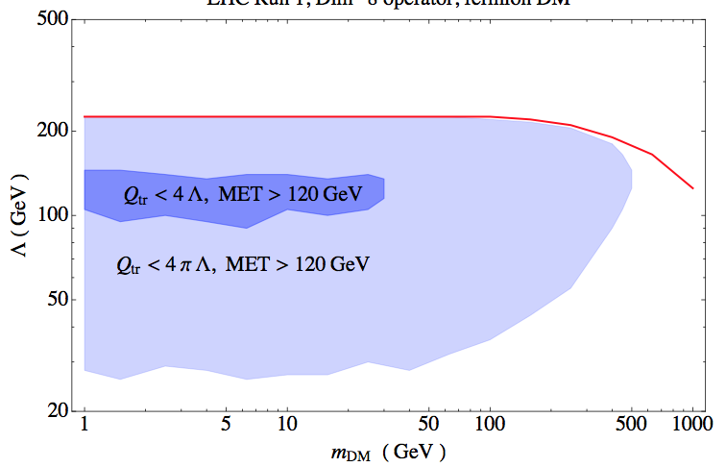
Higgs as a DM Probe
The nature of Dark Matter is one of the major open questions
  Assuming DM gets mass from EWSB it should couple to the Higgs → ideal search channel
I am exited to build on my experience in b-jet analyses to search for DM in the bb + MET channel once sufficient run 2 data is collected
Low mass: Zh → bbχχ
  Complementary to direct detection
High mass: Mono-h with h→bb
  Predicted as most sensitive channel
Predicted bb + MET EFT Limits (8 TeV)
In the longer term there are many exciting possibilities:
  Precision h coupling measurements
  Higgs self coupling via e.g hh → bbττ
  at HL-LHC
arXiv:1402.7074v1
Notes:
In the dominant H->bb decay this gives rise to the same signature, allowing to search over a large range of DM masses.
This is predicted to be one of the most sensitive channels and can set limits within an EFT on the suppression scale or scale of the contact interaction vs DM mass
In the longer term, term there are many exciting possibilities within the Higgs sector
Precession Higgs coupling measurements, such as DESY’s H->ττ analysis, with the full phase-I data
Higgs self-coupling measurements, which can probe the nature of the H potential, with the HL-LHC (and beyond at future linear or circular colliders).
Here b decays, e.g bbττ, will be the most sensitive channels

Slide 22
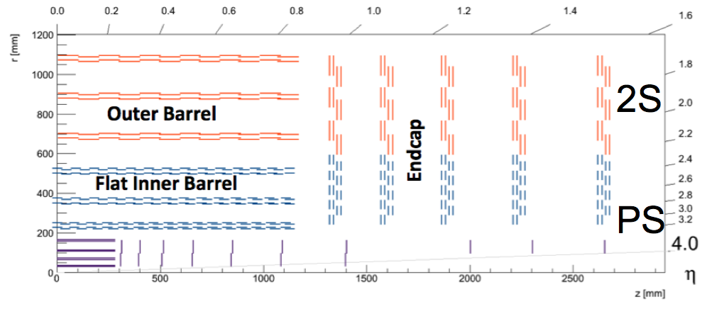
Detector Operations & Development
HL-LHC upgrade is crucial to make the most of physics potential
Building on my expertise in tracking software & DAQ, along with my software experience, I am eager to contribute to DESY’s leading CMS upgrade involvement, e.g. phase-II outer tracker endcap
  Optimising silicon sensor layouts for physics
  Contribute to construction and test work at DESY
I will also take an active role in DESY’s detector operation responsibilities, e.g. DQ monitoring
Notes:
The HL-LHC upgrade is crucial to make the most of the LHC physics potential
For example, the CMS Tracker upgrade will be a key ingredient in the Higgs self-coupling analyses
I will also take an active role in DESY’s detector operation responsibilities, where, for example, building on my leading ATLAS operations roles and software experience, I can become involved in DESY’s DQ monitoring program
19 MINUTES

Slide 23
Conclusion
Having recently found a Higgs boson & with the imminent start of the run-2 LHC, it is a very exciting time for particle physics
I am eager to make a significant contribution to the many interesting LHC opportunities:
  BSM Higgs program with first run 2 data
  Searching for Dark Mater with full run 2 data
  Precision Higgs coupling measurements with full phase-I data
  Higgs self couplings at the HL-LHC and beyond
Based on my significant Higgs experience and leadership roles, I am in an excellent position to make the most of this unique time
I am excited by the prospect of working on CMS within the DESY group
Notes:
With the first run 2 data I will contribute significantly to CMS’s BSM Higgs program
I will then search for Dark Mater with the full run 2 data
With the full phase-I data, I will become involved in precision Higgs coupling measurements
I will then study the Higgs self couplings at the HL-LHC and its potential beyond
I am excited by the prospect of pursuing this program on CMS within the DESY group

