Slide 1
Physics Validation
Carl Gwilliam
Marie-Helene Genest
19th December 2013
Simulation Steering Group Meeting

Slide 2
Validations 18/12/13: DC14 (1)
5 validation tasks for this week:
Several DC14 simulation tests, grouped into 3 tasks
2 tasks on IBL/ITK digi+reco bugfix (ttbar only)
(1) Test of simulation in 17.7.3.1, which will be used for DC14.
Without pileup and no changes expected.
Test: s1860_s1862_r5143 (17.7.3.1, 17.3.12.1) - GEO-21-00-03, FS off
Ref: s1859_s1862_r5143 (17.7.1.2, 17.3.12.1) - GEO-21-00-03, FS off
ATLPHYSVAL-39
(2) Check impact of frozen showers in 17.7.3.1 (w/o pileup)
Ref is test from task 1. Similar changes expected to last FS validation
Test: s1861_s1862_r5143 (17.7.3.1, 17.3.12.1) - GEO-21-00-03, FS on
Ref: s1860_s1862_r5143 (17.7.3.1, 17.3.12.1) - GEO-21-00-03, FS off
ATLPHYSVAL-39

Slide 3
Validations 18/12/13: DC14 (2)
(3) Several technical simulation changes for 17.7.3.1/.2
AthenaMP-II, New GEO tag naming, SLC6 release.
Reference is the test from task 1. No changes expected in all cases.
Test 1: (AthenaMP): s1860_s1862_r5143 (17.7.3.1, 17.3.12.1) - GEO-21-00-03, FS off, no pileup
Test 2: (SLC6): s1866_s1862_r5143 (17.7.3.2, 17.3.12.1) - GEO-21-00-03, FS off, no pileup
Test 3: (GEO naming): s1865_s18XX_r51XX (17.7.3.2, 17.3.12.2) - GEO-21-00-03, FS off, no pileup
Ref: s1860_s1862_r5143 (17.7.3.1, 17.3.12.1) - GEO-21-00-03, FS off
ATLPHYSVAL-39
Geo naming task not run in time due to crash in HITS merging
Fixed in 17.6.51.2 (thanks for quick turn around)
Running merging and digi+reco for ttbar scout
Hoping to be able to have TAG-level comparison by Friday
Since this is only a technical change this would probably be sufficient

Slide 4
Validations 18/12/13: IBL/ITK
4) Check of vertex bugfix for ITK digi+reco in 17.3.10.1.
Truth info accidentally used re-ordering the vertex container which may have caused a small bias in some samples, resulting in the primary vertex ID being more efficient than would be expected using usual sum(pT^2) criteria.
Only small changes in vertex efficiency expected
Test: s1636_r5087 (17.3.10.1,AtlasProductuion) - No pileup, ttbar only
Reference: s1636_r4528 (17.3.10.1,AtlasProductuion) - No pileup
ATLPHYSVAL-52
(5) Check of vertex bugfix for IBL digi+reco in 17.3.10.1.1
Same issue as task 4. Again small changes in vertex efficiency expected.
Test: s1638_r5119 (17.3.10.1.1,IBLProd) - No pileup, ttbar sample only
Reference: s1638_r4514 (17.3.10.1.1,IBLProd) - No pileup
ATLPHYSVAL-52

Slide 5
Validations 29/11/13 (2)
(3) Validation of GEO-21 with MC11 configuration with pileup
Follow up on previous validation of MC11 with GEO-21 without pileup a
Test : s1786_r4980 (17.2.11.7.1, 17.0.7.3 with GEO-21)
Reference: s1372_r3043 (16.6.7.18, 17.0.5.6 with GEO-18)
ATLPHYSVAL-41
(4) Validation of digi+reco in 17.2.12.1 for mc12 prod (GEO-20)
Two tests:
r5079 with the nominal configuration but digi+reco in the latest release
r5080 which includes technical changes to DB access via frontier in digi+reco (including trigger DB).
Test1 : s1469_r5079 (17.2.0.2, 17.2.12.1)
Test2 : s1469_r5080 (17.2.0.2, 17.2.12.1)
Reference: s1469_r4764 (17.2.0.2, 17.2.11.1)
ATLPHYSVAL-50

Slide 6
Overview
Have most results:
Electrons, photons, MET, muons (except 1/4), tracking (except 4), secondary tracking, jets (except 4/5), tau (except 2/3), b-tagging, top (except 4), Higgs (except 4)
Physics/CP groups really pushed hard to get this validated
Still waiting for a few results:
Jets(4/5), muons (1/4), tracking (4), tau (2/3), SUSY, top (4), Higgs (4), exotics
Ones in bold relavent for DC14
Things looking very good from what we can see so far for all DC14 tasks and IBL/ITK digi+reco:

Slide 7
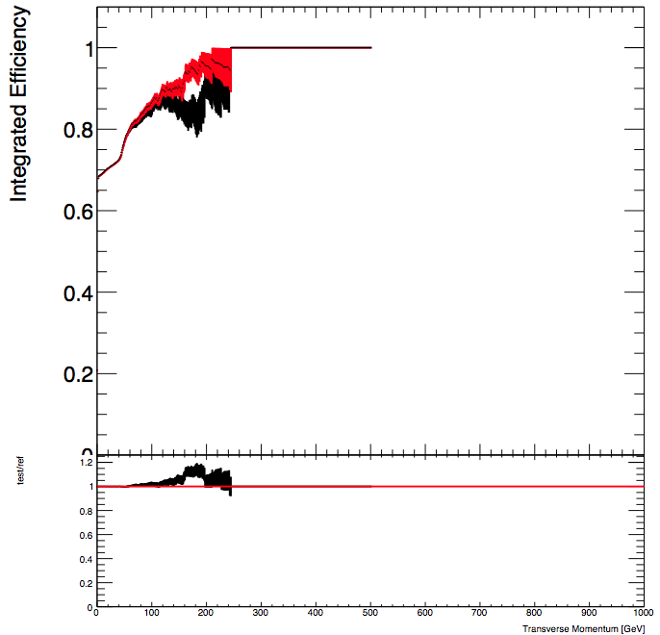
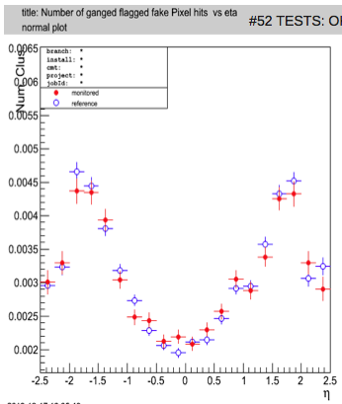
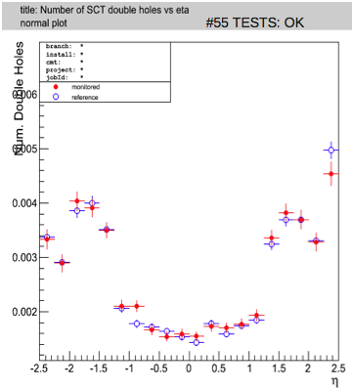
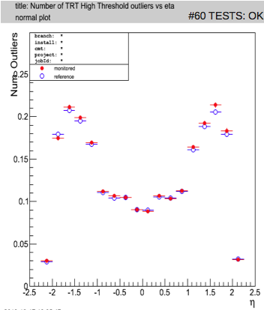
17.7.3.1 Simulation
In general looks good
b-tag yellow but diffs similar to usual
Largest diff seen is increase in muon efficiencies at high p_{T}
Similar for all muon types
Some small diffs in tracking for ganged pixels, holes, outliers (true for all tasks)

Slide 8
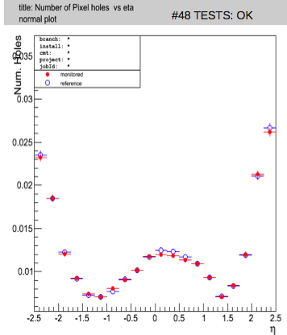
17.7.3.1 Simulation: AthenaMP/SLC6
Some small differences seen but pretty much all within stat uncertainties
An example of a largest one seen for SLC6: pixel holes

Slide 9
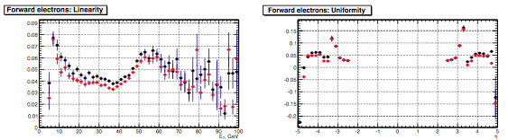
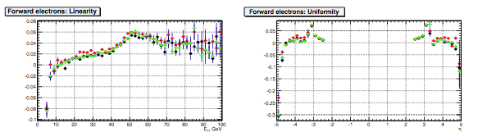
Frozen Showers in 17.7.3.1 (1)
Some diffs in E response (linearity/uniformity) for forward elecs
Uniformity (right) similar to seen in 17.7.1.2 validation (bottom)
Larger difference for linearity seen by egamma (left) but not for SM (later)
Shape clearly different to previous results too
Test (FS on)
Ref (FS off)

Slide 10
Frozen Showers in 17.7.3.1 (1b)
Differences noticeably larger than MC12 new FS library validation

Slide 11
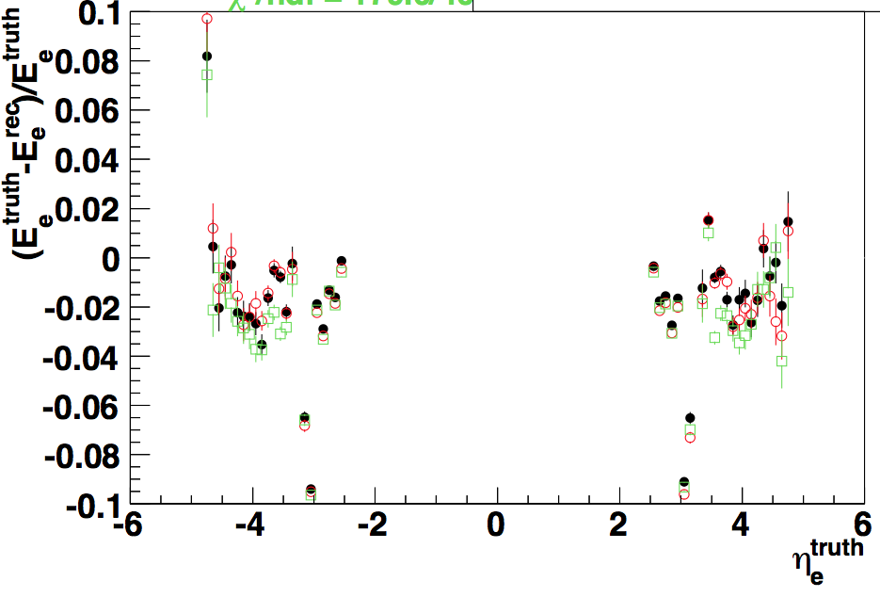
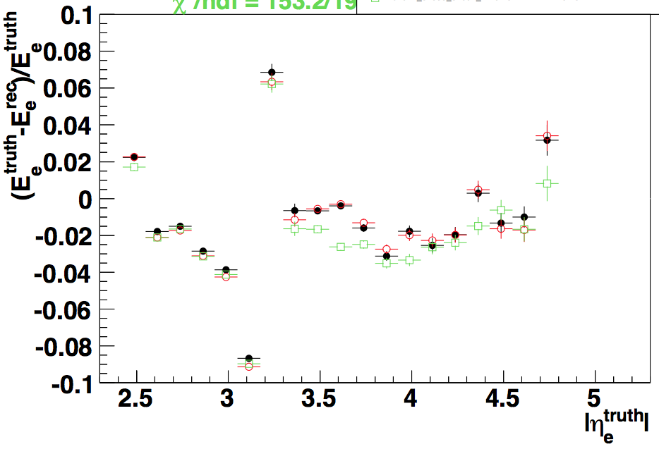
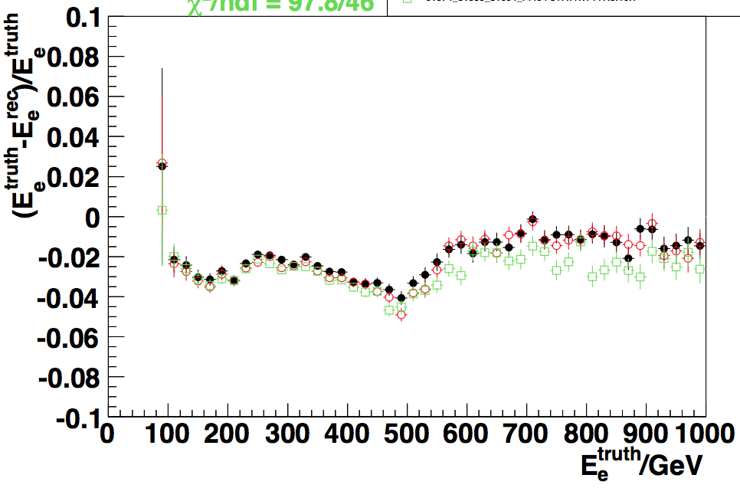
Frozen Showers in 17.7.3.1 (2)
SM Z->ee also see difference in linearity for fwd elecs
But here similar to 17.7.1.2 validation (bottom)
Note: colors switched wrt egamma; RHS plot definition inverted wrt previous
Test (FS on)
Ref (FS off)

Slide 12
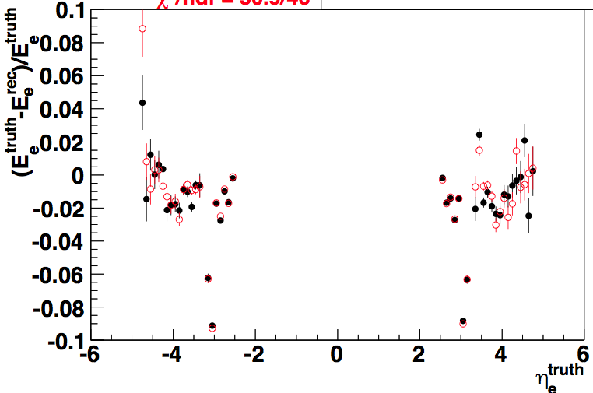
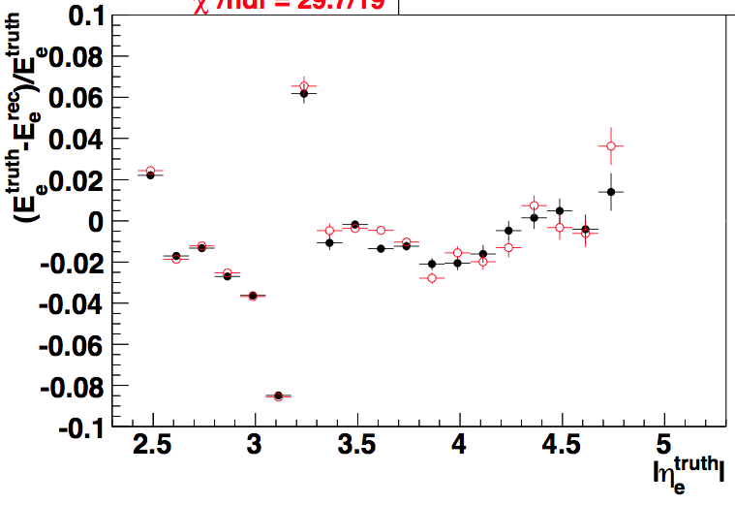
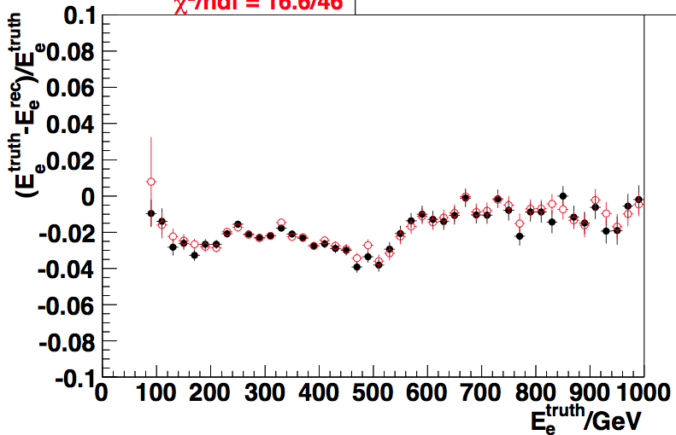
Frozen Showers in 17.7.3.1 (2b)
Again significantly larger differences in linearity than in MC12

Slide 13
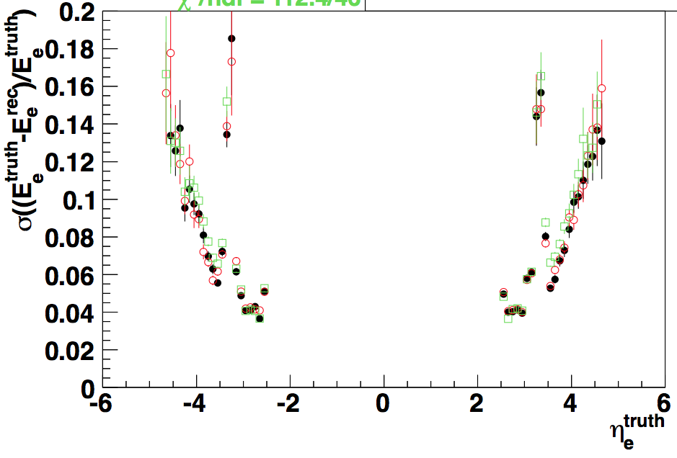
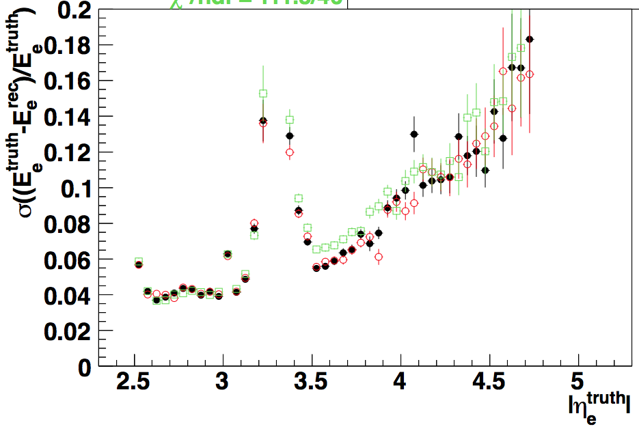
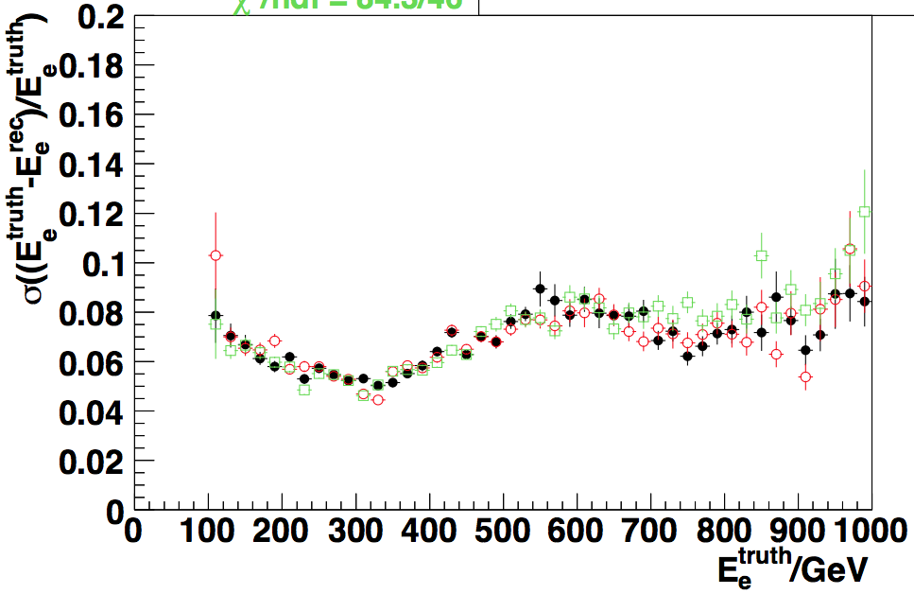
Frozen Showers in 17.7.3.1 (3)
SM Z->ee further see difference in resolution for fwd elecs
Again similar to previous validation (bottom)
Test (FS on)
Ref (FS off)

Slide 14
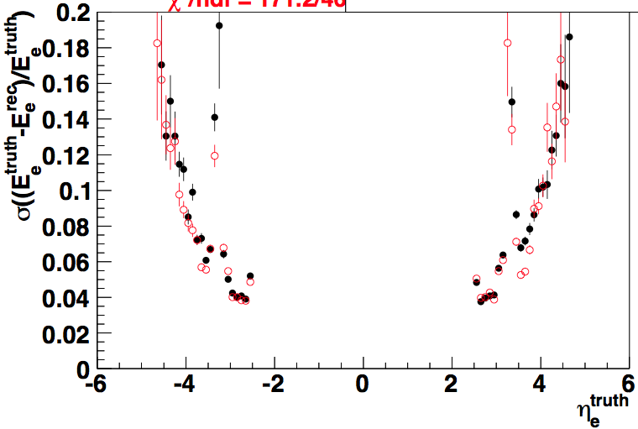
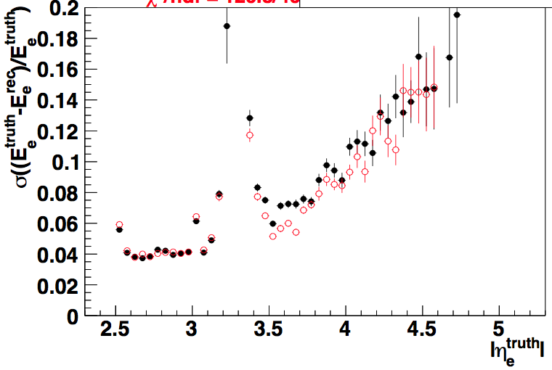
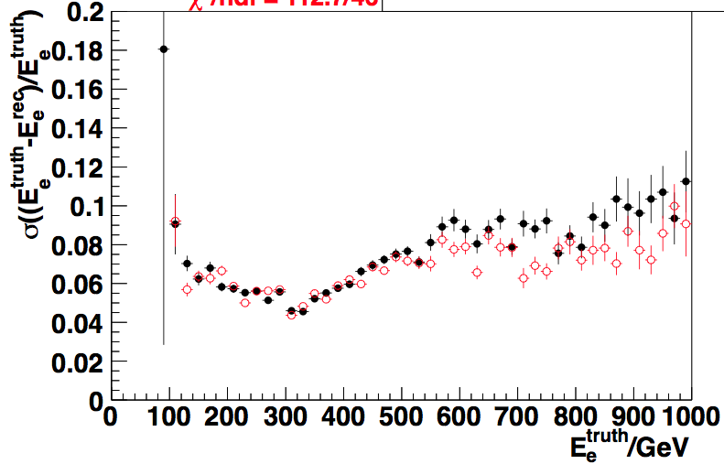
Frozen Showers in 17.7.3.1 (3b)
Resolution changes similar to those seen in MC12

Slide 15
Frozen Showers in 17.7.3.1 (4)
Egamma/Z -> ee linearity differences are clearly larger than those seen in MC12
Photon results marked green but haven’t seen plots to check in depth the level of differences
Given the above would suggest to not use FS for DC14 at this point

Slide 16
New Geometry Naming
Include TAG comparison if get in time

Slide 17
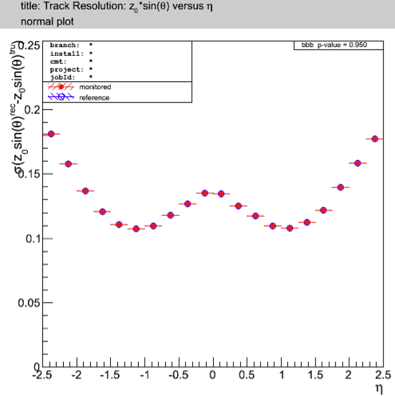
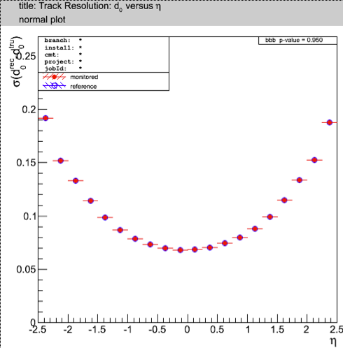
IBL/ITK digi+reco
Several groups struggling to run on task 4 (ITK)
Likely due to changes to job options needed for IBL
For IBL task (5), things look good so far
Including vertex-dependent tracking variables
Don’t yet have a vertex distribution itself
Unfortunately unable to run b-tagging for these samples
Mistakenly included "JetTagNtuple/preInclude_Reco_trf_IBL.py” which was found previously to disable some required containers.

Slide 18
Upcoming validations
+
Plans for next meeting

Slide 19
Upcoming Validations (1)
Validation of AFII for DC14 in 17.7.2.1/17.7.3.1.
Reminder: no validated AFII with pileup so proposed plan is:
AFII vs latest validated AFII in 17.6.0.7 without pileup
AFII vs validated G4 in 17.7.3.1 without pileup to check expected AFII diffs
AFII with pileup vs G4 with pileup
ATLPHYSVAL-37
Sample A done for 17.7.1.2
Probably want to rerun with 17.7.3.1?
Can run these samples over holiday
Continue run-dependent conditions tag validation for simulation
Disentangle effect of beamspot change & other conditions changes by:
MC12b simul and digi+reco conditions tag with override of BS to new tag
Run-dep simul & digi+reco conditions tag with override of BS to MC12b tag
Sample A reco running
MC11, MC10 after MC12 validated
MC10 with full sample A (changes in MET); others only tracking validation (BS)
ATLPHYSVAL-34

Slide 20
Upcoming Validations (2)
Validation of new TRT digi+reco code in 17.3.12.Y
In parallel with run-dep conditions tests as requires new conditions tag
ATLPHYSVAL-34
Waiting for cache
Check new GEO naming for simul (17.7.3.1) & digi+reco (17.3.12.2)
Depends on if get results of TAG-level validation before holidays.
ATLPHYSVAL-43
Check digi+reco in 17.3.12.1
Plan to properly validate by comparing to last validated digi+reco
Already needed to use for 17.7.3.1 simul validation (new GEO + 64 bit ID)
Sample A done with GEO-20 to compare to validated 17.2.12.1
Do we want to redo?
GEO-21?
Pileup?
New Reco_tf.py (being validated in separate tasks – see next slide)
ATLPHYSVAL-45

Slide 21
Upcoming Validations (3)
Validation of new Reco_tf.py and Digi_tf.py in 17.2.12.1
Two tests: digi and reco in two separate steps or one combined step
ATLPHYSVAL-56
Sample A reco running
Validate updated IBL GEO + code (2 steps) for run 2 DC14
ATLASPHYSVAL-33: simul & digi+reco in 17.3.12.1
ATLASPHYSVAL-15: simul in 17.7.3.1 & digi+reco in 17.3.12.Y
Still two steps?
Waiting for digi+reco cache
Validation of overlay in 17.2.11.15
Will have two references: previous overlay + standard MC12 simul
Since overlay samples only use HCP data a pile up reweighting is needed
HCP GRL must also be applied to the overlay ones (since comes from data)
Sample A done
ATLASPHYSVAL-49

Slide 22
Upcoming Validations (4)
Validation of ITK in 17.7.3.1
Needed to allow non-Gaussian beamspot.
Slightly longer term
ATLPHYSVAL-53

Slide 23
First Meeting Plans
What are priorities for first post-Christmas meeting?
Monday 13th Jan (brought forward to gain some time)
Possible tasks (samples available or can be run over holiday):
AFII simulation
New digi and reco transforms
17.3.12.1 digi+reco
Run-dependent conditions in MC12b
New GEO naming (depending on TAG-validation)
Overlay
Maybe slightly too many for one meeting
Might squeeze in if don’t need to do GEO-naming
Should really get overlay done
If we need to postpone something, which one?

