Slide 1


End of module questionnaire
This is your final chance to have a say on how the course is run and raise any issues you may have
  Also, improving it for future student cohorts
We will take your views on board
  Reporting back on common issues
  Making changes to alleviate them where possible
If not done, please take 5 mins to fill this in now
  https://liverpool.surveys.evasysplus.co.uk/
Notes:
Before starting today’s lecture, I’d like to give you 5 mins to fill in the end of module questionnaire …
Which this time it is electronic rather than paper based.

Slide 2
Introduction to Computational Physics (PHYS105)
Lecture 11: Modules and Fitting Revisited
Carl Gwilliam
(C.Gwilliam@liverpool.ac.uk)
Attendance code: 908651
Notes:
Record and attendance code!
Morning everyone
Don’t forget to register your attendance
This week we are going to look at python modules and, in doing so, revisit fitting.
As usual, please feel free to interrupt with questions at any time

Slide 3
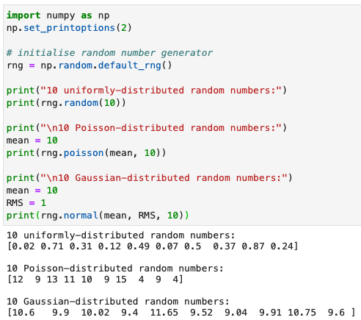
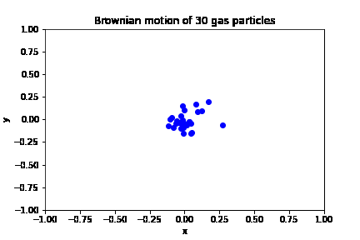
Lecture 10: Recap
Last week we looked at at category of numeric techniques known as Monte Carlo (MC) Methods
  Which use random sampling to obtain results by performing many trials or experiments
In doing so, we saw how to generate random nums following a given distribution in Python
Applied MC approach to simple problems
  Define range over which inputs can lie
  Generate many random inputs over range
  Perform deterministic computation on these
Can be easily extended to more complex cases
Notes:
First though, lets recap last week, where we looked at … which use … experiments
In doing so, …
First we setup the default random number generator by calling np.random.default_rng()
Then for uniform random numbers we simply call the random() function with the number of random numbers we want as input, in this case 10.
For random numbers following a Poisson distribution, which remember describes discrete events occurring over an interval of space or time, we call the poisson function instead, which takes the mean and size as inputs
Finally, Gaussian- or normal-distributed random numbers are generated by calling the normal() function, with the mean, RMS and size as arguments, and describe many situations with large number of events due to the CLT
We then applied the Monte Carlo approach to several simple problems (sim + int), following a set of general steps
(read) .. in order to obtain the result.
in the summative problem you saw how to generate a single gas particle
This may seem simple but once you can generate one you can easily add others, such as the 30 shown here, …
… making them bounce of the walls (point)(and eventually each other) to model an ideal gas
Matplotlib even allows you to animate the results, though it is beyond this course.

Slide 4
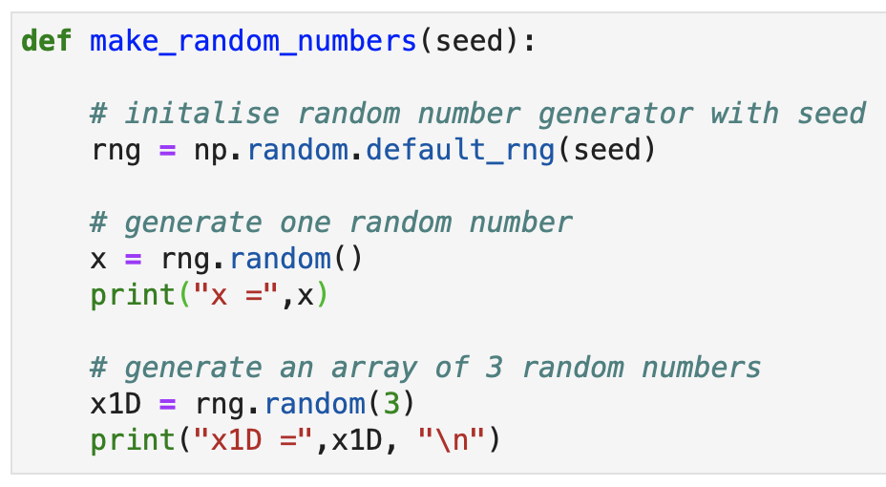
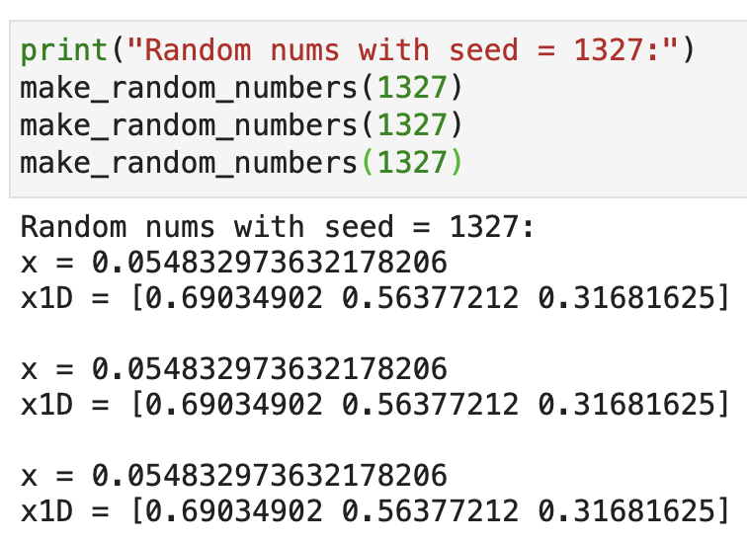
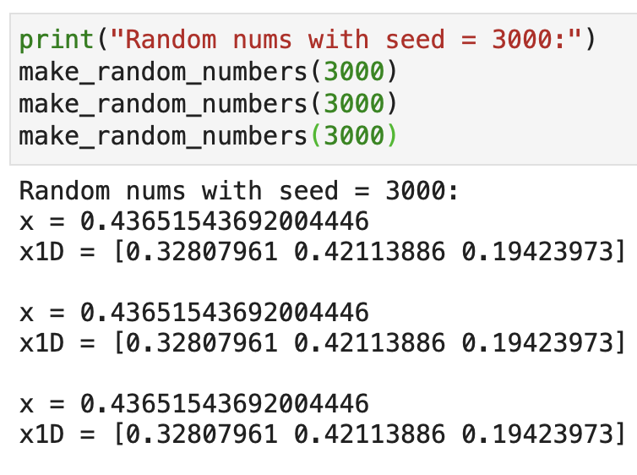
Lecture 10: Formative problem solutions
Exercise 1: Check how the seed works by running with the same and different seeds
  While the sequence of numbers is random, we often want to be able to repeat it again
    E.g. so we can compare results, debug etc
  The seed allows this by setting the point within the random sequence where we start
    If the seed is the same, we start at the same point → get the same random sequence
    If we change the seed, we start at a different point → hence get a different sequence
  If we don’t set a seed, we start at a random point in the sequence of random numbers
    Hence getting a different set of random numbers each time
Function to aid testing multiple times
Same seed = same result
Diff. seed = diff. result
Notes:
Before we go on to this week’s topic, lets as usual look at the solutions to last week’s formative problems, and feedback on any common issues
Ex1 was to check how the seed works by running the code with the same or different seeds multiple times
(read)
(read)
… get the same sequence of random numbers, as shown here
… get a different *repeatable* sequence of random numbers, as shown here
Example:
Note how I used a function that takes the seed as input and simply called this to run the code multiple times
If we don’t …

Slide 5
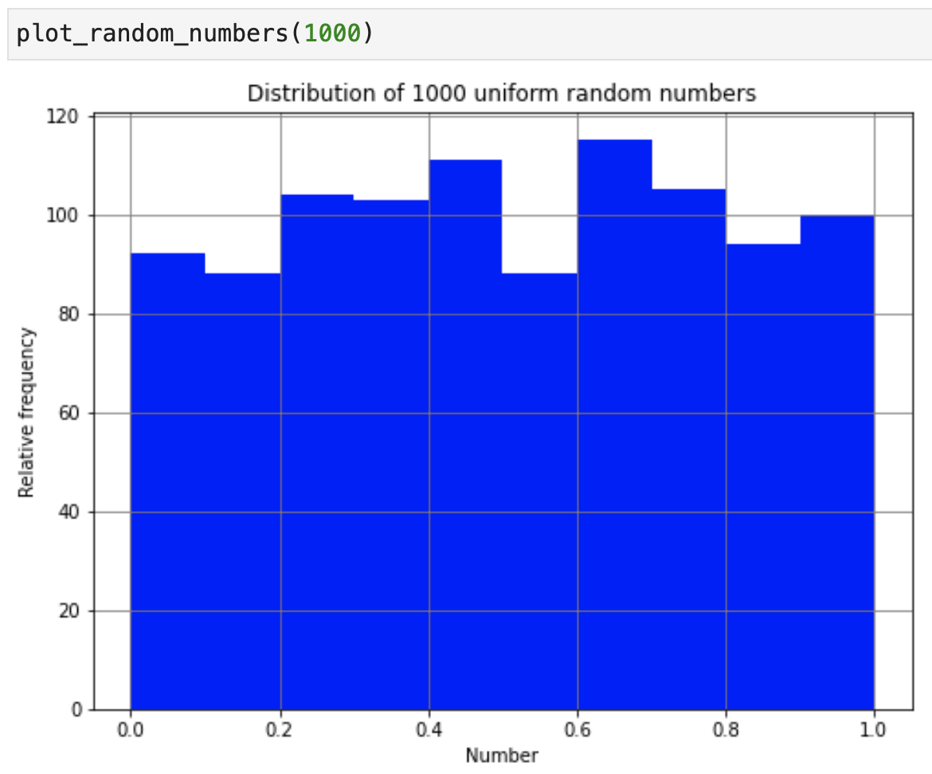
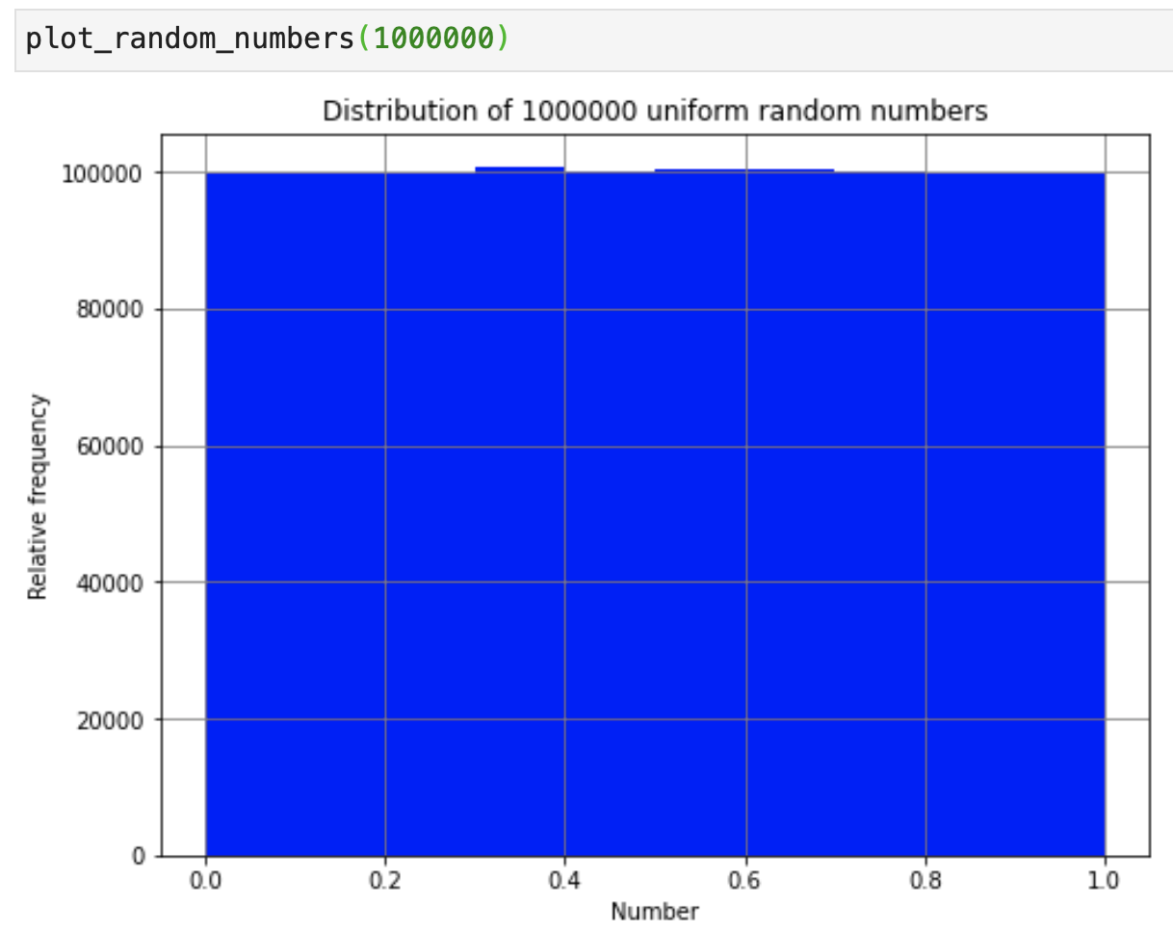
Lecture 10: Formative problem solutions (2)
Exercise 2: Investigate the distribution of random numbers as we increase the number of trials
  Numbers are spread uniformly between 0 and 1 → expect N_{trials} / N_{bins} in each bin on average
  But, since they are random, there is of course fluctuation around this average
  The more trials you run the less fluctuation there is
    In fact, the error on a given bin content N is approximately σ_{Ν} = √N (following the central limit theorem)
N_{trials} = 1000
N = 1000/10 = 100
σ_{N} = √100 = 10
σ_{N}/N = 10/100
= 10%
N_{trials} = 1e7
N = 1e7/10 = 1e6
σ_{N} = √1e6 = 1000
σ_{N}/N = 1000/1e6
= 0.1%
Notes:
Ex2 was to investigate … trials from 1000 (point) to 10 million (point)
Since the numbers are uniformly spread between 0 and 1 we expect the number in each bin to be the number of trials divided by the number of bins on average
In our example, where we have 10 bins, we get 100 per bin in the first case (point) and 1 million per bin in the second case (point)
However, since the numbers are random they will fluctuate about this average, changing each time you run the code
But the more trails you run the less fluctuation about the average there is, or the smaller the uncertainty is, as you saw for the pi example in the notebook
Example
This is why we need to use samples of large sets of random numbers to get a good deterministic result
In fact, we can quantify this, and check it behaves as we expect, since the uncertainty on a given number N (assuming the CLT) is just root N
So, for the 100 events per bin the uncertainty is 10 and we indeed see fluctuations of this size (point)
For 1M events per bin on the other hand the uncertainty is 1000. While this is bigger, which seems contrary to what we expect, we have to consider the percentage error, which, dividing the uncertainty by the bin content, is 0.1% in this case compared to 10% in the previous case. Hence the fluctuations will be of the scale of only 0.1% which is very small.

Slide 6
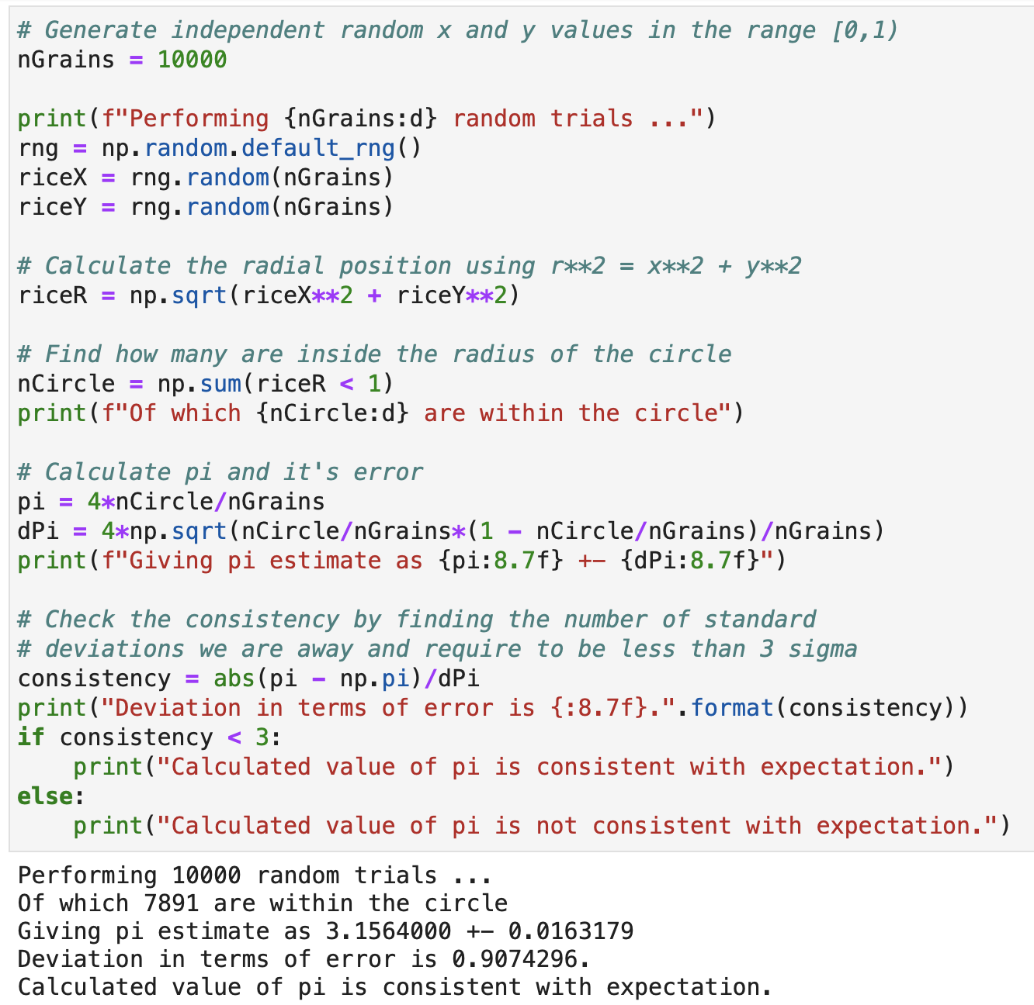
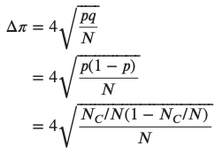

Lecture 10: Formative problem solutions (3)
Exercise 3: Determine the error on the MC estimate of π to see if it is consistent with
the known value
  For the error we simply code the derived formula into python using NumPy
  To check if it it consistent you need to use the consistency check we covered in lecture 6
p = probability of being within circle
q = probability of being outside circle
Notes:
Ex 3 continued unc theme by asking you to determine the … value
Reminder of how calculated pi numerically: throw 10000 uniform random numbers in x and y, calculate the radius and sum those < 1, then divide by the total number and times by 4
For the error we simply code the formula that was derived in the notebook, which can be written in terms of just the number of trials and the number within the circle by substituting the probability of being inside (p) or outside (q)
To check if it is consistent with the known value, which we can take from np.pi, we need to use the consistency check that you have used in labs and which we saw in week 7
I remind you that this calculates how significant the difference is by taking the absolute difference between the two values and dividing by the total uncertainty (add in quad)
In our case the known value of pi is very exact and so has no significant uncertainty, hence we just divide the difference by the error we have calculated on our estimate
I got pi as 3.156 with an error of 0.016 or so, which is less than 1 sigma away from the known value and hence they are consistent since this is less than our usual bound of 3

Slide 7
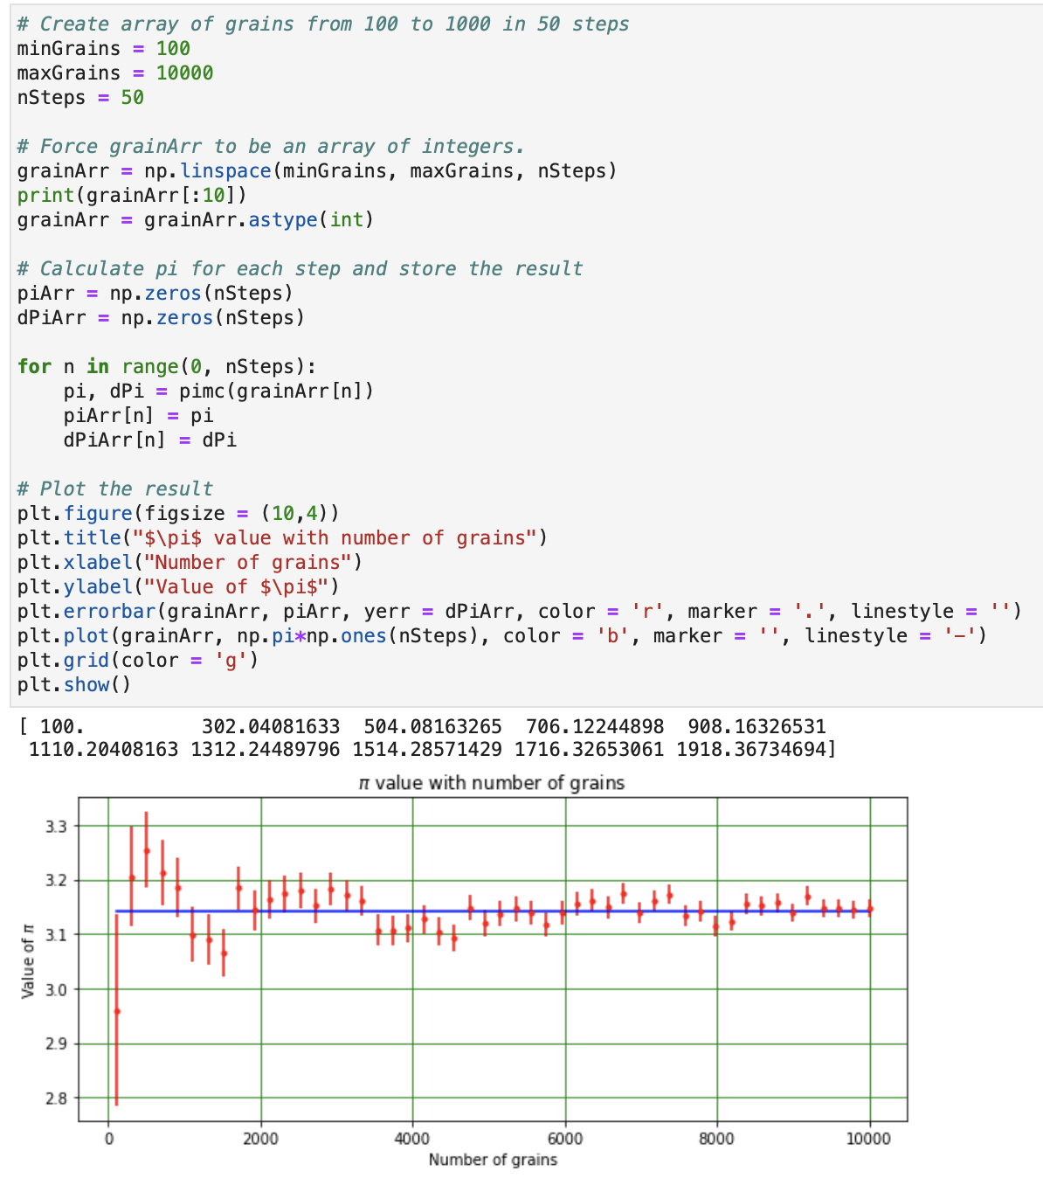
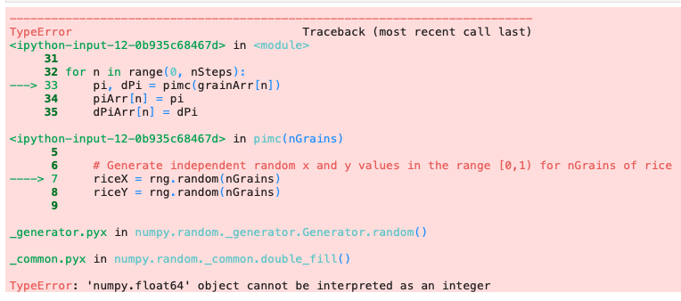
Lecture 10: Formative problem solutions (4)
Exercise 4: Fix the bug to plot the uncertainty on π versus the number of grains
  The issue is that the grainArr contains floats, while rng.random() expects ints → convert
    E.g. using astype(int) or int()
  Once fixed then we see that, as we should expect from Ex2, the more grains we throw
  the better our precision on the estimate of π
    i.e smaller uncertainty
Notes:
Ex4 gave you some practice at debugging by fixing the error in the code to plot the uncertainty on pi as we increase the number of trials
Convert the code into a function
Create an array of the number of grains from 100 to 10000 in steps of 50
Loop over this and call the function for each, storing the value and the error in arrays. Finally plot this but got an error
Remembering how we read the error starting from the bottom, we can see that we have a TypeError (point), which tells us that we are using a float somewhere python expects an int
If we then look at the traceback it tells us that the code calls the pimc() function on L33 (point) and then gives an error when trying to call rng.random() with the nGrains as an argument within that function (point)
This is because, as we can see in the printout here (point) the way we have setup our array using linspace gives floating point (or decimal) numbers while np.random expects an integer (or whole) number of events of course
So we need to convert the floats to ints and the easiest way to do this is to use numpy’s astype() function (point) with int as an argument to convert the whole array (as saw in earlier week)
Another, equally good method, that several people used, was to simply put the int() function around the nGrains in the call to the pimc() function or random() (point to error)

Slide 8
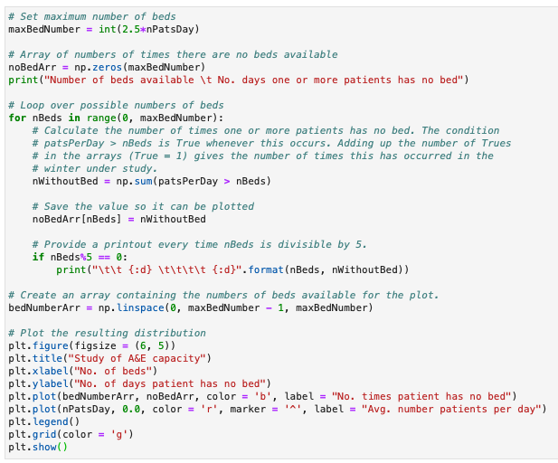
Lecture 10: Formative problem solutions (5)
Exercise 5: Add comments to the code, explaining each line of the for loop in particular
Notes:
Finally, Ex5 asked you to add comments to the code, explaining each line of the for loop in particular
The amount of comments is a bit a matter of taste and here I have probably over-commented to be didactic
For the for loop, the first line (point) calculates the number of times one or more patient has no bed.
We use numpy’s array at a time method to check when each element in our patient array is greater than the number of beds under study, getting an array of False (if not) and True (if so)
We then sum this up to find the number of days it occurs, remembering True and False are treated as 1 and 0, respectively
And store the result at the correct point in the array
We use our remainder operator to print out the results every time the number of beds is divisible by 5
Any questions on the formative exercises?
Grades and feedback on Week 9 assignments have been posted on canvas

Slide 9
Moving beyond Jupyter notebooks
During the course, we have been writing our Python code exclusively in Jupyter notebooks
  Which are a great resource for learning + developing code interactively and disseminating the results
However, they also have some disadvantages, especially for writing longer programs
  Large notebooks can be messy and are slow to both open and run
  There is a large potential for conflicts between piece of code e.g. overwriting names
  You often need to run all the cells and the results may depend on the order in which they’re run
  If you want to reuse code elsewhere you have to copy-and-paste it into a new notebook
As you write more complex problems you will want to split things up into modular chunks
  Each of which does a specific task, allowing you to focus on the problem at hand
Also, going forward, you will increasingly want to reuse code you have developed
  Both code from within PHYS105 (e.g. fitting code) and also future courses
This doesn’t mean we need to give up on Jupyter notebooks entirely
  We can have the best of both worlds by moving reusable pieces of code into modules
Notes:
If not, let’s move on to today’s topic …
So far … the results, as we have seen
(Read)
As I am sure you have noticed …
… as you have almost certainly encountered
(read others)
(Read)

Slide 10



Python modules
Python allows us to write programs in a modular way by separating code into modules
This module approach has several advantages
  Simplicity: a module can focus on a particular
  problem or a small portion of a larger problem
  Maintainability: smaller chunks are easier to
  maintain and reduce the possibility of conflicts
  Reusability: the code we have written can be
  reused in many notebooks without duplicating
You have already used many Python modules
  Built-in modules e.g. math
  Third-part modules e.g numpy, scipy
  Modules I wrote e.g. LabModule
Will now see how you can write your own modules
  That you can add to and reuse in the future
Fitting
Plotting
import
import
import
import
Numerical
Another
Notes:
(Read first bullet) … modules, hence the name
For example, you might want a module for your fitting code as we will make today (point)
But you might also want a module for your plotting code, a module for numerical analysis, and potentially others (point)
Each of which you can import and use in any notebook (point)
(Read second bullet)
Firstly, simplicity …
Second, maintainability, since …
Finally, reusability …
You have already used many different types of modules
(Read)
If you do labs, …
(Read)

Slide 11
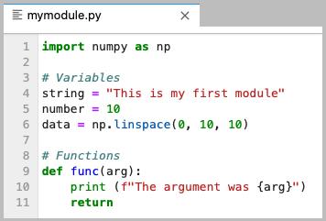
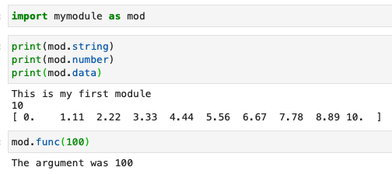
Creating your own module
Creating a python module is actually very easy
  It is just a file containing valid python code
  Written in any editor you like (inc. CoCalc)
  Saved with a .py file extension
It can contain variables, data structures, functions etc
  And can import and use other modules too
To use our module, we just place it
in our current working directory
  I.e. same directory as the notebook
We then simply import it, just like any of the other modules we have used
  Note: don’t include .py suffix
Notes:
(Read first bullet)
Written in any editor you like, which can also be directly in cocalc, and saved with a file extension .py, which stands for python
It can contain essentially any valid python code such as … and can also use other modules too by importing them in the usual way
Let’s take a look at an example python file, which I have called mymodule.py:
Here, I create several variables (point): a string, a number and a numpy data array, exactly as I would in a jupyter notebook, remembering for the latter to import numpy
I also define a function, imaginatively called func (point), which for sake of example, takes one argument and prints that out
Once we have written our module we simply place it in our current working directory where the notebook is and then import it into the notebook just like we would any other module we have used (point)
Note, that the name of the module we import doesn’t include the .py file suffix
We can then access the information in our module in the same way as numpy etc by using the module name, which I have shortened to mod for convenience, followed by the variable or function name separated by a dot
So we can call our variables string, number and data like this and print the results
We can also call our function with the required argument
In each case, we see the expected output.
ANY QUESTIONS on the basics of modules?

Slide 12
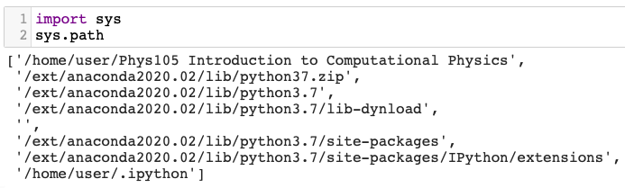
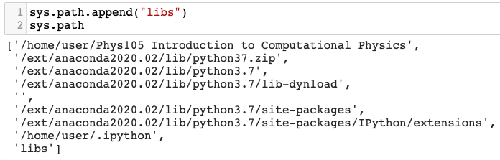
Finding the module
Having to keep our modules in the same directory as our notebook is not very useful
  Particularly if we want to be able to reuse these in other notebooks or places
Luckily, python has a way of specifying where
it looks for files not in the current directory
  Which is specified by the sys.path
By default, it contains a system-dependent
list of paths from your python installation
  But can append new paths, either relative
  or absolute, to it to add new locations
E.g. If we put our module in a libs directory
we simply add this directory to the sys.path
  Then can import is as if it’s in the current dir.
So can move useful code into a central module and simply import it into any notebook we want
Default CoCalc sys.path
Adding a new relative path
Notes:
Now of course, having …
(Read bullet)
Which is specified by the path variable in the sys module we have encountered before
By default … python list of paths to look in from your python installation
Which on cocalc looks like the following for me (point), where you can see I have simply imported the sys module and printed sys.path
Each of these locations is searched in turn to find the requested module
However, as this is just a list ([]), we can easily add to the list of locations searched for modules by simply appending paths to this list
So, for example, if we put our module say in a directory called libs inside our current directory we simply append the relative path libs to sys.path, as shown here (point) and python will now look for any module there too

Slide 13
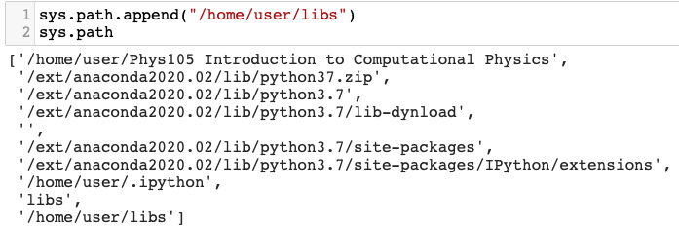
Finding the module
Having to keep our modules in the same directory as our notebook is not very useful
  Particularly if we want to be able to reuse these in other notebooks or places
Luckily, python has a way of specifying where
it looks for files not in the current directory
  Which is specified by the sys.path
By default, it contains a system-dependent
list of paths from your python installation
  But can append new paths, either relative
  or absolute, to it to add new locations
E.g. If we put our module in a libs directory
we simply add this directory to the sys.path
  Then can import is as if it’s in the current dir.
So can move useful code into a central module and simply import it into any notebook we want
Default CoCalc sys.path
Adding a new absolute path
Notes:
If the libs directory was not under our current directory but somewhere else, say in our home directory, we can just append the full, or absolute, path to the list as shown here
So, the idea is that we can move useful code … want, without having to copy-paste the code
Any questions on creating and using python modules?

Slide 14

Reminder of fitting
We perform fits to experimental data to determine the relationship between x and y
  Given the functional form, we can find the values of the unknown params that best describe the data
We determine the best fit by minimising the residuals
  i.e. the distance between the data point and the model
  prediction at that x value, divided by the point’s error
We performed the fit using the least-squares method
  Which is available from the scipy.optimize module
y
y = f(x, β)
y₅
r₅
y = f(x,β)= mx + c
y₄
r₄
→ χ²
y₃
r₃
y₁
y₂ – f(x,β)
r₁
r₂ =
σ_{y2}
y₂
error
c
x
x₁
x₂
x₃
x₄
x₅
Function computing point-by-point residuals to be minimised
Initial guess of free parameters
Tuple of input data (x, y, σ_{x}, σ_{y}) to minimise with respect to
Notes:
Given we going to make a fitting module, it is prudent to remind ourselves about the fitting method we covered in lecture 6 …
To determine the relationship between the independent and dependent variables, x and y, of our data we have to fit it with a functional form
Often we know the expected functional form f(x) from some model or theory and want to see if it describes our data
In doing so we want to find the values of the unknown parameters of the model, which we called beta (point), that best describe our data
We saw in lecture 6 that we determine the best fit by … residuals, which are just the … (point) … error, such that more uncertain points have less influence in the fit
In general, we actually minimise the sum of the square of the residuals (point), which is nothing more than that chi2 statistic that you use in PHYS106 if you do labs
We do this using the so-called least-squared fitting method, which we took from scipy’s optimise module
For our purposes this took three arguments:
The function …, remembering that scipy took care internally of squaring and summing these
The initial guess of any free parameters, which we can find from a plot
And the tuple of input data, in the form of x and y plus the corresponding errors, that internally are passed into the residuals function (fun) to minimise it with respect to

Slide 15
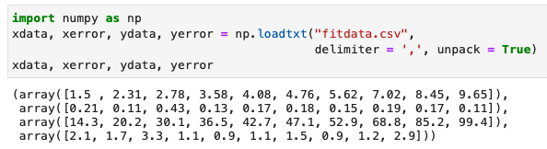
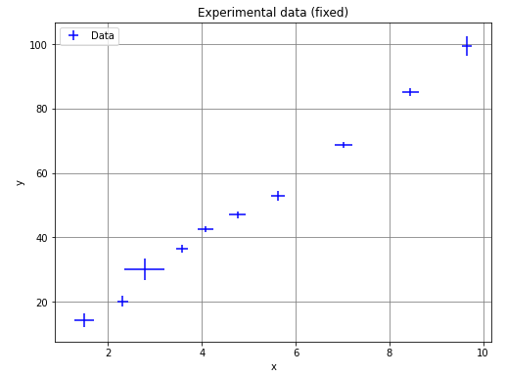
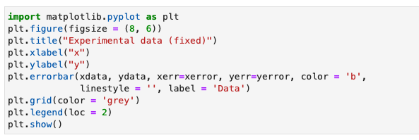
Fitting procedure steps
Read in your data, usually from a file
  Plot to check sensible
  And find initial params
Notes:
Let’s now remind ourselves briefly the steps we need to preform to do a straight-line fit …
Firstly, we must read in the data, values and errors, which we usually do from a file using the np.loadtxt() function (point)
We then plot this to check that it is sensible (point) and to determine the initial parameters, which here are an intercept of around 0 and a gradient of around 10

Slide 16
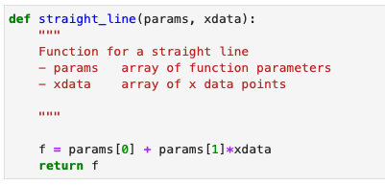
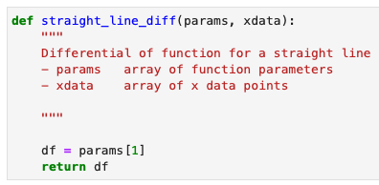
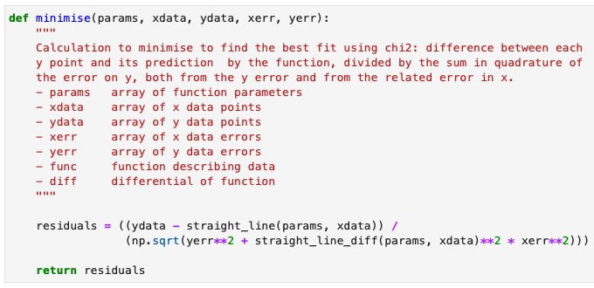

Fitting procedure steps
Read in your data, usually from a file
  Plot to check sensible
  And find initial params
Define the necessary functions
  Functional form and its differential
  Point-by-point residuals
Notes:
We then needed to define the functions that implement the mathematical function of the model and it’s derivative (point)
Which we use to calculate the point-by-point residuals following the previous formula (point)

Slide 17
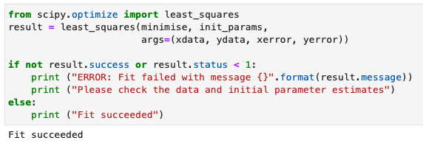

Fitting procedure steps
Read in your data, usually from a file
  Plot to check sensible
  And find initial params
Define the necessary functions
  Functional form and its differential
  Point-by-point residuals
Run least_squares() from scipy.optimize
  Check fit succeeds and get fitted params
Notes:
We then actually run the fit by calling the least_squares method (point), passing in our residual function, the initial guess of the parameters and the data along with its uncertainties
This is the actual FIT part!
This provides a result object with several pieces of information
The first thing we must check is that the fit succeeded, using result.success (point).
If so we can extract the best-fit parameters using result.x (point)

Slide 18
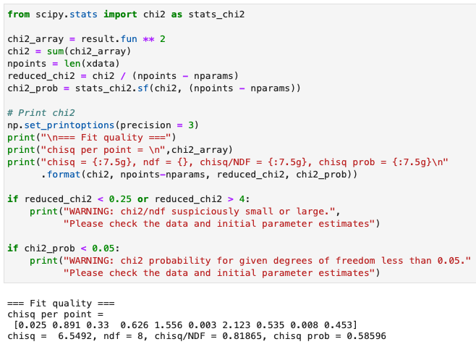
Fitting procedure steps
Read in your data, usually from a file
  Plot to check sensible
  And find initial params
Define the necessary functions
  Functional form and its differential
  Point-by-point residuals
Run least_squares() from scipy.optimize
  Check fit succeeds and get fitted params
Calculate χ² test statistic to check fit is good
  0.25 < χ²/NDF < 4 and/or χ² prob > 0.05
Notes:
We then need to check if the fit is a good description of the data, which we do using our chi2 test statistic
This is calculated from the resulting residuals function, accessed using result.fun, squared and summed
We can divide this by the number of dof to get the chi2 per d.o.f, which should lie roughly in the range ¼ - 4
We can also calculate the probability of this chi2 value, which should be above 5%

Slide 19
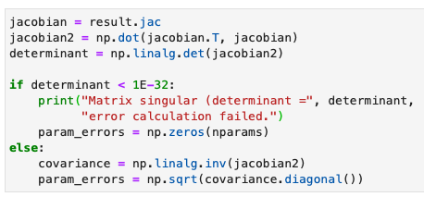
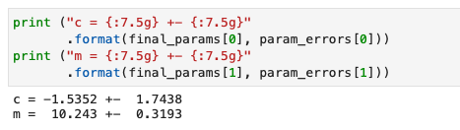
Fitting procedure steps
Read in your data, usually from a file
  Plot to check sensible
  And find initial params
Define the necessary functions
  Functional form and its differential
  Point-by-point residuals
Run least_squares() from scipy.optimize
  Check fit succeeds and get fitted params
Calculate χ² test statistic to check fit is good
  0.25 < χ²/NDF < 4 and/or χ² prob > 0.05
Calculate parameter errors from Jacobian
  Print best-fit parameters and associated error
Notes:
Following this, we need to determine the uncertainties on the fitted parameters, which we extract from the Jacobian matrix received by result.jac
You will understand the calculation for this after looking at matrices in PHYS108 next semester
We can then print out the best fit parameters along with this associated error
Remembering to include the units if there are any

Slide 20
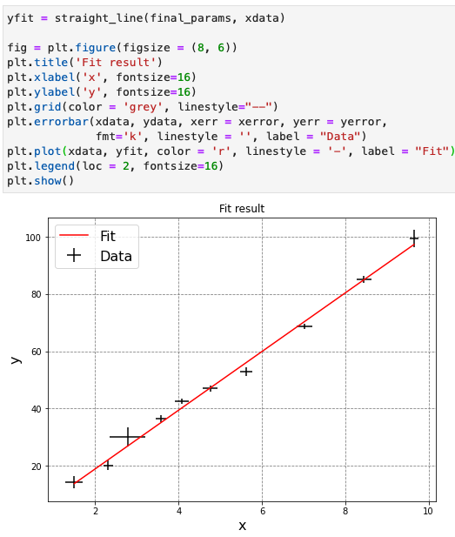
Fitting procedure steps
Read in your data, usually from a file
  Plot to check sensible
  And find initial params
Define the necessary functions
  Functional form and its differential
  Point-by-point residuals
Run least_squares() from scipy.optimize
  Check fit succeeds and get fitted params
Calculate χ² test statistic to check fit is good
  0.25 < χ²/NDF < 4 and/or χ² prob > 0.05
Calculate parameter errors from Jacobian
  Print best-fit parameters and associated error
Plot data and fitted function
  Passing best fit params to functional form
Note: no line connecting data points
Notes:
Finally, we pass the best fit parameters and the x data back to the definition of our straight line (point) to determine the corresponding y values
This allows us to plot the resulting best-fit model (as a line) along with the data, which are drawn as points with error bars and w/o a line
This is not the FIT it is just showing the result of the FIT compared to our data

Slide 21
Fitting procedure steps
Read in your data, usually from a file
  Plot to check sensible
  And find initial params
Define the necessary functions
  Functional form and its differential
  Point-by-point residuals
Run least_squares() from scipy.optimize
  Check fit succeeds and get fitted params
Calculate χ² test statistic to check fit is good
  0.25 < χ²/NDF < 4 and/or χ² prob > 0.05
Calculate parameter errors from Jacobian
  Print best-fit parameters and associated error
Plot data and fitted function
  Passing best fit params to functional form
Encapsulated into a reusable fit function in lecture 6
Note: no line connecting data points
Notes:
At the end of lecture we encapsulated all this into a function that we could call to reuse

Slide 22
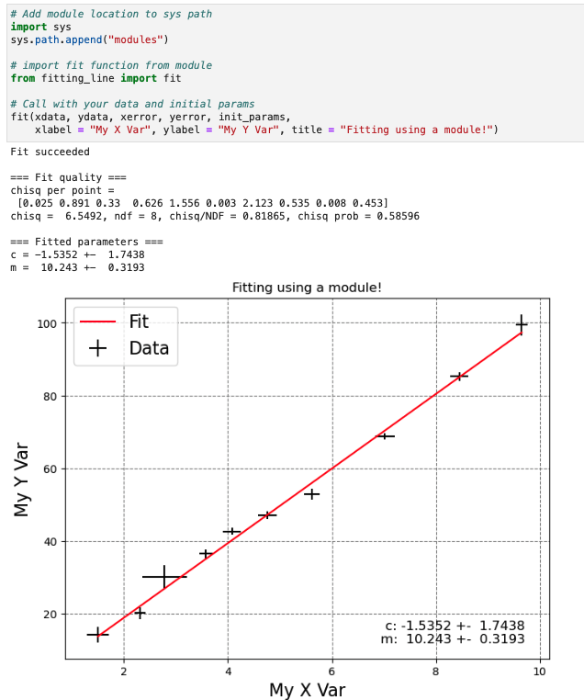
Fitting procedure steps
modules/fitting_line.py
Read in your data, usually from a file
  Plot to check sensible
  And find initial params
Define the necessary functions
  Functional form and its differential
  Point-by-point residuals
Run least_squares() from scipy.optimize
  Check fit succeeds and get fitted params
Calculate χ² test statistic to check fit is good
  0.25 < χ²/NDF < 4 and/or χ² prob > 0.05
Calculate parameter errors from Jacobian
  Print best-fit parameters and associated error
Plot data and fitted function
  Passing best fit params to functional form
Encapsulated into a reusable fit function in lecture 6 → now move to a module for future use !
Notes:
Now we take the fit function and the other necessary functions and put it into a module (show)
In future you can just point the sys.path to this module’s location
Then import it and call with your data and initial params etc
This is all you need to do when you need to do a fit from now on

Slide 23

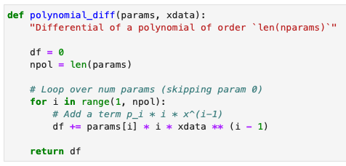
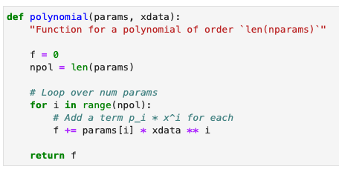

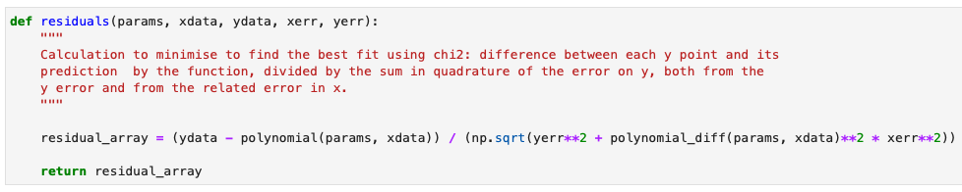
Extending fitting
So far, we’ve only looked at fitting straight lines, but it’s straight forward to extend to other cases
  Just need to know the function and its derivative
For example, we can easily extend our code to be able to fit a generic polynomial:
Notes:
In doing so we can also make our fitting a bit more general …
(Read first bullet)
One relatively simple thing we can do is to extend our code from just a straight line to any polynomial
To do this we first need to write the python functions for a polynomial and it’s derivative
We know that a polynomial is just a constant p0 + p1 times x + p2 times x^2 etc (point) and in fact the constant can be written as p0 times x^0, since anything to the power 0 is just 1, making the structure of all the terms the same
So we need to code this up in a function like our previous straight_line() function, which I have now called polynomial(). Let’s start by setting our function f to 0 (point).
Since we know that the number of polynomial terms is just the length of our array of input parameters we can write a loop over that number using for i in range and add each term to our function (point)
For each parameter we simply add the current value, taken from the ith element of the parameter array, multiplied by x to that power (point)
For the differential wrt x we, of course, multiply each term by the current power and then subtract one from the power (point)
This can be coded up in the same way as the polynomial itself but with each term now being the parameter times the index i times x to the power i-1 (point)
In this case, we start the loop at 1 (point, not 0) since the 0th term was a constant and of course gives no differential
Once we have those functions, it is just a case of replacing the straight_line and straight_line_diff functions in our residuals calculation with the new polynomial versions (point)
And updating the fit function to call that instead

Slide 24
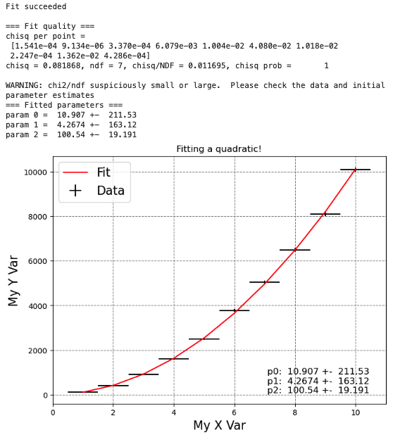
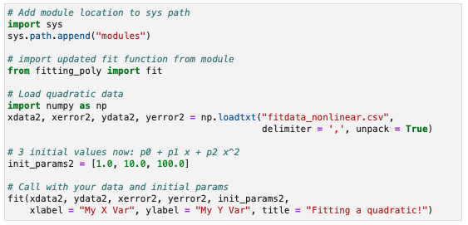
Polynomial fit
We can then update our module with these polynomial functions to make it more general
  modules/fitting_poly.py
Call it exactly as before
  Just remember to give the correct number of initial parameters for the functional form using
E.g. fit a quadratic:
Notes:
Show new module
Highlight the lines that changed: polynomial call + loop to print params and errors
We can then use this to fit a new set of data that is quadratic rather than linear

Slide 25
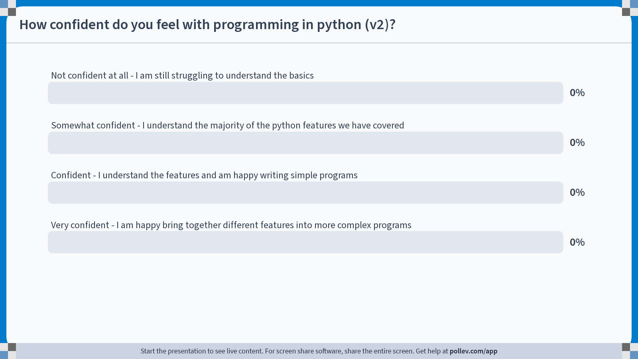
Notes:
Do not modify the notes in this section to avoid tampering with the Poll Everywhere activity.
More info at polleverywhere.com/support
How confident do you feel with programming in python (v2)?
https://www.polleverywhere.com/multiple_choice_polls/YMdt8VmjJEM0pUgltFs8V?state=opened&flow=Default&onscreen=persist

Slide 26

Summary
This week, we saw how to organise our code into modules, splitting it up & allowing it to be reused
  At the same time, we also reminded ourselves about fitting
That’s pretty much it for the PHYS105 course
  I hope it was enjoyable and useful!
You now know the basics of programming in python
  One of the most popular programming languages
Used this to model real-world (physics) problems
  Which you will use throughout your degree and beyond
As a bonus, you go away with a fitting module
  That you can reuse in labs + add to further
The second year Computational Physics (PHYS205) module will build on what you’ve learnt
  Allowing you to use python to undertake a project of your choosing.
Made in python using matplotlib
MerryXmas.ipynb
Notes:
So in summary …
… both within science fields and generally
… using a variety of techniques
… we finally made a fitting module
(Read)
Any final questions ?
If not, Merry Christmas and I hope you have a good holiday.
Here’s a Christmas tree I made in python using matplotlib, the code for which is also in the CoCalc for this week

