Slide 1
Introduction to Computational Physics (PHYS105)
Lecture 11: Modules and Fitting Revisited
Carl Gwilliam
(C.Gwilliam@liverpool.ac.uk)

Slide 2
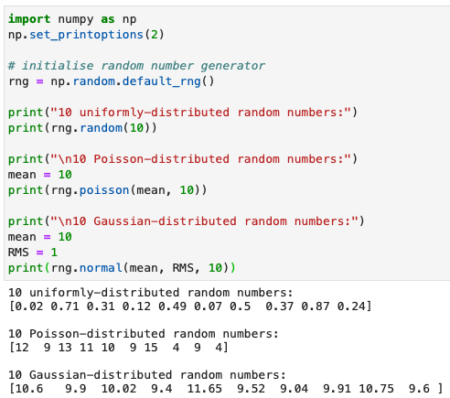
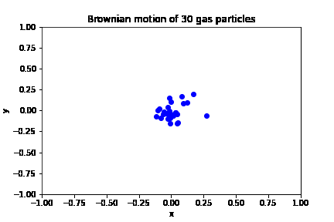
Lecture 10: Recap
Last week we looked at at category of numeric techniques known as Monte Carlo (MC) Methods
  Which use random sampling to obtain results by performing many trials or experiments
In doing so, we saw how to generate random nums following a given distribution in Python
Applied MC approach to simple problems
  Define range over which inputs can lie
  Generate many random inputs over range
  Perform deterministic computation on these
Can be easily extended to more complex cases

Slide 3
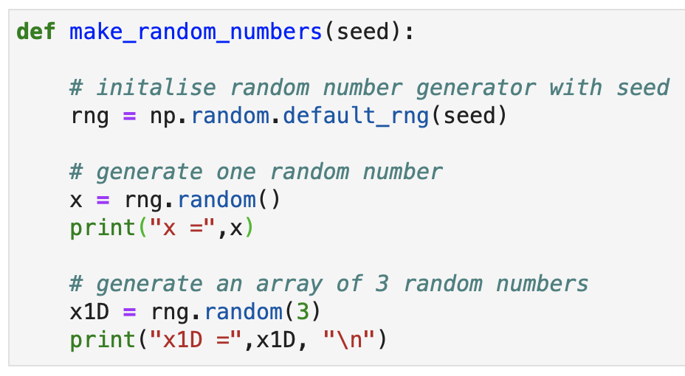
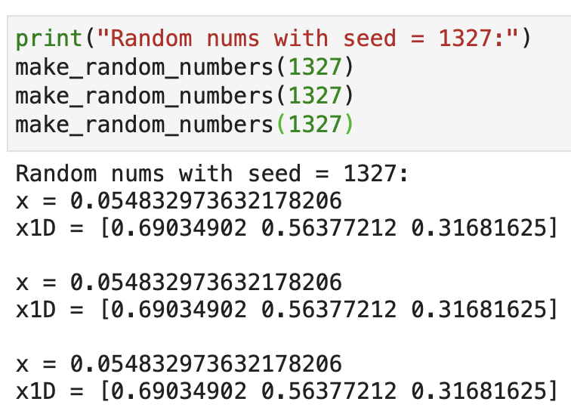
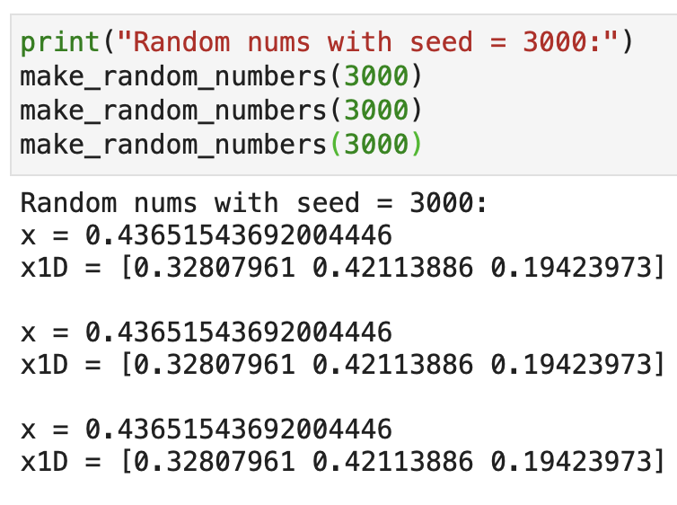
Lecture 10: Formative problem solutions
Exercise 1: Check how the seed works by running with the same and different seeds
  While the sequence of numbers is random, we often want to be able to repeat it again
    E.g. so we can compare results, debug etc
  The seed allows this by setting the point within the random sequence where we start
    If the seed is the same, we start at the same point → get the same random sequence
    If we change the seed, we start at a different point → hence get a different sequence
  If we don’t set a seed, we start at a random point in the sequence of random numbers
    Hence getting a different set of random numbers each time
Function to aid testing multiple times
Same seed = same result
Diff. seed = diff. result

Slide 4
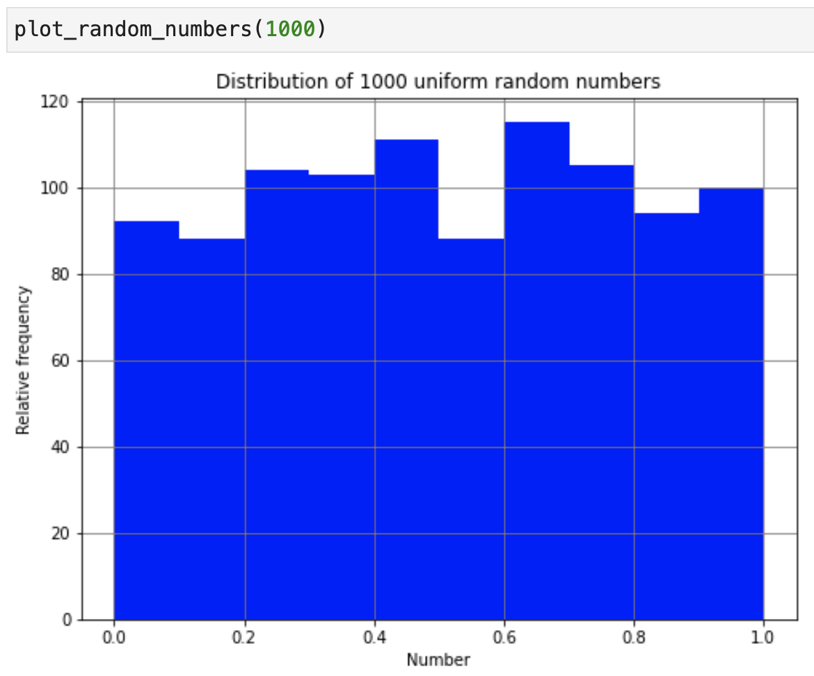
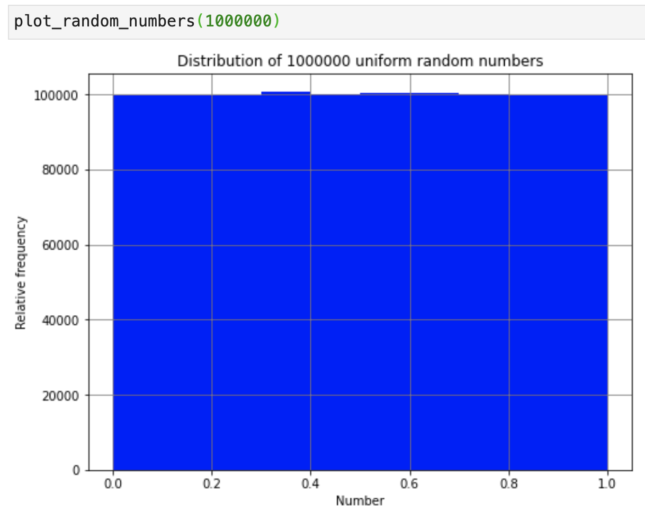
Lecture 10: Formative problem solutions (2)
Exercise 2: Investigate the distribution of random numbers as we increase the number of trials
  Numbers are spread uniformly between 0 and 1 → expect N_{trials} / N_{bins} in each bin on average
  But, since they are random, there is of course fluctuation around this average
  The more trials you run the less fluctuation there is
    In fact, the error on a given bin content N is approximately σ_{Ν} = √N (following the central limit theorem)
N_{trials} = 1000
N = 1000/10 = 100
σ_{N} = √100 = 10
σ_{N}/N = 10/100
= 10%
N_{trials} = 1e7
N = 1e7/10 = 1e6
σ_{N} = √1e6 = 1000
σ_{N}/N = 1000/1e6
= 0.1%

Slide 5
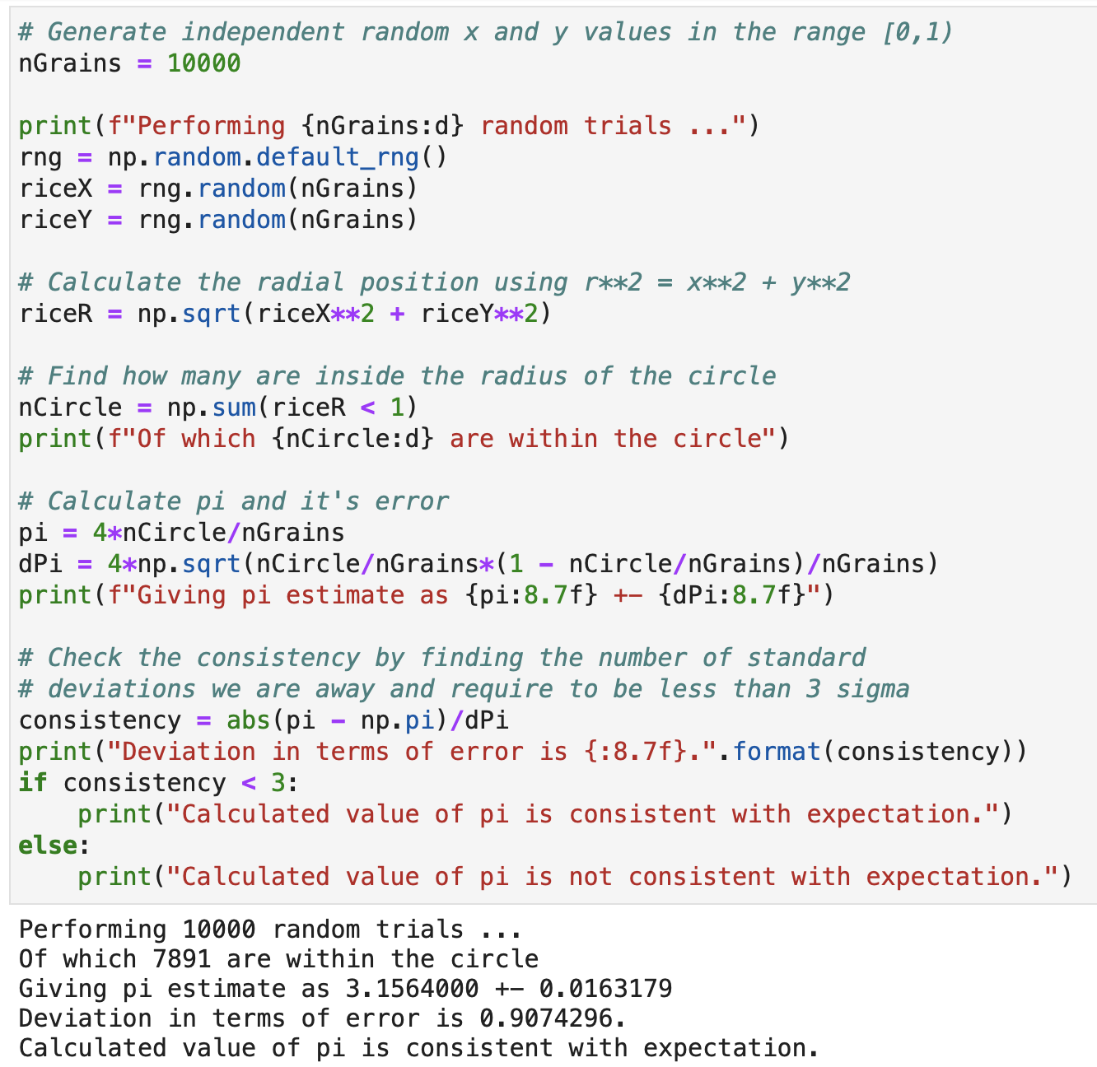
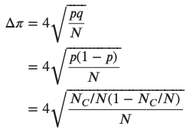

Lecture 10: Formative problem solutions (3)
Exercise 3: Determine the error on the MC estimate of π to see if it is consistent with
the known value
  For the error we simply code the derived formula into python using NumPy
  To check if it it consistent you need to use the consistency check we covered in lecture 6
p = probability of being within circle
q = probability of being outside circle

Slide 6
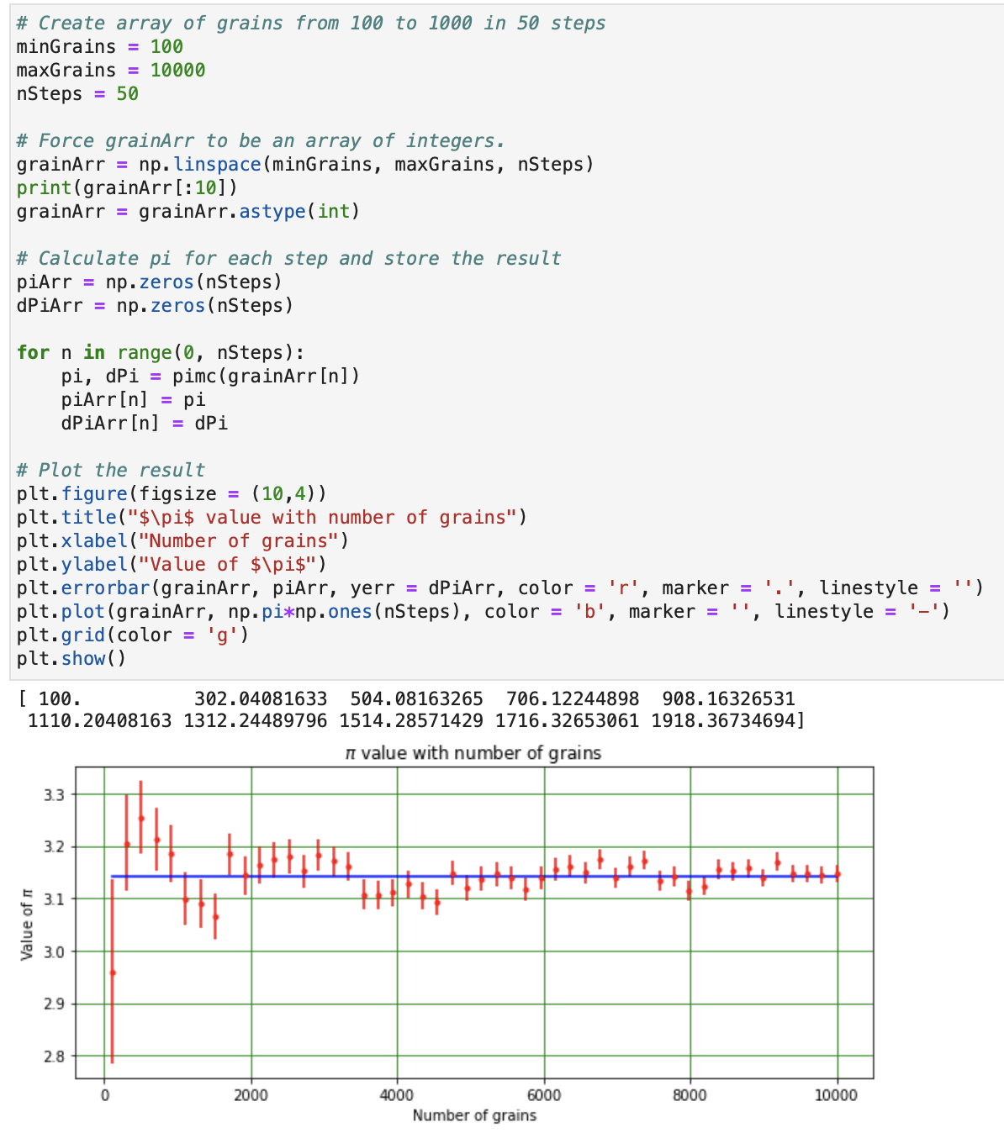
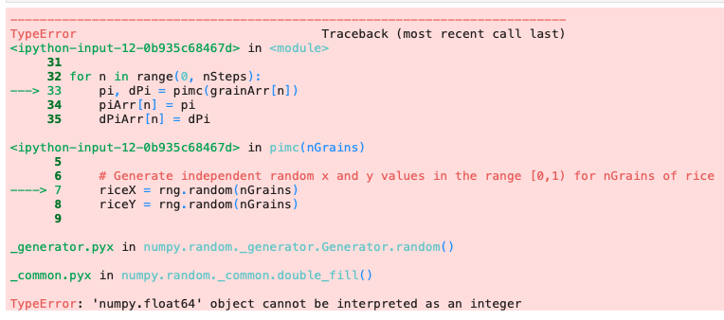
Lecture 10: Formative problem solutions (4)
Exercise 4: Fix the bug to plot the uncertainty on π versus the number of grains
  The issue is that the grainArr contains floats, while rng.random() expects ints → convert
    E.g. using astype(int) or int()
  Once fixed then we see that, as we should expect from Ex2, the more grains we throw
  the better our precision on the estimate of π
    i.e smaller uncertainty

Slide 7
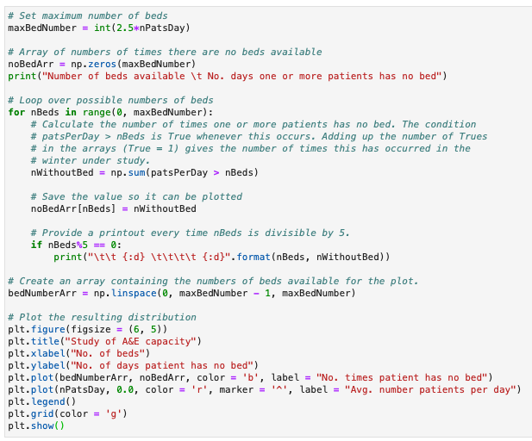
Lecture 10: Formative problem solutions (5)
Exercise 5: Add comments to the code, explaining each line of the for loop in particular

Slide 8
Moving beyond Jupyter notebooks
During the course, we have been writing our Python code exclusively in Jupyter notebooks
  Which are a great resource for learning + developing code interactively and disseminating the results
However, they also have some disadvantages, especially for writing longer programs
  Large notebooks can be messy and are slow to both open and run
  There is a large potential for conflicts between piece of code e.g. overwriting names
  You often need to run all the cells and the results may depend on the order in which they’re run
  If you want to reuse code elsewhere you have to copy-and-paste it into a new notebook
As you write more complex problems you will want to split things up into modular chunks
  Each of which does a specific task, allowing you to focus on the problem at hand
Also, going forward, you will increasingly want to reuse code you have developed
  Both code from within PHYS105 (e.g. fitting code) and also future courses
This doesn’t mean we need to give up on Jupyter notebooks entirely
  We can have the best of both worlds by moving reusable pieces of code into modules

Slide 9
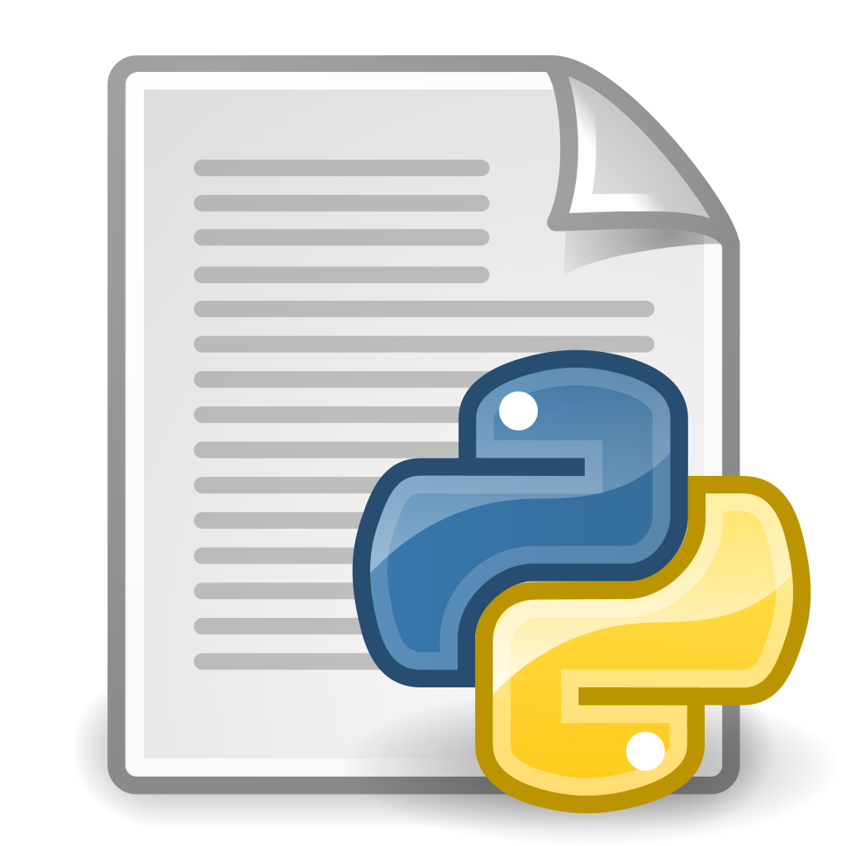


Python modules
Python allows us to write programs in a modular way by separating code into modules
This module approach has several advantages
  Simplicity: a module can focus on a particular
  problem or a small portion of a larger problem
  Maintainability: smaller chunks are easier to
  maintain and reduce the possibility of conflicts
  Reusability: the code we have written can be
  reused in many notebooks without duplicating
You have already used many Python modules
  Built-in modules e.g. math
  Third-part modules e.g numpy, scipy
  Modules I wrote e.g. LabModule
Will now see how you can write your own modules
  That you can add to and reuse in the future
Fitting
Plotting
import
import
import
import
Numerical
Another

Slide 10
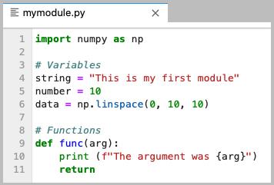
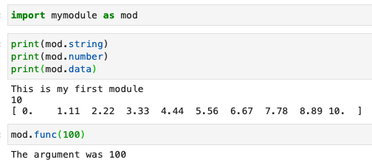
Creating your own module
Creating a python module is actually very easy
  It is just a file containing valid python code
  Written in any editor you like (inc. CoCalc)
  Saved with a .py file extension
It can contain variables, data structures, functions etc
  And can import and use other modules too
To use our module, we just place it
in our current working directory
  I.e. same directory as the notebook
We then simply import it, just like any of the other modules we have used
  Note: don’t include .py suffix

Slide 11
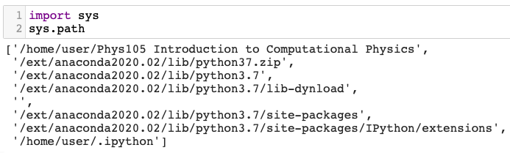
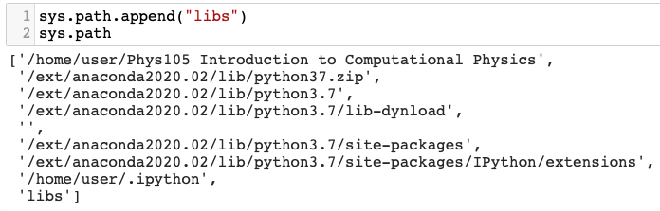
Finding the module
Having to keep our modules in the same directory as our notebook is not very useful
  Particularly if we want to be able to reuse these in other notebooks or places
Luckily, python has a way of specifying where
it looks for files not in the current directory
  Which is specified by the sys.path
By default, it contains a system-dependent
list of paths from your python installation
  But can append new paths, either relative
  or absolute, to it to add new locations
E.g. If we put our module in a libs directory
we simply add this directory to the sys.path
  Then can import is as if it’s in the current dir.
So can move useful code into a central module and simply import it into any notebook we want
Default CoCalc sys.path
Adding a new relative path

Slide 12
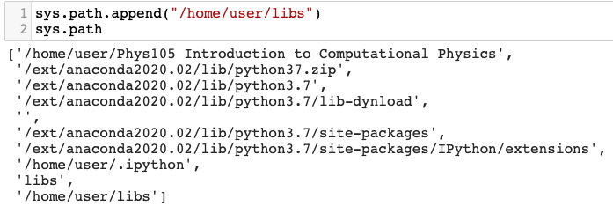
Finding the module
Having to keep our modules in the same directory as our notebook is not very useful
  Particularly if we want to be able to reuse these in other notebooks or places
Luckily, python has a way of specifying where
it looks for files not in the current directory
  Which is specified by the sys.path
By default, it contains a system-dependent
list of paths from your python installation
  But can append new paths, either relative
  or absolute, to it to add new locations
E.g. If we put our module in a libs directory
we simply add this directory to the sys.path
  Then can import is as if it’s in the current dir.
So can move useful code into a central module and simply import it into any notebook we want
Default CoCalc sys.path
Adding a new absolute path

Slide 13

Reminder of fitting
We perform fits to experimental data to determine the relationship between x and y
  Given the functional form, we can find the values of the unknown params that best describe the data
We determine the best fit by minimising the residuals
  i.e. the distance between the data point and the model
  prediction at that x value, divided by the point’s error
We performed the fit using the least-squares method
  Which is available from the scipy.optimize module
y
y = f(x, β)
y₅
r₅
y = f(x,β)= mx + c
y₄
r₄
→ χ²
y₃
r₃
y₁
y₂ – f(x,β)
r₁
r₂ =
σ_{y2}
y₂
error
c
x
x₁
x₂
x₃
x₄
x₅
Function computing point-by-point residuals to be minimised
Initial guess of free parameters
Tuple of input data (x, y, σ_{x}, σ_{y}) to minimise with respect to

Slide 14
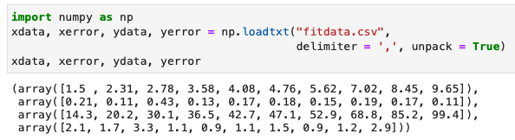
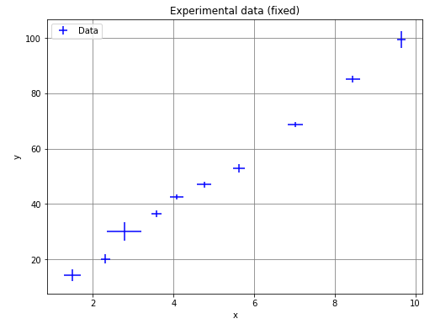
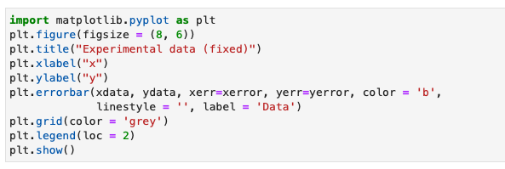
Fitting procedure steps
Read in your data, usually from a file
  Plot to check sensible
  And find initial params

Slide 15
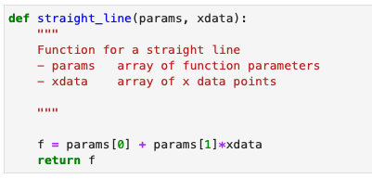
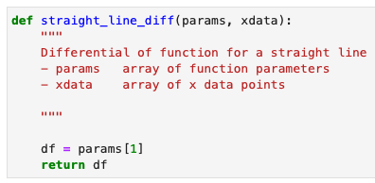
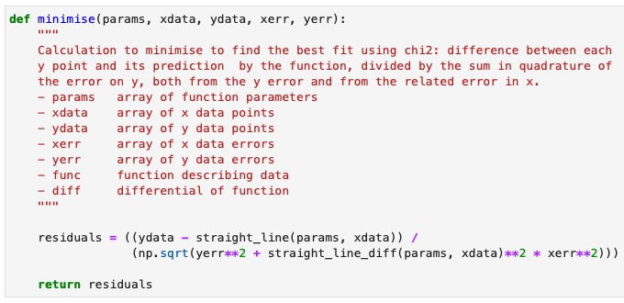

Fitting procedure steps
Read in your data, usually from a file
  Plot to check sensible
  And find initial params
Define the necessary functions
  Functional form and its differential
  Point-by-point residuals

Slide 16
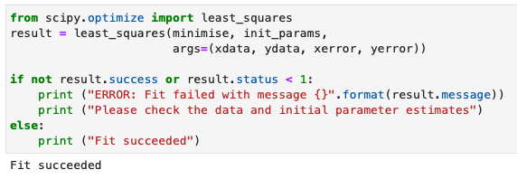

Fitting procedure steps
Read in your data, usually from a file
  Plot to check sensible
  And find initial params
Define the necessary functions
  Functional form and its differential
  Point-by-point residuals
Run least_squares() from scipy.optimize
  Check fit succeeds and get fitted params

Slide 17
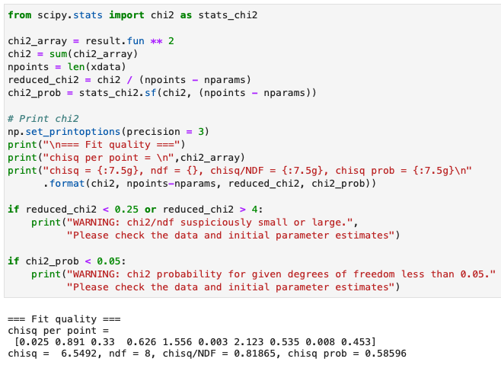
Fitting procedure steps
Read in your data, usually from a file
  Plot to check sensible
  And find initial params
Define the necessary functions
  Functional form and its differential
  Point-by-point residuals
Run least_squares() from scipy.optimize
  Check fit succeeds and get fitted params
Calculate χ² test statistic to check fit is good
  0.25 < χ²/NDF < 4 and/or χ² prob > 0.05

Slide 18
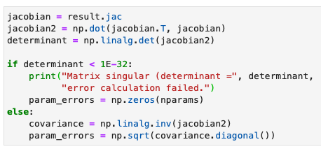
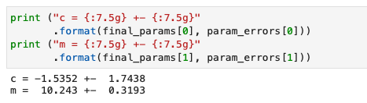
Fitting procedure steps
Read in your data, usually from a file
  Plot to check sensible
  And find initial params
Define the necessary functions
  Functional form and its differential
  Point-by-point residuals
Run least_squares() from scipy.optimize
  Check fit succeeds and get fitted params
Calculate χ² test statistic to check fit is good
  0.25 < χ²/NDF < 4 and/or χ² prob > 0.05
Calculate parameter errors from Jacobian
  Print best-fit parameters and associated error

Slide 19
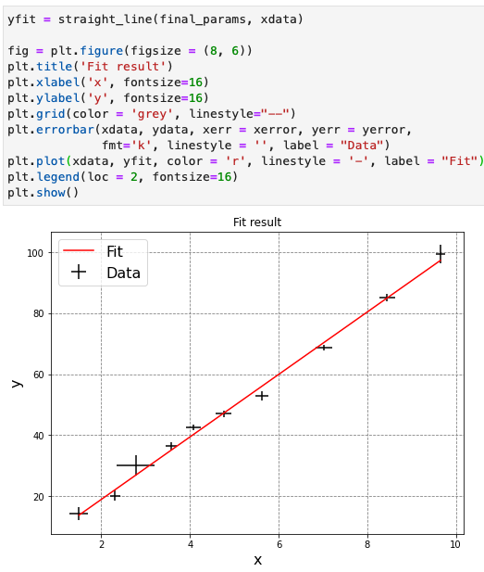
Fitting procedure steps
Read in your data, usually from a file
  Plot to check sensible
  And find initial params
Define the necessary functions
  Functional form and its differential
  Point-by-point residuals
Run least_squares() from scipy.optimize
  Check fit succeeds and get fitted params
Calculate χ² test statistic to check fit is good
  0.25 < χ²/NDF < 4 and/or χ² prob > 0.05
Calculate parameter errors from Jacobian
  Print best-fit parameters and associated error
Plot data and fitted function
  Passing best fit params to functional form
Note: no line connecting data points

Slide 20
Fitting procedure steps
Read in your data, usually from a file
  Plot to check sensible
  And find initial params
Define the necessary functions
  Functional form and its differential
  Point-by-point residuals
Run least_squares() from scipy.optimize
  Check fit succeeds and get fitted params
Calculate χ² test statistic to check fit is good
  0.25 < χ²/NDF < 4 and/or χ² prob > 0.05
Calculate parameter errors from Jacobian
  Print best-fit parameters and associated error
Plot data and fitted function
  Passing best fit params to functional form
Encapsulated into a reusable fit function in lecture 6
Note: no line connecting data points

Slide 21
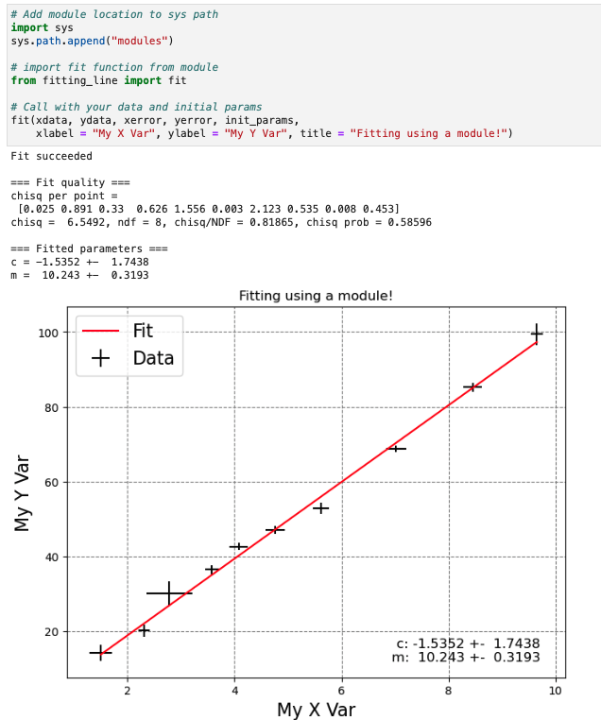
Fitting procedure steps
modules/fitting_line.py
Read in your data, usually from a file
  Plot to check sensible
  And find initial params
Define the necessary functions
  Functional form and its differential
  Point-by-point residuals
Run least_squares() from scipy.optimize
  Check fit succeeds and get fitted params
Calculate χ² test statistic to check fit is good
  0.25 < χ²/NDF < 4 and/or χ² prob > 0.05
Calculate parameter errors from Jacobian
  Print best-fit parameters and associated error
Plot data and fitted function
  Passing best fit params to functional form
Encapsulated into a reusable fit function in lecture 6 → now move to a module for future use !

Slide 22

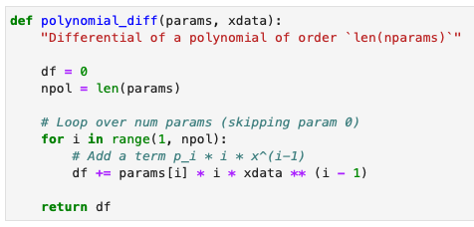
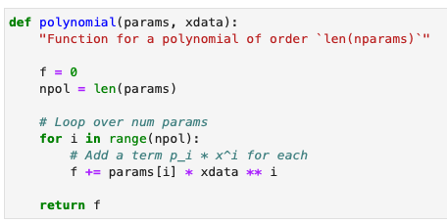

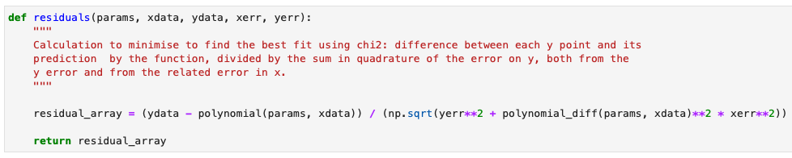
Extending fitting
So far, we’ve only looked at fitting straight lines, but it’s straight forward to extend to other cases
  Just need to know the function and its derivative
For example, we can easily extend our code to be able to fit a generic polynomial:

Slide 23
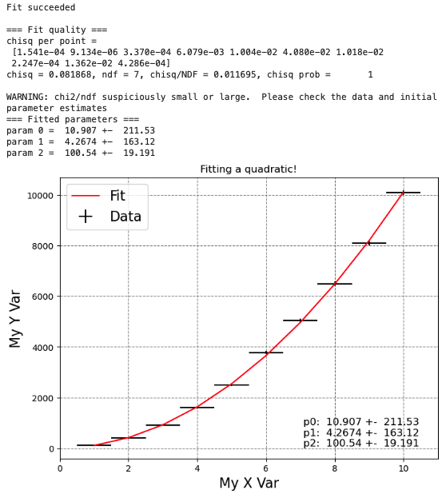
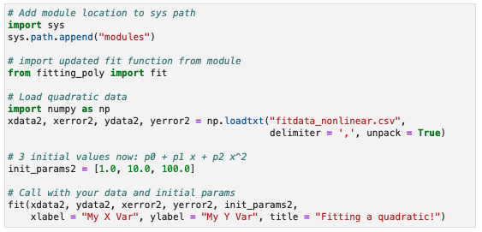
Polynomial fit
We can then update our module with these polynomial functions to make it more general
  modules/fitting_poly.py
Call it exactly as before
  Just remember to give the correct number of initial parameters for the functional form using
E.g. fit a quadratic:

Slide 24
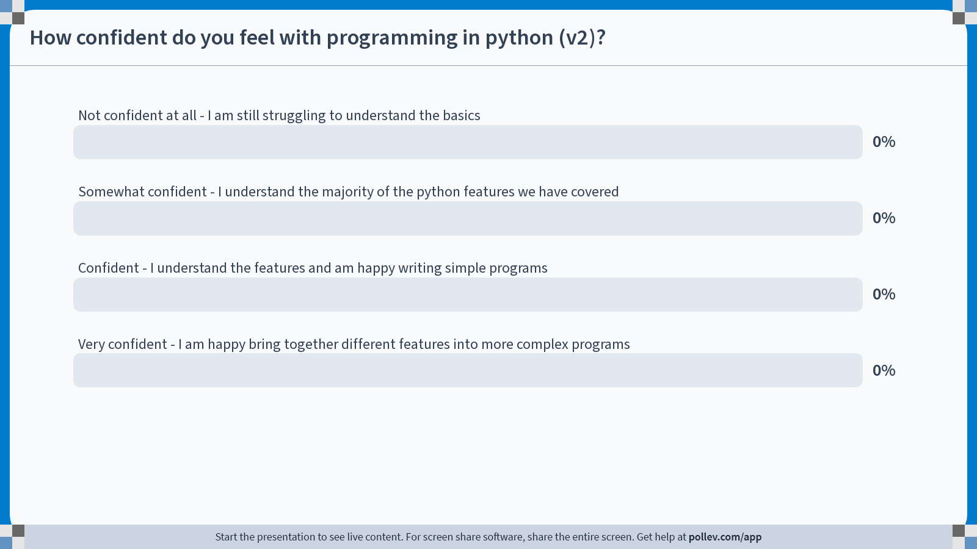
Notes:
Do not modify the notes in this section to avoid tampering with the Poll Everywhere activity.
More info at polleverywhere.com/support
How confident do you feel with programming in python (v2)?
https://www.polleverywhere.com/multiple_choice_polls/YMdt8VmjJEM0pUgltFs8V?state=opened&flow=Default&onscreen=persist

Slide 25

Summary
This week, we saw how to organise our code into modules, splitting it up & allowing it to be reused
  At the same time, we also reminded ourselves about fitting
That’s pretty much it for the PHYS105 course
  I hope it was enjoyable and useful!
You now know the basics of programming in python
  One of the most popular programming languages
Used this to model real-world (physics) problems
  Which you will use throughout your degree and beyond
As a bonus, you go away with a fitting module
  That you can reuse in labs + add to further
The second year Computational Physics (PHYS205) module will build on what you’ve learnt
  Allowing you to use python to undertake a project of your choosing.
Made in python using matplotlib
MerryXmas.ipynb

