Slide 1
Introduction to Computational Physics (PHYS105)
Lecture 10: Monte Carlo Methods
Carl Gwilliam
(C.Gwilliam@liverpool.ac.uk)
Attendance code: 737487
Notes:
RECORD + attendance code !!
Morning everyone
Please register your attendance
This week we are going to look at a new type of numeric technique known as Monte Carlo methods
As always, please feel free to interrupt with questions

Slide 2
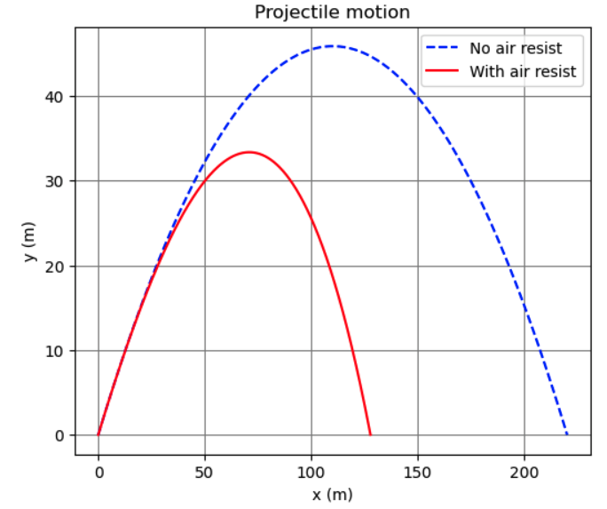
Lecture 9: Recap
Last week we looked at a real-world physics problem
  Which could not be solved analytically
We were able to solve this using Euler’s method
  Basically, just splitting it up into small steps
    Such that angle is constant for each
  Then iterating over the steps
    Taking values from end of previous step as input
Not only did this let you utilise numeric techniques
  It also allowed you to practice writing (+ debugging!)
  larger programs that use all the python we’ve learnt
In doing so we saw again the power of NumPy
This week we’ll look at another type of numerical technique: so-called Monte Carlo methods
Going from idealised situation to real world
Notes:
Before starting on this week’s material let’s first recap last week, where we looked at a real-world physics problem, projectile motion with air resistance, which …
As mentioned, this week, this week we’ll look at …

Slide 3
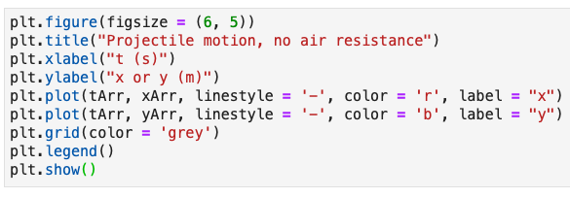
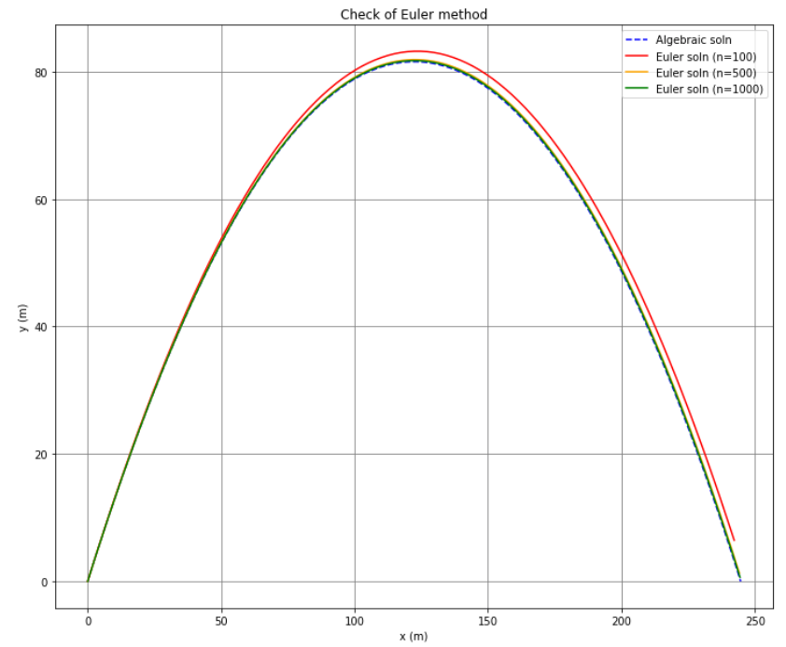
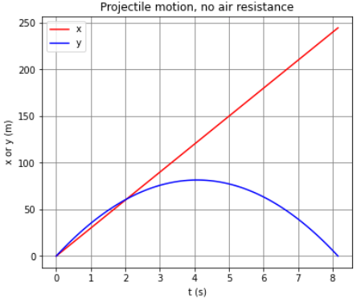
Lecture 9: Formative problem solutions
Ex 1: plot both x and y as function of t
  Recap of simple matplotlib plotting
Ex 2: Test that Euler’s method works as expected + determine min number of steps
  Testing is a key part of programming
  Easiest way is to check with cases where you know the answer → here, we know the analytic solution for case of no resistance
    So set C_{D} = 0 and compare to our analytic result
Numeric result is similar to analytic one and can’t tell difference by eye for more than about 1000 steps
Notes:
First though, we will now look at the solutions to last week’s formative problems
Ex1: was to plot both the x and y positions as a function of time as a recap of our matplotlib plotting techniques
As usual we create a figure and give it a title and axis labels, remembering the units
We then call plot twice, each time giving it the time-array as the x values, and then either the x or y position as the y values
We then call show, remembering to include the legend
The results, shown here, make sense since in the vertical direction the projectile goes up and comes back down as time progresses, while in the horizontal direction it just gets further away with time
Ex2: Was to test Euler’s method worked as expected and determine the minimum number of steps needed
Testing is an important part of programming and this exercise was to get you thinking about how to do that
A good way to do this is to test in cases where we know the answer
For numeric methods this often involves comparing to known analytic solutions for certain restricted cases
So, in this case we know the analytic solution for the case of no air resistance and if it is doing the correct thing the numerical method better be able to reproduce that if we turn the air resistance off
To do this we can just simply set our drag coefficient to 0 (or equivalently the area or air resistance to 0) so there is no drag force
Here I have plotted the result for the no air-resistance case for different numbers of steps compared to the analytic solution
You can see that the numeric result reproduces the analytic one and for more than 1000 steps or so we can’t tell the two apart by eye
Of course, in the real world we would use some compatibility test to compare the two and the level of agreement we require will depend on the accuracy we need

Slide 4
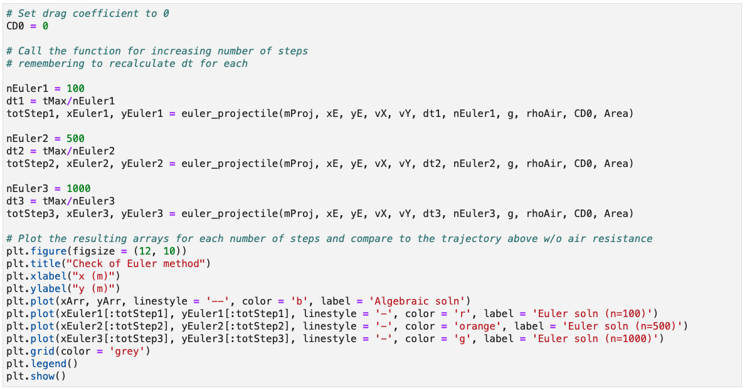
Lecture 9: Formative problem solutions (2)
Ex 2 (cont.): Here we see again the advantage of using functions as reusable building blocks
  You need to remember to recalculate dt each time as depends on number of steps
Notes:
To make this plot we simply call the function 3 times with different numbers of steps
No forgetting to update the time step dt
See the advantage of functions as reusable blocks of code

Slide 5
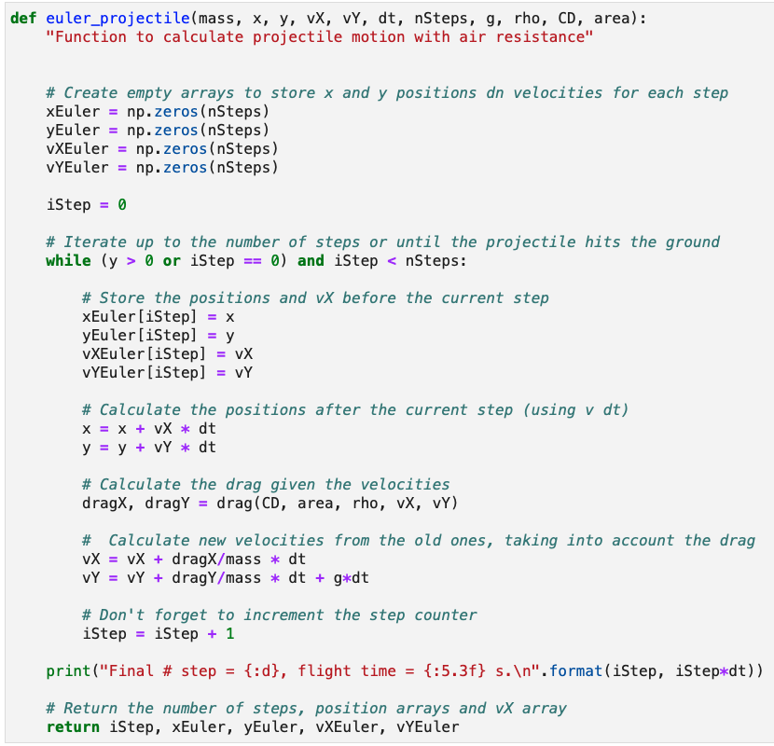
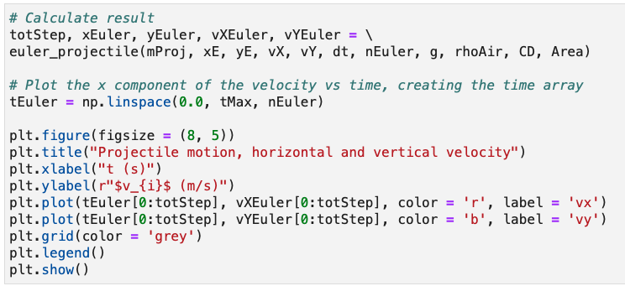
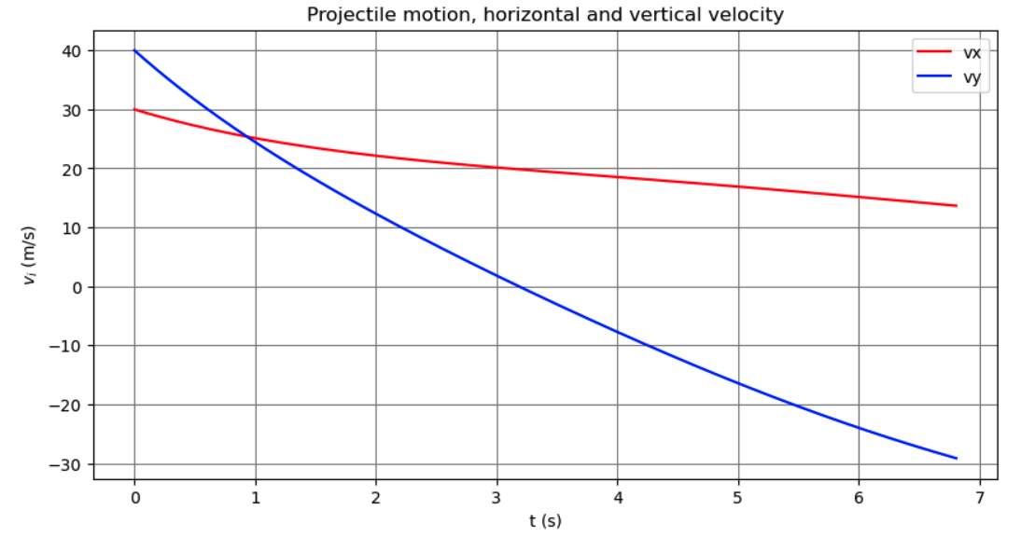
Lecture 9: Formative problem solutions (3)
Exercise 3: Plot both horizontal and vertical components of velocity (on the same plot)
Add array for v_{Y}
Extra call to plot() with tEuler & now vYEuler
Store value of v_{Y} each loop
Return vYEuler array
Notes:
Ex3: was to plot the horizontal and vertical components of the velocity on one plot
First you had to calculate the vertical velocity by mimicking what was done for the horizontal case
We add an array before the loop to store the resulting values (point)
And then we simply add the velocity component to it during the loop (point)
And add the array to the return values
Then we call plot again, this time with the time vs the y-velocity component, to add an extra line to the plot
Again, the result makes sense since in the vertical direction we have a larger force acting against the projectile, due to the extra gravitational force on top of the drag, so the velocity decreases faster

Slide 6
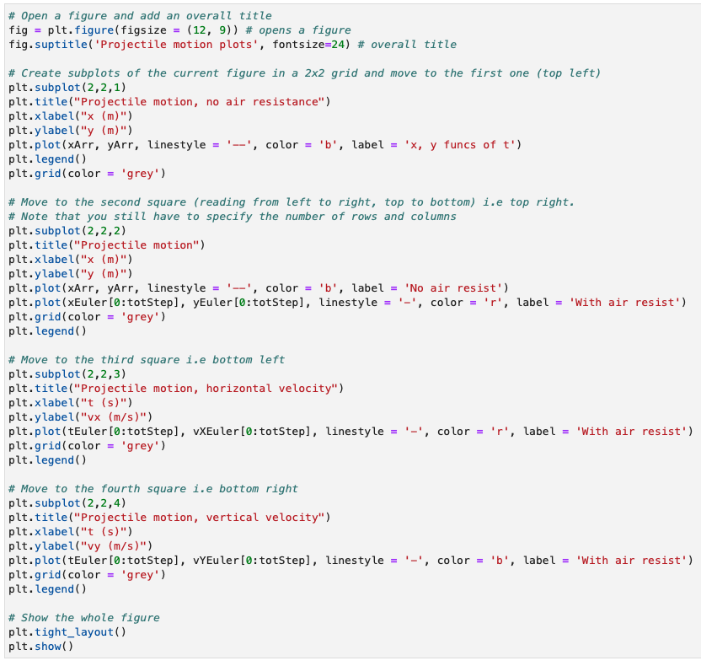
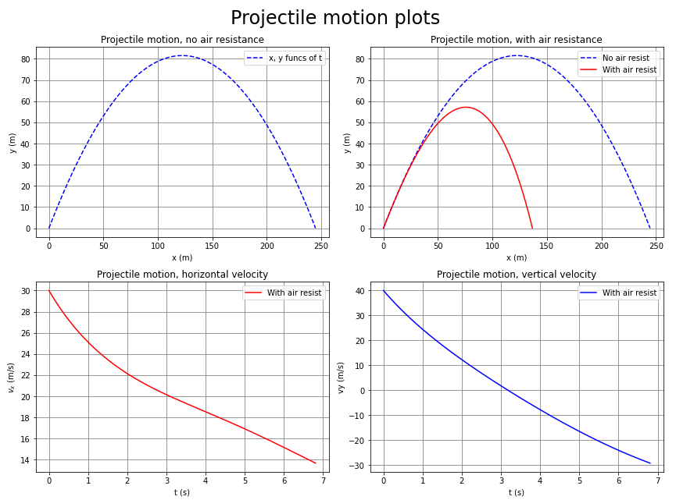
Lecture 9: Formative problem solutions (4)
Exercise 4: Plotting multiple subplots in one
figure → add a fourth plot to show v_{y}
  Copy v_{X} code but change to subplot(2,2,4)
  Key point is this comes before calling show()
Notes:
Ex4: The final exercise was showing you how to plot multiple subplots next to each other, which is often useful to present the full information about a result
Such as the position and the two velocity components
To add a fourth plot, we can simply copy the code, just changing the last argument of the subplot so we are plotting on the fourth area of our grid (point)
Remembering that the first two numbers in subplot are just the total number of plots we want in x and y
Of course, we also have to change what we are plotting
The key point with subplots is that we make a single figure, then call subplot as many times as we want
This must be done before finally calling show() once for the entire figure
Any questions on the formative problems?
The Lecture 9 results have been released on canvas, with an average mark of 71%

Slide 7

Monte Carlo (MC) methods
So far, the numeric methods we have used,
while approximate, are fully deterministic
  This means the result is predictable: given the same input we always get the same result
Monte Carlo methods are an alternate way to
get numerical results using random sampling
  In other words, by performing a set of random trials, or experiments, many times
Although the underlying process is random
we can still get a deterministic prediction
  Provided we perform a sufficiently large
  number of trials or experiments
Particularly useful for problems with large dimensionality, where other methods struggle
  E.g. (Multi-dimensional) Integration & simulation
The Monte Carlo Casino in Monaco
Notes:
Read
Monte Carlo methods (linked here), which are named after the famous Monte Carlo casino, …

Slide 8
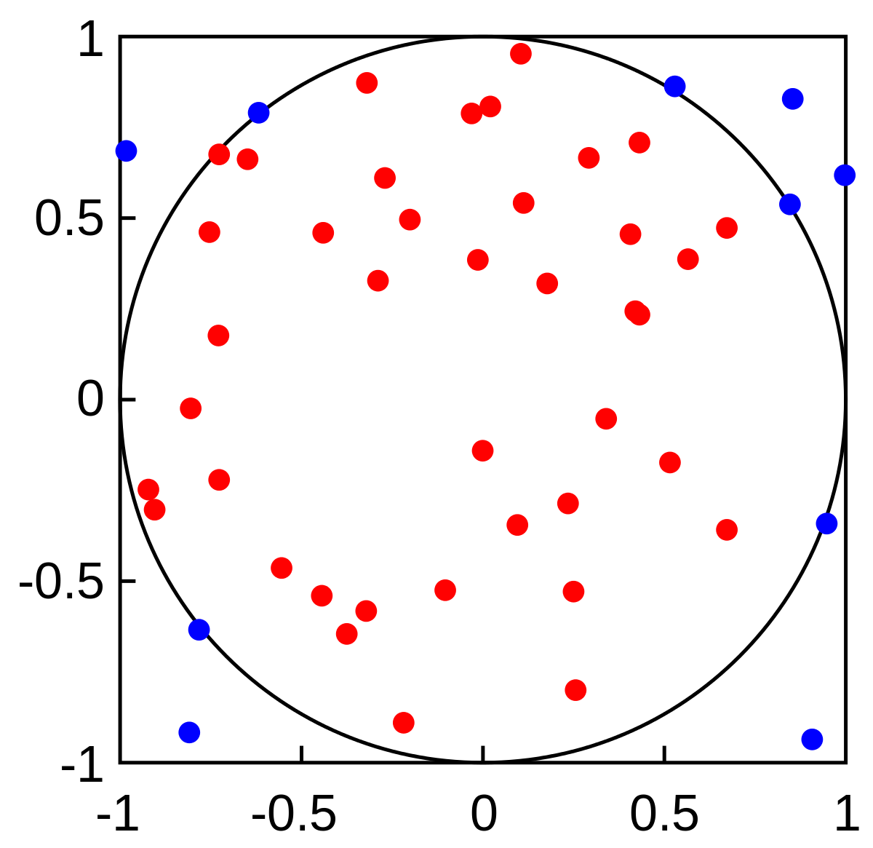
General idea
In simple terms, the Monte Carlo method can be summarised by the following general steps
  Define the range over which our inputs might possibly lie
  Generate many random inputs over that range
  Perform a deterministic computation on the inputs
  Use this to calculate the desired result
For example, consider the following experiment
  Draw a square on the ground, then inscribe a circle within it
  Uniformly scatter grains of rice over it
  Count the number of grains inside the circle
  Take the ratio of this to the total number of grains
The ratio will be equal to the ratio of the square and circle areas
  Hence, if know the square area, we can calculate the area of the circle
  This method may have been used by ancient Persian mathematicians
This idea can be extended to higher dimensions to e.g. calculate multi-dimensional integrals
A_{circle}
N( )
=
A_{square}
N( ) + N ( )
Notes:
Read first bullet
This likely doesn’t make much sense w/o context, so lets look at an example …
Consider the following experiment
… within it, that is centred on the middle of the square and just fits within it (point)
We then uniformly …. over it, for example by throwing them from a large height → random part
After doing so, we count … inside the circle (shown in red)
… and take … grains both inside (red) and outside (blue) the circle → deterministic part
The ratio of these two will, of course, … areas (point to equation)
Read last bullet
Any questions on the general idea?

Slide 9
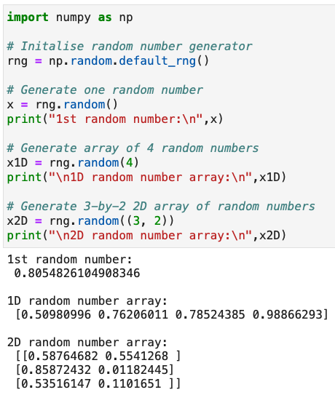
NumPy random numbers
Rather than performing real experiments, we
can use random numbers generated in Python
Can be achieved using NumPy’s random module
  Has several random number generators
Default uses Mersenne Twister algorithm
  Has a repetition period of 2¹⁹⁹³⁷ – 1
Obtained via np.random.default_rng()
  Can optionally specify the starting point
  in the sequence via a seed as argument
    Useful to get repeatable sequence
The basic random() function generates uniform
random numbers x over the range 0 ≤ x < 1
  Either one value at a time or as an array
Notes:
Read first bullet
The easiest way to do this is to use Numpy’s random module, linked here, which has several types of random number generator
We will stick with the default one which uses an algorithm known as the Mersenne Twister (also linked) to generate random numbers
The numbers are not completely random as after a certain time the sequence will begin repeating
But for Numpy’s implementation of the Mersenne Twister this doesn’t happen until we have drawn 2^19937 – 1 random numbers
So for our cases, we’ll probably be OK :D
Once we have imported numpy (point) we can obtain the random number generator by simply calling np.random and then the default_rng() function (point)
Here, rng stands for random number generator
As you will see in the notebook, you can also specify the starting point in the sequence, known as the seed, as an argument
Which is useful to get repeatable sequences for comparisons or debugging
The generator can produce random numbers following various distributions.
The most basic example is the random() function which generates random numbers uniformly, like the grains of rice in our previous example, over the range from 0 to 1
If we call this with no argument we get a single random number in that range (point)
If we call it with an argument we get an array of that many random numbers (point), for example 4 here
We can even pass it a tuple of numbers, in which case we get an n-dimensional array with the given number of random numbers in each dimension
For example a 3x2 array of random numbers here
Show that changes each time it is run → Random

Slide 10
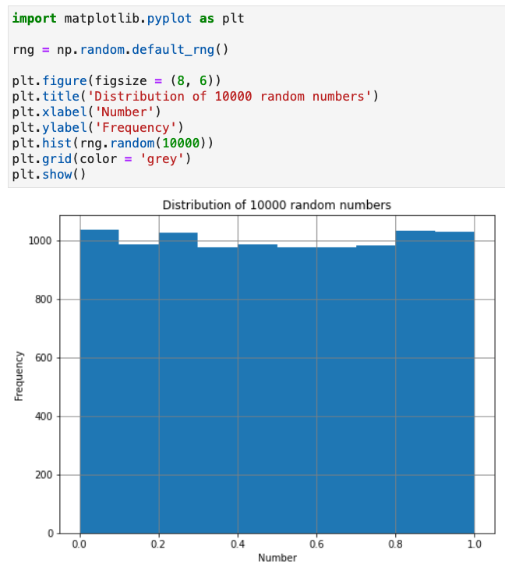
NumPy random numbers
Rather than performing real experiments, we
can use random numbers generated in Python
Can be achieved using NumPy’s random module
  Has several random number generators
Default uses Mersenne Twister algorithm
  Has a repetition period of 2¹⁹⁹³⁷ – 1
Obtained via np.random.default_rng()
  Can optionally specify the starting point
  in the sequence via a seed as argument
    Useful to get repeatable sequence
The basic random() function generates uniform
random numbers x over the range 0 ≤ x < 1
  Either one value at a time or as an array
Notes:
If we generate a large enough set of random numbers, for example 10k here (point), and plot the result, we can see that they are indeed uniformly spread between 0 and 1
You will investigate this more in the notebook
Any questions on the notion of random numbers?

Slide 11
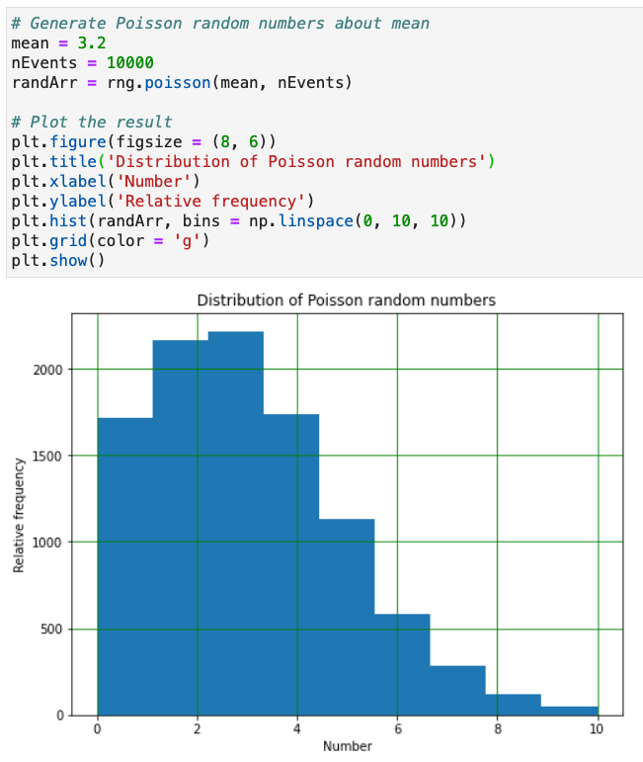

Poisson distribution
Poisson distribution describes the probability that a given number of events occurs in a fixed interval
  Events are discrete and can be over time or space
Assuming events are independent of each other, the probability of seeing x events in the interval is
  Where λ is the known mean rate, which is constant
Can generate random numbers following this via the numpy.random module’s poisson() function
  Takes mean and number of events as arguments
Examples:
  Number of cars passing a given point per minute
  Number of traffic accidents on a given road per mile
Notes:
In addition to being able to produce random numbers uniformly, we can generate them following several other distributions
We will look at a couple of these that are particularly useful for modelling physics problems and which you saw in your PHYS106 lectures
The first of these is the Poisson distribution, which .... given number of DISCRETE events, occur over a given internal in time or space
This can be used to model, for example, the… (read examples)
Assuming … interval, given we know the mean rate (lambda) which is constant, is given by this formula:
The exponential of minus the mean (lambda) times the mean raised to the power of the number of events we are interested in (x), divided by the factorial of the number of events
You will have seen this in the stats lectures and also e.g the radiation experiment if you have done that
For example, if the mean number of cars passing a given point on a road is 3.2 per minute, the numbers measured each minute will follow a Poisson distribution with lambda = 3.2 as the mean
We can generate random numbers following this distribution simply using the poisson() function from the numpy random module, in a similar way to the uniform() function we saw on the previous slide
As well as the number of events to generate it now also takes the mean as an input argument (point)
So, for our car example, if we wanted to model how many cars we’d see each minute we’d call this with 3.2 as the mean and the numbers we get each minute might be 2, 3, 2, 5, 4 etc
In the plot here I have plotted 10k such events and the result is distributed asymmetrically around the mean with a tail to small and larger numbers
So, while our number of cars each minute is often round the mean it may sometimes be as low as 0 (point) or a high as 10 or more (point)

Slide 12
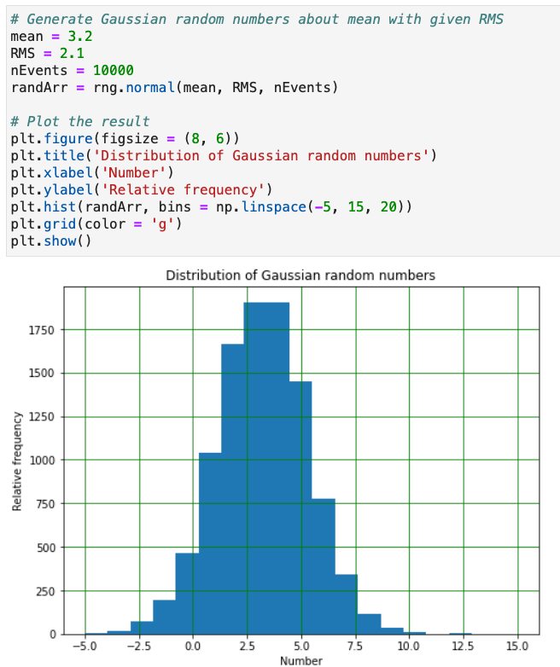

Gaussian (or Normal) distribution
The Gaussian (or Normal) distribution describes the probability of a continuous value x based on the mean value (μ) and its RMS spread (σ)
  Has a characteristic symmetric bell shape
Based on the Central Limit Theorem, the result
of any sufficiently large number of random trials
tends towards a Gaussian distribution
  Hence it can describe many natural phenomena
  E.g. heights/weights/IQs/etc of a population
Can generate random numbers following this via
the numpy.random module’s normal() function
  Takes mean, RMS & number of events as arguments
Notes:
Another useful distribution is the Gaussian, or Normal, distribution that we have already encountered several times in the course
This distribution describes the probability of a value x that is now continuous, rather than discrete as in the Poisson case
Given a known mean value (mu) and an RMS spread (sigma) the probability of seeing a given value x is described by the formula we have seen previously
Which has a characteristic bell shape
The CLT, linked here, tell us is that the result of any …
(read subbullets)
We can generate random numbers following a Gaussian distribution using the normal() function, which takes the mean, RMS and number of events (point) as arguments.
Here I have picked a mean of 3.2 again and an RMS of 2.1 and again generated 10k events
We can see the result is a distribution around the mean which now, unlike the Poisson case, is symmetric.
Any questions on random numbers?

Slide 13


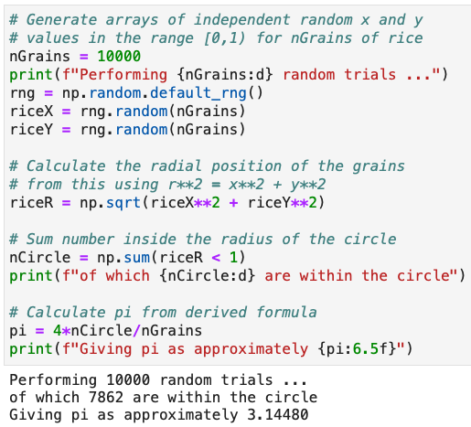
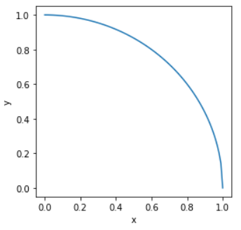
Monte Carlo integration
Let’s return to our earlier circle area example and use it to estimate the value of π numerically
  Specifically consider the case of a 2x2m square with an inscribed circle of radius 1m
We can code this in python and since the problem
is symmetrical we only need to model 1 quadrant
  Use random number
  generator to create
  indep. random nums
  uniformly in x and y
  Count how many lie
  within the circle
The more random trials
the more accurate π is
  Will investigate this
  in the notebook
r = 1 m
Notes:
Now that we know how to generate random numbers in python, let’s return to our circle example
And consider specifically a case of a 2x2m square with a inscribed circle of radius 1m
We know that the ratio of the number of grains in the circle to the total number is the ratio of the area of the circle and the square
Which for this specific case it is obviously pi x 1m^2 divided by x 2x2m
So, the result is pi/4, which can be rearranged to estimate pi numerically
Rather than throwing grains of rice we can now use our Python uniform random number generator to produce random x and y positions
Since the problem is symmetric we can cut it down to just doing one quadrant, as shown here, which aligns with numpy’s random range 0->1
So, lets see how we would code this up (point to each piece)
We get our default random number generator, that we will call rng
We then call the random function twice, each with 10k trials, to generate independent random distributions of the x and y positions
We can calculate the radial position for each of these x-y points using Pythagoras
We then use numpy’s array-at-a-time functionality to find only those with a radius below 1m i.e. in the circle and sum this (T = 1, F = 0)
Following our formula we then take 4 times the ratio of the number of trials inside the circle to the total number of generated trials
And, for 10k trails, we get pi as 3.1448 (point)
Will change each time as random
(switch slide)

Slide 14
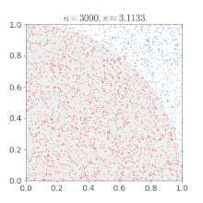
Monte Carlo integration
Let’s return to our earlier circle area example and use it to estimate the value of π numerically
  Specifically consider the case of a 2x2m square with an inscribed circle of radius 1m
We can code this in python and since the problem
is symmetrical we only need to model 1 quadrant
  Use random number
  generator to create
  indep. random nums
  uniformly in x and y
  Count how many lie
  within the circle
The more random trials
the more accurate π is
  Will investigate this
  in the notebook
Notes:
Of course, the more trails we perform (i.e. generating more random numbers) the more we fill out the two areas (as shown here – point) and the more accurate the result (point)
You will investigate the accuracy of our estimate and how it improves with more trails in the notebook
Any questions on MC integration?

Slide 15
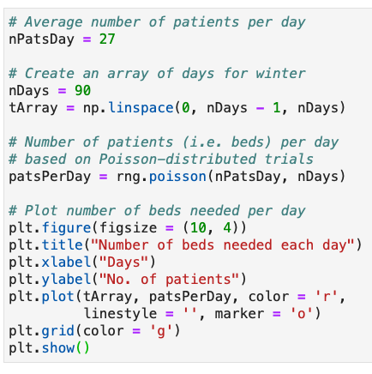
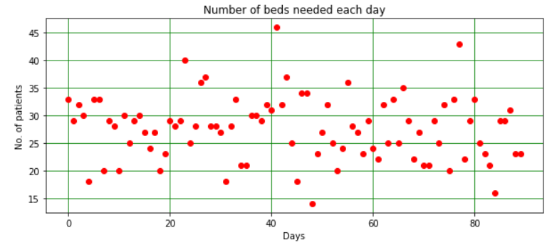
Monte Carlo simulation
Let’s now look at simulating the number of A&E beds needed in the Liverpool Royal Hospital
  Given that records show the average number of people requiring a bed is 27/day in winter
  Assuming that after 1 day, each A&E patient is moved to another ward to simplify the problem
We can model this using a Poisson distribution
  We know the average number of patients
  Can use this to find expected number of patients
  (and hence beds) needed, each winter’s day
Notes:
Let’s now look at a different type of problem where, instead of integration, we use Monte Carlo to start to simulate a real-life problem
The problem we will look at is estimating the number of A&E beds needed in the Liverpool Royal Hospital. Record show that …
To simplify the problem we will assume that … ward
Given we know the mean rate, we can use our Poisson distribution to model the number of patients, which we can use to find … day.
We first setup a variable for our average number of patients per day (point)
We then create an array of the number of days from 0 to 90, which is the number of days in a meteorological winter, using linspace (point)
We then use NumPy’s Poisson function, passing our mean and the number of days as arguments, to get the corresponding array of patients per day (point)
If we then plot this vs the time (point) we get this plot which shows the number of patients per day over the winter
Which as expected fluctuates around the mean of 27
If you project this onto the y axis, which you will do in the notebook, you will see that it follows a Poisson distribution

Slide 16
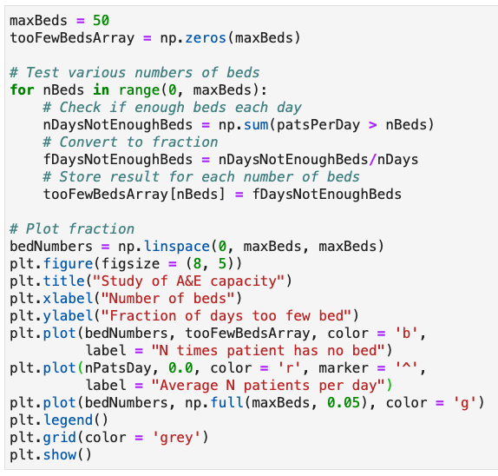
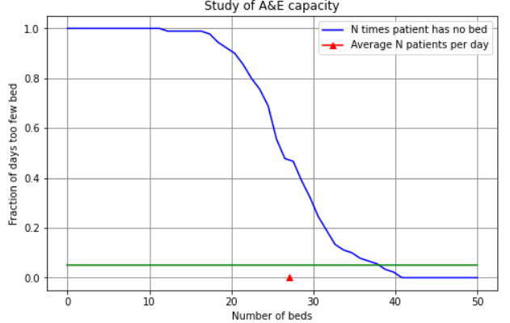
Monte Carlo simulation (2)
Suppose the hospital manager asks how many A&E beds they need so they never run out?
  Not a well-formed problem: even an enormous
  number of beds will one day be too few
  Need to make it more quantitative: let's say we
  want enough beds 95% of the time (i.e. 2σ)
We can test the above distribution of patients
against a range of different numbers of beds
  And see what fraction of the times we run out
Need 38 beds
this winter
But what about next winter & the ones after?
Notes:
Now we can use this to predict things. Suppose …
The first thing is that this is not a … few, for example during an unexpected pandemic!
To make it more quantitative lets say we want enough beds 95% of the time (which is 2 sigma)
Of course, in reality we probably want this to be much higher e.g. 99% (or 3 sigma) and you will use this in the notebook but I use 2 sigma here just so I need to generate less trials
To do this we can test our distribution of patients we created above against a range of number of available beds and … out in each case
So let’s write some code to do this ….
Let’s test a number of beds from 0 up to a maximum number of 50 (point)
We first set up an array of this length to store the results for each number of beds we are going to test
We then want to test the various number of beds so we use a for loop to iterate over the range from 0 to our max number of 50
For each number of beds, we use numpy’s array-at-a-time methods to see on how many days our random number of patients exceeds this number and sum this up
We then divide this by the total number of days to find the fraction of days where we don’t have enough beds and store this in our results array
We can then plot the results
We create an array of beds from 0 to 50 using linspace, and then plot our result against this
I also mark the mean number of patients and draw a line at 5%
From the resulting plot we can see that as we increase the number of beds available we reduce the fraction of days we run out of beds as expected
Which passes 50% when we are at the average
And goes below 5% at 38 beds
So we would need 38 beds to have enough beds 95% of the time
But this is only for this winter. What about the next one and the ones after this?
We clearly need to simulate more winters to be sure and again you will investigate this in the notebook.
Any questions on MC simulation?

Slide 17

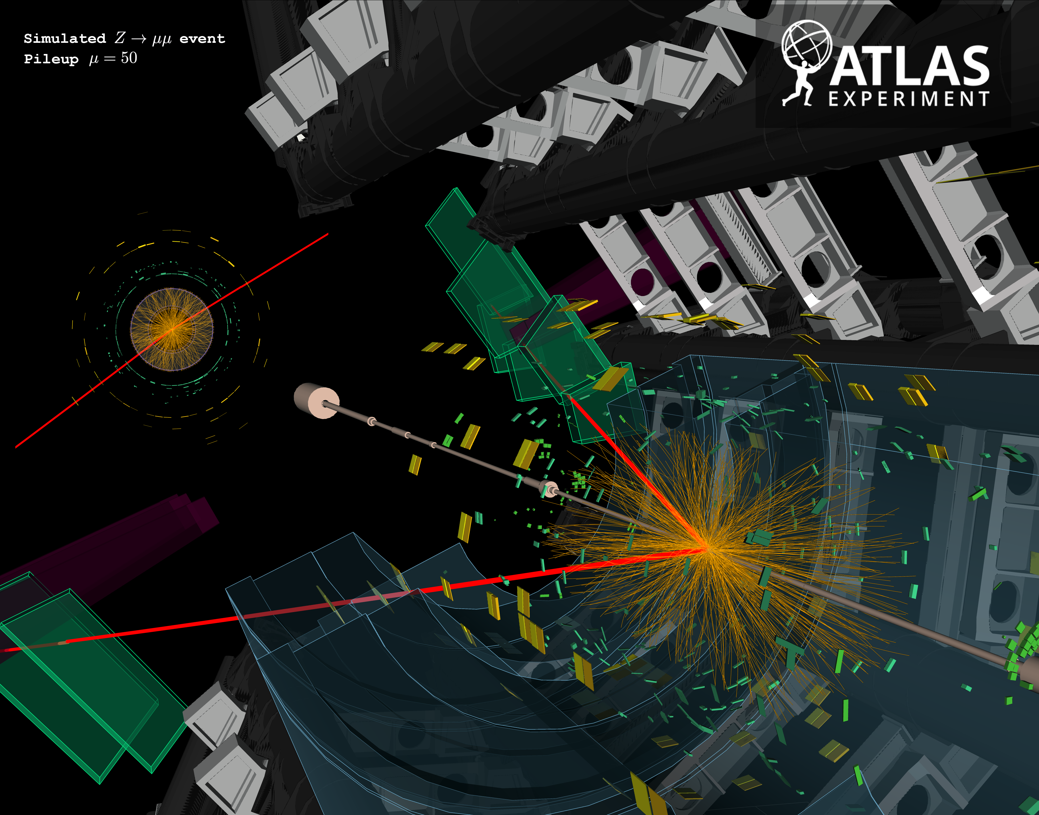
Physics Monte Carlo simulation
Monte Carlo are used extensively in physics
  Across many domains
Especially particle physics
  To simulate particle production + interaction with the detector
  E.g ATLAS Z → μμ event
Millions of lines of code
  Producing billions of simulated events/year
You will look at a simple example of a gas particle
in this week’s notebook
Notes:
Such MC method are … domains
This is especially true in my research area of particle physics, where they are used to … detector
For example, this is a display of a simulated decay of a Z boson to two muons, shown by the red lines, in the ATLAS detector at the LHC
Each of the orange lines shows a charged particle track and each of the yellow and green blocks a calorimeter energy deposit
Monte Carlo is used to generate each of these particles and simulate the interactions with the material of the detector
As you might expect, this is a very complex simulation and in fact takes millions of lines of code
ATLAS uses this to produce huge numbers of such simulated events: over a billion per year
Of course, you won’t code anything this complex, but you will look at a simple example of simulating a single gas particle in this week’s notebook

Slide 18
Summary
This week we looked at MC: a different type of numeric method based on random trials
  Which can be very useful in cases of large dimensions, particularly for integration and simulation
In doing so we introduced Python’s random number generators
  Seeing how to generate trials following different distributions
In the notebook, you will look further at the examples we started in the lectures
  And then, as said, simulate the motion of a simple gas particle
Reminder: answers must be your own, individual work and not created using generative AI
  Suspected breaches are taken seriously and can have severe consequences (up to being expelled
  from the course) as detailed in COPA Appendix L,
  Even first offence can be zero in the assignment and a written warning
Next week we will revisit fitting and pull things together into your own python module
  That you can use In lab going forward and continue to add to over time
Notes:
So in summary …
Any final questions?

