Slide 1
Introduction to Computational Physics (PHYS105)
Lecture 10: Monte Carlo Methods
Carl Gwilliam
(C.Gwilliam@liverpool.ac.uk)

Slide 2
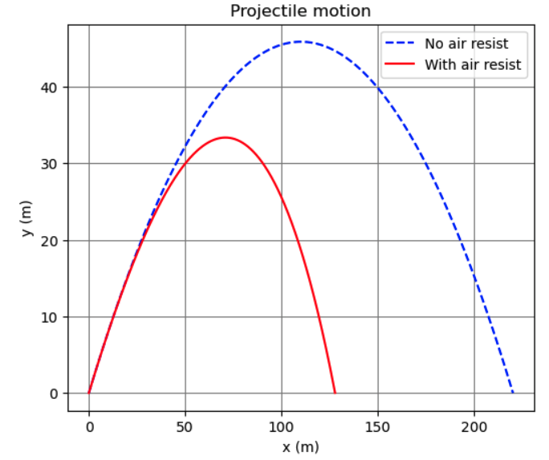
Lecture 9: Recap
Last week we looked at a real-world physics problem
  Which could not be solved analytically
We were able to solve this using Euler’s method
  Basically, just splitting it up into small steps
    Such that angle is constant for each
  Then iterating over the steps
    Taking values from end of previous step as input
Not only did this let you utilise numeric techniques
  It also allowed you to practice writing (+ debugging!)
  larger programs that use all the python we’ve learnt
In doing so we saw again the power of NumPy
This week we’ll look at another type of numerical technique: so-called Monte Carlo methods
Going from idealised situation to real world

Slide 3
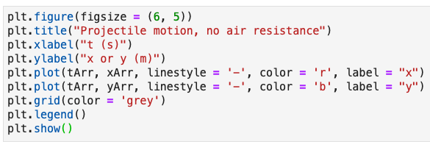
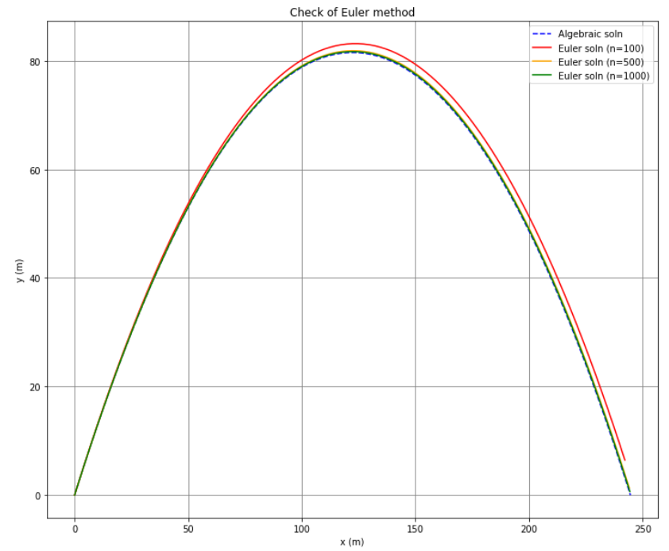
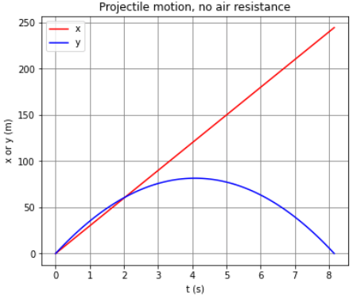
Lecture 9: Formative problem solutions
Ex 1: plot both x and y as function of t
  Recap of simple matplotlib plotting
Ex 2: Test that Euler’s method works as expected + determine min number of steps
  Testing is a key part of programming
  Easiest way is to check with cases where you know the answer → here, we know the analytic solution for case of no resistance
    So set C_{D} = 0 and compare to our analytic result
Numeric result is similar to analytic one and can’t tell difference by eye for more than about 1000 steps

Slide 4
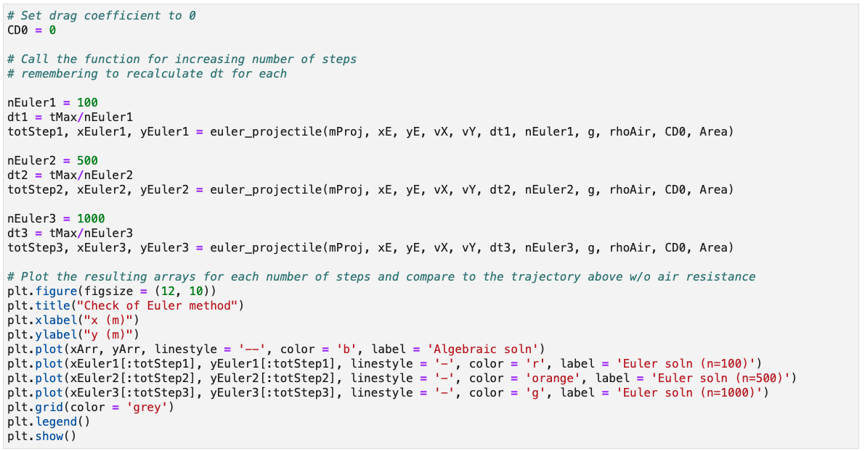
Lecture 9: Formative problem solutions (2)
Ex 2 (cont.): Here we see again the advantage of using functions as reusable building blocks
  You need to remember to recalculate dt each time as depends on number of steps

Slide 5
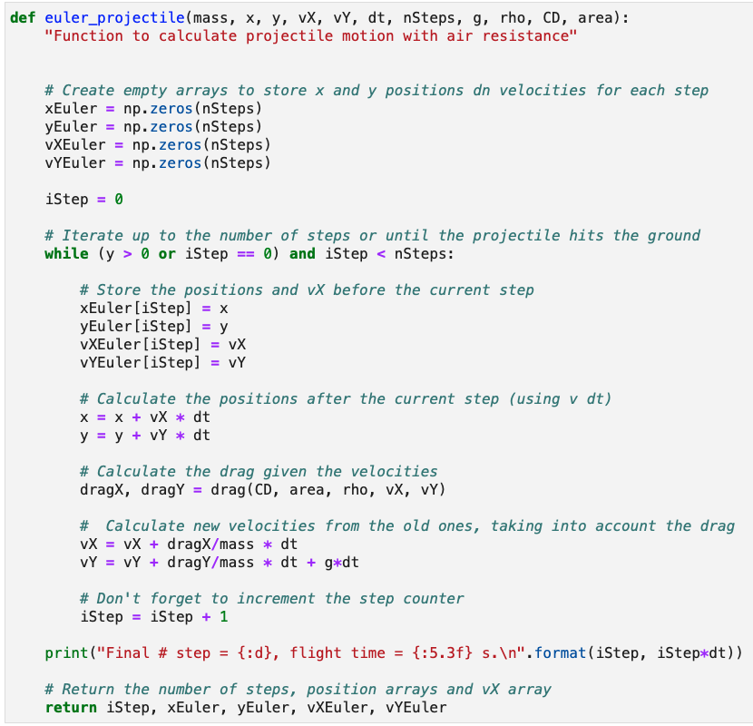
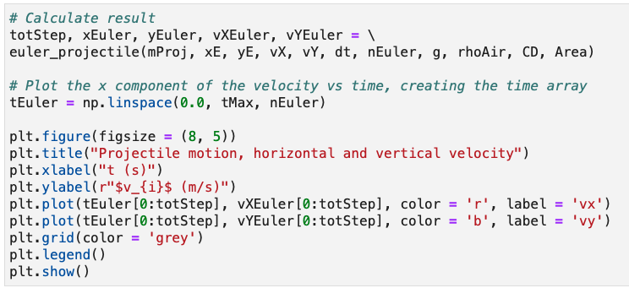
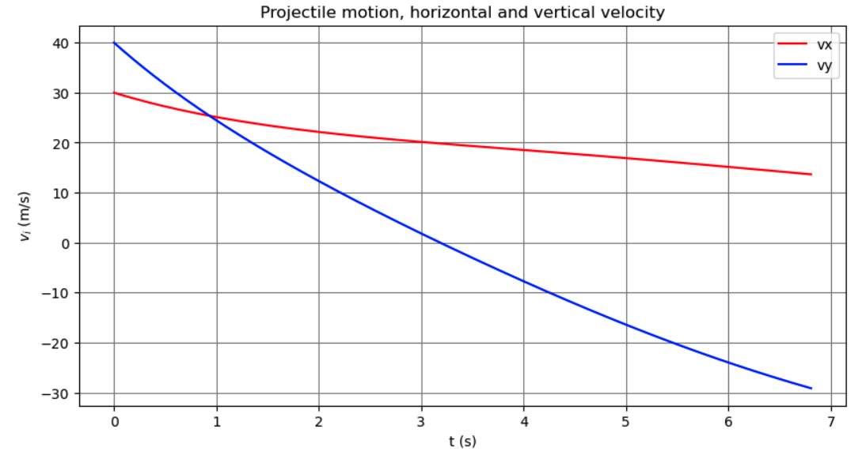
Lecture 9: Formative problem solutions (3)
Exercise 3: Plot both horizontal and vertical components of velocity (on the same plot)
Add array for v_{Y}
Extra call to plot() with tEuler & now vYEuler
Store value of v_{Y} each loop
Return vYEuler array

Slide 6
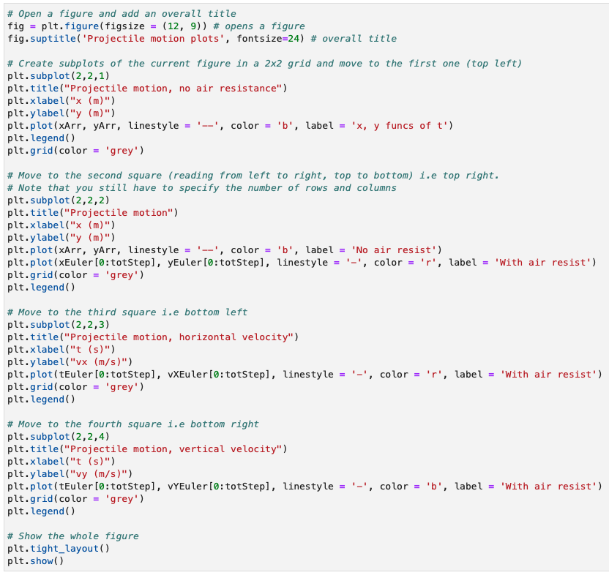
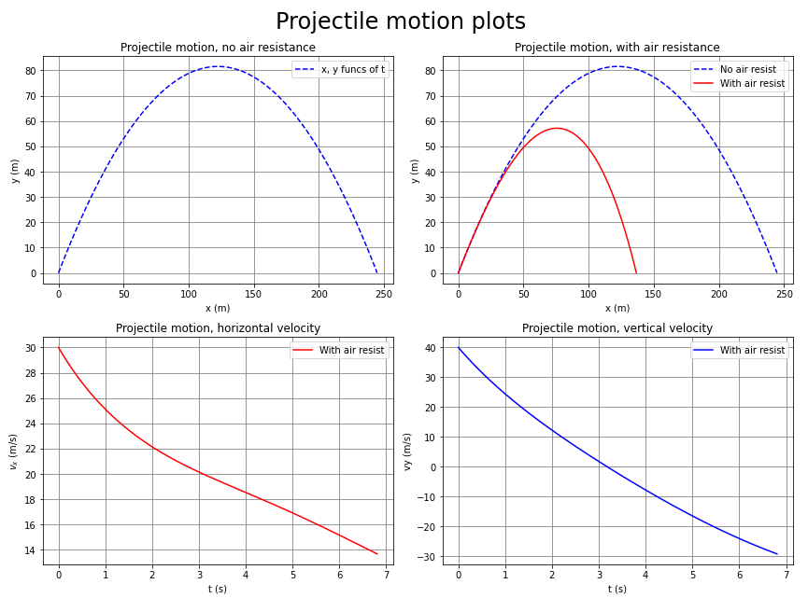
Lecture 9: Formative problem solutions (4)
Exercise 4: Plotting multiple subplots in one
figure → add a fourth plot to show v_{y}
  Copy v_{X} code but change to subplot(2,2,4)
  Key point is this comes before calling show()

Slide 7

Monte Carlo (MC) methods
So far, the numeric methods we have used,
while approximate, are fully deterministic
  This means the result is predictable: given the same input we always get the same result
Monte Carlo methods are an alternate way to
get numerical results using random sampling
  In other words, by performing a set of random trials, or experiments, many times
Although the underlying process is random
we can still get a deterministic prediction
  Provided we perform a sufficiently large
  number of trials or experiments
Particularly useful for problems with large dimensionality, where other methods struggle
  E.g. (Multi-dimensional) Integration & simulation
The Monte Carlo Casino in Monaco

Slide 8
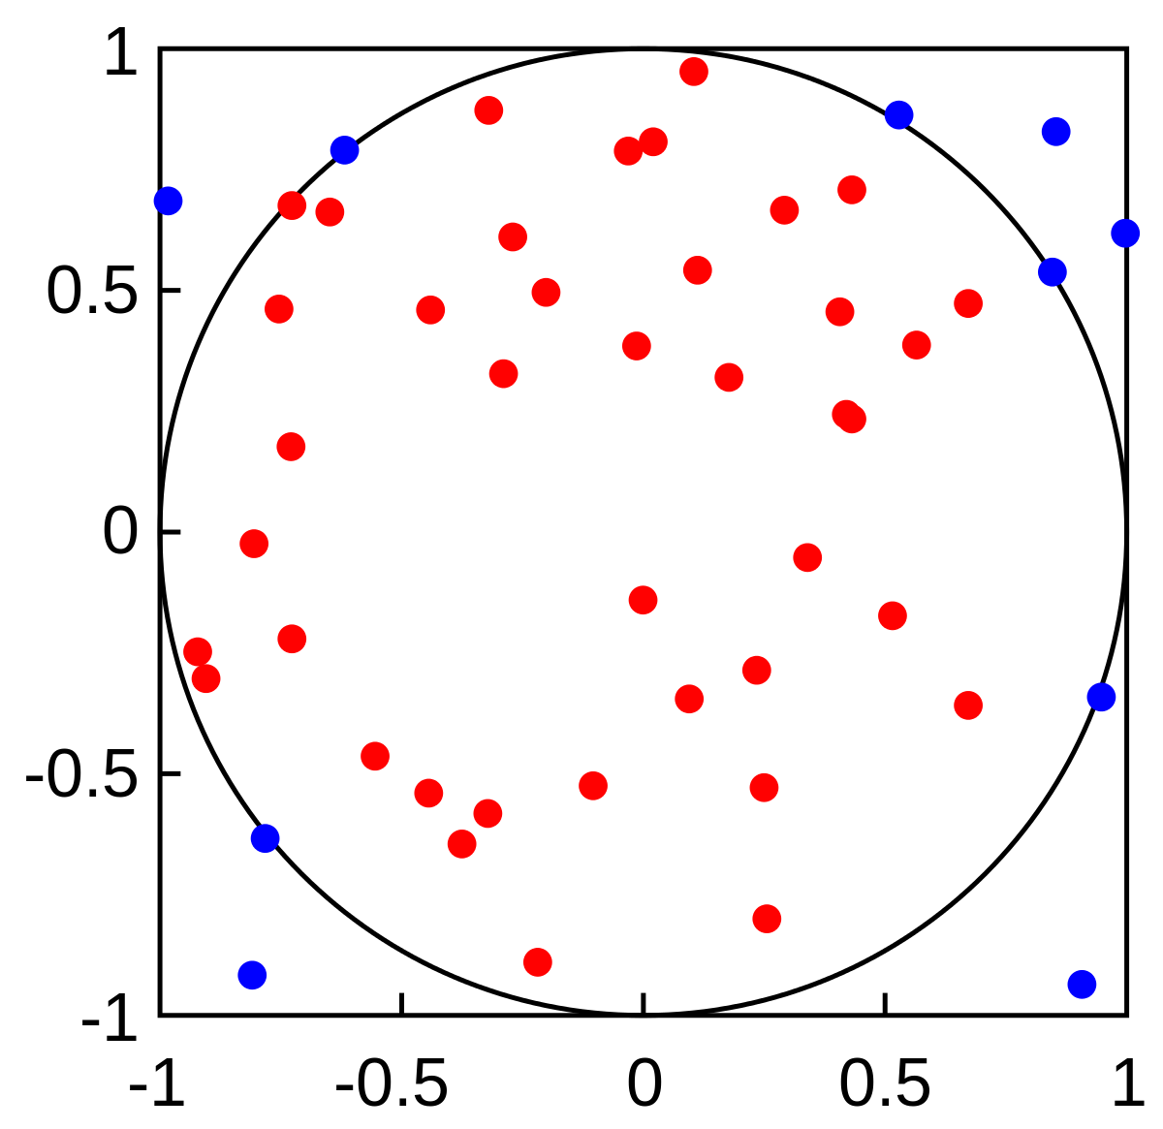
General idea
In simple terms, the Monte Carlo method can be summarised by the following general steps
  Define the range over which our inputs might possibly lie
  Generate many random inputs over that range
  Perform a deterministic computation on the inputs
  Use this to calculate the desired result
For example, consider the following experiment
  Draw a square on the ground, then inscribe a circle within it
  Uniformly scatter grains of rice over it
  Count the number of grains inside the circle
  Take the ratio of this to the total number of grains
The ratio will be equal to the ratio of the square and circle areas
  Hence, if know the square area, we can calculate the area of the circle
  This method may have been used by ancient Persian mathematicians
This idea can be extended to higher dimensions to e.g. calculate multi-dimensional integrals
A_{circle}
N( )
=
A_{square}
N( ) + N ( )

Slide 9
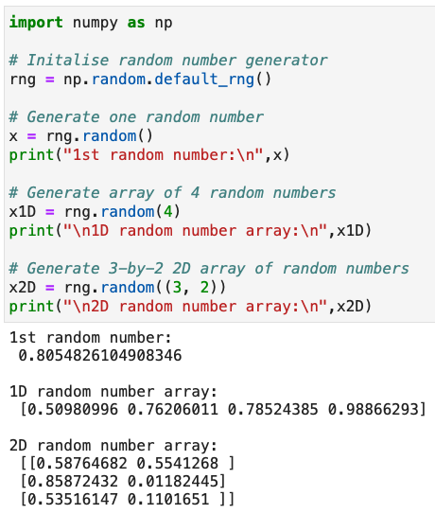
NumPy random numbers
Rather than performing real experiments, we
can use random numbers generated in Python
Can be achieved using NumPy’s random module
  Has several random number generators
Default uses Mersenne Twister algorithm
  Has a repetition period of 2¹⁹⁹³⁷ – 1
Obtained via np.random.default_rng()
  Can optionally specify the starting point
  in the sequence via a seed as argument
    Useful to get repeatable sequence
The basic random() function generates uniform
random numbers x over the range 0 ≤ x < 1
  Either one value at a time or as an array

Slide 10
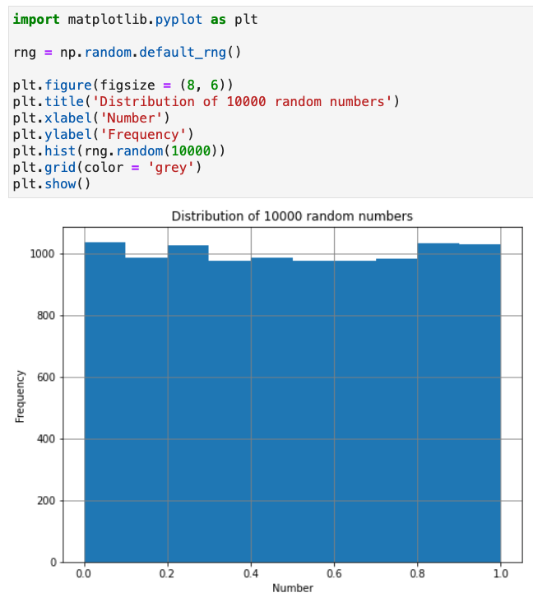
NumPy random numbers
Rather than performing real experiments, we
can use random numbers generated in Python
Can be achieved using NumPy’s random module
  Has several random number generators
Default uses Mersenne Twister algorithm
  Has a repetition period of 2¹⁹⁹³⁷ – 1
Obtained via np.random.default_rng()
  Can optionally specify the starting point
  in the sequence via a seed as argument
    Useful to get repeatable sequence
The basic random() function generates uniform
random numbers x over the range 0 ≤ x < 1
  Either one value at a time or as an array

Slide 11
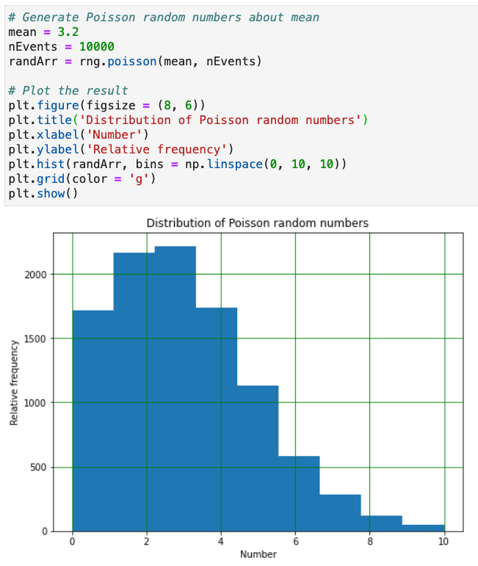

Poisson distribution
Poisson distribution describes the probability that a given number of events occurs in a fixed interval
  Events are discrete and can be over time or space
Assuming events are independent of each other, the probability of seeing x events in the interval is
  Where λ is the known mean rate, which is constant
Can generate random numbers following this via the numpy.random module’s poisson() function
  Takes mean and number of events as arguments
Examples:
  Number of cars passing a given point per minute
  Number of traffic accidents on a given road per mile

Slide 12
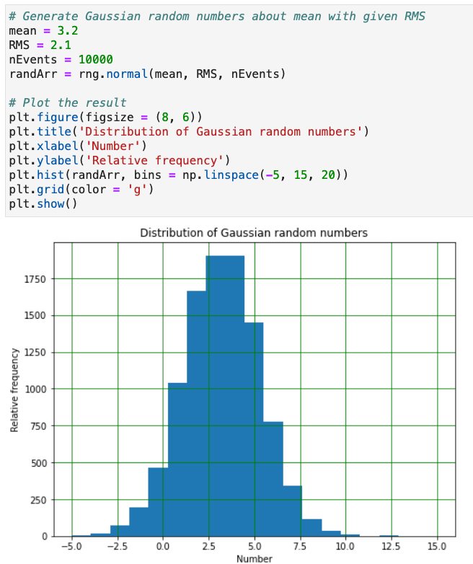

Gaussian (or Normal) distribution
The Gaussian (or Normal) distribution describes the probability of a continuous value x based on the mean value (μ) and its RMS spread (σ)
  Has a characteristic symmetric bell shape
Based on the Central Limit Theorem, the result
of any sufficiently large number of random trials tends towards a Gaussian distribution
  Hence it can describe many natural phenomena
  E.g. heights/weights/IQs/etc of a population
Can generate random numbers following this via the numpy.random module’s normal() function
  Takes mean, RMS & number of events as arguments

Slide 13


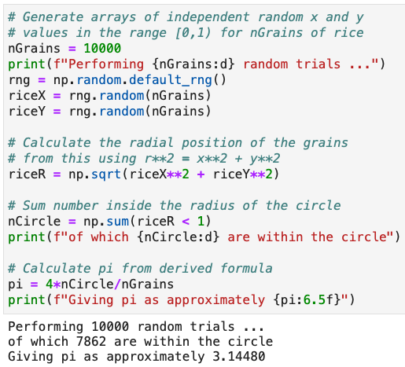
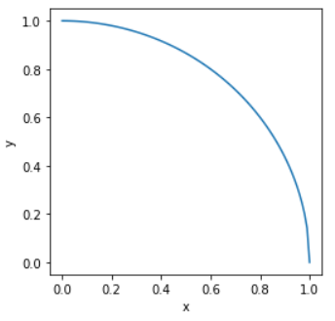
Monte Carlo integration
Let’s return to our earlier circle area example and use it to estimate the value of π numerically
  Specifically consider the case of a 2x2m square with an inscribed circle of radius 1m
We can code this in python and since the problem
is symmetrical we only need to model 1 quadrant
  Use random number
  generator to create
  indep. random nums
  uniformly in x and y
  Count how many lie
  within the circle
The more random trials
the more accurate π is
  Will investigate this
  in the notebook
r = 1 m

Slide 14
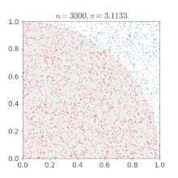
Monte Carlo integration
Let’s return to our earlier circle area example and use it to estimate the value of π numerically
  Specifically consider the case of a 2x2m square with an inscribed circle of radius 1m
We can code this in python and since the problem
is symmetrical we only need to model 1 quadrant
  Use random number
  generator to create
  indep. random nums
  uniformly in x and y
  Count how many lie
  within the circle
The more random trials
the more accurate π is
  Will investigate this
  in the notebook

Slide 15
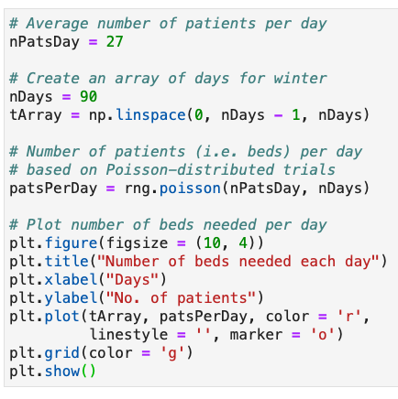
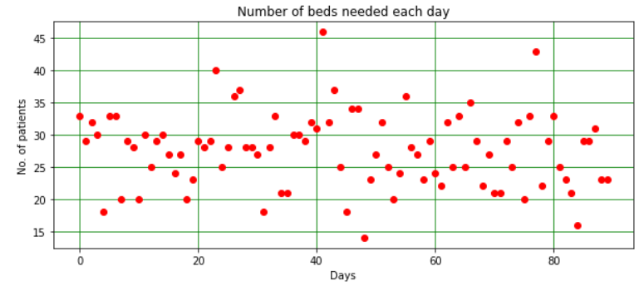
Monte Carlo simulation
Let’s now look at simulating the number of A&E beds needed in the Liverpool Royal Hospital
  Given that records show the average number of people requiring a bed is 27/day in winter
  Assuming that after 1 day, each A&E patient is moved to another ward to simplify the problem
We can model this using a Poisson distribution
  We know the average number of patients
  Can use this to find expected number of patients
  (and hence beds) needed, each winter’s day

Slide 16
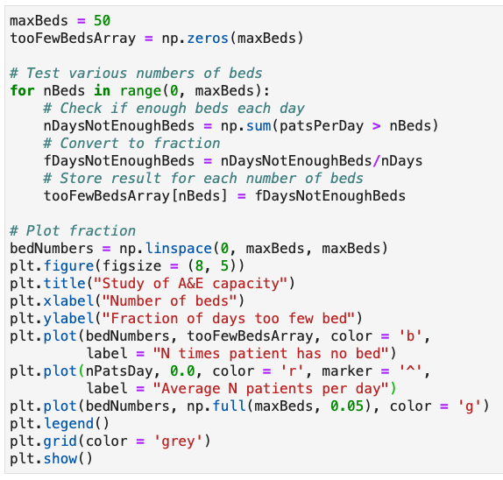
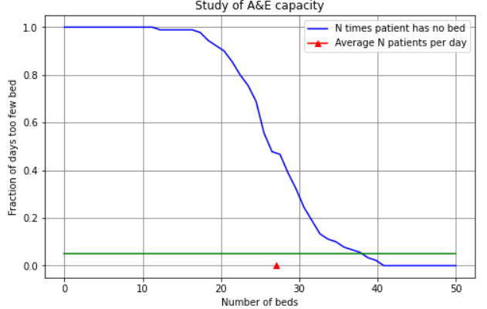
Monte Carlo simulation (2)
Suppose the hospital manager asks how many A&E beds they need so they never run out?
  Not a well-formed problem: even an enormous
  number of beds will one day be too few
  Need to make it more quantitative: let's say we
  want enough beds 95% of the time (i.e. 2σ)
We can test the above distribution of patients
against a range of different numbers of beds
  And see what fraction of the times we run out
Need 38 beds
this winter
But what about next winter & the ones after?

Slide 17

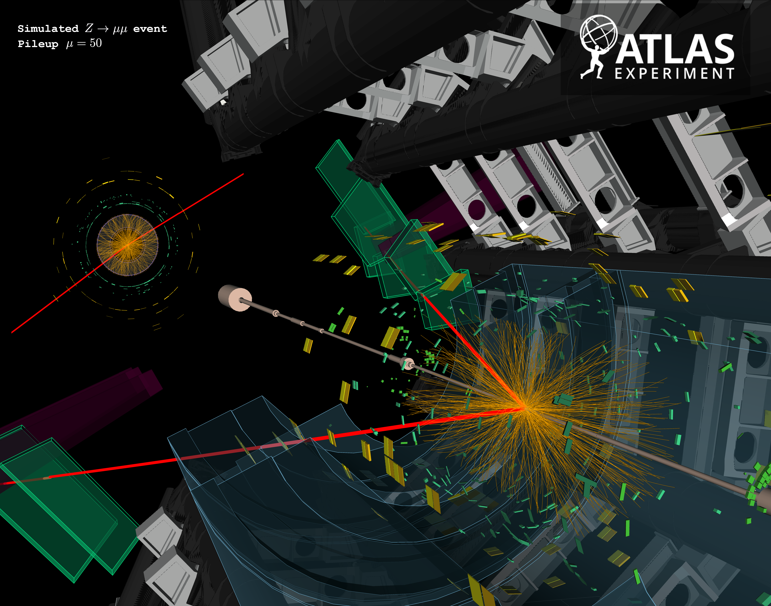
Physics Monte Carlo simulation
Monte Carlo are used extensively in physics
  Across many domains
Especially particle physics
  To simulate particle production + interaction with the detector
  E.g ATLAS Z → μμ event
Millions of lines of code
  Producing billions of simulated events/year
You will look at a simple example of a gas particle
in this week’s notebook

Slide 18
Summary
This week we looked at MC: a different type of numeric method based on random trials
  Which can be very useful in cases of large dimensions, particularly for integration and simulation
In doing so we introduced Python’s random number generators
  Seeing how to generate trials following different distributions
In the notebook, you will look further at the examples we started in the lectures
  And then, as said, simulate the motion of a simple gas particle
Reminder: answers must be your own, individual work and not created using generative AI
  Suspected breaches are taken seriously and can have severe consequences (up to being expelled
  from the course) as detailed in COPA Appendix L,
Next week we will revisit fitting and pull things together into your own python module
  That you can use In lab going forward and continue to add to over time

