Slide 1
Introduction to Computational Physics (PHYS105)
Lecture 8: Numeric Calculations
Carl Gwilliam
(C.Gwilliam@liverpool.ac.uk)
Attendance code: 746400
Notes:
Record + attendance code!
Morning everyone
Please remember to register your attendance
This week are are going to start looking at numeric techniques
As always, please feel free to interrupt at any time with questions

Slide 2
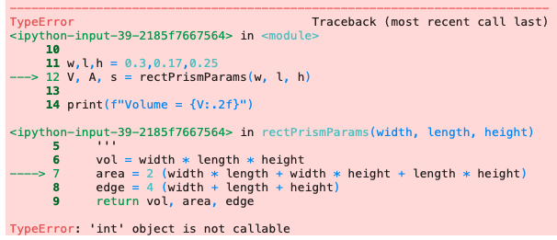
Lecture 7: Recap
Last week we looked at the various types of python errors we can get
  Code that is syntactically incorrect and therefore won’t parse at all
  Programs that start but give a run-time error and don’t complete
  Programs that run but produce incorrect results
We saw how to understand and debug python error messages:
ModuleNotFoundError
Harder
ImportError
SyntaxError
NameError
TypeError
ValueError
Traceback: how the code got to the error point, with lines run indicated by --->
IndexError
KeyError
Read from bottom to top
AttributeError
ZeroDivisionError
IndentationError
The error type
The error message itself
Notes:
Before starting this week’s material let’s first recap last week, where we …
Which, as you no doubt saw in the problems class, get more difficult to debug as you go down
In particular, we saw how to read and understand python errors and use them to debug code. As a reminder …
You should read from the bottom up
The bottom left gives the type or class of the error; we looked at several of these (listed on the right) interactively
Next to that is the error message itself
Above this is the so-called traceback, which shows how the code got to the point of error, indicating the pertinent lines with an arrow
I also remind you that notebook we looked at interactively, both the buggy version and the solved version, is available in the lecture 7 CoCalc material if you want to recap
Hopefully now you feel a bit more comfortable with python errors and can use these messages to help debug any issues you encounter in the remainder of the course
The demonstrators are still there to help of course but you should try to practice decoding the errors

Slide 3
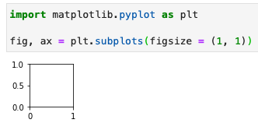
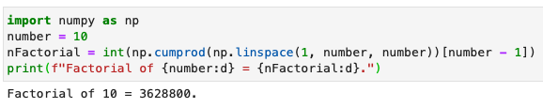
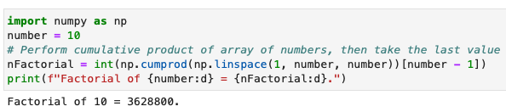



Lecture 7: Formative problem solutions
Exercise 1: Naming and comments
  Was not clear what the code does → look from inside out, printing each step if needed
    linspace creates array of numbers 1-10
    cumprod takes the cumulative product
    We then take the last item of product array
    Hence, factorial of number!
  Simply changing the name would help clarify
  Comment(s) would help further
Exercise 2: Debugging ModuleNotFoundError
  Simple typo in module name: pyploy → pyplot
Exercise 3: Debugging NameError
  Typo in line accessing index 1: L → l
Notes:
As usual, we will now look at the solutions to last week’s formative problems and feedback on some common issues
Ex1: was on naming and comments: the meaning of the code was not clear
You can work it out by looking at it in the order python would execute i.e. from inner function call to outer (point)
If you are unsure then printing each part is always a good strategy
So what’s happening? We see…
First, calls np.linspace which we have used many times now and you should know creates array of numbers: here from 1->10 in unit steps
Then, cumprod (which you can google) performs the cumulative product making an array where each element is the product of the items in the original array up to that point (show print)
This produces a new array and we then use square brackets with the index 9 to take the last item
So this is the product of the numbers up to 10 -> simply factorial of number
Read remaining bullets
Ex2: Solve the ModuleNotFoundError
Simple typo of pyplot as pyploy (point). Once fix that it imports fine.
Ex3: Similar thing but for a NameError
Capitalisation, which is important in python: L not l. Once fix, runs fine

Slide 4



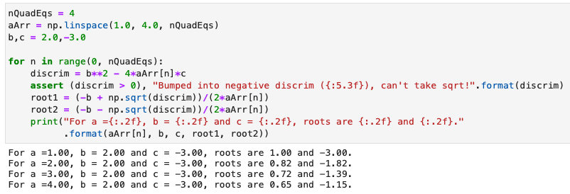
Lecture 7: Formative problem solutions (2)
Exercise 4: Explaining SyntaxError
  We have used round brackets rather than square brackets to access the list element
  Python sees round brackets as us trying to call a function, hence complains as we can’t give a function a value using assignment (=)
Exercise 5: Debugging IndexError
  We are trying to use a float as an index but index must be an integer (or slice etc)
Exercise 6: Code runs but produces the wrong result
  We have got the quadratic equation formula wrong
  Should be -4ac not -3ac
  Always check the results!
    E.g. with known cases
Notes:
Ex4: Explain the syntax error, which said ...
Can only assign the result of the function call to a variable on the LHS (not RHS)
Ex5: After fixing this to square brackets there was still an error, this time an IndexError
Because, as the message says, arrays can only take certain types as an index e.g. integer and slices (as we saw) + a few we have not covered
We try to give it float (anything with decimal in is a float even if fractional part is 0)
Simply replace by an integer 1 not 1.0 (or, as some people did, could convert index to integer after using int() – both are fine)
Ex6: Code to calculate the solution to the quadratic equation, which runs w/o error but gives the wrong result
Error is simple: Quadratic equation wrong: -3ac -> -4ac
But, as you will have seen, these kind of bugs, were the code runs without error messages, can be very hard to debug (esp. if buried in long code)
Are very important though as if we get the wrong result the code is pretty much useless
Luckily, we are not likely to deal with critical code but a mistake could literally be the difference between life and death in some cases
We need to test our code e.g wrt known results e.g via calculator (and in official production code developers often spend many hours writing several test programs for different scenarios)
QUESTIONS: Any questions on the formative problems?
Grades for lecture 6 problems released in canvas with a slightly lower, but still good, average mark of 58%

Slide 5



Physics calculations
Solving physics problems requires calculations that often involve evaluating equations
  Finding the roots
  Solving sets of equations
To solve these problems computationally we need to be able to deal with them in python
For some equations we are lucky enough to know the analytic form of the solution
  Even in this case, solving by hand quickly becomes time consuming
  Several dedicated programs have been developed to automate algebraic calculations
    E.g. MathWorks and even a python module SymPy, although we will not cover this in our course
For most equations this is not the case, so we need to solve them using numeric techniques
  Employing various approximate methods, such as graphical, discretisation, iteration, etc
We will look at such methods over the next few weeks
  Building up our python skills and solving real-world problems
  Integrating
  Differentiating
  Etc
Notes:
Let’s now move on to the topic of this week’s lecture …
By their very nature …
For some … exception rather than rule, particularly if we look at real-world problems (as we shall see)
If an analytical solution exists we can solve it algebraically
However, in many cases still … so easier and more efficient to solve using a computer
e.g. … mathworks online or even the sympy python module (though we won’t cover this)
If no analytic solution exists, we need to solve numerically, which just means using one or other approximations
And we shall see several different methods …
This can be done in python combining the numpy and scipy modules we have encountered already and we will look at these over the next few weeks
Practicing our python in realistic programs as we go

Slide 6
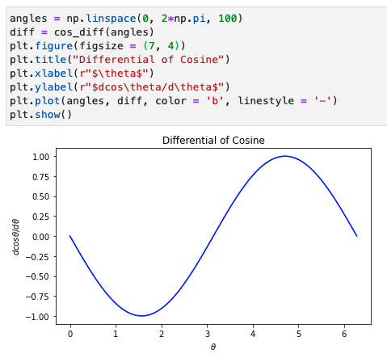


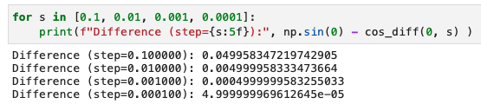

Differentiation
Numerical methods may sound daunting but they are not really anything special
  You have almost certainty come across them before, just not called them this
Differentiation is simply the change in y over the
change in x as the size of the x-step tends to 0
Can calculate a differential numerically using this
  Example: differentiation of cosθ
  Gets closer to the correct value the smaller dθ
Notes:
For example, when you learnt differentiation I am sure you started off from the change in the y value of a function over the change in the x value (i.e. gradient) for a given step dX
Then made this step dx smaller and smaller
Finding that the differential is just the limit as the step size dx tends to 0, as written here
Since numeric methods are nothing more than approximations, we can use this equation for the difference in a function at x+dx compared to x divided by the step size dx to calculate a differential numerically
So, lets do that. For example, lets look at the differentiation of cos(theta), which of course we can know the answer analytically to be –sin(theta), numerically
We write a python function, which I have called cos_diff, that takes two args: theta and the size of our step (now dtheta with default)
Inside the function we simply calculate cos(theta + dtheta) – cos(theta) divided by the step size dtheta following our equation defining a differential above (point)
We can call this for theta 0 and we get something close to the expected 0
As we reduce the step size we get closer and closer to actual differentiation and hence to to the real value of 0 (point)
(remember variables are stored with limited precision so may not be exactly 0)
Going beyond just evaluating this at one value (0), we could create a numpy array of theta angles from 0 to 2pi (point) and pass this into our numeric approximation
Due to numpy’s array-at-a-time calculations, the result is the array of the corresponding differential at each theta point
If we plot this with matplotlib, we see it is indeed –sin(theta) as expected (or a sine wave flipped over)
We have just done our first numeric calculation! And it hopefully wasn’t so scary.

Slide 7
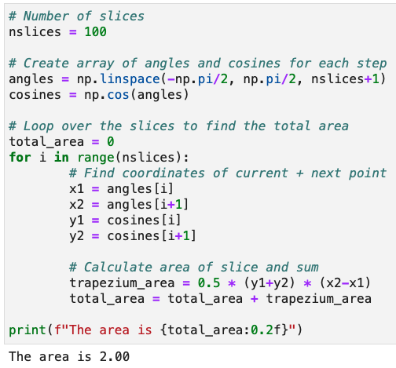
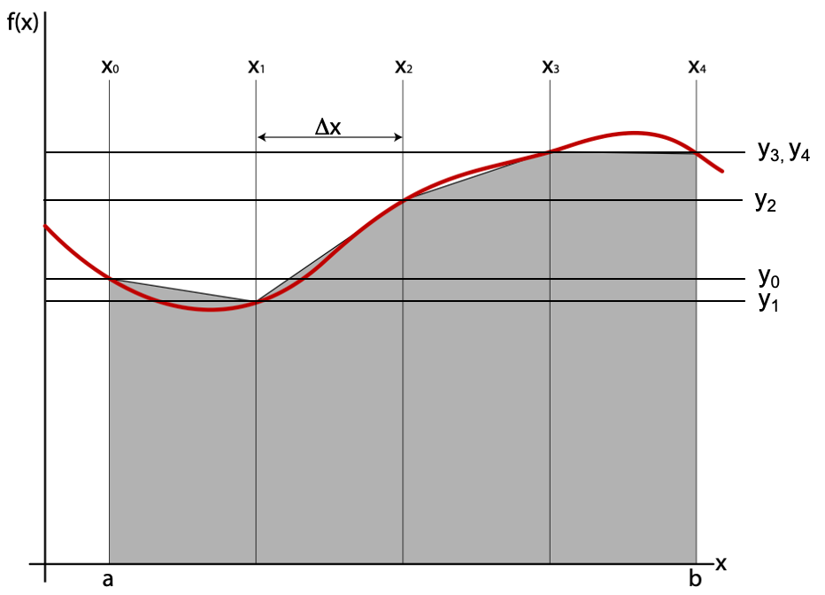
Integration
We know that physically, integration is simply calculating the area under the given function
  Between a given set of bounds in the discrete case
Can be calculated numerically by simply splitting
into a series of small slices & summing their areas
  Each slice can be approximated by a trapezium
  whose area is given by 0.5 (y_{i+1} + y_{i}) (x_{i+1} – x_{i})
E.g: integral of cosθ from –π/2 to π/2
  The smaller the slices the more accurate the answer (see notebook)
Notes:
We can also perform an integral numerically. We know …
… of small discrete slices (akin to the method we used for differentiation when we went from a continuous derivative to discrete steps) and summing their areas as you see here
We can approximate each slice by a trapezium whose area is given be width x average height
Let’s do this in python for e.g cos theta between –pi/2 and +pi/2
We will try 100 slices and create an array of the angles between –pi/2 and pi/2 using np.linspace (note the edges are the nslices + 1)
We use numpy’s array at a time functionality to get the corresponding cosines
We now need to loop over the range of slices (which is one less than entries) starting from 0 (default) …
For each we get the x values at that point in the angles array and the next one (I+1), plus the corresponding y values from the cosines array
Then we calculate the area of the trapezium
Then sum the area, using a variable defined as 0 to start with outside the loop
If we print the area we get the expected value of 2
Of course, the move slices the more accurate the result and you will investigate this in the notebook
Any questions on numeric methods so far?

Slide 8
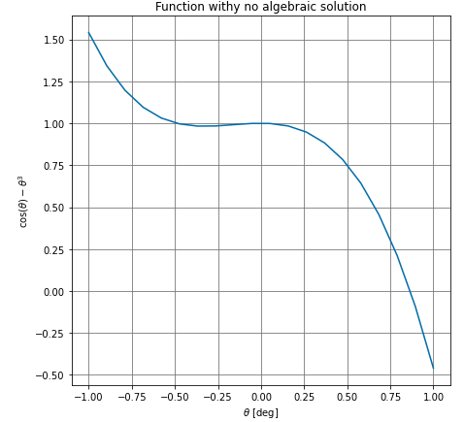
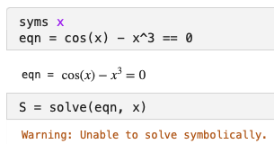
Solving equations
Even many seemingly simple equations cannot be solved analytically using algebraic methods
Example: consider finding the solution(s) of cos(θ) – θ³ = 0
  Plotting the function clearly shows a solution exists
  But it you ask programs like MathWorks or SymPy
  to solve it, they are unable to provide an answer
Rather than just throwing our hands up, we must instead solve it using numerical methods
  Which can be achieved by various methods …
*
Notes:
OK, what about solving equations?
For example …
If we plot the function we clearly see that a solution exists i.e. the function passes through 0
But if we try to ask … it is unable to provide answer
Don’t need to understand this

Slide 9
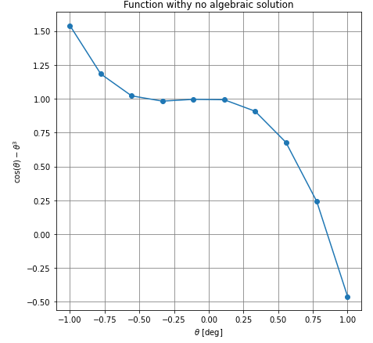



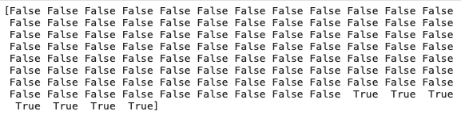

Solving equations
Graphical approach: a naïve method is to draw a plot and simply read off the value
  More accurate the more points you have
  but still relies on eyeballing the plot
NumPy approach: store values as arrays and do equivalent manipulation programmatically
  Create array of angles & corresponding values
  Use array-at-a-time operation to see where values are less than 0 → array of True/False
  Convert True/False to integer (1/0) and use np.argmax to find index of first max value
  Use index to find solution in array of angles
≈0.85
Notes:
The simplest method we can think of to solve this is to do it graphically
Here is the plot of our function again but were this time I have used somewhat less points and labelled them with a marker
You can see that matplotlib interpolates between the points with a straight line
If we read off where the line graph crosses zero we get something like 0.85 as the solution
Of course, the more points we use the less far matplotlib has to interpolate and in principle the more accurate our result
But we are still limited by the fact we are eyeballing the plot
A step up from this is to do the equivalent thing programmatically, rather than by eye, by storing the data as a numpy array not a graph
First, let’s write our equation as a python function using numpy so it works with an array
Then we create an array of angles using linspace, over the range of our plot -1, 1
Here is the code doing this in ten steps and making the plot above.
Since we are now doing it programmatically we can now use many more points e.g. 100
We then pass it to our function to get the corresponding array of our equation values
We can use our array-at-a-time operations to require the result to be < 0
Which gives us an array of booleans, as you can see, which are True where it is < 0 and False where it is not
We then simply need to find the point at which it switches from False to True to see where It crosses 0
To do this we convert the array from booleans to integers, where True becomes 1 and False 0, using the astype() function
We then use numpy’s argmax() function (show docs), linked here, which finds the index of the max value or, if there are more than one of the max value the first of these
So in our case this will give us the index of the first 1 (which was the first True i.e the first point < 0).
We simply use the result as the index to our angle array to find the corresponding angle where this occurs.
Here we get ≈0.88, which seems sensible given our eyeballed guess but is likely more accurate.
Of course, if we make our array bigger, adding more points, we will get a more accurate result (try 1000)
QUESTIONS: Any questions on the numeric solutions or what we have done so far ?

Slide 10
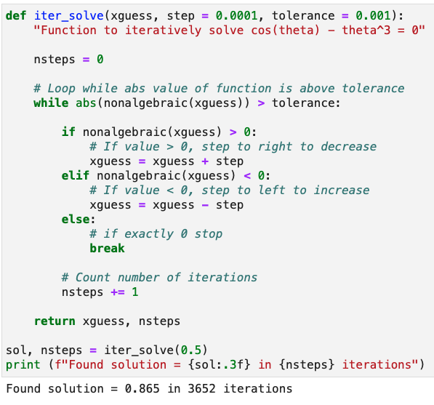


Solving equations (2)
Iterative approach: start from initial guess & step left/right if function value less/greater than 0
  Revaluate function and keep stepping left/right till value is 0 within a certain tolerance
*
guess
solution
*
In fact, scipy.optimize has a sophisticated iterative root-finding function called fsolve
Notes:
Another category of numerical methods is to take an iterative approach i.e. to make an initial guess and keep refining it
Which is what the least-squared fitting we saw in lecture 7 did, starting from our initial parameter guesses
In our case we can start from a guess by eye and find the value of the function at that point
If it is > 0 we have to move to the right (point)
if it is < 0 we would move to the left (point starting from end)
We then re-evaluate the function at the new point and continue moving left/right, depending which side of 0 the result is, until we get the solution, in our case 0, within a certain tolerance
Let’s write a function to do this in python that I have called iter_solve
It takes our initial guess for the solution, the size of the step we want to take left/right in x each time and the tolerance we want for the solution
We then have a while loop that evaluates our function at the starting guess and checks if it is more than tolerance away from 0
Note the use of abs for the modulus since at this point we don’t care which side of 0 it is, just if it is more than tolerance away we need to keep going
If the function is > 0 we add step to our initial guess to move right, else if it < 0 we subtract step from our initial guess to move left
Note, there is a probability we hit exactly 0 by luck on one of the iterations, in which case we obv want to stop so we use a break statement
The while loop then continues round, moving a step left/right each time, until the condition is satisfied i.e. the function is 0 within the specified tolerance
At that point it returns the result and also, just to see how many iterations it takes, the number of steps
We call this with e.g. 0.5 as the starting guess and we get a solution of 0.865 which is similar to our previous guesses but more accurate and it took ~3600 iterations.
The nice thing about the iterative method is we can control explicitly the tolerance we want
Of course, at the expense of needing more iterations and hence longer CPU time if we want it more accurate
We could improve on this approach in many ways (can anyone suggest any?) for example making the size of the step be dynamic so it is is bigger if we are further from 0 and smaller if we are closer
But we don’t need to since scipy.optimise module…
We just import the fsolve function and then call it with the python function representing our equation (which it expects to be rearranged in a form equal to 0) and the initial guess (can also take other args such as the tolerance but here I have gone with the default)
In this simple case we get the same result as our iter_solve function, 0.865, so we did a pretty good job ☺
Any questions on numeric methods?

Slide 11
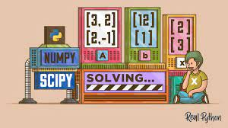
Summary
This week we have started to look at how to tackle problems that cannot be calculated analytically
  In particular: integration, differentiation and solving equations
In doing so we introduced the concept of numerical methods
  Which are nothing more than a variety of approximations
  Such as discretization, iteration and graphical approaches
The notebook will give you chance to try out these methods
  While continuing to further practice your python coding
Next week, we will see how to solve differential equations numerically
  And apply this to a real-world example, namely projectile motion taking into account air resistance
Notes:
Any final questions?

