Slide 1
Introduction to Computational Physics (PHYS105)
Lecture 8: Numeric Calculations
Carl Gwilliam
(C.Gwilliam@liverpool.ac.uk)

Slide 2
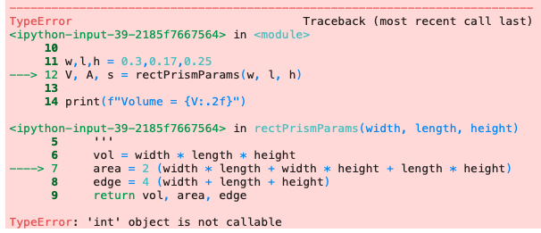
Lecture 7: Recap
Last week we looked at the various types of python errors we can get
  Code that is syntactically incorrect and therefore won’t parse at all
  Programs that start but give a run-time error and don’t complete
  Programs that run but produce incorrect results
We saw how to understand and debug python error messages:
ModuleNotFoundError
Harder
ImportError
SyntaxError
NameError
TypeError
ValueError
Traceback: how the code got to the error point, with lines run indicated by --->
IndexError
KeyError
Read from bottom to top
AttributeError
ZeroDivisionError
IndentationError
The error type
The error message itself

Slide 3
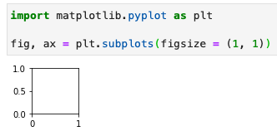
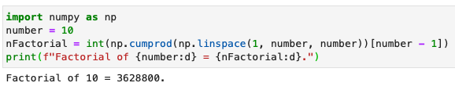
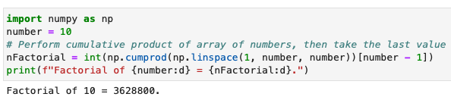



Lecture 7: Formative problem solutions
Exercise 1: Naming and comments
  Was not clear what the code does → look from inside out, printing each step if needed
    linspace creates array of numbers 1-10
    cumprod takes the cumulative product
    We then take the last item of product array
    Hence, factorial of number!
  Simply changing the name would help clarify
  Comment(s) would help further
Exercise 2: Debugging ModuleNotFoundError
  Simple typo in module name: pyploy → pyplot
Exercise 3: Debugging NameError
  Typo in line accessing index 1: L → l

Slide 4



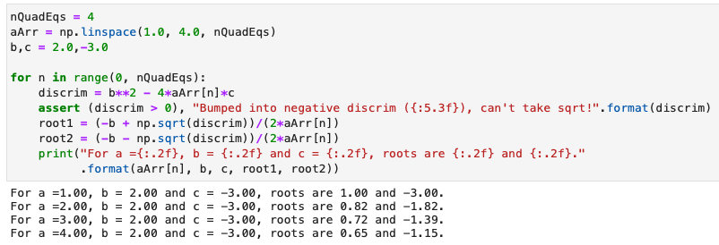
Lecture 7: Formative problem solutions (2)
Exercise 4: Explaining SyntaxError
  We have used round brackets rather than square brackets to access the list element
  Python sees round brackets as us trying to call a function, hence complains as we can’t give a function a value using assignment (=)
Exercise 5: Debugging IndexError
  We are trying to use a float as an index but index must be an integer (or slice etc)
Exercise 6: Code runs but produces the wrong result
  We have got the quadratic equation formula wrong
  Should be -4ac not -3ac
  Always check the results!
    E.g. with known cases

Slide 5



Physics calculations
Solving physics problems requires calculations that often involve evaluating equations
  Finding the roots
  Solving sets of equations
To solve these problems computationally we need to be able to deal with them in python
For some equations we are lucky enough to know the analytic form of the solution
  Even in this case, solving by hand quickly becomes time consuming
  Several dedicated programs have been developed to automate algebraic calculations
    E.g. MathWorks and even a python module SymPy, although we will not cover this in our course
For most equations this is not the case, so we need to solve them using numeric techniques
  Employing various approximate methods, such as graphical, discretisation, iteration, etc
We will look at such methods over the next few weeks
  Building up our python skills and solving real-world problems
  Integrating
  Differentiating
  Etc

Slide 6
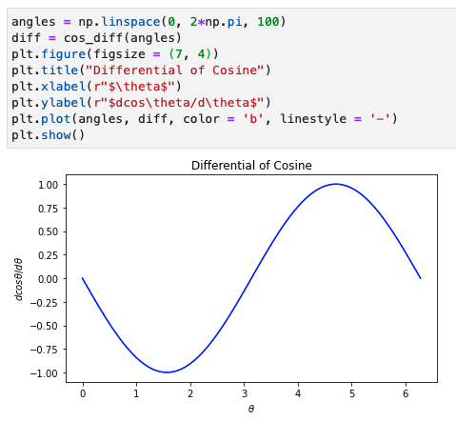


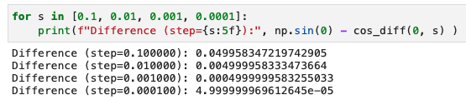

Differentiation
Numerical methods may sound daunting but they are not really anything special
  You have almost certainty come across them before, just not called them this
Differentiation is simply the change in y over the
change in x as the size of the x-step tends to 0
Can calculate a differential numerically using this
  Example: differentiation of cosθ
  Gets closer to the correct value the smaller dθ

Slide 7
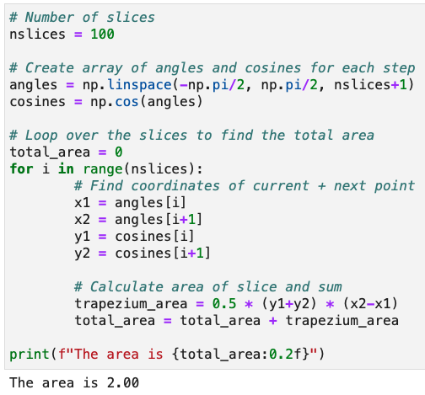
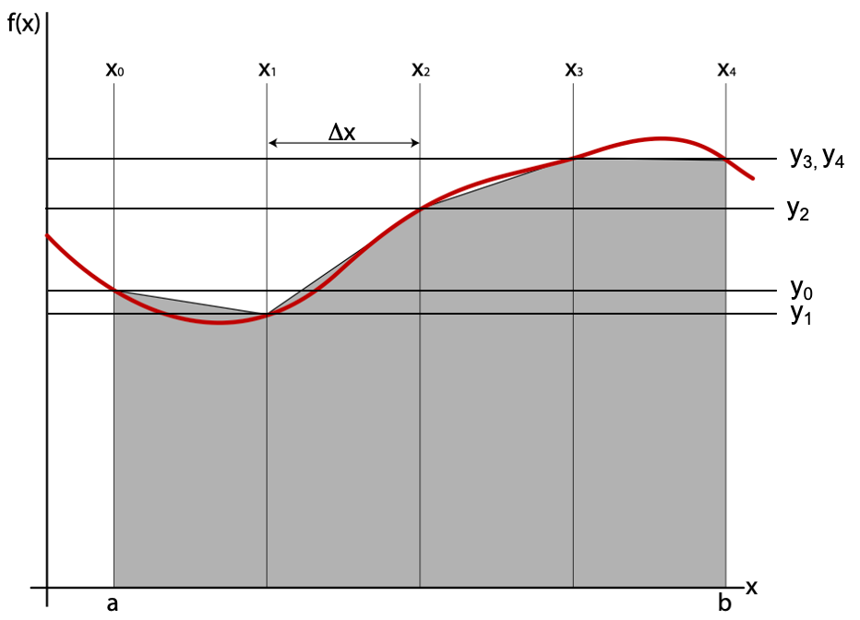
Integration
We know that physically, integration is simply calculating the area under the given function
  Between a given set of bounds in the discrete case
Can be calculated numerically by simply splitting
into a series of small slices & summing their areas
  Each slice can be approximated by a trapezium
  whose area is given by 0.5 (y_{i+1} + y_{i}) (x_{i+1} – x_{i})
E.g: integral of cosθ from –π/2 to π/2
  The smaller the slices the more accurate the answer (see notebook)

Slide 8
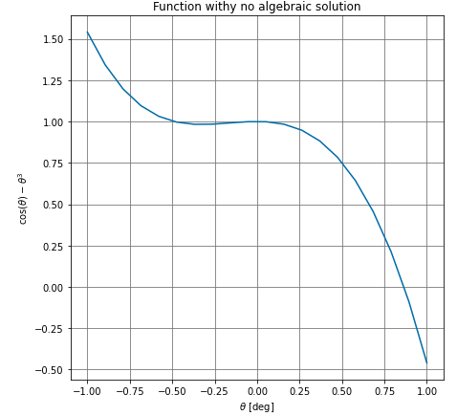
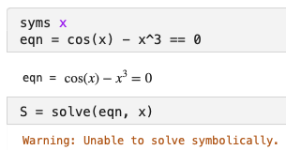
Solving equations
Even many seemingly simple equations cannot be solved analytically using algebraic methods
Example: consider finding the solution(s) of cos(θ) – θ³ = 0
  Plotting the function clearly shows a solution exists
  But it you ask programs like MathWorks or SymPy
  to solve it, they are unable to provide an answer
Rather than just throwing our hands up, we must instead solve it using numerical methods
  Which can be achieved by various methods …
*

Slide 9
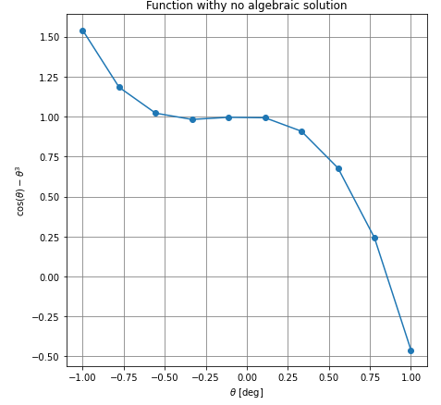



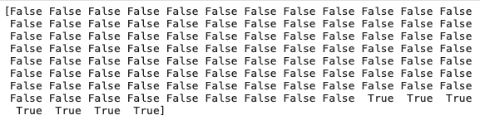

Solving equations
Graphical approach: a naïve method is to draw a plot and simply read off the value
  More accurate the more points you have
  but still relies on eyeballing the plot
NumPy approach: store values as arrays and do equivalent manipulation programmatically
  Create array of angles & corresponding values
  Use array-at-a-time operation to see where values are less than 0 → array of True/False
  Convert True/False to integer (1/0) and use np.argmax to find index of first max value
  Use index to find solution in array of angles
≈0.85

Slide 10
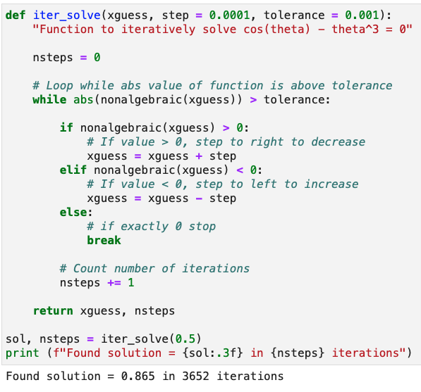


Solving equations (2)
Iterative approach: start from initial guess & step left/right if function value less/greater than 0
  Revaluate function and keep stepping left/right till value is 0 within a certain tolerance
*
guess
solution
*
In fact, scipy.optimize has a sophisticated iterative root-finding function called fsolve

Slide 11
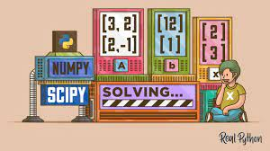
Summary
This week we have started to look at how to tackle problems that cannot be calculated analytically
  In particular: integration, differentiation and solving equations
In doing so we introduced the concept of numerical methods
  Which are nothing more than a variety of approximations
  Such as discretization, iteration and graphical approaches
The notebook will give you chance to try out these methods
  While continuing to further practice your python coding
Next week, we will see how to solve differential equations numerically
  And apply this to a real-world example, namely projectile motion taking into account air resistance

