Slide 1

Mid-Module Questionnaire
This is your chance to have a say on how the course is run and raise any issues you may have
  There will also be another questionnaire at the end of the module
We will take your views on board
  Reporting back common items in the lecture and canvas
  Making changes to alleviate issues where possible
Please pick up a form from the front of the lecture theatre
  And take 5 minutes to fill this is now
At the end of the lecture please bring your forms to the front.
Attendance code: 277907
Notes:
RECORD + Attendance code!!
Morning everyone
Please remember to register your attendance!!
Before starting, I am going to distribute the mid-module questionnaire

Slide 2
Introduction to Computational Physics (PHYS105)
Lecture 7: Good Practice and Debugging
Carl Gwilliam
(C.Gwilliam@liverpool.ac.uk)
Notes:
This week we are going to look at good coding practice and how to debug code errors
As always, please interrupt if you have questions

Slide 3
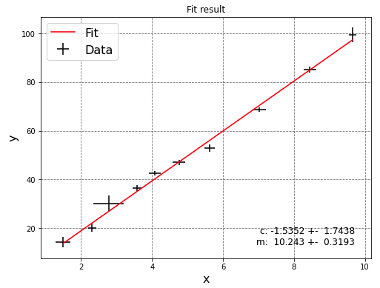

Lecture 6: Recap
Last week we started the second part of the course, using python for real physics problems!
Started with fitting a functional form to data.
  Read in data from files (using np.loadtxt)
    Plot to check sensible
    Find initial params
  Define necessary functions
    Functional form and its differential
    Point-by-point residuals
  Run least_squares() from scipy.optimize
    Check fit succeeds and get fitted params
  Calculate χ² test statistic from the residuals
    Check fit is good e.g. 0.25 < χ²/NDF < 4
  Calculate parameter errors
    Print best-fit parameters and associated error
  Plot data and fitted function
    Passing best fit params to functional form
Encapsulated all this in a reusable function
You will use this over-and-over in labs
  Will create your own python module for this in the last week of PHYS105
Notes:
First lets recap what we learnt last week, where we started …
In particular, we were fitting a functional form to data to determine the values of the free parameters that best describe it
Let’s summarise the steps we needed to do this
Read in …. using np.loadtxt() + Plot to … and find …
Define … which are the functional form for the model, in our case a straight line, and its differential, which is needed to translate error on x to corresponding y-error
Also, the function that uses these to calculate array of point-by-point residuals [point + explain] (remember scipy will take care of summing and squaring)
Run the fit using … which is so called because it minimises the sum of the squares of the residuals
This takes the residual function, the initial guess of the parameters and the data + errors as arguments
… using corresponding properties of the results object
Calculate the chi2 test statistic from the residuals
Calculate parameter errors from the Jacobian matrix, which you will learn more about in PHYS108 next semester, and print…
We then pass the best-fit parameters, along with x data, back to our model function to get the fitted y values and plot along with data
This is what LabModule,py does and the result looks something like this

Slide 4
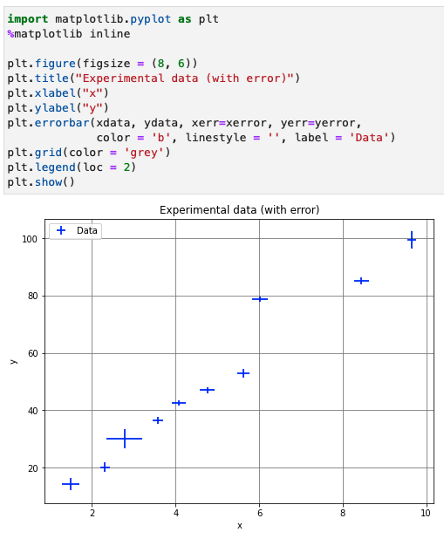
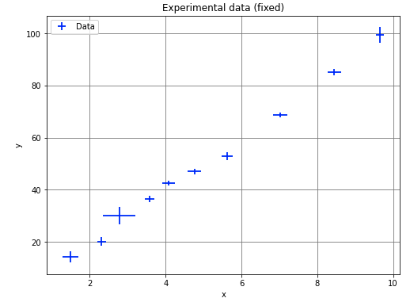

Lecture 6: Formative problem solutions
Exercise 1: Plot the experimental data and fix any errors compared to the table above
  Plot data read from csv file using errorbar()
  Clear that 8th point is incorrect → fix by updating array value at index 7 and replot
Notes:
As usual, we will now look at the solutions to last week’s formative problems and feedback on some common issues
Ex1: Plot the data and fix and issues (don’t need scipy yet as not fitting)
Take the data that was read from the file and plot using matplotlib as usual, using the error bar function (point)
Several people did both plot and errorbar but you only need the latter as errorbar can do everything we need
However, when plotting data don’t join the markers up → linestyle = ”” (point) to remove line
Point 8 clearly doesn’t lie on the straight line and if we compare to the table in the notebook the file has a mistake for that point in its x and y values (important to check!)
Fix by updating the csv file or simply resetting the values [point] in the np array you have read
Some people struggled doing this: remember can access any element of a data structure sing square brackets with the index (remembering it starts form 0 -> 7 for the 8th point) and then, just like any variable, assign a value to this using equals (as we saw in week 2). Need to do this for both the x and y values
Replotting, it looks much better & consistent with a straight line by eye
And we fitted it as an example and showed that is the case

Slide 5
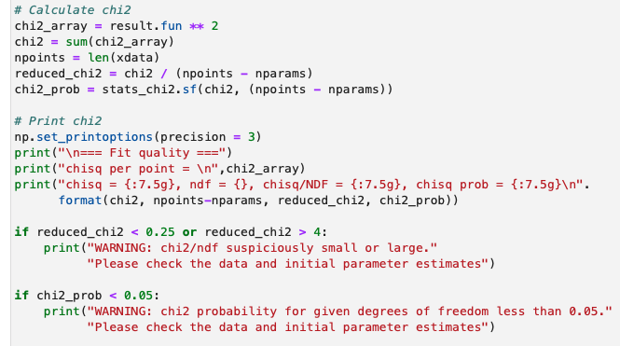

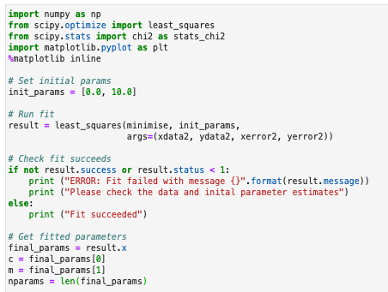
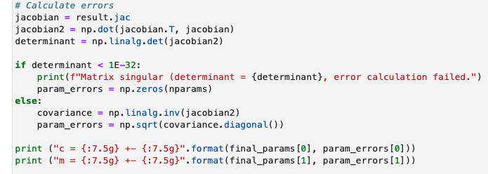
Lecture 6: Formative problem solutions (2)
Exercise 2: Fit extended data
Calculate χ² and check fit is good
Read data
Run fit and check it succeeds
New data
Calculate param errors and print
Get fitted parameters
Notes:
Ex2: The data was extended by two extra points and we needed to update the fit
People struggled with which bits needs to be rerun (and in which order). Lets go through it following the overview from the first slide
Read in the data: in this case rather than updating the CSV file I just used np.append to add the new points to the already read np arrays (point)
Called new arrays a different name to make it clear and avoid any conflicts
Note: np.append doesn’t change original array but returns a new array
Since we are still dealing with a straight line our model functions and the residual function don’t change so we don’t need to redefine them
Can also use the same initial parameter guess
Need to rerun the fit with the new data
Call least_squares with minimise function, initial param guesses and xdata2 etc (point) in correct order (same as residual func)
Some people missed this (which is what actually does the fit) → results will then be from the 10-point fit
Check new fit succeeds and get updated fitted parameters from result.x (point)
Calculate chi2 test statistic from the residuals obtained from result.fun (point), by squaring and summing it, and divide by the NDF (points – params)
Then check good fit
Calculate the parameter errors from the result.jac
Printing the result of the parameters, along with their errors

Slide 6
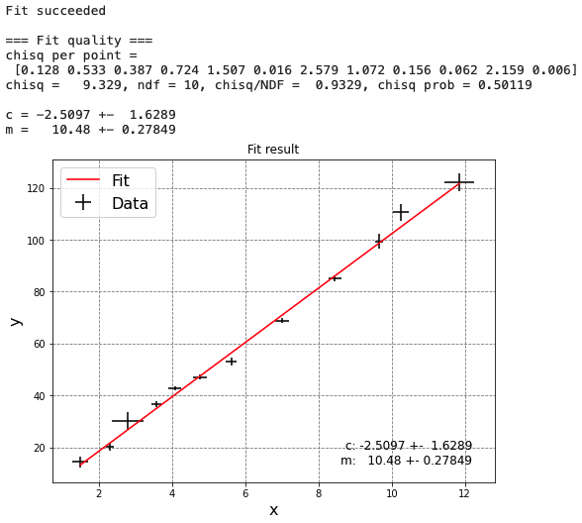
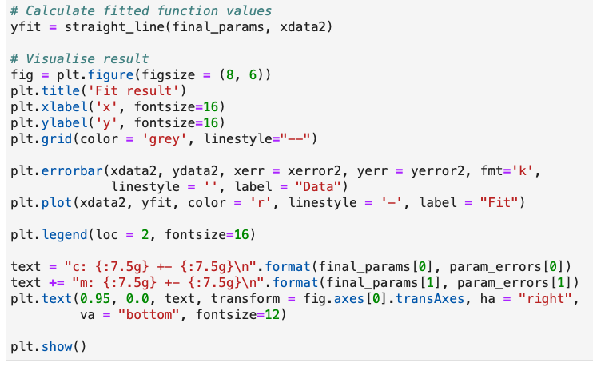
Lecture 6: Formative problem solutions (3)
Exercise 2 (cont): Fit extended data
Evaluate best fit y and plot
New data!
Notes:
Ex2 cont.: Finally, we plot the data (as points) and best-fit function (as line)
Passing the NEW best fit parameters and the NEW x data to the straight_line model function (point)
Some people passed the old xdata here and yfit will only be 10 elements long → matplotlib will complain about different sized x and y arrays if pass xdata2 when plotting
* This cell (examples) has everything we need to do the fit and we put it in a function at the end of the notebook

Slide 7
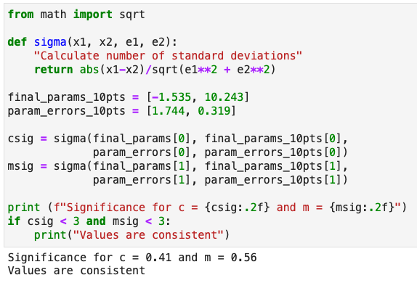

Lecture 6: Formative problem solutions (4)
Exercise 3: Does straight line still fit the data
  Yes, as shown by χ^{2:}
    χ²/ndf between ¼ and 4
    χ² prob greater than 5%
Have the gradient or intercept changed significantly?
  No, values are still compatible within errors
  Quantify by ”Consistency Check” (as in labs)
Total error
Now that we have developed our first real physics program, it is time to take a step back …
Notes:
Ex3: was about getting you used to thinking about the results of your fit, and doing so in a quantitative manner (which will be needed in labs etc)
The first part asked if the straight line still fit the data. To answer that we simply need to check our chi2 test statistics.
The chi2/ndf is between ¼ and 4 + the chi2 prob is > 5%, so yes, the straight line fits the data
The second part asked if the fitted gradient or intercept has changed significantly
We can only answer this by considering the uncertainties on the parameters
E.g. the question is 12 compatible with 10 makes no sense w/o the error; with the error we can say e.g. is 12+-2 consistent with 10 (yes) or is 12+-0.1 consistent with 10 (no)
To do this mathematically we use the consistency check you learnt in labs (if you do PHYS106) or was described in the question
This says that we take the modulus of the difference between the two values (point) and divide by the total error (adding the errors on each in quadrature)
The result tells us how many times the total error they are apart
Generally acceptable if < 3 (covers 99.7% of real consistent cases, while 1sigma = 68% and 2sigma = 95%)
On the python side, we can write a simple function, that I am going to call sigma, to do this
it takes the two values, x1 and x2, along with the two corresponding errors, e1 and e2
We subtract the two using the abs function to take the modulus
Then we divide by the total error, which we find by adding the two in quad and sqrting
We can call this for both the intercept and gradient, c and m, and in this case both are consistent within 3 sigma (in fact even 1 sigma) so there is no significant change
Note: once you have this function, you can use it each time you need to do such a check in labs!
Can put it in your lab module in lecture 11
Grades for summative assignment 5, where the average was 82%, were released on canvas on Monday, but 20 people didn’t submit anything
Any Questions on last week’s formative problems?

Slide 8
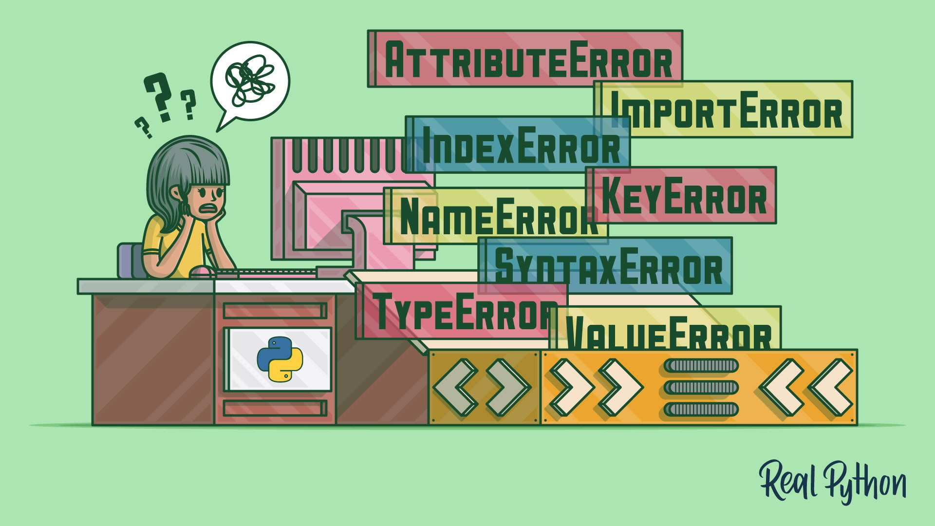
Python errors
At many points during the course you will have come across issues with your code
  Where python has given you a big fat error message or you get the wrong result
We can try to avoid these via good coding practice
  Using sensible variable names,
  Writing useful comments,
  Checking inputs/values, etc
But no matter how good we are, as we write more
complex programs we’ll encounter them more often
There are several different types of error we may encounter
  Code that is syntactically incorrect and therefore won’t parse at all
  Programs that start but give a run-time error and don’t complete
  Programs that run but produce incorrect results
This week, we are going to look in detail at how to understand these errors and debug them
Harder to debug
Notes:
Good practice: you will see examples of this later in the lecture and in the notebook
Syntactically incorrect, i.e. not valid python, so it doesn’t know how to execute it
Run-time error, since we ask python to do something incorrect, and don’t complete
Finally: Run without an error message but produce the incorrect result
These types of error get harder to the debug as we go down the list

Slide 9
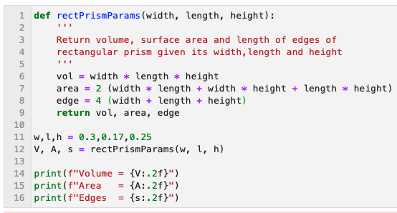
Understanding and debugging error messages
Real example saw during week 4 PC class
  Can turn on line numbers by
  View → Line Numbers → Show
Notes:
Let’s take a look at a real example I saw during the lecture 3 PC class for the exercise calculating the rectangular prism parameters …
As a reminder, we wrote a function that takes the width, length and height of the prism
Calculates the volume, surface area and length of edges and returns these
We call this function with some example parameters and print the returned results
The first thing to do to help debugging is to remember to turn on the line numbers in your jupyter notebook
By going to the view menu and selecting line numbers and show --> see them here on the left
If we were to run this …

Slide 10
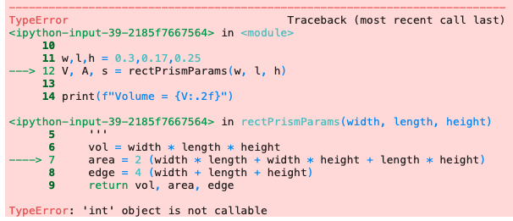
Understanding and debugging error messages
Real example saw during week 4 PC class
  Can turn on line numbers by
  View → Line Numbers → Show
Notes:
… we would get a scary-looking python error
But, while it may look scary at first glance, the error message is our friend and tells us how to identify the error
We just need to remember how to read it …

Slide 11
Understanding and debugging error messages
Real example saw during week 4 PC class
  Can turn on line numbers by
  View → Line Numbers → Show
Read from bottom to top
Notes:
The first thing is that you should always start reading the error message at the bottom
Which gives the summary
And work our way up
Which shows how python got to the point of error

Slide 12
Understanding and debugging error messages
Real example saw during week 4 PC class
  Can turn on line numbers by
  View → Line Numbers → Show
Read from bottom to top
The specific type of error
that was encountered
  In this case a “TypeError”
  Python is telling us the type of the object is incorrect
Notes:
We starting by looking at the bit highlighted in the red box
Which tells us what the type or class of error encountered was
We will go over the different types in a bit and in the notebook
In this case it is a so-called TypeError
i.e. we are doing something that is not supported by the type of variable we have

Slide 13
Understanding and debugging error messages
Real example saw during week 4 PC class
  Can turn on line numbers by
  View → Line Numbers → Show
Read from bottom to top
The specific type of error
that was encountered
  In this case a “TypeError”
  Python is telling us the type of the object is incorrect
The error message itself
  In this case python thinks we are trying to
  call an integer (like we would do a function)
Notes:
We then look at the error message itself, which is highlighted in the purple box
Call integer … which is not possible
Hence the TypeError since we can’t call an integer type

Slide 14
Understanding and debugging error messages
Real example saw during week 4 PC class
The “traceback”, showing how the code got to the point of the error through various function calls, going from most recent at the bottom to least recent at the top.
  The lines indicated by the ‘--->’ are the ones called; the others are for context.
  In this case it calls rectPrimsPamas(…)on L12 & then gives an error in calculating the area on L7
  Can turn on line numbers by
  View → Line Numbers → Show
Read from bottom to top
The specific type of error
that was encountered
  In this case a “TypeError”
  Python is telling us the type of the object is incorrect
The error message itself
  In this case python thinks we are tying to
  call an integer (like we would do a function)
Notes:
The remaining part of the error message, highlighted in the green box is the so-called traceback …
In this case it says that the error is on line 7 (point to error)
Which is the line calculating the area (as we can see in the code, point)
It got to that line by calling the rectPrimsParams function on L12 (point)
Which is here in the code (point)
So now we know that
Python called our function on L12
Executed the code in the function till line 7
Tried to call an integer
and failed with a TypeError because this is not possible
QUESTION: So, can anyone tell me what the error on line 7 is?

Slide 15
Understanding and debugging error messages
Real example saw during week 4 PC class
So, what’s the mistake in the code here?
  We are missing a multiplication sign * between the integer and the brackets!
  Python sees this as trying to call a function: 2()
  But you can’t call an integer, hence the error
*
The best way to get familiar with this is practice → let’s look at some in a notebook now …
Notes:
Yes, we are missing a multiplication sign between the integer and the brackets (on both L7 and, in fact, L8)
While this indicates multiplication in maths it doesn’t in python
We must explicitly specify this with the asterisk
If we don’t python sees 2 followed by round brackets
Which it reads as if we are trying to call the function named 2. But 2 is not a function, it is an integer.
So we can’t do this -> bang! an error message
So, we see how we can use the error message to help us find and fix errors in our code
Now the only way we can get comfortable with debugging errors this way is to practice
Let’s do this for a few diff. kinds interactively now!
(You will do more in the notebook)
But first any QUESTIONS on how to understand error messages?

Slide 16

Summary
This week we looked at various python errors and how to understand and debug them
In particular, in the lecture we looked at:
  Errors that prevent the program running at all
  Programs that start but don’t complete
Learnt more about how to read python error messages
  And practiced this with several different error types
In this week’s notebook you will explore errors further:
  How to reduce the scope for errors with good coding practice
  Debugging more of the above errors yourself
  Finally, some programs that run but give the incorrect result!
You will make coding mistakes (I still make many!)
  But with practice you can find and fix them quicker!
Notes:
Any questions on these errors?
The example errors are available with the rest of the lecture code snippets in this week’s CoCalc assignment
There is also a version with the errors fixed so you can see what we did
Any final questions?

