Slide 1
Introduction to Computational Physics (PHYS105)
Lecture 7: Good Practice and Debugging
Carl Gwilliam
(C.Gwilliam@liverpool.ac.uk)

Slide 2
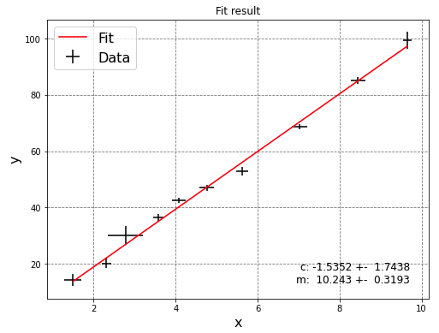

Lecture 6: Recap
Last week we started the second part of the course, using python for real physics problems!
Started with fitting a functional form to data.
  Read in data from files (using np.loadtxt)
    Plot to check sensible
    Find initial params
  Define necessary functions
    Functional form and its differential
    Point-by-point residuals
  Run least_squares() from scipy.optimize
    Check fit succeeds and get fitted params
  Calculate χ² test statistic from the residuals
    Check fit is good e.g. 0.25 < χ²/NDF < 4
  Calculate parameter errors
    Print best-fit parameters and associated error
  Plot data and fitted function
    Passing best fit params to functional form
Encapsulated all this in a reusable function
You will use this over-and-over in labs
  Will create your own python module for this in the last week of PHYS105

Slide 3
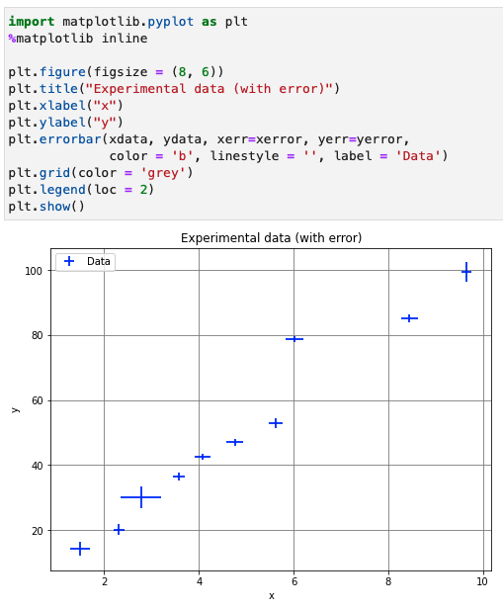
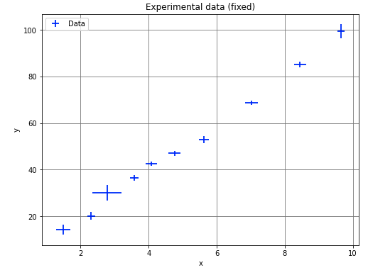

Lecture 6: Formative problem solutions
Exercise 1: Plot the experimental data and fix any errors compared to the table above
  Plot data read from csv file using errorbar()
  Clear that 8th point is incorrect → fix by updating array value at index 7 and replot

Slide 4
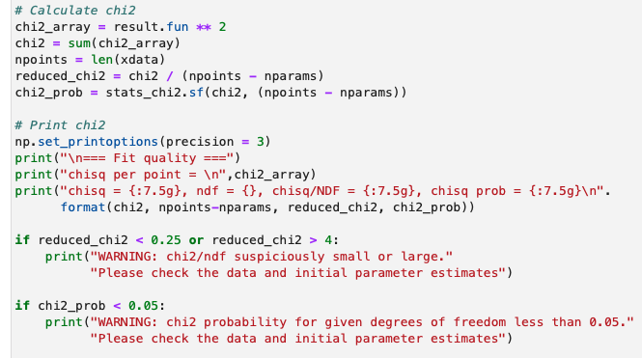

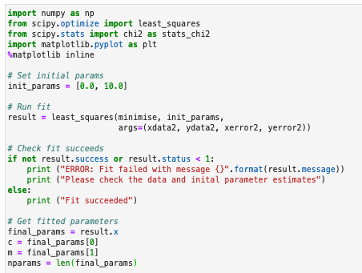
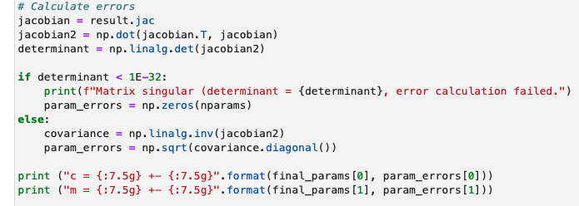
Lecture 6: Formative problem solutions (2)
Exercise 2: Fit extended data
Calculate χ² and check fit is good
Read data
Run fit and check it succeeds
New data
Calculate param errors and print
Get fitted parameters

Slide 5
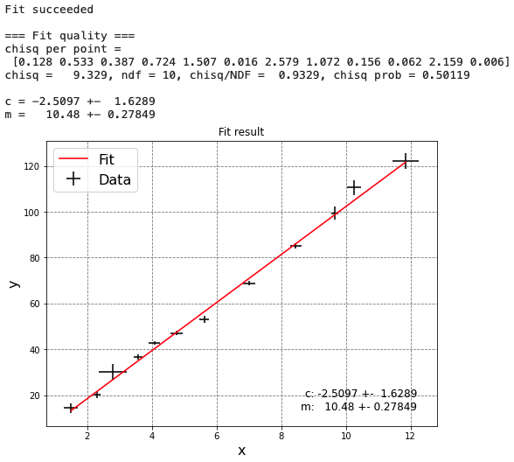
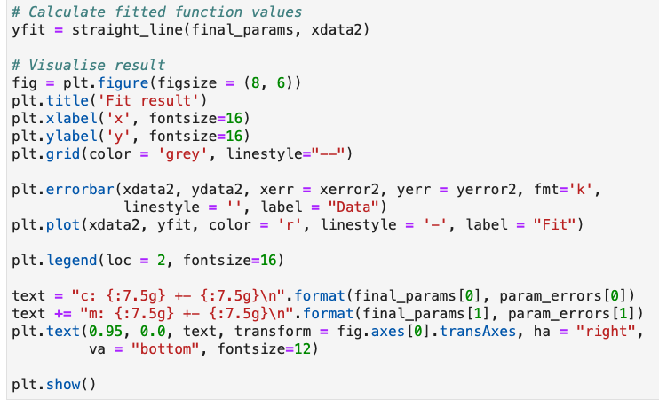
Lecture 6: Formative problem solutions (3)
Exercise 2 (cont): Fit extended data
Evaluate best fit y and plot
New data!

Slide 6
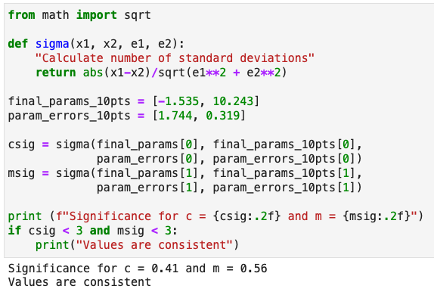

Lecture 6: Formative problem solutions (4)
Exercise 3: Does straight line still fit the data
  Yes, as shown by χ^{2:}
    χ²/ndf between ¼ and 4
    χ² prob greater than 5%
Have the gradient or intercept changed significantly?
  No, values are still compatible within errors
  Quantify by ”Consistency Check” (as in labs)
Total error
Now that we have developed our first real physics program, it is time to take a step back …

Slide 7
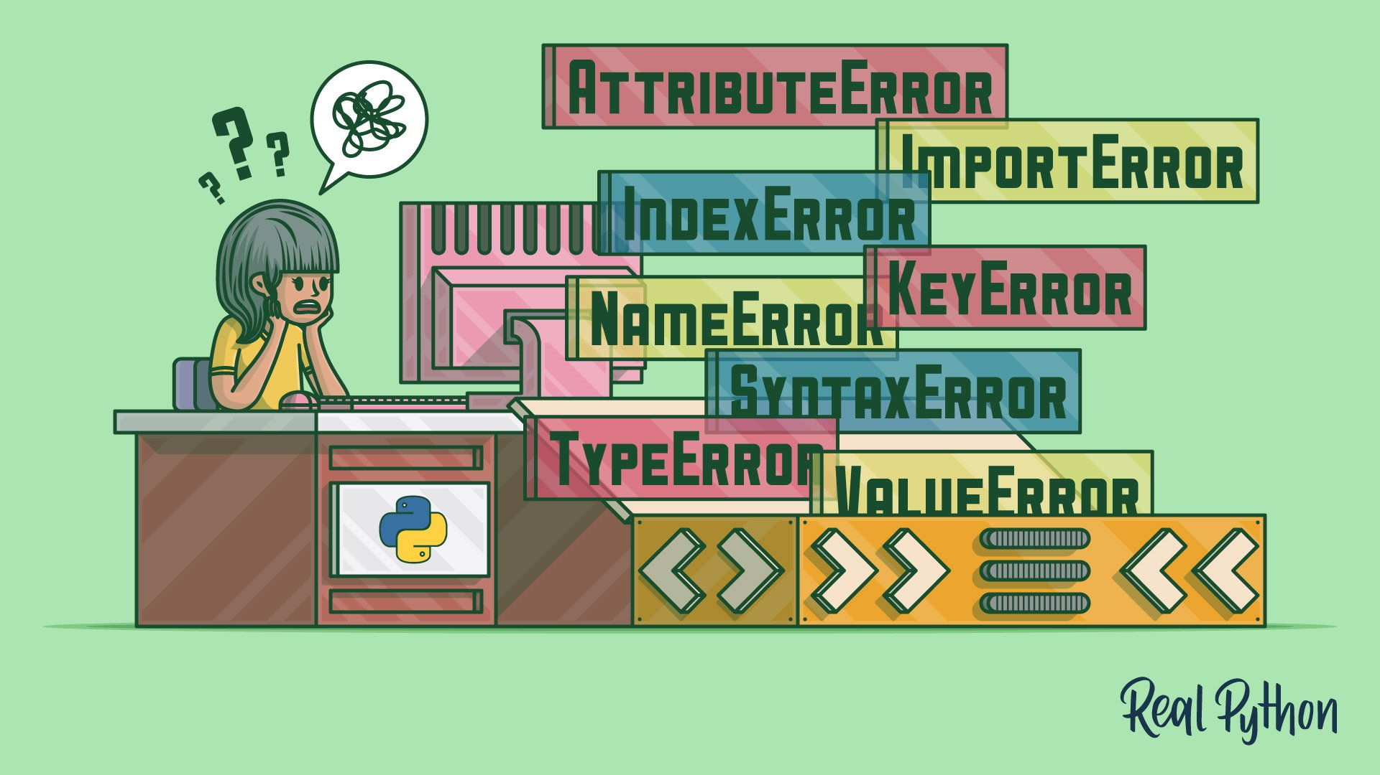
Python errors
At many points during the course you will have come across issues with your code
  Where python has given you a big fat error message or you get the wrong result
We can try to avoid these via good coding practice
  Using sensible variable names,
  Writing useful comments,
  Checking inputs/values, etc
But no matter how good we are, as we write more
complex programs we’ll encounter them more often
There are several different types of error we may encounter
  Code that is syntactically incorrect and therefore won’t parse at all
  Programs that start but give a run-time error and don’t complete
  Programs that run but produce incorrect results
This week, we are going to look in detail at how to understand these errors and debug them
Harder to debug

Slide 8
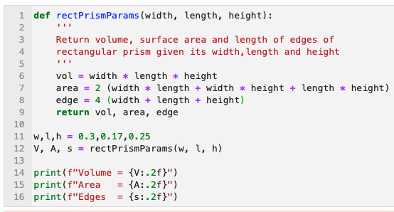
Understanding and debugging error messages
Real example saw during week 4 PC class
  Can turn on line numbers by
  View → Line Numbers → Show

Slide 9
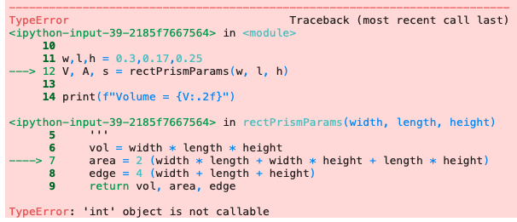
Understanding and debugging error messages
Real example saw during week 4 PC class
  Can turn on line numbers by
  View → Line Numbers → Show

Slide 10
Understanding and debugging error messages
Real example saw during week 4 PC class
  Can turn on line numbers by
  View → Line Numbers → Show
Read from bottom to top

Slide 11
Understanding and debugging error messages
Real example saw during week 4 PC class
  Can turn on line numbers by
  View → Line Numbers → Show
Read from bottom to top
The specific type of error
that was encountered
  In this case a “TypeError”
  Python is telling us the type of the object is incorrect

Slide 12
Understanding and debugging error messages
Real example saw during week 4 PC class
  Can turn on line numbers by
  View → Line Numbers → Show
Read from bottom to top
The specific type of error
that was encountered
  In this case a “TypeError”
  Python is telling us the type of the object is incorrect
The error message itself
  In this case python thinks we are trying to
  call an integer (like we would do a function)

Slide 13
Understanding and debugging error messages
Real example saw during week 4 PC class
The “traceback”, showing how the code got to the point of the error through various function calls, going from most recent at the bottom to least recent at the top.
  The lines indicated by the ‘--->’ are the ones called; the others are for context.
  In this case it calls rectPrimsPamas(…)on L12 & then gives an error in calculating the area on L7
  Can turn on line numbers by
  View → Line Numbers → Show
Read from bottom to top
The specific type of error
that was encountered
  In this case a “TypeError”
  Python is telling us the type of the object is incorrect
The error message itself
  In this case python thinks we are tying to
  call an integer (like we would do a function)

Slide 14
Understanding and debugging error messages
Real example saw during week 4 PC class
So, what’s the mistake in the code here?
  We are missing a multiplication sign * between the integer and the brackets!
  Python sees this as trying to call a function: 2()
  But you can’t call an integer, hence the error
*
The best way to get familiar with this is practice → let’s look at some in a notebook now …

Slide 15

Summary
This week we looked at various python errors and how to understand and debug them
In particular, in the lecture we looked at:
  Errors that prevent the program running at all
  Programs that start but don’t complete
Learnt more about how to read python error messages
  And practiced this with several different error types
In this week’s notebook you will explore errors further:
  How to reduce the scope for errors with good coding practice
  Debugging more of the above errors yourself
  Finally, some programs that run but give the incorrect result!
You will make coding mistakes (I still make many!)
  But with practice you can find and fix them quicker!

