Slide 1
Introduction to Computational Physics (PHYS105)
Lecture 6: Fitting Data
Carl Gwilliam
(C.Gwilliam@liverpool.ac.uk)
Attendance code: 283985

Slide 2
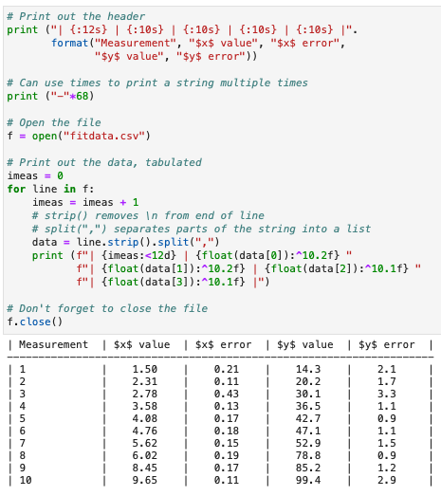
Lecture 5: Recap
Last week we looked at how to input and output info
  Either to/from a user or a file
We saw two ways of nicely formatting strings
  f-strings or the format() function
  Allows to control width, type, precision etc
We saw how to ask the user for input()
  Don’t forget the result is a string by default
  May need converting to int, float
We saw how to open() and close() files
  And how to read() from and write()to them
  Can also read line-by-line using a for loop
Can combine to e.g. read in data and make table

Slide 3



Lecture 5: Formative problem solutions
Exercise 1: Formatting number of eggs
  Use curly braces
    f-string: value entered in-place
    format: value entered via function call
  Format specifier after colon. Here d (rather than .0f as some people put)
Exercise 2: Day and number of week, aligned in columns
  Using tab characters (\t)
    A bit trial-and-error
  Format function
    Specify exact column width
    String (s) as type
  f-string
    Store values as variables
    or provide directly using
    different level of quotes

Slide 4
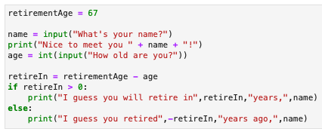
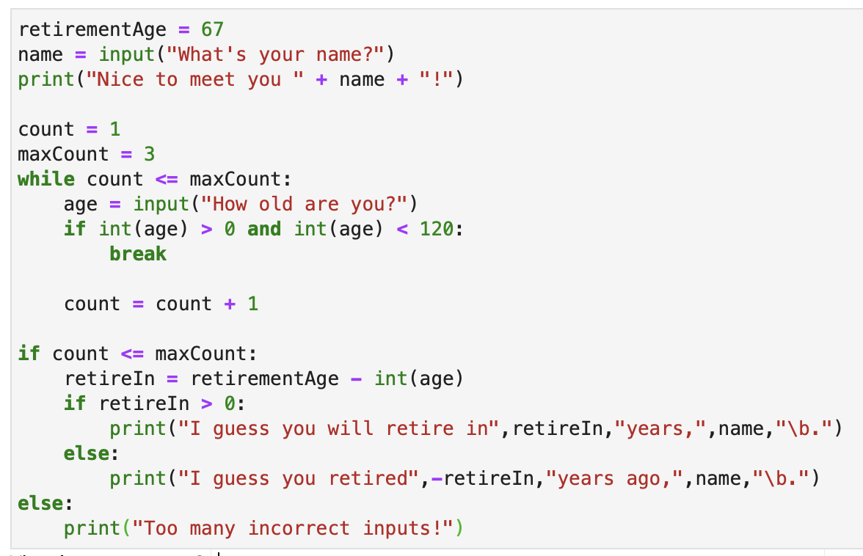
Lecture 5: Formative problem solutions (2)
Exercise 3: fix the error in the code
  By default input variables are read as strings
  But subtracting a string from a number doesn’t make sense → you need to convert them to int to be able to do maths with them.
Exercise 4: check age range 3 times
  Use a while (or for) loop to ask for input 3 times
    Don’t forget to increment the count
  If in the correct range you can just break
    Won’t run rest of loop so doesn’t ask again
    Otherwise, it will go round the loop asking again
  After the while loop we check the final count
    If count <= 3, a correct value has been entered
    → calculate the retirement age and print out
    Else print an error message
  Some people did if age in range(0,120)
    Works but inefficient

Slide 5
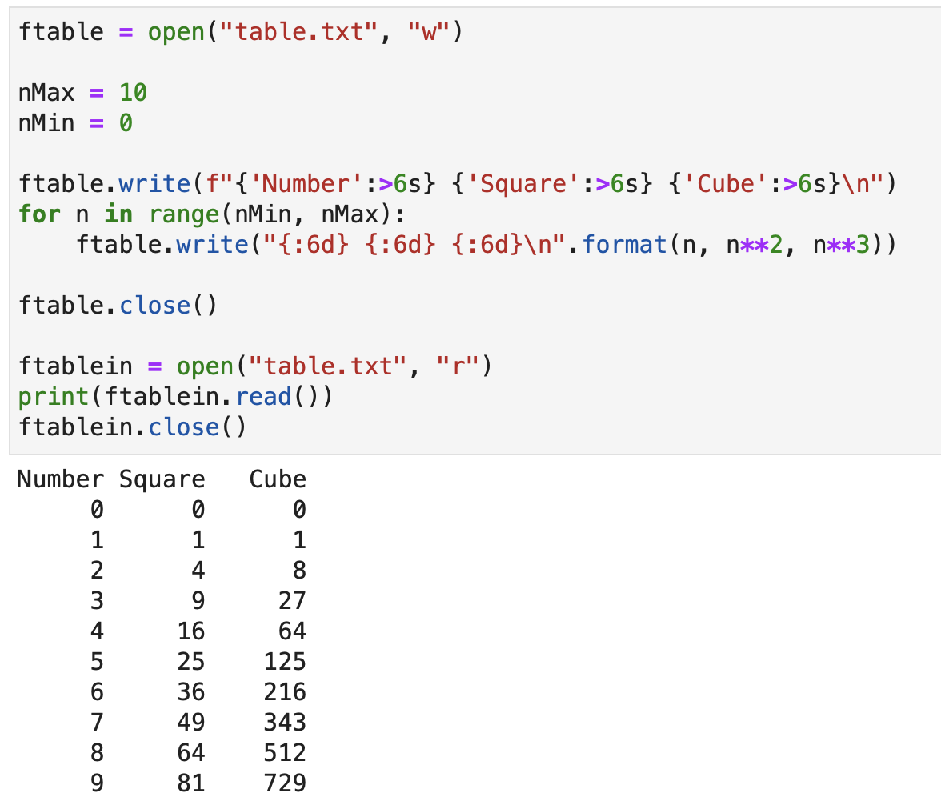
Lecture 5: Formative problem solutions (3)
Write out table of numbers, with squares and cubes, to a file and then read it back in
  Open the file
  Use the write function to output the string
  both for the header and each of the lines
    Don’t forget the new line (\n)
  Loop over the range of numbers using for
  Format with either f-string or format function
    Specifying integer (d) and width (here 6)
  Open the file again and call read()
  Don’t forget to close() the file each time

Slide 6


The course so far …
So far we have been focusing on learning how to use the basics of python.
We have seen ….
  How to use jupyter notebooks to write python programs
  How to store data in data structures, particularly NumPy arrays
  How to use functions, either existing ones or our own, to analyse the data
  How to control the flow of our programs via loops and conditional expressions
  How to make plots to visualise our data using matplotlib
  How to deal with input and output
From now on we are going to focus on pulling these together to analyse physics problems
  This will allow you to practice your python skills
We will see how to break down the problems so that we can solve them computationally
  In doing so, we will introduce a new python module: SciPy
  We will also look at how to debug issues in more depth (next week)
You can
program in python

Slide 7

Notes:
Do not modify the notes in this section to avoid tampering with the Poll Everywhere activity.
More info at polleverywhere.com/support
How confident do you feel with programming in python?
https://www.polleverywhere.com/multiple_choice_polls/et7NdcQJVI9TlAqWvZj97?state=opened&flow=Default&onscreen=persist

Slide 8
Tackling physics problems
There are many different types of physics problem, which differ in the approach & tools needed
  We will look at a range of problems in the coming weeks to develop the techniques needed
Fitting a functional form to data to extract the best-fit parameters (this lecture)
Numerical solutions of equations (lecture 8+9)
  Finding the roots
  Integrating and differentiating
  Solving differential equations
    E.g. projectile motion with air resistance
Using random numbers to produce Monte Carlo models (lecture 10)
  Integration e.g. calculating π
  Simulation e.g. bed availability in a hospital, motion of gas particles
Finally, we will see how to bring your code together in your own reusable module (lecture 11)
  That you can then use in labs to fit data going forward

Slide 9
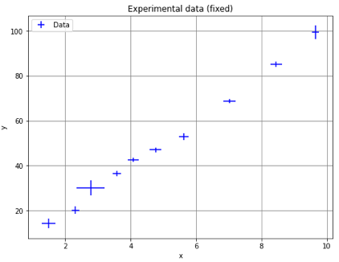
Line fitting
When we take experimental data, we usually want to determine the relationship between the dependent variable, y, and the independent variable, x: y = f(x)
  E.g. straight line, polynomial, exponential, power law, …
Often we know the expected functional form, for example from an underlying theory
  But we have some unknown parameters β: y = f(x, β)
In order to find these, we need to “fit” the expected
functional form to the data to find out:
  If the expected function form is compatible with
  our data, within the measurement uncertainties
  If so, what are the values of the free parameters
  that best describe the data we have taken
So, how do we fit the function to the data?
  E.g. which line is the ”best fit” to these points?
  First, we need to quantify the ”best fit”
Which straight line?

Slide 10


Finding the best fit (1)
In simple terms, the best fit is the one that lies closest to the set of data points overall
  This is where the sum of the distance between the prediction and each data point is smallest
  This distance is called the “residual” and for each point i is given by
The most common method is the least-squared method
  So-called because it minimises the squares of the residuals
The above formula assumes that we measure the data
points exactly, but in reality, they have an uncertainty σ_{yi}
  The larger the uncertainty the less we trust that point
  → points with smaller error have a larger weight
  We take this into account by measuring the residuals
  in terms of the size of the uncertainty on the point
y
y₅
r₅
y = f(x,β)= mx + c
y₄
r₄
y₃
r₃
y₁
y₂ – f(x₂,β)
r₁
r₂ =
σ_{y2}
y₂
error
c
x
x₁
x₂
x₃
x₄
x₅

Slide 11

Finding the best fit (2)
Now that we have a measure of how good a fit is (S) we want to find the best fit
  By varying the free parameters β to get the minimal value of S
In principle, this is simple: differentiate wrt β and set to zero: dS/dβ = 0
  And for a straight line, y = mx + c, this can be done analytically
But, in general, there is no analytical solution, so we need to use a numerical method
  Starting from an initial guess of the solution and then iterating to improve
We can use the third-party Scientific Python (SciPy) library to do this
  Provides a wide range of mathematical & scientific routines
  Works with NumPy arrays, of course!
Includes an optimisation module that provides a least_squares fitting routine
  (We will see in the later weeks how simple numerical methods work)
S
β

Slide 12


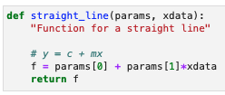
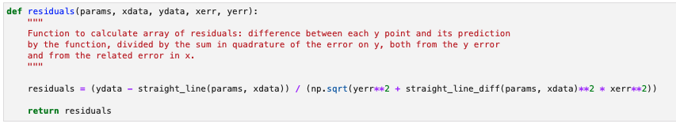
Least-squares: input
SciPy’s least_squares function can take many arguments, but for our needs it looks like
The first arg is the function (fun) that that computes the residuals and will be minimised
  Note, this must simply return a NumPy array of individual residuals per point
  SciPy takes care of squaring and summing these internally
y
dy
dx
x
Total error on y

Slide 13

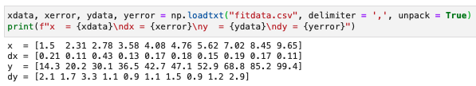
Least-squares: input (2)
SciPy’s least_squares function can take many arguments, but for our needs it looks like
The second arg is an initial guess (x0) of the free parameters β
  This is a sequence (list, tuple, array) of numbers
  Its length must equal the number of parameters
  Can usually be determined by eye from a plot of the data
Lastly, args is a a tuple of the input “data” that our function will be minimised with respect to
  In our case four NumPy arrays (xdata, ydata, xerrors, yerrors), often read from a file
  Gets passed indirectly into the residual function during minimisation
m ≈ 40/4 = 10
40
4
c ≈ 0
New: unpack into individual arrays
rather than 2D array

Slide 14

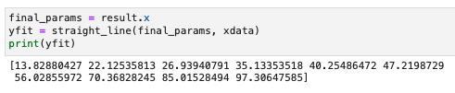
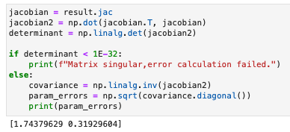


Least-squares: output
Once read the data and defined the residuals function & initial params, we can perform the fit
  Get a result object, containing several useful pieces of information ...
success: a boolean that tells us if the fit succeeded
  This is the first thing we must check
x: best fit parameters after the minimisation
  Can be fed back to our function to get final y values
jac: the Jacobian matrix (see PHYS108 in S2)
  Contains the first order partial derivatives
  Can be used to get the covariance matrix
  and hence the parameter uncertainties

Slide 15
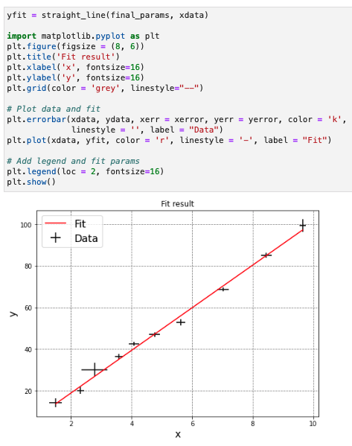

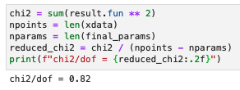

Least-squares: final result
First thing is to check if the function fits the data well using the χ² per degree of freedom (i.e. reduced Χ²)
  This χ² is simply the S function we defined earlier, which we divide by NDF = N(data) – N(params)
  For a good fit, should ≈ lie in range 0.25 < χ²/NDF < 4
We can then plot the best-fit line over the data
and print the best-fit parameters obtained
  Along with their uncertainties of course

Slide 16
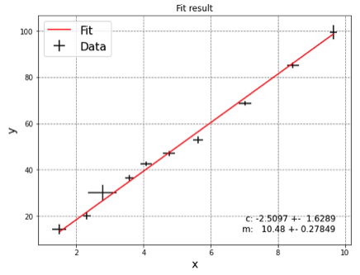
Summary
We have now started the second part of the course: using python to solve real physics problems
  Pulling together and practicing the various pieces we have learnt so far
    Variables, data structures, functions, control flow, input/output …
    NumPy arrays and functions, Matplotlib figures, …
This week we have looked at how we can fit a function to data to extract the parameters
  Something you will do time-and-time again when comparing theory to data (e.g. in labs)
In doing so, we introduced the SciPy package
  Can perform a variety of scientific calculations
  We only scratched the surface of what it can do
  We will use if further in the upcoming weeks
You will be able to practice fitting in this week’s notebook
  Going through step-by-step what we outlined here
  Finally, applying this to real experimental data

