Slide 1
Introduction to Computational Physics (PHYS105)
Lecture 5: Input and Output
Carl Gwilliam
(C.Gwilliam@liverpool.ac.uk)
Notes:
Start recording + attendance code
Moring everyone!
This week we are going to talk about how to deal with input and output, both to/from the user and also files, and how to format that output nicely
As always, please feel free to interrupt with questions at any point

Slide 2
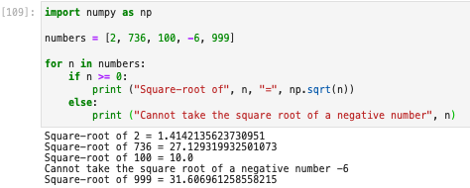
Lecture 4: Recap
Last week we learnt how to control the flow of our program’s execution
Executing code only if certain conditions are true
  Using if…elif…else
Repeatedly executing pieces of code
  Either for a range or data structure or while a condition is true
These both utilise
  Relational operators
  Boolean variables
  Logical operators
==,!=,>,<,>=,<=
True,False
and,or,not
X | Y | X and Y | X or Y
True | True | True | True
True | False | False | True
False | True | False | True
False | False | False | False
Notes:
OK, let’s recap last week, where we learnt …
Utilise …
…. equals (stress == not =), not equals ….
… the result of which is a boolean variable, T/F
... and which can be combined using logical operators: and (both input true), or (one input true), not (negates value)
As a reminder, here is the example we saw last week where want to take sqrt of list of numbers
Mention difference to continue
Go over

Slide 3
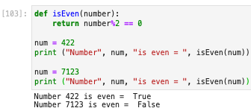
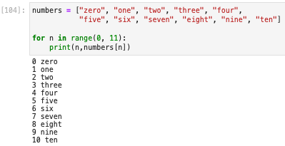

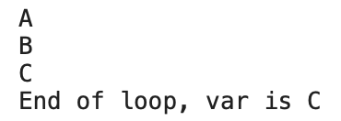
Lecture 4: Formative problem solutions
Exercise 1: Function to test if odd or even
  Check if the remainder when divide by 2 is 0
  Result is a boolean (True or False)
Exercise 3: Can we loop over a tuple
  Yes, only difference is it’s immutable
Exercise 2: for loop to print number & name
  We access the element of an array using []
  Simply pass the loop index into the brackets
    On each iteration this takes the values 0, 1, … 10 i.e. the elements of the list we need to access
  If you are struggling with loops think what will happen each iteration & what you would write for that specific iteration, then generalise
Notes:
As usual, we will now look at the solutions to the formative problems and feedback on some common issues
Ex1: The easiest way to test if a number is even is to check if the remainder when dividing by 2 is 0
From Week 1 we know that we find the remainder using the % operator
We can then test if this is 0 using the == (not = 0) operator
At this point some people started to write if/else conditions, which is fine but not really needed … the result of this will be a boolean variable (T/F)
Can just return this, without any if conditions -> print result -> true or false
Ex2: Some people struggled with this.
First let’s write a for loop over numbers 0->10 using the range function, remembering the upper bound is exclusive so we need 11
You know that you can access the given element of a list by passing the index in []
Think what happens when loop: each iteration the variable n takes the values 0,1,2… 10 (as can see from the print out)
We can simply use this as the index of the array and pass in square brackets: numbers[n] -> on first iteration this will be …
i.e. do 1 iteration, then generalise using the loop variable (n in this case)
Ex3: Create a tuple using round rather than square brackets
Loop over it with a for in same way as a list

Slide 4

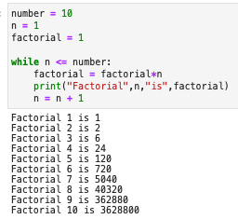
Lecture 4: Formative problem solutions (2)
Exercise 4: explain the calculation of the precision using a while loop
  Starts with eps = 1.0, so eps + 1.0 > 1.0
  Enters loop and haves the eps value
  Keeps going while the computer can tell
  the difference between eps+1 and 1
  Eventually eps is so small that eps+1 is the same as 1 to the precision stored
  The condition in the while then fails
  The precision is the last value where can tell the difference → twice the final eps value as have halved since then
  Note: can print eps value in loop to see this
Exercise 5: Factorial of each of first 10 numbers
  The loop var n gives the current number
  At each iteration we times the result so far by the current number, n, and reset the result
  Some people just printed 10 factorial rather than the factorial of each element up to 10.
Notes:
Ex4: … and was to get you thinking about how the computer works at the same time as looking at loops
The variables are only stored to a certain precision, and it is good to be aware of this as can affect calculations in some cases
A good debugging strategy is always to print out variables in the loop (eps in this case) to see what is happening
Ex5: We know the factorial of a number is the product of the numbers up to and including that number
We can calculate this simply with a loop if think about it in the correct way
First write the while loop to loop while n is <= 10, remembering to update the value by 1 each time to prevent an infinite loop
Each iteration the loop variable takes the numbers 1, 2 …
We can keep track of the product of the numbers seen by the loop so far using a variable
Start with setting =1 outside the loop then multiplying by n each iteration and update the result i.e. assign back to same value
The product so far IS the factorial up to that point -> print
Many problems can be solved like this so will use this kind of method several times
Summative marks for the lecture 3 assignment released in canvas: 25 not submitted but average of those that did was 80%
Any questions on the formative problems?

Slide 5
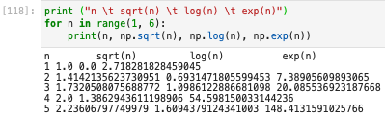
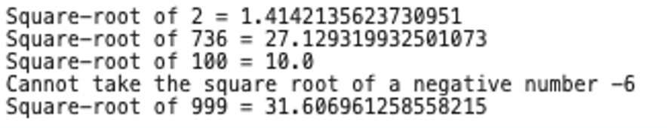
Formatting
We saw how to output results to the screen using the print()function already in lecture 1
  However, as we have seen, the result can often be messy
Often, we want to output the results of calculations to a certain precision
  E.g. in labs a precisions that is sensible given the uncertainties on the value
Further, when working with arrays of data we often want to tabulate the results
How can we do this?
  There are two related ways: the newer “f-strings” and the somewhat older format function
  Will show both since they are both still in use, but you should prefer “f-strings” in general
Output of example on slide 2:
Notes:
Let’s start this week’s topic …
Precision
For example, the output of the sqrt in slide 2 has a lot of precision we probably don’t care about
In labs, for example, often want to quote a value to a precision that is sensible given the uncertainties on the value
Tabulate the results
e.g. loop over numbers 1 to 6 and print the number itself, along with the sqrt, log and exp
If we do that with a bare print statement, we don’t get proper columns as nums bleed into each other as you can see

Slide 6
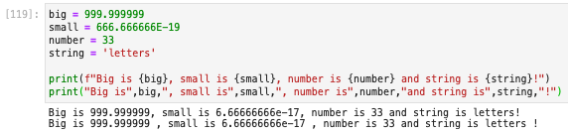
F-strings
Formatted string literals, or f-strings for short, are identified by an f preceding the string
Within such a string we can write python expressions in braces
  Such expressions can be a literal value, the name of a python variable or a more complex expression
Let’s see an example compared to the standard print syntax
  Here the variables big, small, number and string have been passed into the f-string in braces
  Apart from avoiding the spurious space before the comma, it may seem like we have not gained much
But the power of f-strings is that we can also include instructions of how to format the result of
the expression within the braces, which are hence known as a “format field” …
Notes:
f preceding the string before (i.e outside) the quotes (point)
Expressions in CURLY braces
literal (e.g. 2.0) , variable
more complex expressions (as we will see)
The f tells python to look for braces in the string and evaluate the contained code, replacing them in the string with the result
Suppose we have the variables … refer to code … and want to print them into a sentence
If we wanted to do this up to now, we would have called print passing in the different variables as separate args (separated by commas)
With an f-string, however, we call the print function in the same way, but it just takes one ”f-string” i.e quotes preceded by letter f
We then put each variable into this within braces at the correct position
Spurious space before the comma (point), which comes from the default space added by print between each argument

Slide 7
Format specifier
The format specification is placed after the expression within the braces, separated by a colon
We can use this to explicitly tell python how to display a given type using a “type specifier”
So, in our previous example, we could have
  Again, this looks pretty similar since the default python string representation does a good job
Type | Specifier | Meaning
String | s | String (this is the default)
Integer | d | Decimal integer
 | b, o, x | Binary, Octal, Hexadecimal integer
Float | f | Floating point
 | e | Float point in scientific notation e.g. 1e10
Common type specifiers (there are many others)
Notes:
So we have the string, preceded by an f and within this we can have curly braces that contain the value or expression we want to print
This can be followed by a colon and then the specification of how we want to print it, still inside the curly braces
We can … Lets look at some of the most common type specifiers …
To put the output as a string we use s for string
For an integer we use d for decimal
Can also output in other formats e.g. binary (b), …
For a float we use f or if we want it in scientific notation i.e. 10^ we use e since computers tend to display 10^ as e
Example: where we have now told it to print big as a float (:f), small as a float in scientific notation (:e), number as a decimal (:d) and string obv. as a string (:s)
Show binary as example
Again … But the format specification allows us to do a lot more …
Any questions on f-strings and format specifications so far?

Slide 8

Width and Precision
The type specifier can also be preceded by a number (e.g. 10.3f)
The whole part of the number specifies the width of the field the value is printed in
  This can be useful for aligning values in tables
For float types (f, e, …) the fractional part of the number specifies the precision in d.p.
  Note, you can specify just the decimal part to give the precision w/o specifying the width
Notes:
Width in number of characters
Padding the rest of the width with spaces (or another character if specified)
For example, here we have told python to print each in a field of width 12, so we get spaces if the output of the variable is shorter than that.
Not so useful in this case but can be used for aligning values in tables: by making the width larger that the widest print out we expect in any row
Precision
For example can tell it to print big to 2dp (12.2f) , and small to 3 dp (12.3e) -> see the difference to the previous result
Just give .2 or .3 with no whole number
Note that it rounds it nicely rather than simply truncating

Slide 9
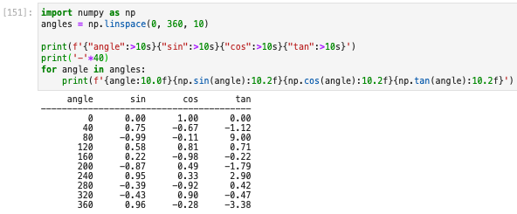
Alignment
Alignment | Symbol
Left | <
Centre | ^
Right | >
Within the width of the field, you can choose how to align the value
  Default if not specified is strings (numbers) are left (right) aligned
This is again useful for tabulation
  For example, putting everything together we can print a table of trig functions to 2d.p.
Note: you can multiply a string by a number to repeat it
Notes:
Left is a left arrow, right a right arrow and centred an up arrow (shift 6)
E,g. here we printed big left aligned, small centred and number right aligned
You can see this changes where the value is wrt the space
The default, if don’t specify, is strings are left aligned and numbers right aligned
Go over example: Create a numpy array of 10 angles angles from 0 to 360
print a header, with the title of each column given as a literal string (could be a var). For the format we obviously want a string (s), and we chose right aligned (>) in a field of width 10
Note: need to use different quotes (single and double) for the outer and inner string so python can tell difference, but can be either way
print a line: here we see that multiplying a string by a number repeats it that many times (which is kinda intuitive)
Then loop over our angles using the for loop saw last time, and print an f-string
We give each thing we want to print in braces, with the braces representing each column: for the angle a simple variable, while for the others it’s the actual calculation, showing the braces can contain more complex expressions.
(Best not to let this get too long as becomes hard to read)
Each is printed in the same field width of 10 to line up with the headers, with no dp for the angle (10) and 2 dp for the trig results (10.2)
We use the default right alignment (since we have not specified)
Get a nicely aligned table with a reasonable precision → very useful for presenting data/results
Any questions on width, precision and alignment?

Slide 10
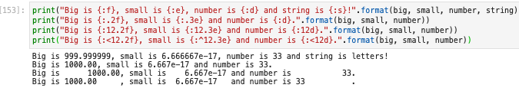
Format function
The usage of the somewhat older format() function syntax is similar to the f-string
Again, we specify the formatting in braces at the correct point in the string
  With exactly the same syntax as above
The difference is that we provide the variables via the format function called on the string
  Rather than placing them directly in the braces within the string
  The variables have to be passed to format in the same order you want them to appear
Having the variables and the formatting specified in different places is cumbersome
  Hence the preference for the newer f-strings
Notes:
Here are the corresponding examples to the above f-string ones.
They look every similar, except there is no f at the start.
But you see that the braces now contain nothing before the colon
Instead, they just have the format specifier
The variables are then filled in from those in the format function, which have to …
…cumbersome, in particular it is easy to forget which corresponds to which
You’ll practice both in the problems class
Any questions on formatting in general?

Slide 11


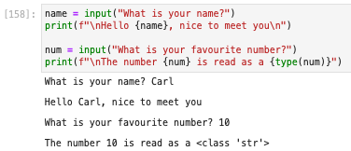
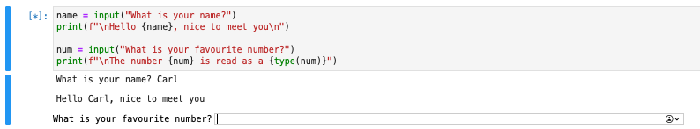
Keyboard input
Now we have looked at how we format output we will look at to how to get user input
This is done using the input() function
  The argument is a prompt string printed to the user
  The return is what the user has input
When python gets to each call of input it presents a box for the user to type their input
  After the input you must press return
  The result is always returned as a string
    Must convert if needed (see notebook)
Notes:
Go over example
Ask the user for their name, passing the question as an argument to the input function
Store the result as a variable and print it out
We then ask them their favourite number and do the same, this time using an f-string
When python gets to each input call, it presents a box and waits for user input
Enter value and press return
So we see that it prompts for the first question (point)
Only when have entered that and pressed return does it print the result (point) and the ask the second (point)
We also see that the type of num in the second case is a string (point)
This is because the return from input is always a string; if you want it as some other type (e.g. for calculations) you must explicitly convert it
As you’ll see in this week’s notebook

Slide 12

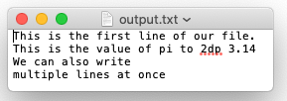
Reading and writing files
Now we have seen how to input and output to the screen, what about reading/writing a file?
In order to do this, we must first open a file using the open() function
  This takes the name of the file and an optional mode
    read = “r” (default), write = “w”, both = “rw”
  It returns a ”handle” to the file that we can use to interact with it
We can write a string to the file using the write() function
  Can use f-strings or format with the format specifiers above to format the output
Note: after finishing we must remember to close() the file
Notes:
This is very useful to be able to read in experimental data or write out results to store them permanently or to be able to input them somewhere else for example
For NumPy arrays of data we can use the savetxt and loadtxt we saw, but we might want to store other information.
Takes two args: the first is the name of the file and the second is an optional mode, which defaults to read (point to code)
We can write …
Let’s look at an example
Open a new file called output.txt for writing (passing “w” as the mode) and assign it to the variable fout
Can call write function as many times as we want using fout.write (same as calling np.cos for example)
Can use normal strings or if want to format the output f-strings or format(), that we just learnt about, as input (e.g. pi to 2dp)
Here I have printed one line per write statement so we need to have \n at the end for a new line (it’s not done automatically)
Can write multiple lines at once using multiple \n within a single write statement
Close function to close the file
If we open the file with some editor we can see the expected output …

Slide 13
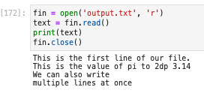
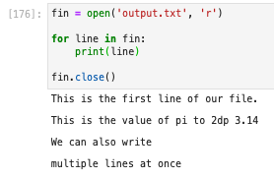
Reading and writing files (2)
We read the file back in using the read() function
  We must remember to open the file for reading first
  And close again when we are done
This reads the whole file at one into a single string
  What if we want to read it line-by-line?
  For example, to allow processing each line
We can easily do this with a for loop
  Since the file handle provides a kind of data
  sequence we can iterate over directly
Each line of the file is separated by a blank line
  This is because print() writes a new line character
  at the end of each string, but this is also already
  present in the line read from the file → twice
  You will see how to solve this in the notebook
Notes:
Can read back file using read (point to example)
Open for reading passing the file name and ”r” as the mode since only want to read (could omit as r is default)
Assign this to a variable, which I’ve called fin
Call the read function and assign the result to a variable -> print out
Close again
Data sequence can iterate over
Open as before and assign to a variable
loop over file using for loop with same syntax as saw last week …
Each iteration the variable is that line of text and we can do what we want with it e.g. print
Can see in the output that …
Show tojenizing with split() e.g. ChatGPT
Any Questions on input and output?

Slide 14





Summary
This week we have looked at input and output
  How to receive input from the user
  How to read/write a file
  How to format our output
You now know all the basics of python that you will need for this course
  Of course, there are more advanced features (some of which you will cover in PHYS205)
  And you need further practice
  But you have learnt the basic building blocks
For the rest of the course, we will focus on using python to perform useful calculations
  Fitting experimental data
  Numerical calculations
  Monte Carlo methods
In doing so we will practice what we have learnt (+ see a few new features along the way)
You can
program in python
Notes:
After first bullet: … and, of course, you will look at this in more detail in the notebook which has been released in canvas
Congratulations … even if it may not feel like it sometimes
These will make heavy use of the numpy and matplotlib modules we have become familiar with
And introduce a new one, scientific python or scipy
Any final questions?

