Slide 1
Introduction to Computational Physics (PHYS105)
Week 5: Input and Output
Carl Gwilliam
(C.Gwilliam@liverpool.ac.uk)

Slide 2
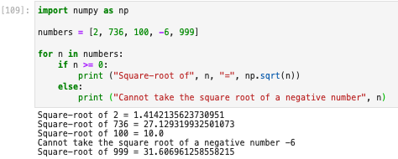
Week 4: Recap
Last week we learnt how to control the flow of our program’s execution
Executing code only if certain conditions are true
  Using if…elif…else
Repeatedly executing pieces of code
  Either for a range or data structure or while a condition is true
These both utilise
  Relational operators
  Boolean variables
  Logical operators
==,!=,>,<,>=,<=
True,False
and,or,not

Slide 3
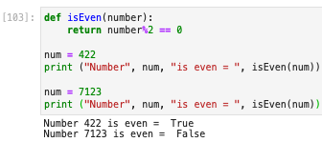
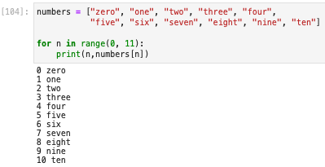

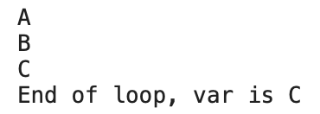
Week 4: Formative problem solutions
Exercise 1: Function to test if odd or even
  Check if the remainder when divide by 2 is 0
  Result is a boolean (True or False)
Exercise 3: Can we loop over a tuple
  Yes, only difference is it’s immutable
Exercise 2: for loop to print number & name
  We access the element of an array using []
  Simply pass the loop index into the brackets
    On each iteration this takes the values 0, 1, … 10 i.e. the elements of the list we need to access
  If you are struggling with loops think what will happen each iteration & what you would write for that specific iteration, then generalise

Slide 4

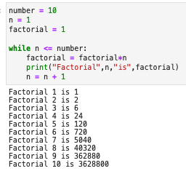
Week 4: Formative problem solutions (2)
Exercise 4: explain the calculation of the precision using a while loop
  Starts with eps = 1.0, so eps + 1.0 > 1.0
  Enters loop and haves the eps value
  Keeps going while the computer can tell
  the difference between eps+1 and 1
  Eventually eps is so small that eps+1 is the same as 1 to the precision stored
  The condition in the while then fails
  The precision is the last value where can tell the difference → twice the final eps value as have halved since then
  Note: can print eps value in loop to see this
Exercise 5: Factorial of each of first 10 numbers
  The loop var n gives the current number
  At each iteration we times the result so far by the current number, n, and reset the result
  Some people just printed 10 factorial rather than the factorial of each element up to 10.

Slide 5
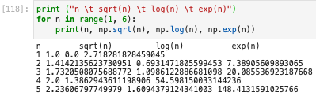
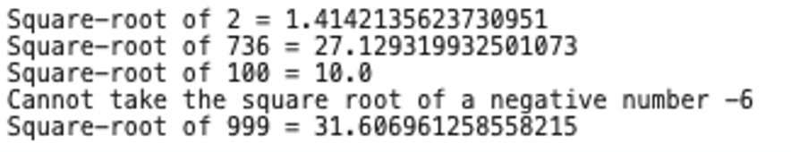
Formatting
We saw how to output results to the screen using the print()function already in week 1
  However, as we have seen, the result can often be messy
Often, we want to output the results of calculations to a certain precision
  E.g. in labs a precisions that is sensible given the uncertainties on the value
Further, when working with arrays of data we often want to tabulate the results
How can we do this?
  There are two related ways: the newer “f-strings” and the somewhat older format function
  Will show both since they are both still in use, but you should prefer “f-strings” in general
Output of example on slide 2:

Slide 6
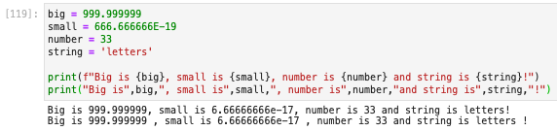
F-strings
Formatted string literals, or f-strings for short, are identified by an f preceding the string
Within such a string we can write python expressions in braces
  Such expressions can be a literal value, the name of a python variable or a more complex expression
Let’s see an example compared to the standard print syntax
  Here the variables big, small, number and string have been passed into the f-string in braces
  Apart from avoiding the spurious space before the comma, it may seem like we have not gained much
But the power of f-strings is that we can also include instructions of how to format the result of
the expression within the braces, which are hence known as a “format field” …

Slide 7
Format specifier
The format specification is placed after the expression within the braces, separated by a colon
We can use this to explicitly tell python how to display a given type using a “type specifier”
So, in our previous example, we could have
  Again, this looks pretty similar since the default python string representation does a good job
Type | Specifier | Meaning
String | s | String (this is the default)
Integer | d | Decimal integer
 | b, o, x | Binary, Octal, Hexadecimal integer
Float | f | Floating point
 | e | Float point in scientific notation e.g. 1e10
Common type specifiers (there are many others)

Slide 8

Width and Precision
The type specifier can also be preceded by a number (e.g. 10.3f)
The whole part of the number specifies the width of the field the value is printed in
  This can be useful for aligning values in tables
For float types (f, e, …) the fractional part of the number specifies the precision in d.p.
  Note, you can specify just the decimal part to give the precision w/o specifying the width

Slide 9
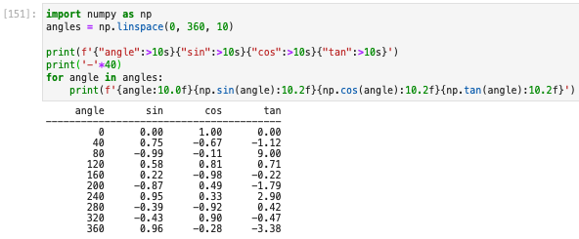
Alignment
Alignment | Symbol
Left | <
Centre | ^
Right | >
Within the width of the field, you can choose how to align the value
  Default if not specified is strings (numbers) are left (right) aligned
This is again useful for tabulation
  For example, putting everything together we can print a table of trig functions to 2d.p.
Note: you can multiply a string by a number to repeat it

Slide 10
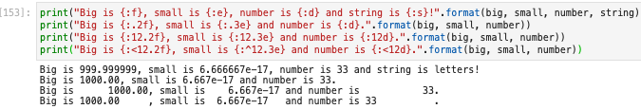
Format function
The usage of the somewhat older format() function syntax is similar to the f-string
Again, we specify the formatting in braces at the correct point in the string
  With exactly the same syntax as above
The difference is that we provide the variables via the format function called on the string
  Rather than placing them directly in the braces within the string
  The variables have to be passed to format in the same order you want them to appear
Having the variables and the formatting specified in different places is cumbersome
  Hence the preference for the newer f-strings

Slide 11


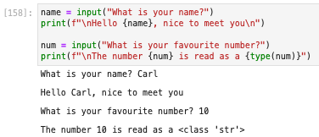
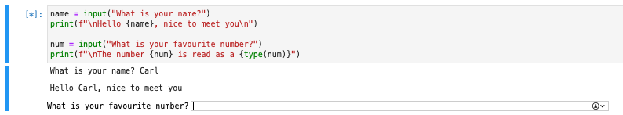
Keyboard input
Now we have looked at how we format output we will look at to how to get user input
This is done using the input() function
  The argument is a prompt string printed to the user
  The return is what the user has input
When python gets to each call of input it presents a box for the user to type their input
  After the input you must press return
  The result is always returned as a string
    Must convert if needed (see notebook)

Slide 12

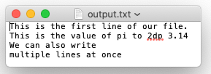
Reading and writing files
Now we have seen how to input and output to the screen, what about reading/writing a file?
In order to do this, we must first open a file using the open() function
  This takes the name of the file and an optional mode
    read = “r” (default), write = “w”, both = “rw”
  It returns a ”handle” to the file that we can use to interact with it
We can write a string to the file using the write() function
  Can use f-strings or format with the format specifiers above to format the output
Note: after finishing we must remember to close() the file

Slide 13
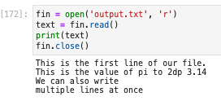
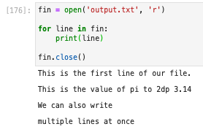
Reading and writing files (2)
We read the file back in using the read() function
  We must remember to open the file for reading first
  And close again when we are done
This reads the whole file at one into a single string
  What if we want to read it line-by-line?
  For example, to allow processing each line
We can easily do this with a for loop
  Since the file handle provides a kind of data
  sequence we can iterate over directly
Each line of the file is separated by a blank line
  This is because print() writes a new line character
  at the end of each string, but this is also already
  present in the line read from the file → twice
  You will see how to solve this in the notebook

Slide 14





Summary
This week we have looked at input and output
  How to receive input from the user
  How to read/write a file
  How to format our output
You now know all the basics of python that you will need for this course
  Of course, there are more advanced features (some of which you will cover in PHYS205)
  And you need further practice
  But you have learnt the basic building blocks
For the rest of the course, we will focus on using python to perform useful calculations
  Fitting experimental data
  Numerical calculations
  Monte Carlo methods
In doing so we will practice what we have learnt (+ see a few new features along the way)
You can
program in python

