Slide 1
Introduction to Computational Physics (PHYS105)
Lecture 4: Flow Control
Carl Gwilliam
(C.Gwilliam@liverpool.ac.uk)
Attendance code: 224329

Slide 2

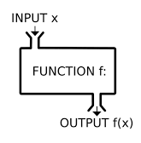
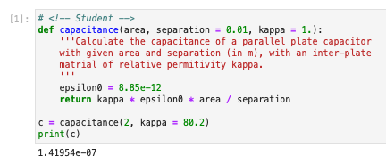
Lecture 3: Recap
Last week we learnt how to define our own functions
  Allowing us to write reusable calculations
  Please write your code in functions where appropriate!
They consist of 3 main pieces
  Inputs: passed as comma-separated set of arguments
  Body: code that performs the work
    Must be indented
  Outputs: comma-separated values specified by return
FUNCTION
f BODY
We also looked more at plotting
  Histograms, lines, and points
  with error bars

Slide 3
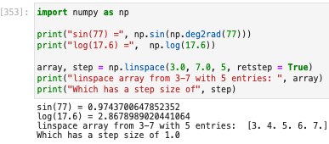
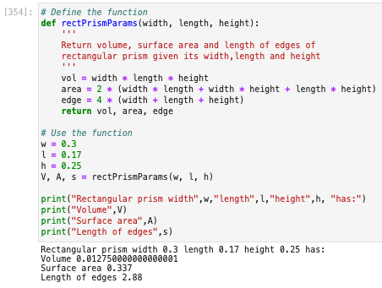
Lecture 3: Formative problem solutions
Exercise 1: Using np for sine & natural log
  And creating arrays with linspace
  Notes on Ex 1:
    NumPy has a function to convert deg → rads
    retstep = True gives the step from linspace
  Notes on Ex 2:
    It is good practice to add docstrings to explain what the function should do
    Remember, the variables don’t need to have
    the same name inside & outside the function
Exercise 2: Function to calculate prism values

Slide 4
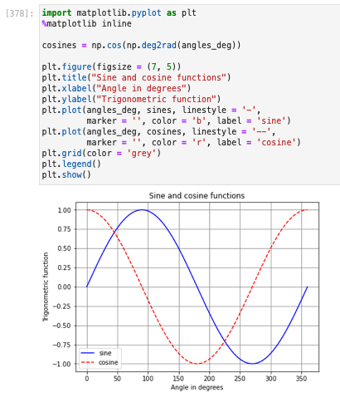
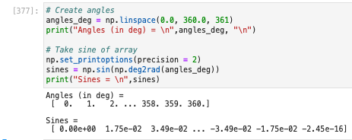
Lecture 3: Formative problem solutions (2)
Exercise 3: Use array-at-time functionality to take
sine of angles from 0 to 360º
  Can use (a)round()to set precision of a given array
  or set global print precision: np.set_printoptions()
Exercise 4: Plot sine and cosine functions
  cos calculated just like sin above
  Call plot(x, y, …) twice, once with each
    Takes x and y array, not just y
  Note: use different line colours and styles

Slide 5
Flow control
We now have the structures to store data and the functions to operate on them
  But the calculations we can do are limited since the code we have written so far is purely sequential
Flow Control
Iterative Statements
break
Conditional Statements
if
else
elif
for
while
Transfer Statements
continue
Often, we want to execute code only if a certain condition is met (conditional) or we may want to repeat code multiple times (iterative) e.g. for each element of our data structure
  Today, we will look at each of these in turn …

Slide 6



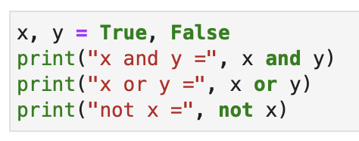
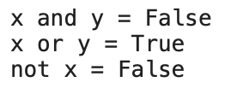
Relational and boolean operators
We can compare numerical values using relational operators: ==,!=, >=, <=, >, <
  Similar to the corresponding mathematical symbol, but note == for equality (as = is assignment)
The result of these is either True or False
  This is represented by a special type of variable, called a boolean or bool
Boolean values can be combined using logical, or boolean, operators: not, and, or
  In the same way as e.g. logic gates in electronics
X | Y | X and Y | X or Y
True | True | True | True
True | False | False | True
False | True | False | True
False | False | False | False

Slide 7
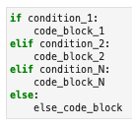
Conditional execution
Allows us to execute code depending on certain conditions
Conditional execution is achieved via if…elif…else
  The latter two are both optional
Starts with if followed by a bool condition and a colon (:)
  True: the indented code block is executed
  False: passed to the next part of test if present
Next, we have any potential elif conditions
  Similar in format to the if condition
  Only attempted if previous if/elif statement is False
Finally, we may have an else statement
  Has no associated condition
  Executed if all the above if/elif statements are False
In
True
Condition 1
Code body 1
False
True
Condition 2
Code body 2
False
True
Condition N
Code body N
False
Else code
body
Out

Slide 8
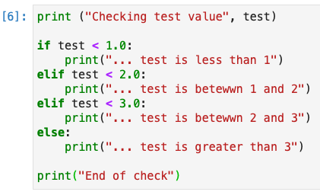



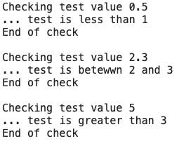
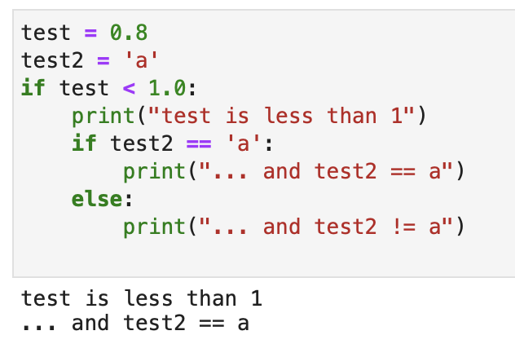
Conditional execution (2)
Let’s look at some examples ….
  Simple if condition:
  Full if…elif…else condition:
Can also nest if…elif…else conditions:

Slide 9

Iterating
Often want to execute code for a range of values
  E.g. each item in a data structure (list, tuple, np.array, etc)
Copy-and-pasting code is not scalable
  Need a way of iterating over a range of values …
Each item in
range/structure
In
Yes
False
For loop
  Loop over a given range of values
  Loop over each item in a data structure
Last item?
While loop
  Iterate while a condition is true
Condition
No
True
For code
body
While code
body
Let's look at each in turn …
End of loop
End of loop

Slide 10

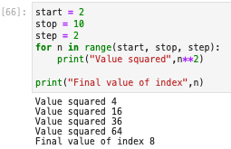
For loop: range
The start of the loop is indicated by the for keyword
  Followed by the name of a variable used as an index,
  which takes the variables given by the range function
    Both the start and step are optional, defaulting to 0 and 1
  The definition is ended by a colon (:)
The indented code block is executed for each index value returned by range …
From this example we can see what happens:
  The index n is set to start value of range i.e 2
  The body of the for loop is executed
  The value of the index n is incremented by step
  and compared to stop
    If it is less than stop the body is executed
    This continues in step increments
  Until n + step ≥ stop, when the loop terminates
    Final value of n is the last allowed value (e.g. 8)
Exclusive

Slide 11

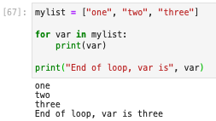
For loop: data structure
For loops can also cycle directly through the elements of a data structure (list, tuple, np.array, etc)
  Without the needed for an index
The syntax here is very similar but without range()
  And the variable after for now takes the value of the
  current element in the data structure not an index
Here is an example:
  The var is assigned to the first element (“one”)
  The body of the for loop is then executed
  The var is assigned to each next item in the structure
    And the body is executed
  Until it has reached the end of the data structure
Note:
  The two forms of the for loop are not really different: in the first case the range function just returns a sequence of integers (kind of like a list) that the for loop iterates over in the same way as the second

Slide 12

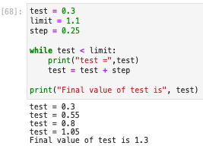
While loop
A while loop provides another way to iterate, while a condition is true rather than over a sequence
The start of the loop is indicated by the while keyword
  Followed by a condition on a predefined variable
  As always, the definition ends with a colon (:)
The indented code block is executed while the condition is true
  Unlike the for loop, the user is responsible for updating the
  variable driving the condition. Else you’ll get an infinite loop!
Let’s see an example:
  The condition is evaluated with initial value of test (0.3)
  If the condition passes the body is executed
    Unlike a for loop, body may never be executed
  The body updates the value of the test variable
    If the condition is still true body is executed again
  Until the condition fails
If this happens in the PC class,
just restart the jupyter kernel .

Slide 13

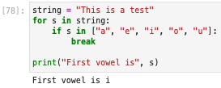

Transfer: continue and break
The for and while loops repeat a block of code until end of the range/list or the condition fails
  But sometimes we may wish to alter this and there are two ways we can do this …
The continue statement
  Skip to beginning of next iteration
  Without executing any further code
  in the current iteration
The break statement
  Jump directly to the very end of the loop
  Without executing any further code in the current iteration nor any further iterations
Note: here we have a new use of the in operator
  As well as iterating in for loops it can be used to
  test if something is contained in a data structure

Slide 14
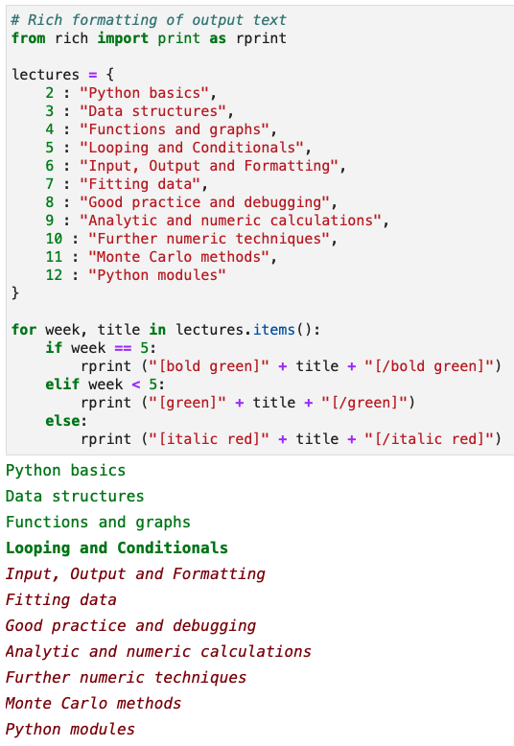
Summary
This week we looked at how to control the flow of
our python program’s execution
How to only execute code in certain cases
  if … elif … else
How to repeatedly execute pieces of code
  Over a range or data structure
  While a condition is true
This will allow us to write much more useful programs
You will look at these further in the problems classes
We only have one more week of building up our python
  Then we will move on to real physics uses to practice

