Slide 1
Introduction to Computational Physics (PHYS105)
Lecture 3: Functions and Graphs
Carl Gwilliam
(C.Gwilliam@liverpool.ac.uk)
Attendance code: 198014
Notes:
RECORD + Attendance Code!!
Morning everyone
Please don’t forget to register your attendance
How did you find last week’s problems class?
Is it starting to make sense? Would anyone like to give any input?
This week we are going to discuss functions in python and go more into detail on plotting

Slide 2
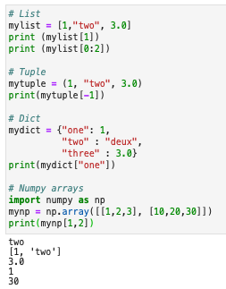
Lecture 2: Recap
Last week we learnt about various python data structures
  Both sequences (index) and mappings (key:value)
Built-in structures
  Lists []: mutable sequences of variables of any type
  Tuples (): like lists but immutable (can’t change elements)
  Strings “” or ‘’ : immutable sequences of characters
  Dicts {}: mapping of keys to values
NumPy arrays
  More efficient structures for numerical calculations on the
  same type of value in 1 or more dimensions
  Can be used to read data from file and write back out
All have similar syntax for accessing/changing the elements
  Can use negative indices to count from the back
  And slices to get a range of elements [lo:hi)
Notes:
Before we do so, let’s recap last week, where we …
Sequences = set of values referred to using position, starting from 0, as an index
Mappings = instead of an index, relate a key to a value (like a directory)
Refer to example as go through
List: assign elements with square brackets; Tuple: assign elements with round brackets
Saw strings were also data structures containing an immutable sequence of characters in quotes (single or double)
Dict: created with with curly brackets and contain key:value pairs (with a colon) separated by commas
Due to flexibility of mixed types these quickly get slow -> Use Numerical python -> numpy arrays (very like lists)
Sequences: Access using index starting from 0.
Can use –ve index to go from back or slice lo:hi to give range; In 2D just use two indices (either in separate square brackets or separated by a comma
Mappings: same except use the key instead

Slide 3
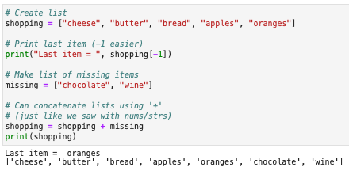
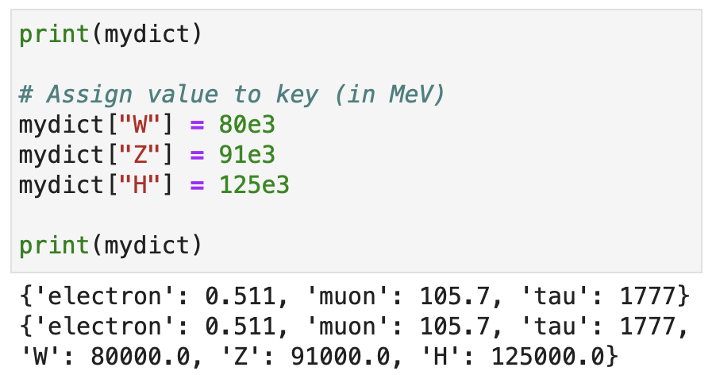

Lecture 2: Formative problem solutions
Exercise 1: Print last item of shopping list then add two missing items to it
  For the last item could use 4 or -1 as index
  For lists the + operator performs concatenation
    Could also have used append() to add items
    one-by-one or extend() to add new list
  A few people mistakenly created a list of lists by
Exercise 2: Extend the particle mass dict
  Adding W, Z and H bosons
  Could also use update()with 2nd dict
  Most did this correctly but a few created a
  new dict with all the items from scratch
    Rather than adding new items to existing dict
  Also, many put these masses in GeV
    Rather than consistently in MeV
Two brackets = nested list
Notes:
Like last week, we will now look at the solutions to the formative problems and some common issues
Ex 1: All managed to create list
Say why -1 better: don’t need to change if increases in size
+ for numbers, strings, lists
append takes single element (if give a list will get a list within a list); fif you want to give a list you need to use extend takes list (same as +)
Can see list of lists due to two brackets (shows items of list can contain other lists -> nested data structures) [show]
Ex2: We saw that can change an element by assigning to the corresponding key
If the key doesn’t exist it creates a new element with this value
E.g. assign 80 to the new key “W” using square brackets, just like simple variable (could also use the update function)
May not always be able to change the initial dict if someone else created it or don’t have all values at the start

Slide 4
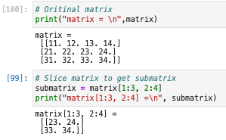
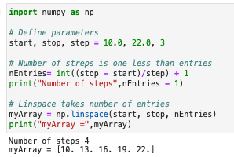

Lecture 2: Formative problem solutions (2)
Exercise 3: Create array using np.linspace, printing the array and number of steps
  Note: you can assign multiple variables
  on one line using commas
  Some people entered nEntries = 5 by hand
  Many also printed the step size or number of entries rather than the number of steps
    Which is the number of entries minus 1
Exercise 4: Print out 2x2 lower right matrix
  Remember slices indices are inclusive on
  lower bound but exclusive on upper one
  NB: As go to last index, don’t need upper bound
  Some people created a new array of the
  elements from scratch rather than slicing
Must use form with single square brackets [x, y] for this, not [x][y]
Notes:
Ex 3: Didn’t cover in last week’s lecture but one of most useful ways of creating an array
linspace creates and array from start to stop with n linear-spaced (as opposed to log-spaced) entries. Hence the name.
Now in the question you were told the step size but not what takes -> needs the nEntries
… by hand … Can calculate entries from # steps + 1(need to do so for more complex problems)
N steps = difference between start and end in terms of number of steps, as int then + 1
Once have this create linspace
Many also … number of steps = nEntries – 1 = 4 as see from output (not 3 which is the size of the step)
Ex 4: Go through slice indices, first row and then column, reminding upper is exclusive
if no upper index in slice then goes to end, similar for lower index -> will start from the beginning

Slide 5
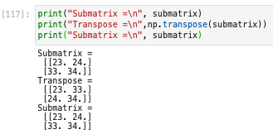
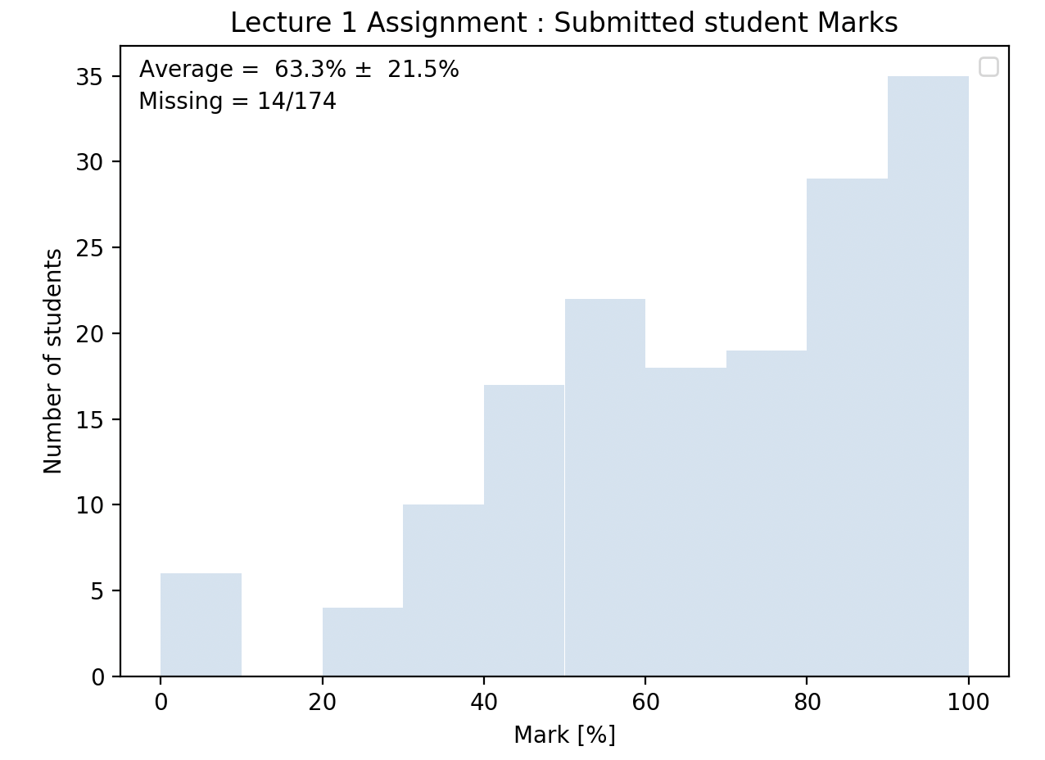
Lecture 2: Formative problem solutions (3)
Exercise 5: Swap the matrix rows and cols
  Using np.transpose()
  Note: transpose function doesn’t change original but makes a transposed copy
    Can assign result to a variable
Lecture 2 summative: marks released in Canvas
  Analysed using python with matplotlib ☺
Notes:
Ex 5: Use submatrix that assigned on previous slide
Transpose takes an array and returns a transposed copy
Show help/docs, esp. example part
Need to call this with np.
Doesn’t change original, which can see if print that out after, but rather a copy which you can assign to a variable
QUESTIONS on formative problems?
Have released the marks and feedback on the first week assignment in canvas
Analysed the summative marks
8% missing -> won’t pass
Average = 63% and peaked at high values -> most above pass mark
If you are below this mark and struggling please get in touch

Slide 6
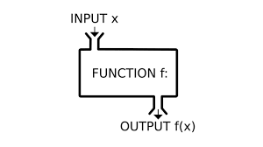
Functions
To be able to manipulate our data we need to look at functions in more detail
Functions are self-contained pieces of code that, when called, accomplish a specific task
  They take in data as comma-separated arguments, process it, and return some result
We have already used several functions
  Directly available functions e.g print()and type()
    https://docs.python.org/3/library/functions.html
  Functions in built-in modules e.g. math.sin()
  Functions from third-party modules e.g. np.linspace()
The power of functions is that, once written, they can be used over and over again
  Performing the same task on different inputs to get new results (without rewriting code)
This week we will look at writing and using our own functions
  Generally, if you write code that you will use (or think you will use) more than once, make a function!
  You will lose marks throughout the course if you don’t make appropriate use of functions
Notes:
Now that we can store our data we want to be able to manipulate it
Which we do using functions as we have seen. This week we will look at these in more detail
Point to diagram
Similar to functions in maths
Modules:
precede with name followed by dot
Alternatively, import just functions want (e.g. from math import sin) -> no longer need
Performing …, which is more efficient as don’t have to rewrite code

Slide 7
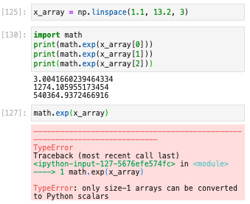


NumPy functions
Before doing so, we will briefly revisit NumPy functions to see a particularly powerful feature
Often, we want to apply a function to a whole array
  E.g. perform a math operation like exponentiation
Since the built-in math.exp function only takes one
input variable we’d need to call it for each element
However, the equivalent NumPy function, np.exp,
can also take arrays as arguments:
  This is significantly faster so we’ll use the np version
The same is true of pretty much all NumPy functions
  And math operators also work on whole NumPy arrays
Notes:
… such as the np.transpose function you used last week
When have array of data want to apply function (e.g. exponentiation) to all the data i.e. the whole array
… each element -> go over example
This quickly gets tiresome as array gets larger and, even once we know how to use a loop to repeat (next lecture) this is not efficient
Solution = equivalent numpy function np.exp
As well as single value can take an array, performing array-at-a-time operations rather than element at a time and returning a new array
Get error if try with math.exp (+ explain how to read again)
More efficient -> faster -> use np rather than math ones when dealing with arrays
Will play with this in the notebook this week
QUESTIONS on array-at-a-time function usage?

Slide 8

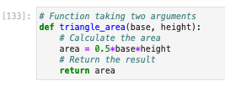
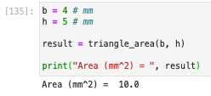
Writing our own functions
We define a python function using the def keyword, followed by the name of the function
  After this we have a comma-separated list of any arguments in brackets and a terminating colon (:)
The body of the function does the work
  It consists of indented lines of code
  An optional return statement to give any result(s)
Let’s look at an example for calculating the area of a triangle:
Once we have defined it, we call it as with the built-in functions
  Passing the arguments in brackets and assigning the return value to a variable
  Note: the names of the variables outside the function don’t need to match those inside
Notes:
Point to the example (pseudo-code)
Must have a colon
Indentation is how python knows which code lines are part of the function
Doesn’t matter how much but you need to be consistent
Go over example [show] – defined but not used so no output:
def then sensible name
2 arguments: base and height
performs calculation (can be many lines) – note indentation
Returns the area
We use the function by calling it by name and passing our particular values as arguments, in correct order, like any other function
It returns the area, which we assign to a variable that we use like any other variables
Note: names don’t have to match -> those inside the function arguments are just placeholders that are assigned to our particular inputs when we call the function
QUESTIONS on writing functions so far?

Slide 9




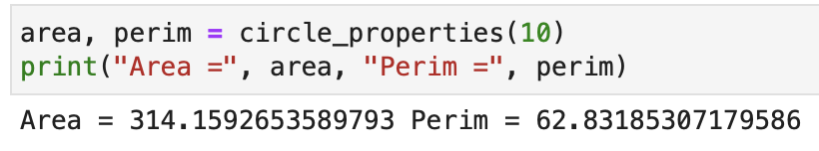
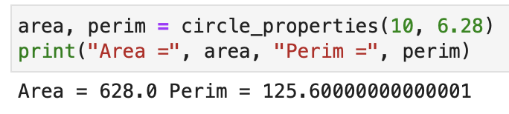
Arguments and return values
We can return multiple values from a function
  The result is a tuple
  Each element can be assigned to a separate variable
Arguments can also have default values
  By assigning to a value in definition
  If argument left out when called, get default
Notes:
Go through example
takes in one argument now, calcs area and perimeter -> both lines indented, return both separated by comma
If call, we get a tuple, and can access each element by index
But easier to assign directly to multiple values (separated by a comma)
Automatically unpacks the tuple. Of course, must have correct number of vars for how many elements returned
Let’s give it an extra argument, which is the value of pi
Obviously, this is generally 3.14 … so we can assign it to this by default, exactly like assigning a normal var
Then use this new arg (pi) rather than np.pi inside the function
Since has a default -> don’t need to provide it
If call with no 2nd argument, uses this default -> same result
But if we pass it a value (e.g. a different geometry) this overwrites the default

Slide 10
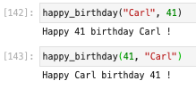



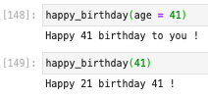

Named arguments
So far, when calling a function we have passed in the arguments in the order they are defined
  Python uses the order to work out which argument is which
  In general, calling with a different order doesn’t make sense
These are called positional arguments, but you can also specify the arguments by name
  And in this case the order doesn’t matter
When combined with default arguments, these allow us to call a function in different ways
  E.g. can leave out the first argument unlike with positional args
  This is useful when have many optional arguments as we shall see
Notes:
So far … Suppose we have a happy bday function that takes a name and age and prints out a message
You can see here that we don’t have to return anything
Python uses order … Go over correct call and how it knows which is which based on order + wrong assignment if call in other order
These … by name, using the argument names we gave when we defined the function (again like any variable assignment)
Although we passed in the age first, python knows what to do since we have told it explicitly that this is the age -> not using position
NB: Don’t confuse with defaults, which are given when defining the function, not calling it.
You might wonder why this is useful? First, more explicit I,e, easier to read and second when combined…
Change function to give defaults: If we don’t know the name we just say “to you” and if we don’t know the age we assume 21
If call positionally then the we have to give the args in order -> no way to just give the age although default for name-> would be assigned to the name -> doesn’t make sense
When using named arguments, we can just give age = and not the name
Call in multiple ways -> useful when have many arguments since allows some arguments to be optional
QUESTIONS on arguments and return values?

Slide 11
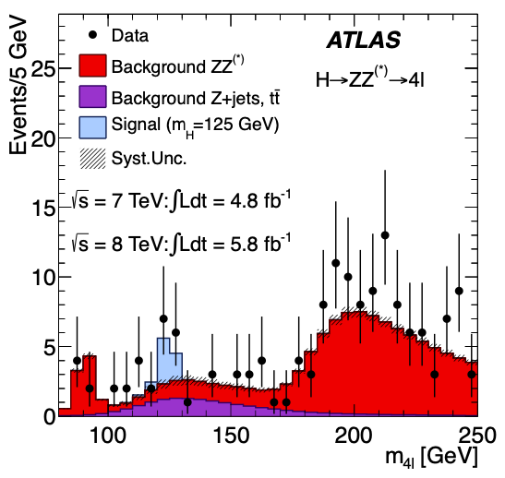
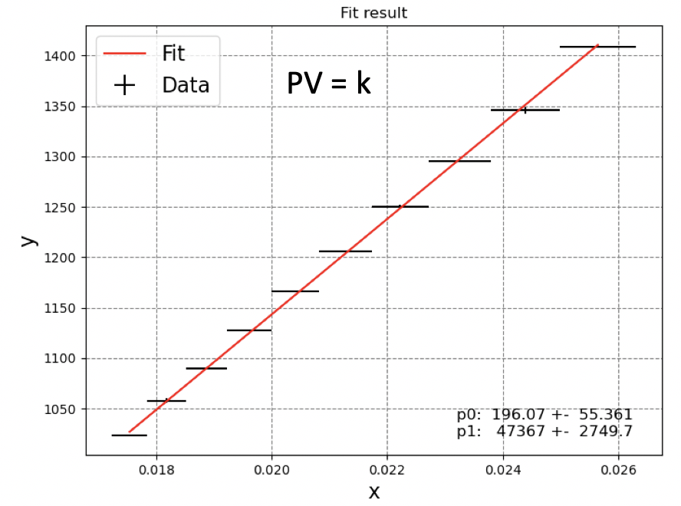
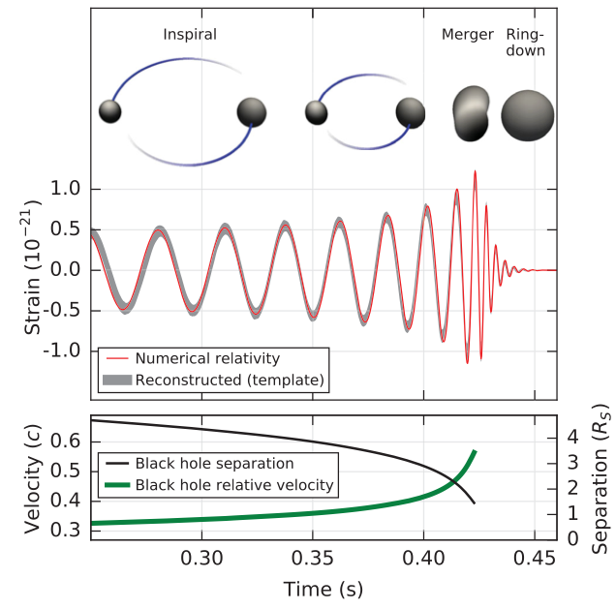
Plotting
As mentioned last time, we often want to visualise data e.g.
  Experimental results, results of calculations
  Comparisons of the two
This will be the case in your PHYS106 laboratories
  Will plot the data taken and fit them e.g.
It is also the case in almost all scientific papers
  And in many other fields too
Higgs Discovery
Gravitational wave discovery
Notes:
Now we know more about how functions work we can go back to the plotting that we started looking at last time
Scientific papers, such as the plots I showed previously for …

Slide 12
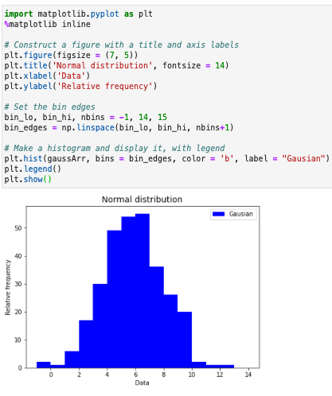

Matplotlib Histograms
We have seen how matplotlib can plot hists
We create a figure(), giving the size tuple
  And set the title + axis labels
We plot the histogram with hist()
  We can explicitly specify the bin edges
It also takes many other params
  These are named args with default values
We can also add a legend()
  Which shows the hist labels
# edges =
# bins + 1
Notes:
Import
Go over example …
We create …
Now understand how we specify the figsize or fontsize -> named arguments with default values -> optional
Hist takes the data as a numpy array
Now add explicitly bin edges (easiest to use linspace -> go through -> bins+1 as number of edges) and a label as named parameters
Takes many other params (do before call hist and show help)…
Looks scarry but mostly only use a subset
Before showing … call legend function makes a legend from labels for each plot -> important if have several plots on a given figure (as we’ll see)

Slide 13
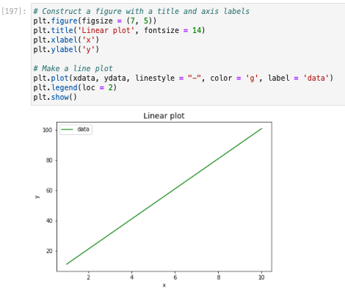
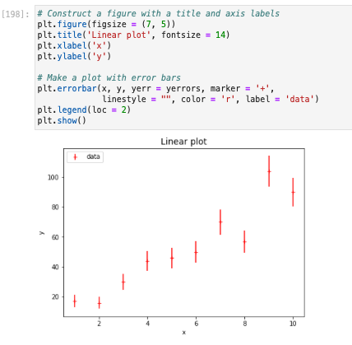
Other Matplotlib plots
It also has many, many other types of plots, from simple to complex. Two important ones are:
  Data as lines or markers: plot(x, y, …)
  Data with errors: errorbar(x, y, yerr =, …) None, …)
In each case x, y (and yerr) are NumPy arrays of the same size
  Many of the other options you can pass are the same for all e.g. color
Notes:
Two important ones (which we will use a lot): plot + errorbar
Same (as see) except for the function that defines what is plotted (e.g. hist part)
Plot takes numpy arrays of x and y data -> line
along with optional linestyle etc (show different ones)
legend also has an optional param to specify where to plot it that we didn’t use on previous page (2 -> top left rather than default top right which would overlap)
errorbar (saw last week in notebook) e.g. for data, takes the same but optionally np arrays of x (saw in last week’s nb for RMS or FHWM) or y errors (here) or indeed both
along with optional marker style (show different ones)
By default joins points up which we don’t want for data -> empty linestyle
Errorbar is a bit of a misleading name: it draws the points AND the associated error bars
Show example of 10% xerr
QUESTIONS on plotting?

Slide 14
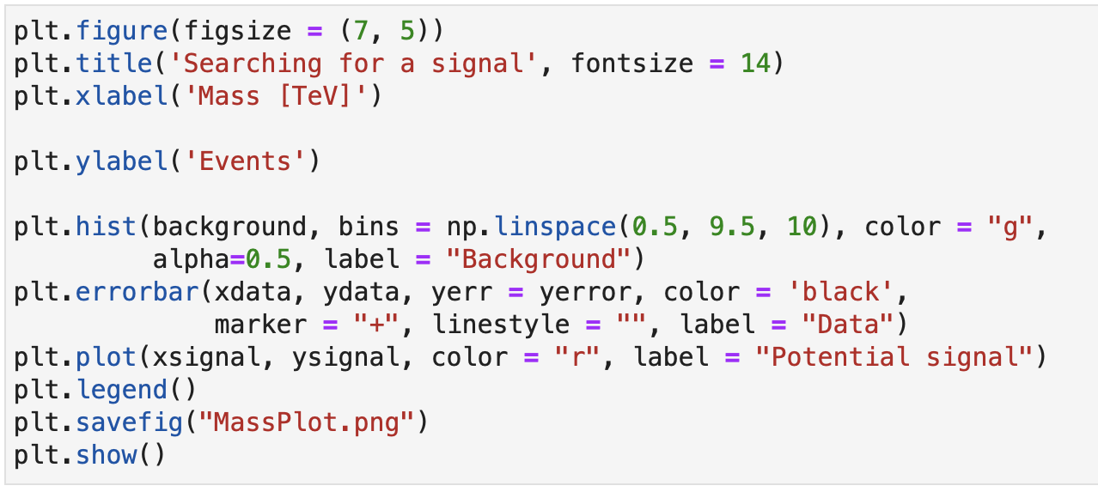
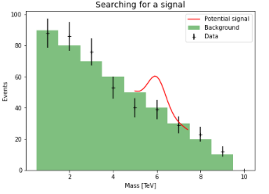
Complete Plot
You can plot multiple results on one figure
  Simply call the appropriate function for each
  set of data before showing the figure
The results can be plotted as different types
  We can mix hist(), plot() and errorbar()
E.g.: search for a new 6 TeV particle
  Plot background simulation as hist
  Plot potential signal as a line
  Plot data as points with error bars
Can also save the figure to a file
  Using savefig() with the output name
  Useful for inputting figures to lab reports etc
No signal here!
Publication standard plots
Notes:
Create figure as normal but create multiple plots by calling hist/plot/errorbar multiple times before calling show
Example from my field, like the higgs search I showed in L1 and earlier
Search for a new particle at 6 TeV
Theoretically predicted background -> hist
A hypothetical signal -> gaussian as a line centred at 6 TeV
We then compare this to the data which we plot as markers with error bars of course
Each are simply numpy arrays
Publication standard plots!
It if often useful to save these to an output file, rather than just displaying them in line,
E.g. for input to lab repots
You can do this using savefig() (BEFORE show) with the output name as an argument (don’t just use a screen shot!)
Unfortunately, data follows background -> no sign of a signal -> unlike Higgs, no Nobel prize for us
QUESTIONS: Any questions on plotting various types (individually or together?)

Slide 15
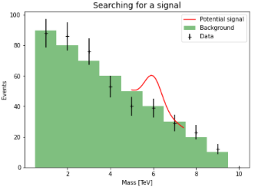
Summary
This week we looked at how to write and use our own functions
  Allow us to perform calculations multiple times without rewriting code
You should get into the practice of writing functions
  Will save you work and time in the long run!
We also looked in more detail at plotting
  Allowing us to visualise and compare results
Saw different types of visualisation
  Lines, points, histograms
  And how to combine these
Along the way we had more practice with NumPy
You will exercise these and see more features in the problem class
Notes:
which I released the notebook for in cocalc this morning and opened the assignment in canvas.
Again, please do try the formative questions
QUESTIONS: any final questions?

