Slide 1
Introduction to Computational Physics (PHYS105)
Lecture 3: Functions and Graphs
Carl Gwilliam
(C.Gwilliam@liverpool.ac.uk)

Slide 2
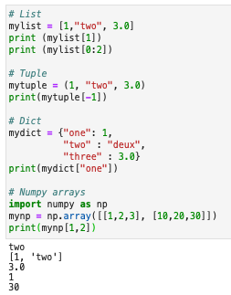
Lecture 2: Recap
Last week we learnt about various python data structures
  Both sequences (index) and mappings (key:value)
Built-in structures
  Lists []: mutable sequences of variables of any type
  Tuples (): like lists but immutable (can’t change elements)
  Strings “” or ‘’ : immutable sequences of characters
  Dicts {}: mapping of keys to values
NumPy arrays
  More efficient structures for numerical calculations on the
  same type of value in 1 or more dimensions
  Can be used to read data from file and write back out
All have similar syntax for accessing/changing the elements
  Can use negative indices to count from the back
  And slices to get a range of elements [lo:hi)

Slide 3
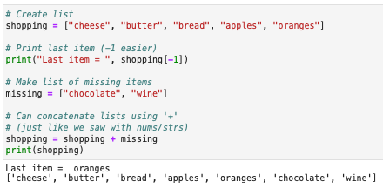
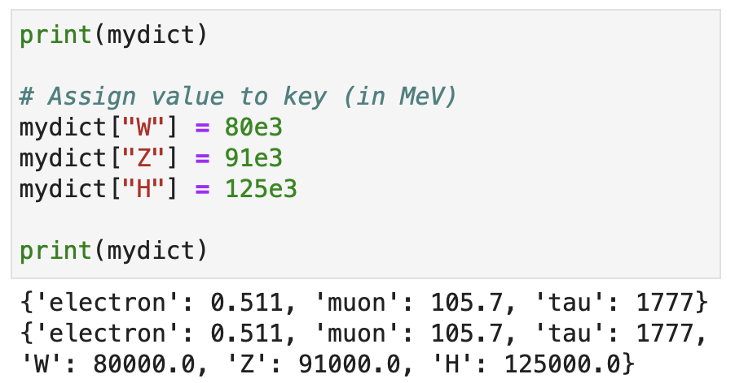

Lecture 2: Formative problem solutions
Exercise 1: Print last item of shopping list then add two missing items to it
  For the last item could use 4 or -1 as index
  For lists the + operator performs concatenation
    Could also have used append() to add items
    one-by-one or extend() to add new list
  A few people mistakenly created a list of lists by
Exercise 2: Extend the particle mass dict
  Adding W, Z and H bosons
  Could also use update()with 2nd dict
  Most did this correctly but a few created a
  new dict with all the items from scratch
    Rather than adding new items to existing dict
  Also, many put these masses in GeV
    Rather than consistently in MeV
Two brackets = nested list

Slide 4
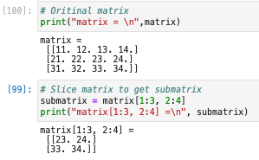
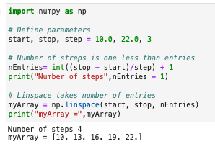

Lecture 2: Formative problem solutions (2)
Exercise 3: Create array using np.linspace, printing the array and number of steps
  Note: you can assign multiple variables
  on one line using commas
  Some people entered nEntries = 5 by hand
  Many also printed the step size or number of entries rather than the number of steps
    Which is the number of entries minus 1
Exercise 4: Print out 2x2 lower right matrix
  Remember slices indices are inclusive on
  lower bound but exclusive on upper one
  NB: As go to last index, don’t need upper bound
  Some people created a new array of the
  elements from scratch rather than slicing
Must use form with single square brackets [x, y] for this, not [x][y]

Slide 5
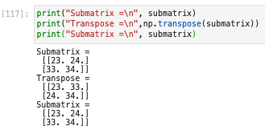
Lecture 2: Formative problem solutions (3)
Exercise 5: Swap the matrix rows and cols
  Using np.transpose()
  Note: transpose function doesn’t change original but makes a transposed copy
    Can assign result to a variable

Slide 6
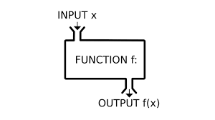
Functions
To be able to manipulate our data we need to look at functions in more detail
Functions are self-contained pieces of code that, when called, accomplish a specific task
  They take in data as comma-separated arguments, process it, and return some result
We have already used several functions
  Directly available functions e.g print()and type()
    https://docs.python.org/3/library/functions.html
  Functions in built-in modules e.g. math.sin()
  Functions from third-party modules e.g. np.linspace()
The power of functions is that, once written, they can be used over and over again
  Performing the same task on different inputs to get new results (without rewriting code)
This week we will look at writing and using our own functions
  Generally, if you write code that you will use (or think you will use) more than once, make a function!
  You will lose marks throughout the course if you don’t make appropriate use of functions

Slide 7
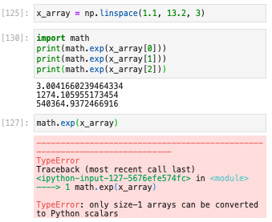


NumPy functions
Before doing so, we will briefly revisit NumPy functions to see a particularly powerful feature
Often, we want to apply a function to a whole array
  E.g. perform a math operation like exponentiation
Since the built-in math.exp function only takes one
input variable we’d need to call it for each element
However, the equivalent NumPy function, np.exp,
can also take arrays as arguments:
  This is significantly faster so we’ll use the np version
The same is true of pretty much all NumPy functions
  And math operators also work on whole NumPy arrays

Slide 8

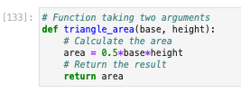
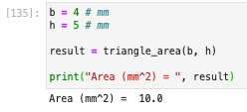
Writing our own functions
We define a python function using the def keyword, followed by the name of the function
  After this we have a comma-separated list of any arguments in brackets and a terminating colon (:)
The body of the function does the work
  It consists of indented lines of code
  An optional return statement to give any result(s)
Let’s look at an example for calculating the area of a triangle:
Once we have defined it, we call it as with the built-in functions
  Passing the arguments in brackets and assigning the return value to a variable
  Note: the names of the variables outside the function don’t need to match those inside

Slide 9




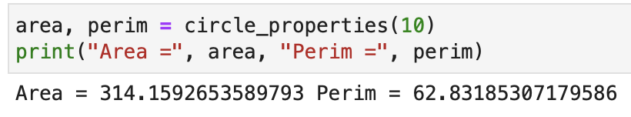
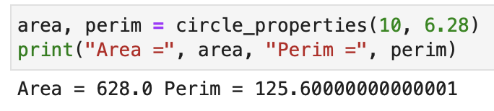
Arguments and return values
We can return multiple values from a function
  The result is a tuple
  Each element can be assigned to a separate variable
Arguments can also have default values
  By assigning to a value in definition
  If argument left out when called, get default

Slide 10
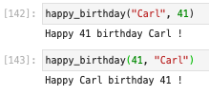



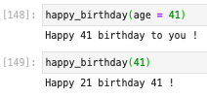

Named arguments
So far, when calling a function we have passed in the arguments in the order they are defined
  Python uses the order to work out which argument is which
  In general, calling with a different order doesn’t make sense
These are called positional arguments, but you can also specify the arguments by name
  And in this case the order doesn’t matter
When combined with default arguments, these allow us to call a function in different ways
  E.g. can leave out the first argument unlike with positional args
  This is useful when have many optional arguments as we shall see

Slide 11
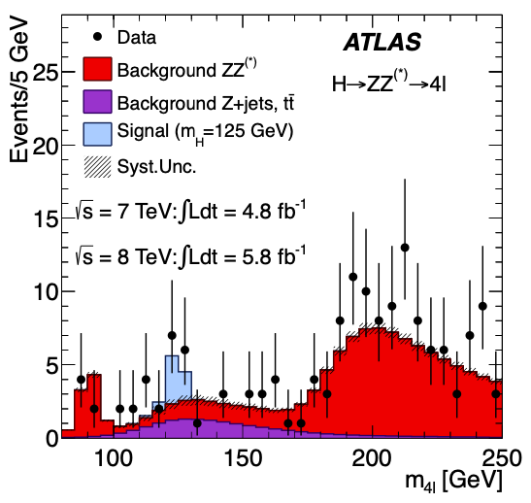
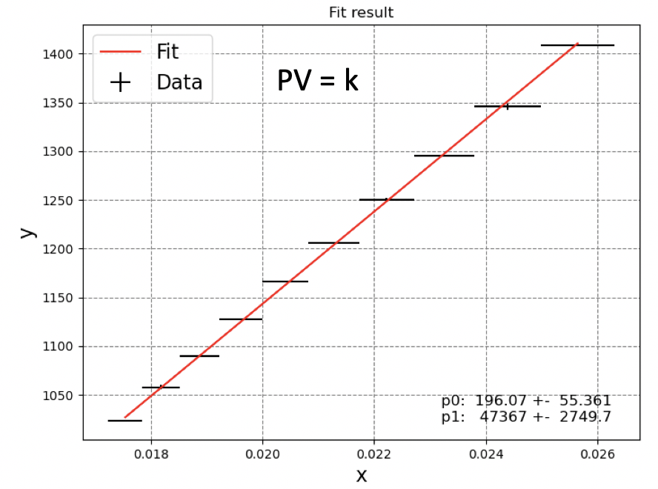
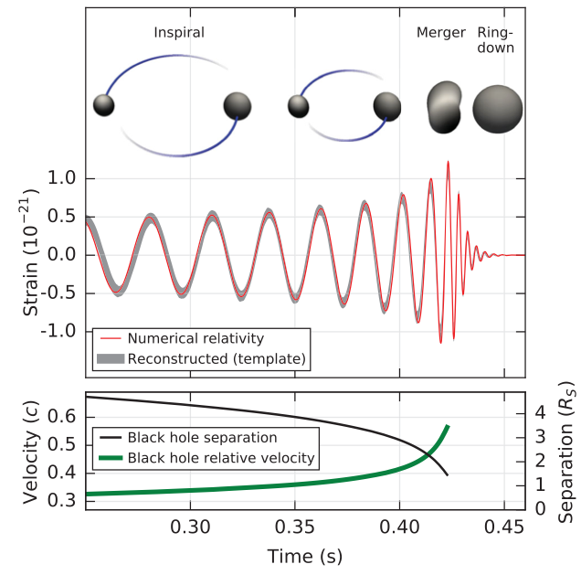
Plotting
As mentioned last time, we often want to visualise data e.g.
  Experimental results, results of calculations
  Comparisons of the two
This will be the case in your PHYS106 laboratories
  Will plot the data taken and fit them e.g.
It is also the case in almost all scientific papers
  And in many other fields too
Higgs Discovery
Gravitational wave discovery

Slide 12
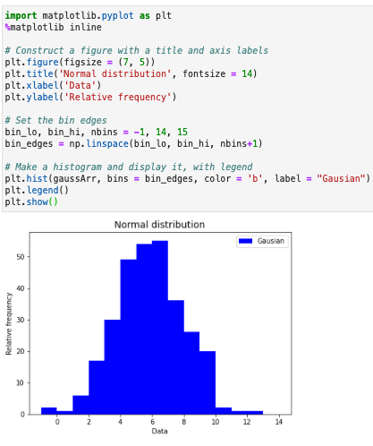

Matplotlib Histograms
We have seen how matplotlib can plot hists
We create a figure(), giving the size tuple
  And set the title + axis labels
We plot the histogram with hist()
  We can explicitly specify the bin edges
It also takes many other params
  These are named args with default values
We can also add a legend()
  Which shows the hist labels
# edges =
# bins + 1

Slide 13
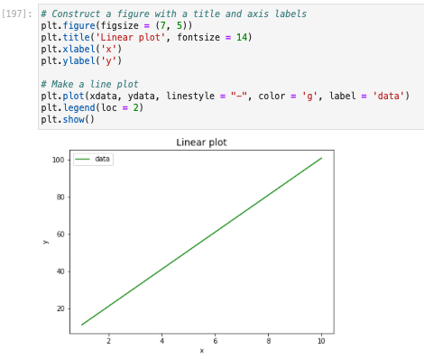
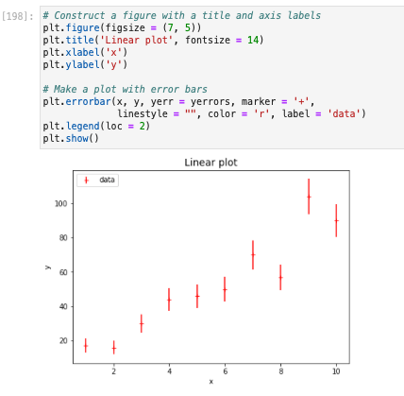
Other Matplotlib plots
It also has many, many other types of plots, from simple to complex. Two important ones are:
  Data as lines or markers: plot(x, y, …)
  Data with errors: errorbar(x, y, yerr =, …) None, …)
In each case x, y (and yerr) are NumPy arrays of the same size
  Many of the other options you can pass are the same for all e.g. color

Slide 14
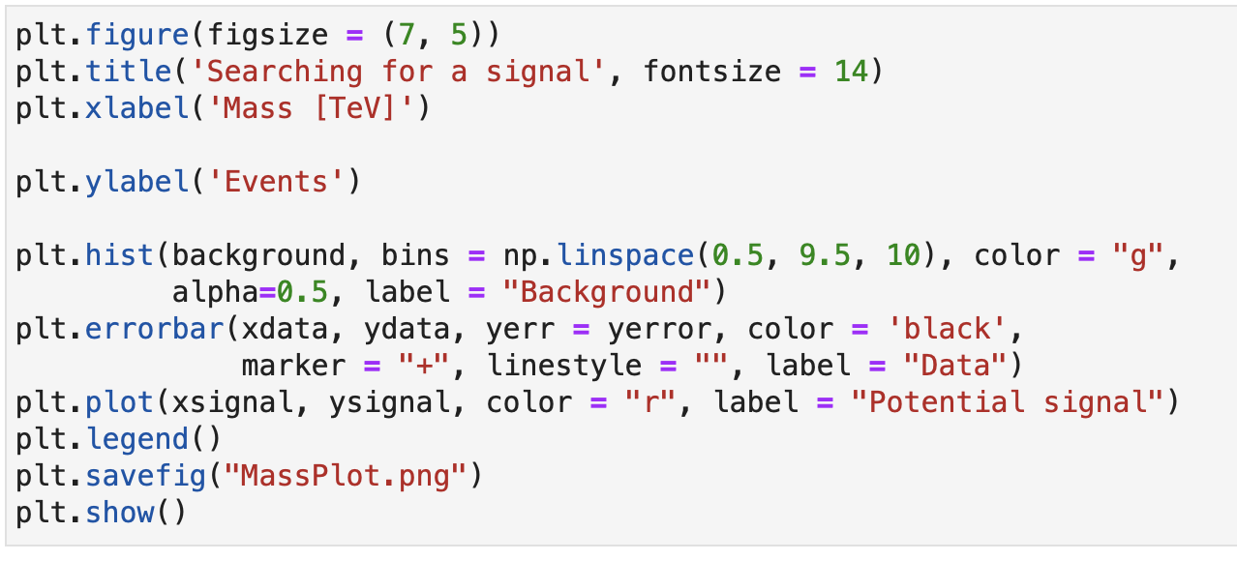
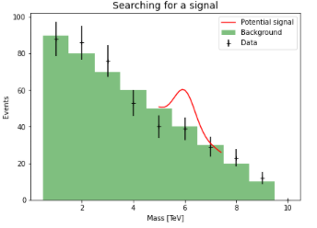
Complete Plot
You can plot multiple results on one figure
  Simply call the appropriate function for each
  set of data before showing the figure
The results can be plotted as different types
  We can mix hist(), plot() and errorbar()
E.g.: search for a new 6 TeV particle
  Plot background simulation as hist
  Plot potential signal as a line
  Plot data as points with error bars
Can also save the figure to a file
  Using savefig() with the output name
  Useful for inputting figures to lab reports etc
No signal here!
Publication standard plots

Slide 15
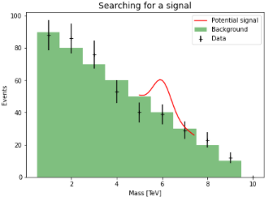
Summary
This week we looked at how to write and use our own functions
  Allow us to perform calculations multiple times without rewriting code
You should get into the practice of writing functions
  Will save you work and time in the long run!
We also looked in more detail at plotting
  Allowing us to visualise and compare results
Saw different types of visualisation
  Lines, points, histograms
  And how to combine these
Along the way we had more practice with NumPy
You will exercise these and see more features in the problem class

