Slide 1
Introduction to Computational Physics (PHYS105)
Lecture 2: Data Structures
Carl Gwilliam
(C.Gwilliam@liverpool.ac.uk)
Attendance Code: 652195

Slide 2
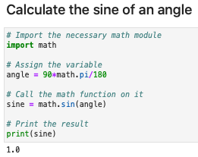
Lecture 1: Recap
Last week we learnt the basic building blocks of python programs
  As well as learning how to work with jupyter notebooks in CoCalc
Variables: symbolic name referring to an object or value stored
in memory, which are assigned to it using the = operator
  The type of the variable defines what can be done with it
  E.g. integer, float, string
Functions: blocks of code that do something when called using
() with the input variables as arguments between the brackets
  If called from modules (libraries of code) you need to proceed the function name with the module name followed by a dot
Comments: documentary pieces of code, starting with a #, to
explain what is being done
  Should be concise and will be taken into account in marking
We combined these into simple programs.

Slide 3
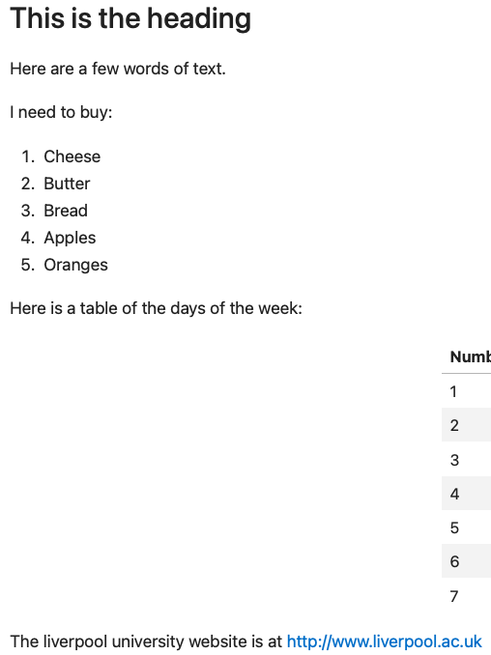
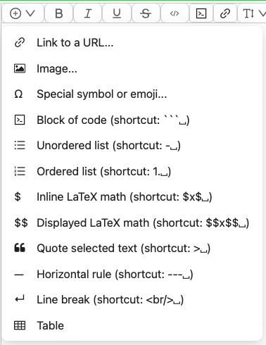
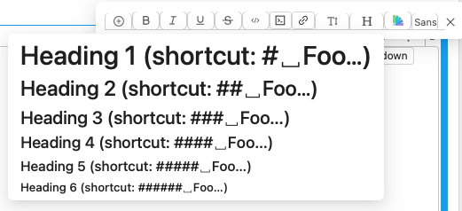
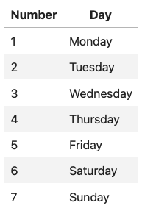

Lecture 1: Formative problem solutions
Exercise 1: Making and deleting a cell
  Click on “+” in the menu (or type Esc+b),
  Edit menu → Delete cells (or type Esc+d+d)
Exercise 2: Write a simple text document
  Make sure cell is in text mode!
  Enter the heading using the H
  option from the cell’s menu
  Then from the “+” menu enter
    A link and an ordered list
    A table: need to add/delete
    rows and columns via
    Markdown
TODO

Slide 4
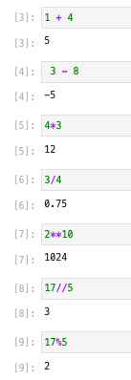


Lecture 1: Formative problem solutions
Exercise 3: “Hello, World!” Reply
  Change the variable to your name e.g. John
  Change the text to reply to PHYS105 or me
  Technically it is not a reply if you just change
  the name to yours (which many people did) ☺
Exercise 4: Mathematical operators
  +: addition
  - : subtraction
  *: multiplication
  /: division
  **: raise to the power
  //: integer or floor division
    i.e. throw away decimal
  %: remainder after division
    i.e. after integer division

Slide 5
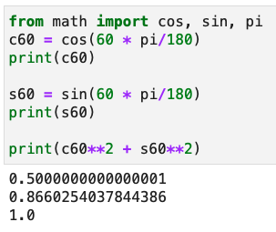
Lecture 1: Formative problem solutions
Exercise 5: sine and cosine
  Import the relevant items from the math module
  Call cos or sin function
    With the input angle passed in brackets
    Not forgetting to convert to radians!
  Assign the results to a variable
    And output them using the print function
  Print the sum of the squares similarly
    Here, since I am only using the value once, I chose
    not to assign the result to a variable first.
Marks for the summative exercise and feedback will be released in Canvas by next Monday

Slide 6
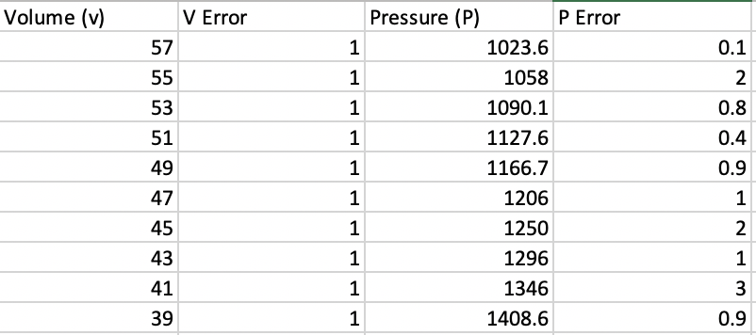
Data
Often, we want to perform calculations not just on a single value but on sets of data
  Such as measurements taken in a lab or the results of many calculations
This week, we will look at how to store and manipulate series of data in python
  Including reading in / writing out data to / from files
You will, of course, practice this in this week’s notebook
Table: Data from a measurement of Boyle’s law (PV = constant)

Slide 7
Python data structures
Data Structures
Sequence Types
Mapping Types
List
Tuple
String
Dict
Python has several built-in data structures, including
General purpose
Sequence of values
Immutable
Also a data structure
Maps one value to another
Will look at each of these in turn …

Slide 8




Lists
Lists are the most versatile of python’s data structures, simply consisting of a sequence of values
  They are assigned by a comma-separated list of values in square brackets
  Note: the items in a list can have a mixture of types (this is true of most built-in data structures)
We access a specific element via the index
  Passed in square brackets []
  Note: indices start from 0 in python (not 1)!
We can change the elements of a list
  Assign a new value to an index with =
Once you have the element of a list you can use it exactly as you would the element itself
  Operator results depend on type of element

Slide 9
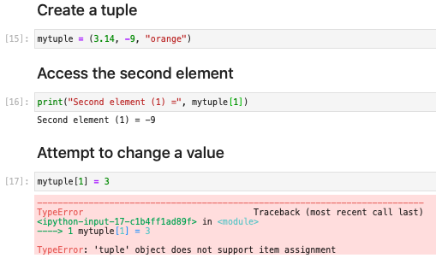

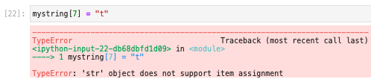
Tuples and strings
Tuples are assigned with round brackets and are similar to lists, except they are immutable
  I.e. unlike a list, the elements of a tuple cannot be changed after the tuple is constructed
Strings are also data structures, which simply contain a sequence of characters
  Individual characters can be accessed using indices but like tuples they are immutable

Slide 10


More on indexing
For all the sequence types (lists, tuples, strings) you can also use negative indices or “slices”
Negative indices refer to the position of an element from the end of the data structure
  Rather than the beginning
  The last element is -1, the second to last -2, etc.
Slices allow us to access a range of elements, rather than just one
  Take the form of the beginning and end index of the range, separated by a colon (:)
  Note, the first index is included (inclusive) while the last is not (exclusive)

Slide 11
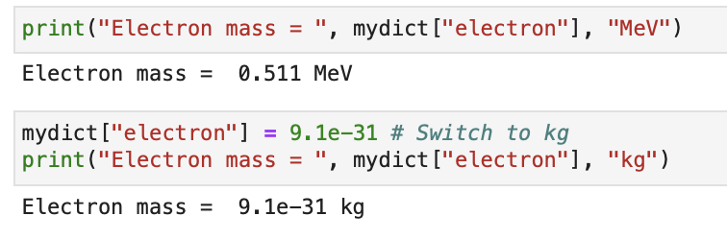
Dictionaries
Dictionaries (or dicts) are a mapping data structure: they associate a key to a given value
  They are assigned by a comma-separated list of key:value pairs in curly brackets {}
Again, we access/change the elements by [], but this time passing the key not the index
Dicts are often useful for look up tables, using one thing to find another
  Above we have used strings as keys, which is often the case, but it can also be ints, floats, …
  They are not so useful in calculations so we will not use them so extensively in the course

Slide 12


NumPy
The flexibility of python in e.g. allowing data structures to contain mixed types comes at a price
  Manipulations on these data structures can be relatively slow, particularly for big data sets
The solution is the Numerical Python module
  NumPy is a third-party python library
  Once installed (as it is on our CoCalc system) we
  use it like any other module
It consists of:
  Array structures for efficient storage of data
    Can be 1D (vectors), 2D (matrices) or more (tensors)
  Functions for rapid manipulation of the data (next week)
NumPy is one of the fundamental packages
for scientific computing in python
  Many other python modules built on top of it
  We will make heavy use of it throughout the course
Article Link

Slide 13
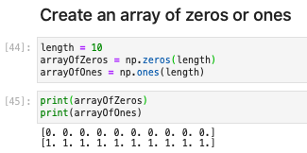

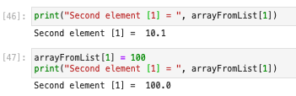
NumPy Arrays
NumPy arrays can be created/filed in many ways e.g.
  Note the np. to call array etc from the NumPy module
  You will see other ways of creating arrays in the notebook
The elements can be accessed/changed just like for a list (including slices or negative indices)
  But the new elements must be of the same type (note, it converts int 100 to float 100.0 below)

Slide 14
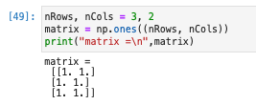




NumPy Arrays (2)
Multidimensional arrays are created similarly
  Giving a tuple with the size of each dimension
  E.g. 2D arrays by giving a tuple of rows and columns
The elements are accessed/changed using two indices
  Specifying the row and column index (both from 0)
  Can be in separate [i][j] or separated by a comma [i,j]
As we will see, there are a whole host of functions to manipulate NumPy arrays
  Will look at these in more detail next week and use them throughout the course
Note: two sets of brackets

Slide 15
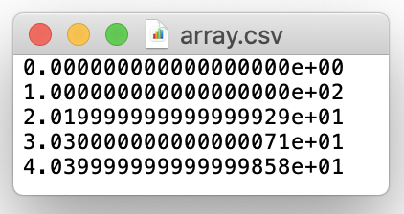


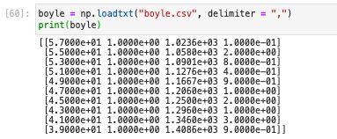

Reading/writing data to/from arrays
If you have data in an array (e.g. some results) you can write it to a file using np.savetxt
  E.g. as comma-separated variables (csv), which can be read by e.g. Excel
Conversely, data in a file (e.g. from a lab experiment) can be read into an array using np.loadtxt
This also works for several columns of data
  Giving a 2D array of nRows, nCols

Slide 16
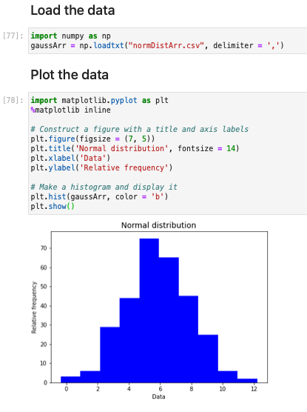

Histograms
Once we have data we usually want to visualise it
This can be done using the matplotlib module
  Powerful package with many plotting types
    Histograms, line graphs, much more
  Takes NumPy arrays as input
You will look at plotting some first, simple histograms in this week’s notebook
  import matplotlib.pyplot as plt
  Create a plt.figure()
  Fill using plt.hist()
  Display using plt.show()
Will go into more detail next week
  And use often in subsequent weeks
Figure is displayed inline in notebook

Slide 17
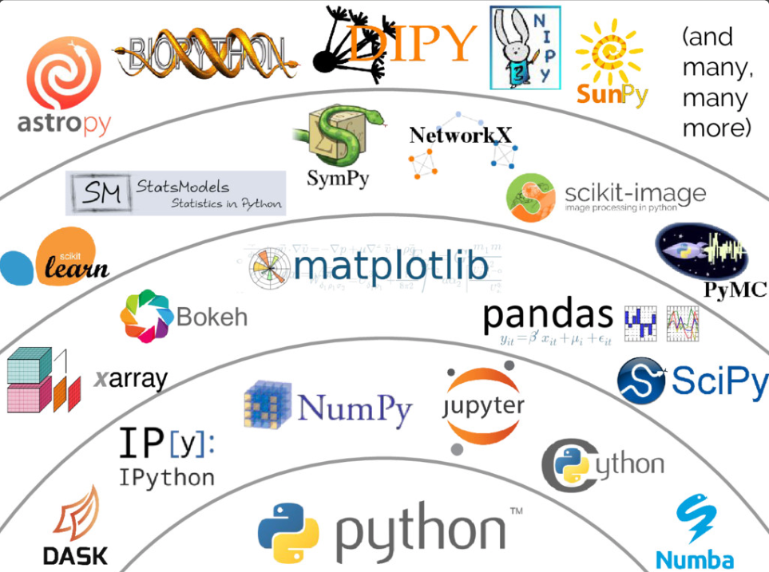


Summary
This week we looked at how to store data in python
  And the various data structures available to do this
In particular, we introduced NumPy for efficient numerical storage and computations
  This will be the bedrock of our scientific calculations
We saw how to read and write data using NumPy
Finally, we started to look at how we can visualise
the resulting data using matplotlib
  Again, this will be essential for scientific analysis
  E.g. in PHSY106 labs
You will use these in this week’s problems class
  Looking more in depth and practicing hands on
+ many
more

