Slide 1
Introduction to Computational Physics (PHYS105)
Lecture 1: Introducing Python and Jupyter
Carl Gwilliam
(C.Gwilliam@liverpool.ac.uk)
Attendance Code: 821816

Slide 2




Organisation
Lectures
  Tuesday @ 10:00-11:00
  In Thomson-Yates Lecture Theatre (Rm 104)
Computer Classes
  Monday @ 09:00--11:00
  In CTL PC teaching centre (PCTC)
Assessment
  100% coursework (no exam)
  Exercises in computing classes
    Several formative / week
    One summative / week (equal weighting)
    Released before lecture; deadline end of Mon
  Note: this course is exempt from the default
  Uni extension policy to allow rapid feedback
    All students: 1 day extension (i.e. end of Tues)
    Support plan: additional 3 days (i.e. end of Fri)
Staff
  Prof Carl Gwilliam (Rm 315)
    Module Coordinator
    C.Gwilliam@liverpool.ac.uk
  Prof Neil McCauley (Rm 310)
    Academic Demonstrator
    N.McCauley@liverpool.ac.uk
  Along with several postgrad demonstrators
    For the computer labs
  Please get in touch at any point if need help
Ned
Brad
Sophie
Sarah
Ibrahim

Slide 3
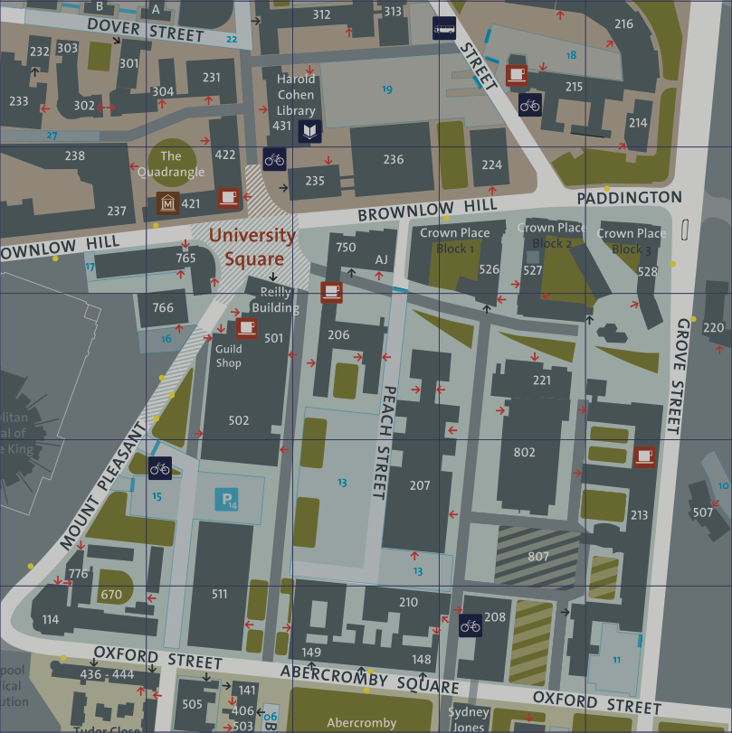
Locations
Lectures
Thompson Yates Lecture Theatre
Room 104
Computer Labs
Central Teaching Lab
PC Teaching Centre (PCTC)
  All zones
Academic Offices
Oliver Lodge Laboratory
Room 315 & 310 (3rd floor)

Slide 4
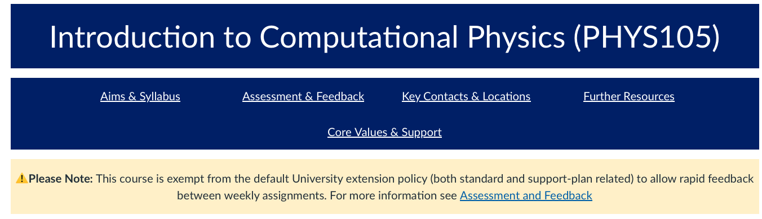
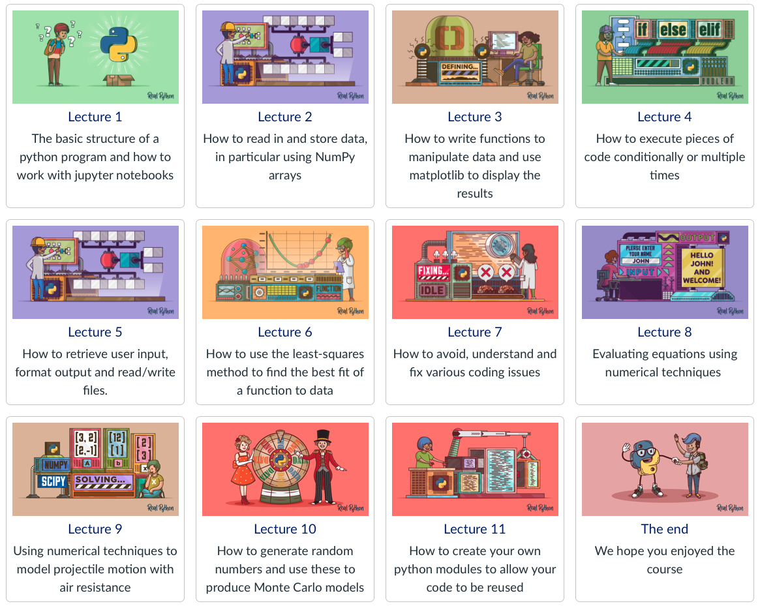
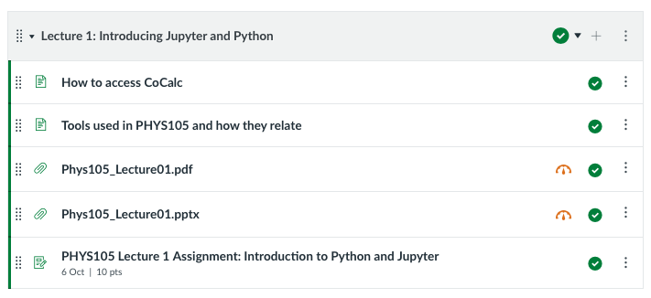
Canvas
All info is available on the course Canvas page
  https://canvas.liverpool.ac.uk/courses/84543
Click on links at top for course details
  e.g. Aims & Syllabus, Assessment & Feedback,
  Contacts & Locations, Further Resource, etc
Click on each image for that week’s material
  Slides will be released 24h before the lecture
  Video recordings shortly after the lecture
Submit work by clicking on assignment
  And uploading saved PDF of notebook

Slide 5

Aims and outcomes
The main aim of the course is to be able to create and run computer algorithms to solve real physical problems, breaking the problems down into steps amenable to such methods
  Illustrating the insight into physics which can be obtained using computational methods
In doing so, we will introduce
  Basic computer algebra (using the python language)
  Techniques for analysing and presenting data
  Elementary numerical methods and “Monte Carlo” techniques
By the end of the course you will be able to
  Program and use simple (python) algorithms on a computer
  Produce algorithms to solve simple physical problems.
  Analyse (including numerically) and present physical data
  Produce simple “Monte Carlo” (MC) models
Prior coding
We will not assume any prior coding knowledge

Slide 6
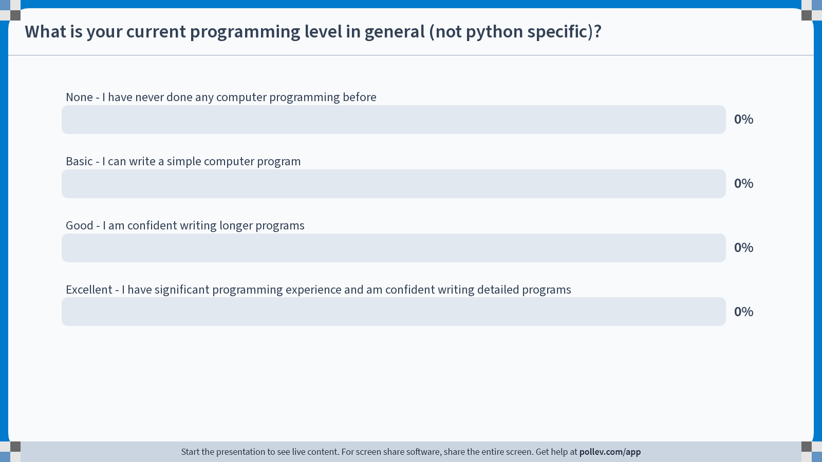

Slide 7
Outline syllabus
The first part (a bit less than half) will develop your python skills
  The second half will focus on practicing these by applying them to solve various physical problems
Lecture 1
  Python basics + Jupyter notebooks
Lecture 2
  Data structures
Lecture 3
  Functions and graphs
Lecture 4
  Looping and conditional execution
Lecture 5
  Input, Output and formatting
Lecture 6
  Fitting data
Lecture 7
  Good practice and debugging
Lecture 8
  Introduction to numerical methods
Lecture 9
  Further numeric techniques (projectile motion)
Lecture 10
  Monte Carlo methods
Lecture 11
  Python modules + fitting revisited

Slide 8
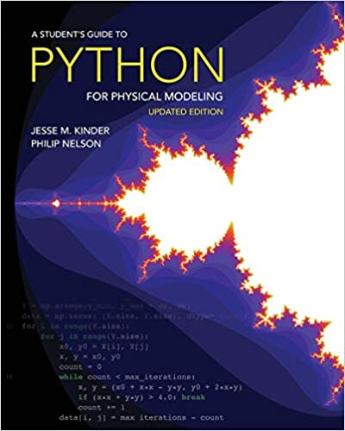
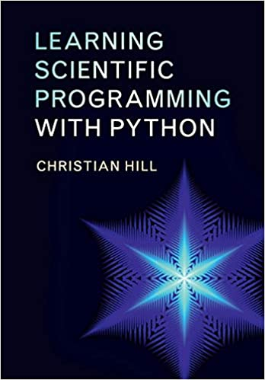
Recommended Textbooks
A Student’s Guide to Python for Physical Modelling - Kinder and Nelson
  Princeton University Press
Learning Scientific Programming with
Python - Hill
  Cambridge University Press

Slide 9
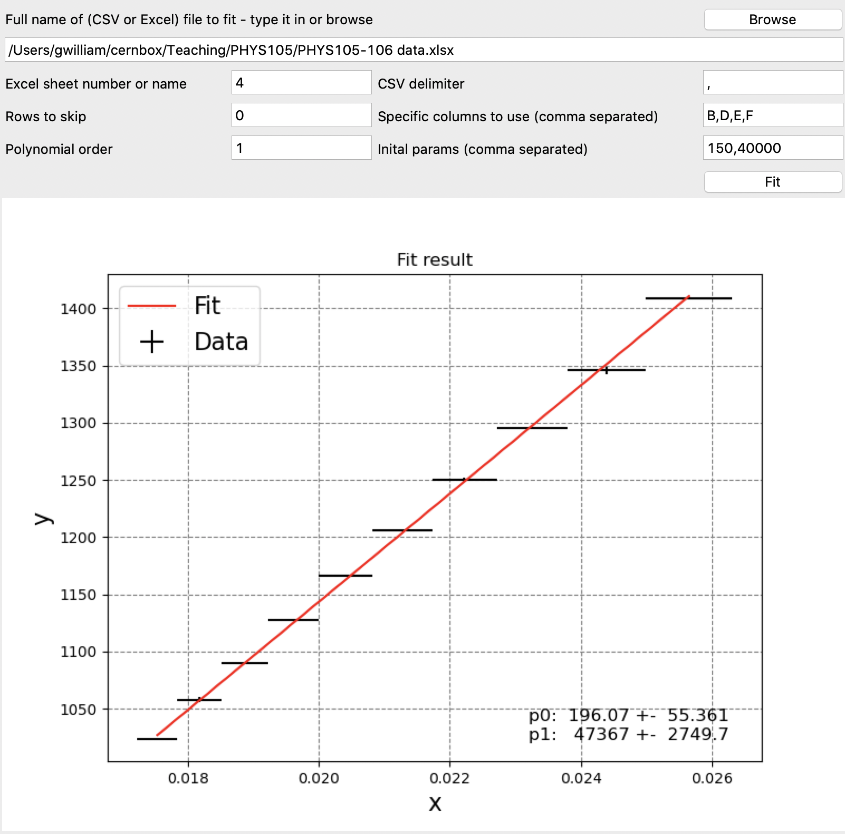
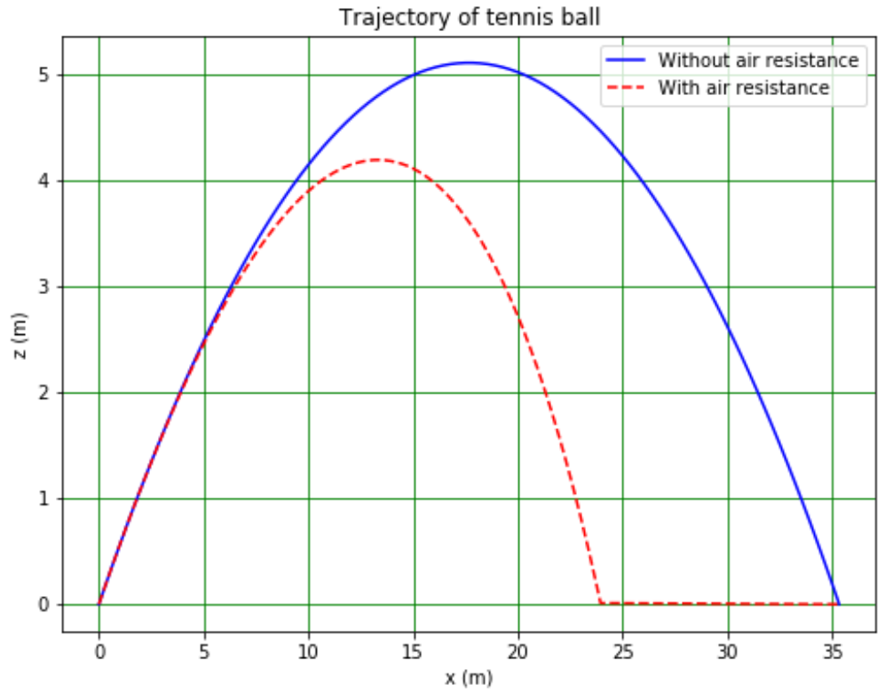
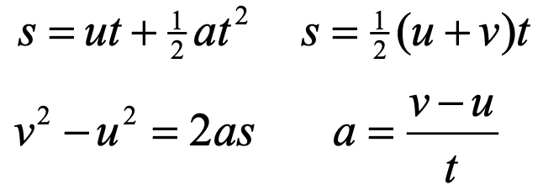
Why do I need to program?
Many cases where this will be essential in your physics degree
Analyse + visualising experimental data
  E.g. fitting data from Boyle’s law experiment
Calculating results with no analytic solution
  E.g distance travelled by tennis ball thrown
  at 20 m/s at an angle of 30º to horizontal
    We know how to solve this using equations of motion, but result doesn’t agree with real life
    Need to include air resistance → numerical
PV = k
P
1/V

Slide 10
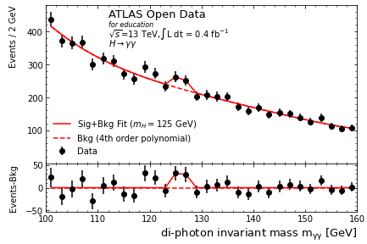
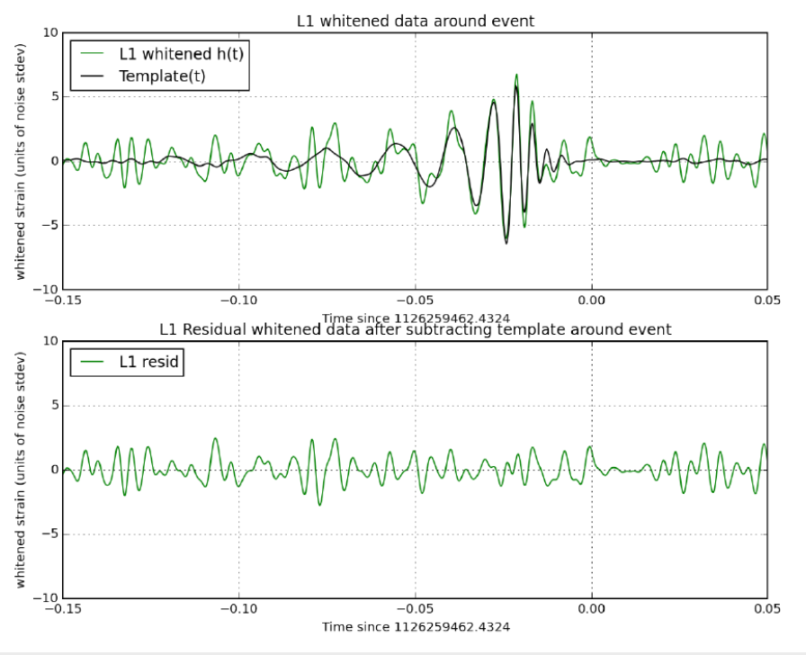
Why do I need to program?
Used in almost all real physics (and wider scientific) research
Particle physics (my research area)
  E.g. finding the Higgs boson in ATLAS data
  https://atlas.cern/resources/opendata
  Analyse ATLAS Open Data with Jupyter Notebooks
Astronomy
  E.g Gravitational wave detection with Ligo
  https://www.gw-openscience.org/tutorials/
  Guide to GW detection and noise

Slide 11
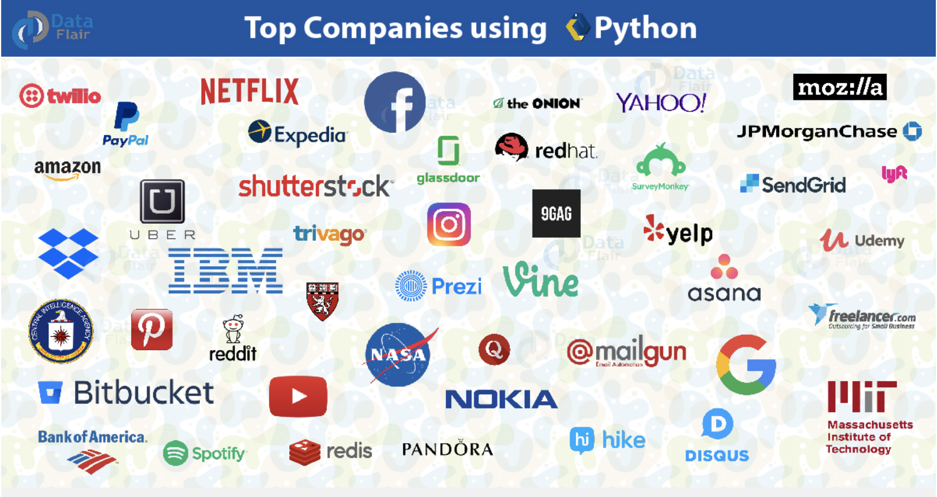
Why do I need to program?
Used in many other careers outside science too
  https://data-flair.training/blogs/python-career-opportunities/

Slide 12
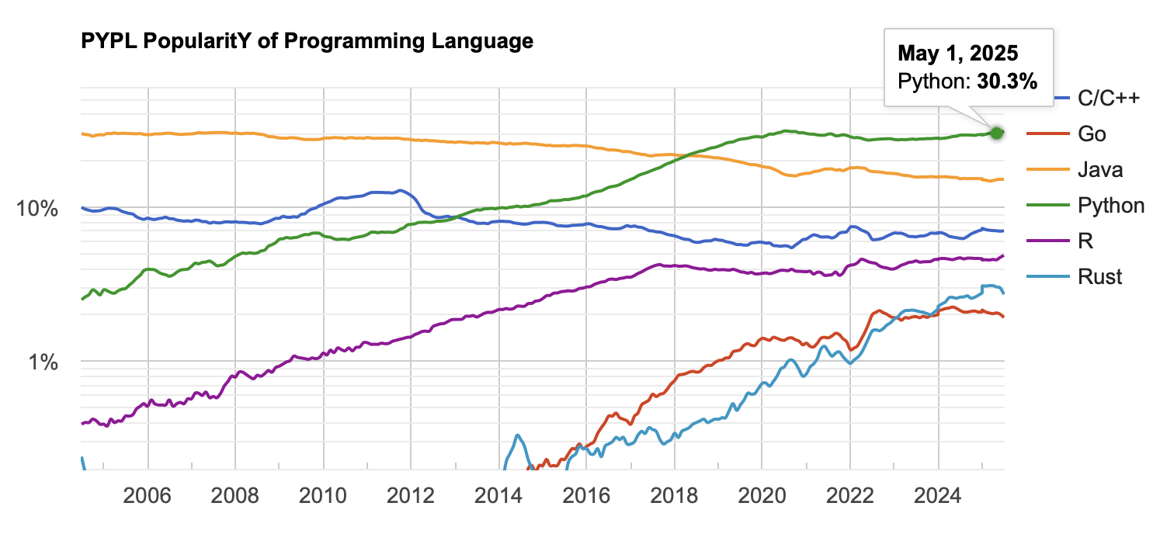
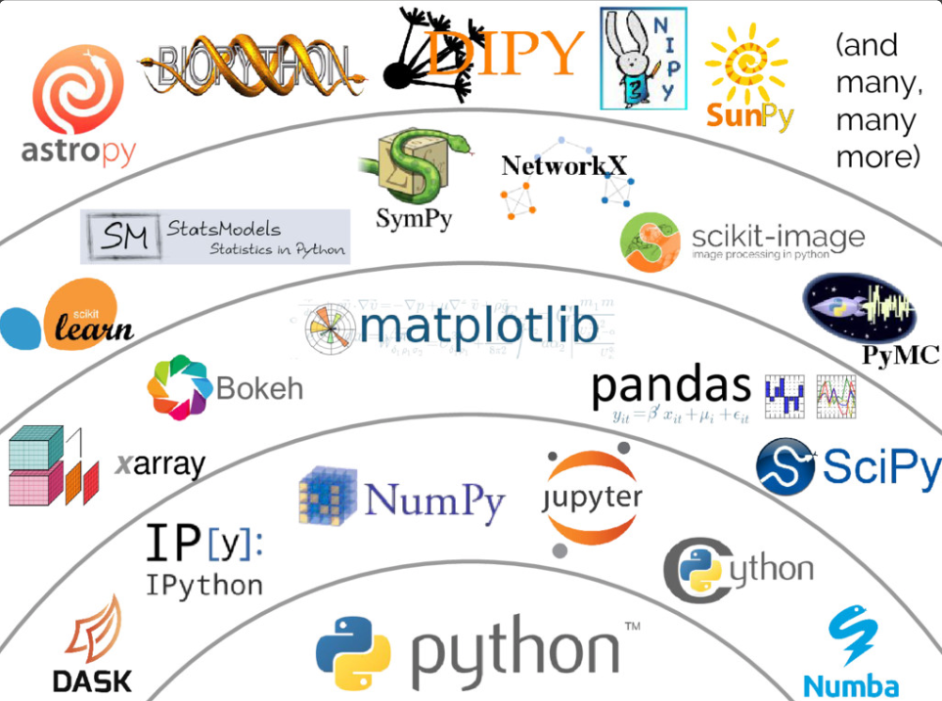


Why python?
Powerful but easy to learn and use
  Readable syntax
Most popular and fastest growing
  From google trends using PyPL
  Similar trend within physics
50%
10%
1%
+ many
more
Large and mature library of tools
  Both built-in and external
Vast scientific ecosystem
  Storage and manipulation of large data
  Data processing and visualisation
  Physics-specific packages

Slide 13
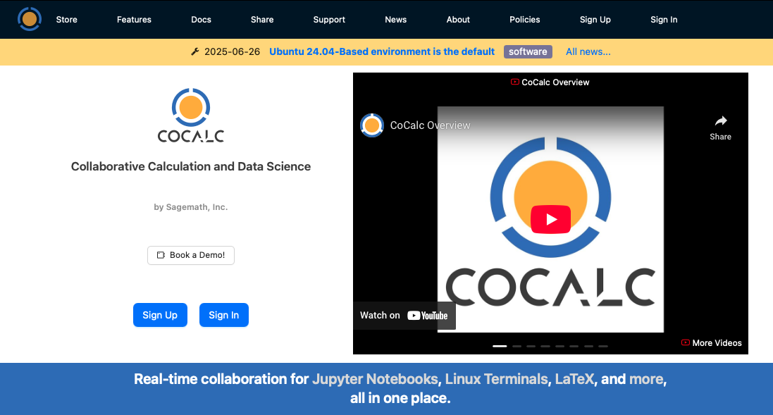
CoCalc
We will be running our programmes using the web-based CoCalc platform: https://cocalc.com
  A collaborative online workspace, allowing us to share documents, code and assignments
Make sure you sign up to CoCalc
  Using your university email in exactly
  the form the CoCalc invite was sent to
Go to the first week’s code by clicking
on Projects and then in turn on
  Your Name – PHYS105
  Introduction to Computational
  Physics/PHYS105_2025
  Phys105 Introduction to
  Computational Physics
  ComputerClassesStudent
  Phys105-Lecture01
Open the jupyter notebook
  Phys105-Lecture01-student.ipynb
    Make sure it is the .ipynb (notebook) not the .pdf
Note: If you can’t see the folder/notebook you may need to click “Restart project” button and wait a bit first

Slide 14

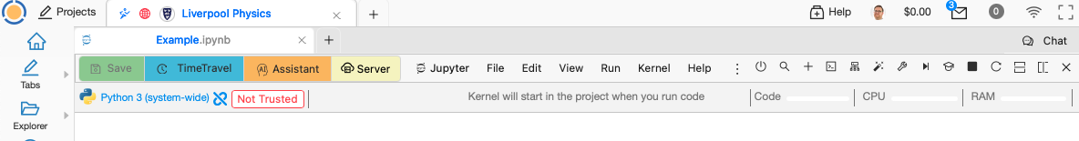




Jupyter notebooks
Jupyter notebooks are a web-based way of developing code interactively
  They keep documentation, computer code and the resulting output together
  Produce nicely formatted documents, which can be shared
The basic unit of a notebook is a cell, which can be created by clicking the icon (or Esc+b)
  To delete the cell, from the menu use Edit → Delete Cells (or Esc+d+d)
A cell can contain either python computer code (default) or Markdown-formatted text
  To change to text, select it (by clicking on it) then click on icon → Change Cell to Markdown (or Esc+m)
  To change it back to code, select it and use Cell Type icon→ Change Cell to Code (or Esc+y)
To run a cell (and move to the next) click the icon in cell or jupyter menu (or shift + enter)
Projects
Notebooks
Activity Bar
CoCalc Menu
Jupyter Menu

Slide 15

Breakdown of components
CoCalc
Collaborative online coding platform (i.e. website)
  Allows lecturers and students to work together
  All files are stored, saved and synchronised here
Jupyter Lab
Runs program that reads .ipynb notebook files
  Can also be run directly on your local machine
Notebook (.ipynb)
Python Code
A file type containing instructions for displaying text
and code cells, interpreted by Jupyter Lab
  Python cells are executed by the python interpreter
  Text cells are rendered by markdown interpreter
  These are separate entities brought together in Jupyter
Formatted Text
The programming language we will be using
  Performs calculations and data processing
  Our main goal is learning to code in python
Formatted text entered via Markdown syntax
  CoCalc has a graphical WISYWIG editor interfaced to this

Slide 16

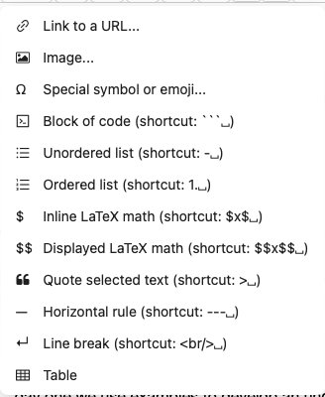
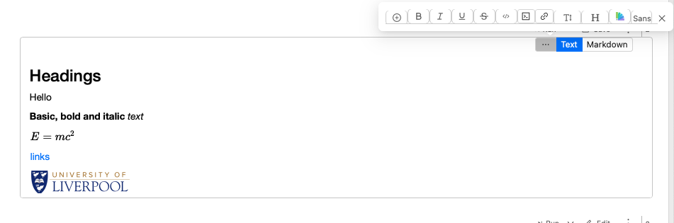
Jupyter notebooks: Text cells
Text cells allow you to enter formatted text along with formulae, hyperlinks, images and much more
  These are formatted using a specification known as Markdown
CoCalc has a helpful visual WISYWIG editor to avoid having to enter markdown directly (via icon)
  Simple to use but does lack some of the more detailed power of Markdown
Click the Markdown button, to see underlying structure
Formulae are entered using LaTeX syntax
To finish editing the text, simply run the cell

Slide 17
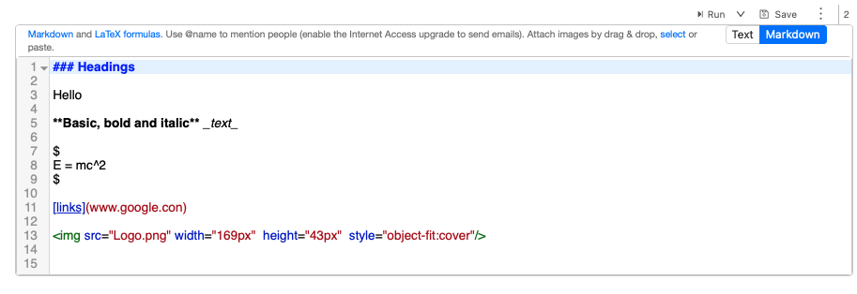
Jupyter notebooks: Text cells
Text cells allow you to enter formatted text along with formulae, hyperlinks, images and much more
  These are formatted using a specification known as Markdown
CoCalc has a helpful visual WISYWIG editor to avoid having to enter markdown directly (via icon)
  Simple to use but does lack some of the more detailed power of Markdown
Click the Markdown button, to see underlying structure
Formulae are entered using LaTeX syntax
To finish editing the text, simply run the cell

Slide 18

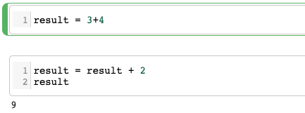


Jupyter notebooks: Code cells
Text cells allow us to write attractive documents quickly and efficiently, but the power of
notebooks is that they allow these documents to be combined with computer code
  We can describe a problem and work on the program to solve it in the same place
  Output is displayed inline
Code cells used to write python code e.g.
When the cell is run, code is executed
  And result output inline
Can edit the cell and rerun
Together, the separate code cells in a
notebook build up a program
  The results of previous cells, once run,
  can be used in subsequent ones
During the course, we will learn how to
develop python programs from scratch
  Starting with the basics in the lecture 1 notebook

Slide 19
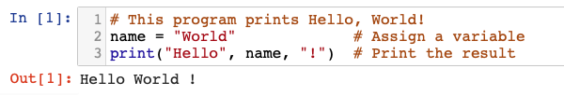


Hello, World!
The canonical first program in any computing course is “Hello, World!”
  The following python program does just that, highlighting some of the basics features of python
Note: If they are not displayed, you should turn on line numbers
for all cells via the View menu!
The basic building blocks of any program are variables
  Store some value and provide a symbolic label to refer to it
  Assigned a value, here ”World”, with the equals “=“ sign
The other main building blocks of programs are functions
  Pieces of code that do something with the variables
  Called using brackets, with input variables as arguments
Finally, we can document the code with comments
  Start with a # and don’t actually do anything when code runs
  You will lose marks for not writing appropriate comments where needed

Slide 20
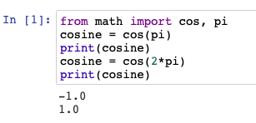
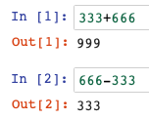
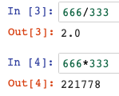
Python as a calculator
The power of any programming language is allowing us to perform calculations
  Often those which are too difficult or time consuming to do by hand
Python can perform all the basic arithmetic
  Using the math operators you might expect
  Although some are a bit more obscure
A module is simply a library (i.e. collection) of python code, such as variables and functions
  Code in a module has to be imported before use
  We will come across many useful modules as the course progresses
It can also do more complex mathematics
  Such as trigonometric functions
  These live in the math module
  Note, variables can be reassigned to new values

Slide 21

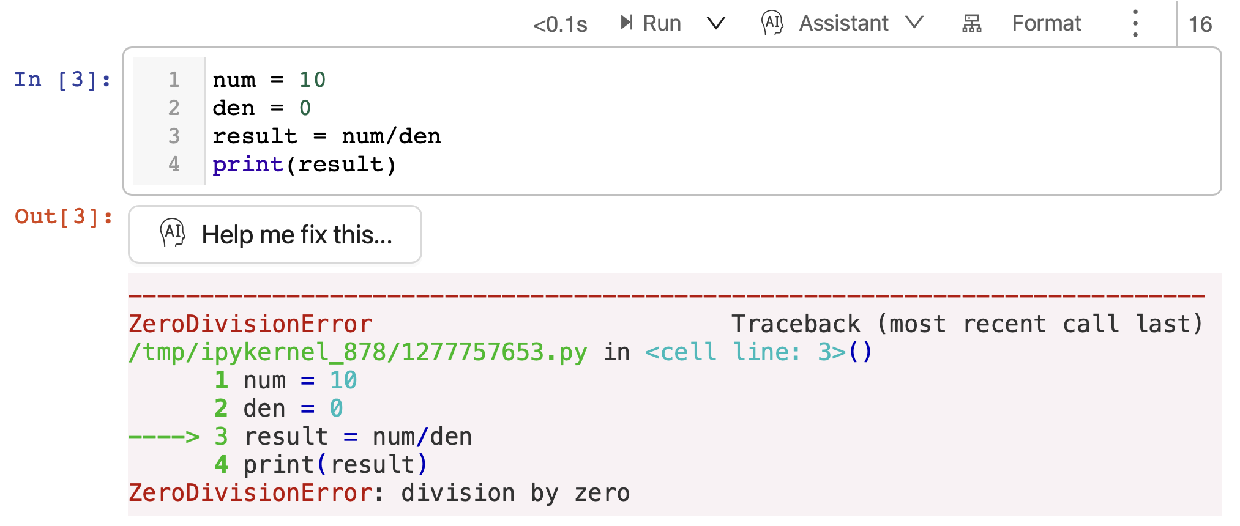
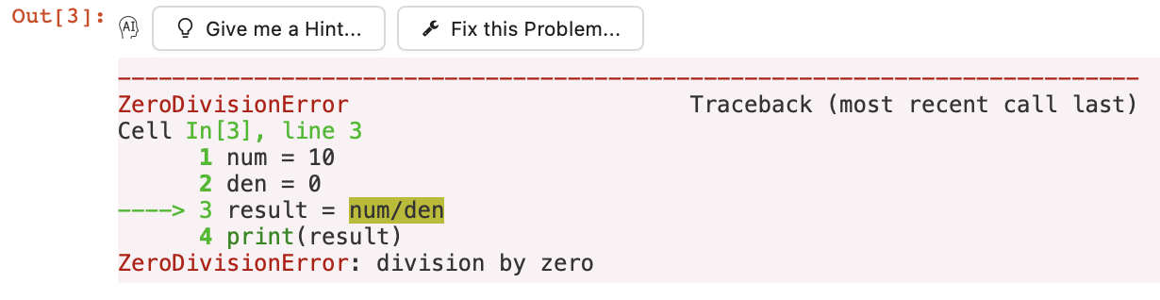
Errors
Often when coding you will make a mistake and introduce a bug into the code
  Don’t panic, this happens often even to experienced programmers!
In many cases python will display an error message to help you debug what is wrong
  These contain lots of useful information → please read them!
We will look at error messages & how to debug them in more detail later
  Along with tips on good coding practice to help reduce the number of errors
Code
Error Message

Slide 22
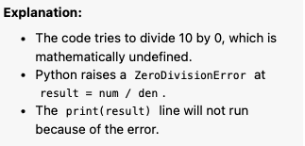

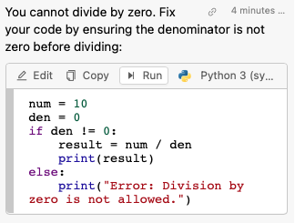
Errors
Often when coding you will make a mistake and introduce a bug into the code
  Don’t panic, this happens often even to experienced programmers!
In many cases python will display an error message to help you debug what is wrong
  These contain lots of useful information → please read them!
We will look at error messages & how to debug them in more detail later
  Along with tips on good coding practice to help reduce the number of errors
Code
CoCalc even lets you us AI
To explain the code and/or for error help
Error Message

Slide 23
Errors
Often when coding you will make a mistake and introduce a bug into the code
  Don’t panic, this happens often even to experienced programmers!
In many cases python will display an error message to help you debug what is wrong
  These contain lots of useful information → please read them!
We will look at error messages & how to debug them in more detail later
  Along with tips on good coding practice to help reduce the number of errors
While AI tools like ChatGPT are very useful to help with understanding and debugging, they must NOT be used to generate code for the assessments, since these must be your own work! More details in this University guidance.
Code
CoCalc even lets you us AI
To explain the code and/or for error help
Error Message

Slide 24
Summary
Computer programming is an invaluable tool for many scientific problems
  And python is by far the most popular language
Over the course of PHYS105, you will learn how to program in python
  Starting from scratch and by the end making your own module
We will see how to use it to solve several real physics problems
  Such as projectile motion, fitting experimental data, numerical solutions and MC methods
We will see how to visualise and present the results
The first computing classes next Monday will go over the basics of python and Jupyter from today
  Will allow you to put into practice what we have discussed in the lecture
  Demonstrators will help you to work through the material, including formative (practice) exercises
  At the end you will have the first summative (counts to mark) assignment exercise
    Which should be uploaded to canvas by the end of Monday (work submitted after extension period will score 0!)

