Slide 1
Liverpool Particle Physics
Masterclass 2026
Carl Gwilliam & Saskia Charity
8th October 2025
Liverpool PP Masterclass Meeting

Slide 2
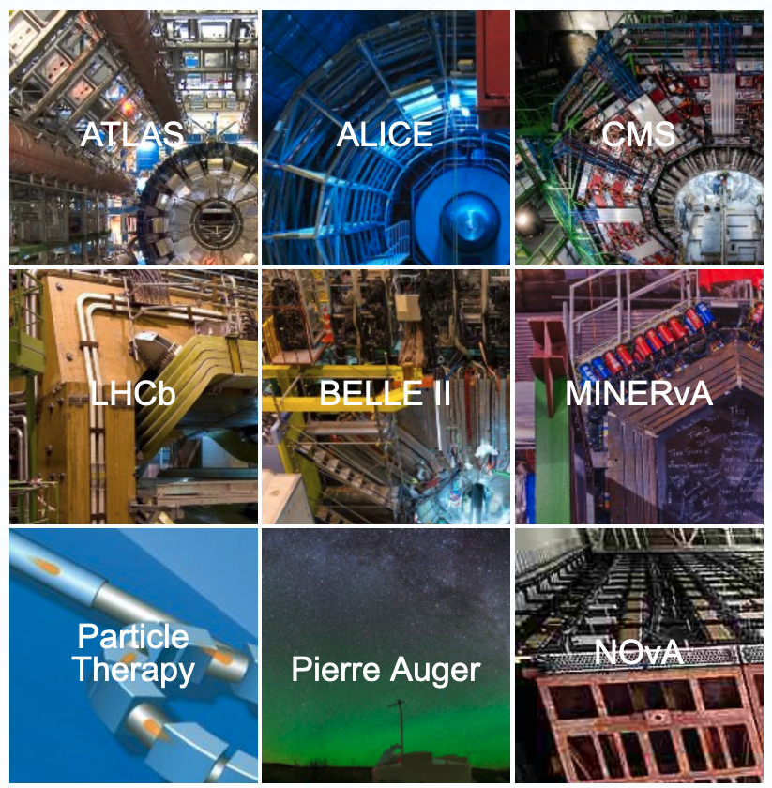
International PP Masterclasses
Each year 13,000+ students in >60 countries learn about the mysteries of particle physics as part of the International Particle Physics Outreach Group (IPPOG)
  https://physicsmasterclasses.org/
In person one day session at a university/research centre, in Spring, with talks and hands-on activities
  Many activities on several experiments to choose from
  VC discussion with other institutes at end of the day
Aimed at 15-19 year olds (i.e. year 11-13 students)
  Although year 12 ideal since they will have started A-levels and not yet applied for university
Goals
  Show what it is like to be a particle physicist for the day
  Encourage students to come to Liverpool to do Physics

Slide 3
2025 Liverpool Masterclass

Slide 4
Overview
In March, Liverpool hosted 1st Masterclass in over a decade
  Coordinated by Carl and Saskia, with help from >25 staff
  + PhD students and 10 undergraduate students (thanks!)
Attended by more than 150 year-12 A-level students
  ≈20 schools from across north-west & as far away as Jersey
  50 places dedicated to widening-participation schools
Day was a huge success with generally positive feedback from both teachers and students alike
  Students found teaching lab tours and hands-on exercises most interesting, but lectures most useful
  100% of schools would come back and >50% of students more likely to come to Liverpool afterwards
Plan to keep 2026 event broadly similar
  But address the main constructive feedback from last time
    (see backup for details)

Slide 5
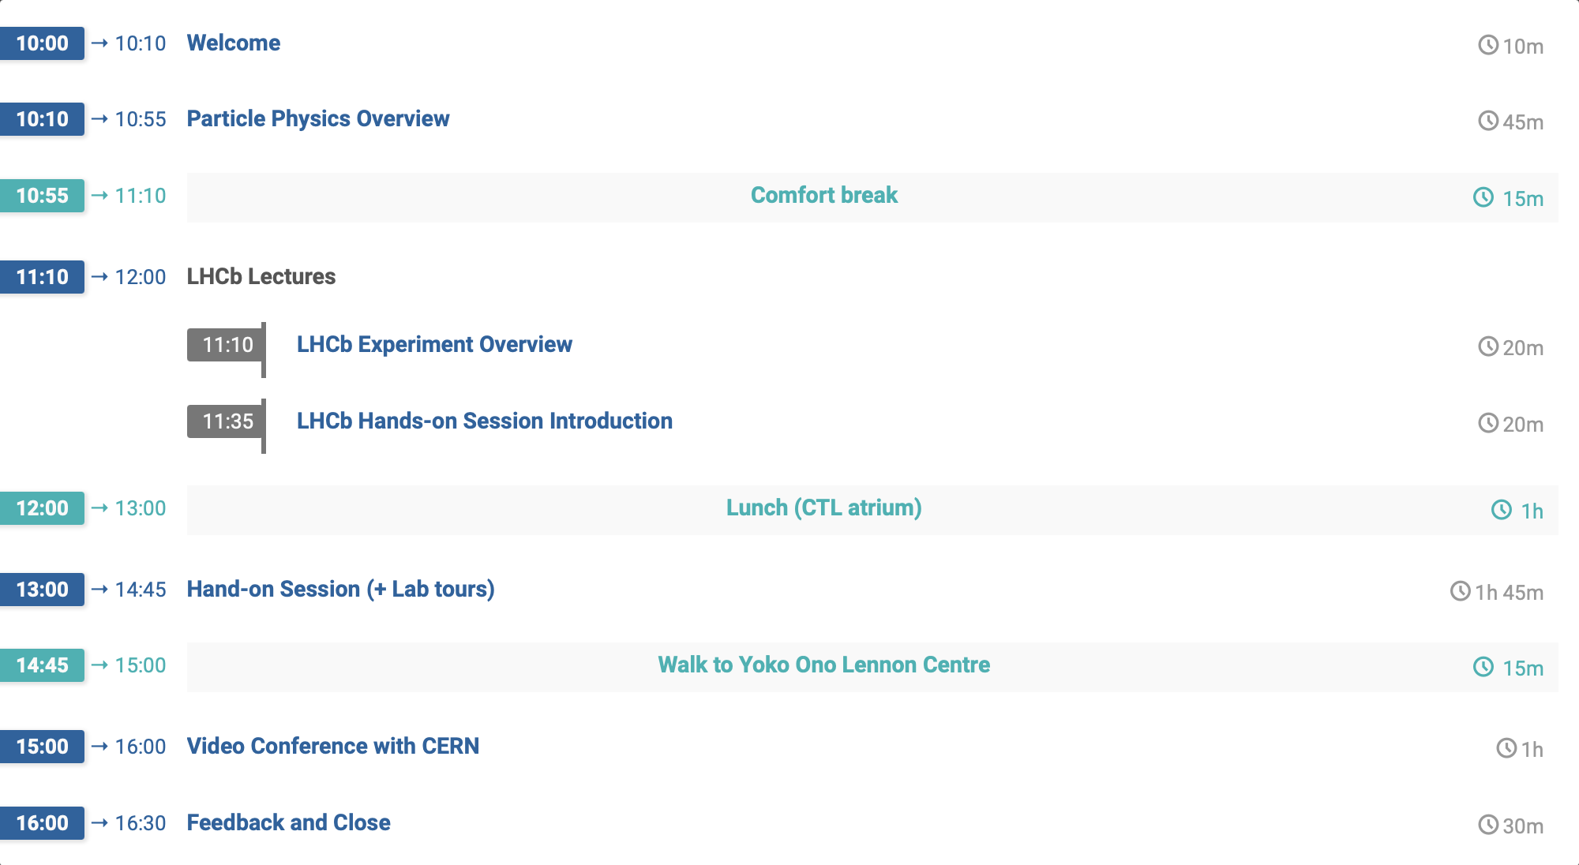
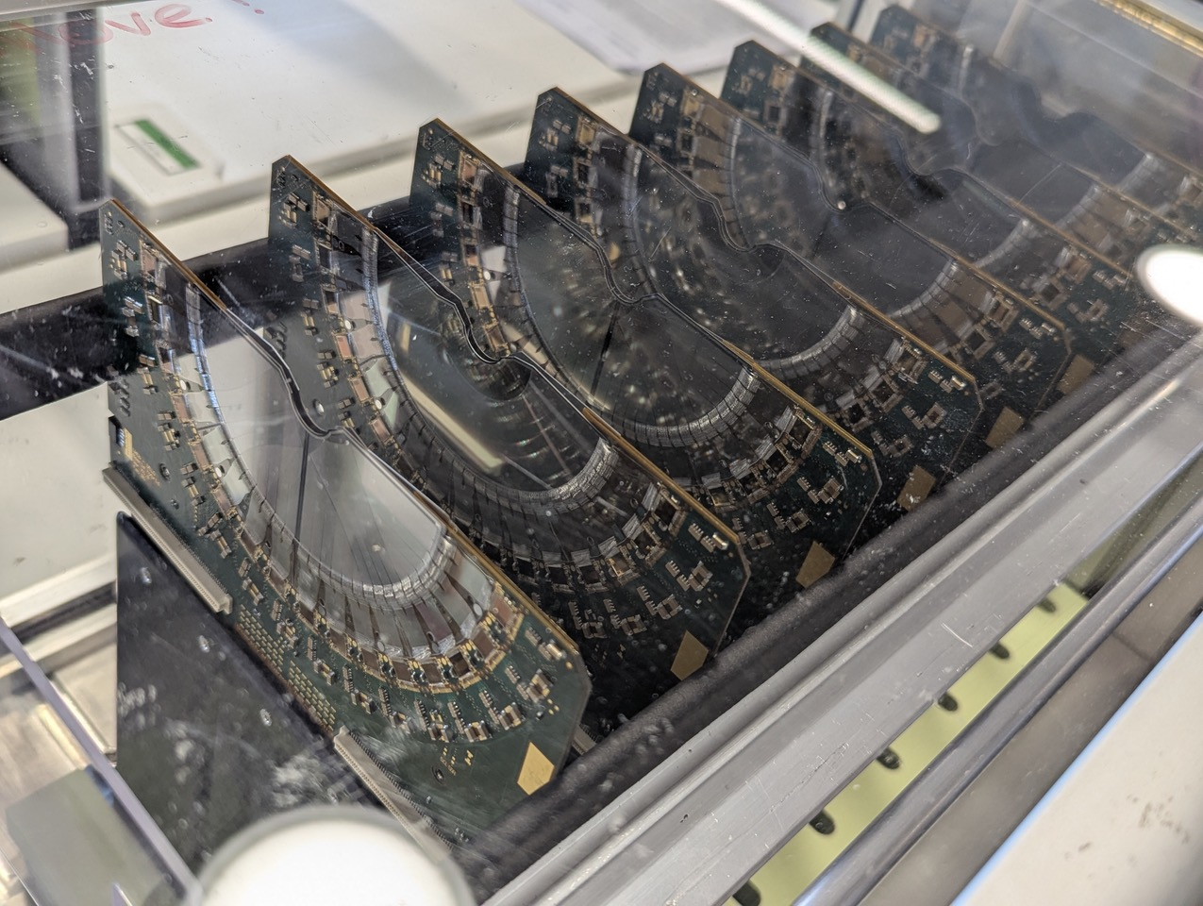
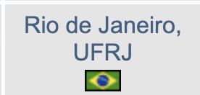




Agenda
https://indico.ph.liv.ac.uk/event/1883/
Introductory talk linked to A-level by Saskia
Talks on LHCb by David Hutchcroft + Paras Naik with Liverpool-built VELO detector on display
Hands-on activity on real LHCb data, led by David
+ tours of teaching labs with demonstrations by UGs
Compare results with other groups + virtual tour of LHCb led by Liverpool PhD student Ho Sang Li

Slide 6
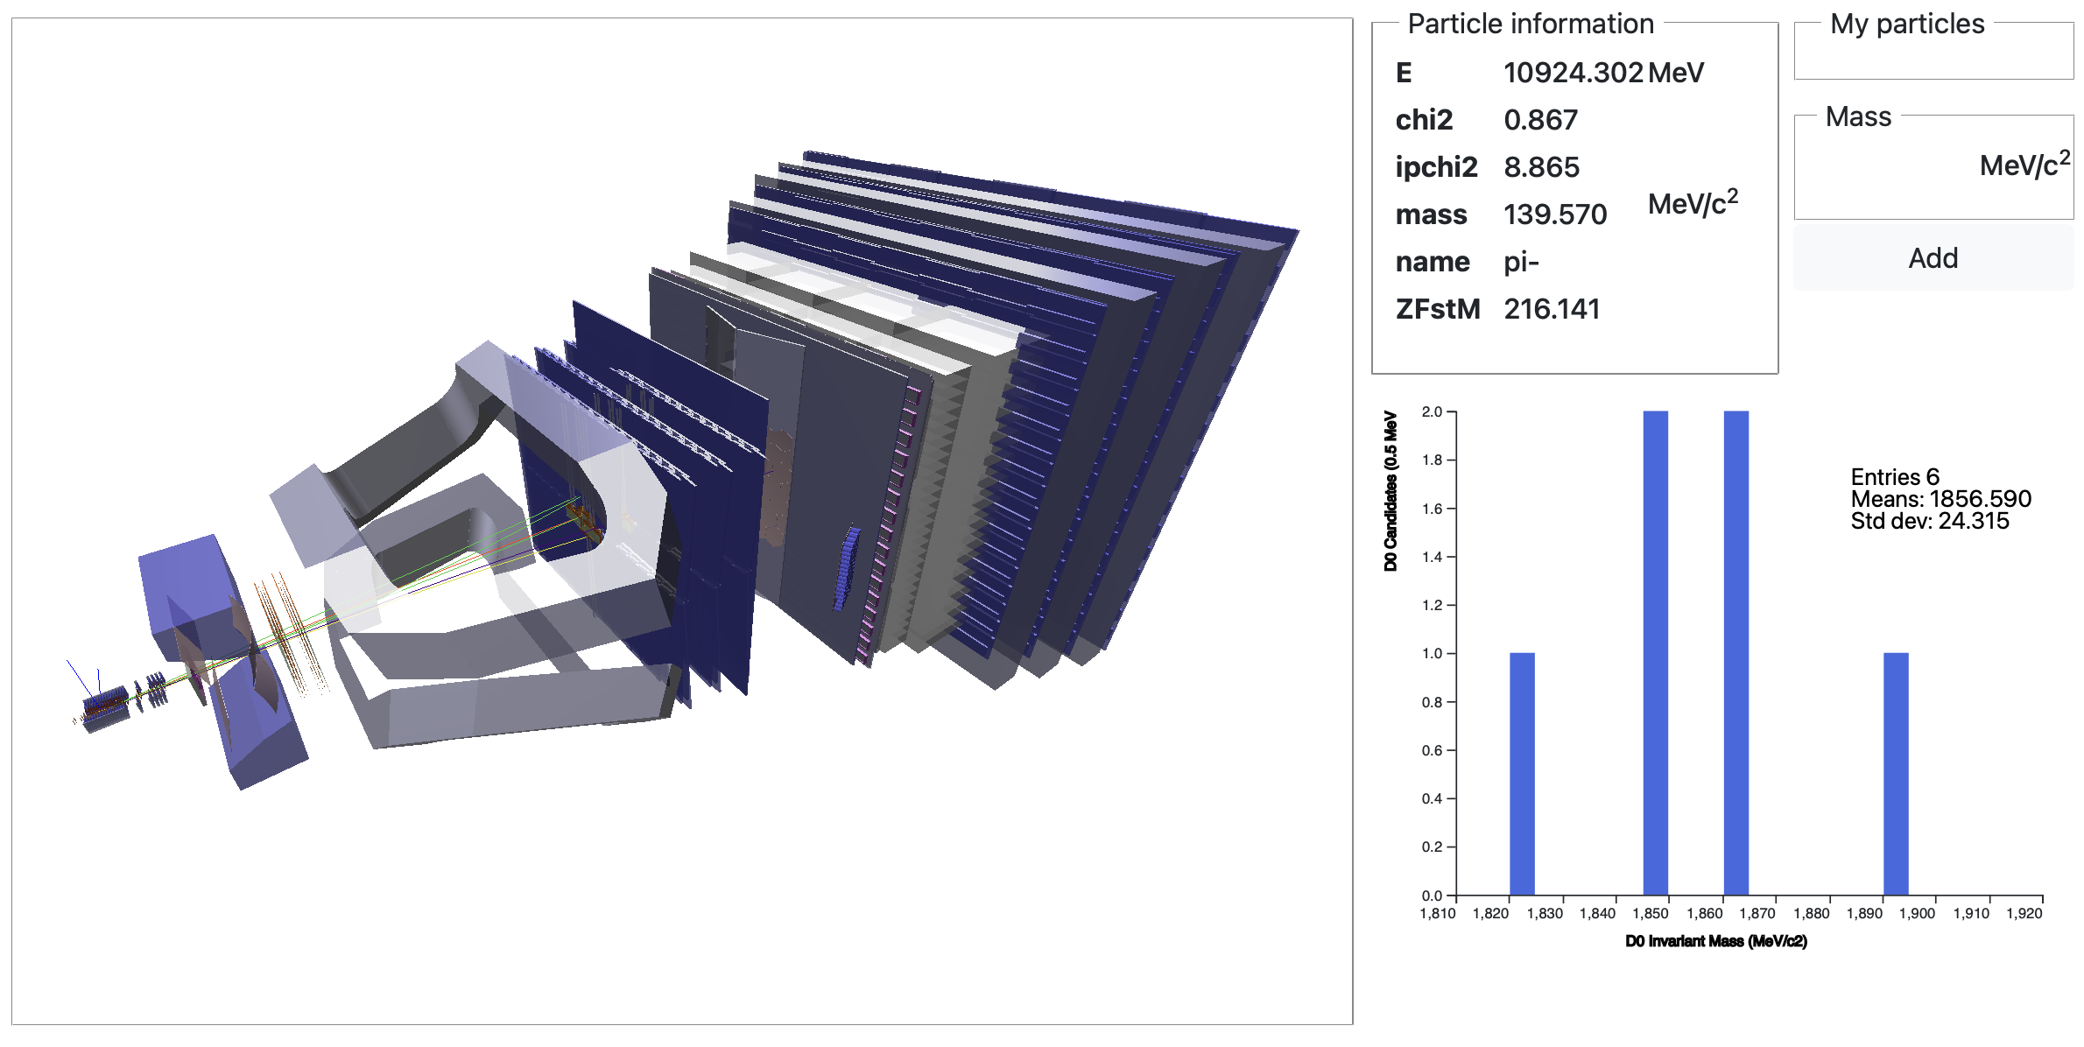
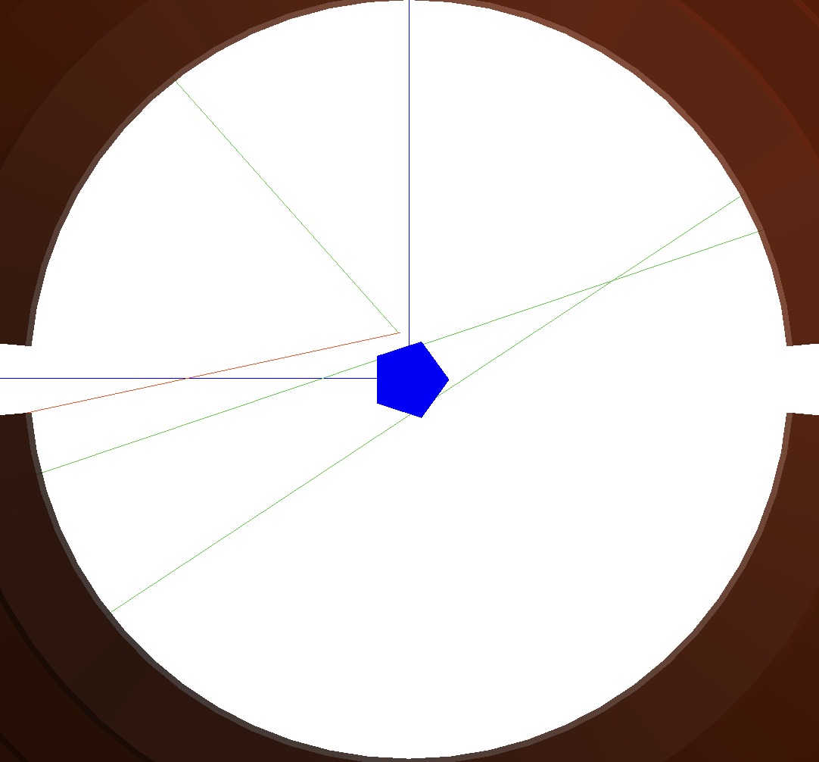
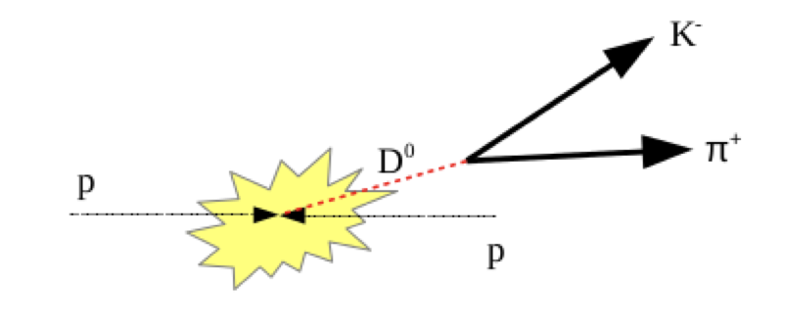
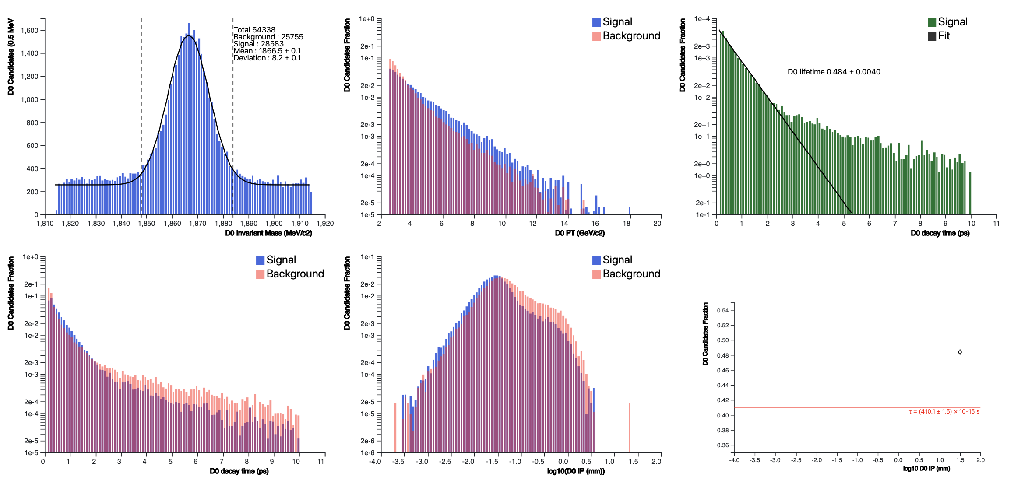
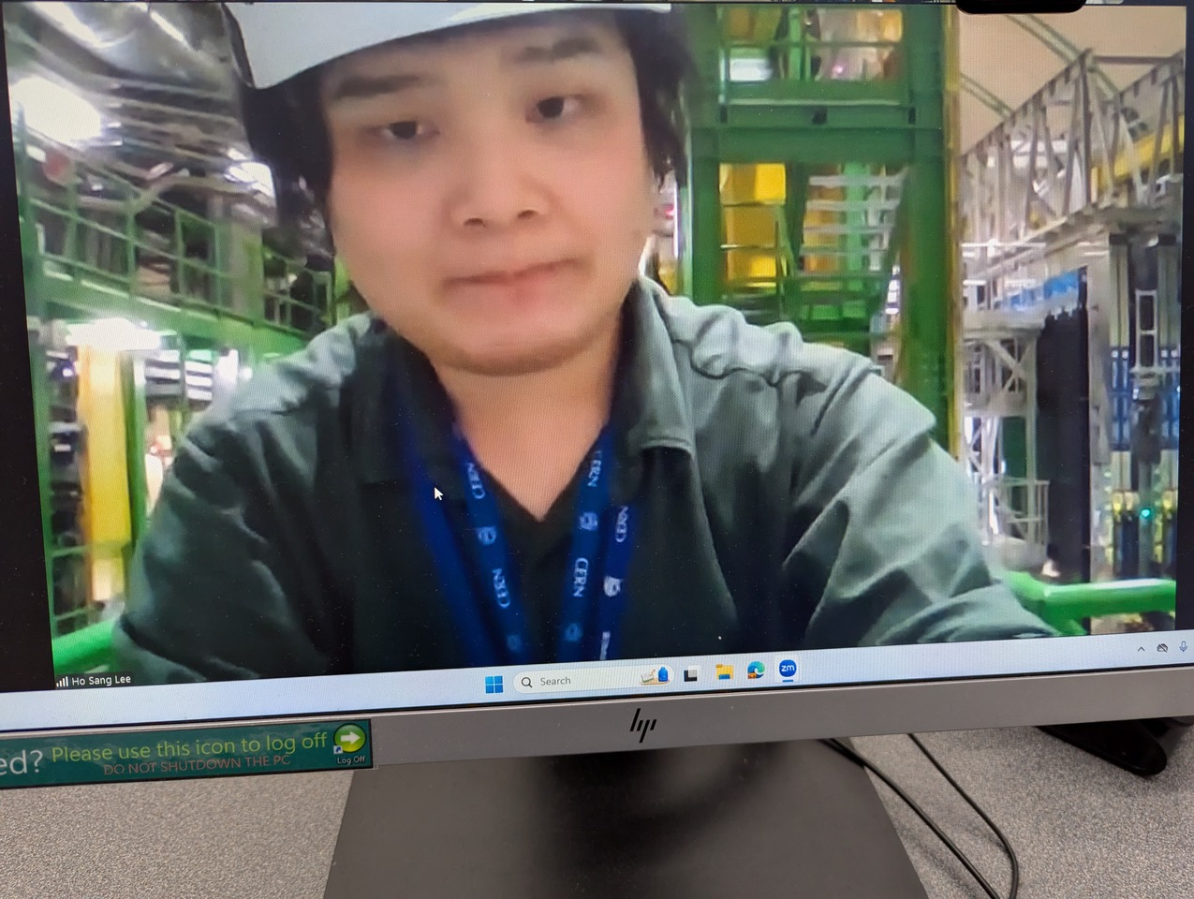
Hands-on Activity
https://lhcb-outreach.web.cern.ch/lhcbinternationalmasterclasses/d0-lifetime/
Identify D⁰ → k±π∓ events in LHCb
  Find decay tracks + plot mass
π⁺
k⁻
Invariant Mass
Separate signal from background
via cuts and extract D⁰ lifetime
  Report at video conference
Ho in LHCb cavern

Slide 7
2026 Liverpool Masterclass

Slide 8
Dates/Times
Call for dates already announced by IPPOG and we have put in the following options
  Wednesday 18th March
    In term time, hence Weds only option
  Friday 27th March
    In Uni but not school easter holiday
Should get conformation of which is chosen in November
  If both dates are possible could consider to run two days given interest last time
  Would depend on sufficient person power and likely too much of a stretch
Thanks to Gita, our new APVC(E) we already have rooms booked for these days ☺
  Have the entire CTH/CTL for the full day (to prevent anyone else using)
  Includes lecture theatres, GFlex, both PCTC (could use both?!) and atrium
Like last time we would propose to run it from 10:00 – 16:00
  Giving time for schools to arrive and then return back

Slide 9
Morning
Start with the introductory lecture from Saskia in CTH LTB like last time
  Received very good feedback, with students finding it most useful
To address feedback that there were too many lectures and not enough interaction
  Move to Gflex (if numbers allow)
  Split into groups and rotate round different activities
    Lab tours (to prevent disruption to hands-on activity with schools getting out of sync that we had)
  Need to come up with at least two other activities e.g.
    Find the higgs, particle builder,, quirky quarks, SM game from BSF, Quark Quest, Q&A, Pub Quiz, …
Then have a single LHCb lecture just before lunch
  Geared strongly towards the hands-on activity that will come in the afternoon
Lunch (12-13:00)
  Move to pre-packed lunches to prevent issues seen last time
    Long queues and the first people eating all the food
  Could use both the atrium and the Gflex to allow more space for people to sit
    Would need to pay for cleaning of Gflex though in that case

Slide 10
Afternoon
Dedicated to the hands-on LHCb activity from 13-~14:45
  There is an updated version in progress that they hope will be ready in time
  Will need to familiarise ourselves with this and have a training session nearer the time
  Based on feedback, need to make instructions less text heavy and more user friendly
    But some central effort already in this direction
Followed by Video Conference (VC) with CERN back in CTL LTB at 15:00-16:00
  Based on feedback need to prepare students more for this
    Students to present our results
    A couple of questions to ask
  Might be helpful for this to get into LT a bit in advance (as we don’t have to travel as far this time)
Will again run the pre/post-questionnaires
  Both as the schools arrive (< 10:00) and before they leave (> 16:00)
  Based on these, and developments in the exercises, may make larger changes for future years

Slide 11
Planning and
Next Steps

Slide 12

People
We need people to
  Help organise the event
  To participate on the day
Advance organisation
  Suggest/test interactive exercises
  Update LHCb hands-on instructions (if needed)
On the day
  People to lead a group of around 10 students from a school
  Be there for the interactive exercises and the hands-on sessions
    Based on feedback would be good to be there for everything
    except the lecture (say 11-16:00) to develop bond with students
    Will require ~20 people
  One person to lead the VC session and test the setup before

Slide 13
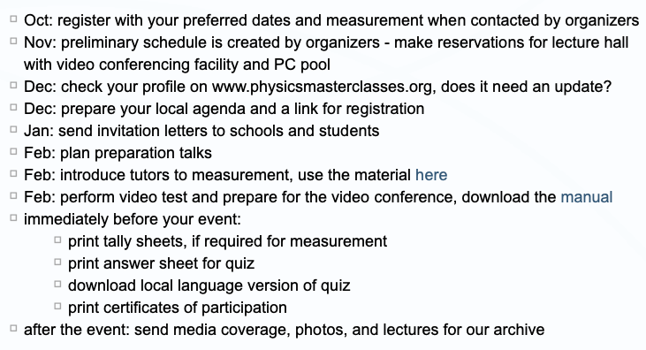
Next steps
“Official” schedule
Most urgent items are
  Finalise the plan for the day and develop the interactive exercises
  Make sure we have sufficient people signed up for the day itself
We are here
Communication
  Will have semi-regular meetings on a fortnightly
  or monthly basis as needed
    To avoid polling each time good to find a general slot,
    so please fill the poll below:
    https://www.when2meet.com/?32832020-awh5y
  Please also sign up to the MS Team’s channel
    General | PPMasterclass-O365-Team | Microsoft Teams

