Slide 1
Search for a SM Higgs Boson in the Decay H -> WW -> ll with 200 pb⁻¹ at ATLAS
Carl Gwilliam
On behalf of the ATLAS Collaboration
29th June 2010
QCD10 Conference

Slide 2
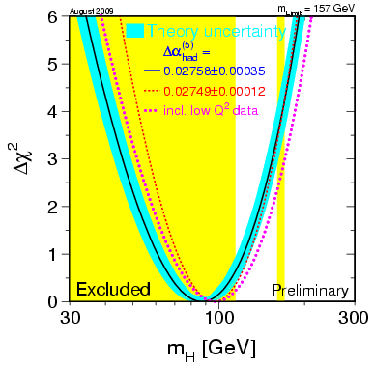
Introduction
In the Standard Model the Higgs mechanism is responsible for giving masses to all other particles
Current limits (95% C.L.):
LEP direct searches
m_{H} > 114.4 GeV
Global fit to precision EW data (excludes direct search results)
m_{H} < 157 GeV
Latest Tevatron H->WW results
162< m_{H} < 166 GeV excluded
The H->WW^{(*)}->lνlν decay mode gives strong sensitivity to a SM Higgs in the intermediate mass range of 130 < m_{H} < 200 GeV
Present the sensitivity of the ATLAS detector in this channel for 200 pb⁻¹ at a centre-of-mass energy √s = 10 TeV

Slide 3
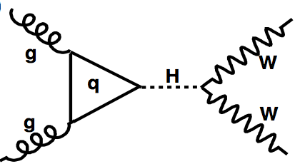
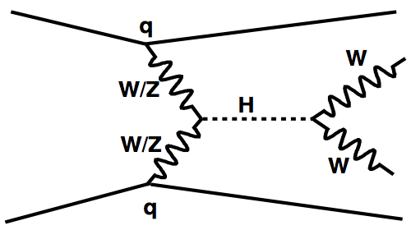
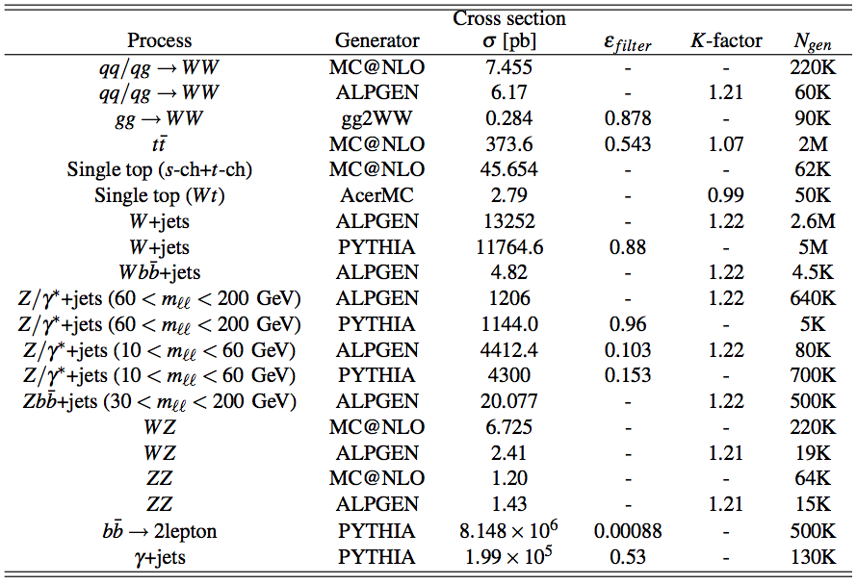
Signal and Backgrounds
Consider H->WW^{(*)} production in range 130 < M_{H} < 200 GeV
gluon Fusion
(ggF)
Vector Boson Fusion
(VBF)
Dominant
10-20%
Background Processes:
Continuum WW production
Dominates H + 0j analysis
tt and single top production
Dominates H + 2j analysis
W + jets production
Z/γ* + jets production
WZ/ZZ production
Many other samples used for cross-checks

Slide 4
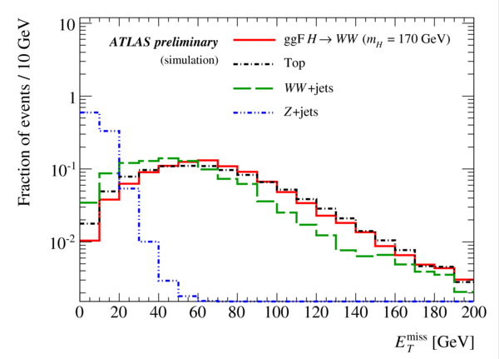
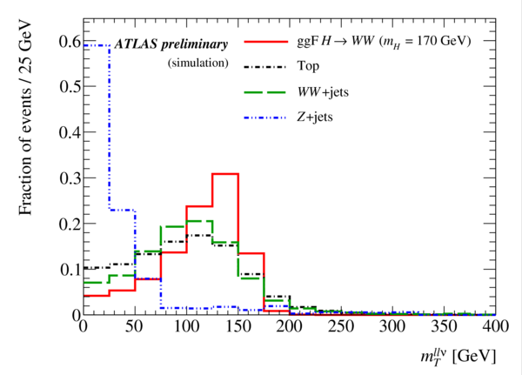
Pre-Selection
Exactly 2 good oppositely-signed isolated leptons with P_{t} > 15 GeV and |η| < 2.5
Invariant mass m_{ll} > 15 GeV and inconsistent with Z boson
Missing E_{t} > 30 (40) GeV for eμ (ee/μμ) channel
Transverse mass of leptons and missing E_{t}, m_{T}^{llν} > 30 GeV
Perform separate analyses depending on jet multiplicity
These are labeled H + 0 jets, H + 1 jet and H + 2 jets in the following

Slide 5
H + 0 Jet Analysis
Most of the ggF signal contains no high P_{t} hadronic activity
Vetoing jets allows to greatly suppresses top background
H + 0j Cuts
No jets with P_{t}^{jet} > 20 GeV and |η| < 3
Transverse momentum of lepton pair P_{t}^{ll} > 30 GeV
Common topological cuts (applied to all analyses)
Invariant mass of lepton pair m_{ll} < 50 GeV (80 GeV for H + 2j)
Azimuthal separation between leptons Δφ^{ll} < 1.3 rad
Transverse mass
m_{H}=170 GeV

Slide 6
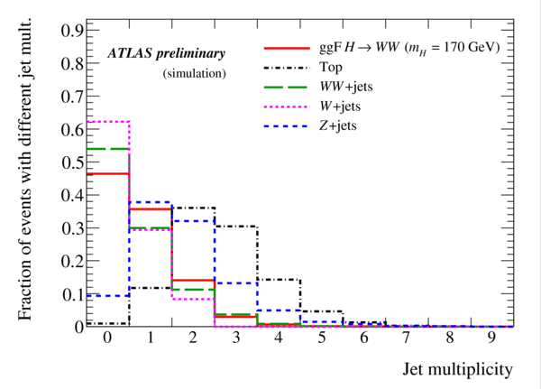
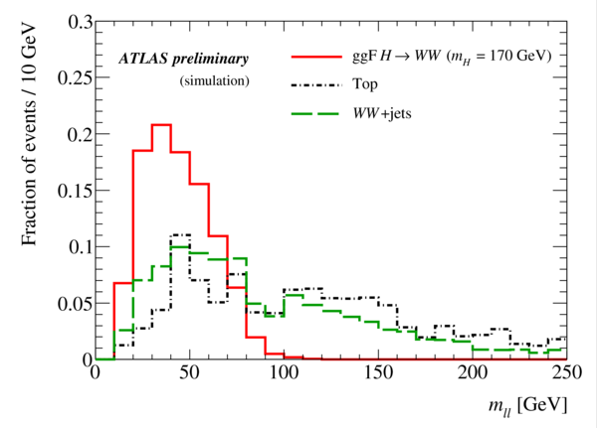
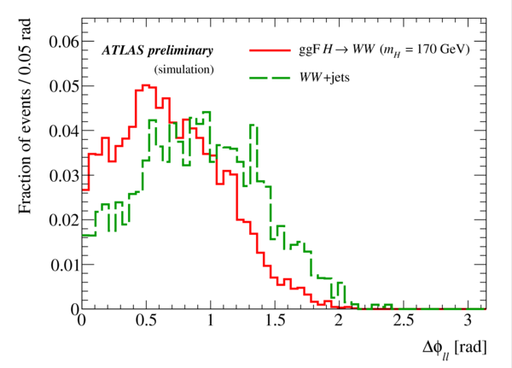
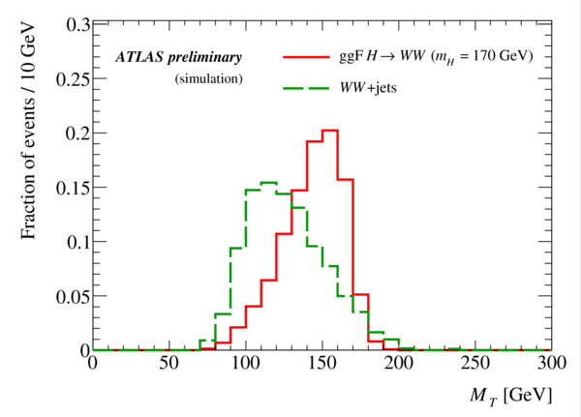
H + 0 Jet Analysis (2)
m_{H} = 170 GeV

Slide 7
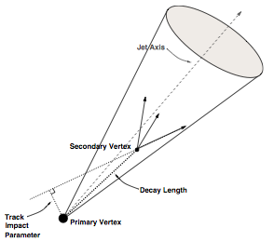
H + 1 Jet Analysis
A significant fraction of the ggF signal contains a high P_{t} jet arising from QCD radiative corrections. Require:
1 “tag” jet with P_{t}^{jet} > 20 GeV and |η| < 3
Veto events where tag jet is identified as a b-jet
Reconstruct explicit secondary vertex
Require signed L/σ_{L}> 5.7 (ε_{b}=60%)
30 GeV
Reject events consistent with Z -> ττ
L/σ_{L}
m_{H}=170 GeV

Slide 8
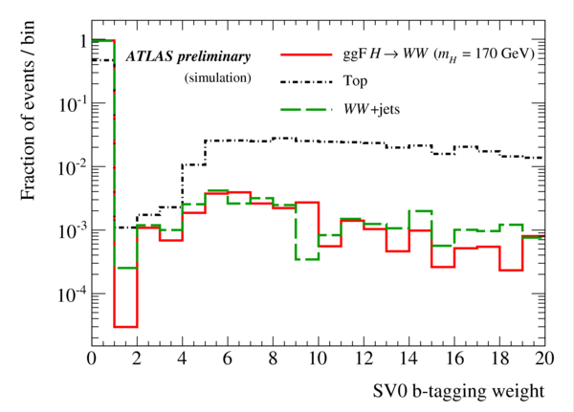
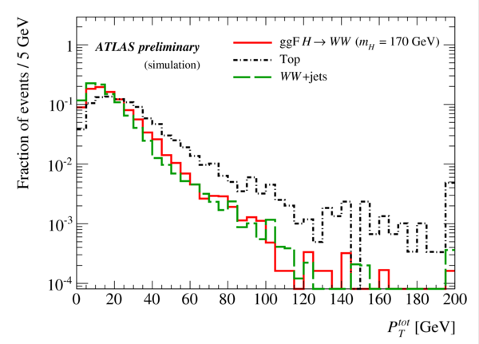
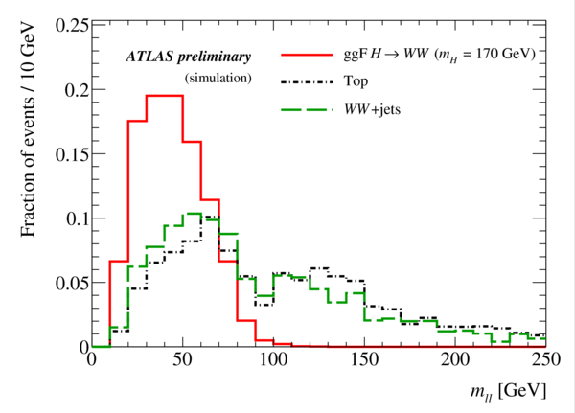
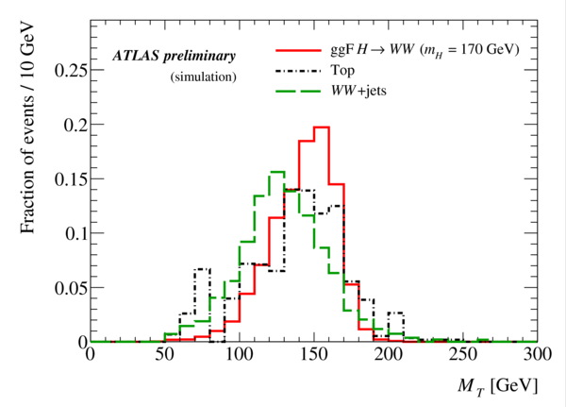
H + 1 Jet Analysis (2)
m_{H} = 170 GeV

Slide 9
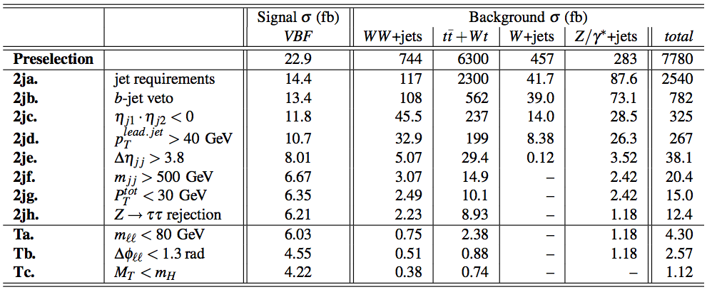
H + 2 Jet Analysis
The VBF signal contains 2 “tag” jets. Require:
2 “tag” jets with P_{t}^{jet} > 20 GeV and |η| < 3, not identified as a b-jets
Tag jets in opposite hemispheres η_{j1}η_{j2} < 0 with rapidity gap Δη_{jj} > 3.8
Transverse momentum of leading jet P_{t}^{j1} > 40 GeV
Dijet invariant mass m_{jj} > 500 GeV
30 GeV
Reject events consistent with Z -> ττ
tag jet
tag jet
m_{H}=170 GeV

Slide 10
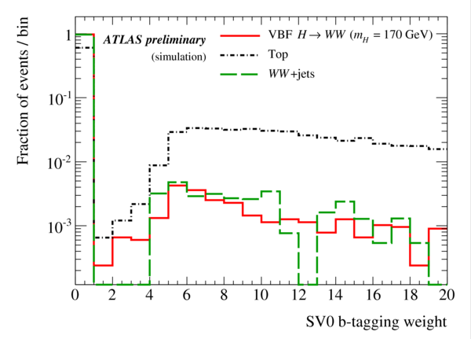
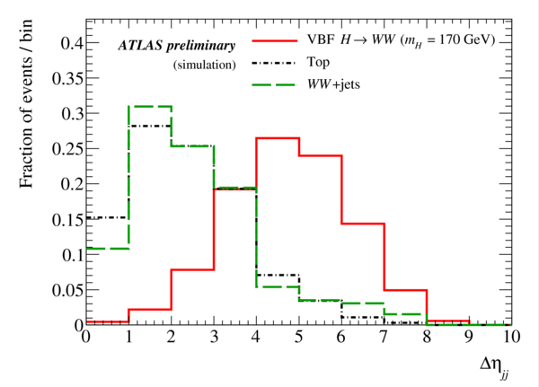
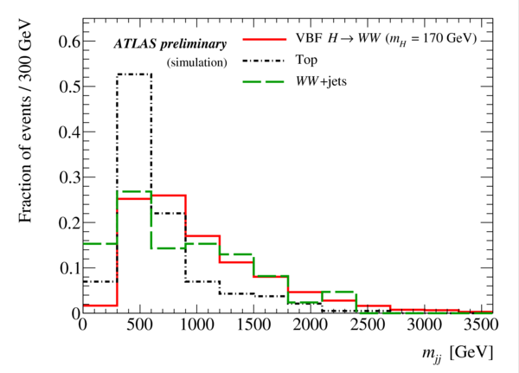
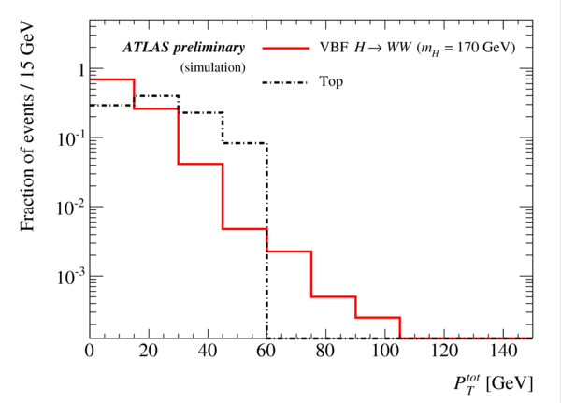
H + 2 Jet Analysis (2)
m_{H} = 170 GeV

Slide 11
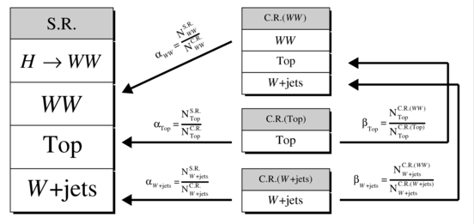
Data-Driven Background Estimation
Reduce dependency on MC by estimating backgrounds from data whenever possible
Define control regions (C.R.) dominated by a single background and use to normalise the contribution in the signal region (S.R.)
Extract normalisation factors from data wherever possible

Slide 12
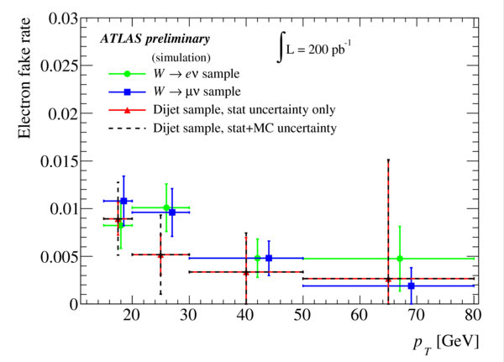
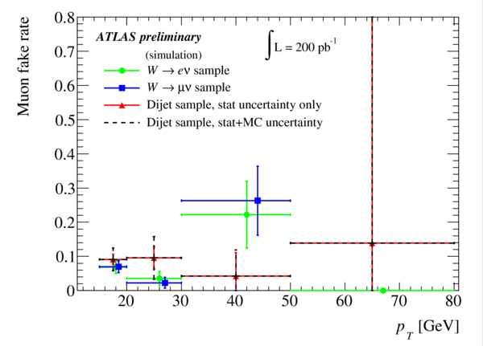
W + Jets Background Estimation
Loosen lepton selection to obtain a control region dominated by W+jets
Expect ≈ 100 events/channel in 200 pb⁻¹
Define lepton fake rate as:
Can measure approximate lepton fake rate from data using dijet sample
Jet triggers provide dijet enriched sample
Veto events consistent with Z or W mass
Estimated number of reconstructed W+jets events in signal region (S.R.) is
where α_{W+jets} is a scale factor derived from MC

Slide 13
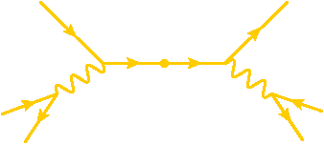
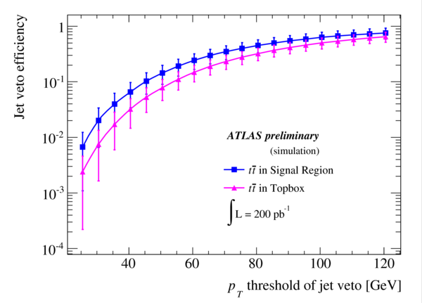
Top Background Estimation
b
b
t
t
q
W⁻
W⁺
l⁺
q’
ν
“Top-box” control region (H + 0 jets)
Select semi-leptonic tt events by requiring 1 lepton + ≥1 b-tagged jet
Full reconstruct event and require both tops satisfy M_{t} > 150 GeV
Expect ≈ 1000 events in 200 pb⁻¹
Can estimate jet veto efficiency using lead jet not from W or b-tagged.0 events/channel in 200 pb⁻¹
“b-tagged” control region (H + >0 jets)
Reverse b-jet veto, requiring jets are identified as b-jets + remove M_{T} cut
In H + 2 jets, exclude signal by reversing M_{ll} cut + loosen kinematic cuts
Almost pure top sample with up to ≈ 40 events/channel in 200 pb⁻¹
Measure events in control region from data and extrapolate to signal region using scale factor α_{top}:
α_{top} related to b-tagging efficiency for b-tagged control region

Slide 14
WW Background Estimation
“Reversed Δφ” control region (H + <2 jets)
Reverse dilepton azimuthal angle and invariant mass cuts
Apply additional Z veto in same-flavour channels
Expect up to ≈ 30 events/ channel in 200 pb⁻¹
Although dominated by WW this control region still contains significant tt and W + jets contamination
Correct for this by subtracting estimated tt and W + jets backgrounds, scaled to the reversed Δφ control region
“b-vetoed” control region (H + 2 jets)
For H + 2 jets tt contamination begins to dominate the reversed Δφ C.R.
Instead select sample akin to b-tagged top control region but with the b-tagging cut reversed to act as a veto
Still contains some tt contamination, which is corrected for as above

Slide 15
Systematic Uncertainties
Uncertainties on background estimation scale factors from MC
Top/WW Monte Carlo Q² scale
Vary renormalisation/factorisation scale by 1/4 (1/8) and 4 (8) for tt (WW)
Jet Energy Scale (JES) and Jet Energy Resolution (JER)
Scale E_{jet} coherently up/down by 7% for |η|<3.2 and 15% for |η|>3.2
Smear E_{jet} by Gaussian with width 0.45√E for |η|<3.2 and 0.63√E for |η|>3.2
10% uncertainty on b-tagging efficiency
Uncertainty due to limited Monte Carlo statistics
Errors assumed to be uncorrelated between different H + n jet analyses
Signal uncertainties
1% lepton reconstruction efficiency uncertainty (correlated)
Jet Energy Scale uncertainty (uncorrelated)
6% for H + 0 jets and 6.3% for H + 1 jet
Theoretical uncertainty (uncorrelated)
4.5% for H + 0 jets and 2% for H + 1 jet
10% luminosity uncertainty (correlated)

Slide 16
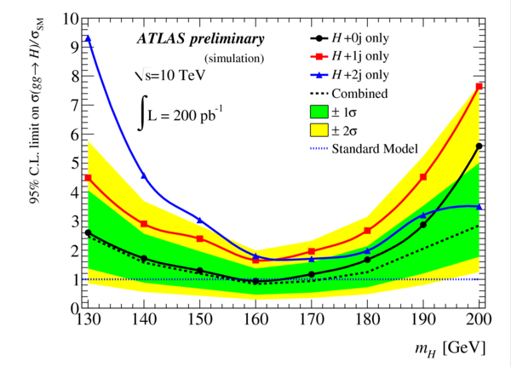
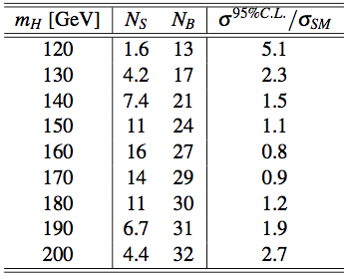
Exclusion Sensitivity @ 200 pb⁻¹
Calculate a one-sided 95% confidence limit using a Maximum Likelihood Ratio technique
Combining the 3 analyses one can exclude a Higgs boson in the mass range 160-170 GeV with 200 pb⁻¹ of data at √s = 10 TeV

Slide 17
Discovery Potential Versus √s @ 1 fb⁻¹
Discovery significance versus √s for 1 fb⁻¹ of well understood data
Simplified analysis
Consider only eμ channel & scale signal significance by √2 to account for ee/μμ channels
Extrapolated to different √s using simple σ scaling
Intended only to give an indication of the relative sensitivity at various √s
With 1 fb⁻¹ of data at √s ≈ 7 TeV could potentially see ≥3σ evidence for a Higgs boson if it has a mass of 160-170 GeV.

Slide 18
Summary
Have presented the sensitivity of the ATLAS detector in the channel H->WW->lνlν with 200 pb⁻¹ of data at √s = 10 TeV
Data-driven methods to estimate the main backgrounds as well as sources of systematic uncertainty have been considered
At √s = 10 TeV can start excluding masses in the range 160-170 GeV with 200 pb⁻¹
At √s = 7 TeV, will obviously need more data
LHC plan is to deliver 1 fb⁻¹ by the end of 2011
Should be possible to exclude significant mass range
Exciting times ahead …
For further details please see ATL-PHYS-PUB-2010-005
http://cdsweb.cern.ch/record/1270568

Slide 19
Back-up Slides

Slide 20
Signal Samples
ggF and VBF signals for various M_{H}

Slide 21
W + Jets Background
Loose lepton criteria:
Systematics:

Slide 22
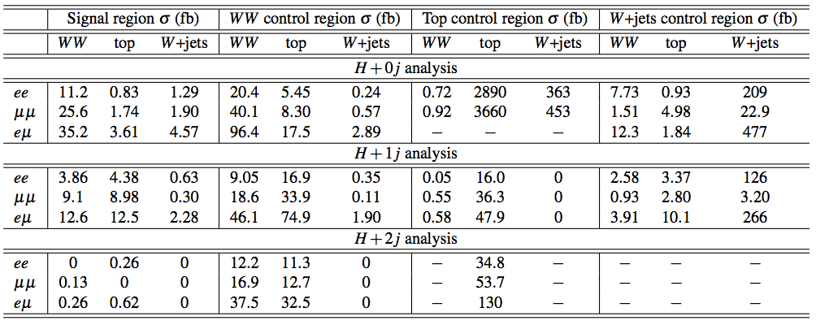
Background Estimation: Statistics
Statistics of the main backgrounds in the various control regions
W + jets and tt control regions give rather pure samples
WW control region still contaminated by other backgrounds, which need to be subtracted

Slide 23
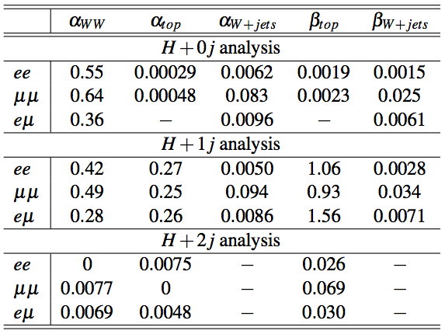
Background Estimation: Scale Factors
Central values for extrapolation ratios

Slide 24
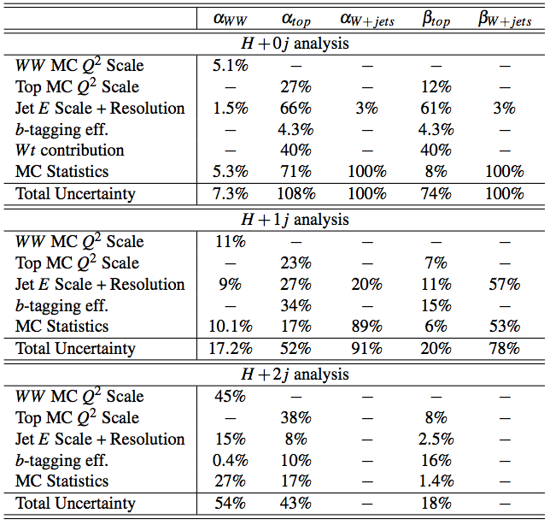
Background Estimation: Systematics
Systematic errors on extrapolation ratios
Uncertainties are assumed to be the same in all lepton final states

