Slide 1
Introduction to CoCalc
And Jupyter notebooks
Carl Gwilliam
(C.Gwilliam@liverpool.ac.uk)

Slide 2
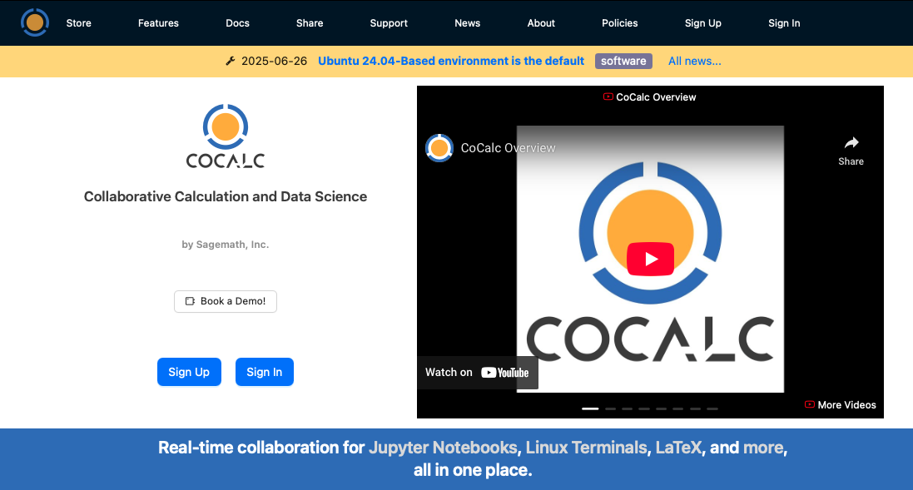
What is CoCalc?
CoCalc is a virtual online workspace for collaborative learning and research: https://cocalc.com
It provides online resources
  CPU, memory, storage
  Via a university licence
Which enables us to
  Share documents & code
  Set & collect assignments
  Work on code together
You will be using it in
  Intro to Computational Physics (PHYS105)
  Practical Physics (PHYS106)
  Other courses in later years
Notes:
* So what is CoCalc …?

Slide 3
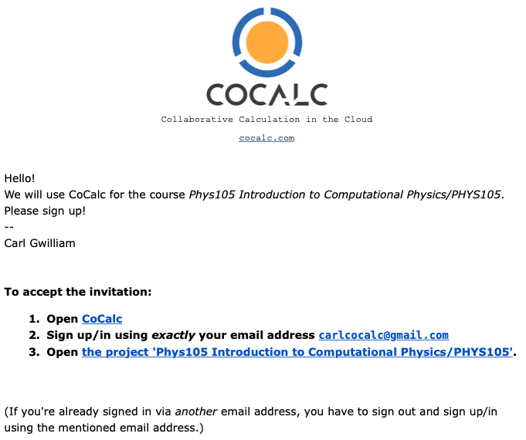
Signing up and logging in
The first thing you need to do is to sign up to the CoCalc platform and log in
  In a way that allows you to use the university license
You should have received an invite email for PHYS105
  Click on link or go directly to the CoCalc webpage
  Sign up with your university email address and a
  password of your choice
    Important: use exactly the address it was sent to
    as CoCalc doesn’t know about uni email aliases
If you have not done this, please do so now
  Let me know if you have not received an invite
  Or if you have issues signing up with it
Once signed up, go to Projects & navigate to
  Name – PHYS105 Introduction to Computational Physics/
  PHYS105_2025
  PHYS105 Introduction to Computational Physics
  ComputerClassesStudent
  Phys105-Welcome
sgXXXXXX@liverpool.ac.uk
Notes:
[problem solve]

Slide 4
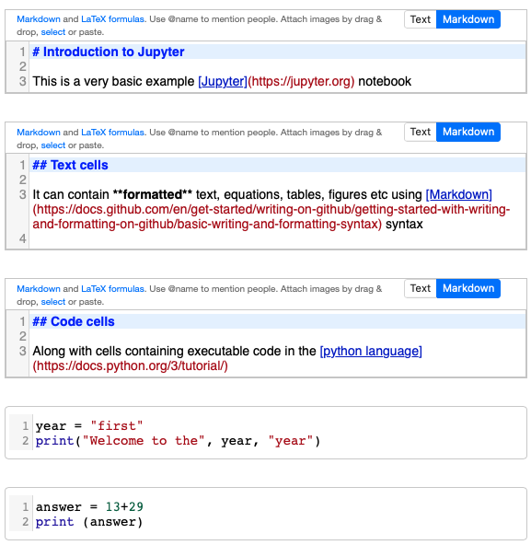
What are Jupyter notebooks?
Jupyter is an interactive development environment for data analysis and software code
  Used widely across both academia and industry
It reads files known as Jupyter notebooks (.ipynb)
which bring together in a shareable way:
  Formatted documentation
  Interactive code development
  The resulting (graphical) output
Notebooks are composed of a series of cells
  Building blocks which can be edited and run
Cells may contain either
  Python computer code
  Markdown formatted text
Can be saved to PDF to submit assignments
  File → Save and Export as … → PDF (.pdf) …
Double-click on a cell to edit
Notes:
Within coclac we will be using jupyter notebooks
Cells shown here
Double click to edit for both text and python code
Change page before saving

Slide 5
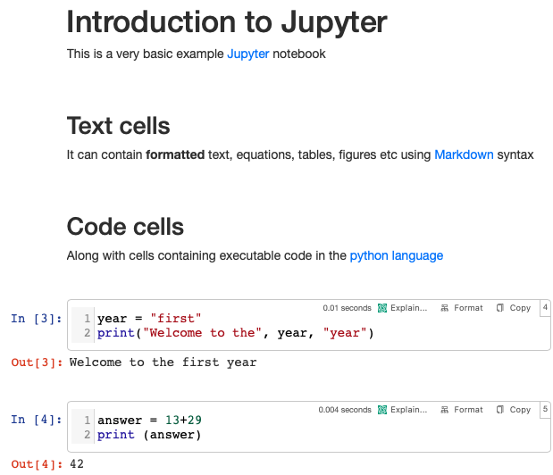
What are Jupyter notebooks?
Jupyter is an interactive development environment for data analysis and software code
  Used widely across both academia and industry
It reads files known as Jupyter notebooks (.ipynb)
which bring together in a shareable way
  Formatted documentation
  Interactive code development
  The resulting (graphical) output
Notebooks are composed of a series of cells
  Building blocks which can be edited and run
Cells may contain either
  Python computer code
  Markdown formatted text
Can be saved to PDF to submit assignments
  File → Save and Export as … → PDF (.pdf) …
Press run ( |) or type shift+enter to execute
Try this now with Example.ipynb in your CoCalc folder
Notes:
After editing they are run by pressing play button or …
Try this now with the Example.ipynb
If you have trouble opening this please let me know [problem solve]
Saving …

Slide 6
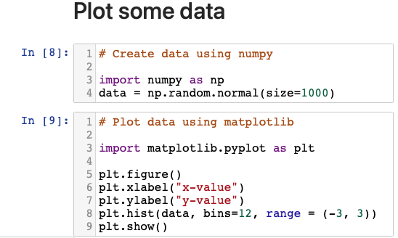
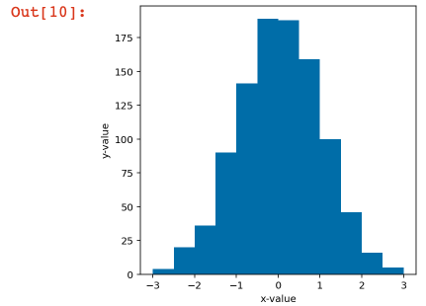
What are Jupyter notebooks?
Allow powerful data analysis and direct visualisation of outputs inline e.g
You will learn all about this, and the tools to do it, in Intro to Computational Physics (PHYS105)
  You are not expected to know them yet and many terms will be new at the moment, so don’t worry!
Notes:
These components will allow us to perform …

Slide 7
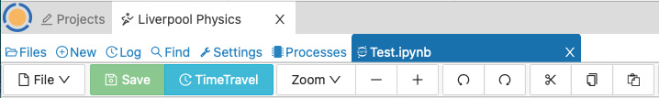
Summary
CoCalc
Collaborative online coding platform (i.e. website)
  Allows lecturers and students to work together
  All files are stored, saved and synchronised here
Notes:
* Since there are lots of tools, I want to finish by outlining how these fit together …

Slide 8
Summary
CoCalc
Collaborative online coding platform (i.e. website)
  Allows lecturers and students to work together
  All files are stored, saved and synchronised here
Jupyter Lab
Runs program that reads .ipynb notebook files
  Can also be run directly on your local machine

Slide 9

Summary
CoCalc
Collaborative online coding platform (i.e. website)
  Allows lecturers and students to work together
  All files are stored, saved and synchronised here
Jupyter Lab
Runs program that reads .ipynb notebook files
  Can also be run directly on your local machine
Notebook (.ipynb)
A file type containing instructions for displaying markdown and code cells, interpreted by Jupyter Lab
  Python cells are executed by the python interpreter
  Text cells are rendered by markdown interpreter
  These are separate entities brought together in Jupyter

Slide 10

Summary
CoCalc
Collaborative online coding platform (i.e. website)
  Allows lecturers and students to work together
  All files are stored, saved and synchronised here
Jupyter Lab
Runs program that reads .ipynb notebook files
  Can also be run directly on your local machine
Notebook (.ipynb)
Python Code
A file type containing instructions for displaying markdown and code cells, interpreted by Jupyter Lab
  Python cells are executed by the python interpreter
  Text cells are rendered by markdown interpreter
  These are separate entities brought together in Jupyter
The programming language we will be using
  Performs calculations and data processing
  PHYS105 will teach you this from scratch

Slide 11

Summary
CoCalc
Collaborative online coding platform (i.e. website)
  Allows lecturers and students to work together
  All files are stored, saved and synchronised here
Jupyter Lab
Runs program that reads .ipynb notebook files
  Can also be run directly on your local machine
Notebook (.ipynb)
Python Code
A file type containing instructions for displaying markdown and code cells, interpreted by Jupyter Lab
  Python cells are executed by the python interpreter
  Text cells are rendered by markdown interpreter
  These are separate entities brought together in Jupyter
Formatted Text
The programming language we will be using
  Performs calculations and data processing
  PHYS105 will teach you this from scratch
Formatted text entered via Markdown syntax
  CoCalc has a graphical WISYWIG editor interfaced to this

Slide 12
Summary
CoCalc
Collaborative online coding platform (i.e. website)
  Allows lecturers and students to work together
  All files are stored, saved and synchronised here
Jupyter Lab
Runs program that reads .ipynb notebook files
  Can also be run directly on your local machine
Notebook (.ipynb)
Python Code
A file type containing instructions for displaying markdown and code cells, interpreted by Jupyter Lab
  Python cells are executed by the python interpreter
  Text cells are rendered by markdown interpreter
  These are separate entities brought together in Jupyter
Formatted Text
The programming language we will be using
  Performs calculations and data processing
  PHYS105 will teach you this from scratch
Formatted text entered via Markdown syntax
  CoCalc has a graphical WISYWIG editor interfaced to this

