Slide 1
School Assignments + Lab Tours
School | Demonstrator(s) | Lab Tour | Number
Dixons Broadgreen Academy + Hilbre High School | Jordy Degens + Conor McPartland | 13:20: Zone 1 → Zone 2 → Zone 3 | 8
Jersey College for Girls | Josh Davies | 13:20: Zone 2 → Zone 3 → Zone 1 | 8
King David High School | Jan Kretzschmar | 13:20: Zone 3 → Zone 1 → Zone 2 | 10
Liverpool College | Luana Parsons-Franca | 13:20: Zone 4 → Zone 5 → Zone 6 | 10
Liverpool Life Sciences UTC / The Studio A | Sven Wonsak | 13:20: Zone 5 → Zone 6 → Zone 4 | 10
Neston High School | Ellen Sandford | 13:20: Zone 6 → Zone 4 → Zone 5 | 6
Ormskirk School | Sam Jenkins | 13:50: Zone 1 → Zone 2 → Zone 3 | 10
Rossall School | Dominika Vasilkova | 13:50: Zone 2 → Zone 3 → Zone 1 | 10
St Francis Xavier’s Catholic Academy | Juan Leite | 13:50: Zone 3 → Zone 1 → Zone 2 | 8
St Hilda’s CE High School | Sean Hughes | 13:50: Zone 4 → Zone 5 → Zone 6 | 10
St Wilfred’s CE Academy | James Brown | 13:50: Zone 5 → Zone 6 → Zone 4 | 10
St Julie’s High School | Tim Greenshaw | 13:50: Zone 6 → Zone 4 → Zone 5 | 6
Liverpool Life Sciences UTC / The Studio C | Unik Limbu | 14:20: Zone 1 → Zone 2 → Zone 3 | 7
The Bishop’s Blue Coat | Ned Howarth | 14:20: Zone 2 → Zone 3 → Zone 1 | 10
The Liverpool Blue Coat School | John Anders | 14:20: Zone 3 → Zone 1 → Zone 2 | 10
The Mosslands School | Estifa’a Zaid | 14:20: Zone 4 → Zone 5 → Zone 6 | 10
Liverpool Life Sciences UTC / The Studio B | Kajal Singh | 14:20: Zone 5 → Zone 6 → Zone 4 | 10
The Sutton Academy | Joaquim Maximiano Gomes | 14:20: Zone 6 → Zone 4 → Zone 5 | 10

Slide 2
Schedule

Slide 3
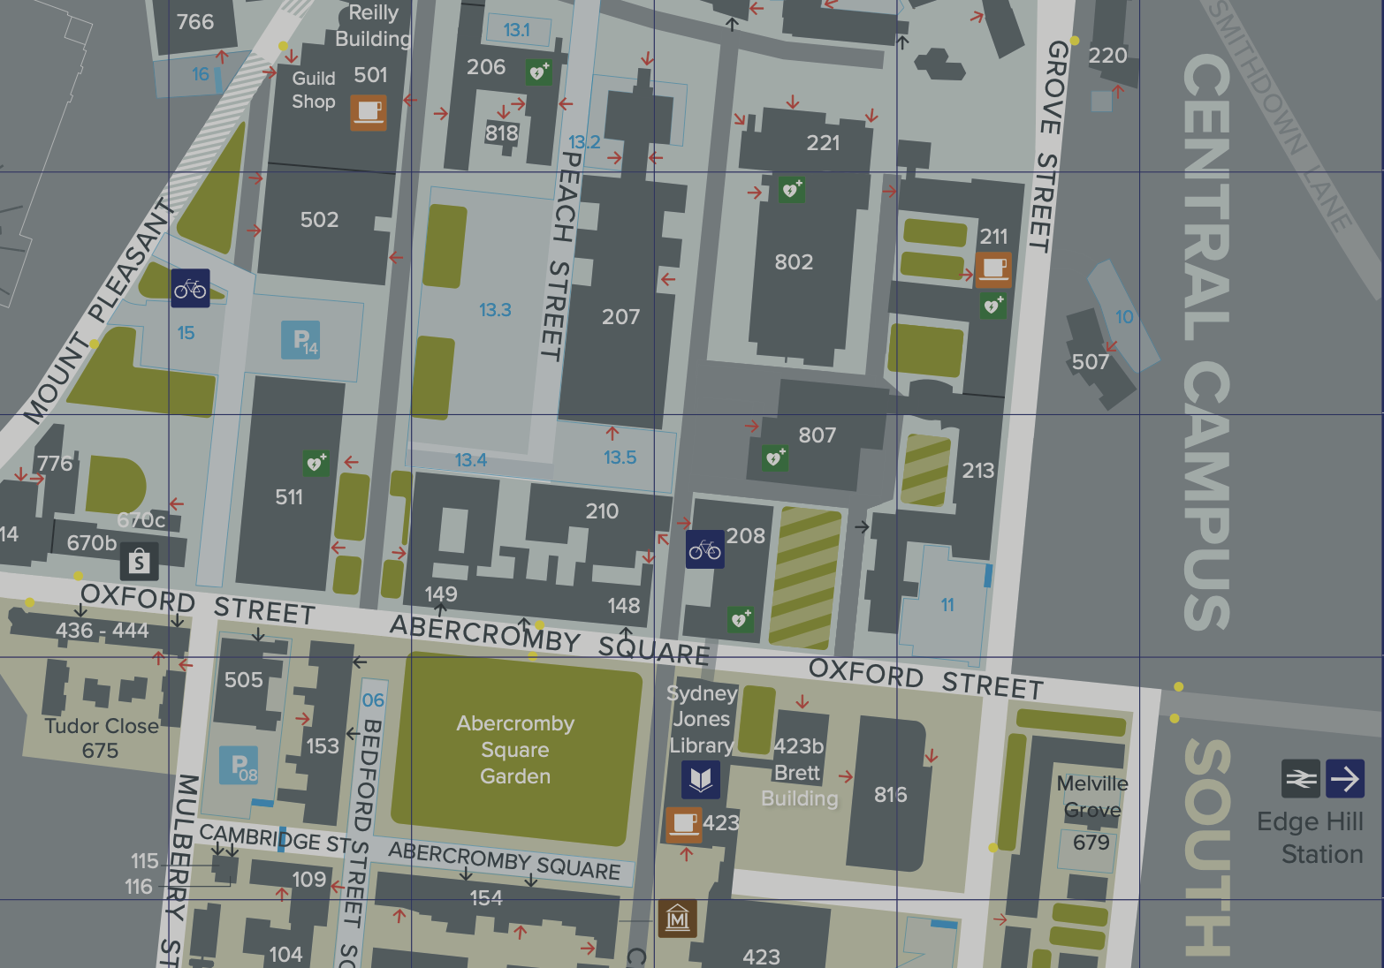
Venues
Lectures (AM)
Central Teaching Hub
Lecture Theatre B
Hands-on (PM)
Central Teaching Lab
PC Teaching Suite
Escorted Across
Video Conference (PM)
Yoko Ono Centre
Lecture Theatre 1
Escorted back to CTL for busses

Slide 4
Safety
Follow instructions from the demonstrators
At all times
Do not take bags or coats into the PC class or labs
Leave them in the lockers provided at lunch
Collect them before we go to the video conference
In case a fire alarm sounds
Stop what you are doing immediately
Exit through the nearest exit
Once outside, wait at the assembly points
If you have questions at any point
Please ask a member of UoL staff
Building specific details on subsequent slides …

Slide 5
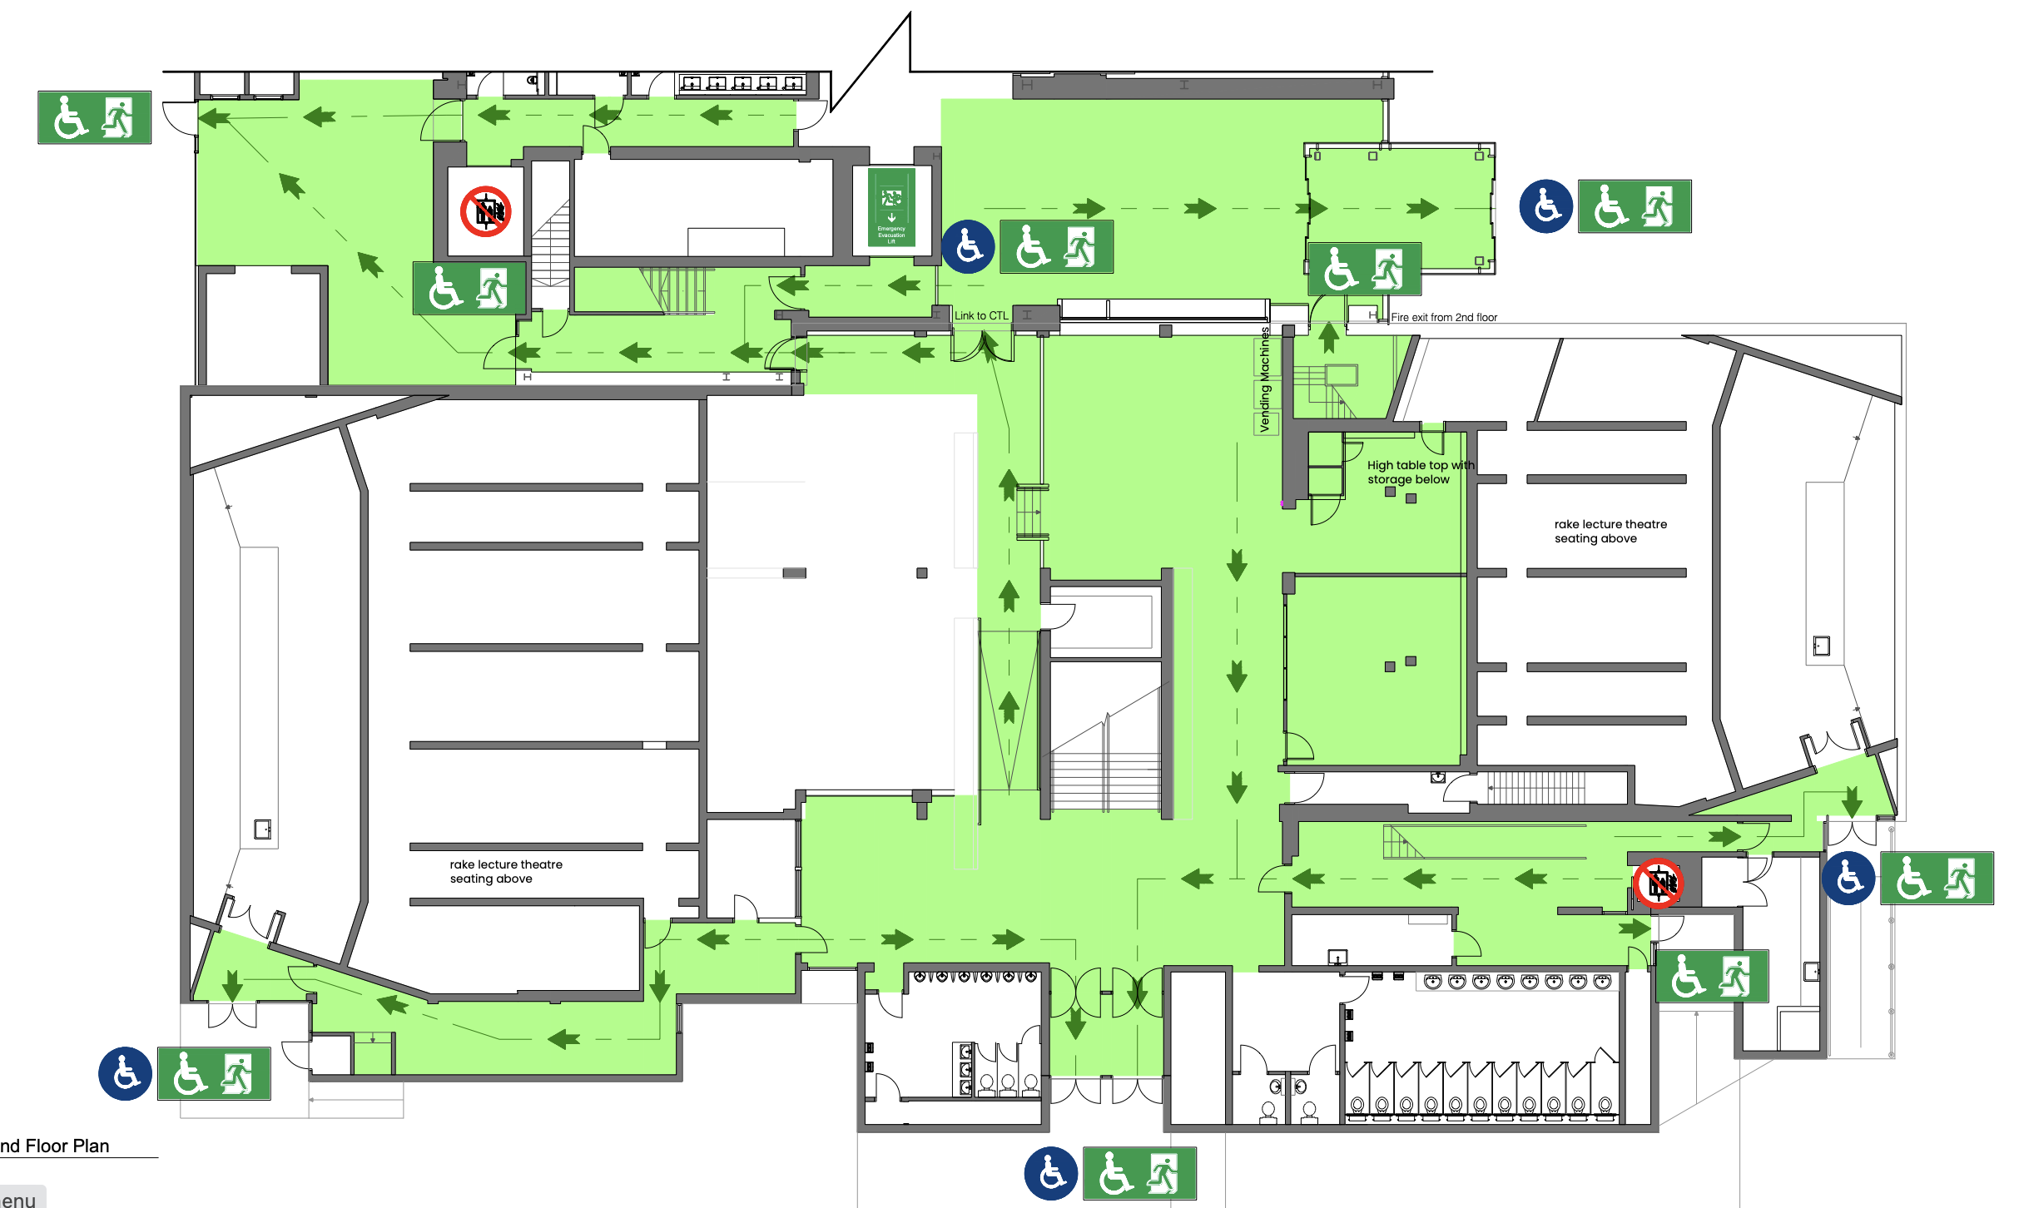
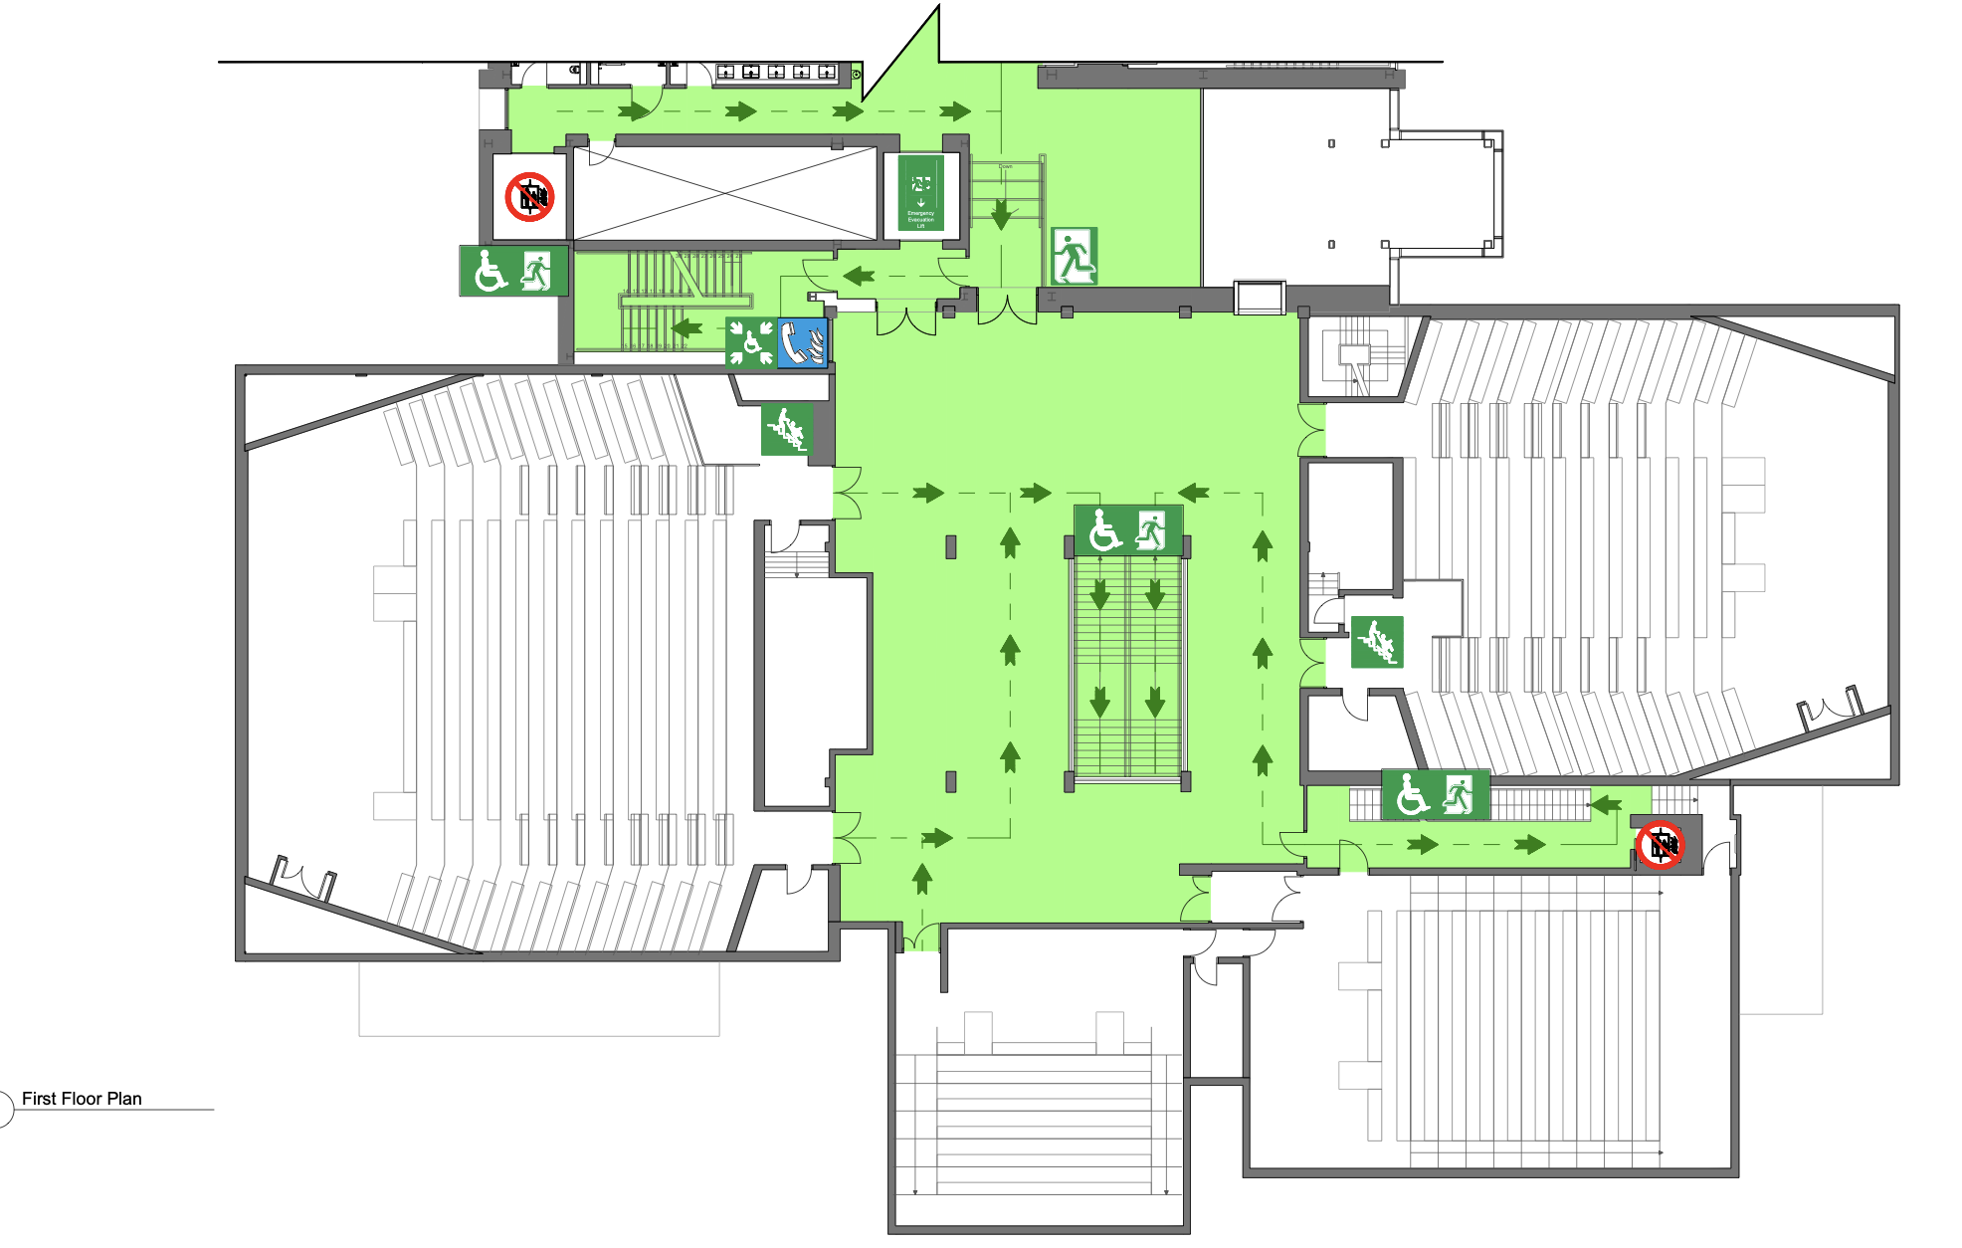
Central Teaching Hub (CTH)
Emergency Exit
Exit through front of lecture theatre or via back and then out downstairs via main entrance or CTL
Assembly point is outside main entrance
Toilets
Downstairs, either side of main entrance
This floor just through into CTL
CTL
Fire Lift
Lecture Theatre B
Lecture Theatre B
Ground Floor
First Floor

Slide 6
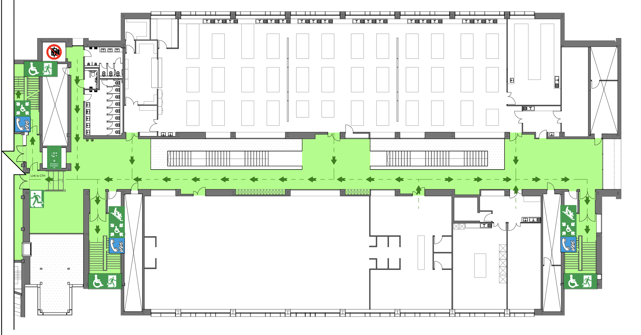
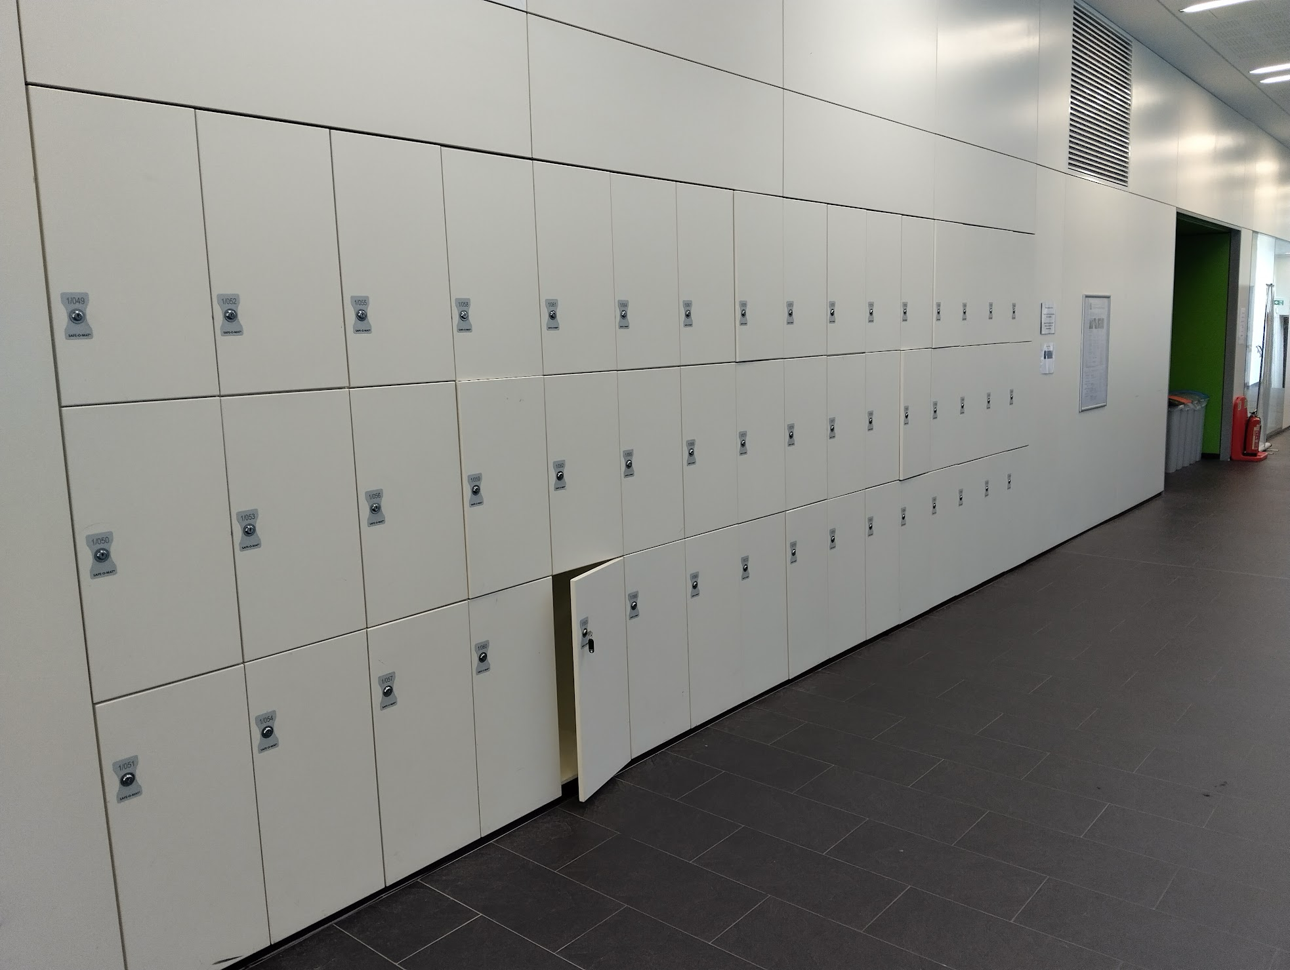
Central Teaching Lab (CTL)
Emergency Exit
Exit through stairs either end and out corresponding exit or through to CTH
Assembly point is outside main entrance
Toilets
Opposite, by the lift and across from the stairs
Lockers (≈100)
Place your bags & coats in lockers before lunch until after PC session
Will need to share
CTH
Fire Lift
PC Teaching Centre
Don’t loose the key
First Floor

Slide 7
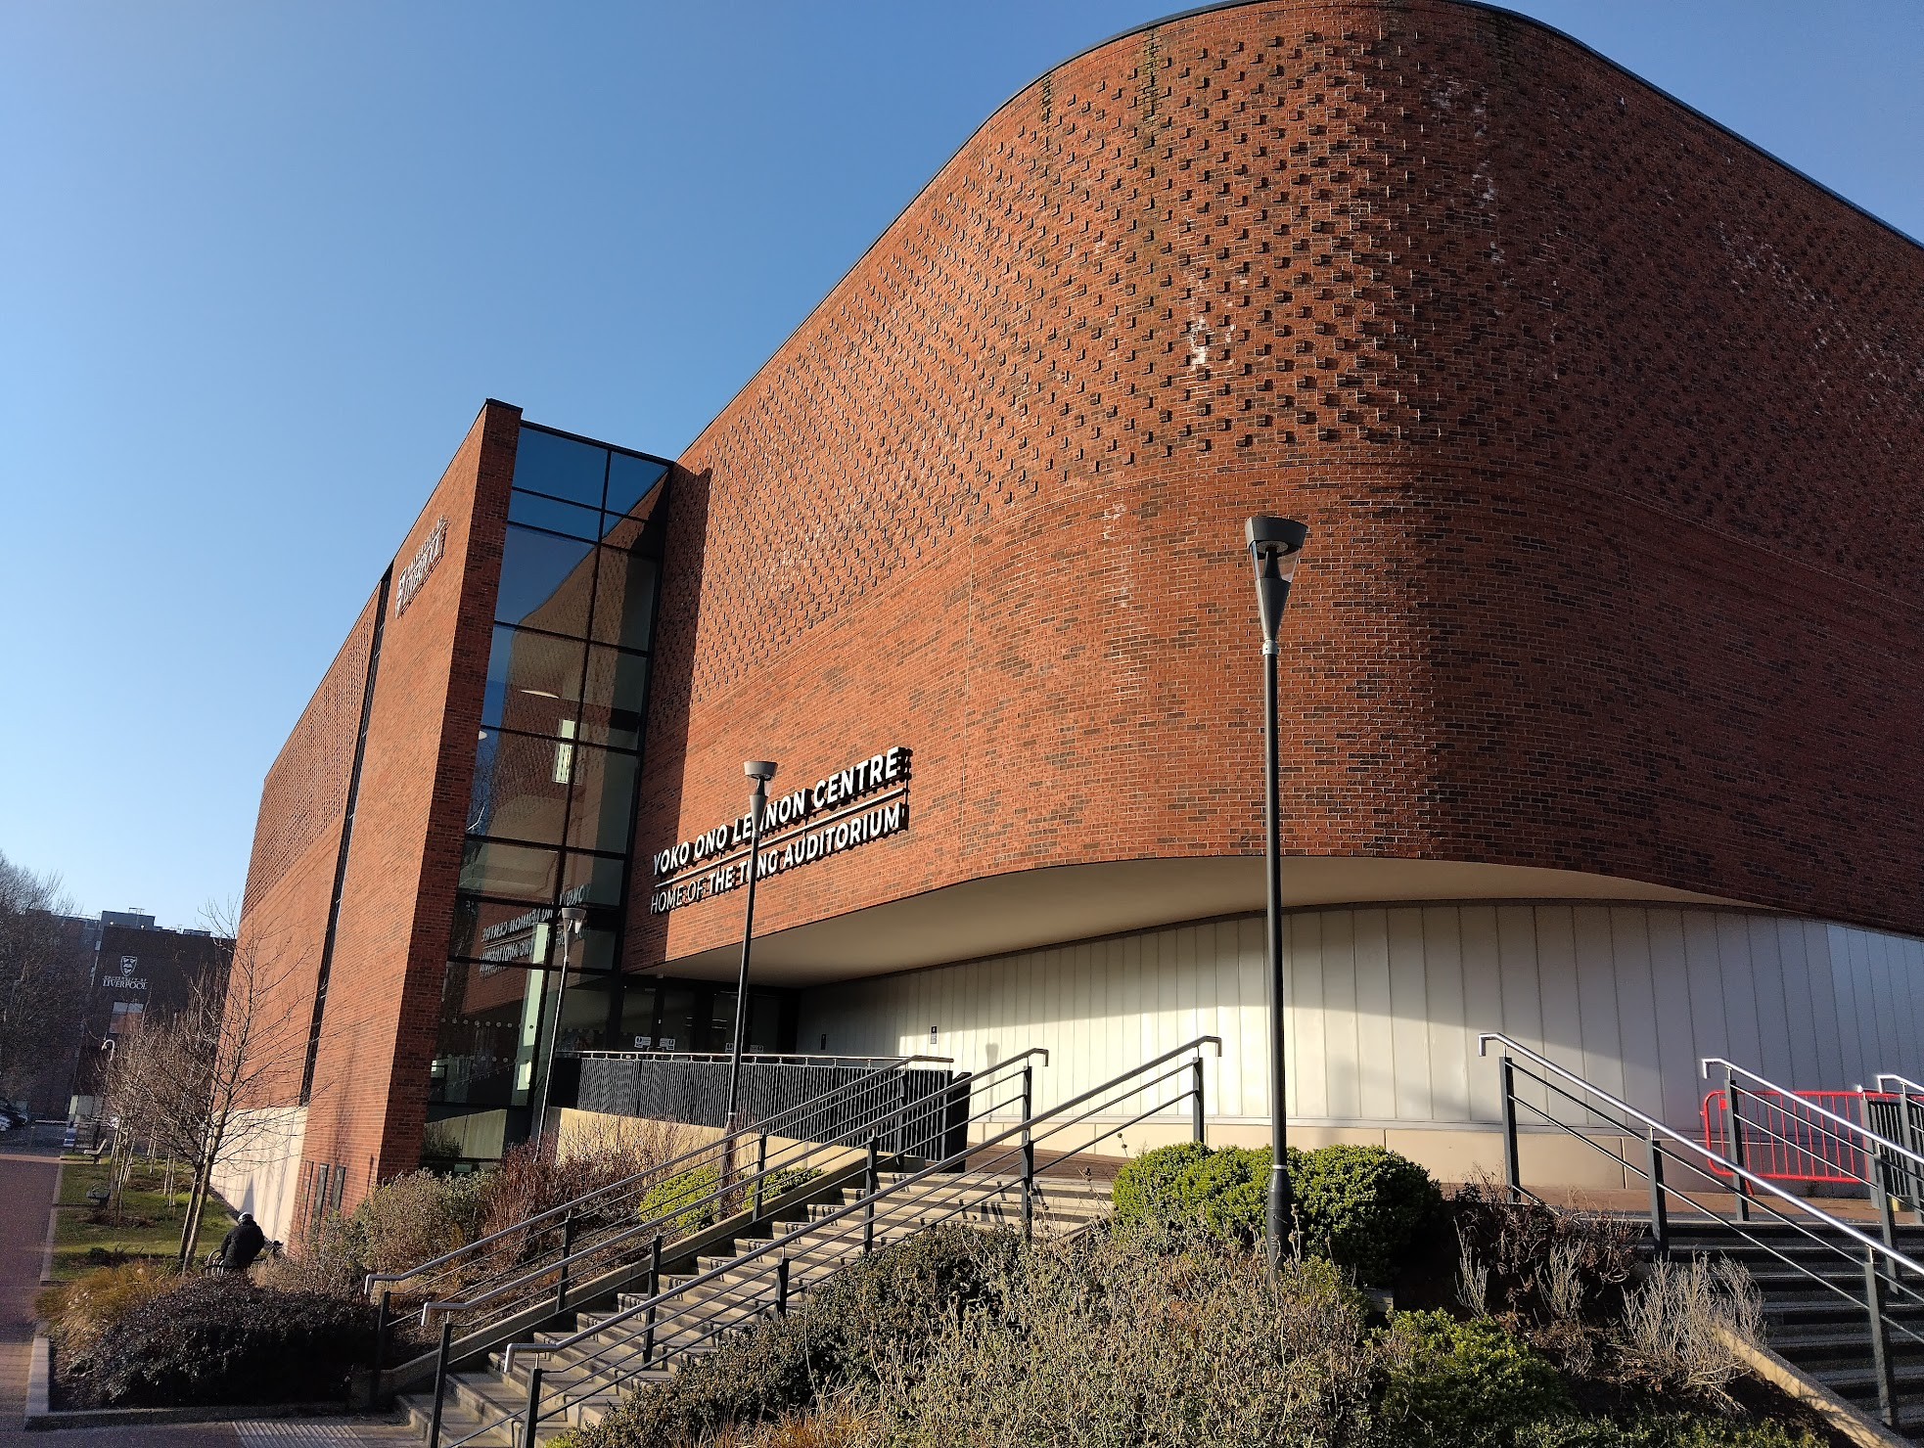
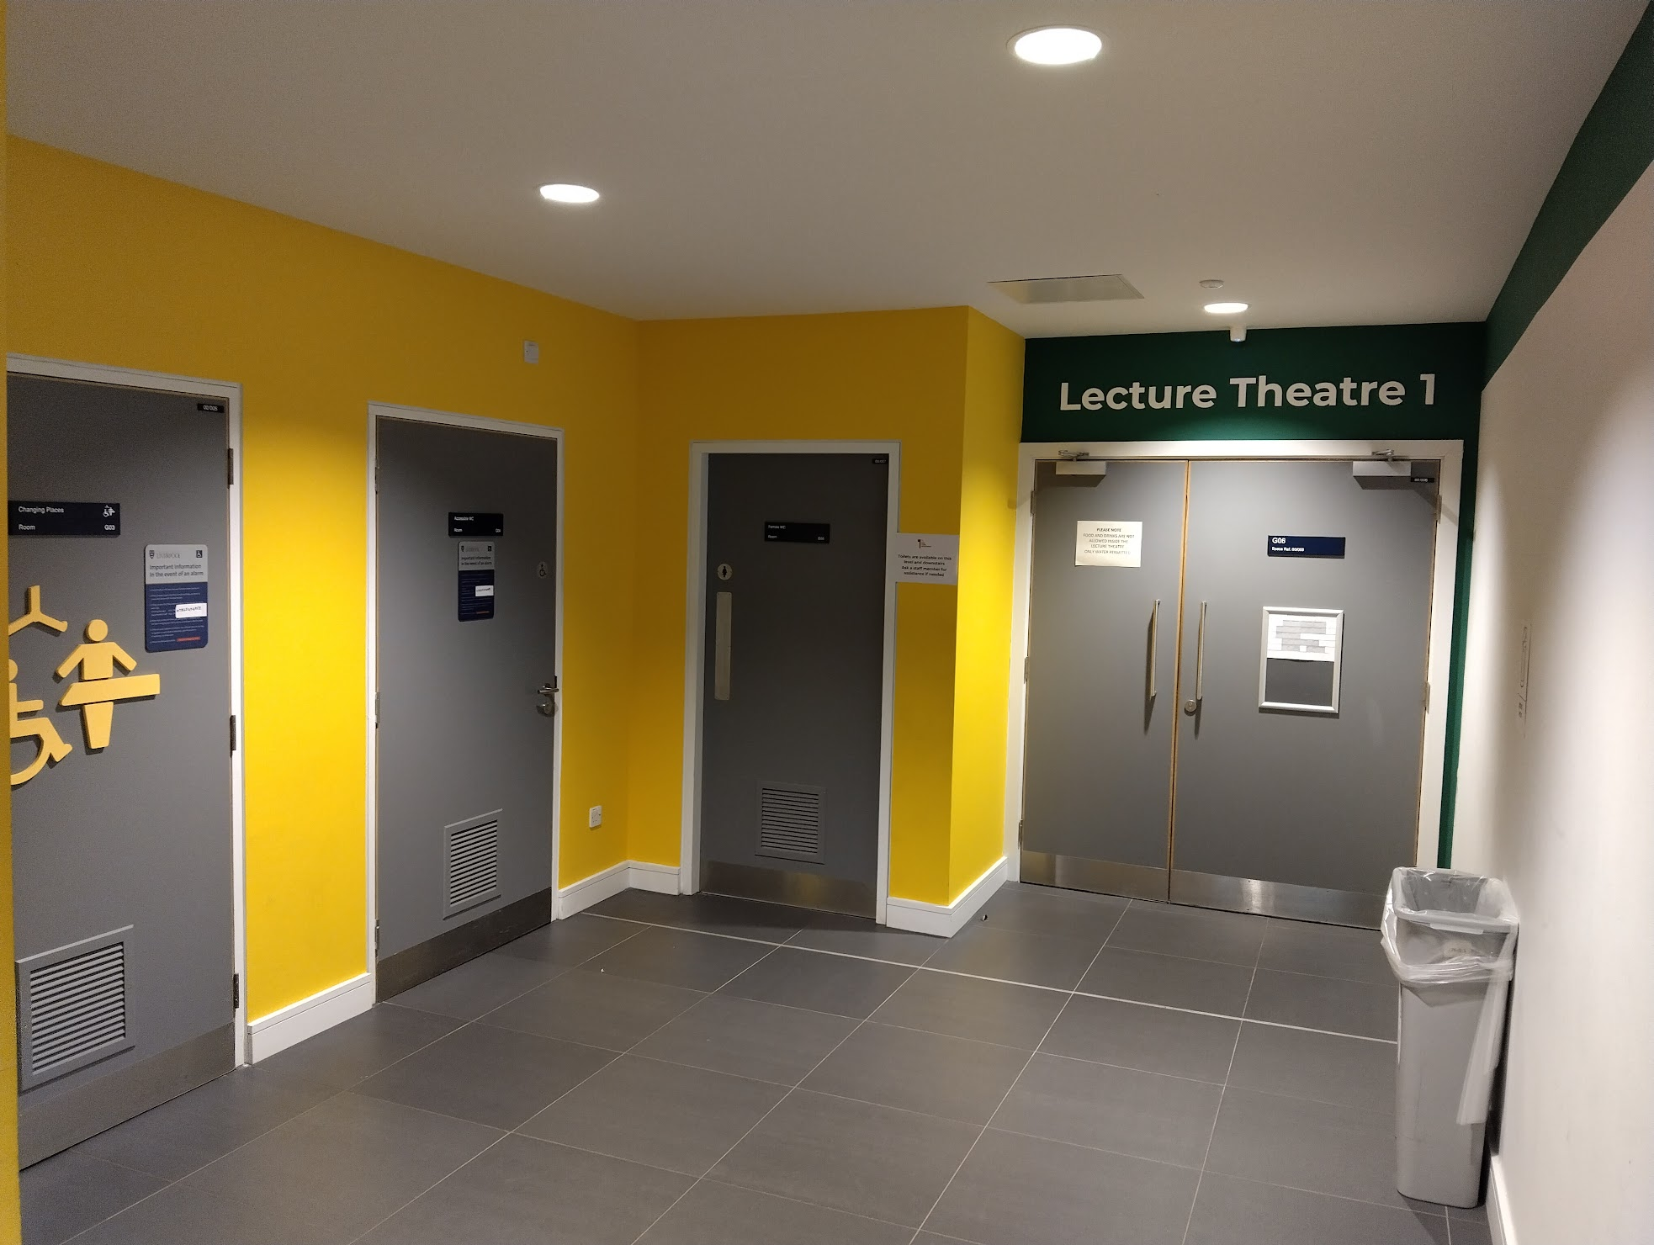
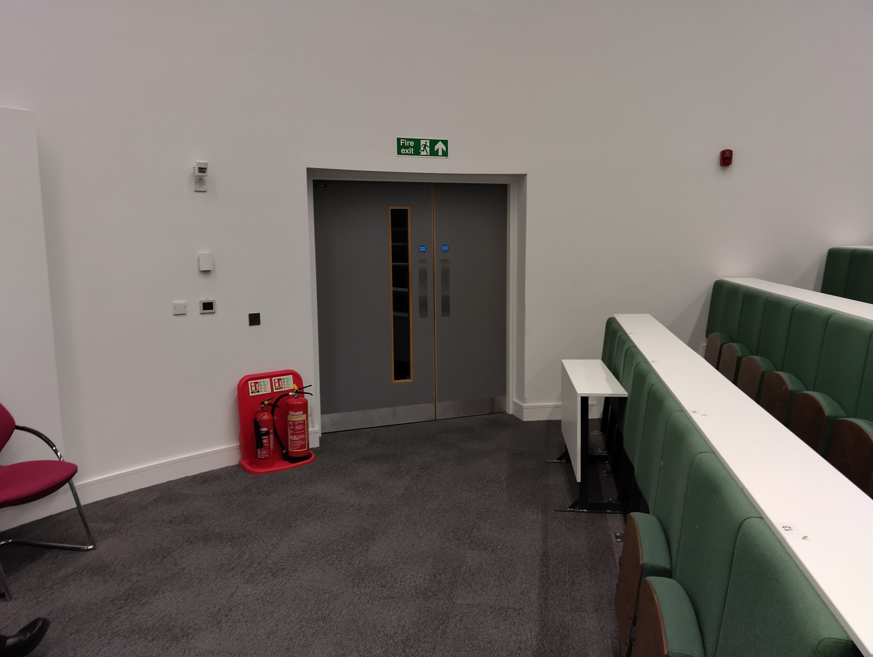
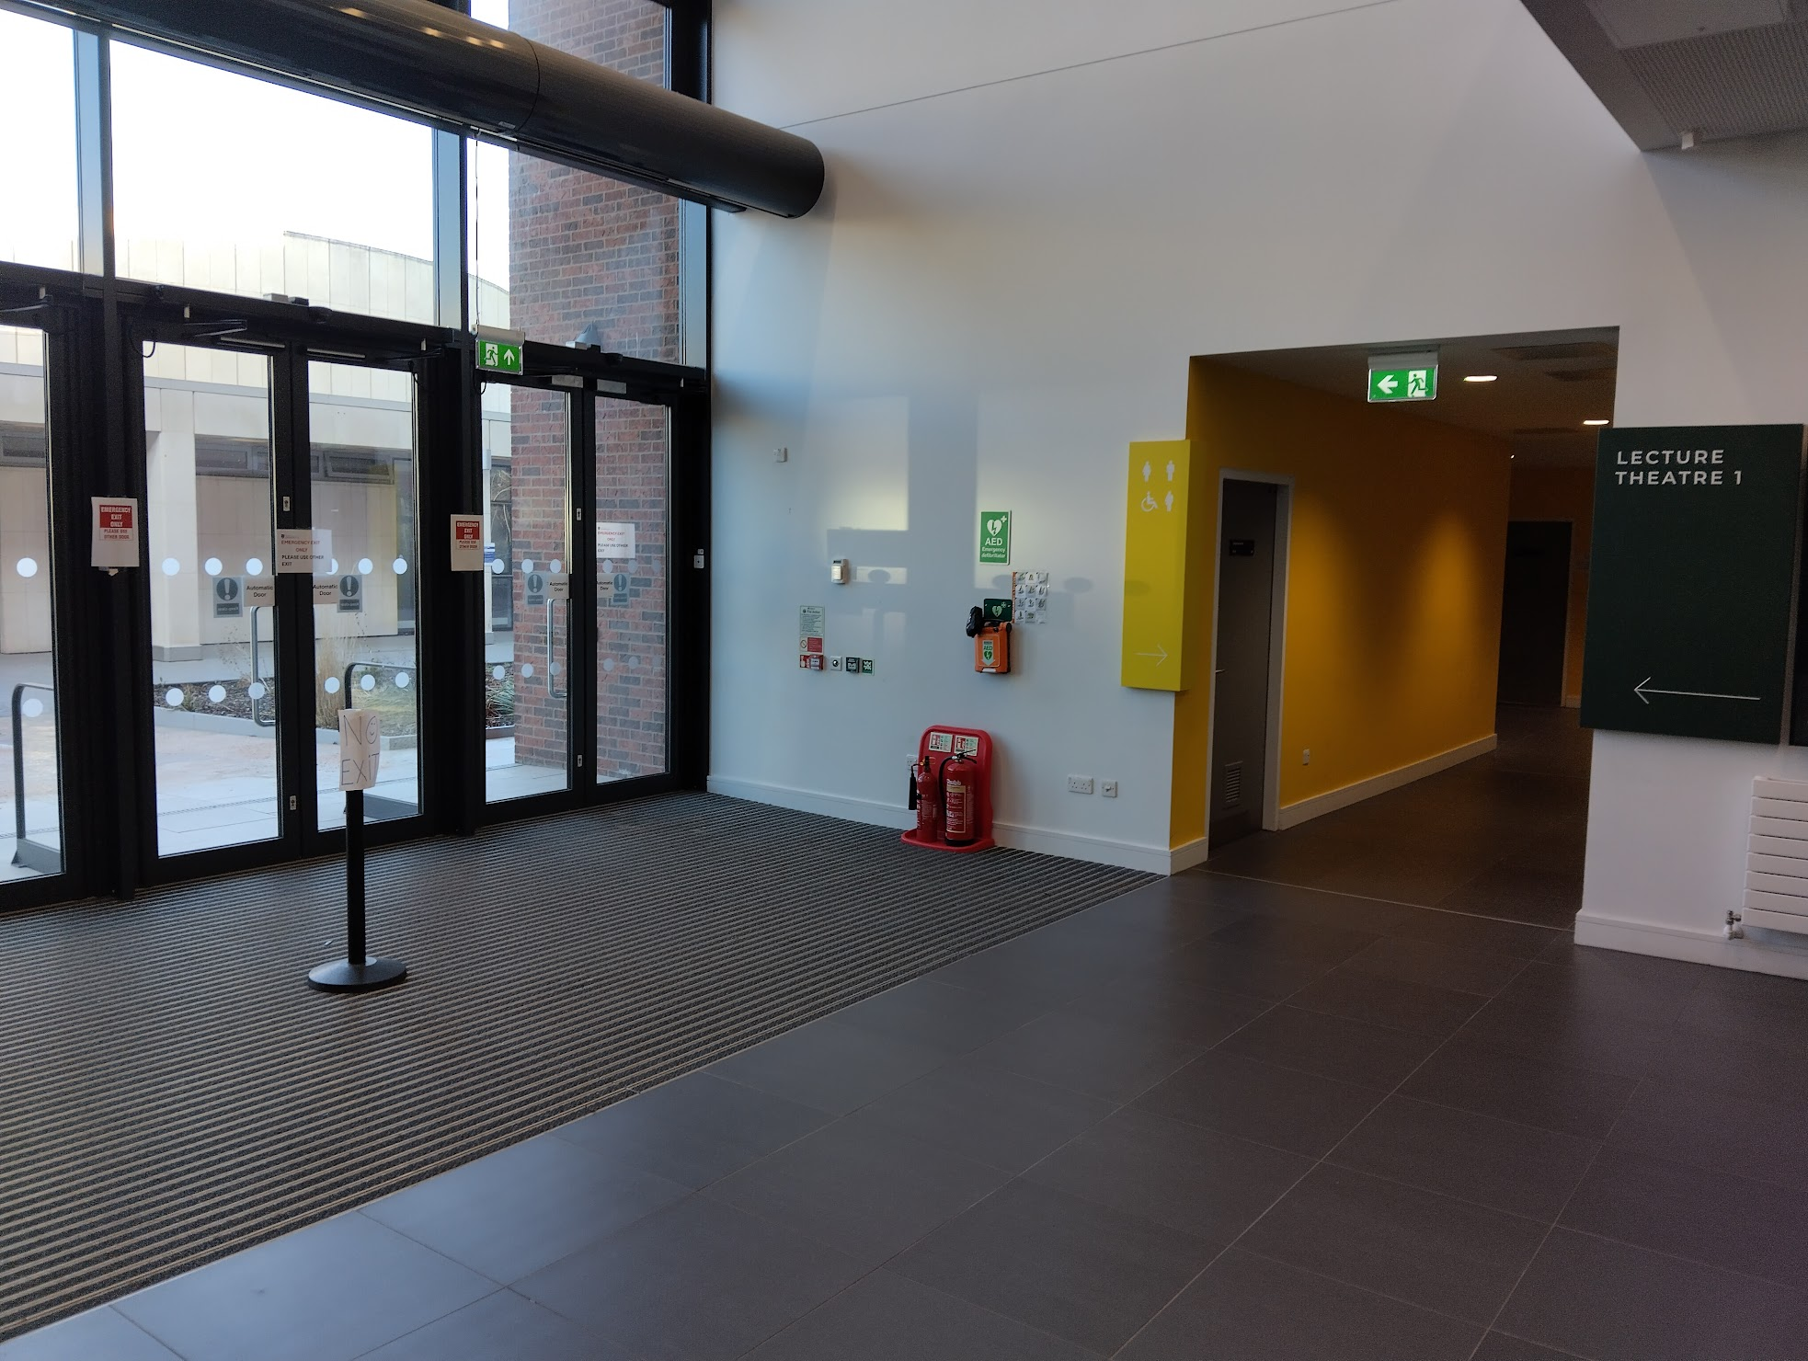
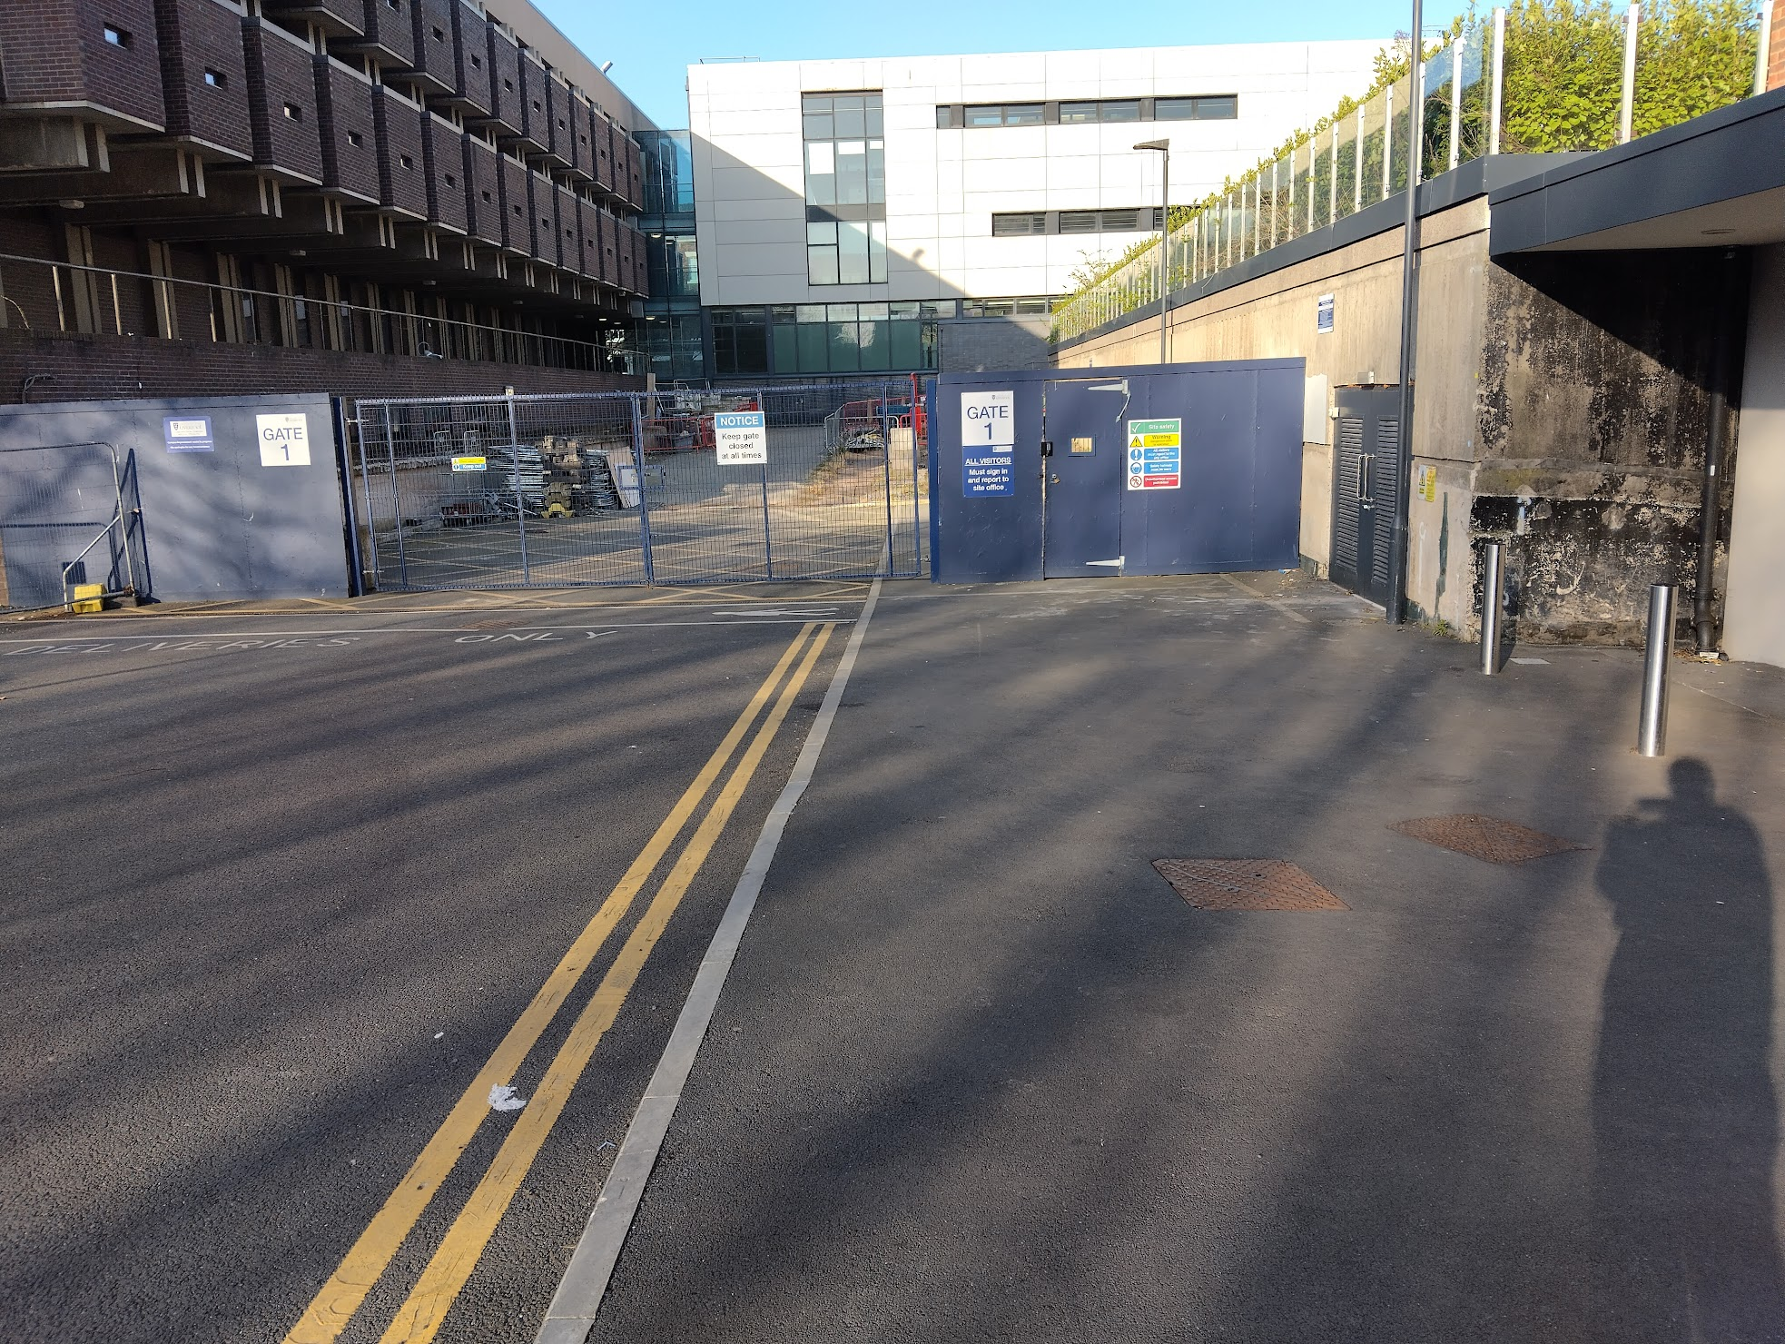
Yoko Ono Lennon Centre (YOLC)
Emergency exits
Front of lecture theatre
Back of lecture theatre and directly right
Assembly point round back of building
Toilets
Directly outside lecture theatre
Entrance

Slide 8
Code of Conduct
We will not accept behaviour which is unkind, upsetting or excludes any person or group of people.
If what you’re doing is making someone feel uncomfortable, that is enough reason to stop doing it.
During the Masterclass you should:
Be kind, respectful and inclusive to everyone
Listen and respect each other’s views and ideas
Use welcoming and inclusive language
Treat everyone equally
Everyone has a responsibility to help keep Masterclasses safe for all. This means:
Don’t take and share pictures, video or audio which includes students from other schools or colleges
Adults should not share personal contact details with students under 18 (or vice versa) or connect with them on social media.
If something needs to be shared this should go via the Masterclass organisers

Slide 9
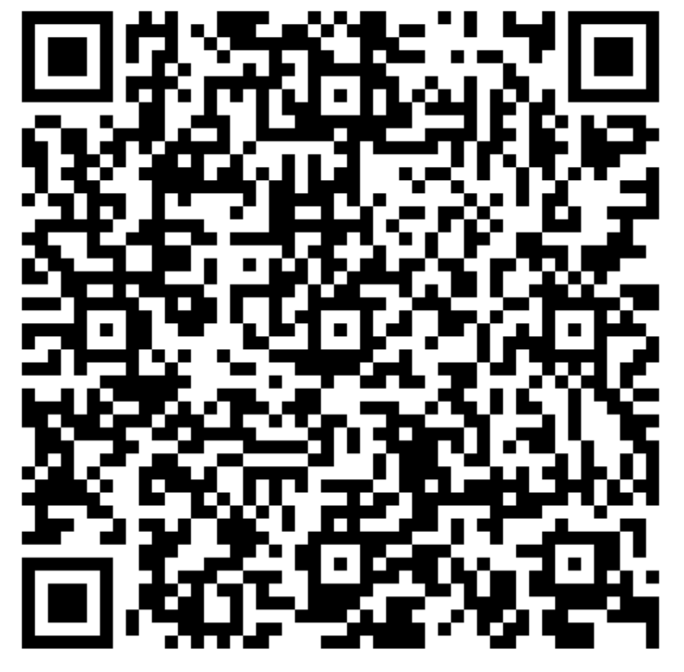
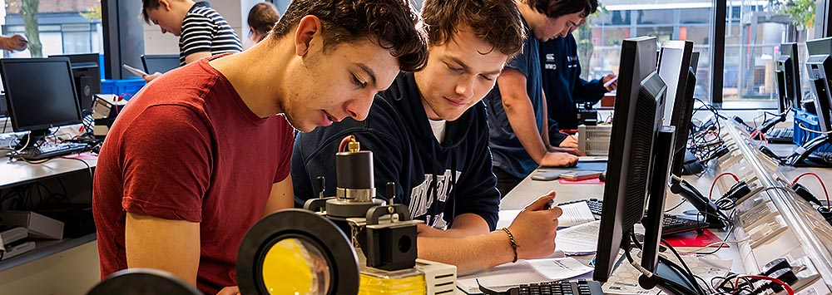
Open days
Learn more about studying a physics degree at the University of Liverpool
Dates/Times: 20th & 21st June , 20th September, 11th October @ 10:00 - 13:30
Venue: Central Teaching Labs
Register: https://tinyurl.com/UoLOpen
Notes:
How sign up -> Ask Hem.

