Slide 1

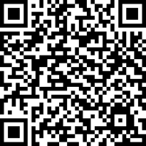
Before you finish …
Please complete the short post-masterclass survey
https://app.onlinesurveys.jisc.ac.uk/s/liverpool/particle-physics-masterclass-post-questionnaire

Slide 2
Goodbye
Carl Gwilliam and Saskia Charity
12th March 2025
Particle Physics Masterclass

Slide 3

Close out
Thanks for coming to the Particle Physics Masterclass
  We hope you had a fun and interesting day
  And were able to:
Learn a little about the basic building blocks of nature
and the forces that bind them together
  And how Liverpool are at the forefront of studying these
Get a feeling of what it is like to do physics research
  Within a large international collaboration
See what the University of Liverpool is like
  Exploring some of our state-of-the-art facilities
@ChatGPT

Slide 4
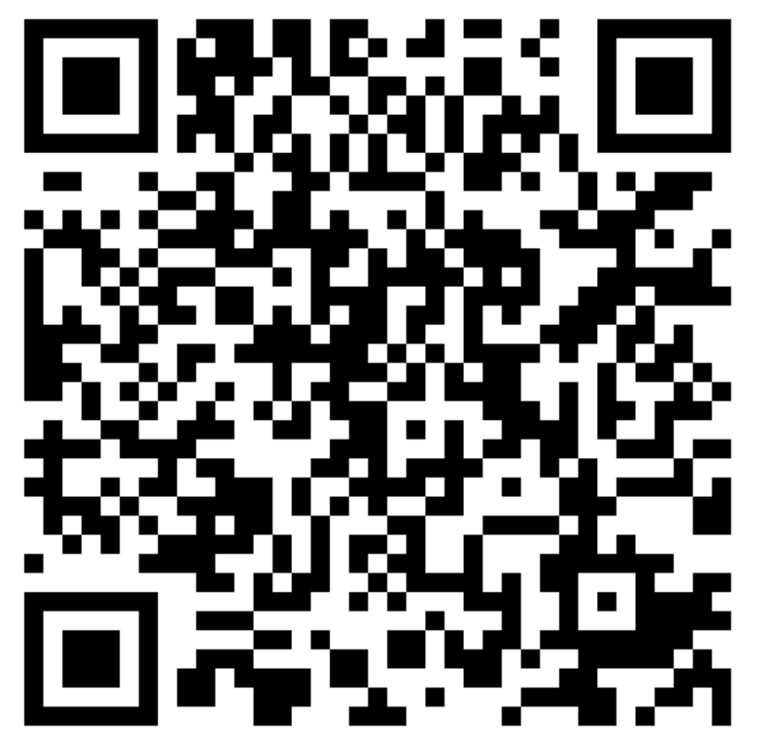
Undergraduate
We offer a wide range of undergraduate courses
  Straight physics
  Theoretical/Mathematical physics
  Astrophysics
  Specialist options
Both 3-year bachelors and 4-year masters
  Semester/year abroad
  Internships
Additional foundation course
  4-year physics BSc in conjunction with
  Carmel College
More details
  https://www.liverpool.ac.uk/physics/study/
  undergraduate/undergraduate-programmes/
Mathematical
Physics (MMath)
Physics with Mathematics (Bsc)
Theoretical Physics (MPhys)
Physics
(MPhys/BSc)
Astrophysics (Mphys)
Physics with Astronomy (BSc)
Physics with Geophysics (BSc)
Physics with Nuclear Science (BSc)
Physics with Medical Applications (BSc)

Slide 5
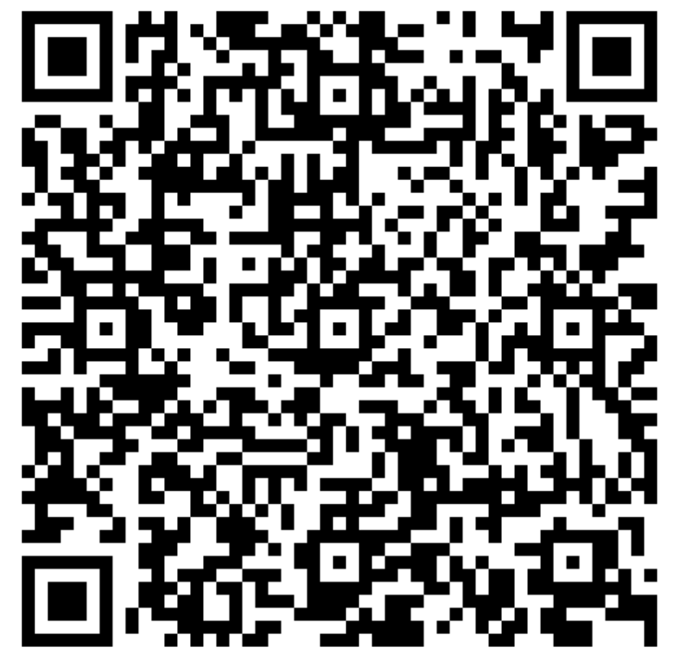
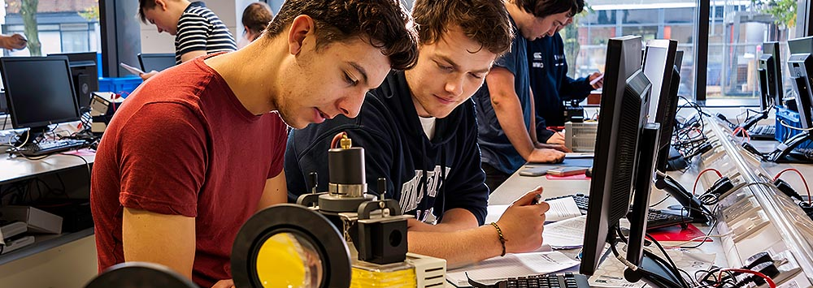
Open days
Learn more about studying a physics degree at the University of Liverpool
  Dates/Times: 20th & 21st June , 20th September, 11th October @ 10:00 - 13:30
  Venue: Central Teaching Labs
  Register: https://tinyurl.com/UoLOpen
Notes:
How sign up -> Ask Hem.

Slide 6

Safe journey home

