Slide 1
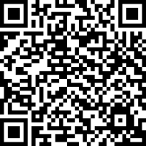
Before we start …
Please complete the short pre-masterclass survey
https://app.onlinesurveys.jisc.ac.uk/s/liverpool/particle-physics-masterclass-pre-questionnaire

Slide 2
Welcome
Carl Gwilliam and Saskia Charity
12th March 2025
Particle Physics Masterclass

Slide 3
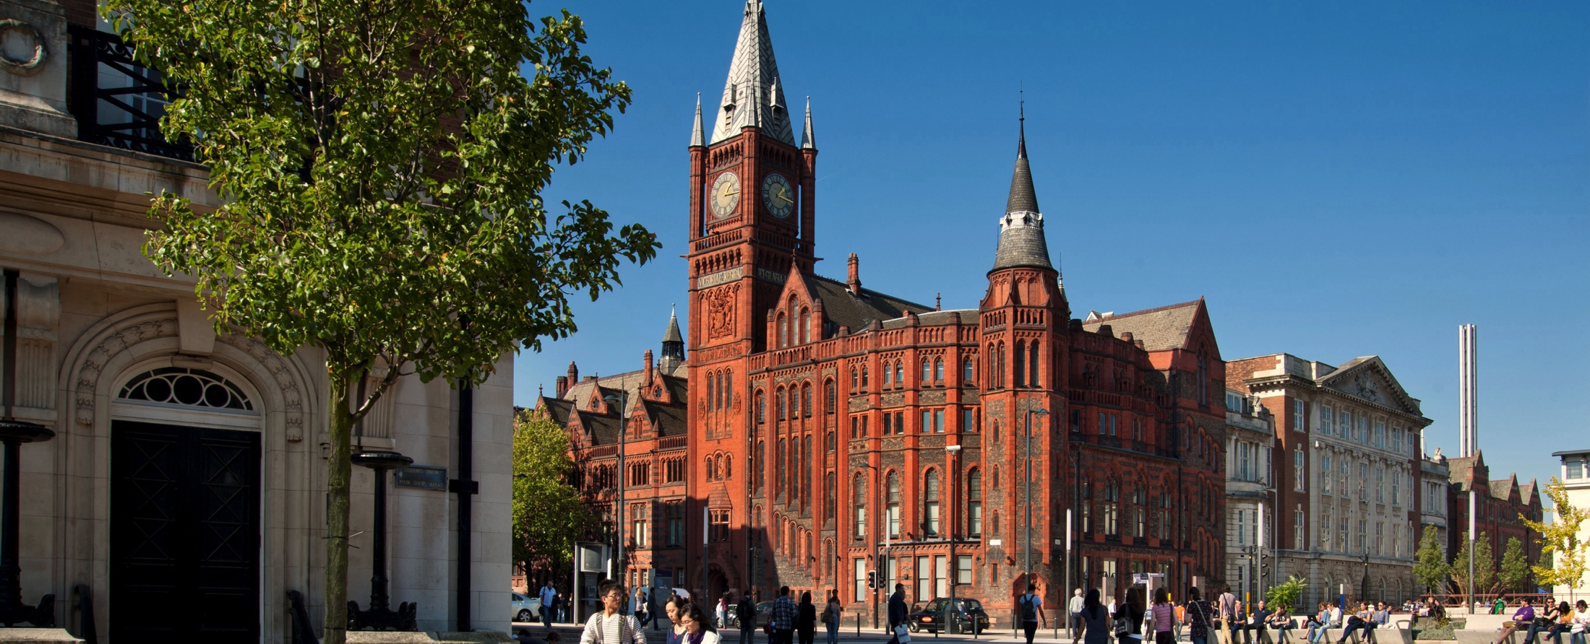
University of Liverpool
Large research-orientated Russell group university
≈ 25,000 students enrolled
Since 1881, we've been at the forefront of world-class research and education
Rated in the world's top 1% of higher education research institutions.
Known for our cutting-edge facilities and relentless pursuit of excellence and achievement
https://www.liverpool.ac.uk

Slide 4
Science and Engineering
University of Liverpool
Faculty of Life and Health Sciences
Faculty of Science and Engineering
Faculty of Humanities and Social Sciences
School of Engineering
School of Physical Sciences
School of Environmental Sciences
School of Electrical Engineering, Electronics and Computer Science
Department of Chemistry
Department of Physics
Department of Mathematics
Faculties
Schools
Departments

Slide 5
Department of Physics
We are one of the best physics departments in the UK.
Ranked in the top 200 physics departments across the world
Collaborating with leading institutes and laboratories around the world
https://www.liverpool.ac.uk/physics/
Physics Education Research
Accelerator Physics
Nuclear Physics
Condensed Matter Physics
Particle Physics
Be a particle physicist for the day!
Today is about getting a taste of what it is like to do real physics research
In one of the largest particle physics groups in the country

Slide 6
Schedule

Slide 7
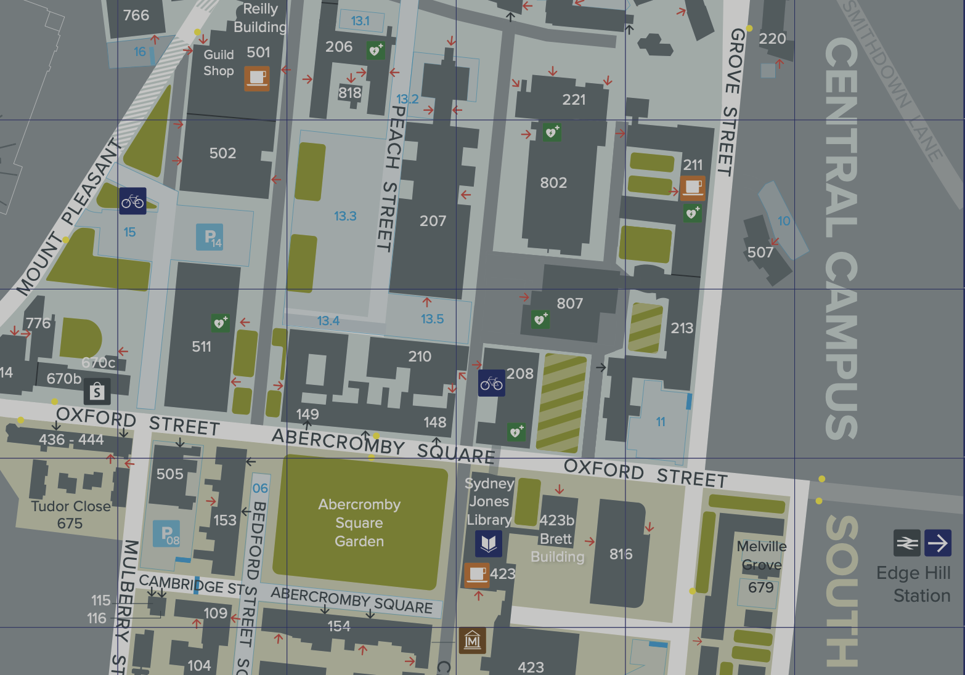
Venues
Lectures (AM)
Central Teaching Hub
Lecture Theatre B
Hands-on (PM)
Central Teaching Lab
PC Teaching Suite
Escorted Across

Slide 8
Safety
Follow instructions from the demonstrators
At all times
Do not take bags or coats into the PC class or labs
Leave them in the lockers provided at lunch
Collect them before we go to the video conference
In case a fire alarm sounds
Stop what you are doing immediately
Exit through the nearest exit
Once outside, wait at the assembly points
If you have questions at any point
Please ask a member of UoL staff
Building specific details on subsequent slides …

Slide 9
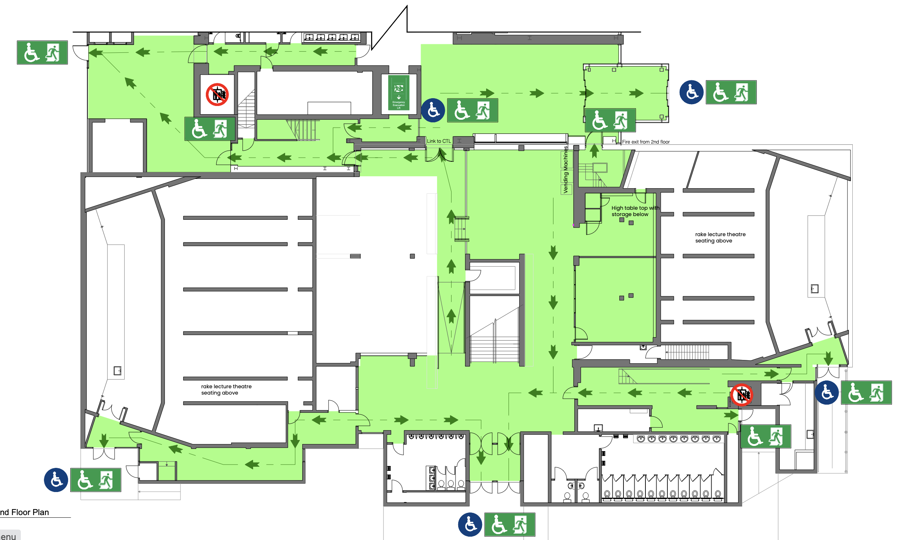
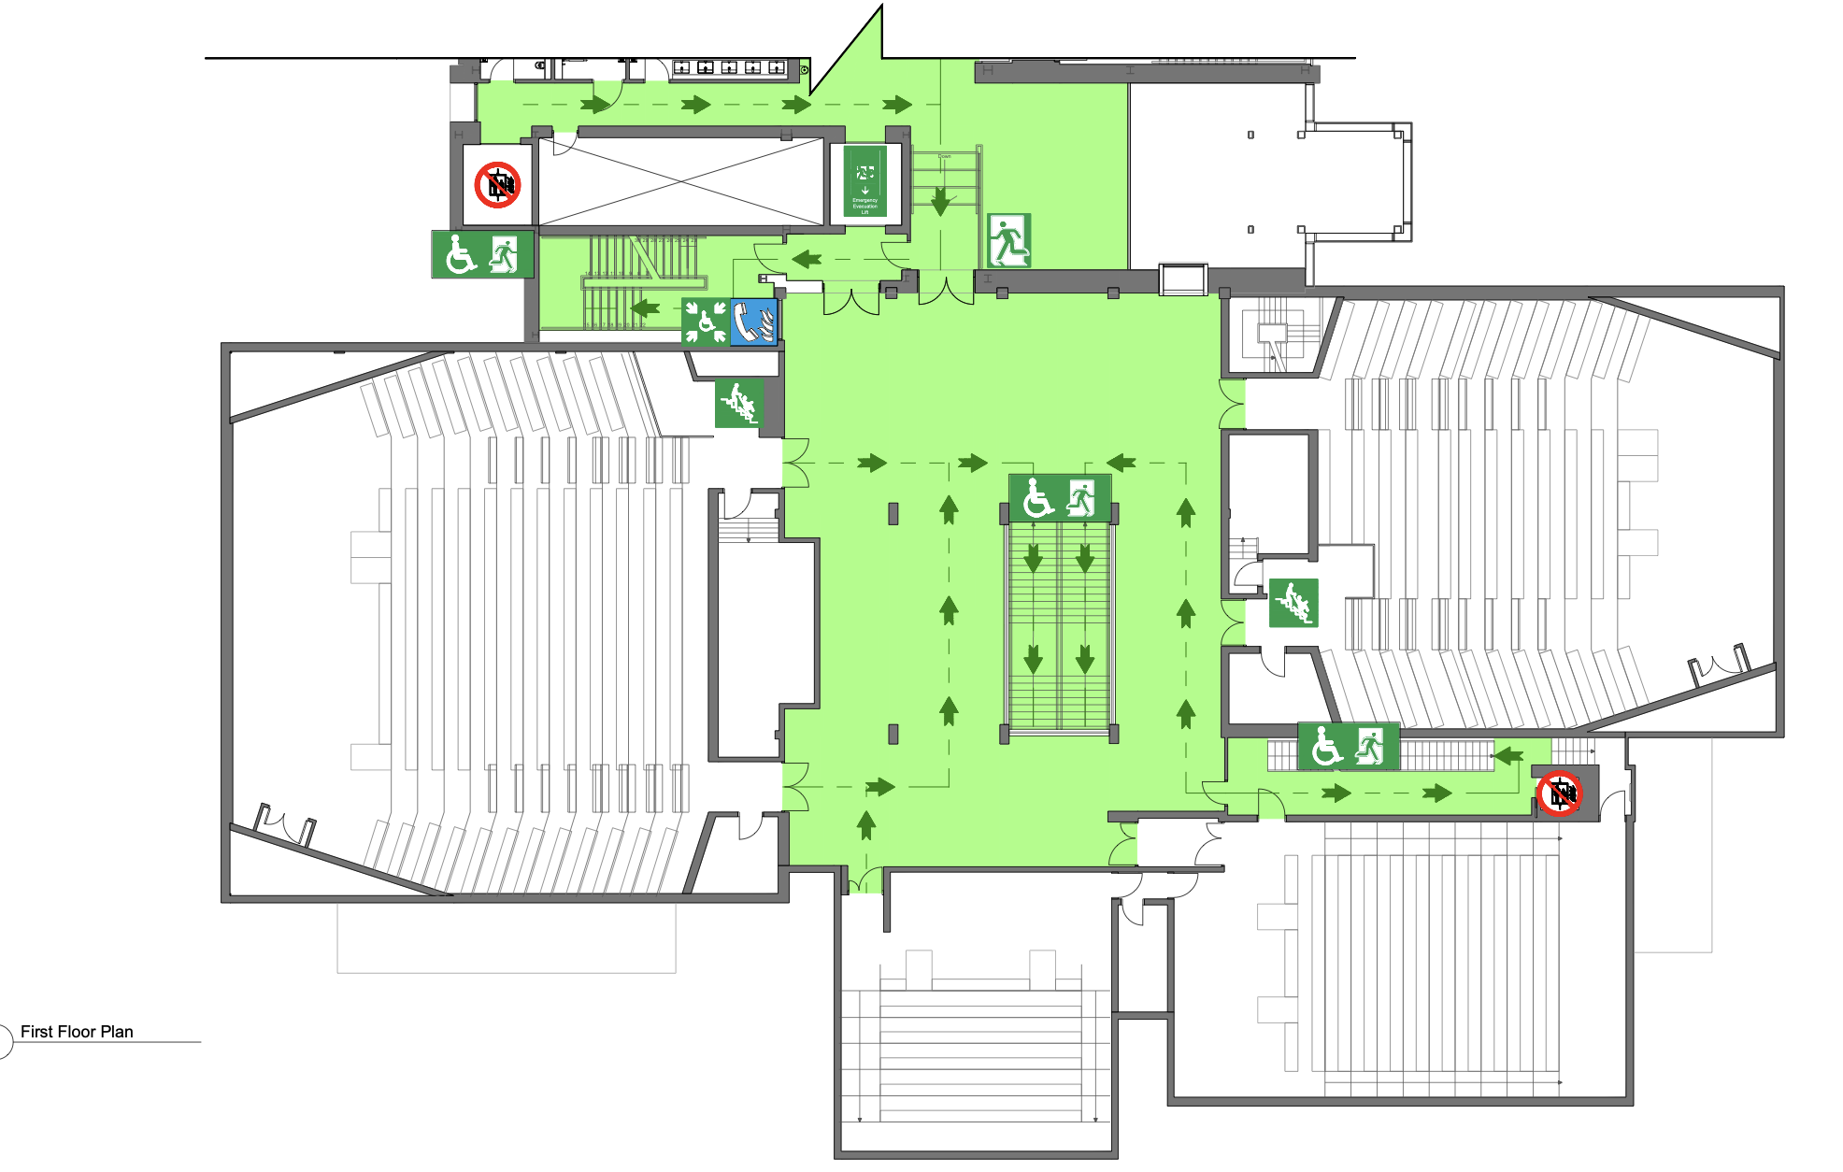
Central Teaching Hub (CTH)
Emergency Exit
Exit through front of lecture theatre or via back and then out downstairs via main entrance or CTL
Assembly point is outside main entrance
Toilets
Downstairs, either side of main entrance
This floor just through into CTL
CTL
Fire Lift
Lecture Theatre B
Lecture Theatre B
Ground Floor
First Floor

Slide 10
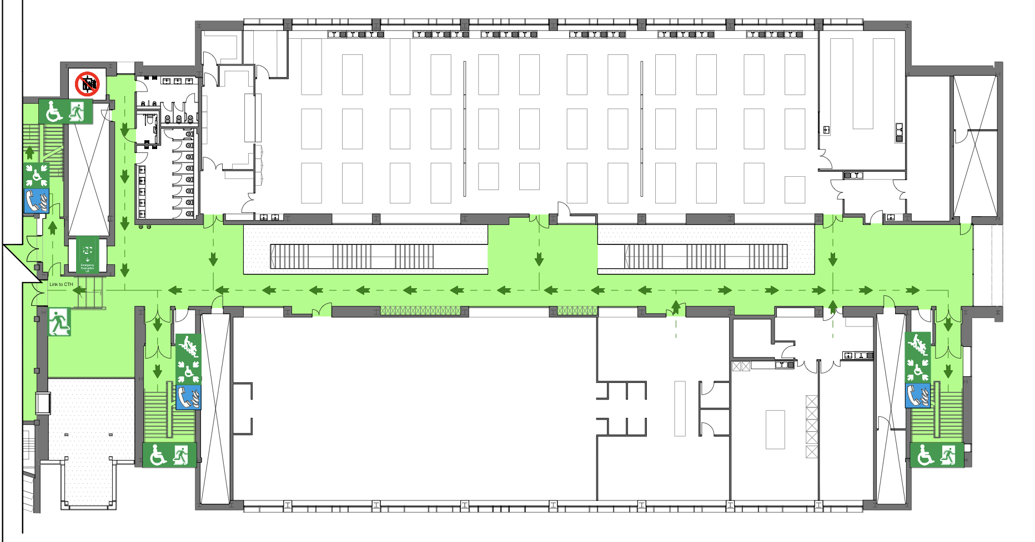
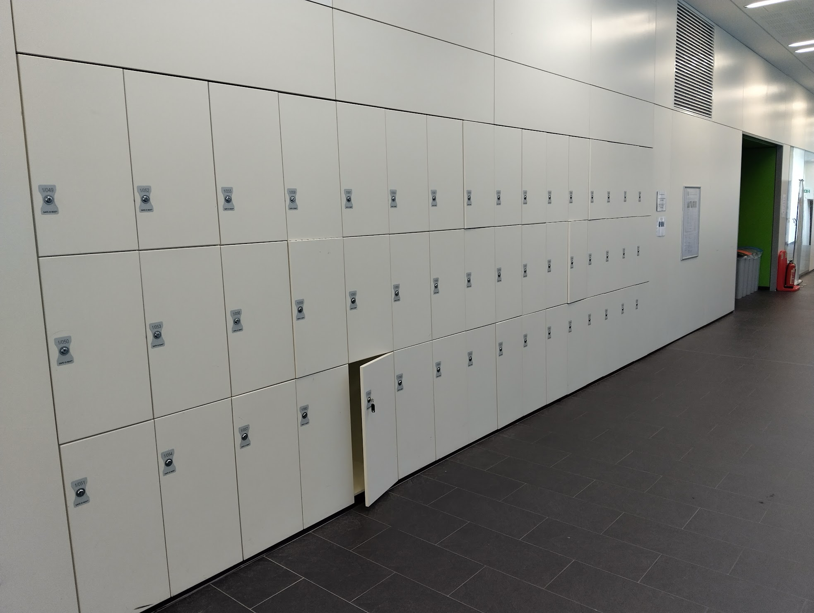
Central Teaching Lab (CTL)
Emergency Exit
Exit through stairs either end and out corresponding exit or through to CTH
Assembly point is outside main entrance
Toilets
Opposite, by the lift and across from the stairs
Lockers (≈100)
Place your bags & coats in lockers before lunch until after PC session
Will need to share
CTH
Fire Lift
PC Teaching Centre
Don’t loose the key
First Floor

Slide 11
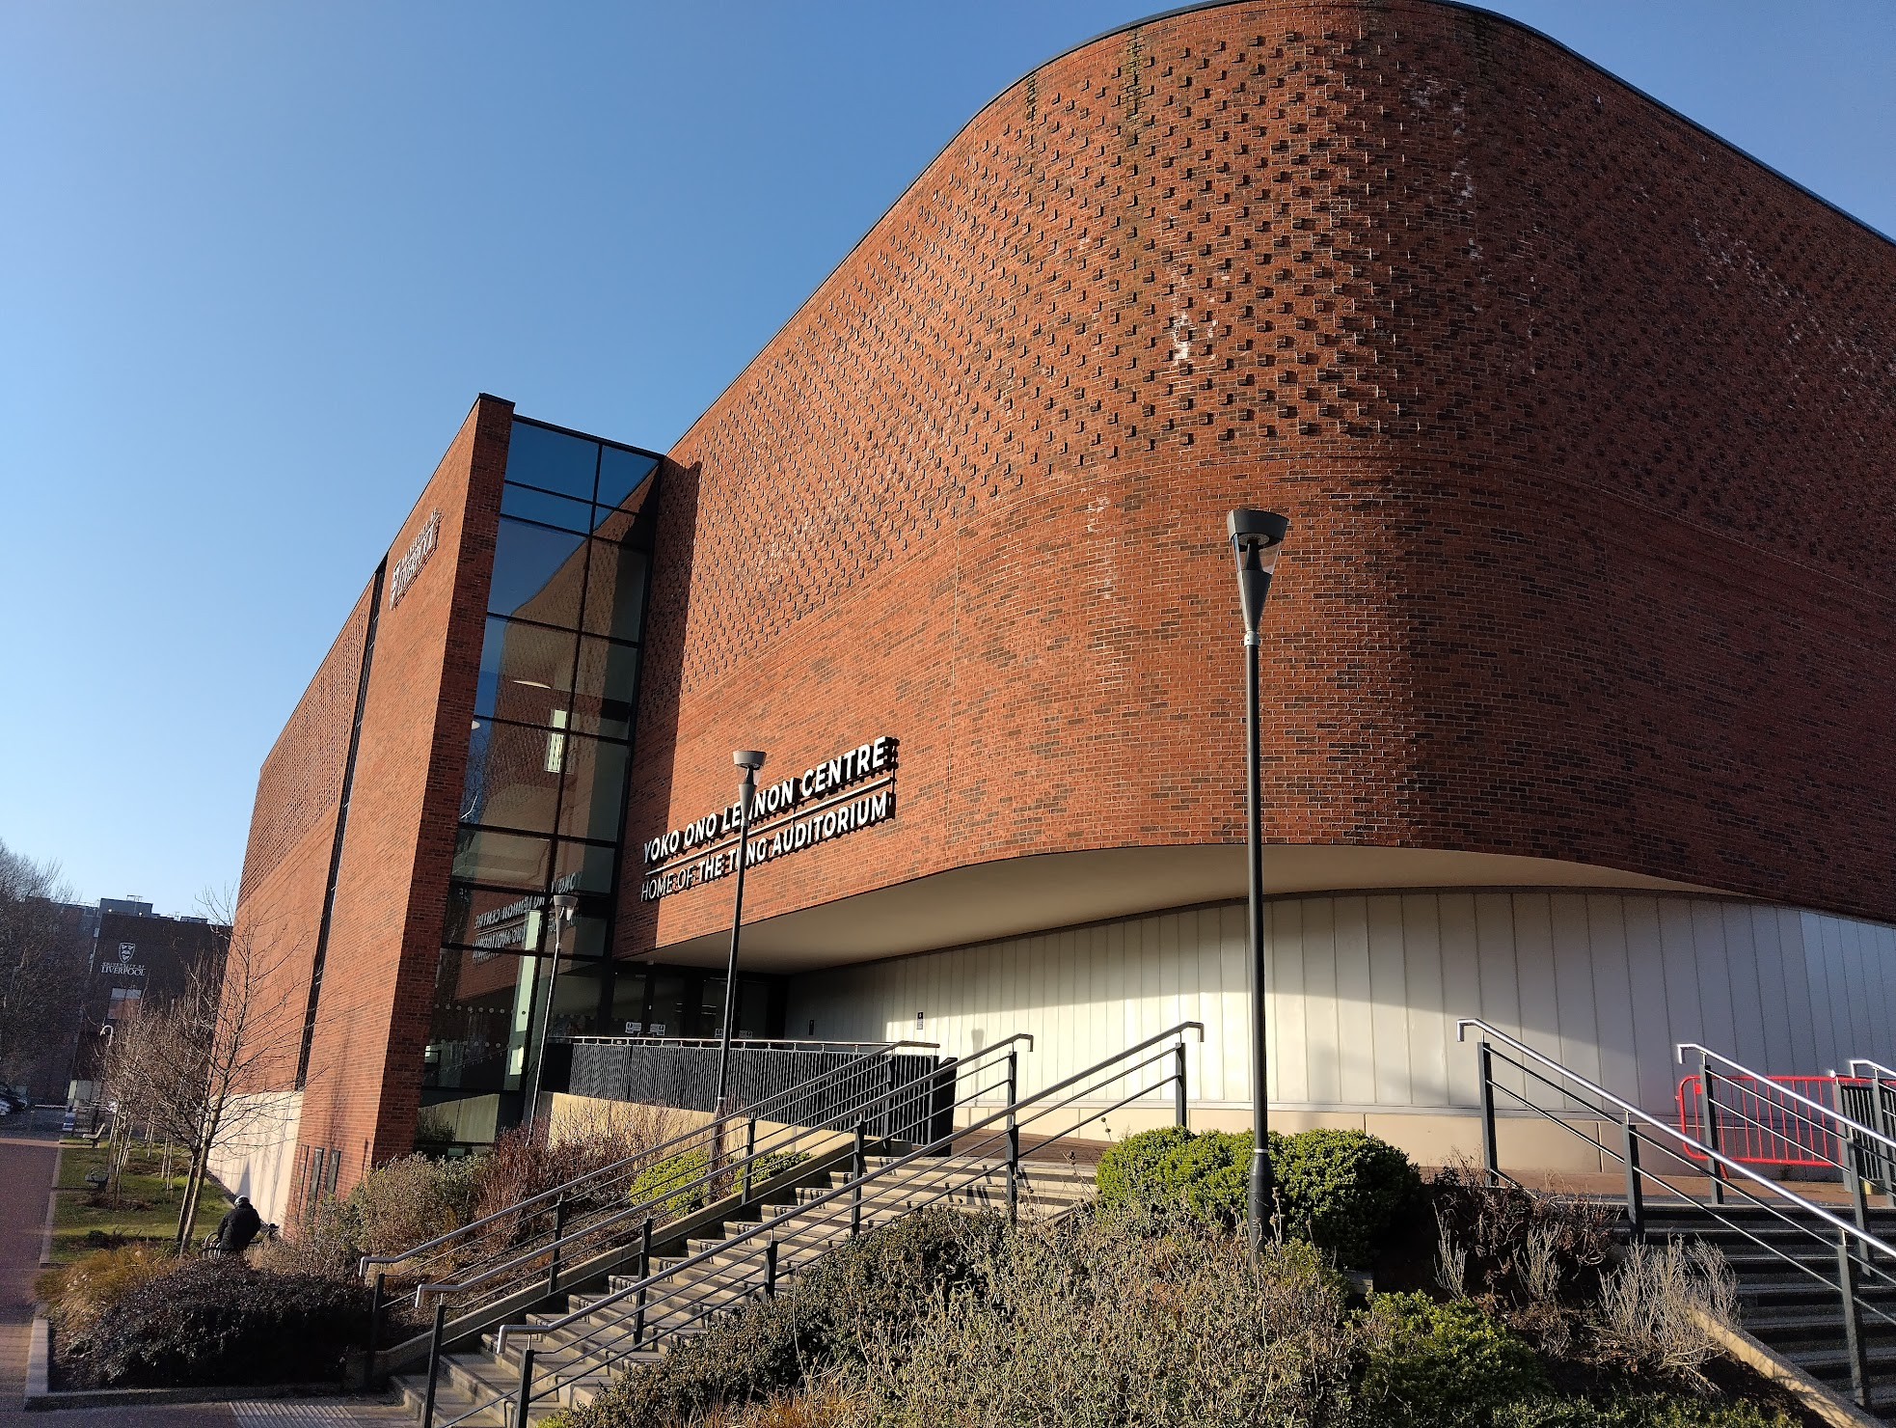
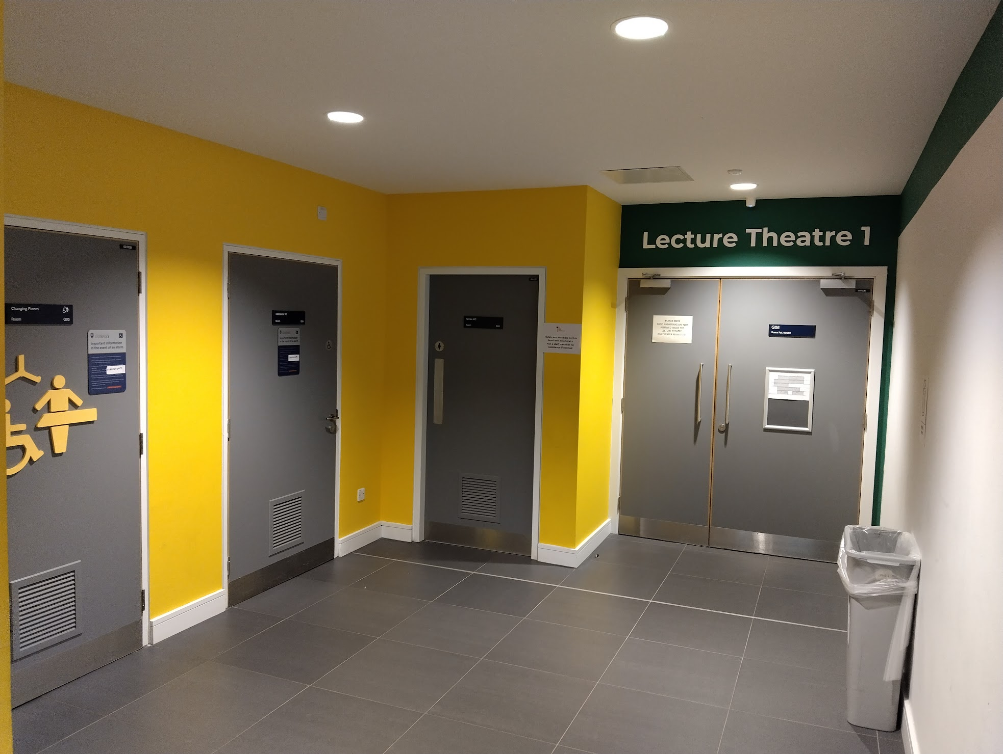
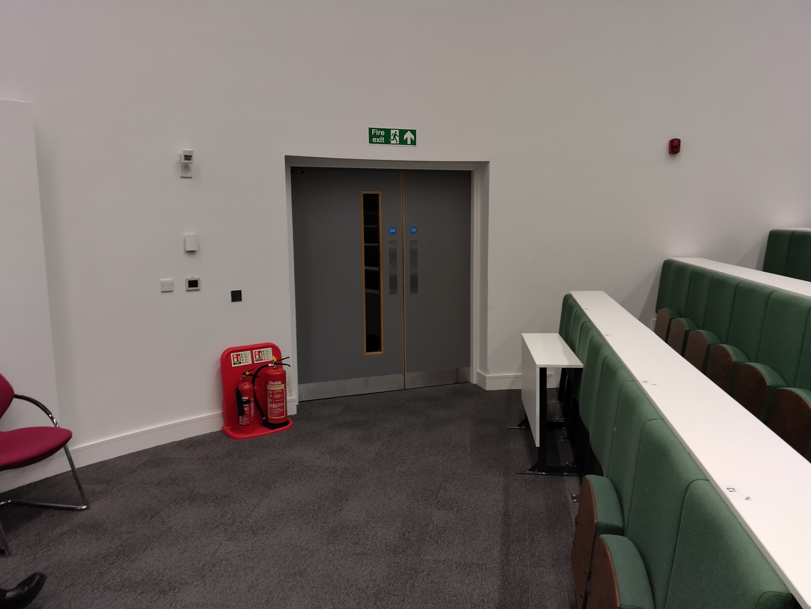
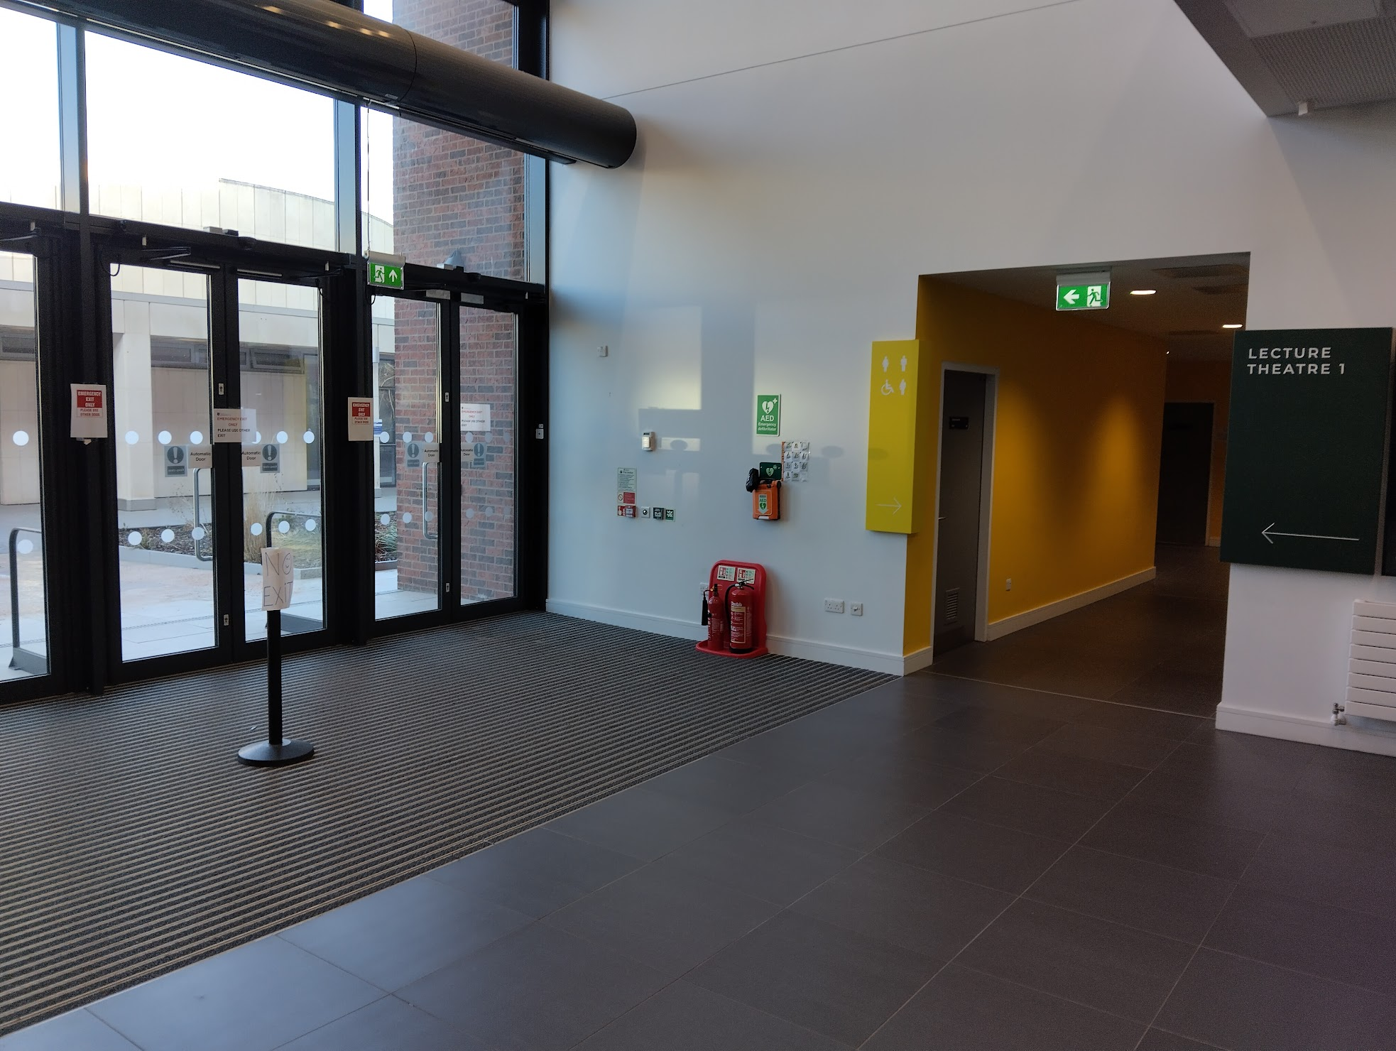
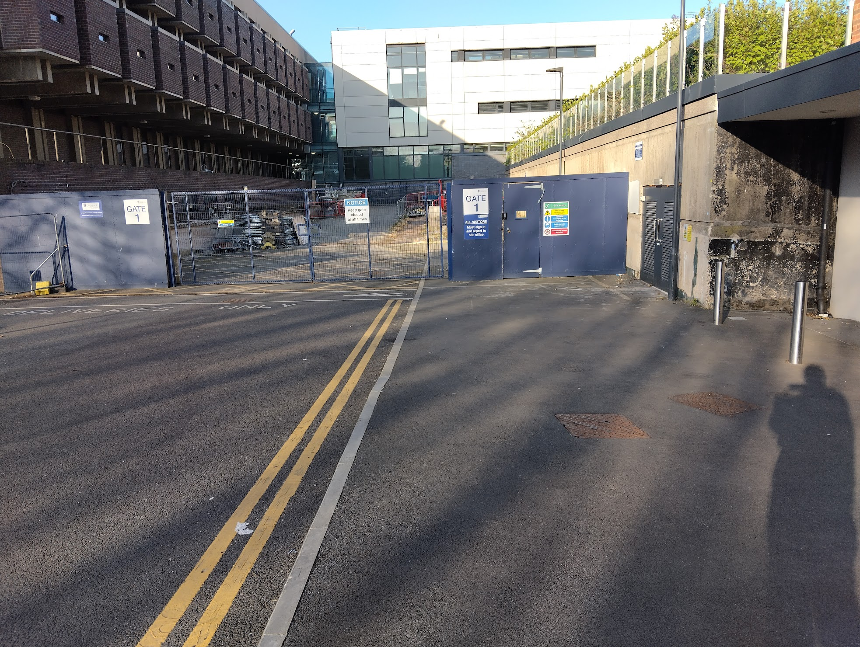
Yoko Ono Lennon Centre (YOLC)
Emergency exits
Front of lecture theatre
Back of lecture theatre and directly right
Assembly point round back of building
Toilets
Directly outside lecture theatre
Entrance

Slide 12
Code of Conduct
We will not accept behaviour which is unkind, upsetting or excludes any person or group of people.
If what you’re doing is making someone feel uncomfortable, that is enough reason to stop doing it.
During the Masterclass you should:
Be kind, respectful and inclusive to everyone
Listen and respect each other’s views and ideas
Use welcoming and inclusive language
Treat everyone equally
Everyone has a responsibility to help keep Masterclasses safe for all. This means:
Don’t take and share pictures, video or audio which includes students from other schools or colleges
Adults should not share personal contact details with students under 18 (or vice versa) or connect with them on social media.
If something needs to be shared this should go via the Masterclass organisers

