Slide 1
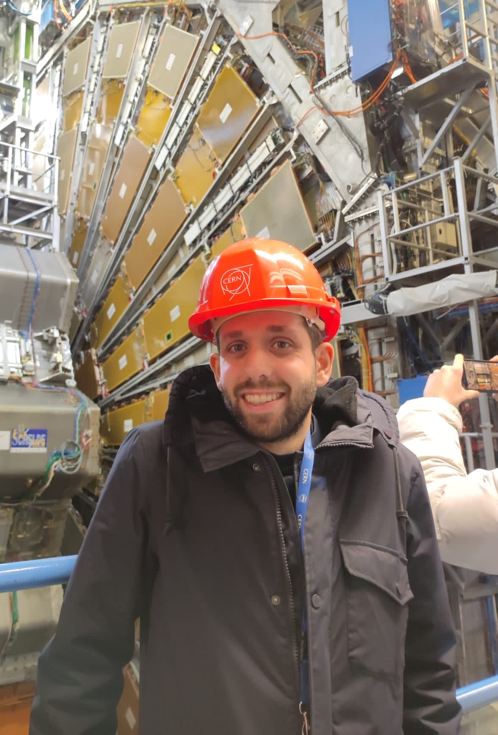
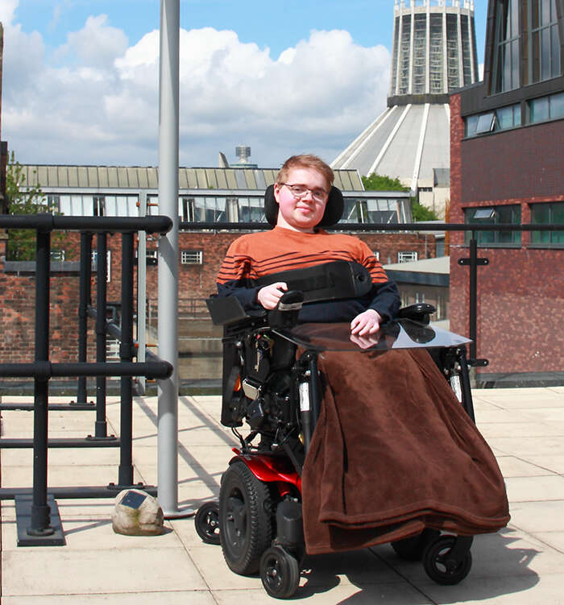
Dixons Broadgreen Academy + Hilbre High School
Jordy Degens
Conor McPartland
Lab Tour: 13:20

Slide 2
Dixons Broadgreen Academy
Jordy Degens
Conor McPartland
Lab Tour: 13:20

Slide 3
Hilbre High School
Jordy Degens
Conor McPartland
Lab Tour: 13:20

Slide 4
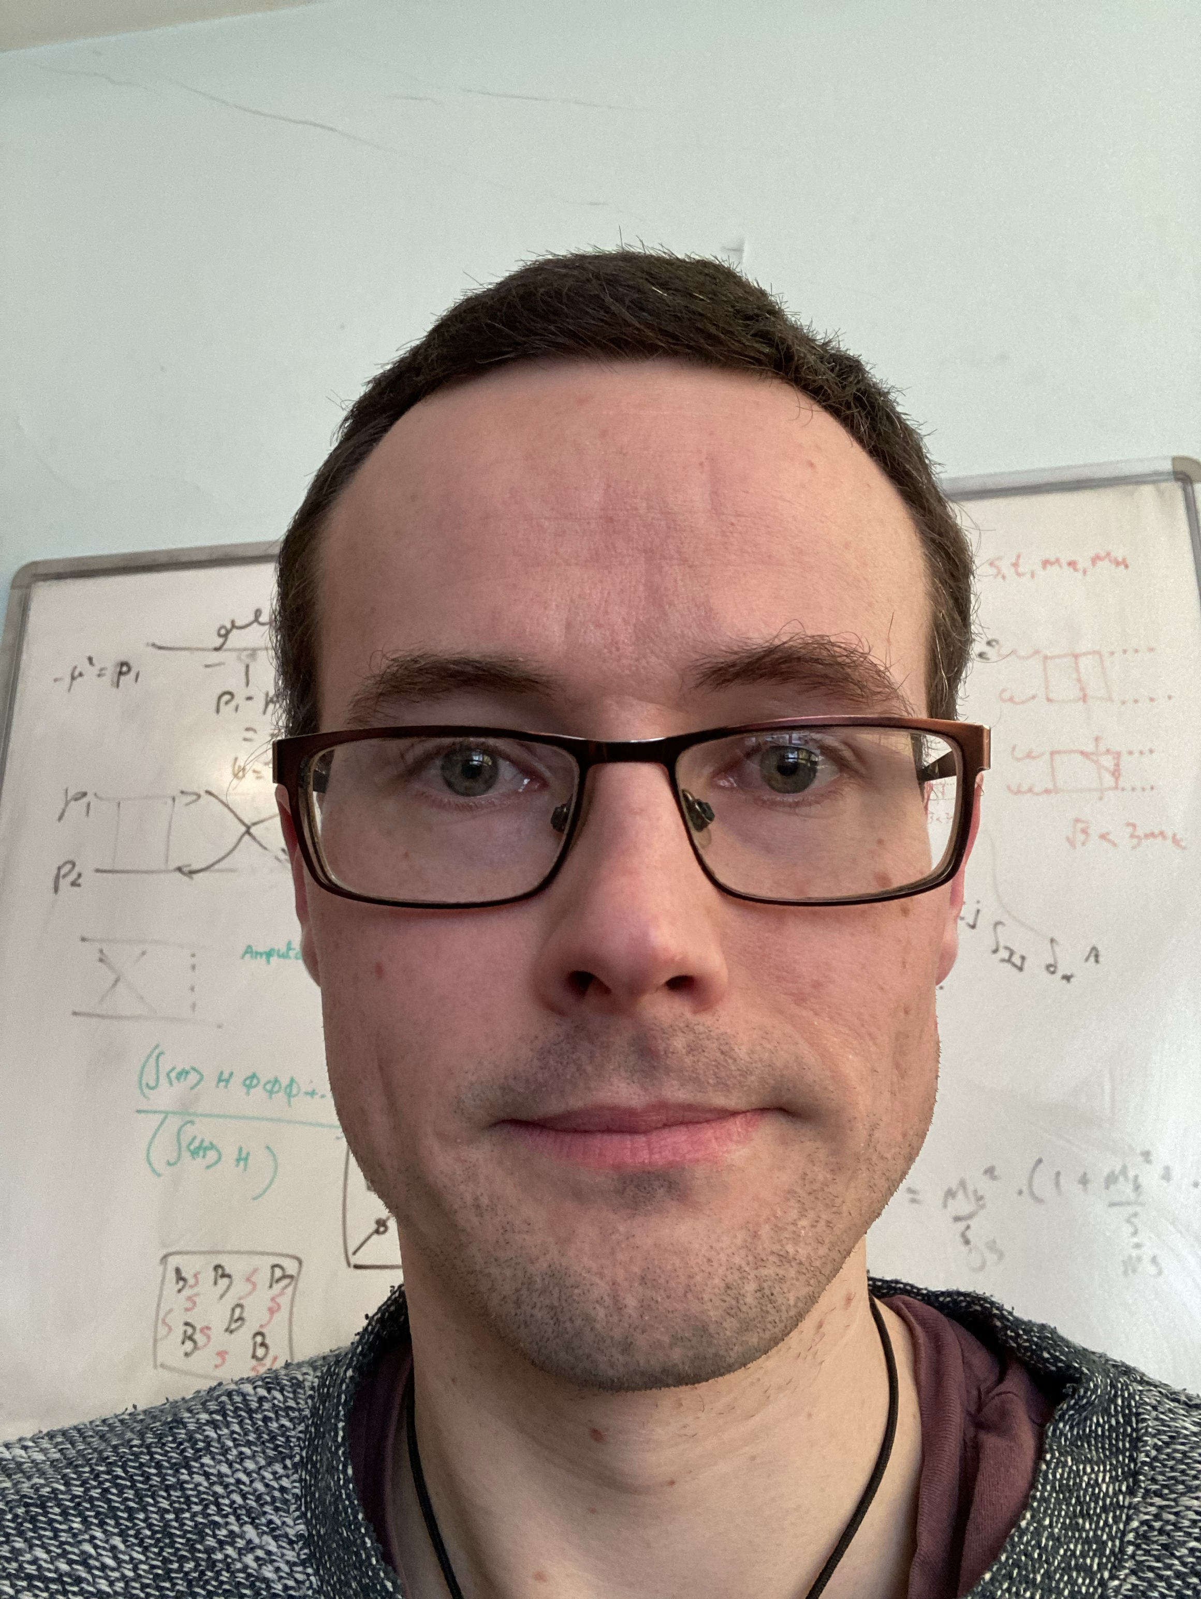
Jersey College for Girls
Add Picture
Josh Davies
Lab Tour: 13:20

Slide 5
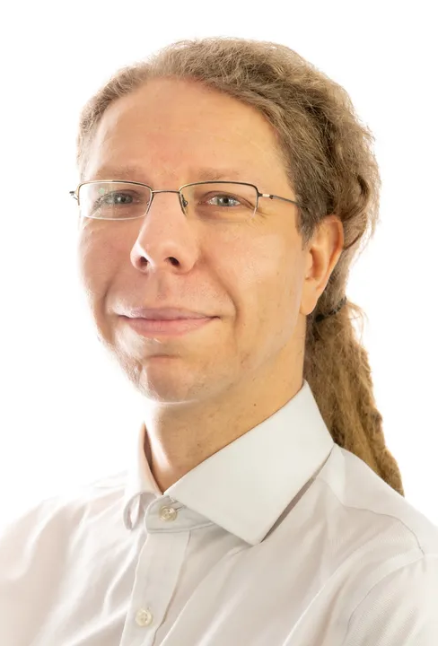
King David High School
Jan Kretzschmar
Lab Tour: 13:20

Slide 6
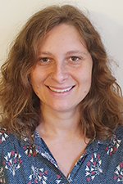
Liverpool College
Luana Parsons-Franca
Lab Tour: 13:20

Slide 7
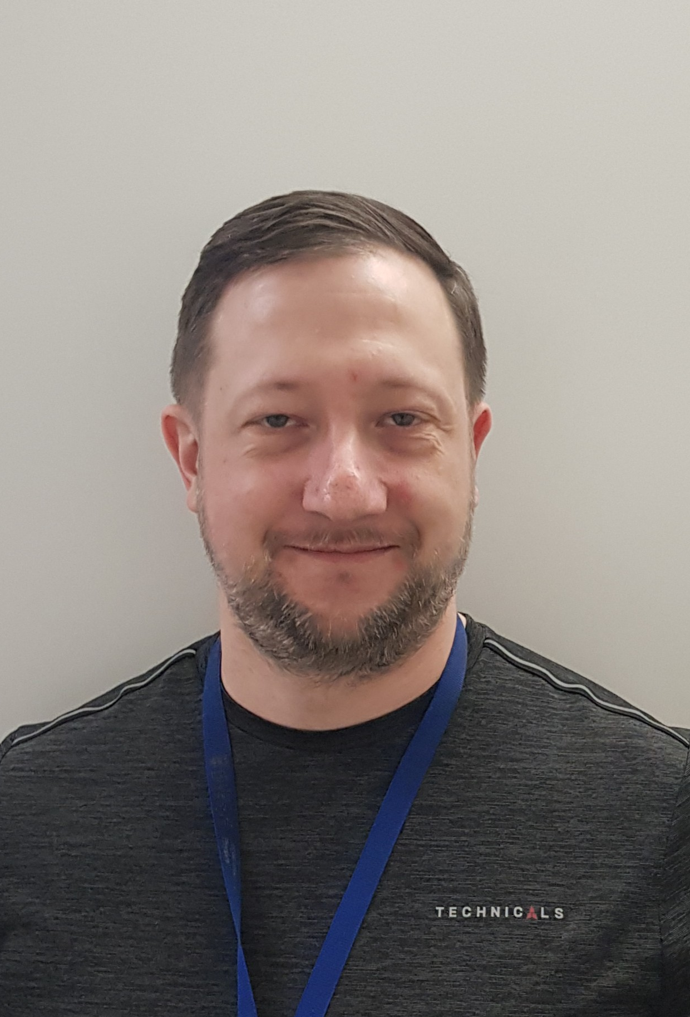
Liverpool Life Sciences UTC / The Studio A
Sven Wonsak
Lab Tour: 13:20

Slide 8
Neston High School
Ellen Sandford
Lab Tour: 13:20

Slide 9
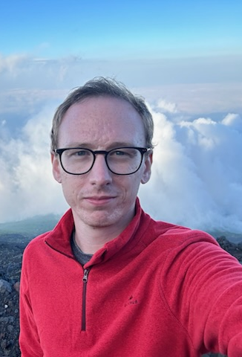
Ormskirk School
Sam Jenkins
Lab Tour: 13:50

Slide 10
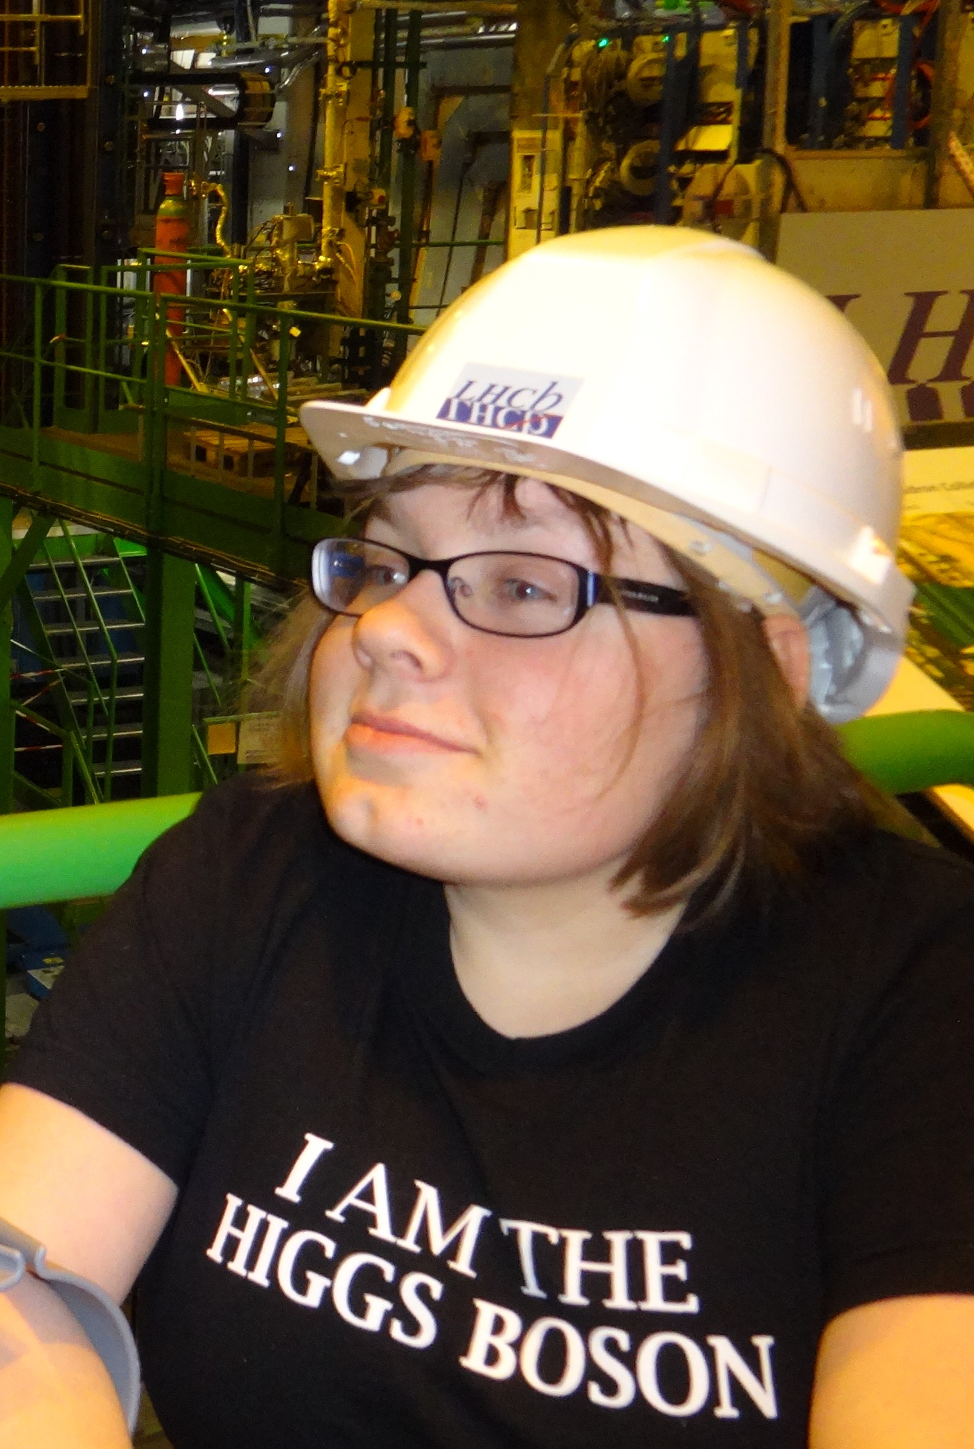
Rossall School
Dominika Vasilkova
Lab Tour: 13:50

Slide 11
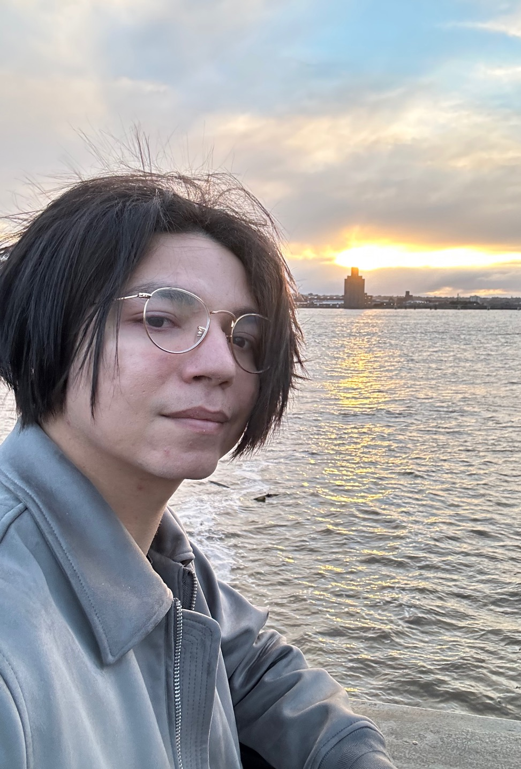
St Francis Xavier’s Catholic Academy
Juan Leite
Lab Tour: 13:50

Slide 12
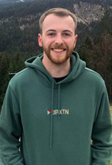
St Hilda’s CE High School
Sean Hughes
Lab Tour: 13:50

Slide 13
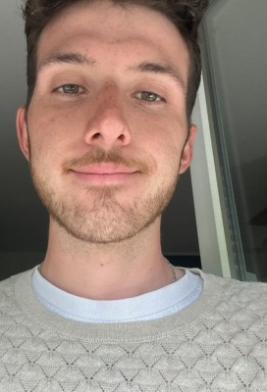
St Wilfred’s Church of England Academy
James Brown
Lab Tour: 13:50

Slide 14
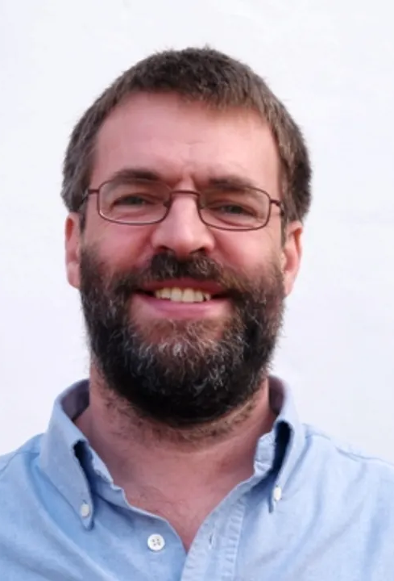
St Julie’s Catholic High School
Tim Greenshaw
Lab Tour: 13:50

Slide 15
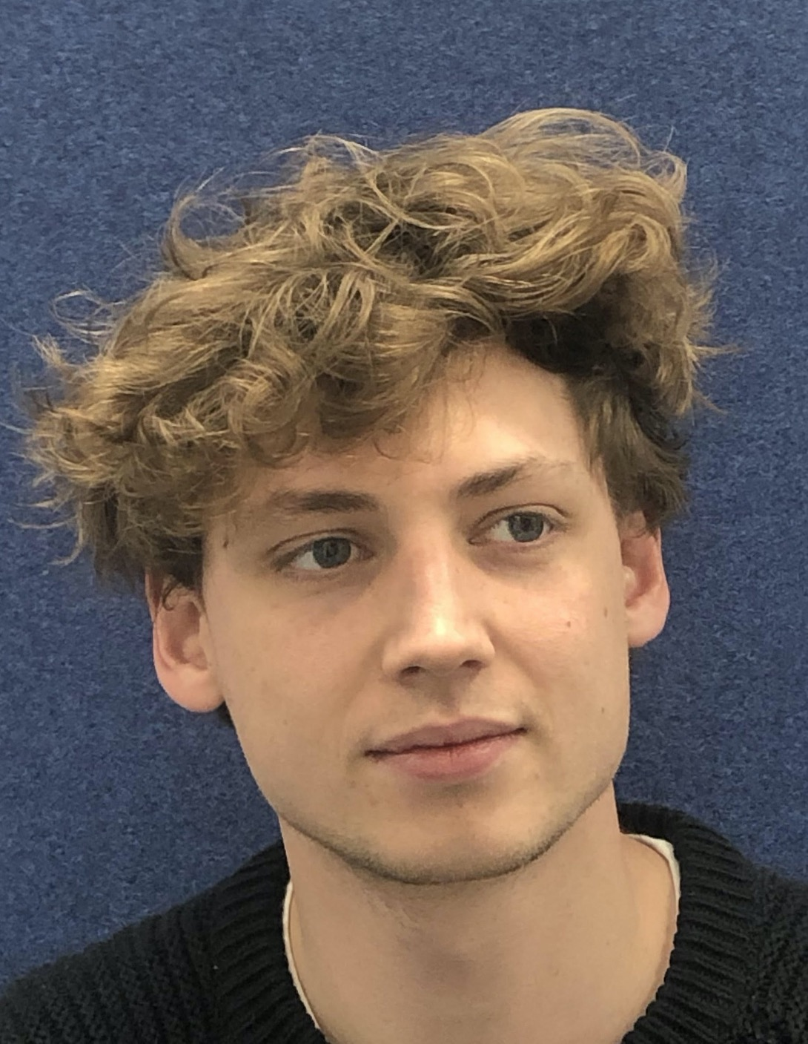
The Bishop’s Blue Coat
Add Picture
Ned Howarth
Lab Tour: 14:20

Slide 16
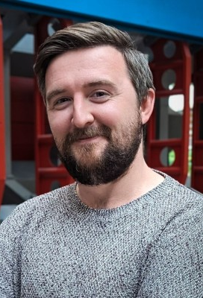
The Liverpool Blue Coat School
John Anders
Lab Tour: 14:20

Slide 17
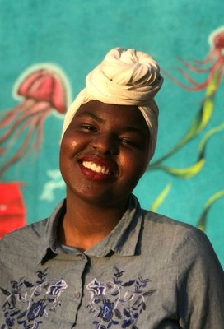
The Mosslands School
Estifa’a Zaid
Lab Tour: 14:20

Slide 18
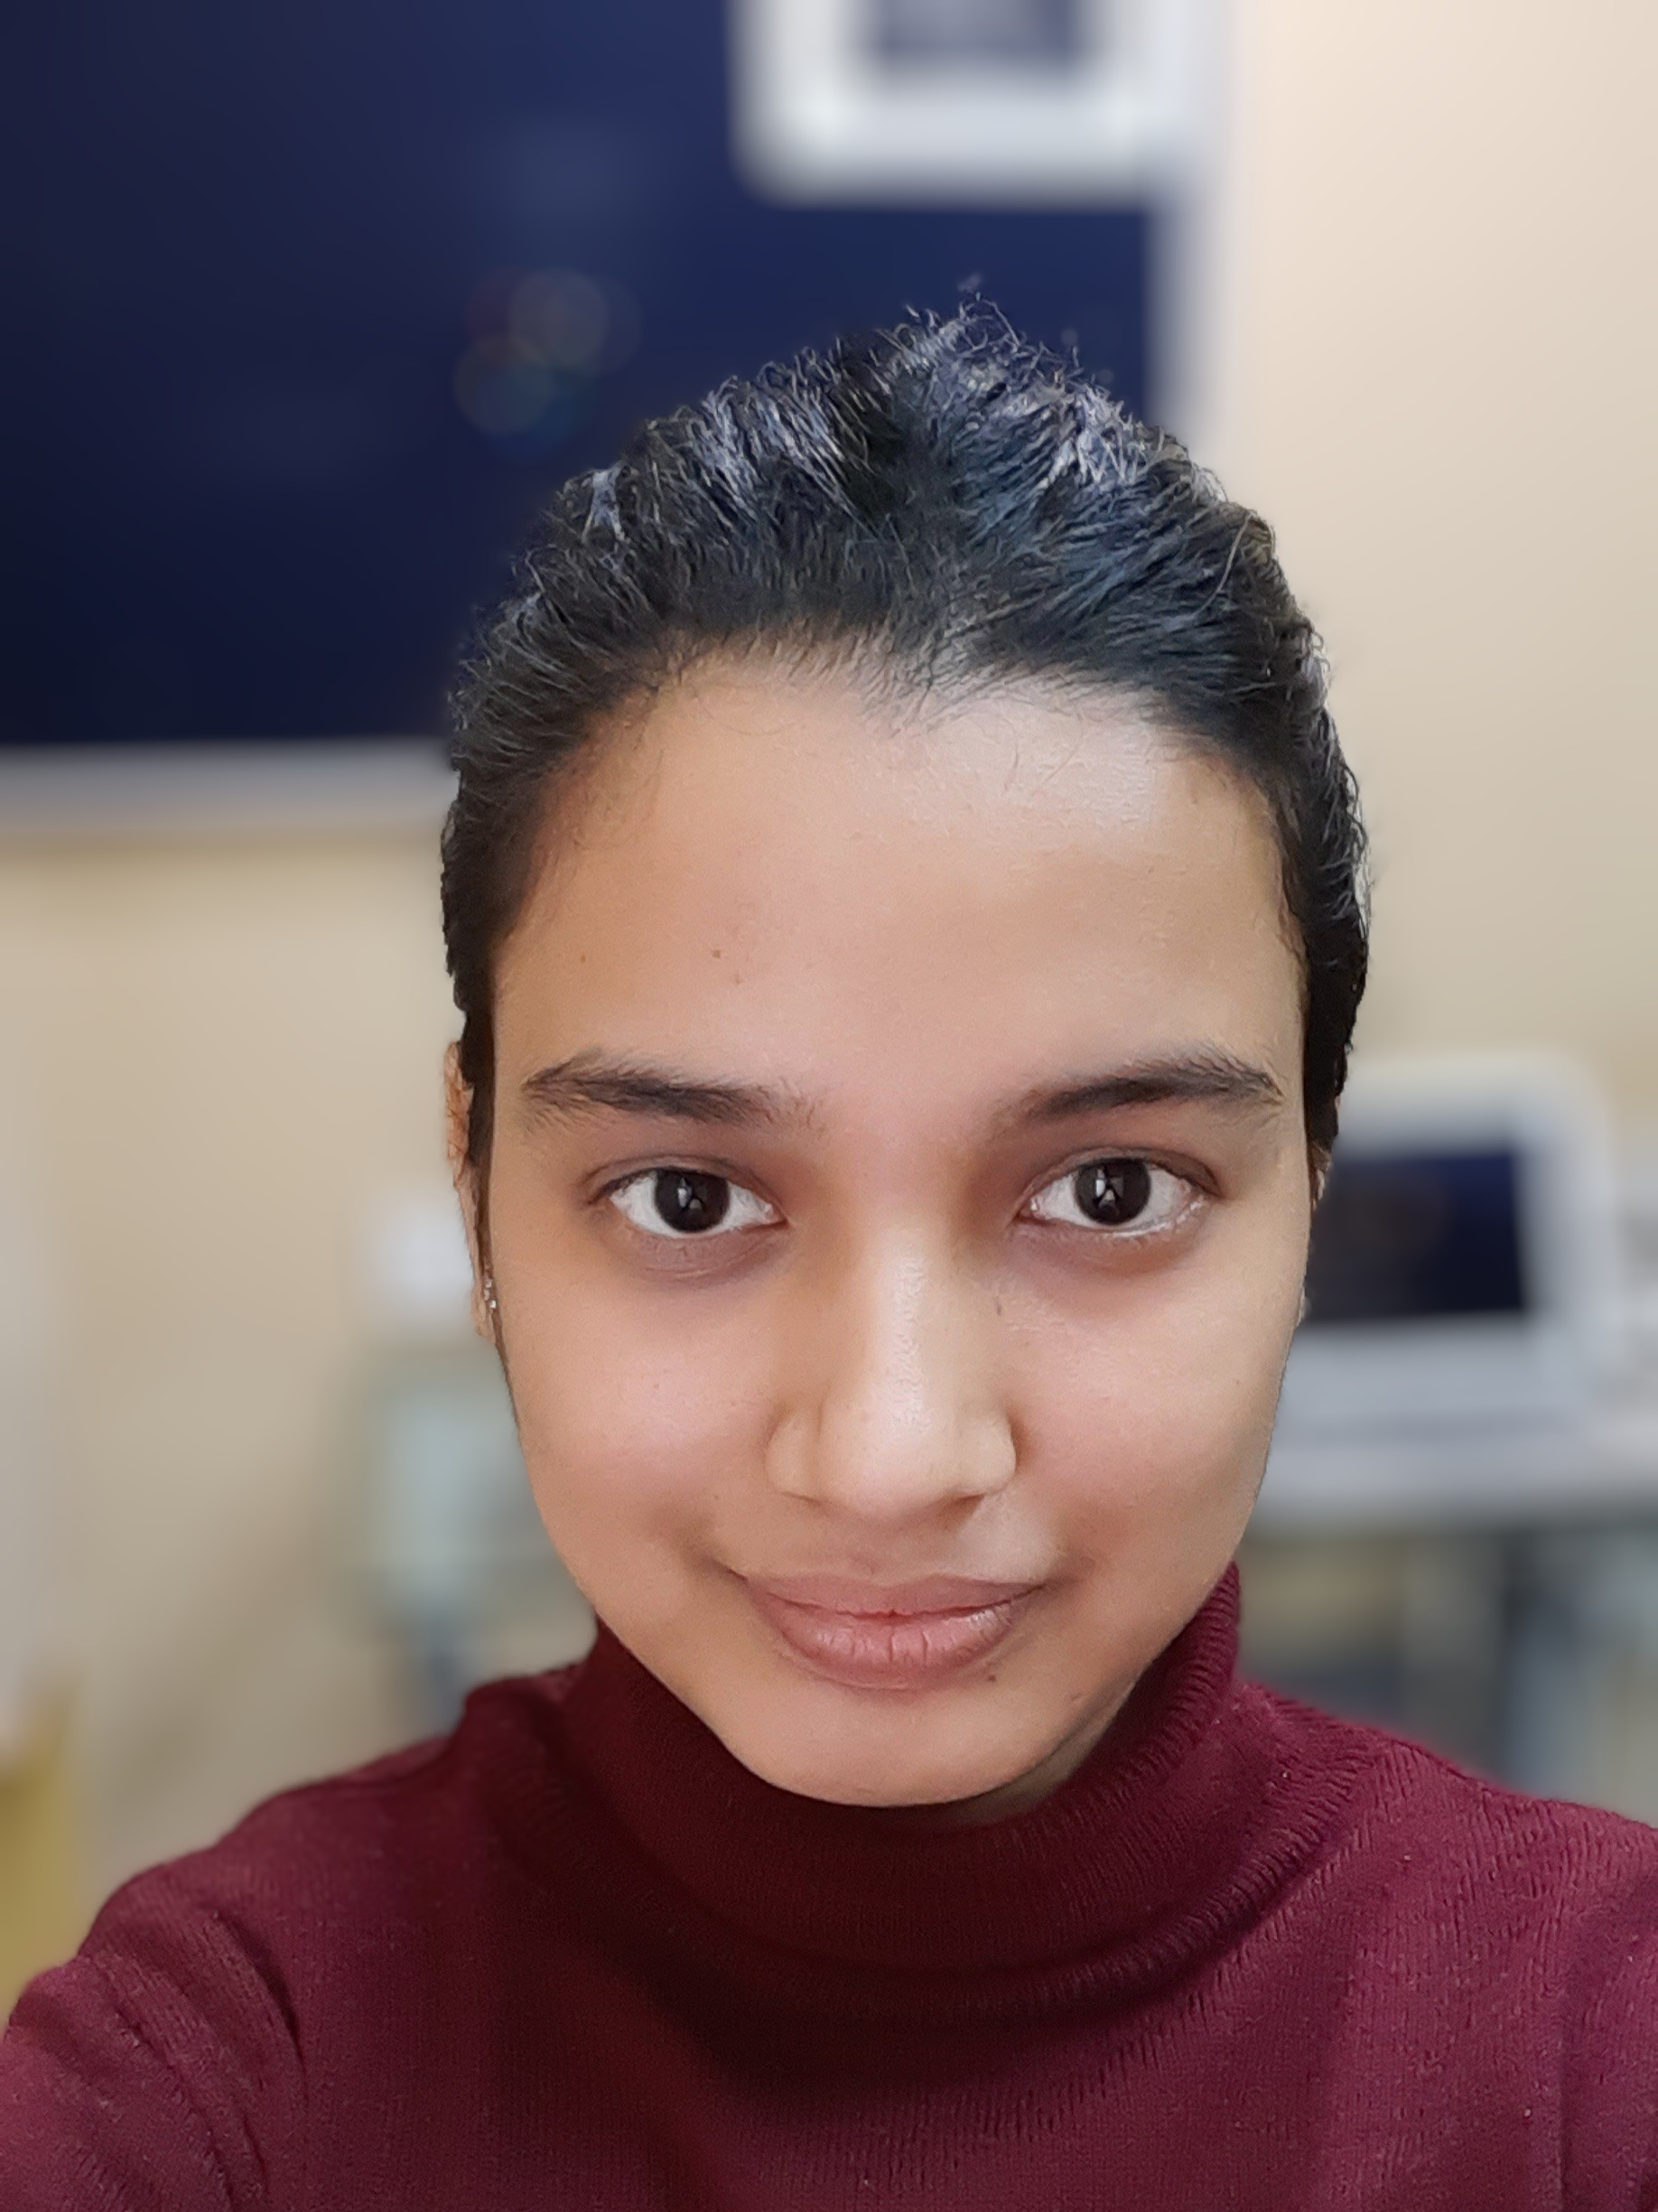
Liverpool Life Sciences UTC / The Studio B
Kajal Singh
Lab Tour: 14:20

Slide 19
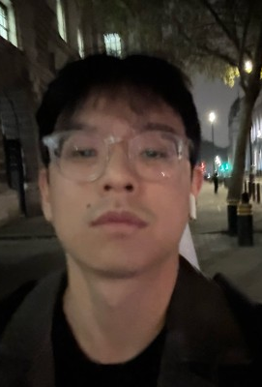
Liverpool Life Sciences UTC / The Studio C
Unik Limbu
Lab Tour: 14:20

Slide 20
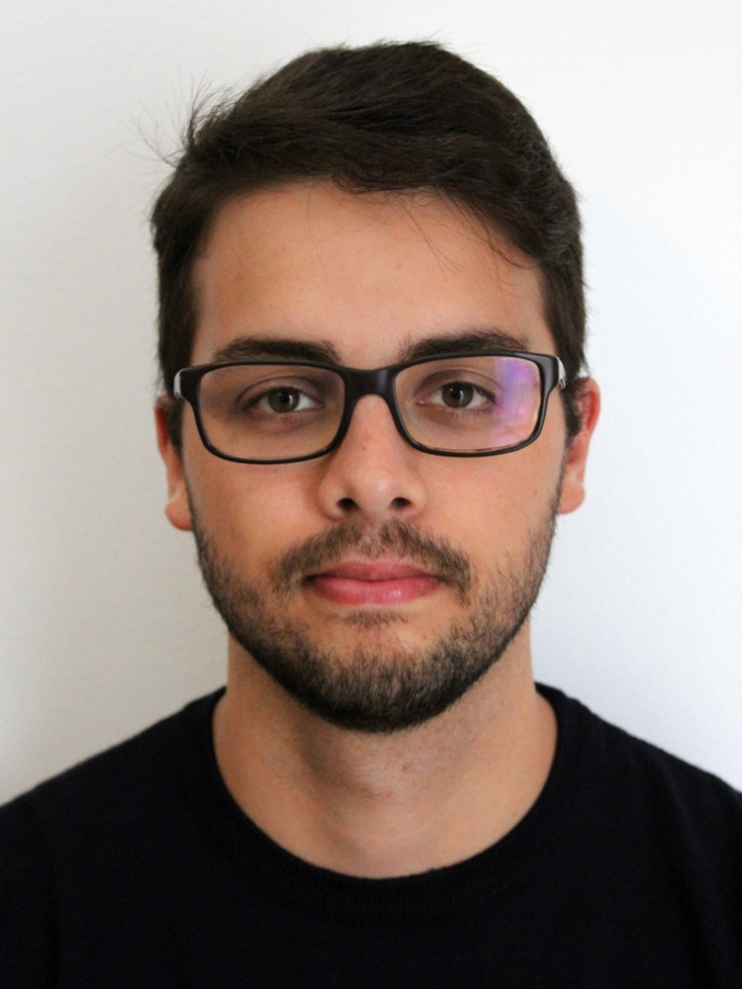
The Sutton Academy
Joaquim Maximiano Gomes
Lab Tour: 14:20

