Slide 1
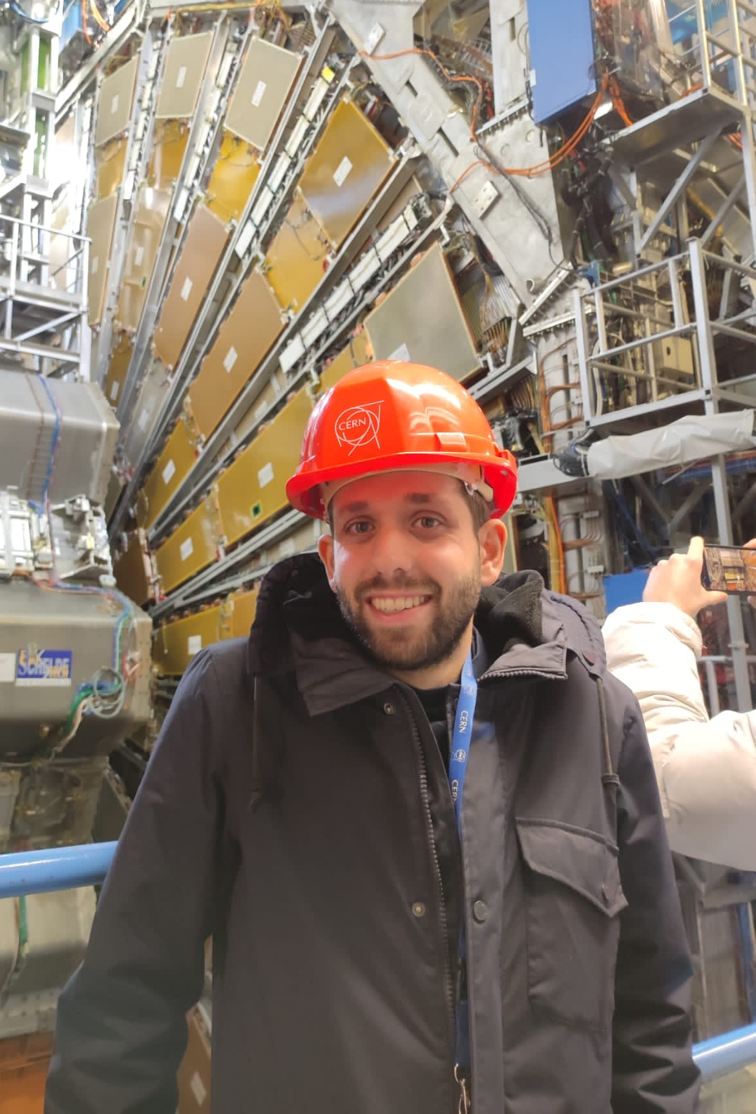
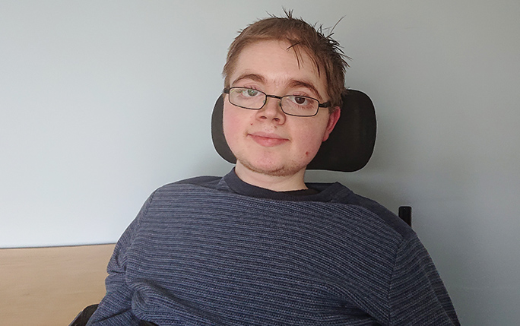
Dixons Broadgreen Academy
+
Hilbre High
School
Jordy Degens
Conor McPartland

Slide 2
Jersey College for Girls
Add Picture
Josh Davies

Slide 3
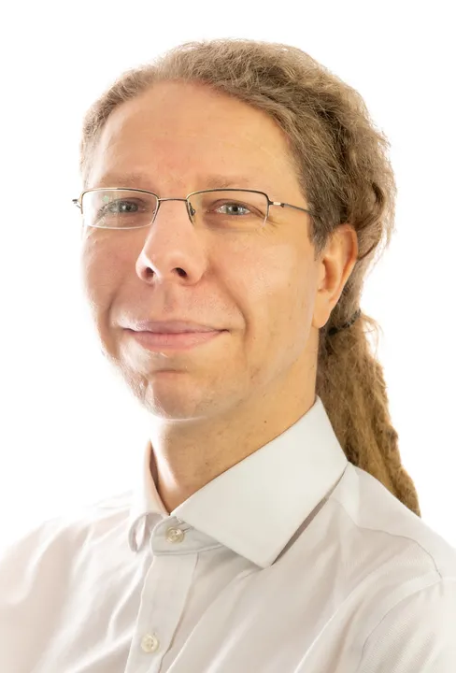
King David High School
Jan Kretzschmar

Slide 4
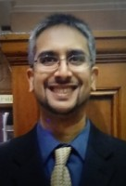
Liverpool College
Paras Naik

Slide 5
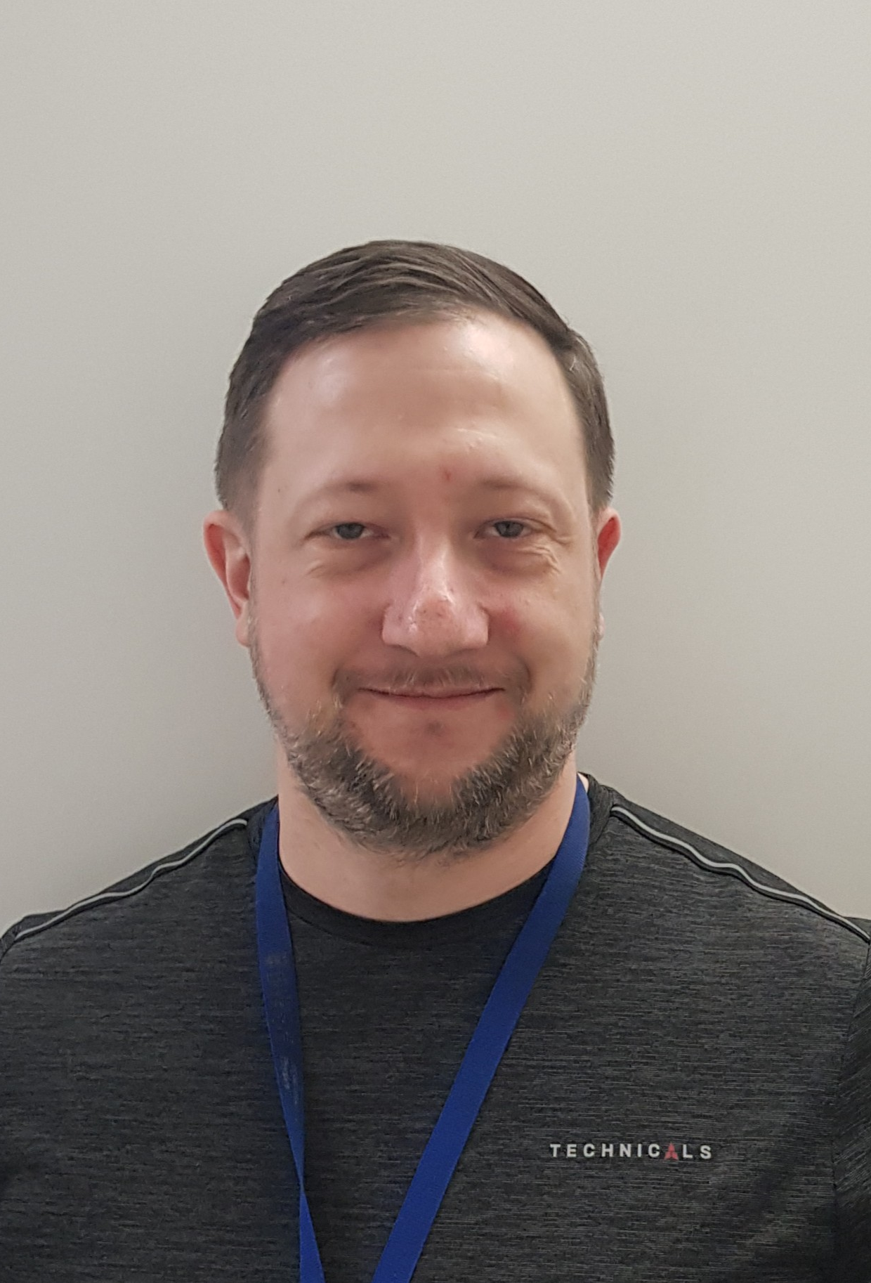
Liverpool Life Sciences UTC
Sven Wonsak

Slide 6
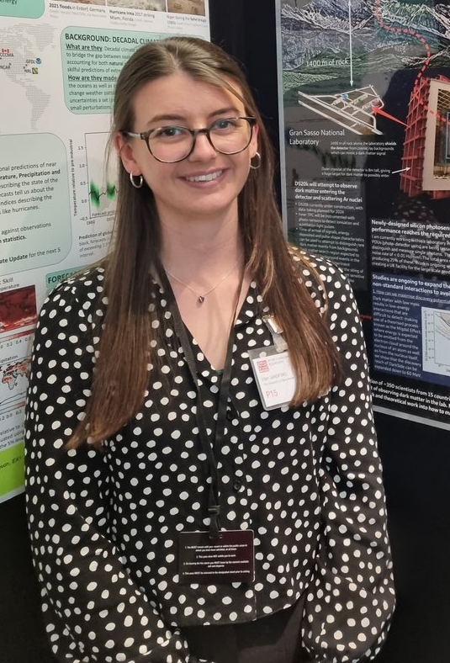
Neston High School
Ellen Sandford

Slide 7

Ormskirk School
Sam Jenkins

Slide 8
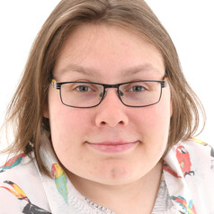
Rossall School
Dominika Vasilkova

Slide 9
St Francis Xavier’s Catholic Academy
Add Picture
Juan Leite

Slide 10

St Hilda’s CE High School
Sean Hughes

Slide 11

St Wilfred’s Church of England Academy
James Brown

Slide 12
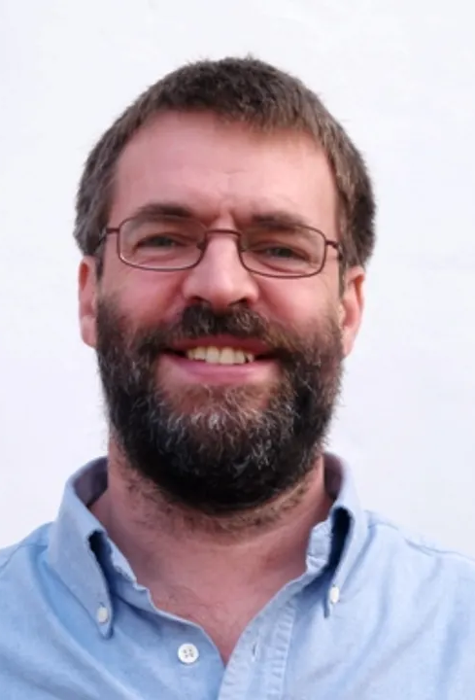
St Julie’s Catholic High School
Tim Greenshaw

Slide 13
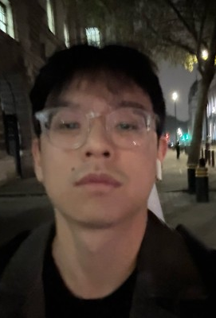
Stafford Grammar School
Unik Limbu

Slide 14
The Bishop’s Blue Coat
Add Picture
Ned Howarth

Slide 15
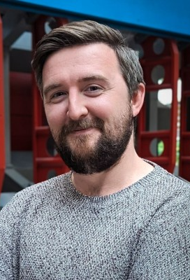
The Liverpool Blue Coat School
John Anders

Slide 16
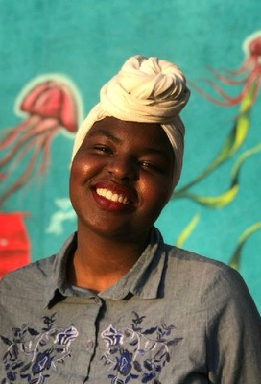
The Mosslands School
Estifa’a Zaid

Slide 17
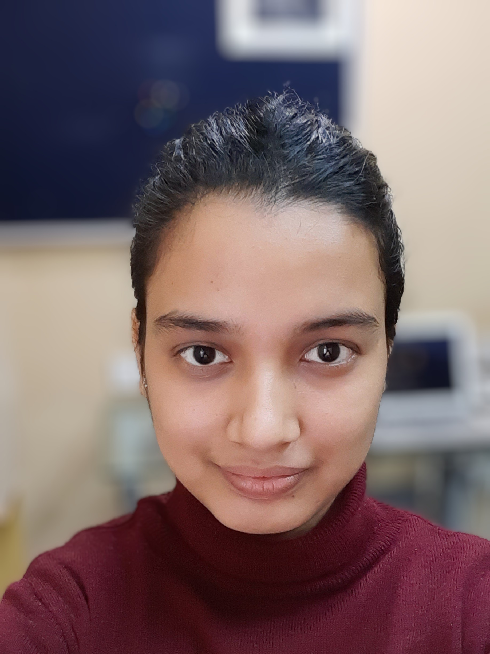
The Studio School
Kajal Singh

Slide 18
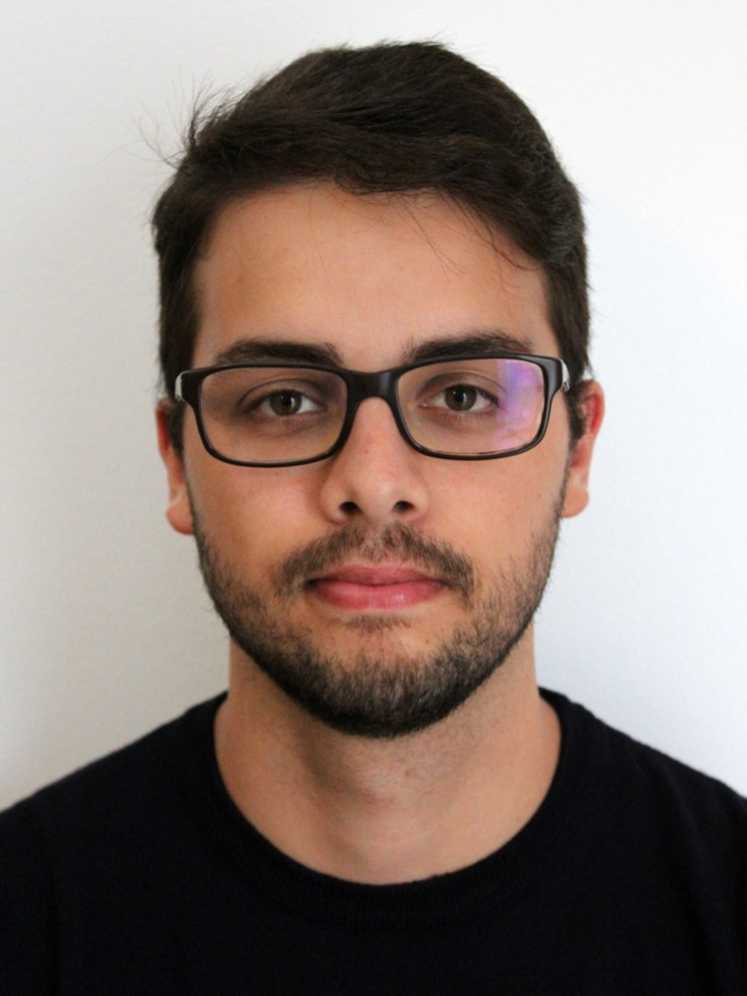
The Sutton Academy
Joaquim Maximiano Gomes

