Slide 1
Demonstrator Info
Carl Gwilliam and Saskia Charity
12th March 2025
Particle Physics Masterclass

Slide 2
Admin Details

Slide 3
School Assignments + Lab Tours
School | Demonstrator(s) | Lab Tour | Number
Dixons Broadgreen Academy + Hilbre High School | Jordy Degens + Conor McPartland | 13:20: Zone 1 → Zone 2 → Zone 3 | 8
Jersey College for Girls | Josh Davies | 13:20: Zone 2 → Zone 3 → Zone 1 | 8
King David High School | Jan Kretzschmar | 13:20: Zone 3 → Zone 1 → Zone 2 | 10
Liverpool College | Luana Parsons-Franca | 13:20: Zone 4 → Zone 5 → Zone 6 | 10
Liverpool Life Sciences UTC / The Studio A | Sven Wonsak | 13:20: Zone 5 → Zone 6 → Zone 4 | 10
Neston High School | Ellen Sandford | 13:20: Zone 6 → Zone 4 → Zone 5 | 6
Ormskirk School | Sam Jenkins | 13:50: Zone 1 → Zone 2 → Zone 3 | 10
Rossall School | Dominika Vasilkova | 13:50: Zone 2 → Zone 3 → Zone 1 | 10
St Francis Xavier’s Catholic Academy | Juan Leite | 13:50: Zone 3 → Zone 1 → Zone 2 | 8
St Hilda’s CE High School | Sean Hughes | 13:50: Zone 4 → Zone 5 → Zone 6 | 10
St Wilfred’s CE Academy | James Brown | 13:50: Zone 5 → Zone 6 → Zone 4 | 10
St Julie’s High School | Tim Greenshaw | 13:50: Zone 6 → Zone 4 → Zone 5 | 6
Liverpool Life Sciences UTC / The Studio C | Unik Limbu | 14:20: Zone 1 → Zone 2 → Zone 3 | 7
The Bishop’s Blue Coat | Ned Howarth | 14:20: Zone 2 → Zone 3 → Zone 1 | 10
The Liverpool Blue Coat School | John Anders | 14:20: Zone 3 → Zone 1 → Zone 2 | 10
The Mosslands School | Estifa’a Zaid | 14:20: Zone 4 → Zone 5 → Zone 6 | 10
Liverpool Life Sciences UTC / The Studio B | Kajal Singh | 14:20: Zone 5 → Zone 6 → Zone 4 | 10
The Sutton Academy | Joaquim Maximiano Gomes | 14:20: Zone 6 → Zone 4 → Zone 5 | 10

Slide 4
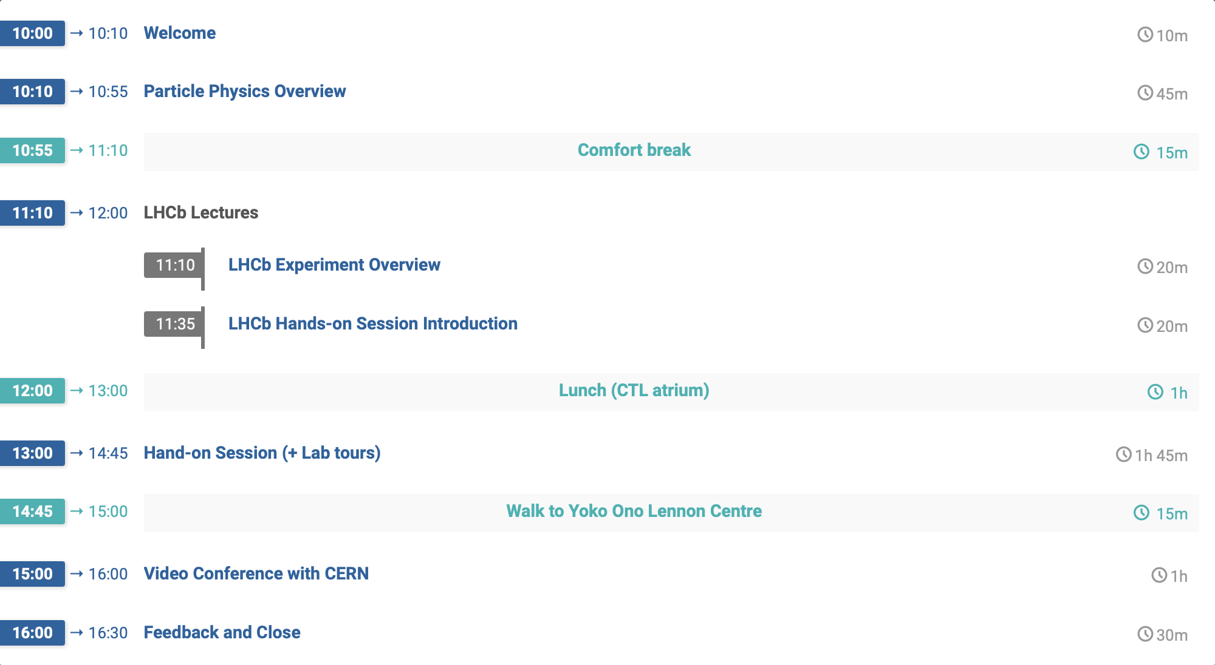
Schedule
Central Teaching Hub LT B
Central Teaching Hub LT B
Central Teaching Lab Atrium
https://tinyurl.com/LHCbPPMC
Central Teaching Lab PC TC
(+ Optics Lab)
Yoko Ono Lennon Centre LT 1
Escort back to CTL for busses

Slide 5
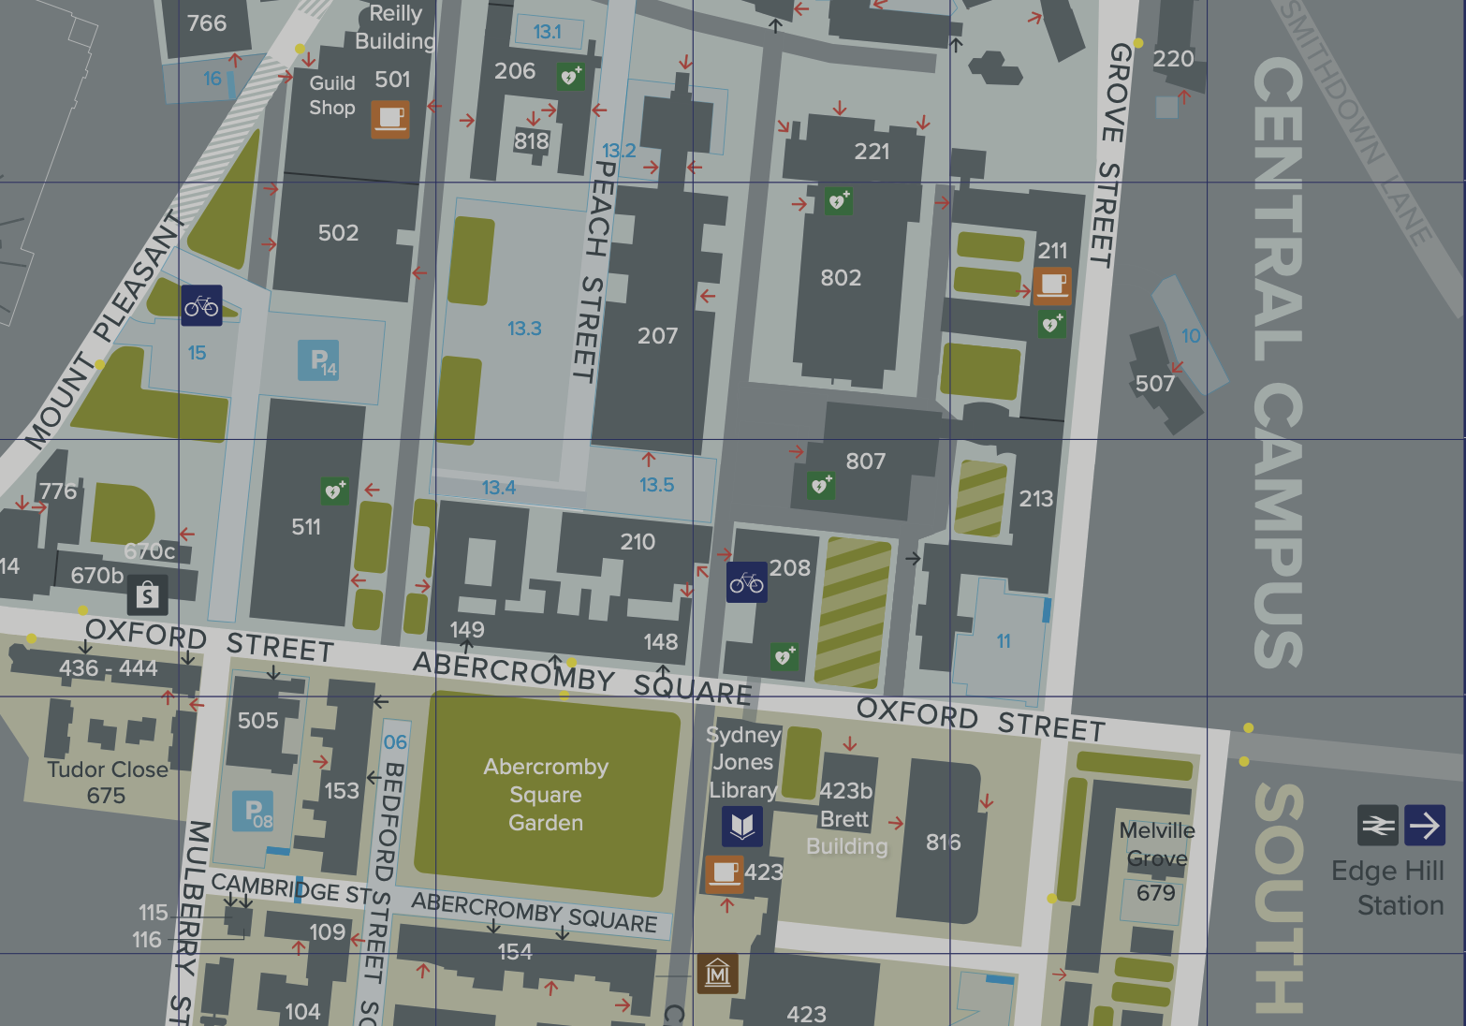

Venues
Lectures (AM)
  Central Teaching Hub
  Lecture Theatre B
Hands-on (PM)
  Central Teaching Lab
  PC Teaching Suite
Escorted Across
Video Conference (PM)
  Yoko Ono Centre
  Lecture Theatre 1
Escorted back to CTL for busses

Slide 6
Instructions

Slide 7
General
Give each student a set of instructions
  These have a unique login ID and password (same for all)
  They also have a tinyurl link to the exercise page they should load and the combination they should use
  Computers have Edge, Chrome and Firefox
Once loaded they should go to “webpage of the exercise”
  Put in their name, grade and individual combination from the sheet then click save
  The first part is the event display, which should take about 30 mins
  Then the second part is the D0 lifetime
Bags/Coats
  Should be left in the lockers outside (will need to share 2 to 1)
Lab tours:
  Please take your group to the optics lab on the ground floor at the allotted time (see above)
Video Conference
  Take them to the YOLC LT 1 (all together) and then bring them back at the end so they can go to busses

Slide 8
Exercises
Event display:
  Easiest way is to turn off the detector and click on zoom
  Looking for an opposite-charge pi and kaon that are displaced
  Click on each (maybe offset) so they appear in the “My Particles” and then click add
  They will get a mean and std. dev, which they should compare to the known mass of 1864.84 GeV/c²
Lifetime
  Click plot D0 mass and then fit mass distribution
  Choose a signal range around the peak and click plot distributions
  Click on various sliders to remove background while keeping signal and click refresh
  Save result of time fit and will appear on bottom plot which is time (note wrong axis label) vs IP
  Systematically vary IP from 1.5 to -2 in 0.2 steps
  Result should get better as remove background
  Click on read instructions for more info

Slide 9
Combination / Questions
Combination
  David has a jupyter notebook to combine all the results for the mass (event display) part
  He will periodically call for students who have an answer for their combination to come up and report it
  Display the notebook and plot on the big screens so everyone can see how the answer shifts as more data is added
  Demonstrators can discuss the updating result with the students
  For the lifetime → we’ll just report one number back at the end (doesn’t make sense to combine)
See if they are any questions they particularly want to ask in the Video Conference (VC)
  There will only be time for one or two
For the VC, find out if anybody from your group would be interested in
  Introducing us (Name of Institute, School year, Number, where they are from, etc) and let Carl/Saskia
  Presenting the final lifetime result (with units)

Slide 10
LHCb Info

Slide 11
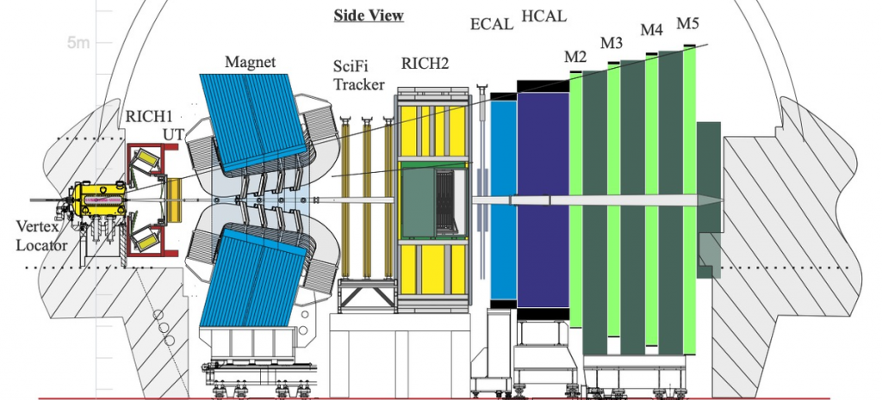
Detector
UoL →
Vertex Locator
Particle ID
Magnet
Tracker
Particle ID
EM + Had
Calorimeters
Muon Detectors

Slide 12
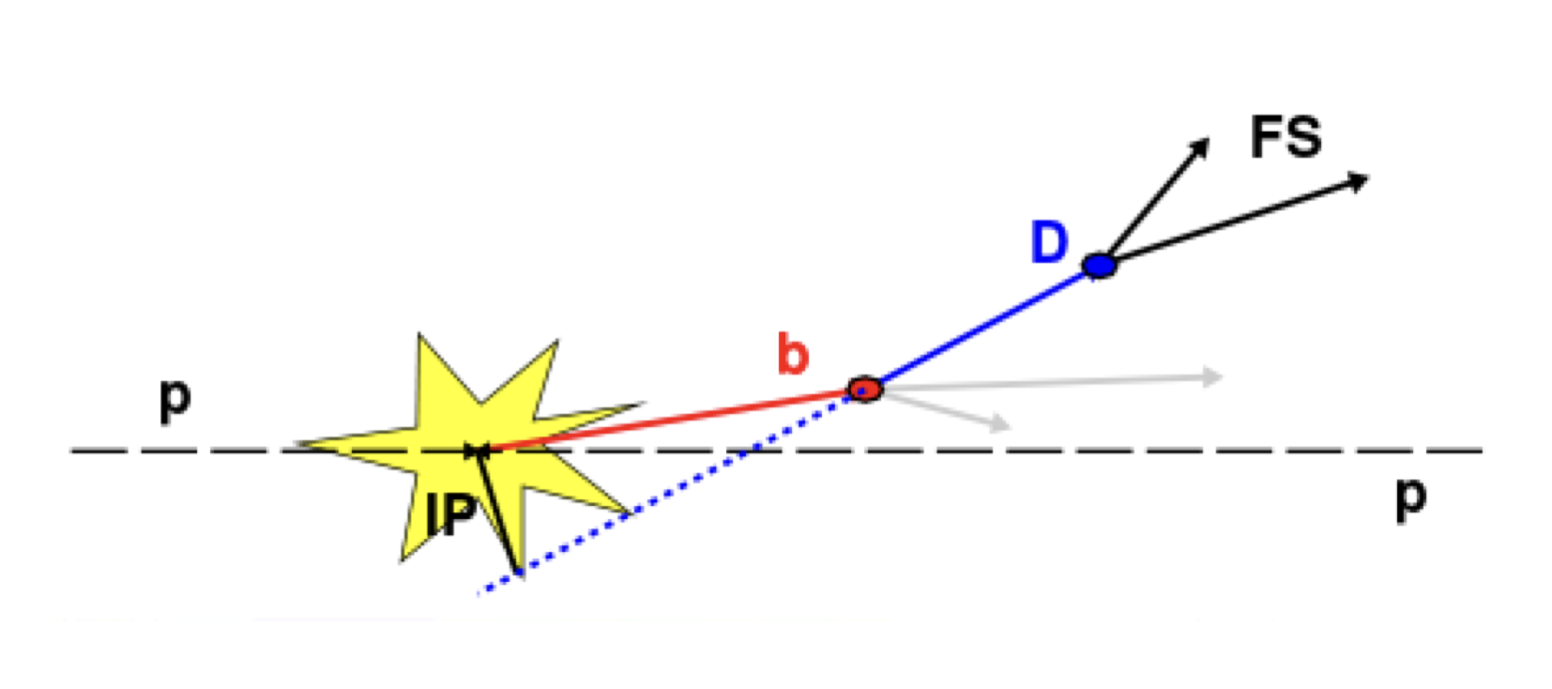
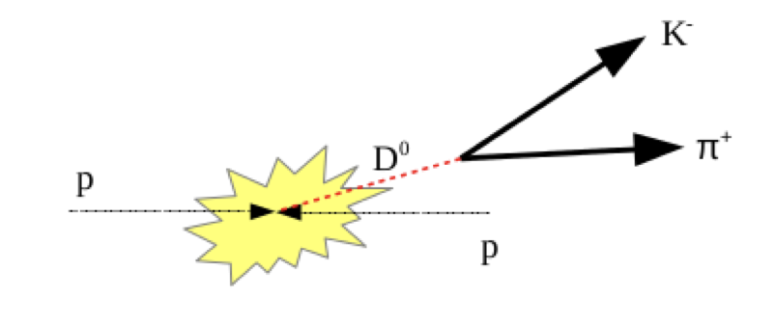
D0 → Kπ
Impact parameter

Slide 13
Safety and Practical Info

Slide 14

Safety
Follow instructions from the demonstrators
  At all times
Do not take bags or coats into the PC class or labs
  Leave them in the lockers provided at lunch
  Collect them before we go to the video conference
In case a fire alarm sounds
  Stop what you are doing immediately
  Exit through the nearest exit
  Once outside, wait at the assembly points
If you have questions at any point
  Please ask a member of UoL staff
Building specific details on subsequent slides …

Slide 15

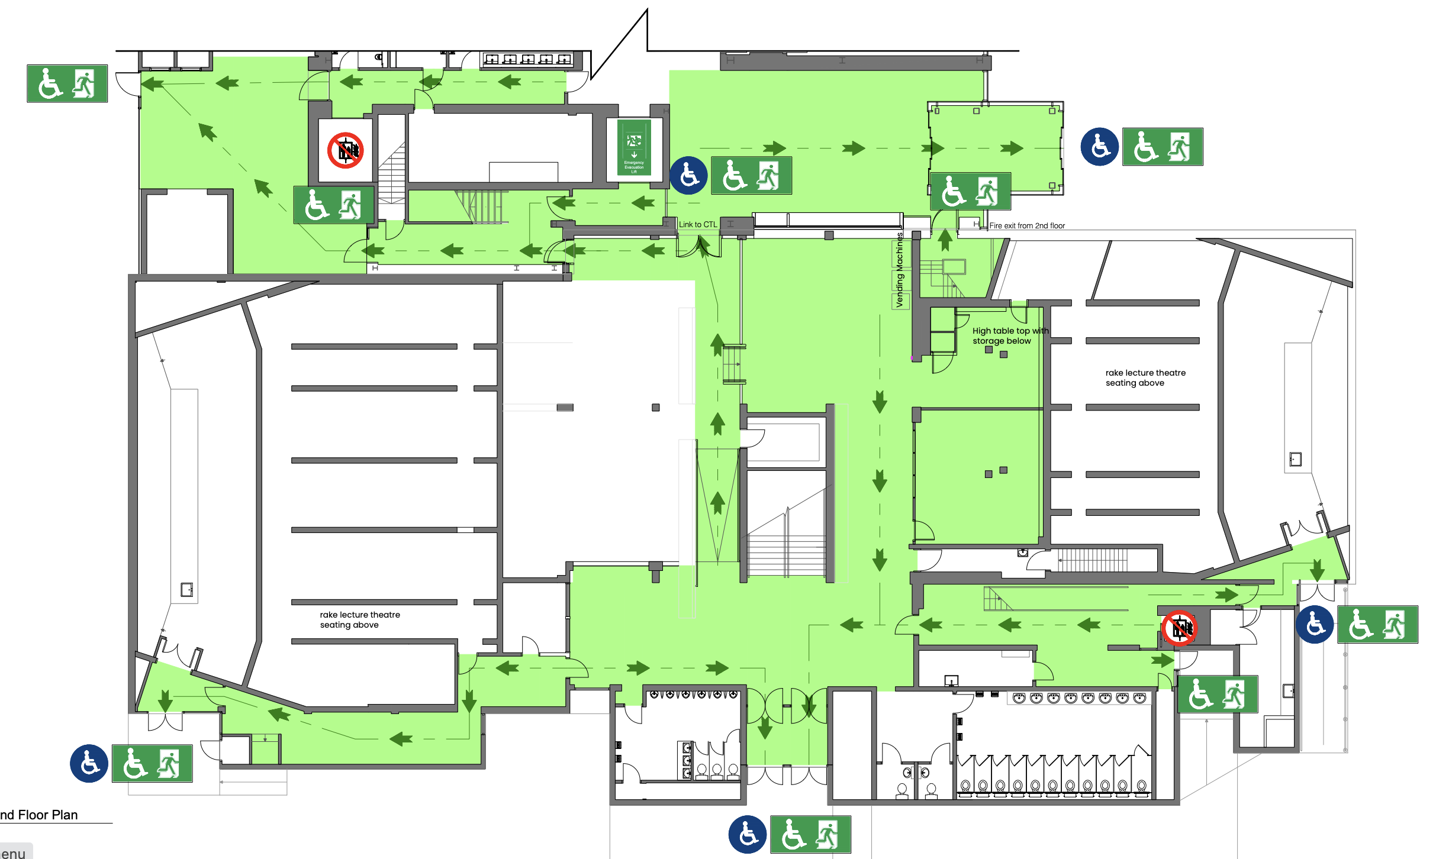
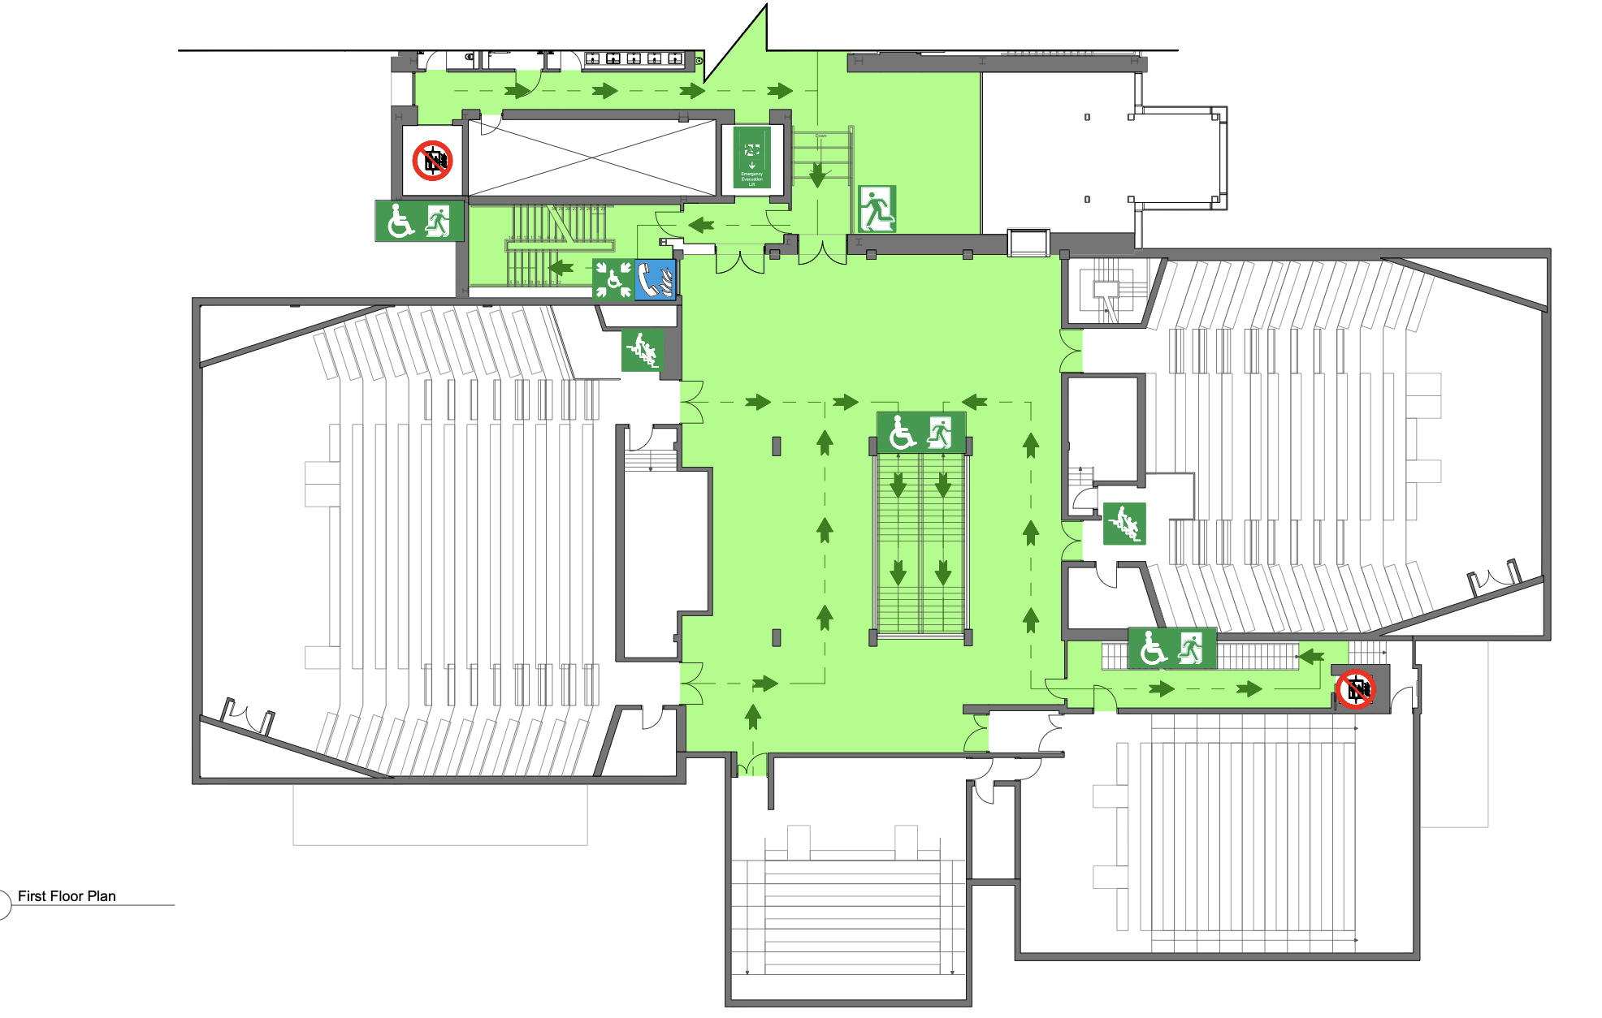


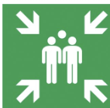
Central Teaching Hub (CTH)
Emergency Exit
  Exit through front of lecture theatre or via back and then out downstairs via main entrance or CTL
  Assembly point is outside main entrance
Toilets
  Downstairs, either side of main entrance
  This floor just through into CTL
CTL
Fire Lift
Lecture
Theatre
B
Lecture
Theatre
B
Ground Floor
First Floor

Slide 16
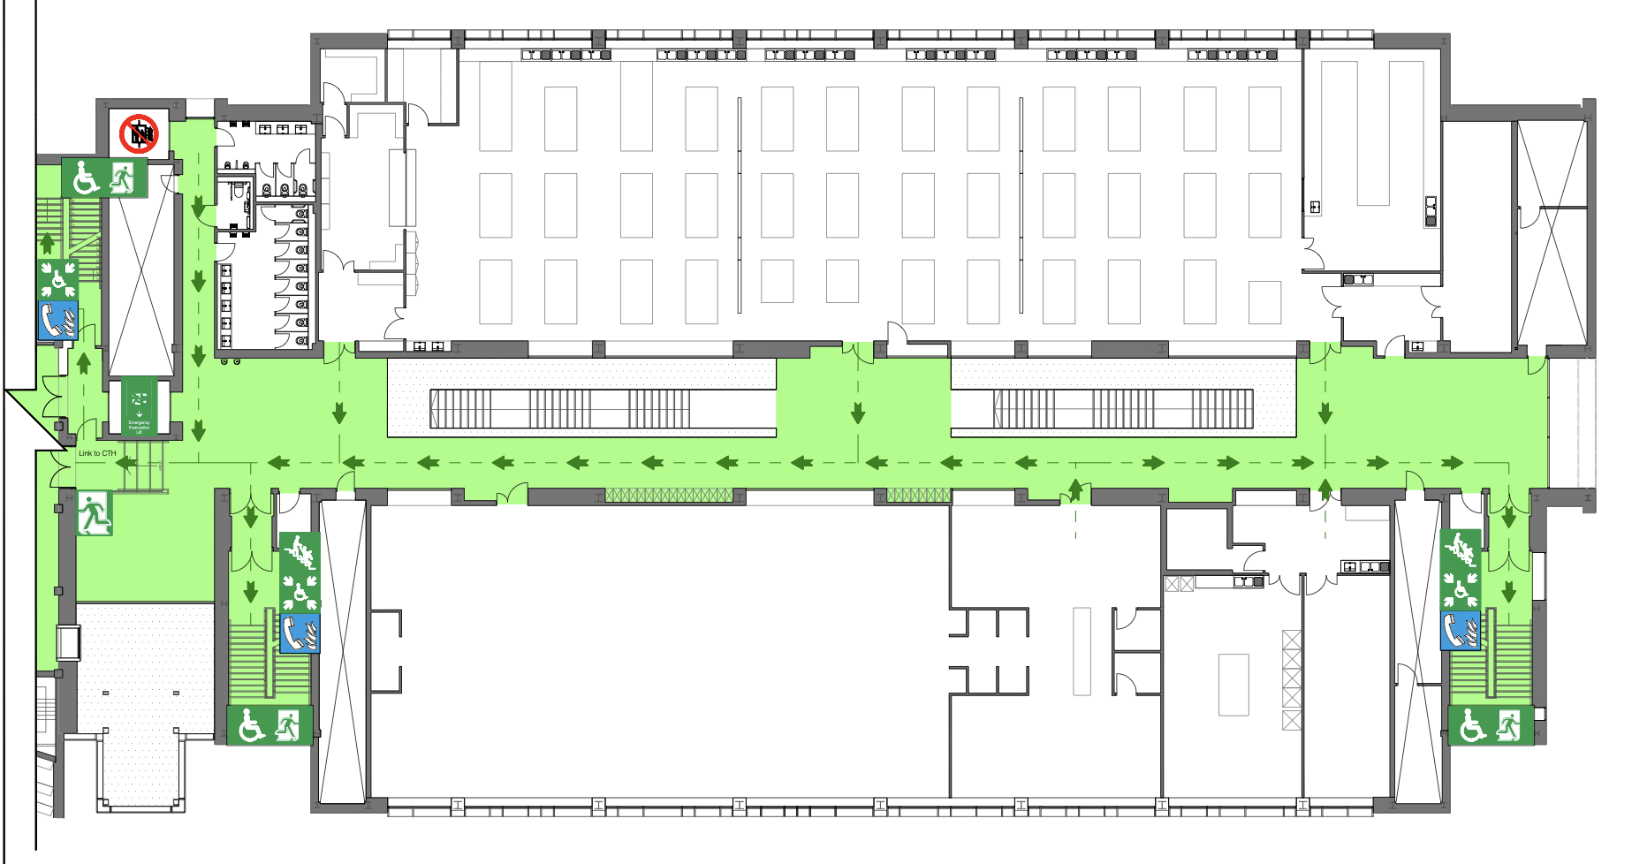
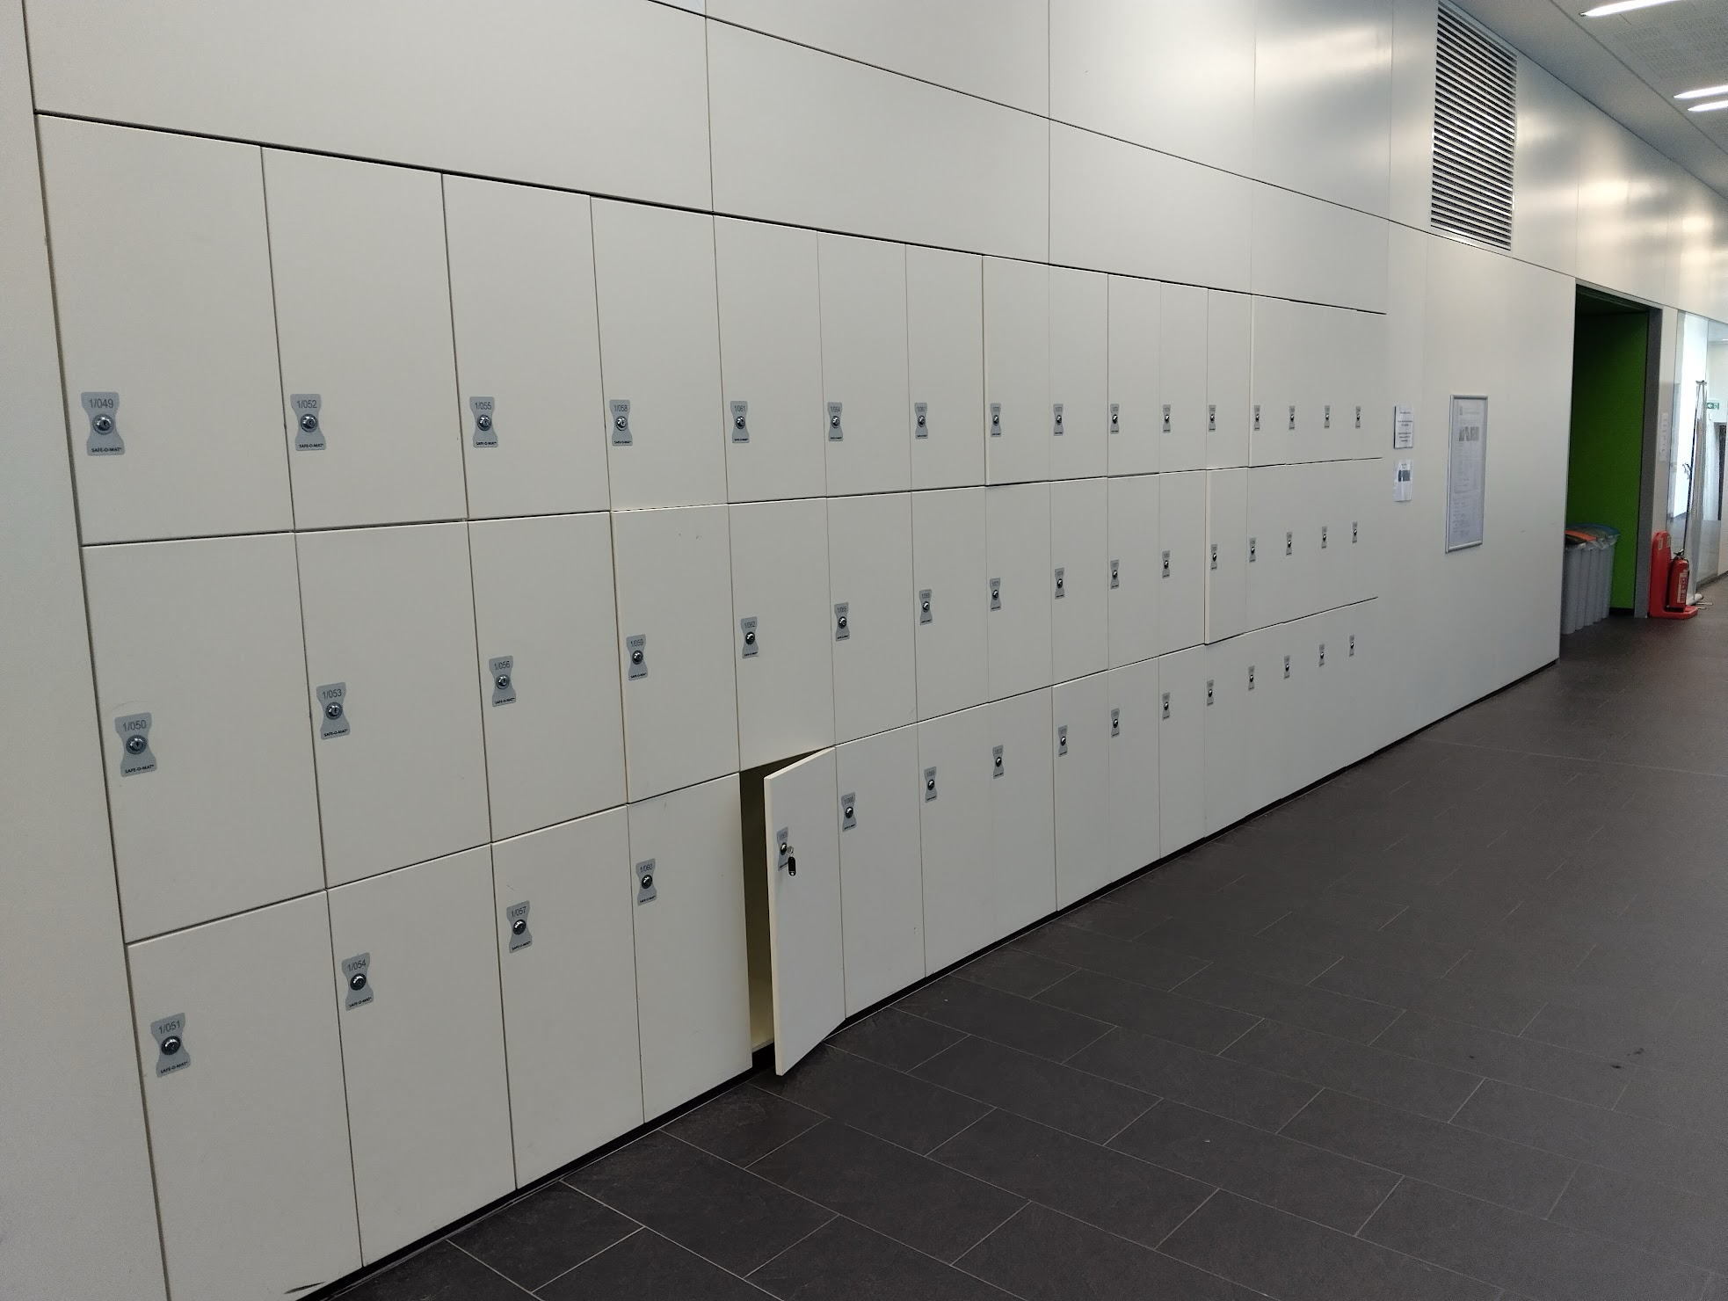
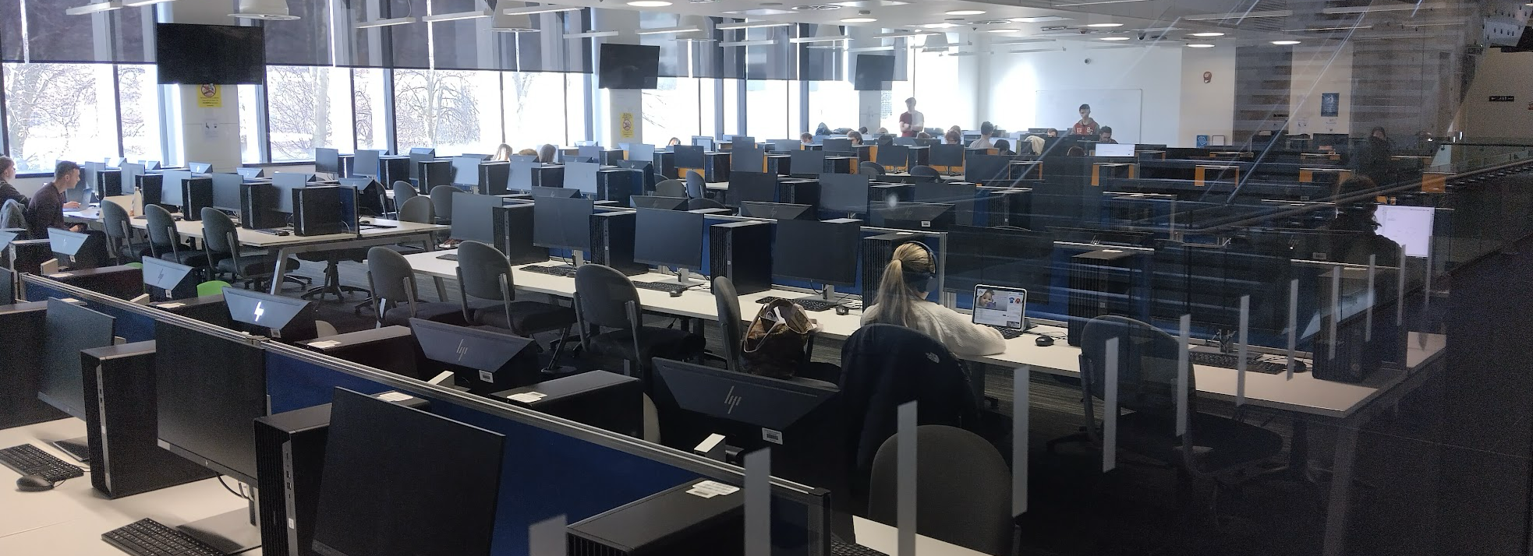
Central Teaching Lab (CTL)
Emergency Exit
  Exit through stairs either end and out corresponding exit or through to CTH
  Assembly point is outside main entrance
Toilets
  Opposite, by the lift and across from the stairs
Lockers (≈100)
  Place your bags & coats in lockers before lunch until after PC session
  Will need to share
CTH
Fire Lift
PC Teaching Centre
Don’t loose the key
First Floor

Slide 17
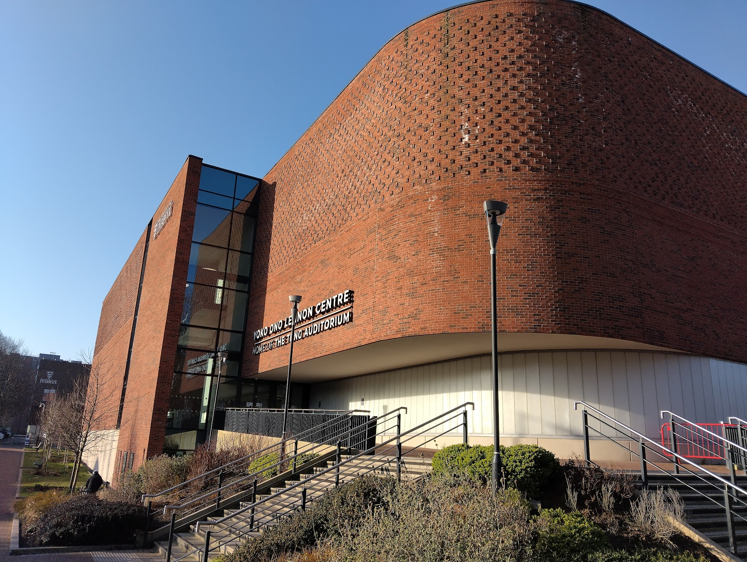
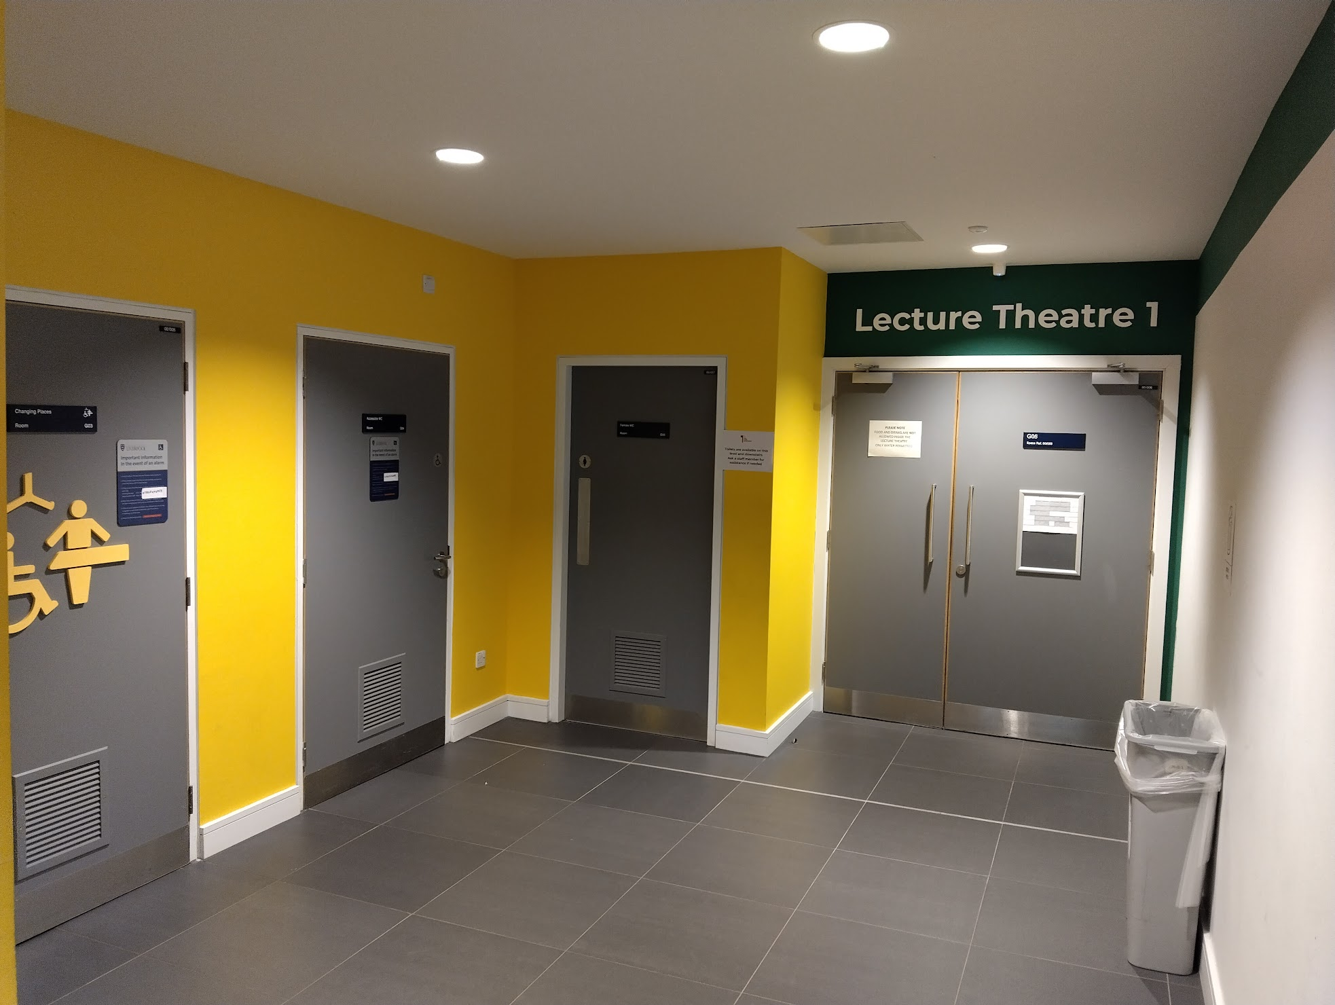
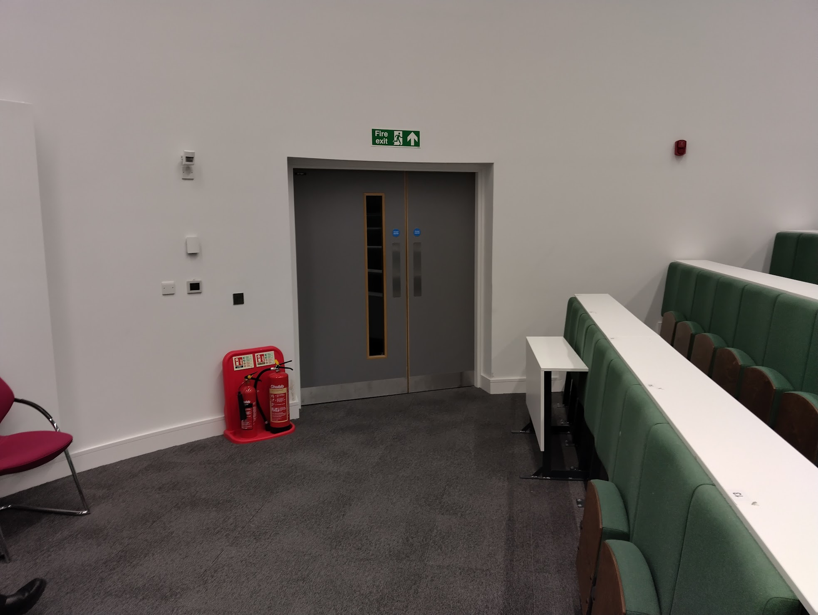
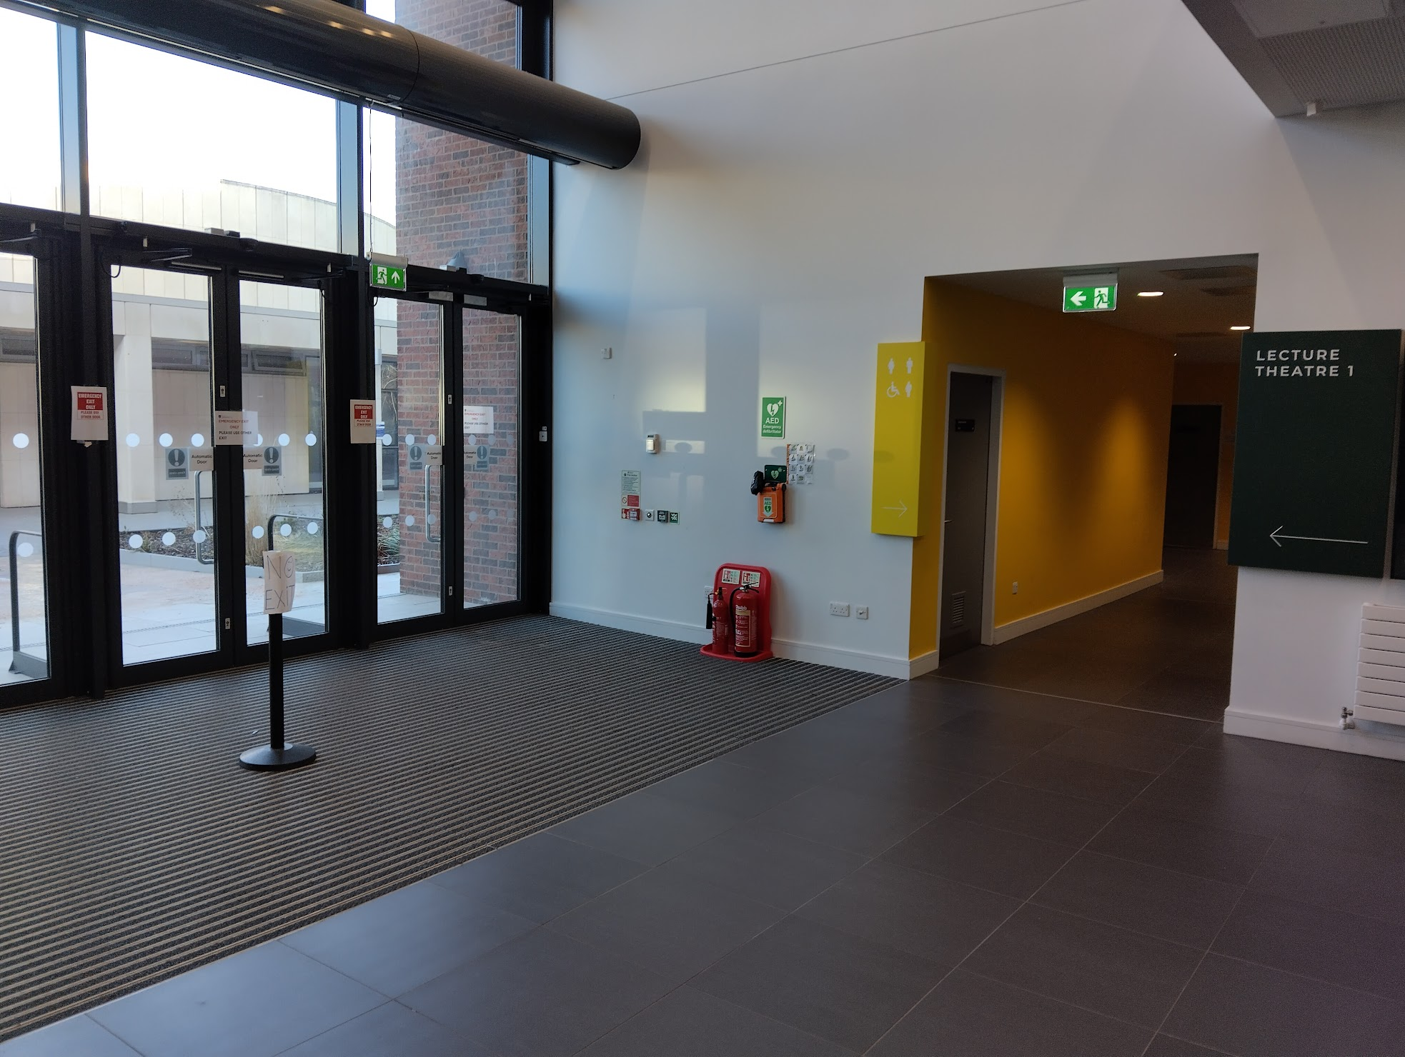
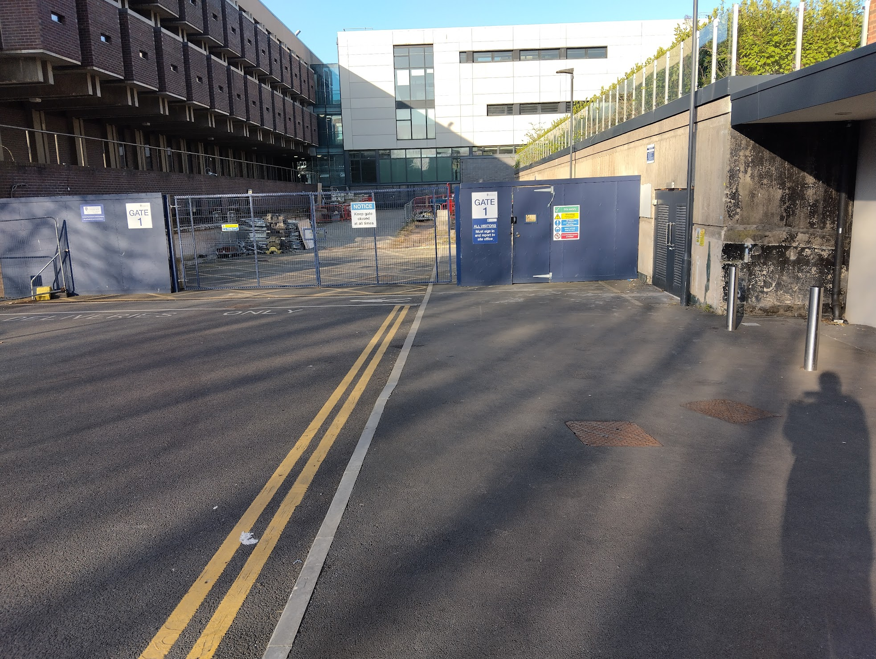
Yoko Ono Lennon Centre (YOLC)
Emergency exits
  Front of lecture theatre
  Back of lecture theatre
  and directly right
  Assembly point round
  back of building
Toilets
  Directly outside lecture theatre
Entrance

Slide 18
Code of Conduct
We will not accept behaviour which is unkind, upsetting or excludes any person or group of people.
  If what you’re doing is making someone feel uncomfortable, that is enough reason to stop doing it.
During the Masterclass you should:
  Be kind, respectful and inclusive to everyone
  Listen and respect each other’s views and ideas
  Use welcoming and inclusive language
  Treat everyone equally
Everyone has a responsibility to help keep Masterclasses safe for all. This means:
  Don’t take and share pictures, video or audio which includes students from other schools or colleges
  Adults should not share personal contact details with students under 18 (or vice versa) or connect with them on social media.
  If something needs to be shared this should go via the Masterclass organisers

