Slide 1
Energy-Related Research in the Department of Engineering
Ieuan Owen

Slide 2
The Generation and Utilisation of Energy is Central to Engineering
Across the Engineering Departments there is research that is:
Obviously Energy Related – e.g. Wind power
Less-obviously Energy Related – e.g. Gas turbine blade cooling
The purpose of this presentation is to illustrate some of these

Slide 3
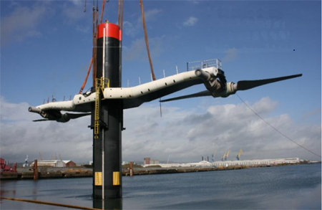
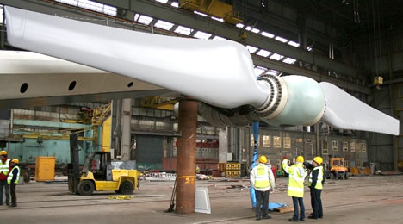
Tidal Stream Turbines (Owen)
Underwater “wind” turbines extracting energy from tidal currents
SeaGen in Strangford Narrows

Slide 4
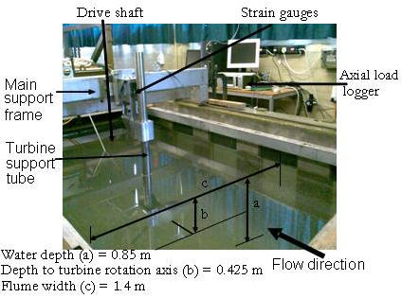
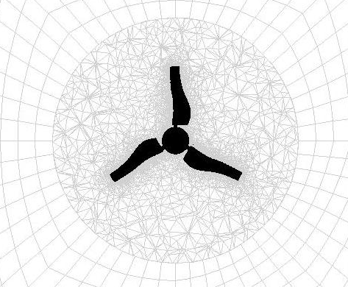
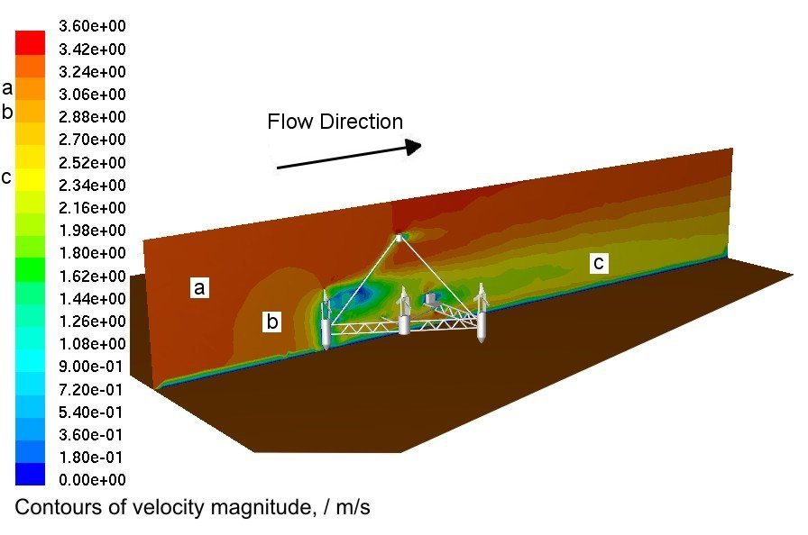
Tidal Stream Turbines

Slide 5
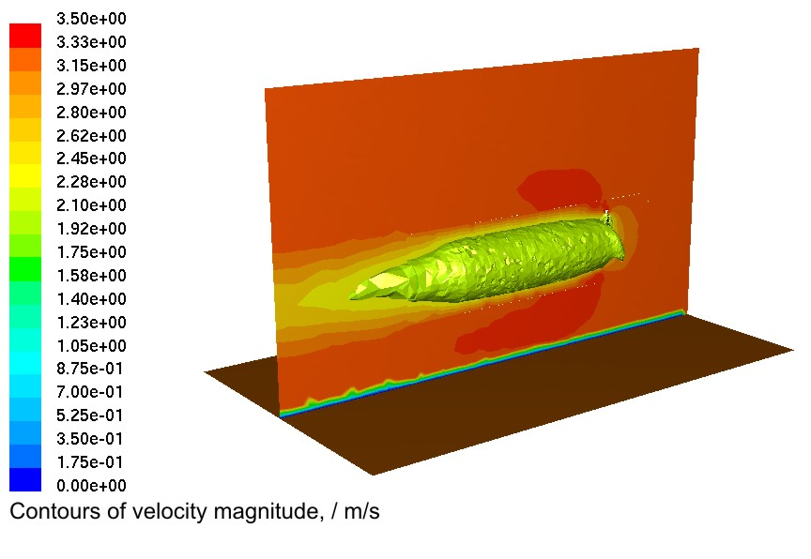
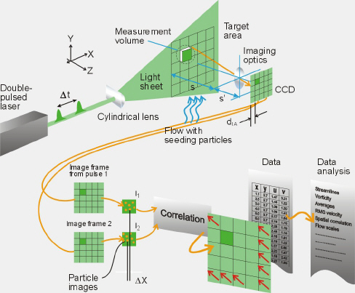
Experimental & Computational Capabilities
Computational Fluid Dynamics of unsteady flow field (Cardiff)
Potential Areas of study:
Effect of complex velocity profiles
Optimised blade geometries
Effects on seabed
Effects on marine life
Measurement of of unsteady flow field by Particle Imaging Velocimetry

Slide 6
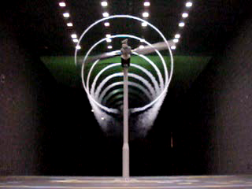
Wind Turbines (Barakos & Ouyang)
Computational modelling of aerodynamics & structural vibration
Computer Modelling
(Barakos, Liverpool)
Wind Tunnel Testing
NASA Ames

Slide 7
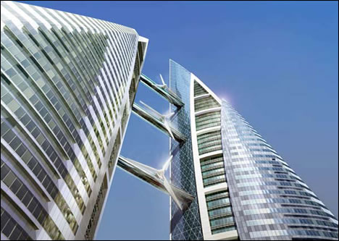
Wind Turbines

Slide 8
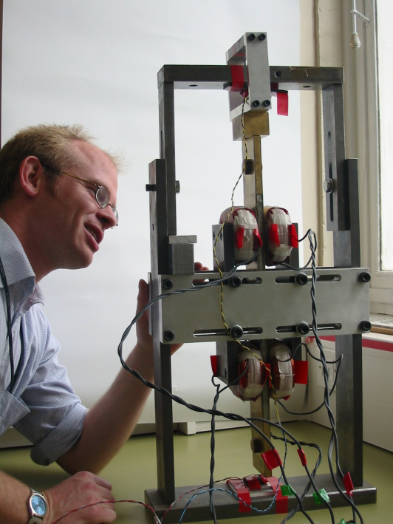
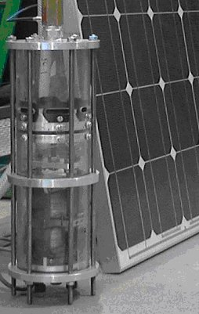
Design for Sustainable Development
Design of “Appropriate Technology”
  Relationship between Sustainable Development, “Appropriate Technology” and the UN “Millennium Development Goals”.
  Novel “Appropriate” water pumps (solar powered) for use in developing countries

Slide 9
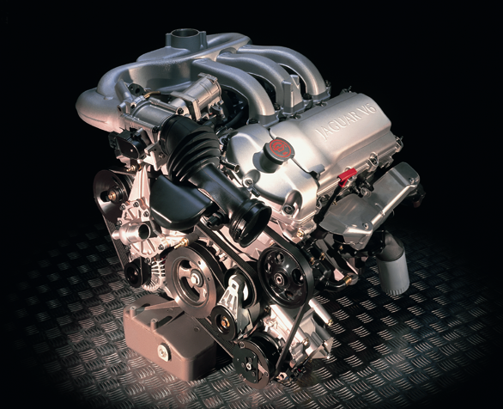
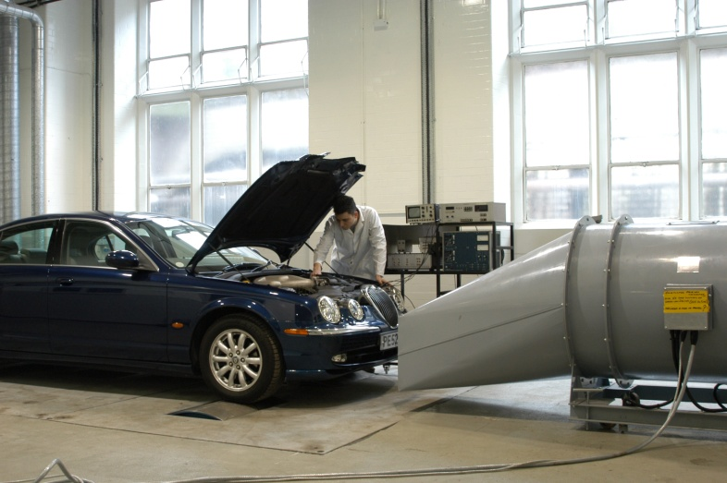
Automotive (Shenton)
Engine testbed
Engine modelling
Laser ignition
Rolling Road Dynamometer
Simulated road testing

Slide 10
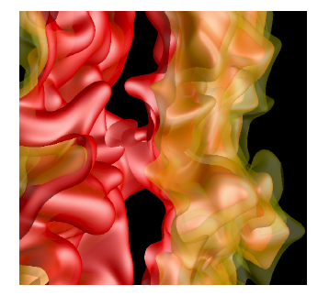
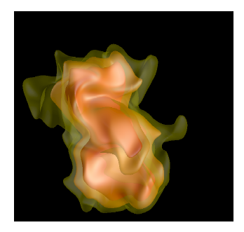
Combustion Modelling (Chakraborty)
Statistically planar flame
Turbulent flame kernel
Direct Numerical Simulation (DNS) of turbulent combustion
Hydrogen blending

Slide 11
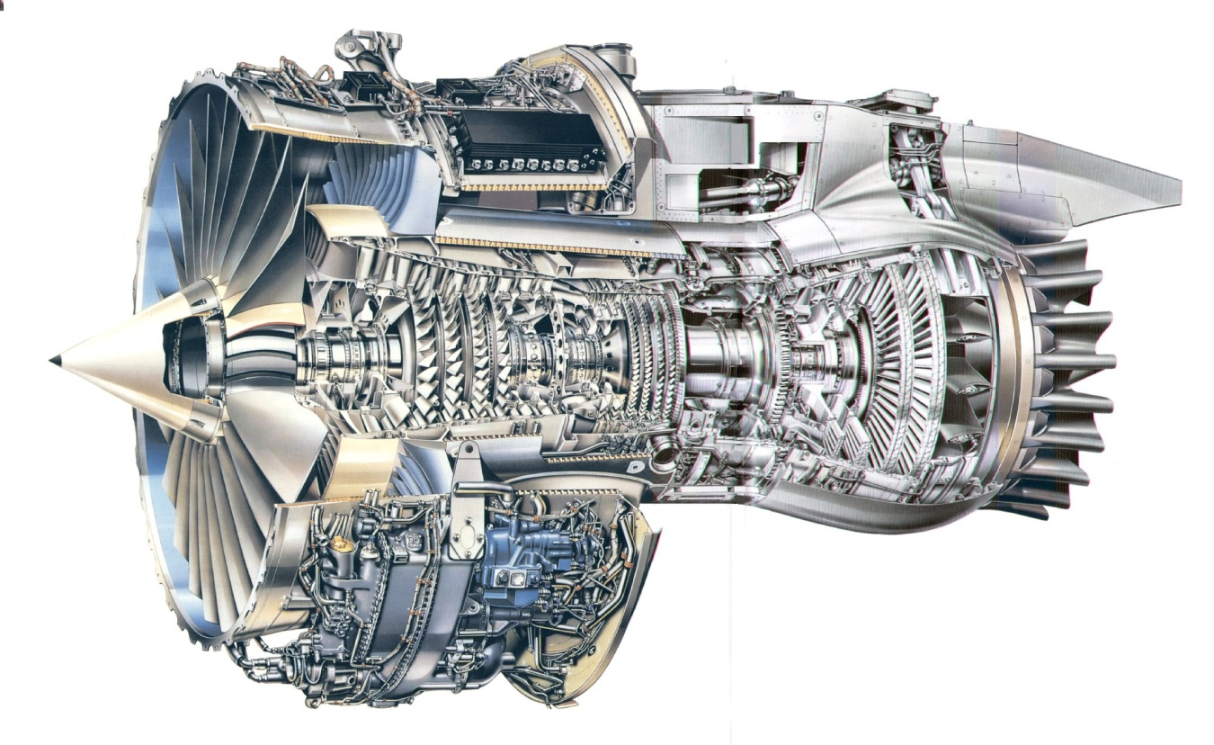
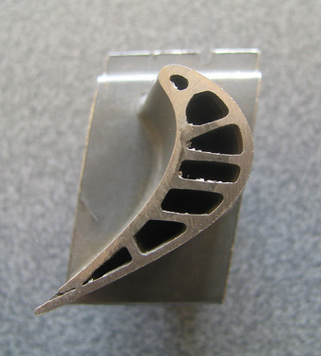
Fundamentals of Gas Turbine
Blade Cooling (Johnson)

Slide 12
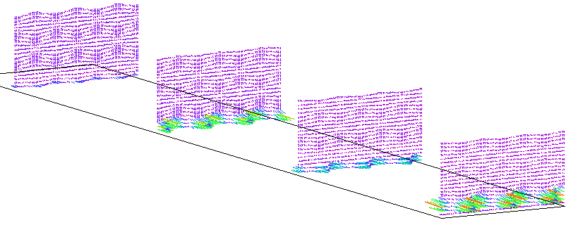
Fundamentals of Gas Turbine
Blade Cooling
Planes normal to flow direction
Flow

Slide 13
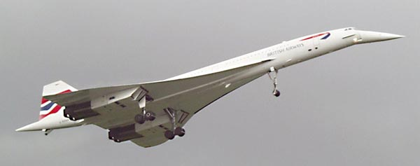
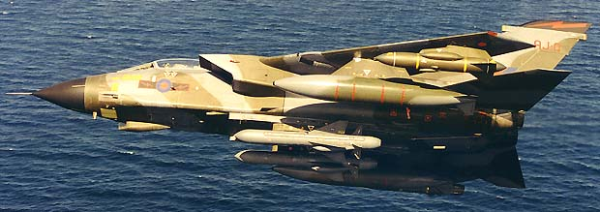
Adaptive Aeroelastic Structures
(Cooper)
Changing aircraft shape in flight to reduce drag and hence conserve fuel

Slide 14
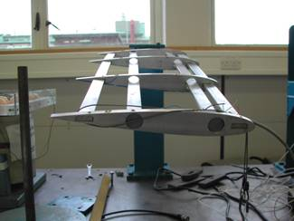
Rotating Spar Concept
Change orientation of spars.
Beams in horizontal position
    stiffness minimum
Beams in vertical position
    stiffness maximum
Use pairs of spars to control bending and torsion
High stiffness
Low stiffness

Slide 15
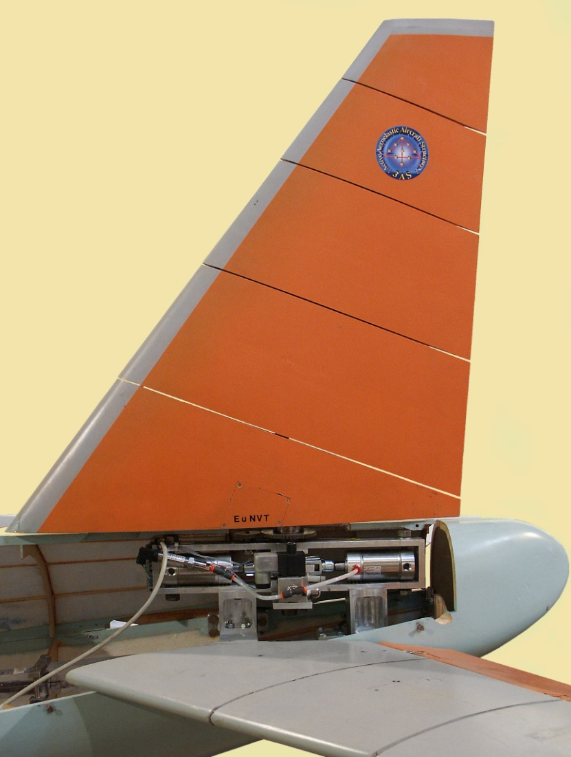
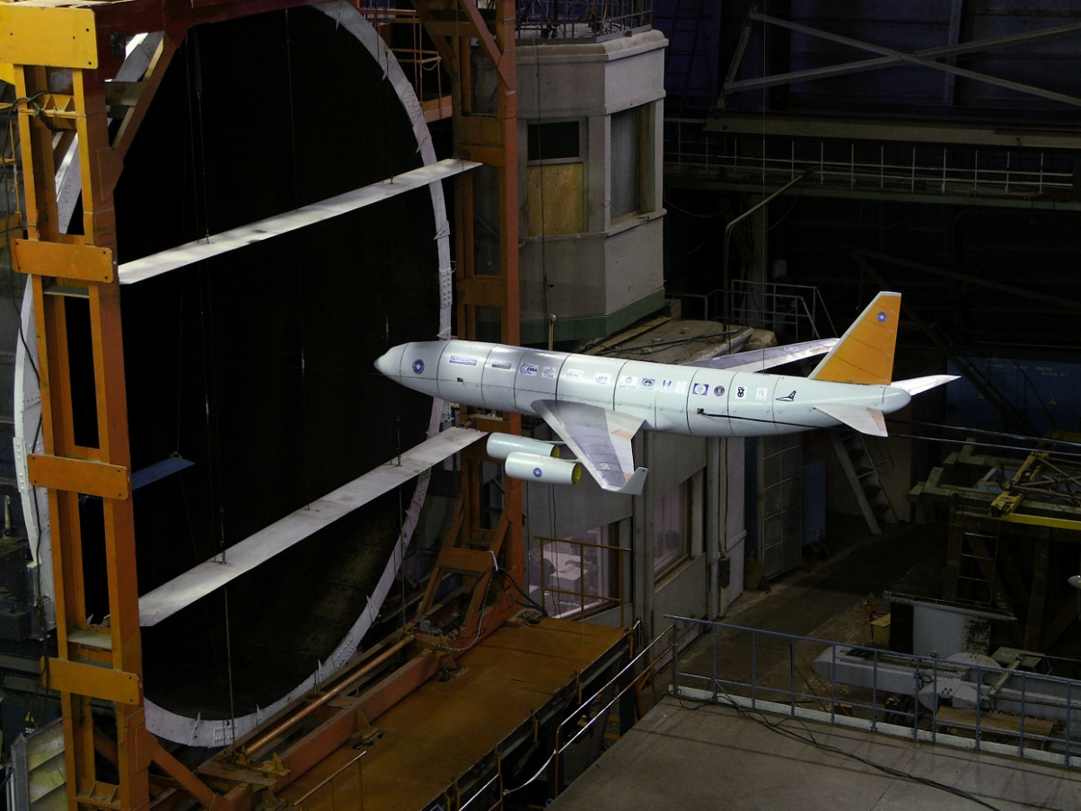
Adaptive Fin on EuRAM Model

Slide 16
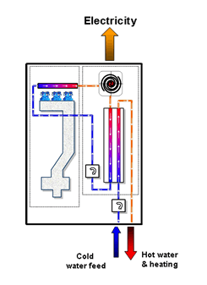
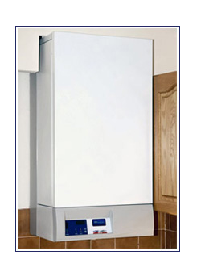
Domestic Combined Heat & Power (Owen - KTP)

Slide 17
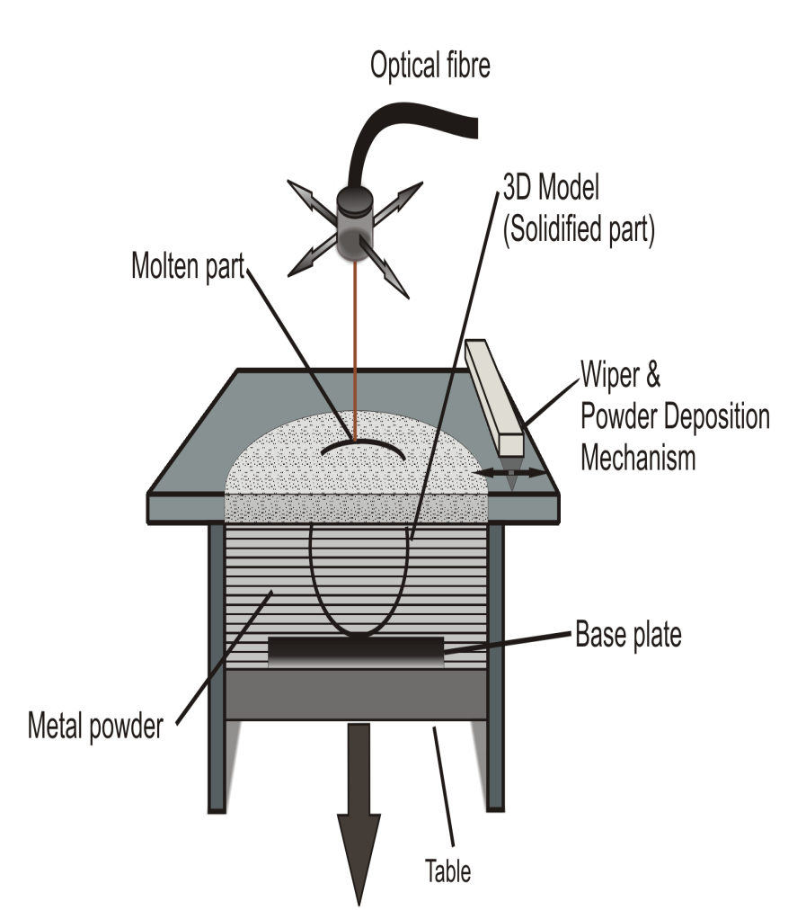
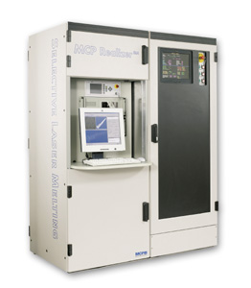
Selective Laser Manufacturing for Heat Transfer Applications
(Owen & Sutclife)

Slide 18
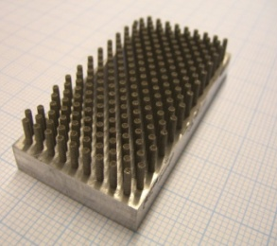
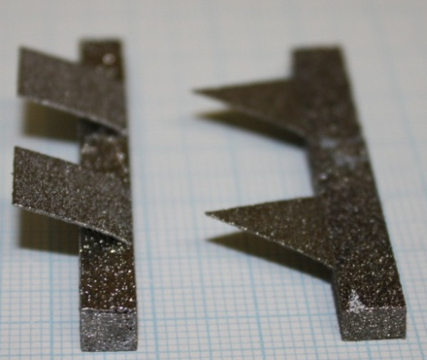
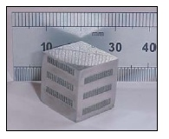
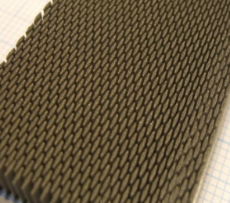
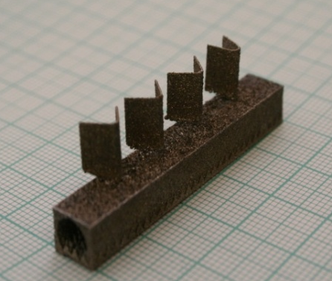
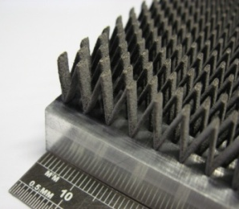
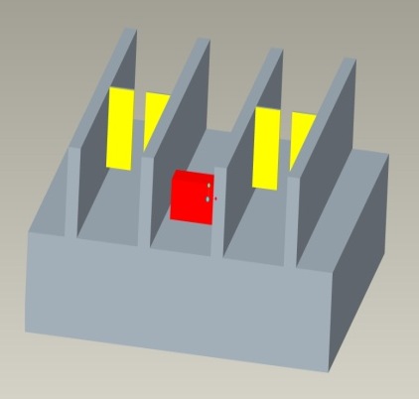
Complex Heat Sinks
Active surfaces using Shape Memory Alloys
Micro Heat
Exchangers

Slide 19
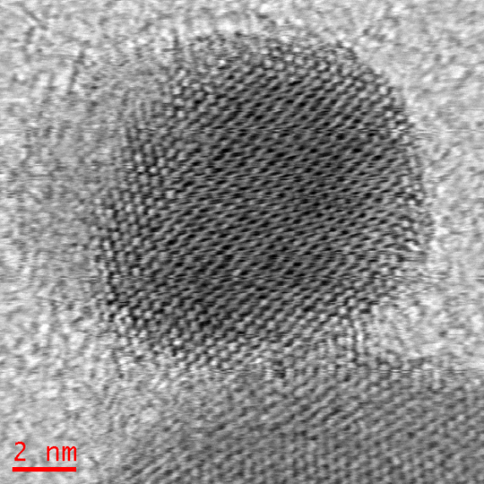
High Temperature Materials (Tatlock)
Oxide Dispersion Strengthening
Creep resistance of ferritic materials for high temperature Heat Exchangers
Non-radiation first walls for fusion reactors
Removal or fixing grain boundaries by very hard oxide nanoparticles
Microstructural control
of ODS-FeCrAl alloys

Slide 20
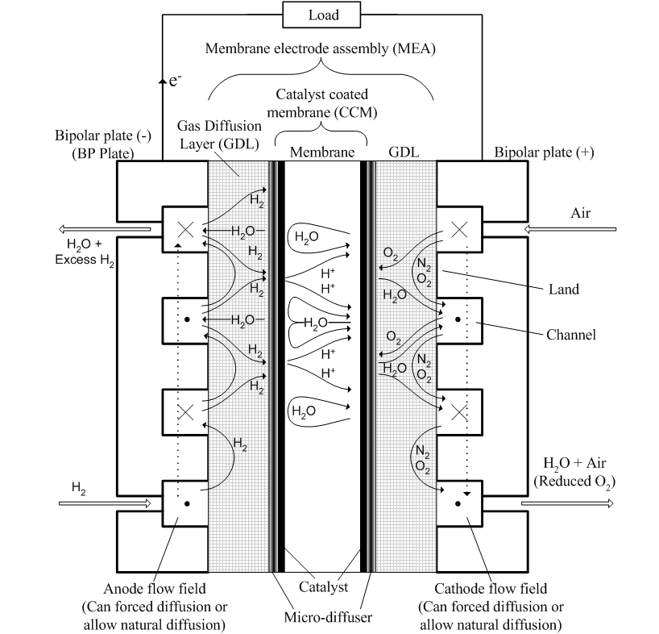
Gas and Water Flows Through
Fuel Cells (Zhang)
1
Fuel (hydrogen) flows in to the catalyst layer through a porous layer to oxide to into photons and electrons.

Slide 21
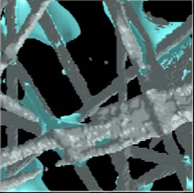
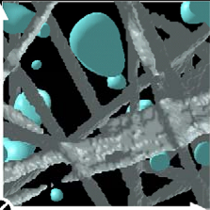
Impact of hydrophobicity on behaviour of liquid water in fuel cells
Hydrophobic
Hydrophilic

Slide 22
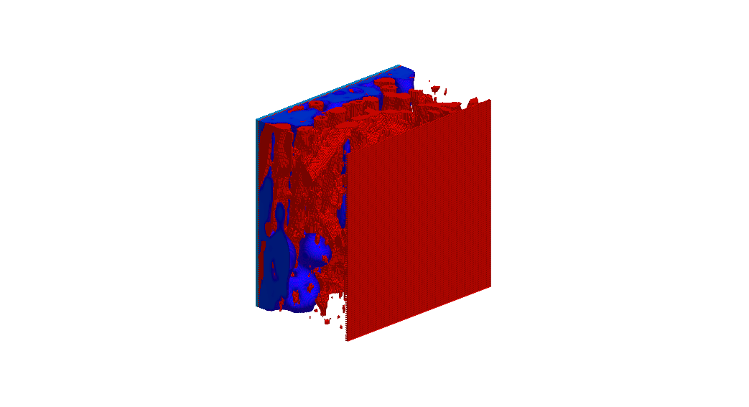
Water flow in a weak hydrophobic porous layer

Slide 23
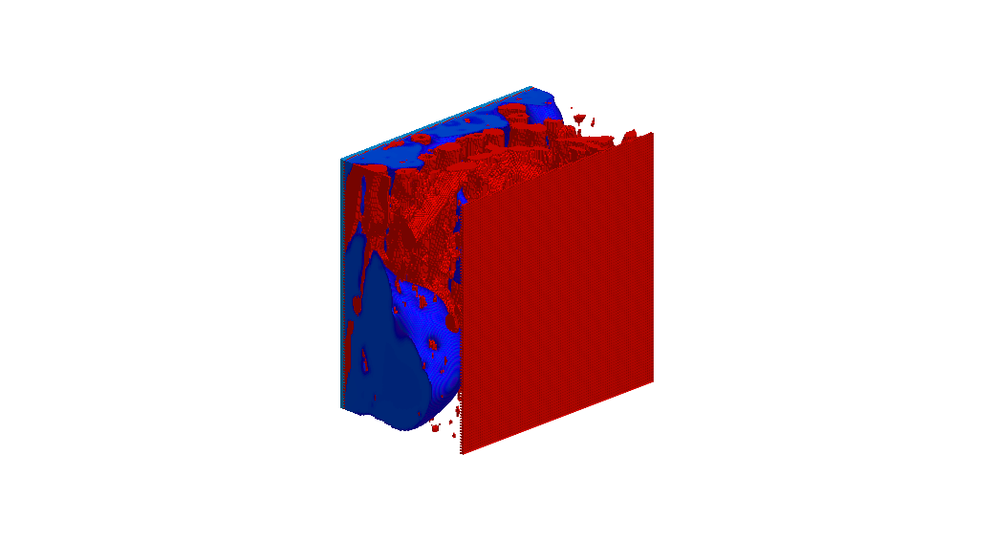
Water flow in a weak hydrophobic porous layer

Slide 24
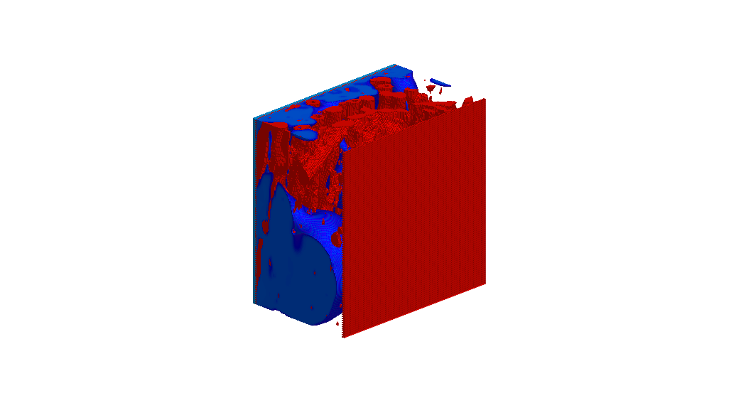
Water flow in a weak hydrophobic porous layer

Slide 25
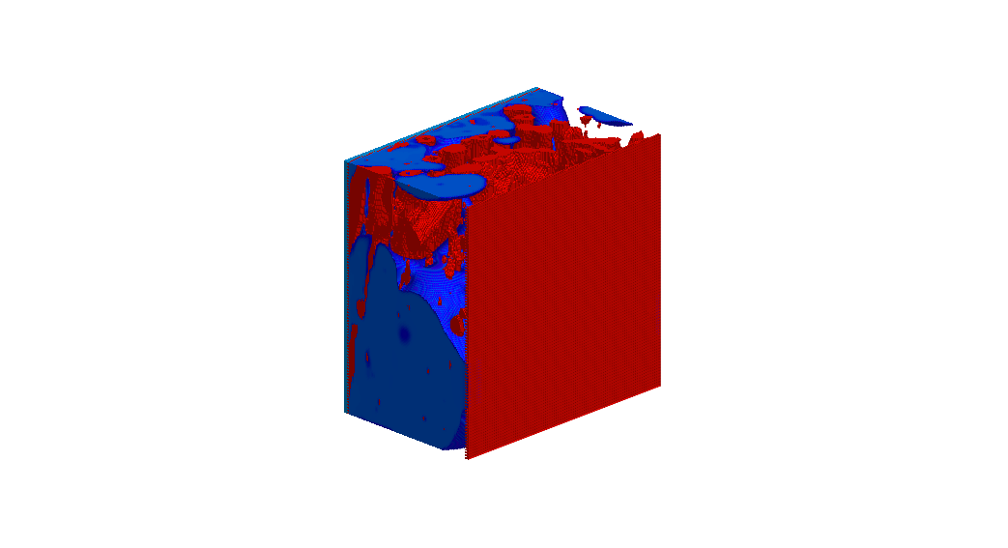
Water flow in a weak hydrophobic porous layer

Slide 26
The gas flow paths through a part of a fuel cell
Gas flow paths
ΔC
3D image from x-ray tomography
Pressure distribution and flow in path

Slide 27
Energy-Related Research in the Department of Engineering
Ieuan Owen

