Slide 1
Liverpool Energy Day
Introduction.
How much energy do we and will we need in the UK?
How can we generate energy without the CO₂?
“Renewable” resources.
Non-renewable energy.
Summary.
Questions for today:
What are we doing at Liverpool University?
What do we want to do in research and teaching?

Slide 2
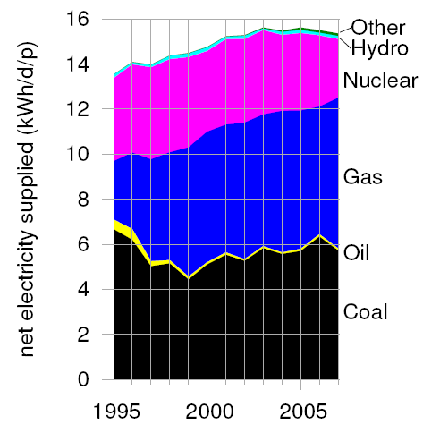
How much energy do we need?
And how do we generate it?
Total current UK electrical power consumption about 40 GW.
UK population about 60 x 10⁶.
Power use is about 670 W per person...
...or about 58 MJ per person per day.
Relate to “everyday” units:
1 kWh = 3.6 MJ, costs about 10p.
1 kWh/d = 40 W.
Power per person of 670 W = 17 kWh/d.
Current energy supply:
40 GW

Slide 3
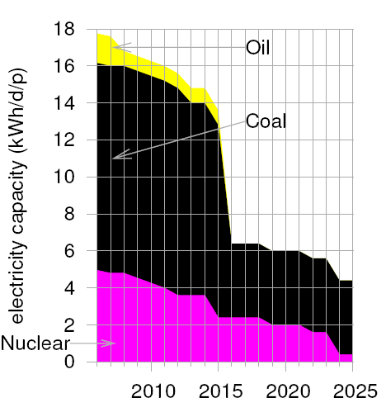
Why do we need to do something new?
Projection of electricity capacity using current resources:
Large shortfall!
There is still lots of coal, so why not burn more of it?
Imja glacier, 1950s...
...and 2007; retreating 74 m per year.
40 GW
Study by energy company EdF.

Slide 4
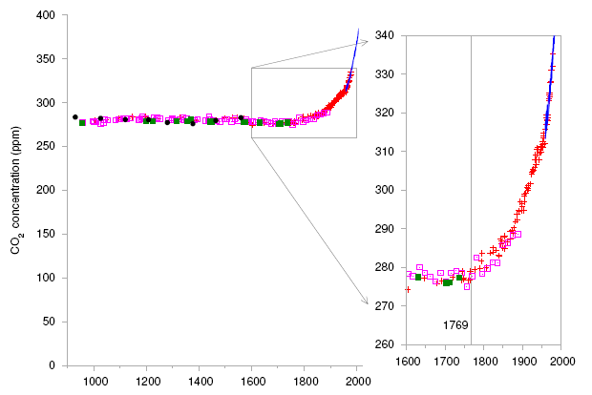
Why do we need to do something new?
“Manmade” CO₂ is causing potentially catastrophic changes in the climate.
Because of global warming, we need electric cars, trains, heating... i.e. more electricity, not less...
...and we need to generate it without the CO₂!
Watt patented steam engine
Early measurements from ice cores.
More recent results, direct measurements from Hawaii.

Slide 5
How much energy will we need?
How can we get it without the CO₂?
In the UK, we now use roughly:
1.6 kW per person on transport.
1.6 kW per person on heating.
0.7 kW per person “electricity” – i.e. computers, fridges, TVs...
Assume in future use electricity for most transport, more efficient than current systems, so require 0.8 kW/p...
...and that we insulate buildings better, use heat pumps etc. so heating requirements 0.8 kW/p.
Total electricity demand then about 140 GW.
(C.f. current figure of 40 GW.)
Renewable* energy resources:
Solar.
Biomass.
Wind.
Waves.
Tides.
Hydroelectric.
Non-renewable energy:
Fusion.
“Clean” coal.
Fission.
Naturally replenished in a relatively short period of time.

Slide 6
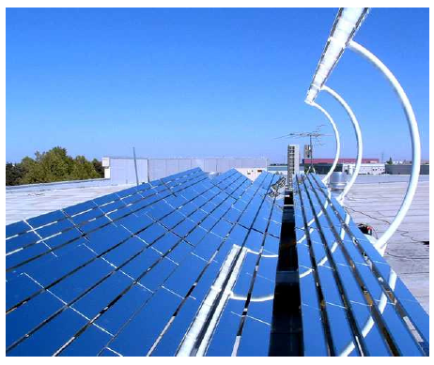
Solar power and biomass
Solar constant 1.4 kW/m².
At ground level ~ 1 kW/m².
Correct for latitude, peak ~ 600 W/m²...to average ~ 200 W/m²...
...and for UK weather ~ 100 W/m².
Supplying 140 GW with solar cells of efficiency ~10% requires area of 14 × 10⁹ m².
This is 6% of land area of UK...
...and more than 100 times the photovoltaic generating capacity of the entire world.
Feasible for ~ 10% of UK needs?
Interesting globally: small proportion of world’s deserts could supply world’s energy needs.
Efficiency of conversion of solar energy to biomass about 1%...
...and then still have to convert to electricity.

Slide 7
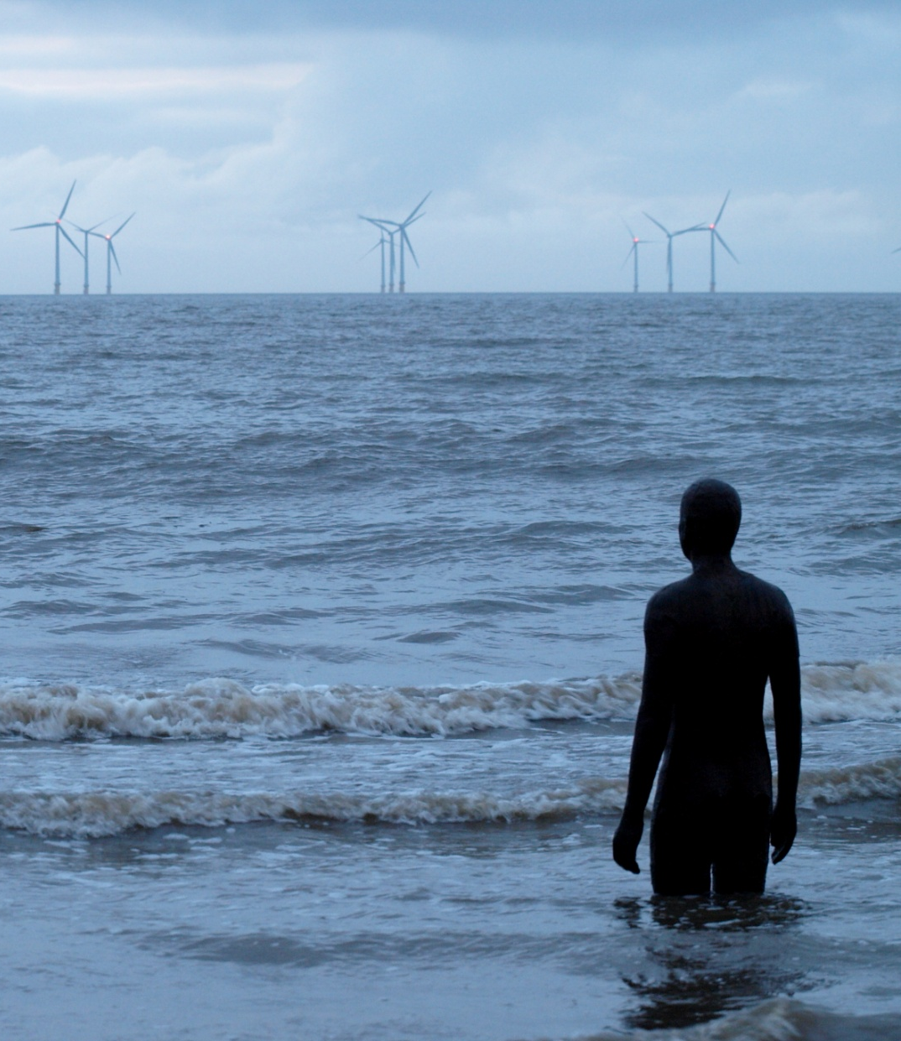
Wind
Average UK wind speed ~ 6 ms⁻².
½ mv², efficiency, max. packing, give wind power density of about 2 W/m².
Need 30% of UK (70 × 10⁹ m², i.e. Scotland) to provide 140 GW.
Off shore, wind speed higher, power density ~ 3 W/m².
Need turbines on ~ 45 × 10⁹ m².
Shallow (10...25 m depth) offshore sites available about 20 000 km²...
...but many competing uses and technical problems.
Provide perhaps 10% of UK’s future electricity?

Slide 8
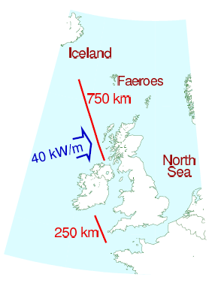
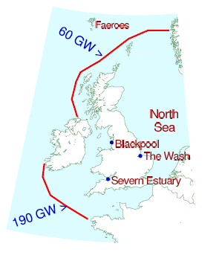
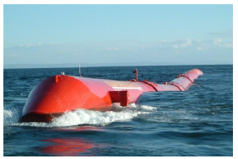
Waves
Tides
Energy in waves hitting UK ~ 40 GW.
Difficult to use efficiently, many competing interests.
Perhaps provide about 5% of UK’s future electrical energy?
Lots of energy in principle (~250 GW).
How can it be used efficiently?
Competing interests?
Perhaps 5% of UK’s future electricity?
Pelamis wave energy collector

Slide 9
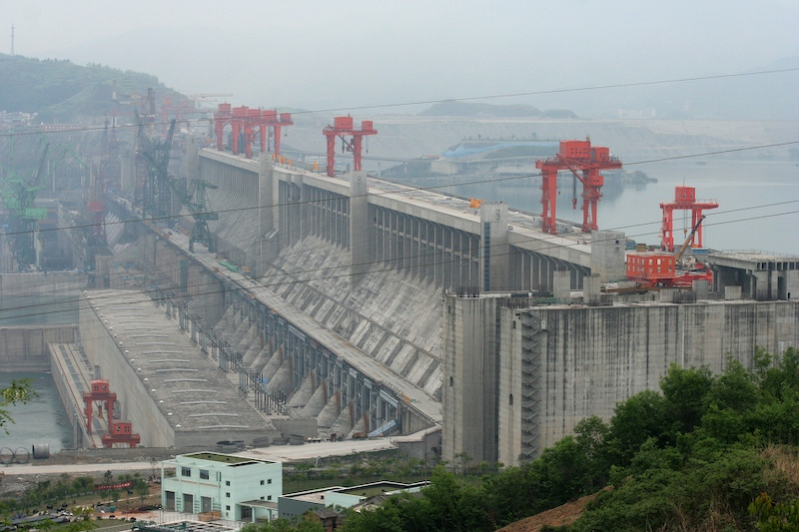
Hydroelectric
Renewable balance
UK power density ~ 0.1 W/m², so cannot make large contribution.
Largest hydro-electric power station is Three Gorges Damn on Yangtse, projected output 20 GW.
Displaced ~ 1.2 × 10⁶ people, caused, and will cause, ecological problems.
Tally for UK so far:
We are still missing the lion’s share...
...and the UK is particularly well off for wind, wave and tidal power!
What about “clean” coal, nuclear fission and nuclear fusion?
Energy source | Prop. of electricity
Solar | 10%
Wind | 10%
Wave | 5%
Tidal | 5%
Other | 5%
Total | 35%

Slide 10
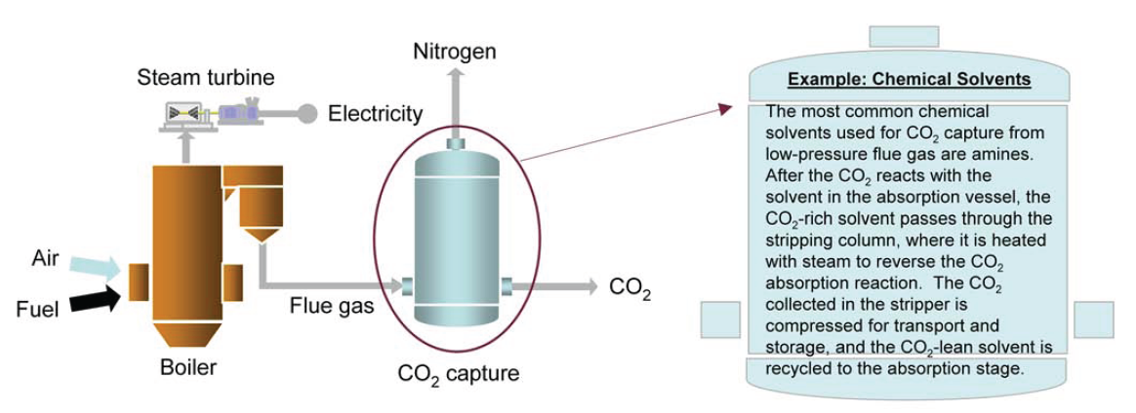
“Clean” coal
Burn coal, capture ~ 90% of CO², permanently store in e.g. depleted oil reservoirs.
Efficiency of power production decreases from ~ 40% to ~ 30%.
UK coal reserves ~ 250 years at current rate of consumption.
Globally very important (China building one new power station every week).
Use technology for cement factories...

Slide 11
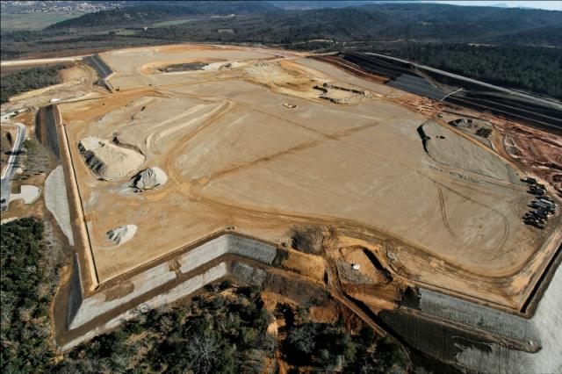
Nuclear fission and fusion
Fission currently provides ~ 20% of UK electrical energy.
But many (perceived) problems:
Safety:
Chernobyl.
Three Mile Island.
Waste:
Actinides with half lives of many thousands of years.
Proliferation.
Uranium reserves uncertain. (Extract from oceans? Use fast breeder reactors?).
New approaches needed: ADSR and thorium?
Fusion under investigation by ITER.
Construction until 2017, first deuterium-tritium plasma 2026?

Slide 12
Summary
Producing enough electricity without causing climate change is a challenge.
Renewables can provide of UK needs (globally, solar much more).
Essential for UK and world that all feasible technologies are investigated (solar, wind, wave, tide, fission, fusion, clean coal) – some may not work!

Slide 13
Energy at Liverpool
What are we doing already?
What do we want to do in the future?
How can we get funding for energy research?
Is there a market for a taught post-graduate programme on energy and the environment?
Should we provide one?
How do we develop and maintain contacts and collaborations:
Within the University?
With other researchers and institutes?
Other issues?

