Slide 1
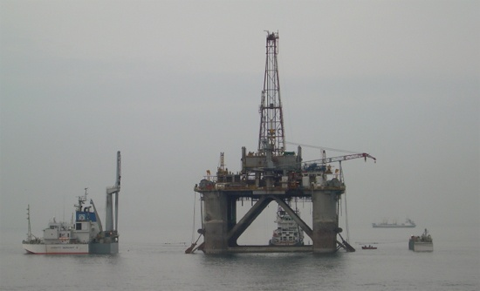
Hydrocarbons: getting the last drops out and putting the CO2 back in
Stephen Flint and colleagues
Earth and Ocean Sciences
First UoL Energy day, June 23rd 2009

Slide 2
(1) Oil and gas: squeezing out the last drop
UoL is world class in multi-scale geoscience approaches to this problem
Evidence
  -3 research groups running some of the largest and most global industrial consortium projects with current funding of £4M+
  -This is fundamental scientific research, published in top journals, supporting 20 PGRs and 5+ Post-Docs
  -Main competitors are Stanford, UT Austin, Rice, Bergen, Imperial

Slide 3
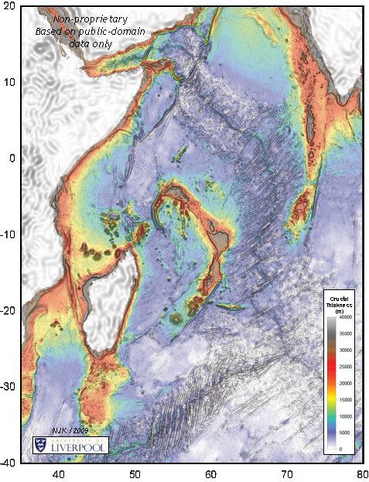
Crustal Thickness Mapping Using Satellite Gravity Inversion
Applications
Location of ocean-continent transition
Mapping micro-continents
Deep-water oil & gas exploration
Law of the Sea (UNCLOS)

Slide 4
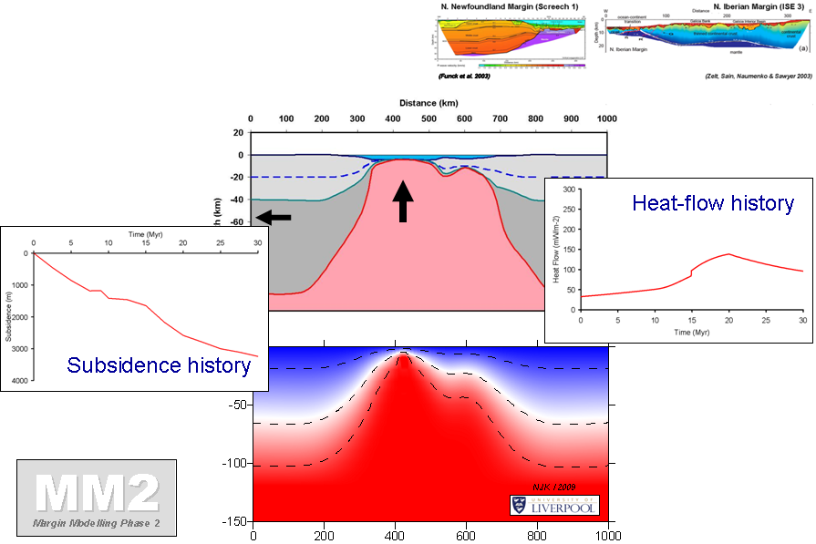
Modelling Rifted Continental Margin Formation
Applications
Ocean-continent transition location
Heat-flow history
Subsidence history
Pure-Shear + Buoyancy Induced Upwelling-Divergent Flow (IUDF)

Slide 5
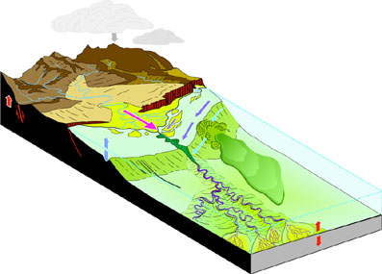
Hydrocarbon reservoirs: the journey of the sand grain
Denudation zone: weathering + erosion
Tributary
Transportational zone: sediment transfer
Flux of
sediment
Depositional zone
Source
Distributary
Sink

Slide 6
Estuary hydrodynamics and sediment transport: POL and EOS
Positive values (red) = accretion
Negative values (blue) = erosion
Areas that were found to be flood dominant still seem to be accreting, as expected (net import of sediment on shallow sand and mud flats).
One theory is that flood-dominant infilling estuaries will, at some point, switch towards ebb dominance and become net sediment exporters or attain morphological equilibrium.

Slide 7
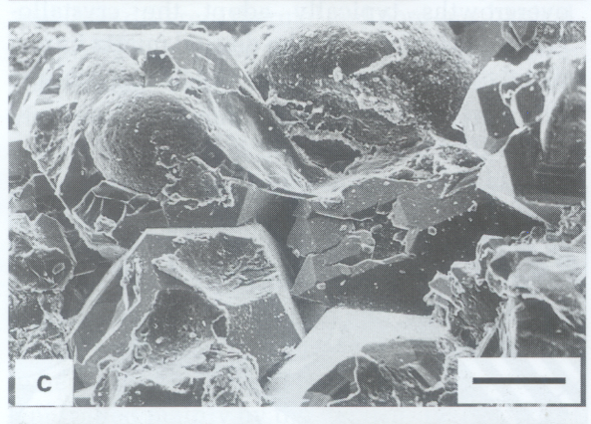
The cement that glues sand grains together
Quartz cemented sandstone at 6000m
Negligible porosity
Chlorite coats on sand grains inhibits growth of quartz cement in deeply buried sandstones (and thus preserves porosity)
Ability to predict chlorite cement distribution would be helpful: exploration and appraisal
No method, or basic understanding, available to help predict occurrence and distribution of chlorite
Chlorite cemented sandstone at 6000m
Good porosity

Slide 8
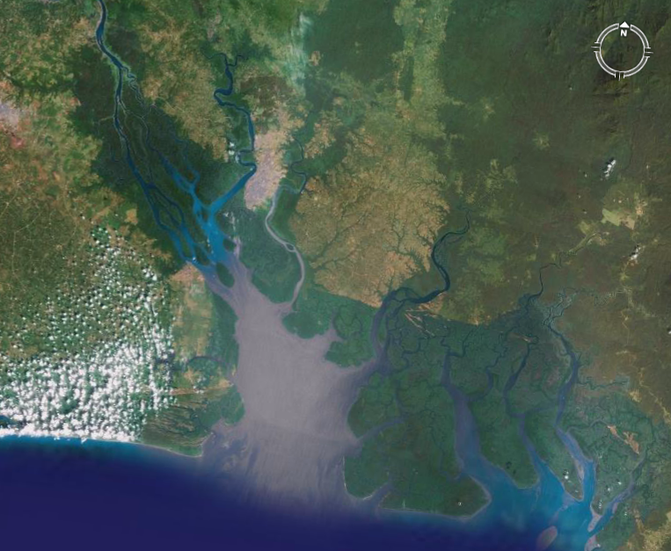
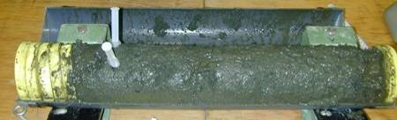
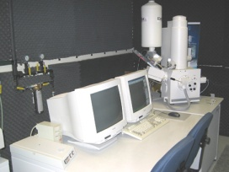
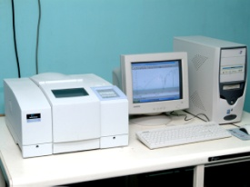
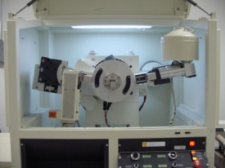
BASIC Project: Prof Richard Worden
Now clear that chlorite-precursor minerals are formed in estuarine environments, need to assess how they are distributed in modern environments.
(1) to develop an understanding of the origin and the distribution of chlorite-precursor minerals
(2) help prediction of distribution of Fe-chlorite in ancient estuarine sandstones
Sample estuaries
Take shallow cores
Analyse with SEM, XRD, infrared , petrology
Deliverables
Integrated sedimentological-, geochemical- and biological-based understanding of the origin of Fe-rich clays in fluvio-deltaic sands,
Maps of Fe-rich clay (chlorite-precursor) distribution relative to the sedimentary environment,
Data on chlorite-precursor distribution on a scale appropriate to reservoir simulator grid blocks,
A way of helping to improve the prediction of positive reservoir quality anomalies in deeply buried sandstones.

Slide 9
What are deepwater reservoirs?
At the end of the clastic sediment transport system
‘The ultimate resting place for the grain of sand’
Denudation zone: weathering + erosion
Tributary
Transportational zone: sediment transfer
Flux of
sediment
Depositional zone
Source
Distributary
Sink

Slide 10
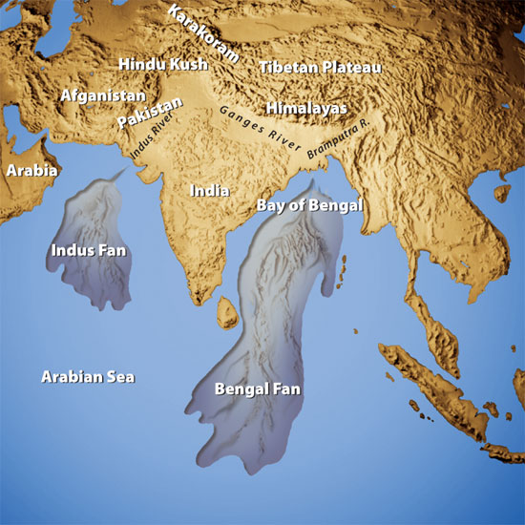

Modern examples
(not charged with oil or gas)
Rivers transport large volumes of sediment to the ocean via turbidity currents
Submarine fan area can be comparable to drainage basin area
The Bengal Fan is 22 km thick (3 million km²
The Indus Fan is 11 km thick and 1 million km²
Amazon and Mississippi fans are >300,000 km²
The ultimate resting place for material eroded from mountains

Slide 11
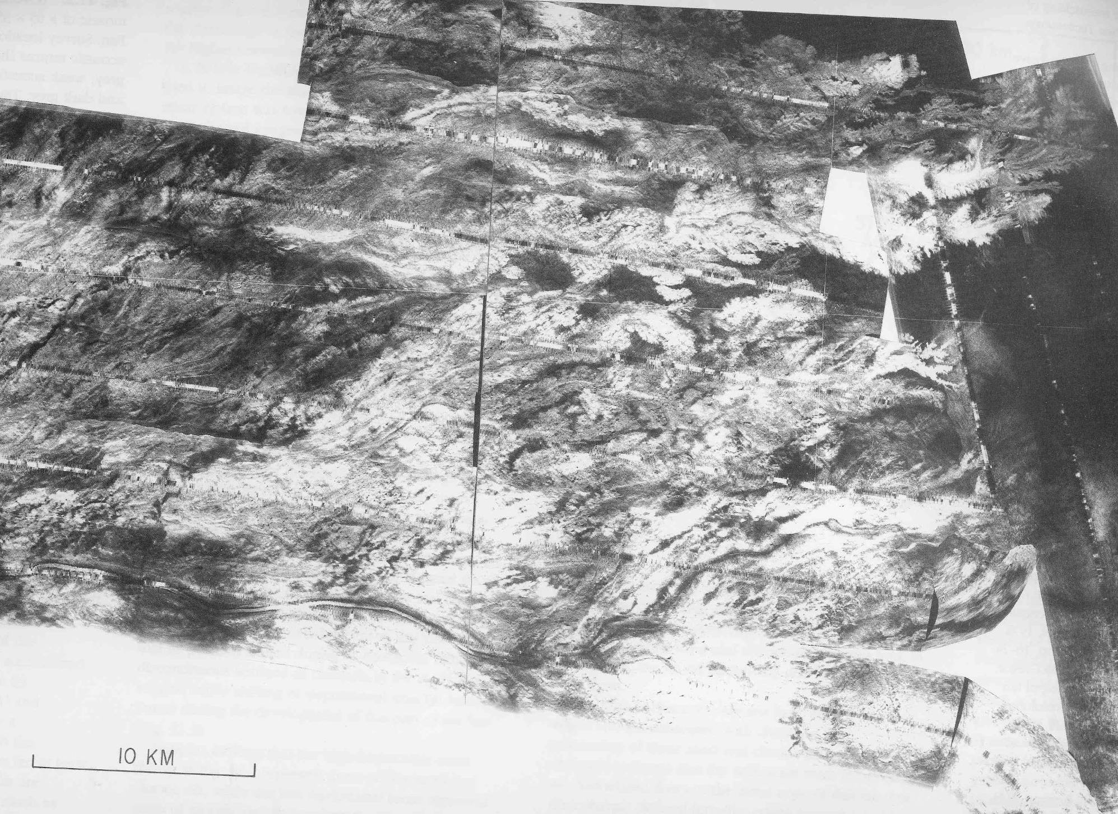
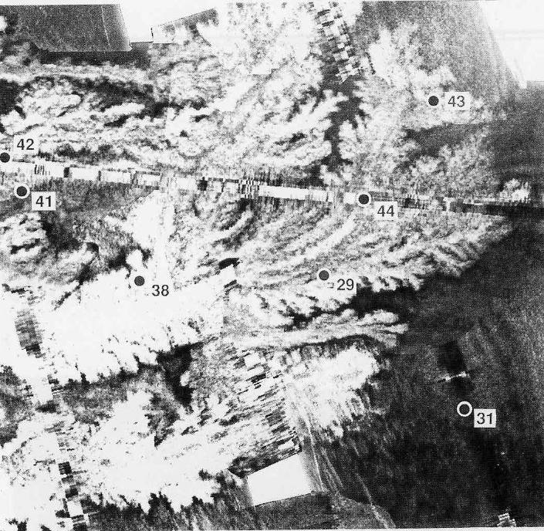
Mississippi fan: terminal lobes
Intricate and elongate ‘leaves’
Composite bodies
Lobes
active

Slide 12
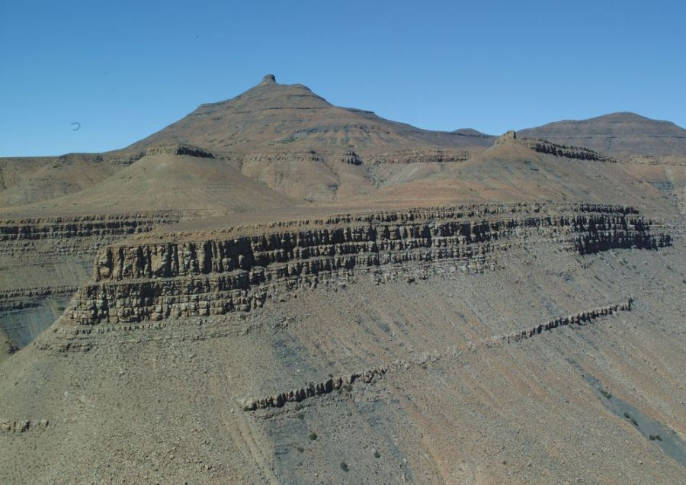
Exhumed deepwater fan deposits, Karoo basin, South Africa
Slope to shelf-edge
Unit 5
Fan 4
Fan 3

Slide 13
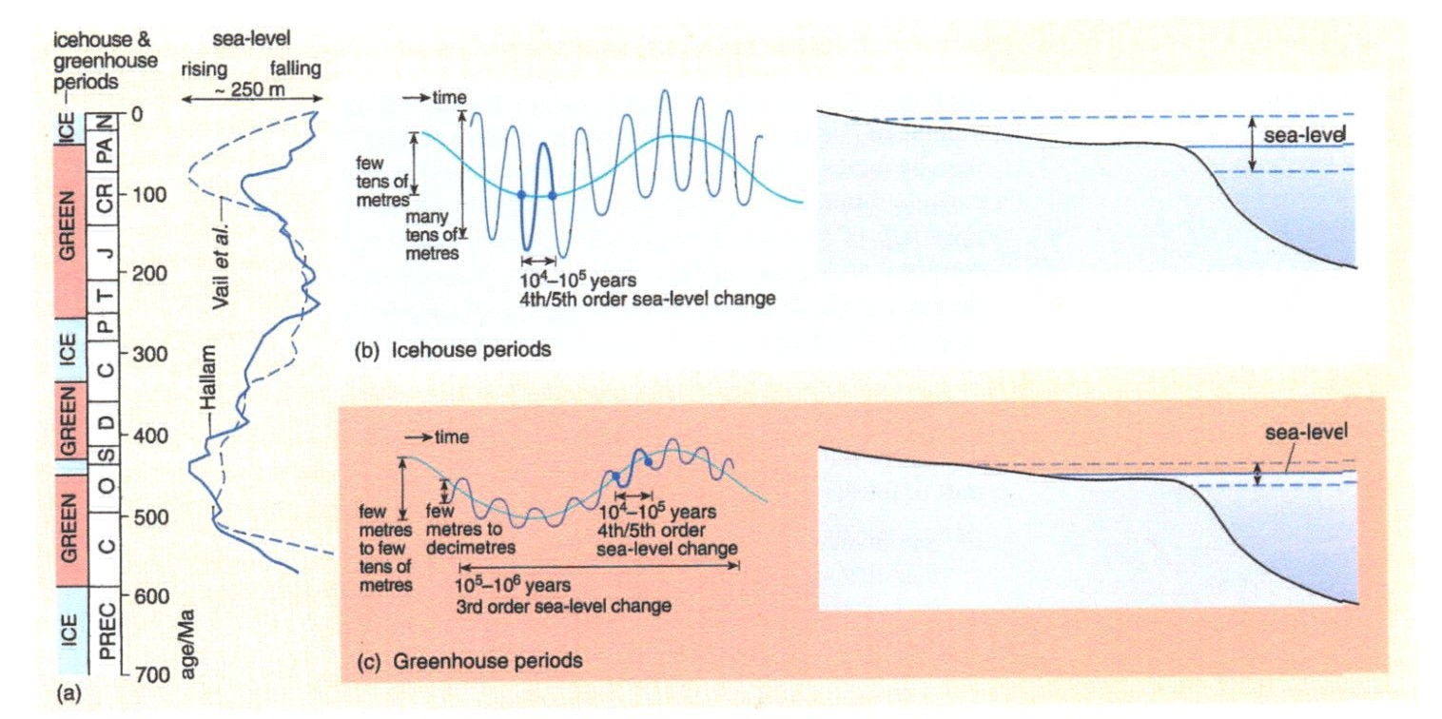
Deeper cuts in the icehouse Carboniferous
Shallow depths of incision in the greenhouse Cretaceous
Different long term climate cycles (icehouse vs. greenhouse)
do not affect the frequency but do affect the amplitude of
sea level changes related to Milankovitch cycles (Coe et al., 2003)

Slide 14
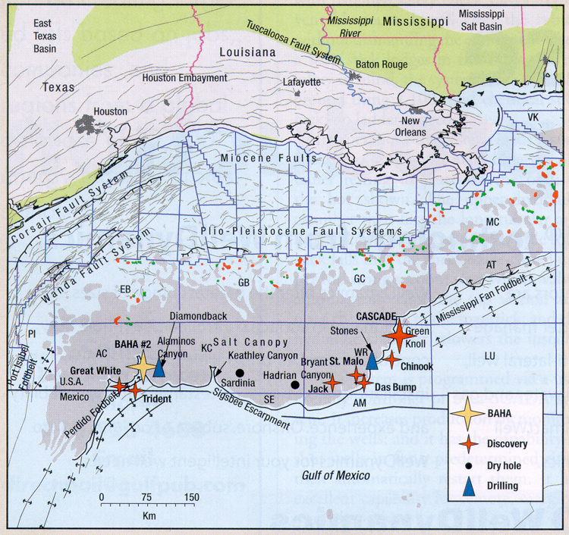
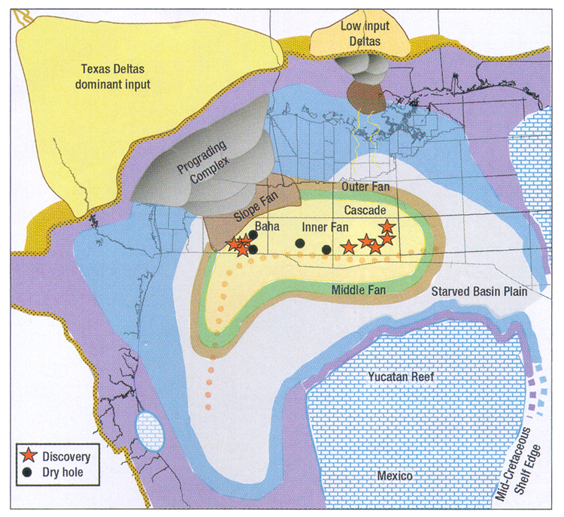
We can then apply this new
understanding to
Exploration: e.g. The ultra
deepwater Wilcox Formation
of the Gulf of Mexico:
America’s new Middle East?
Major new discoveries in
deepwater sandstones, very
similar to the Karoo

Slide 15
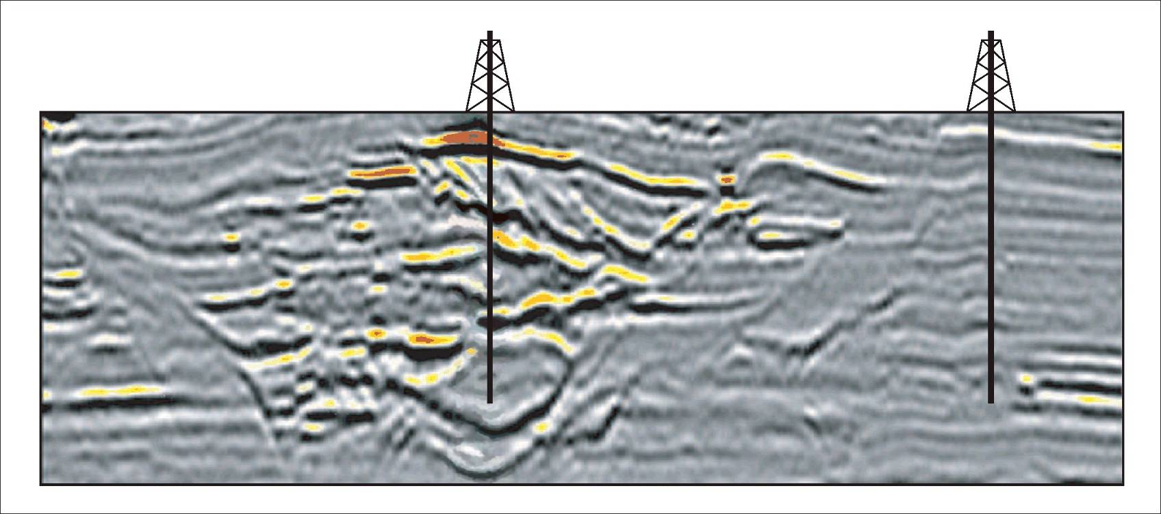
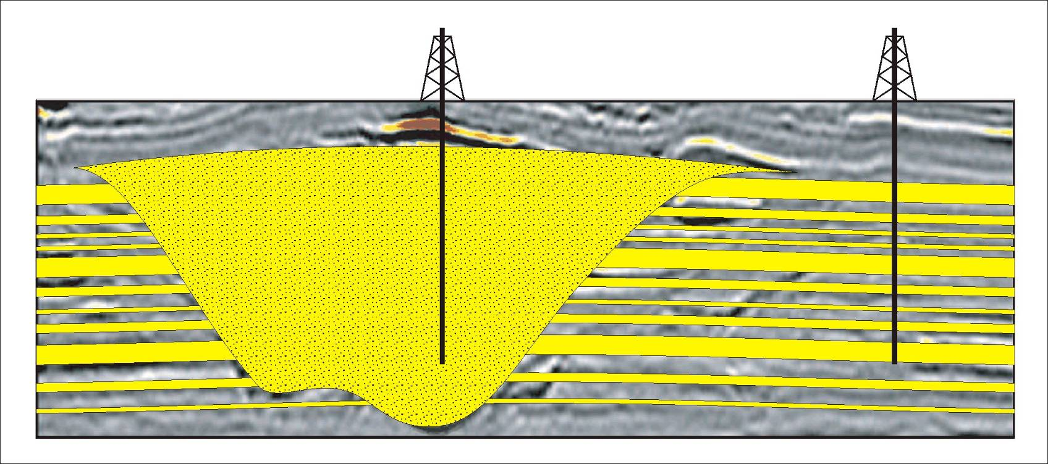
Prediction of Connectivity: will oil or gas flow out of the reservoir, into the well?
Between elements of channel fill?
Between channel fill and adjacent layered strata?
We can investigate this by using outcrop studies

Slide 16
(2) Putting it all back in – or some of it…… Carbon Capture + Storage (sequestration)
Geopolitically big – everyone wants to play
Recent Scottish parliament funded academic positions in Edinburgh, Herriott-Watt/Newcastle grouping
Definitely some aspects of the geoscience are being under recognised as major issues

Slide 17
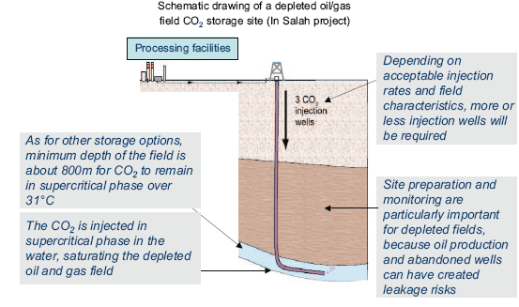
‘Simple’ Case: Inject into an old oil or gas field
http://www.zero-emissionplatform.eu/website/docs/ETPZEP/ZEPTechnologyMatrix.pdf

Slide 18
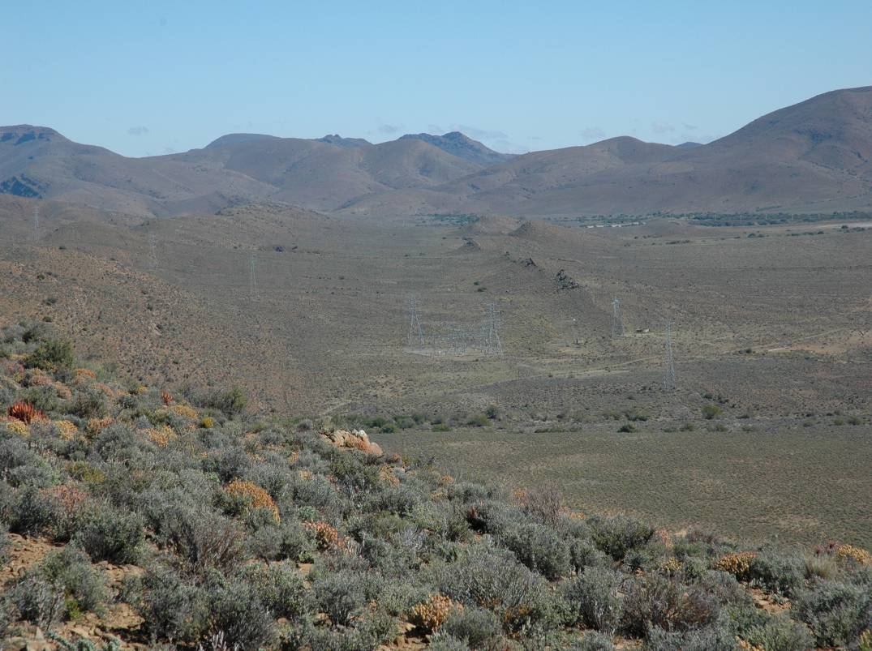
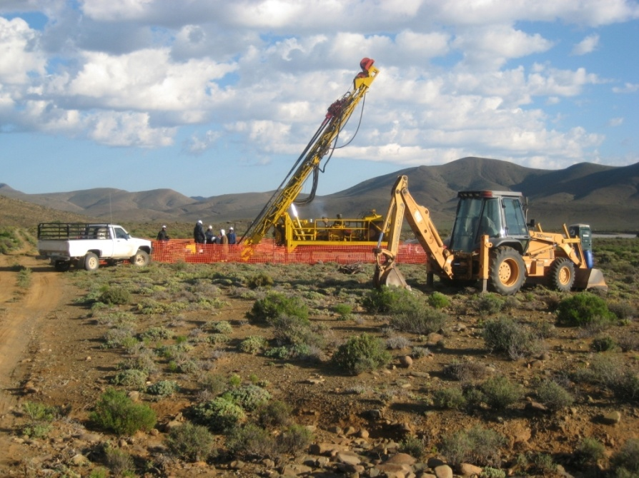

Slide 19
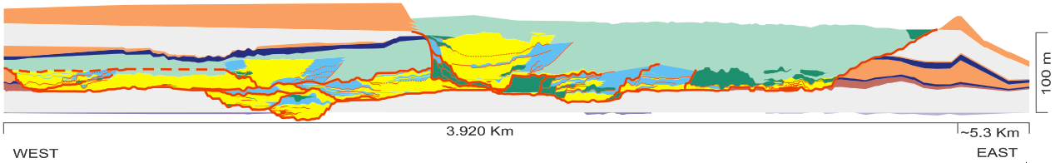
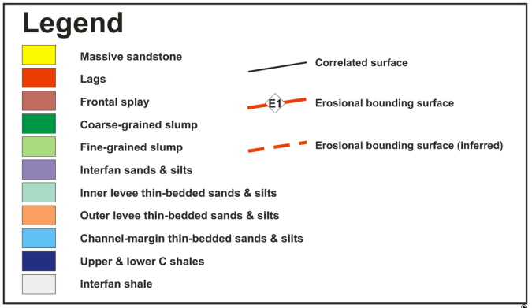
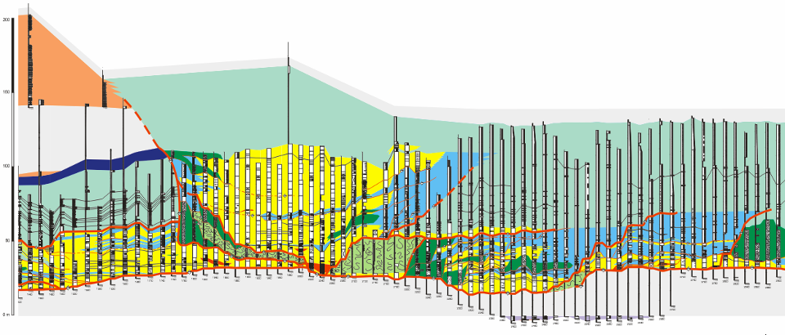
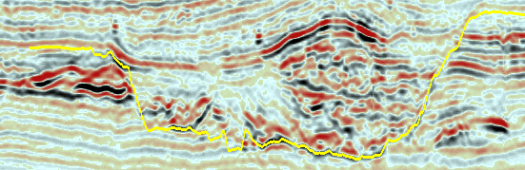
Unit D: western side
Notes:
Slide 21:
Lateral offset is observed between successive channel complexes, suggesting that lateral migration occurred during the backfilling stage.
Deposits within the deeply incised first order surface comprise:
Laterally or vertically stacking sand-prone channel-axis deposits;
Thin-bedded deposits, which are interpreted as levee deposits, interfingering on one side with sandstone-rich channel-fill facies and onlapping onto the eastern wall of the first order erosional surface on the other side. These sediments are best preserved to the east of the channel-axis deposits (opposite the cut bank), and form as the channel axis aggrades;
Slumps probably originated from direct cut-bank erosion at the base of the first order surface.
The external geometry of outer levees is wedge-shaped, converging away from the axis of the first order erosional surface.
The effects of differential compaction account for the difference in thickness.

Slide 20
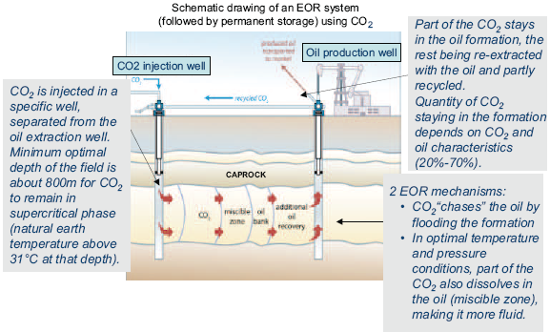
Slightly more clever case: Inject CO2 to help push out remaining oil/gas
http://www.zero-emissionplatform.eu/website/docs/ETPZEP/ZEPTechnologyMatrix.pdf

Slide 21
So, where is the (earth) science in CCS?
We need to know just as much (more) about the geology for putting fluids back in as we did for taking them out
Damage/modifications to the reservoir due to depressurisation
How much can it take…and retain over 100s of years?
Major links to engineering here

