Slide 1
Advanced Reactor Systems – Accelerator Physics Perspective
Kai Hock
Energy Seminar, Liverpool University Physics Department, 17 July 2009

Slide 2
Overview
Accelerator for a nuclear reactor
What are the requirements?
What are the challenges?
What types of accelerator are suitable?
What work has been done?
Is it feasible or even necessary?
Conclusion

Slide 3
Accelerator for a nuclear reactor
Uses:
ADS – Accelerator Driven System
ADSR – Accelerator Driven Subcritical Reactor
ATW – Accelerator-driven Transmutation of Waste
Method:
The accelerator produces a proton beam.
This is directed at a target to produce neutrons, in a process called spallation.
The neutrons drive a nuclear reactor that is operated below criticality, i.e. with no chain reaction.

Slide 4
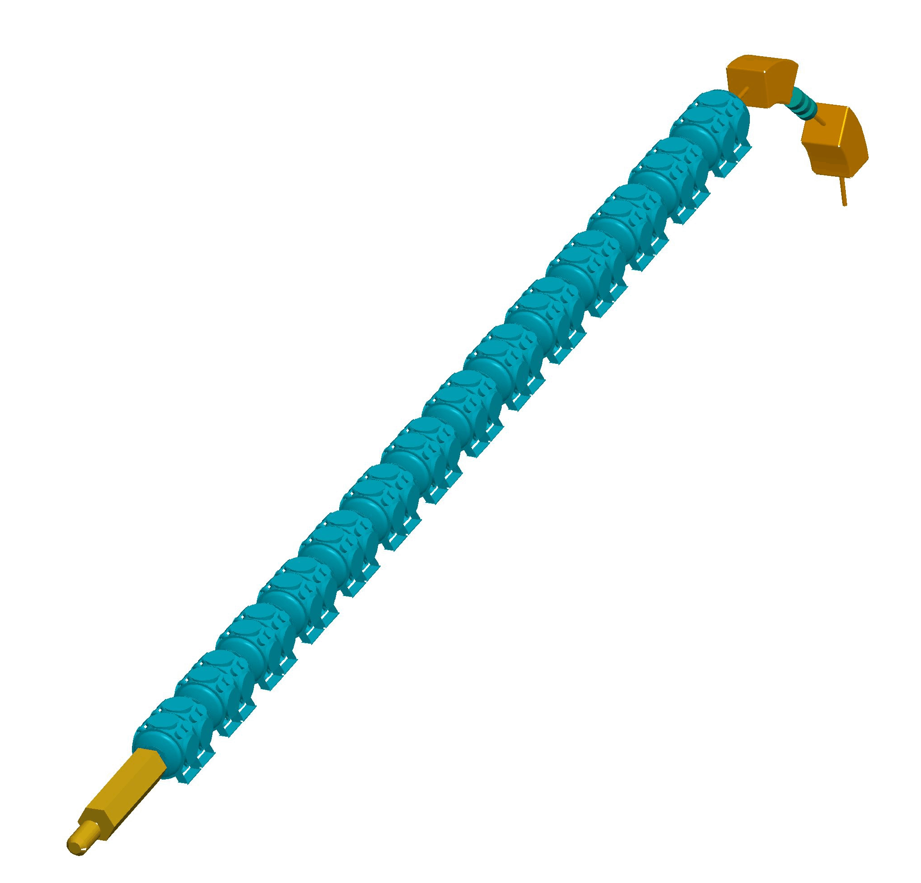
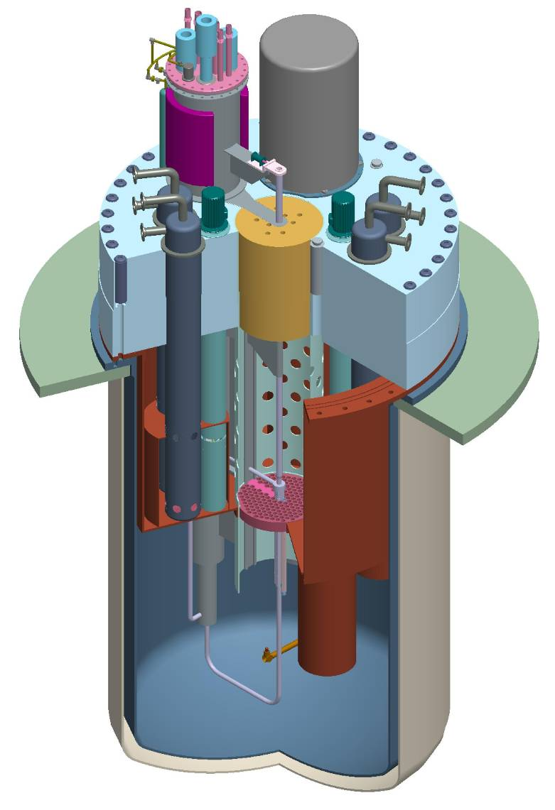
MYRRHA A demonstration project in Belgium for an accelerator driven subcritical reactor
Proton linac
Spallation
target
Subcritical
core

Slide 5
What are the requirements?
There must be enough power from the proton beam – about 10 MW.
Since Power = Voltage x Current
A possible set of parameters would be
1 GeV protons with a beam current of 10 mA.

Slide 6
What are the challenges? 1. High current
In a beam of charged particles, the particles repel one another – this is the space charge effect.
This effect causes the beam to spread out – particles would be lost when they hit the vacuum wall.
For a given energy, a higher current would have a larger space charge effect.
At 1 GeV, 10 mA is a high current for a proton beam – so beam loss is a problem.

Slide 7
What are the challenges? 2. Low failure rate
Operator error or machine malfunction can lead to accelerator down time – or beam trip.
An accelerator can have thousands of beam trips per year.
For Accelerator Driven Systems, this must be reduced to a few tens per year.
A lot of work must be done to improve the reliability of the accelerator.

Slide 8
What types of accelerator are suitable?
Linacs and cyclotrons have been proposed, and more recently the FFAG (both scaling and nonscaling).
In the year 2000, two of the most powerful accelerators were:
- linac at Los Alamos: 800 MeV, 1.5 mA
- cyclotron at Paul Scherer Institute: 590 MeV, 1.8 mA
This is an order of magnitude below the required 1 GeV, 10 mA.

Slide 9
What work has been done?
There have been a lot of simulation studies, and some constructions.
MYRRHA: In 1997, development of an ADS started in Belgium. This would include a proton linac - 600 MeV, 2.5 mA.
TRASCO: In 1998, construction of a superconducting linac for ADS studies started in Italy. Specifications are 100 MeV, 30 mA.
KART: In 2002, construction of an FFAG for ADS studies is started in Japan. Specifications are 150 MeV, 1 μA.
There is some construction work in China as well. There must also be others.

Slide 10
Is it feasible or even necessary?
At the ThorEA meeting, 10 July 2009, Cockcroft Institute:
(I was there, but this account may not be fully accurate)
There was a talk by a man from Aker Solutions, a Norwegian based company that does a lot of nuclear reactor work. This company spent a few million £ an a feasibility study for Thorium reactor. The conclusions are:
Thorium reactors are feasible, profitable and sustainable for tens (or hundreds?) of years.
It can be run above criticality without an accelerator. It can also be run below criticality with an accelerator.
It is worth including a accelerator as a safety catch. The cost of a few hundred million £ is only a fraction of the total cost.

Slide 11
Conclusion
1. An accelerator able to meet the requirements of beam current and reliability is not yet available.
2. A more powerful (=bigger) accelerator can be built, or more than one accelerator could be used. Either one would push up the cost.
Recent studies on the FFAG accelerator suggests that this could be more compact (= cheaper).
More research and development is needed.

Slide 12
Sources
Joint Accelerator Conferences Website
www.jacow.org
ThorEA meeting, 10 July 2009, Cockcroft Institute
http://agenda.hep.manchester.ac.uk/conferenceDisplay.py?confId=1011
L'Agence pour l'énergie nucléaire
http://www.nea.fr/html/ndd/reports/2002/nea3109.html
MYRRHA - Multi-purpose hYbrid Research Reactor for High-tech Applications
http://www.sckcen.be/myrrha/
http://www.nupecc.org/presentations/

