Slide 1
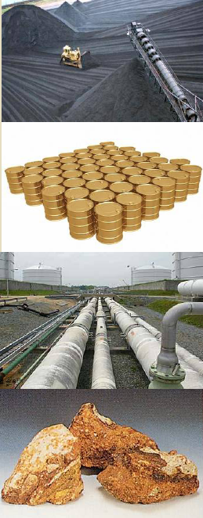
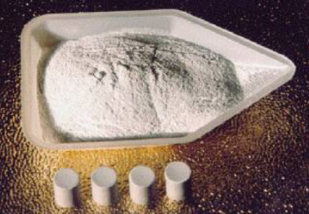
Accelerator Driven Subcritical Reactors
Introduction:
  Fission.
  Conventional reactor.
  Fast breeder reactor.
The Energy Amplifier or ADSR.
Waste from ADSR.
Conventional accelerators.
Fixed Field Alternating Gradient accelerators.
Acceleration using electromagnetic induction?
Summary.
Equivalent are:
5 × 10⁹ tonnes coal
27 × 10⁹ barrels
of oil.
2.5 × 10¹² m³ of natural gas.
65 × 10³ tonnes of uranium
(2.5 g/tonne).
5 × 10³ tonnes of thorium
(10 g/tonne).

Slide 2
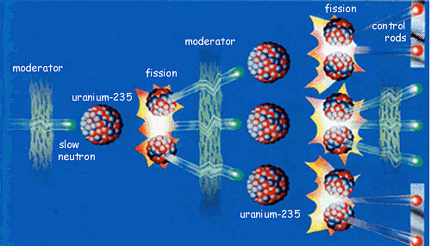
Nuclear fission

Slide 3
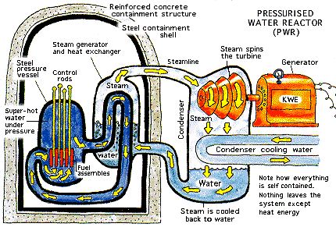
Conventional fission reactor

Slide 4
Features of conventional fission reactor
Each fission:
  Caused by absorption of
  1 neutron.
  Produces ~ 2.5 neutrons.
  Some neutrons lost, leaving k to produce k new fission reactions.
Conventional reactor:
  Require k = 1.
  If k < 1 stops working.
  If k > 1 explodes.
(Perceived) problems:
Safety:
  Chernobyl.
  Three Mile Island.
Waste:
  Actinides with half lives of kyears to 100s of kyears.
Proliferation.
Uranium reserves uncertain.
  Extract from oceans?
  Use fast breeder reactors?

Slide 5
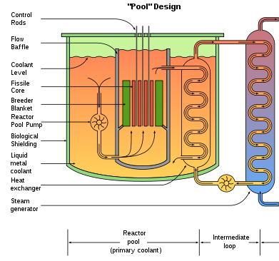
Fast Breeder Reactor
Generally uses ²³⁹Pu as fissile material.
Produced by fast neutrons bombarding ²³⁸U jacket surrounding reactor core.
²³⁹Pu fission sustained by fast neutrons, so cannot use water as coolant (works as moderator).
Liquid metals (or heavy water) used instead.
India has plans to use thorium
in its Advanced Heavy Water Reactors, in these ²³²Th is converted to fissile ²³³U.

Slide 6
Energy Amplifier or ADSR
Accelerator Driven Subcritical Reactor is intrinsically safe.
Principal:
Run with k < 1 and use accelerator plus spallation target to supply extra neutrons.
Switch off accelerator and reaction stops.
Need ~ 10% of power for accelerator.
Can use thorium as fuel.
²³²Th + n → ²³³U.
  Proliferation “resistant”:
    No ²³⁵U equivalent.
    Fissile ²³³U contaminated by “too hot to handle” ²³²U.
  There is lots of thorium (enough for several hundred years)…
  …and it is not all concentrated in one country!
Accelerator
Spallation Target
Protons
Core

Slide 7
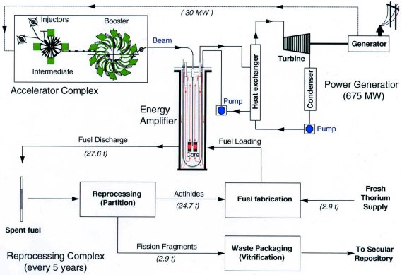
Energy Amplifier or ADSR

Slide 8
Waste from ADSR
Actinides produced in fission reactions are “burnt up” in the reactor.
Remaining waste has half life of a few hundred rather than many thousands of years.
Can use ADSR to burn existing high activity waste so reducing problems associated with storage of waste from conventional fission reactors.
So why haven’t these devices already been built?

Slide 9
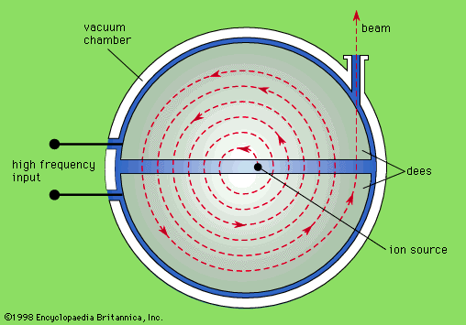
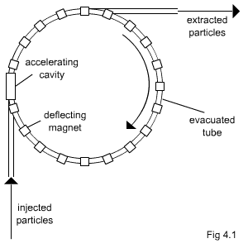
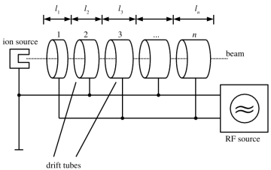
Accelerator
Challenge for ADSRs is accelerator.
Required proton energy ~ 1 GeV.
For 1 GW thermal power need current of 5 mA, power of 5 MW.
Need high reliability as spallation target runs hot.
If beam stops, target cools, stresses and cracks: max. 3 trips per year.
Compare with current accelerators:
  PSI cyclotron: 590 MeV, 2 mA,
  1 MW.
  ISIS synchrotron: 800 MeV,
  0.2 mA, 0.1 MW.
  Many trips per day!
Cyclotron, fixed B field, radius increases: energy needed too high!
Synchrotron, constant radius, B field ramped: current too high!
Linac: perfect, but too costly?

Slide 10
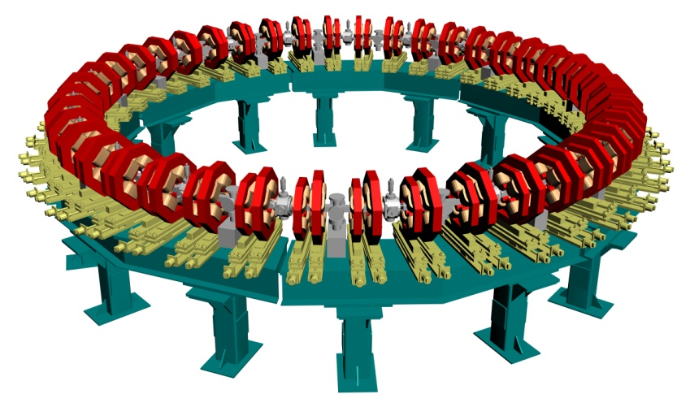
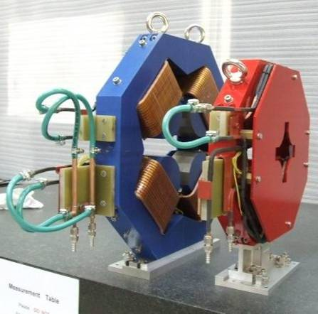
Fixed Field Alternating Gradient Accelerator
FFAG, radius of orbit increases slightly with energy: protons move from low field to high field region.
Simplicity of operation hopefully ensures the necessary reliability.
nsFFAG designed at Daresbury (EMMA):
Construction underway.
Extract at high K
Inject at low K

Slide 11
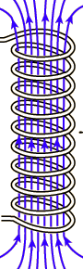
FFAG and acceleration
RF cavities conventionally used to accelerate charged particles.
A problem with FFAG is synchronisation of RF with particle orbits over large energy range.
Alternative: inductive acceleration?
Use Faraday’s Law:

Slide 12
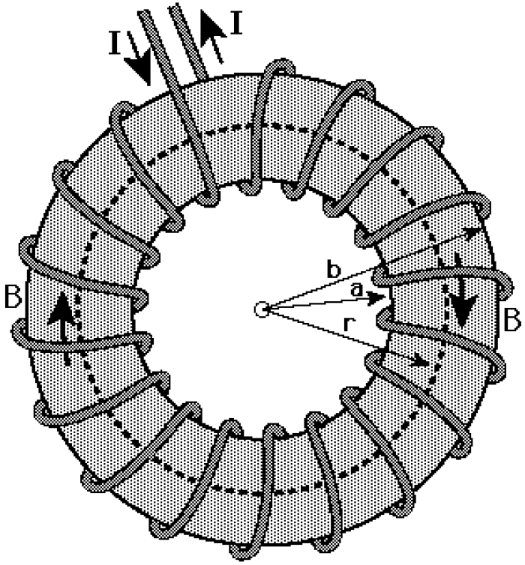
FFAG betatron
Make solenoid into toroid so no problems with stray fields:
Perhaps use one toroid for two FFAGs?
Make toroid part of LCR circuit.
Choose capacitance so resonance at required frequency.
E.g. here:
  f _{B} = 1 kHz.
  T_{B} = 1/f_{B} = 1 × 10⁻³ s.
toroid
L
AC
C
small R

Slide 13
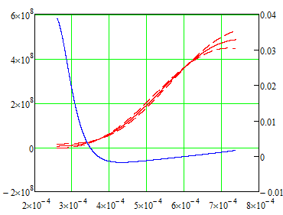
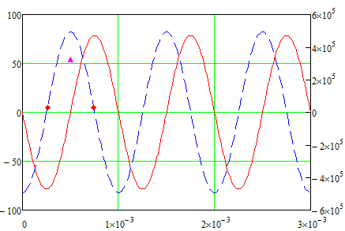
FFAG Betatron
Choose also:
  Field in toroid B = 1 T.
  (Small) toroid radius r_{T} = 5 m.
Inject protons with K_{i} = 5 MeV.
Integrate over
Look at acceleration of particle with central energy and of particles with energy K_{i} ± 0.001 × K_{i}.
Differences for latter amplified by factor 100 in plot:
Accel. to 500 MeV in < 5 × 10⁻⁴ s.
Energy (eV)
Rel. energy spread
Flux (weber)
EMF (V)
Time (s)
Time (s)

Slide 14
Summary
New approaches to power generation through nuclear fission worth considering.
Energy Amplifier or Accelerator Driven Subcritical Reactor interesting:
  Safe.
  Produces waste with short half-life.
  Can use thorium.
Major challenge is requirement for
5 MW, 5 mA, 1 GeV, extremely reliable proton accelerator.
Fixed Field Alternating Gradient accelerators operate with constant magnetic fields, allowing extremely rapid acceleration.
Can problems of synchronising RF with orbiting particles be circumvented by using electromagnetic induction to drive acceleration?
Preliminary studies suggest concept is interesting enough to justify further work.
Tests using EMMA at Daresbury possible?

