Slide 1
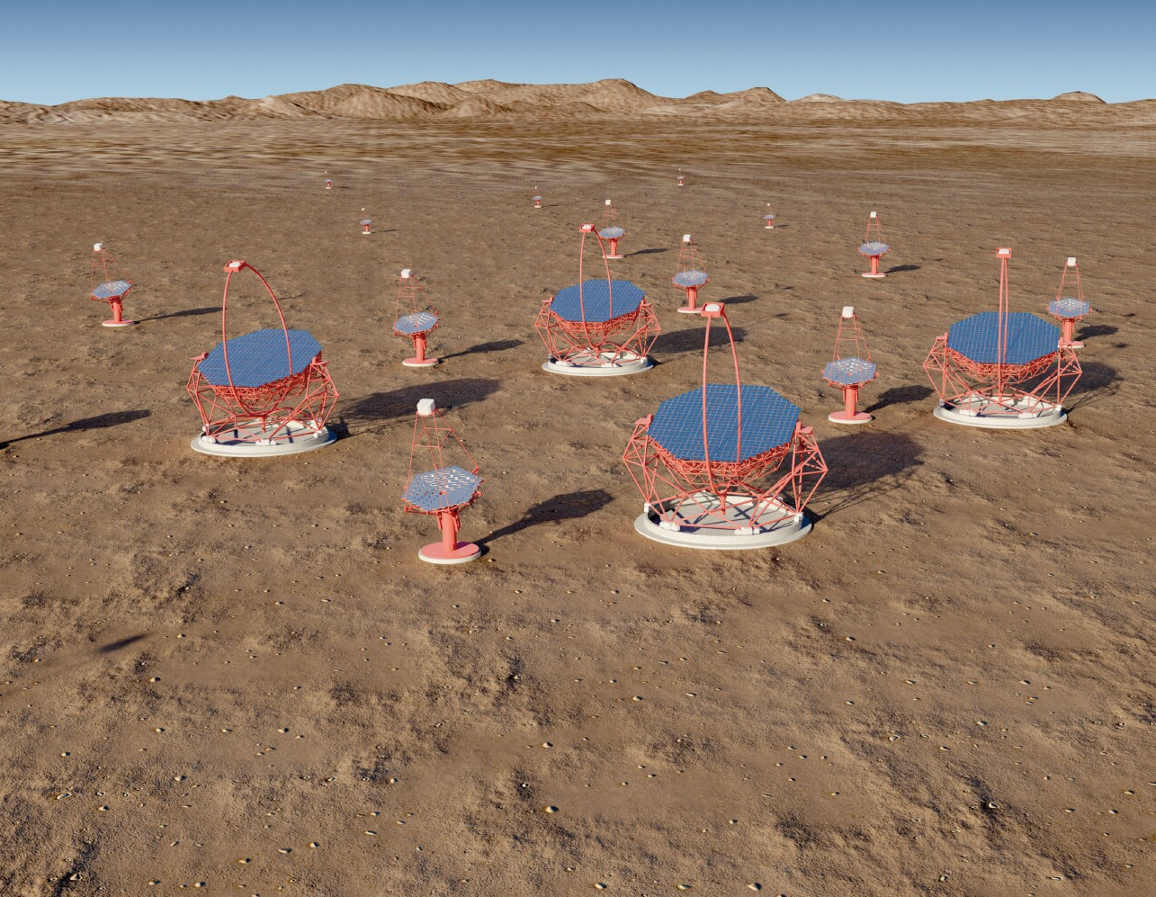
UK participation in the pre-production phase of CTA 2015 – 2017
Introduction
CTA concept and performance
CTA science
Status of CTA
The Gamma-ray Cherenkov Telescope
The Compact High Energy Camera
UK programme for 2015…2017
Work packages
Costs
Summary
Universities of Durham, Leicester, Liverpool, Liverpool John Moores, Oxford.

Slide 2
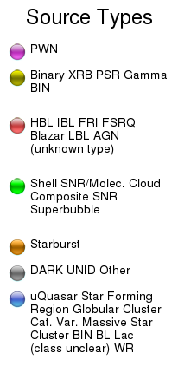
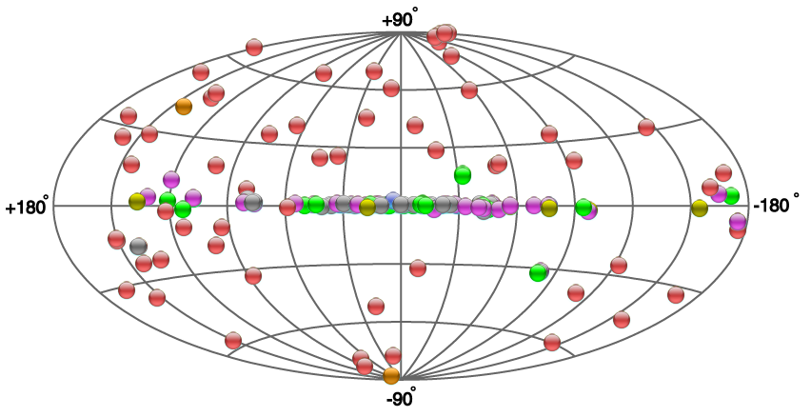
Introduction
First TeV γ-ray source detected by Whipple 10 m telescope in 1989.
As of 20/01/15, 155 γ-ray sources known:
Vast majority found with current generation of Imaging Atmospheric Cherenkov Telescopes (HESS, MAGIC and VERITAS.)
2

Slide 3
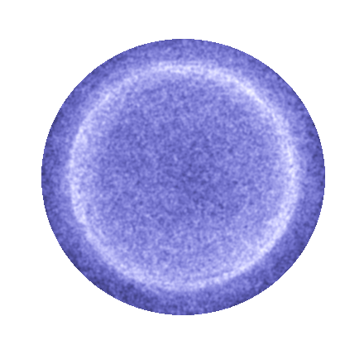
Imaging Atmospheric Cherenkov Telescopes
Very High Energy γ entering atmosphere causes EM shower with maximum at height ~ 8 km.
About 20 Cherenkov photons/m e⁺ and e– path length in λ range 300...400 nm.
UV attenuation length few km
(λ dependent).
Cherenkov angle ~ 1°
(height dependent):
get light pool on
ground with
radius of
~ 120 m.
Primary γ ray
~ 8 km
~ 120 m
3

Slide 4
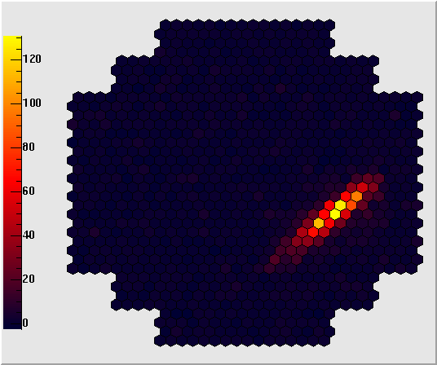
Imaging Atmospheric Cherenkov Telescopes
Sensor quantum efficiency of
20…30%, net result:
  About 1 p.e./m² in few ns for 100 GeV γ-rays.
  About 10³ p.e./m² in few 10s of ns for 10 TeV γ-rays.
Limitations:
  E < 100 GeV, night sky background.
  E = 0.1...5 TeV, cosmic ray background (γ/h separation).
  E > 5 TeV, rate.
Some events recorded with HESS telescope:
4

Slide 5
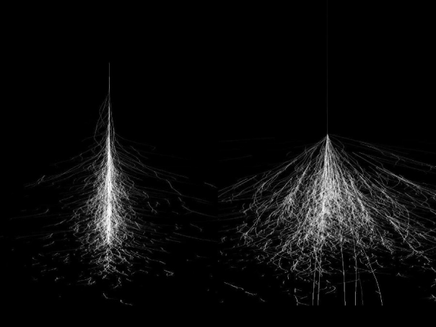
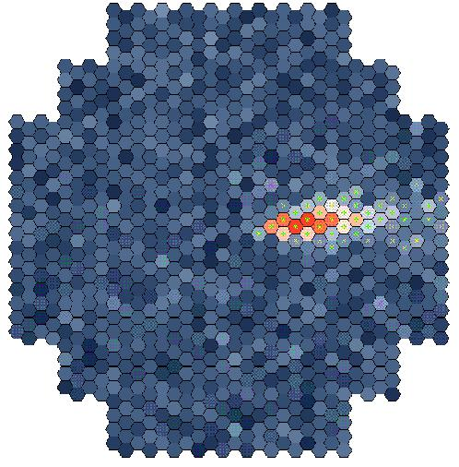
Imaging Atmospheric Cherenkov Telescopes
Multiple images of showers aid γ hadron separation…
…and allow improved angular and energy resolution.
×
5

Slide 6
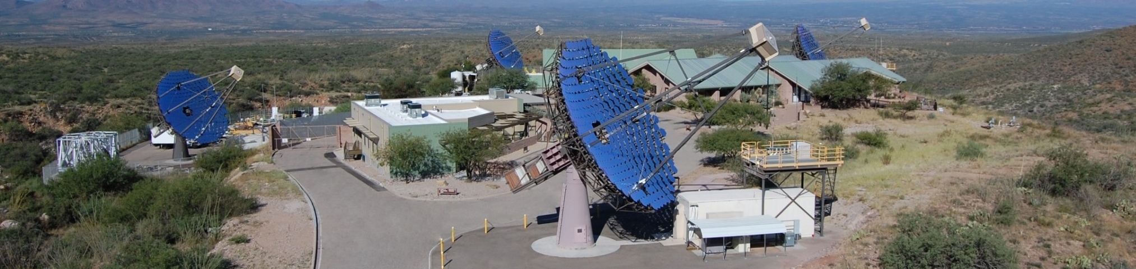
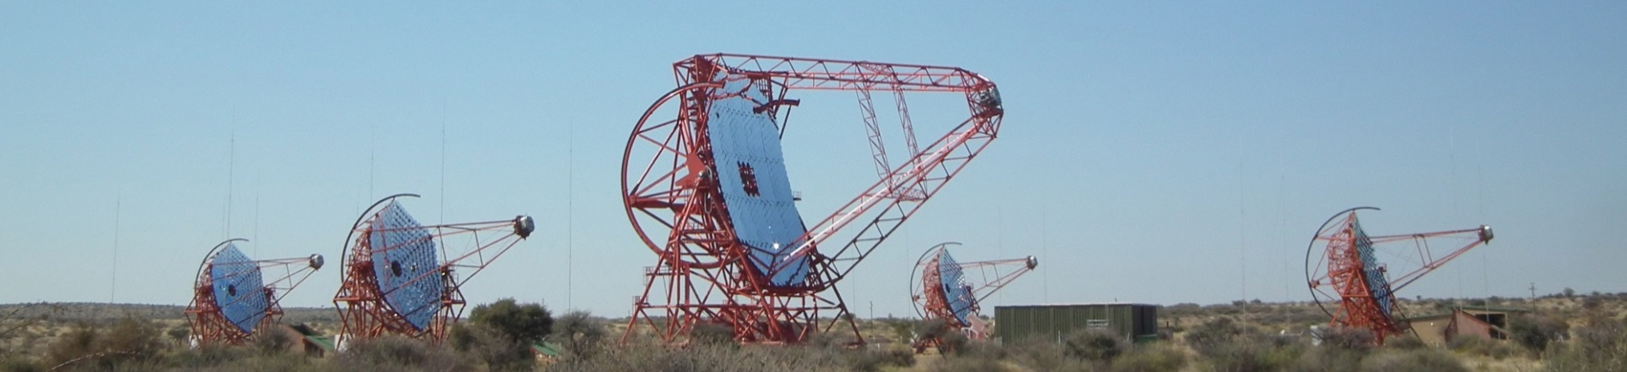
Current IACT arrays
VERITAS
HESS
6

Slide 7
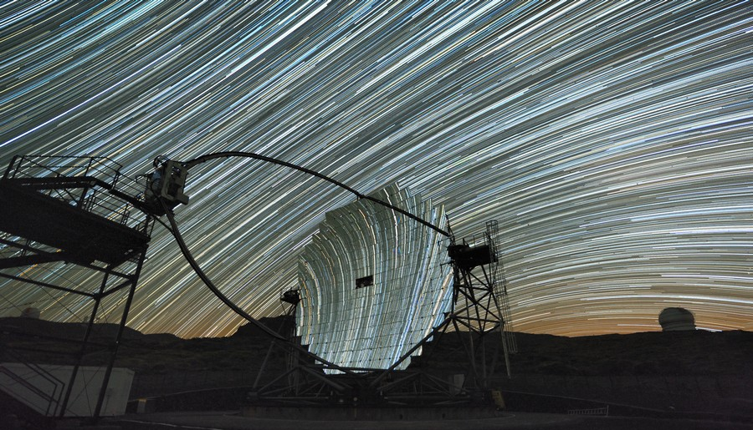
Current IACT arrays
MAGIC
7

Slide 8
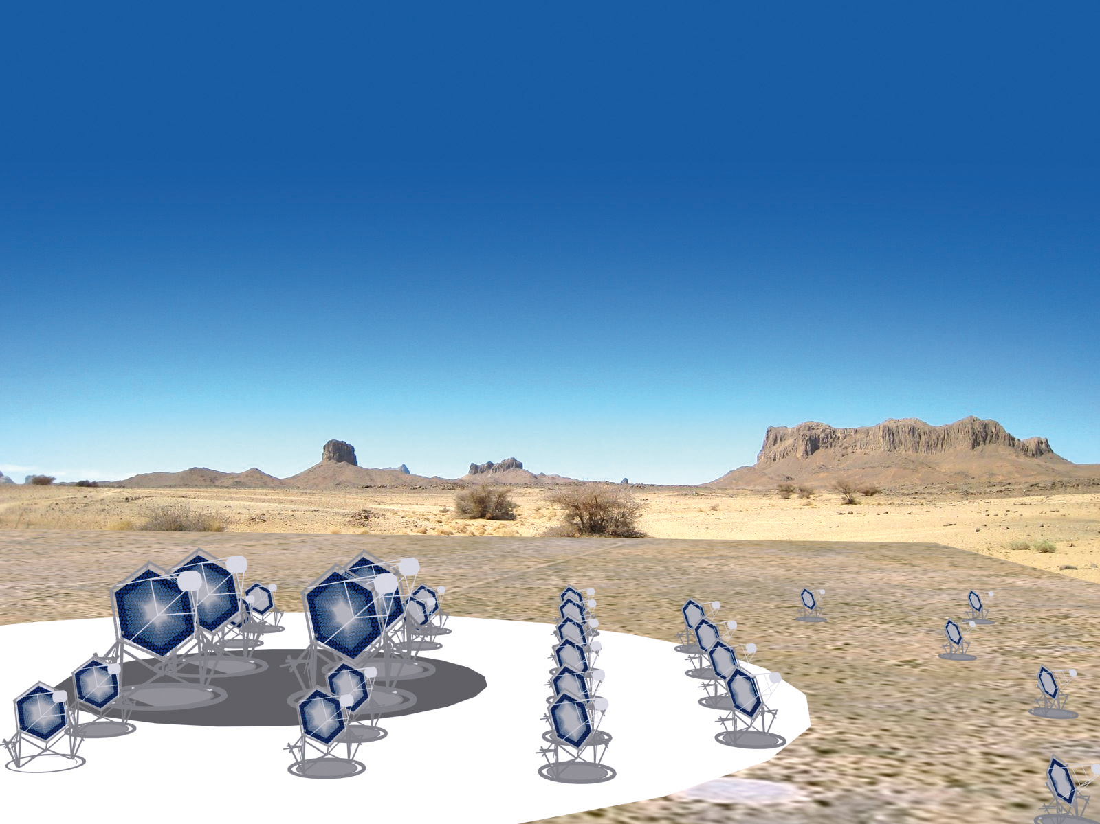
The Cherenkov Telescope Array concept
Low energy
Four 23 m telescopes
4.5º FoV
~2000 pixels
~ 0.1º
Medium energy
Twenty-five 12 m telescopes
6…8º FoV
~2000 pixels
~ 0.18º
High energy
Seventy 4 m telescopes
~ 9º FoV
1000…2000 pixels
~ 0.17º…0.23º

Slide 9
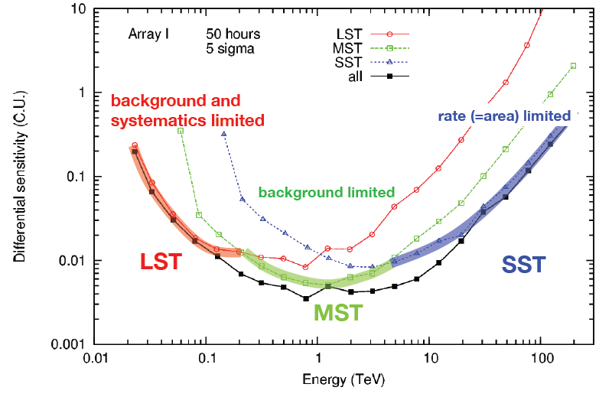
CTA performance – sensitivity
Factor of 10 improvement in sensitivity.
Expect to observe around 1000 sources (galactic and extra-galactic).
Differential sensitivity (C.U.)
9

Slide 10
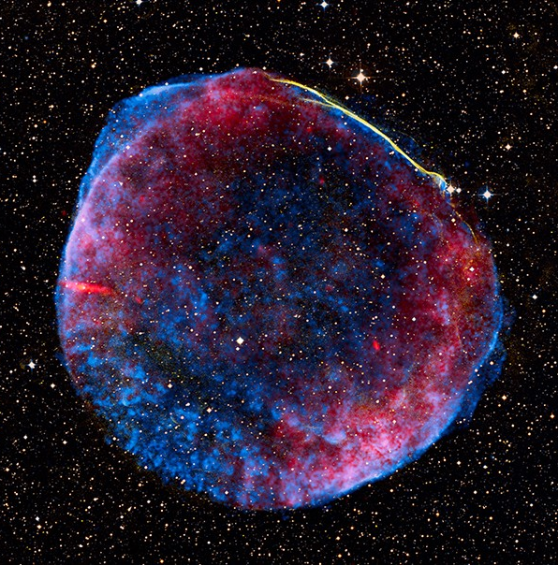


CTA performance
Improve angular resolution by
factor ~ 5.
Substructure of SNR shock fronts can then be resolved:
SN 1006:
CTA resolution
~ 0.02 °.
HESS resolution
~ 0.1°.
10

Slide 11


CTA performance
Increase field of view w.r.t. current instruments by factor ~ 2 to 4.5...9°.
Detect and map extended sources.
Improve survey capability: galactic plane at ~ 0.001 Crab in 250 hours, full sky at ~ 0.01 Crab in 1 year,
> 200 times faster than HESS.
Southern array:
  Galactic and extragalactic sources.
  20 GeV...100 TeV.
Northern array:
  Mainly extragalactic sources.
  20 GeV...1 TeV.
11

Slide 12
CTA performance
Sensitivity compared to other instruments:
Angular resolution compared with other instruments:
12

Slide 13

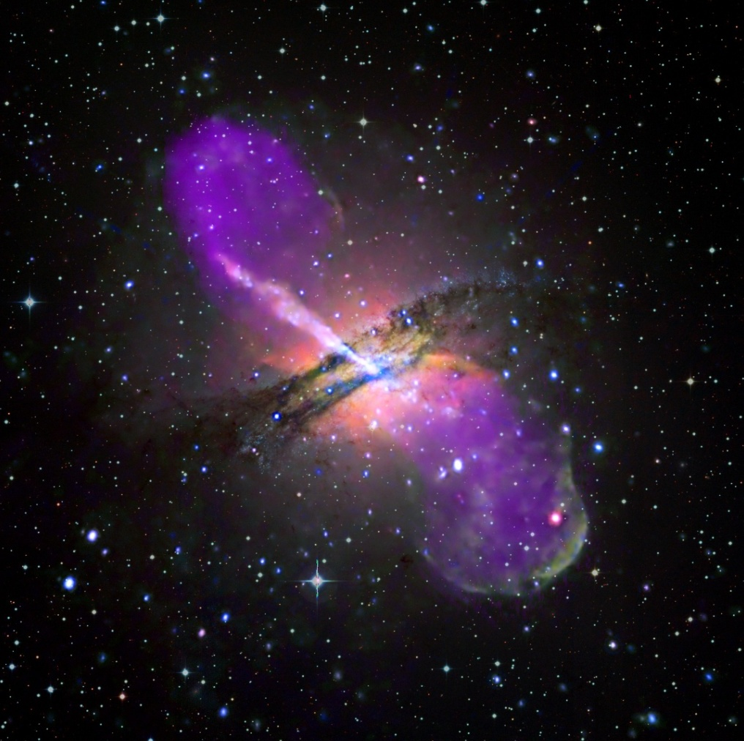

CTA science
Key science drivers:
Understanding the origin of cosmic rays and their impact on the constituents of the Universe.
Understanding the nature and variety of black hole particle accelerators.
Searching for the ultimate nature of matter and physics beyond the standard model.
13

Slide 14
Particle acceleration
Acceleration occurs in SNRs.
E.g. > 100 TeV photons observed from HESS-J1731:
Diffusive shock acceleration thought to be acceleration mechanism.
Reaching PeV energies requires magnetic field amplification (Cosmic Ray feedback effects).
Resolving structure on scale < 10% of SNR radius allows test of these ideas.
CTA will detect all (about 100) recent Galactic SNRs and resolve structure for nearer systems (e.g. RX J1713.7-3946).
14

Slide 15
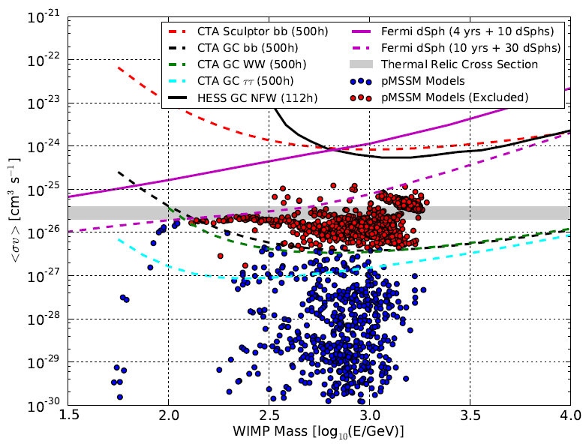
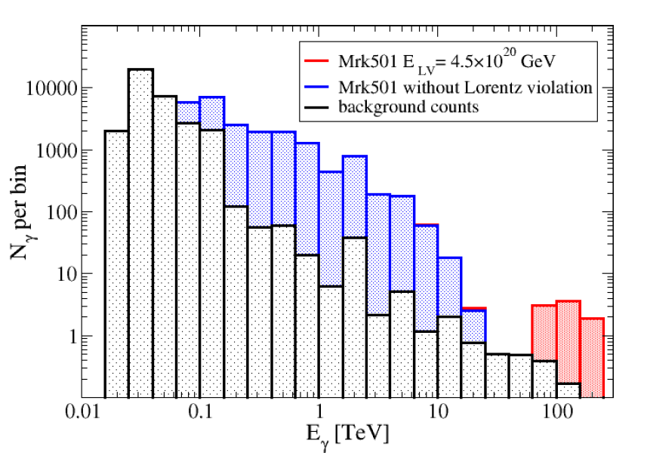
Dark Matter searches
Lorentz invariance
violation
Galactic centre observations with CTA could rule out 50% of WIMPs in pMSSM at 95% CL*.
γ_{VHE}
e⁺
QG may cause LIV.
VHE γ rays interact
with EBL and CMB
(E_{γ} above ~ 1 TeV,
~ 100 TeV, resp.).
LIV changes kinematics of e⁺e– prod.*
Opacity of cosmos decreases at HE.
γ_{EBL}
e–
*Wood et al, arXiv:13050302
*Fairburn et al, JCAP06
15

Slide 16
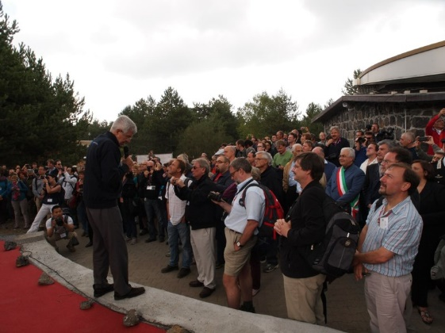
Status of CTA
CTA consists of over
1300 scientists from 201 institutes and 29 countries.
62 UK members from:
  Durham.
  Hertfordshire.
  Leicester.
  Liverpool.
  Liv JMU.
  Nottingham.
  Oxford.
  RAL.
  Southampton.
  Sheffield.
16

Slide 17

CTA timeline
2012 2013 2014 2015 2016 2017 2018 2019 2020
Design
Prototyping
Site Development
Array Construction
Science
SPPRR PDR CDR PRR
This proposal
Southern site decision mid 2015.
Installation of pre-production telescopes on southern site from mid 2016.
SST/MST pre-production arrays complete mid/end 2017.
17

Slide 18
CTA consortium and observatory
Instrument constructed by consortium will be operated as observatory.
CTA Observatory GmbH now formed.
  Resource Board (including STFC) discussing Founding Agreement to construct and operate CTAO.
  Access to CTA data/time will be granted to scientists in countries which have contributed to observatory construction and operation.
  Completion of Agreement expected September 2015.
18

Slide 19

Possible CTA sites
Southern sites
Negotiations started with:
  Aar (Namibia).
  Paranal (ESO – Chile).
Decision expected July 2015, access
mid 2016.
Northern sites
First LST will be built on La Palma.
Shortlist selection March 2015.
Yavapai or Meteor
Crater, USA
La Palma,
Tenerife,
Spain
San Pedro Martir,
Mexico
Paranal, Chile
Leoncito, Argentina
Aar, Namibia
19

Slide 20
Large size telescopes – LSTs
Dish diameter D = 23 m.
Focal length F = 28 m, f = F/D = 1.2.
Camera D_{C} ~ 2.2 m, m_{C} ~ 1.6 t, 1.5” PMs with peak QE ~ 40%.
First telescope on La Palma 2016.
Verification complete mid 2017.
20

Slide 21
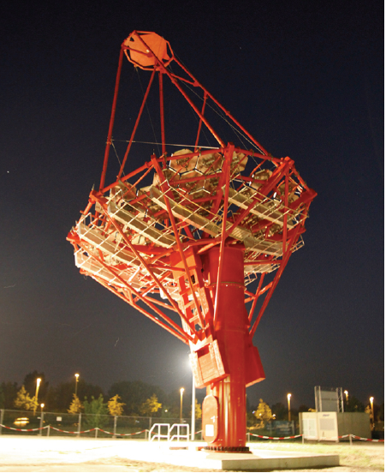
Medium size telescopes – MSTs
D = 12 m, F = 17 m, f = 1.4.
Prototype in Berlin.
D_{C} ~ 2.2 m, m_{C} ~ 2 t, 1.5” PMs (as used in LST camera).
Three pre-production telescopes on southern site by end 2017.
21

Slide 22
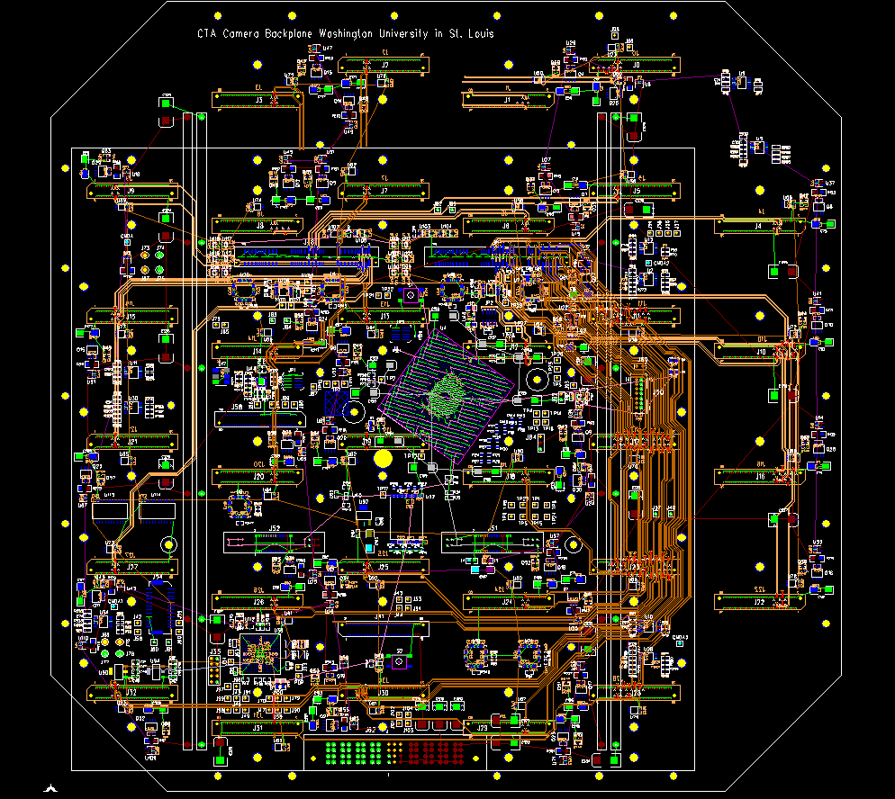
Schwarzschild-Couder Telescopes
D₁ = 11.5 m, D₂ = 6.6 m.
F = 5.9 m, f = 0.51.
SiPM based camera with 11k
6 × 6 mm² pixels.
Readout triggering and power provision using TARGET ASIC/module.
Combine module triggers in Backplane FPGAs to form camera trigger.
22

Slide 23
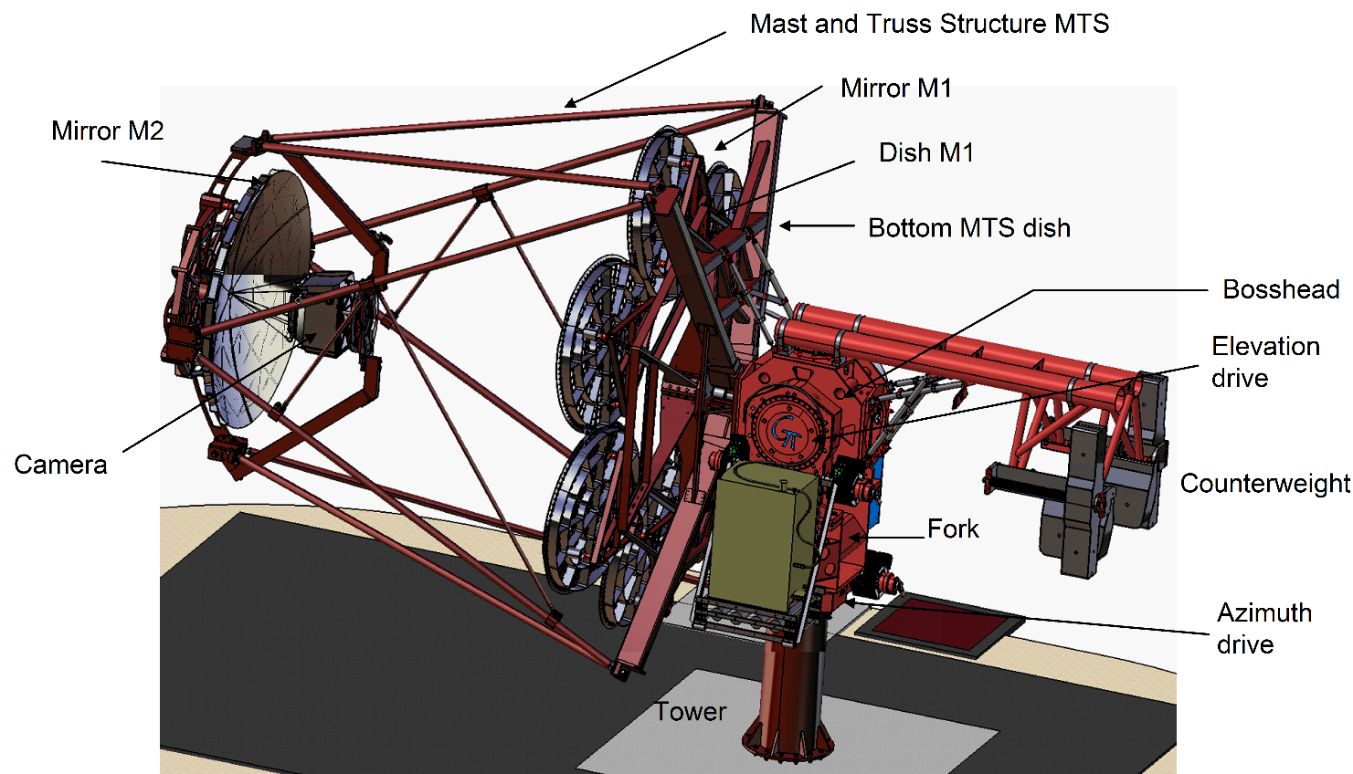
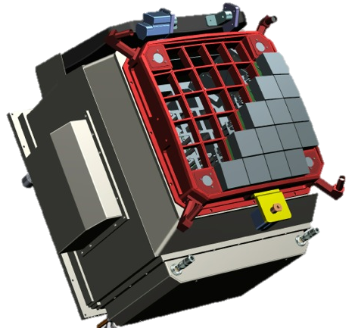
Small size telescopes – GCT
Schwarzschild-Couder
optics.
D₁ = 4 m, D₂ = 2 m,
F = 2.3 m, f = 0.57.
D_{C} = 0.35 m,
m_{C} = 45 kg.
Prototype under construction in Paris.
Three pre-production telescopes on southern site by mid 2017.
23

Slide 24
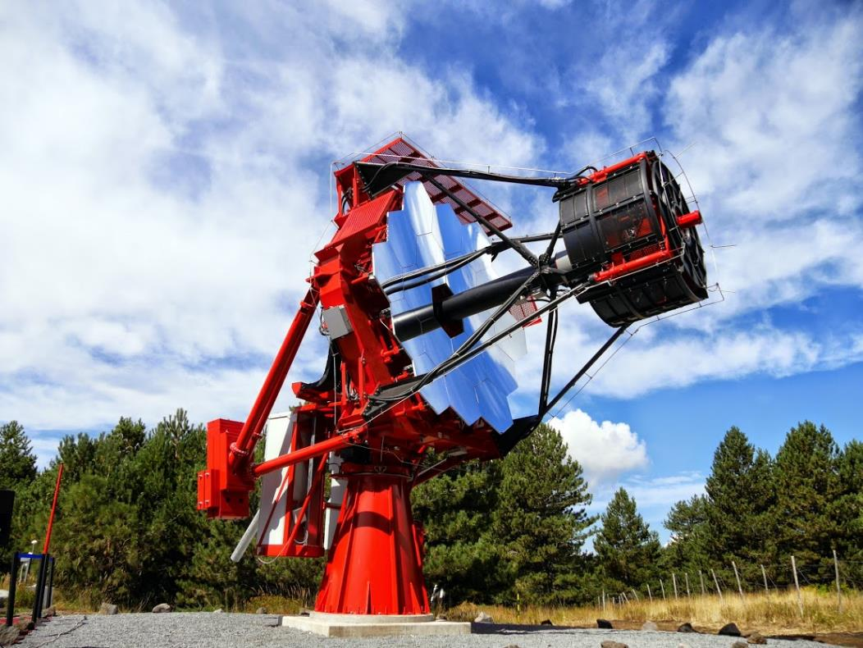
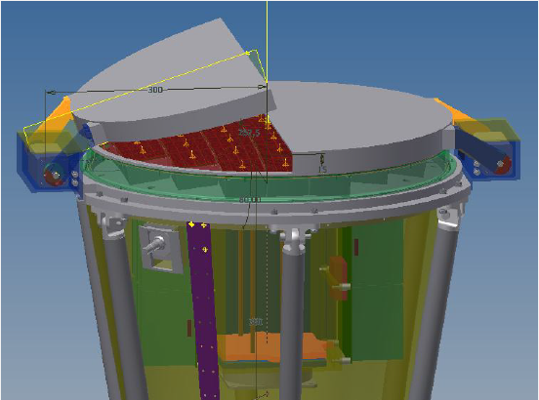
Small size telescope design – ASTRI
D₁ = 4.2 m, D₂ = 1.8 m.
F = 2.2 m, f = 0.51.
D_{C} = 0.37 m, FoV = 9.6°
α_{pix} = 0.17°, a_{pix} = 6 mm.
Pixel square SiPM,
64 per 52 × 52 mm² module
Seven pre-production telescopes on southern site by end 2017.
24

Slide 25
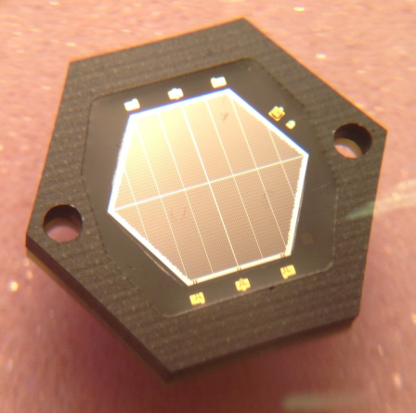
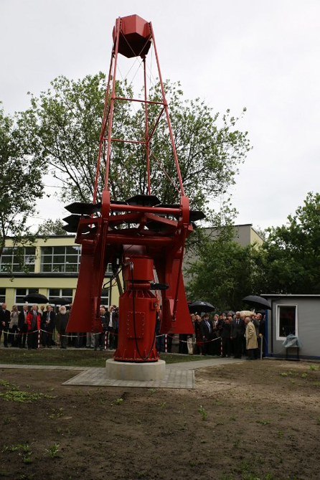
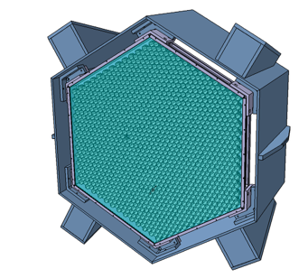
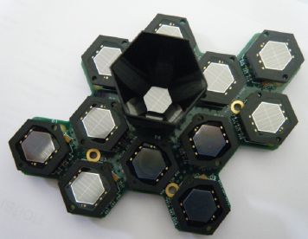
Small size telescope design – SST-1M
SST-1M:
D₁ = 4 m, F = 5.6 m, f = 1.4.
D_{C} = 0.88 m, m_{C} = 190 kg.
α_{pix} = 0.24°, a_{pix} = 23 mm.
Pixel hexagonal SiPM,
flat-to-flat size 9.4 mm,
with light concentrator.
Three pre-production telescopes on southern site by mid 2016.
25

Slide 26
The GCT consortium
Groups:
Adelaide Univ.
Aix-Marseille Univ.
CNRS
Durham University
MPIK- Heidelberg
Nagoya
Observatory of Paris
Univ. Amsterdam
Univ. Erlangen-Nurnberg
Univ. Leicester
Univ. Liverpool
Univ. Oxford
Univ. Paris VII
26

Slide 27
GCT groups
Group | Areas of interest
Adelaide University | SiPM testing
Aix-Marseille University | Leadership of GCT Monte Carlo studies
Centre National de la Recherche Scientifique | Testing prototype mirrors, GCT structure
Durham University | Leadership of GCT optics design, UK mirror and camera activities
Max-Planck Institut für Kernphysik | Camera assembly and testing
Nagoya University | SiPM and TARGET chip testing
Observatoire de Paris/Univ. Paris VII | Leadership of telescope structure design/production, prototype mirror production
University of Amsterdam | Camera DAQ, camera assembly
Universität Erlangen-Nürnberg | TARGET module development and testing
University of Leicester | Leadership of camera mechanical design, UK camera assembly and design, data activities
University of Liverpool | GCT leadership, UK mirror activities, SiPM testing, camera peripherals control, camera lid
University of Oxford | Leadership of camera electronics, TARGET and Backplane firmware
27

Slide 28
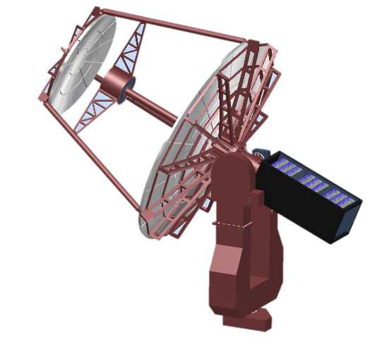
GCT structure/mirror progress
28

Slide 29
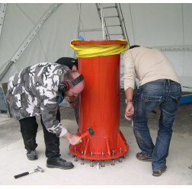
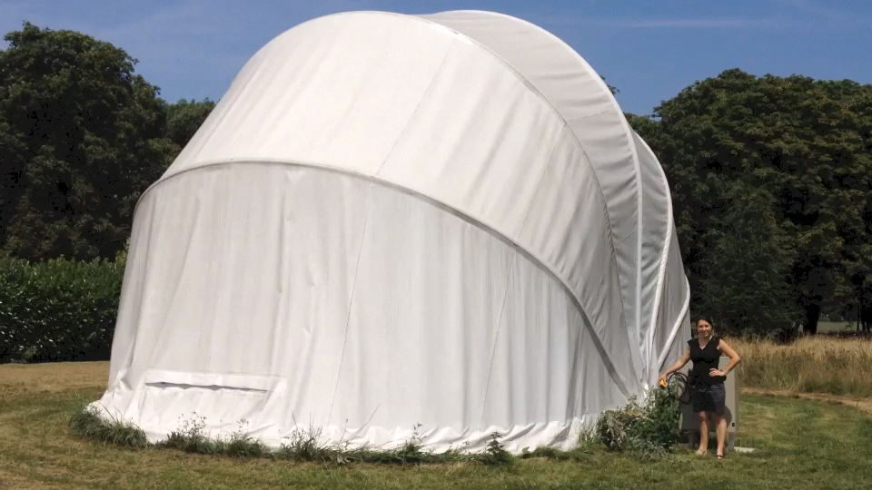
GCT structure/mirror progress
All structural elements now ordered, many delivered.
Foundations for prototype built in Meudon and telescope assembly started.
29

Slide 30
GCT structure/mirror progress
Primary mirror, prototype/pre-prod.
Two prototype petals machined, now being measured.
Coating and polishing in next 2 months.
Secondary mirror, constructed as six petals.
Polished as monolithic unit.
Telescope tested and ready to accept camera in Sept 2015.
30

Slide 31
Compact High Energy Camera
Chilled Block
Chilled Liquid
WP3.6 Thermal Control
Fans
Low Voltage
WP3.4 Backplane
Communications
WP3.1 Photosensor Modules
WP3.5 Camera Controller
WP3.8 Peripherals Control
WP4 LED Flashers, Pointing LEDs
WP3.6 Enclosure, Lid
WP3.2 Preamplifier
Module
WP3.3 Target Module
31

Slide 32
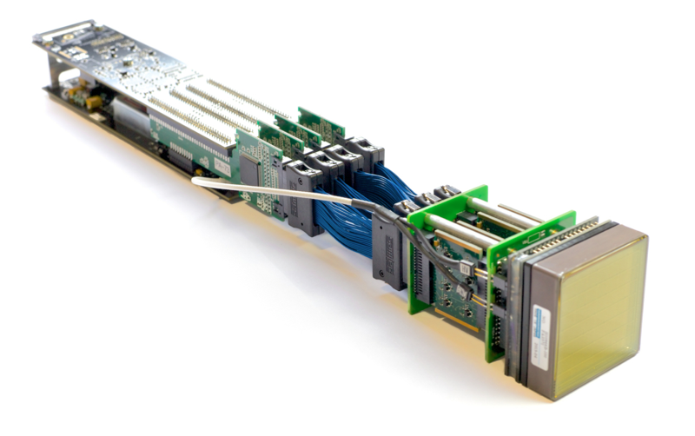
Sensors and
TARGET module
Connection to backplane
Gbit/s UDP
LVDS sub-ns accurate Trigger signals
4 x thick ribbon cable
Impedance matched to preamp and TARGET
4 x 16 ch preamp
0.6 mV Noise
100 MHz bandwidth
HV
0 – 1200 V
12 bit resolution
FPGA
ASIC readout and serialisation
Control and monitoring
TARGET ASIC
Gs/s FADC, 400 MHz bandwidth, 100ns readout windows, 16 μs buffer, analogue sum trigger
32

Slide 33
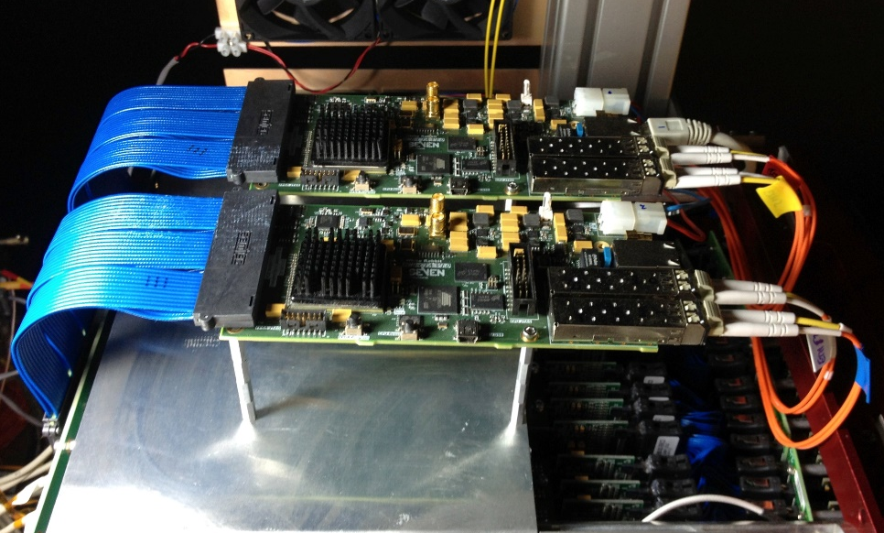
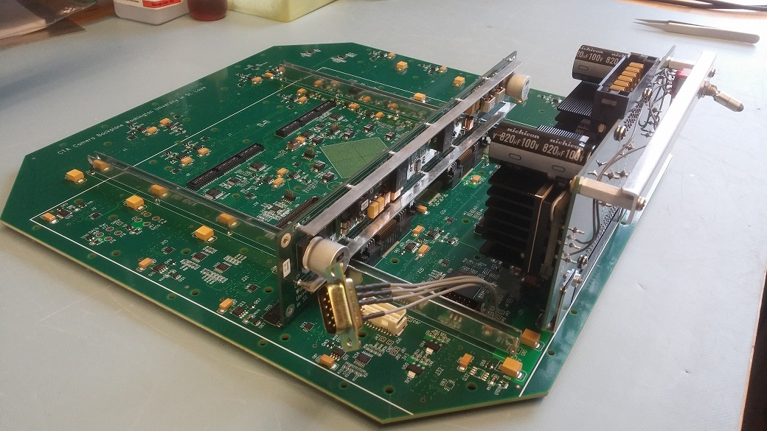
Backplane
DAQ
Module triggers combined in large FPGA to form camera trigger.
Distributes clock and transfers data to DAQ boards.
Prototype board being populated and tested (Washington Univ.).
Digitised signals from TARGET modules read out via Backplane through two DAQ boards, each with two Gbit/s ethernet fibre-optic links.
33

Slide 34
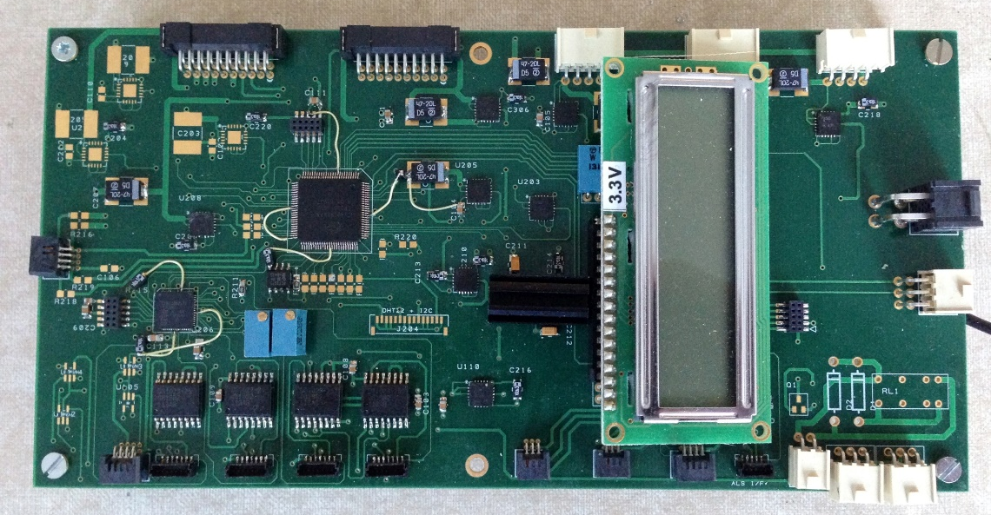
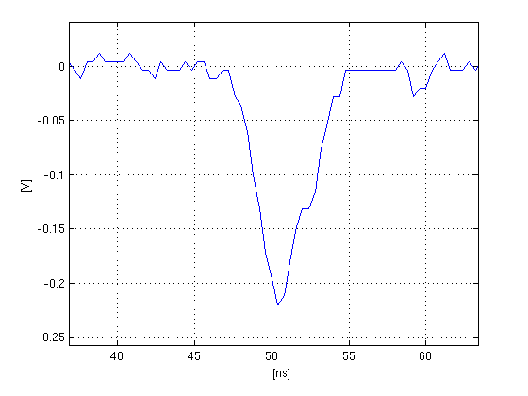
Peripherals board
Flashers
Peripheral control board (lid, fans, flashers, environmental sensors…) PCB produced and populated.
Suffered accidental damage during initial set-up.
Second board now populated, testing started on Monday.
Flat fielding system for camera.
Illuminate via reflection from secondary mirror.
About 1…1000 p.e. FWHM ~ 4 ns.
34

Slide 35
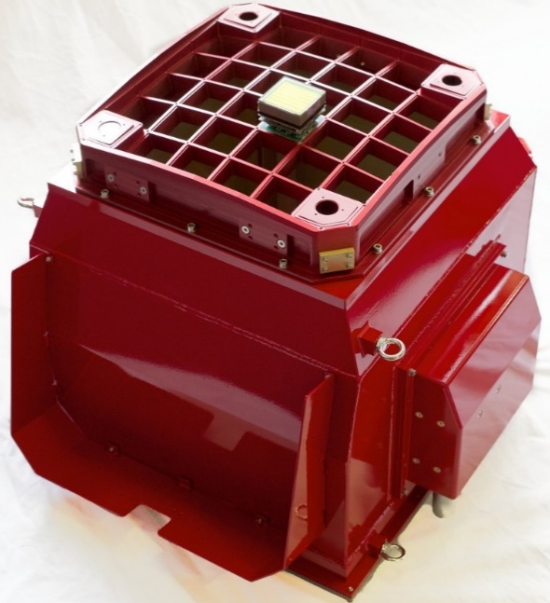
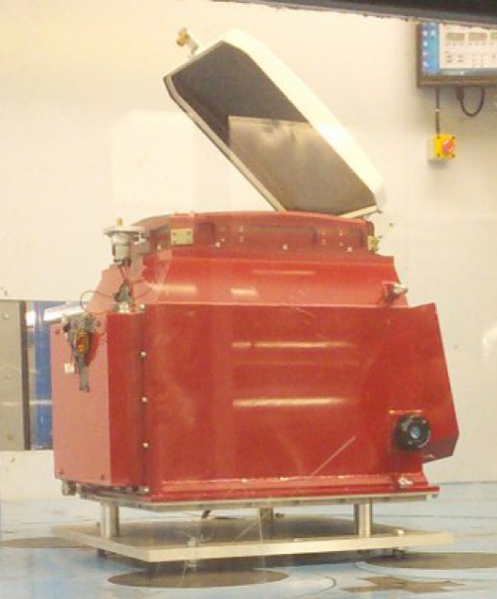
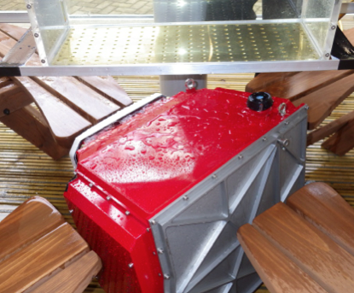
CHEC-M enclosure
Mechanical and thermal design completed and prototype constructed.
MAPMs positioned to 0.35 mm without “tuning”, 0.035 mm achievable with individual adjustment.
Tested in wind tunnel.
  Power of lid motors increased.
Rain test carried out.
  Lid seal redesigned/lid built.
Temperature/UV tests performed.
Integrate new lid and motor system with enclosure.
Install electronics in enclosure.
35

Slide 36
CHEC-M status
Chilled Block
Chilled Liquid
WP3.6 Thermal Control
Fans
Low Voltage
WP3.4 Backplane
Communications
WP3.1 Photosensor Modules
WP3.5 Camera Controller
WP3.8 Peripherals Control
WP4 LED Flashers, Pointing LEDs
WP3.6 Enclosure, Lid
WP3.2 Preamplifier
Module
WP3.3 Target Module
36

Slide 37
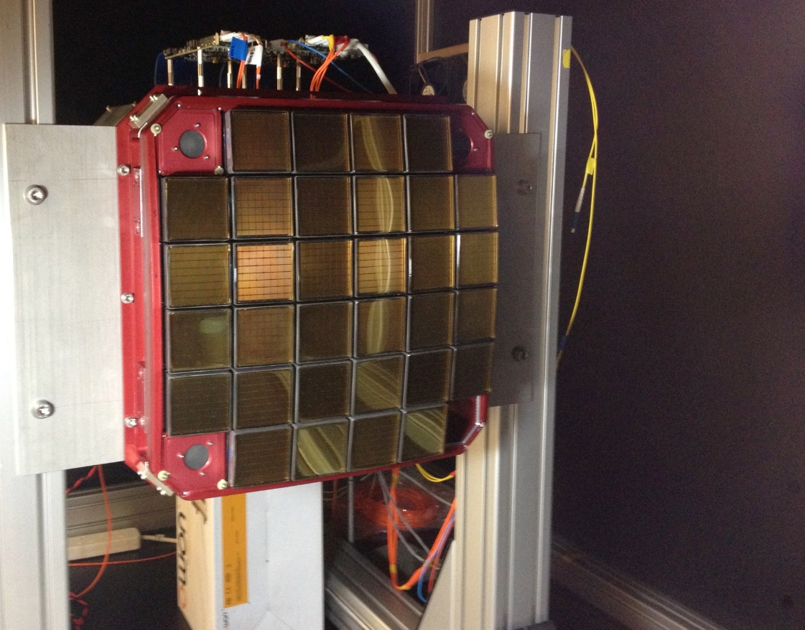
CHEC-M testing
Complete camera assembled, with simplified Backplane for tests (passes data to DAQ boards).
All electrical and mechanical interfaces functioned.
32 camera modules with MAPMs now integrated.
TARGET module communication established after some teething problems.
Use laser on robot arm to allow controlled illumination of camera (varying light spot intensity, size and position).
First light yesterday…
DACQ boards
CHEC-M integrated inside custom dark box
LED Flashers
MAPMs
37

Slide 38
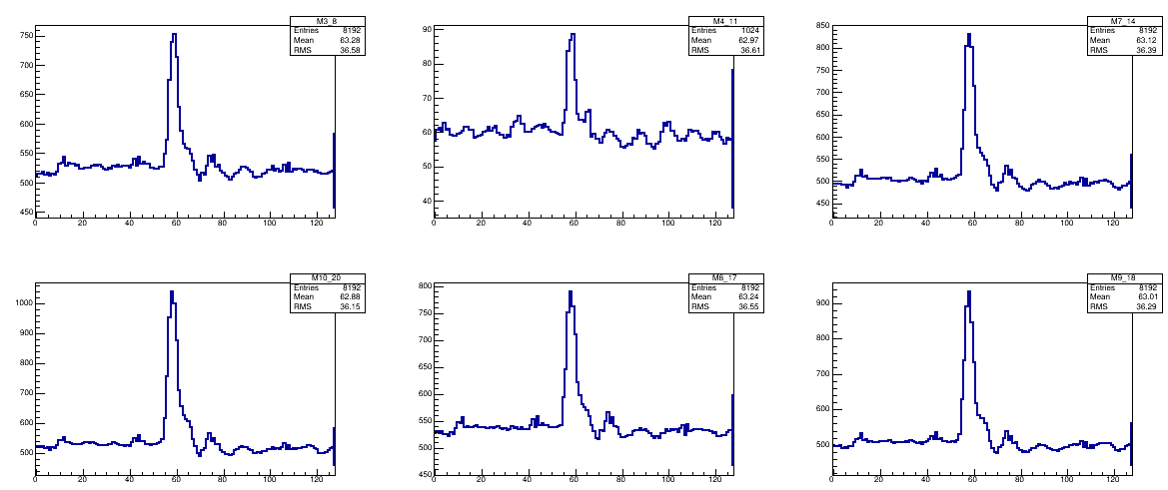
CHEC-M testing
Signals from 6 MAPMs generated using laser light pulses.
ADC samples
Time (ns)
38

Slide 39
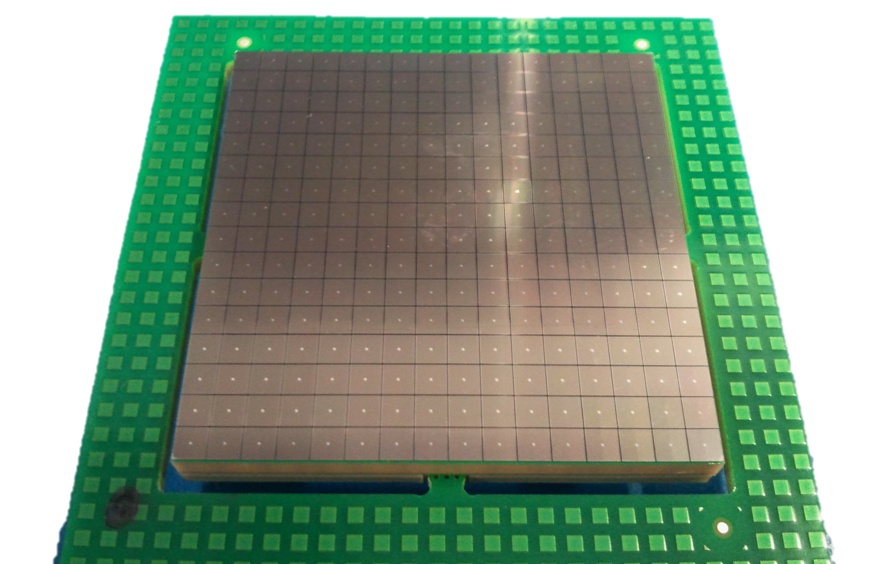
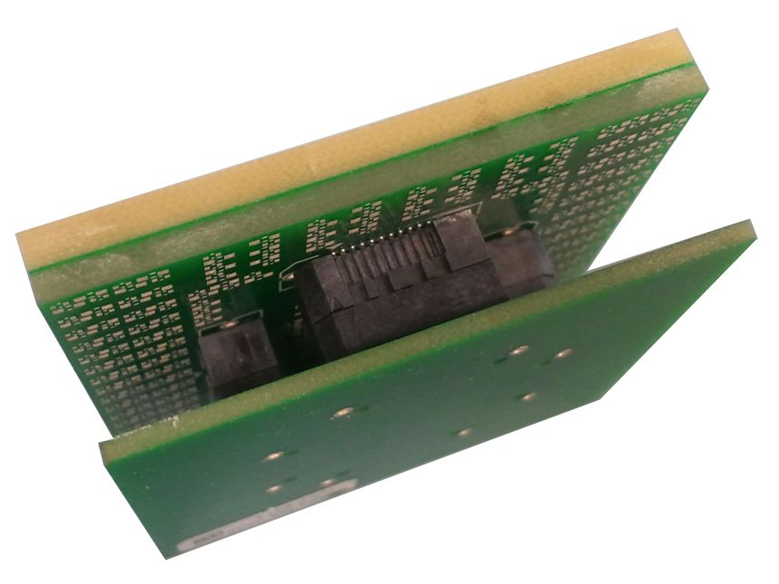
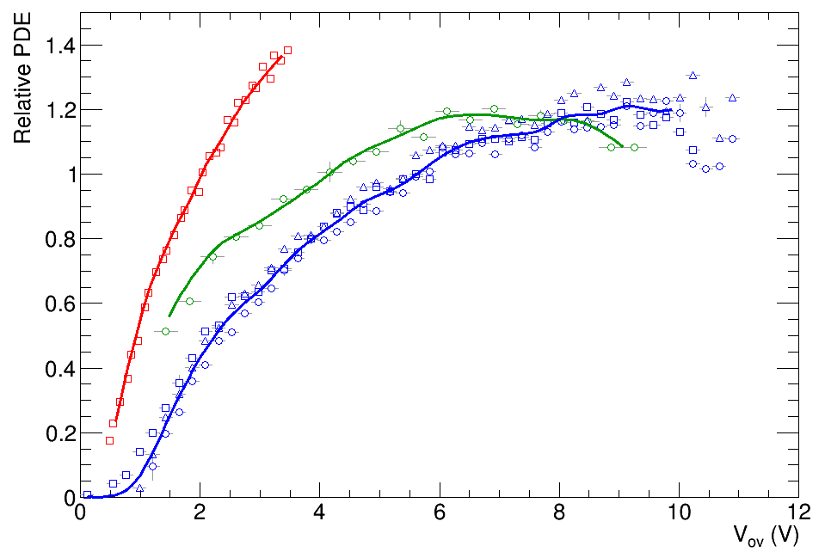
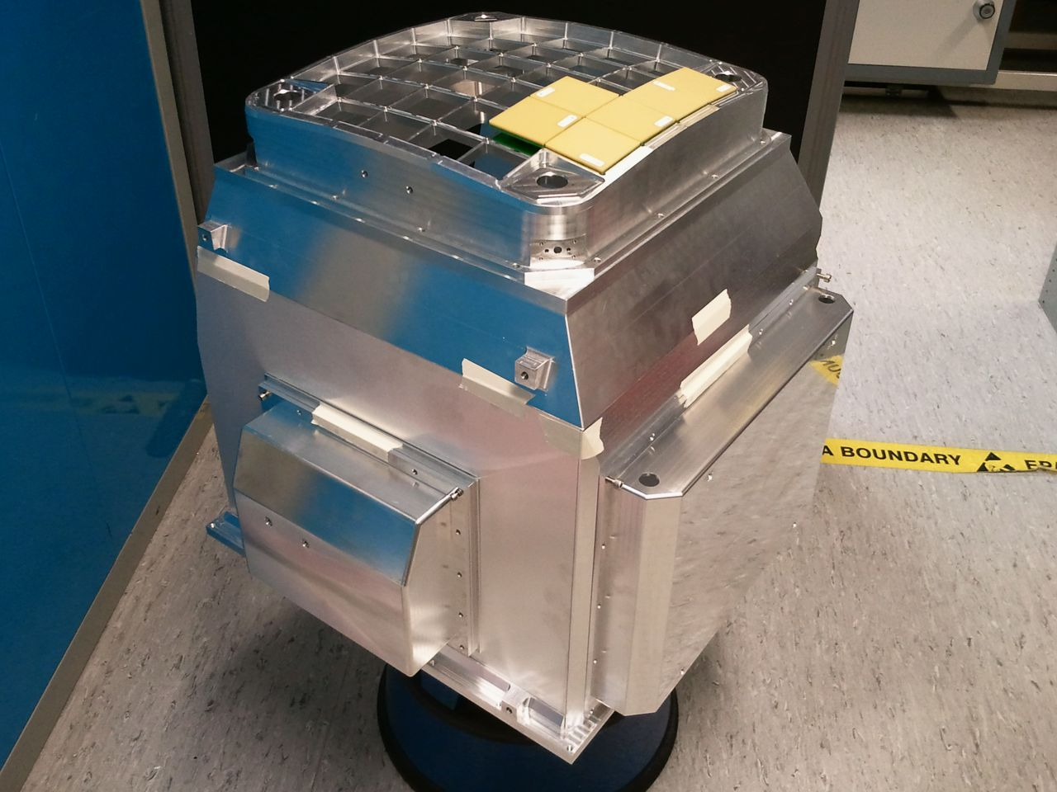
CHEC-S progress
Pre-amp and shaper designed, manufactured and tested.
Range of SiPMs tested.
Best selected and camera’s worth of sensors purchased.
TARGET modules under test.
First SiPM married to pre-amp.
CHEC-S enclosure assembled.
Hamamatsu
Sensl
Excelitas
39

Slide 40
Proposed UK programme, 2015…2017
Goals:
  Prepare contribution to CTA that will guarantee UK access to CTA data and observing time.
Activities:
  Complete CHEC-S Lab and CHEC-M and CHEC-S on-telescope testing.
  Design camera for pre-production phase of CTA compatible with GCT and ASTRI telescopes.
  Make one camera.
  (Two further cameras built to UK design, in Holland and Germany.)
Activities cont.
  Investigate possibility of mirror construction in UK.
  Study GCT camera support structure and alternative drives.
  Prepare for CTA data taking and analysis by contributing to CTA data pipeline and simulation activities.
Programme work packages:
  WP1 – Mirrors.
  WP2 – Structure and drives.
  WP3 – Camera.
  WP4 – Data.
  WP5 – Management.
40

Slide 41
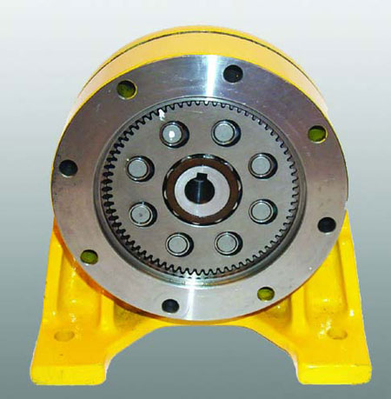
WP1 – Mirrors
WP2 – Structure
and drives
Programme with Glyndwr Innovations.
Machine (male) mould from suitable ceramic.
Develop slumping procedure in oven using 6 mm BK7 glass which gives required mirror shape.
Test mirror.
Durham, Liverpool.
Further FEA of camera support structure, stiffen if needed.
Investigate direct,
harmonic and
orbital drives.
Purchase and test
most suitable
LivJMU.
41

Slide 42
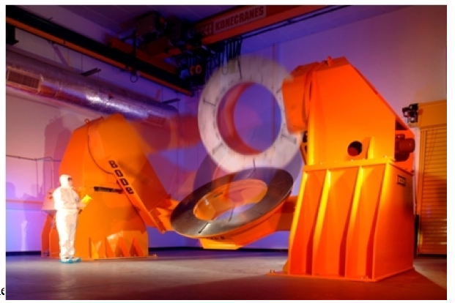
WP3.1, 3.2 – Camera assessment/design
WP3.3 –
Photodetectors
Complete commissioning and testing of CHEC-S cameras using facilities at Leicester and Durham (trigger, dynamic range, linearity, thermal performance…).
Test CHEC-M and CHEC-S on telescope in Paris.
Carry out any necessary electronic and mechanical design modifications.
Leicester, Liverpool.
Choose best SiPMs for GCT camera.
Purchase, characterize, and assemble onto PCB.
Rapid progress with SiPMs…
Liverpool, Leicester.
70
Confidential!
50 LCT4
60
Crosstalk
50LCT5
50
CHEC-S SiPMs
40
PDE
PDE & Crosstalk (%)
30
20
10
0
0
1
2
3
4
5
6
7
8
Vover (V)
42

Slide 43
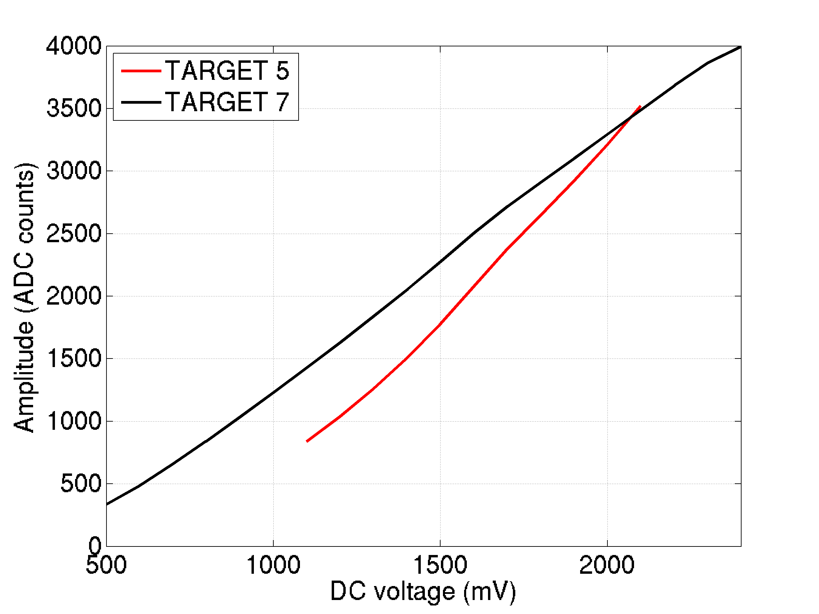
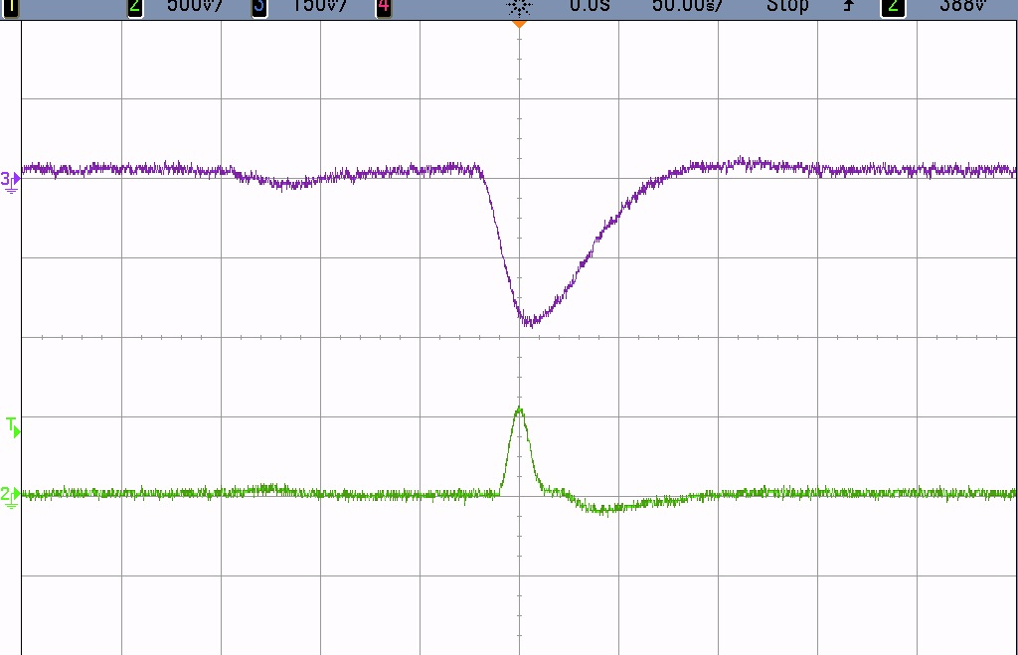
WP3.4.1 – Front end electronics
WP3.4.2 –
TARGET modules
Design preamp/shaper for GCT, want pulse with fast rise time and ~ 6 ns FWHM.
CHEC-S, with discrete components:
Reduce C using surface mount technology/use PACTA ASIC (ECM Barcelona).
Leicester.
TARGET 7 improves on range and linearity of TARGET 5…
…but trigger threshold higher than desired; solve by separating into TARGET C and CCTV (Hawaii).
Modify TARGET modules (Erlangen), develop firmware.
Oxford, Leicester.
Input (four 3 x 3 mm² SiPM pixels)
FWHM ~ 50 ns T_{r} ~ 10 ns
Output FWHM ~ 11 ns, T_{r} ~ 6.5 ns
43

Slide 44
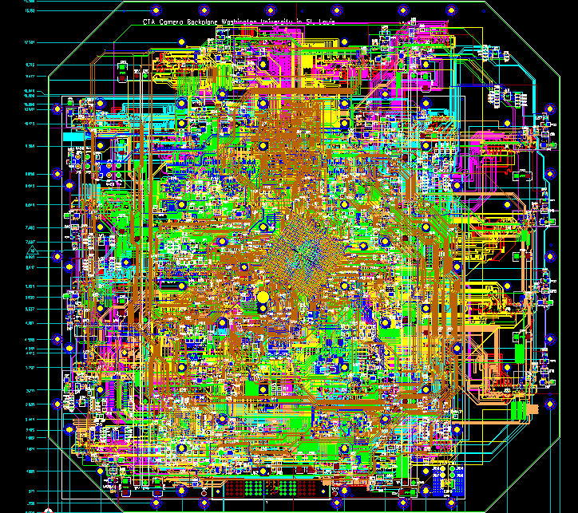
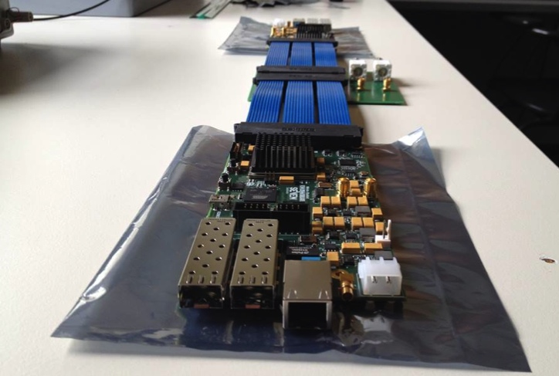
WP3.4.3 – Backplane
WP3.4.4, 3.4.5
– DAQ, peripherals
CHEC/SCT Backplane developed at Washington University.
Purchase Backplane for UK camera.
Oxford.
Upgrade system to single DAQ board per camera, with one 10 Gb/s link.
Amsterdam, with Seven Solutions.
Oxford (firmware, purchase of boards for UK camera).
Design, build and test peripheral control board.
Liverpool.
44

Slide 45
WP3.5, 3.6 – Calibration, auxiliary systems
WP3.7 – Assembly
integration and test
Following tests, carry out any necessary redesign of flashers.
Design calibration system for centre of secondary.
Build 6 new flashers, commission and test.
Durham.
Purchase PSU, chiller and pipework for GCT camera.
Write software to allow chiller control through CTA’s ACS interface.
LivJMU.
Assemble camera electronics/internal mechanics in Leicester and test.
Integrate into enclosure.
Test complete camera in Lab in Leicester.
Ship to Durham for environmental tests, calibration etc.
Check satisfies all CTA qualification tests.
Install on pre-production GCT.
Leicester, Durham, Liverpool, Oxford.
45

Slide 46
WP3 – Camera schedule
2014
2015
2016
2017
2018
2019
2020
Opportunity to change SiPMs – if geometry is compatible (package size) and if preamp changes are not needed/minimal
Prototyping
Final Photosensor Choice?
Further Component Tests
CHEC-M
CHEC-S
Pre-Production
3 Cameras
Production
This proposal
32 Cameras + upgrade of Pre-production cameras if needed
46

Slide 47
WP4.1 – Simulation
WP4.2 – Analysis
pipeline
Improve simulation of GCT using data from camera, telescope and mirror tests (trigger, PDE, optics…).
  Determine telescope and pre-production array sensitivity and angular and energy resolution.
  Contribute to developing instrument response function for complete array.
Durham, Leicester, Liverpool, Oxford.
Contribute to development of off-line analysis pipeline, through implementation of calibration model/instrument response function.
Contribute to development of real-time analysis pipeline for production and pre-production data
Demonstrate CTA pipeline functionality on DiRAC-3.
Work towards establishment of UK CTA data centre.
Leicester.
47

Slide 48
WP5 Management
UK leading GCT collaboration and working within CTA consortium.
Management of GCT through weekly telephone conferences of all collaboration.
Management committee meetings once per month.
Interface with CTA through Project Committee meetings in Heidelberg, biannual CTA meetings (Sept 2015 in Liverpool).
Biannual SST meetings run by UK.
CTA leadership roles in optics, outreach, SST, GCT, mirror testing, camera calibration, KSP (LIV)…
In addition must prepare for production phase.
  Test procedures must be documented.
  Data bases to allow tracking of all components through CTA lifecycle must be prepared.
  Documentation allowing non-specialists to assemble and maintain GCT structure and camera must be prepared.
Support required for CTA-UK members; Proj. Manager requested
(in-kind contribution to CTA).
All groups.
48

Slide 49

Milestones/schedule

Slide 50
Costs
Total £1.9M to STFC.
Costs by category:
Largest component staff.
Until now 67% of staff costs covered by STFC Fellowships, EU, Humboldt Foundation, Leverhulme Trust, JSPS, and CTA-UK Universities.
PhDs: John-Lennon Trust and EU.
By institute:
By work package:
50

Slide 51
Summary
Funding this proposal will:
Enable a continued strong and visible UK contribution to CTA through leadership of the GCT and its camera.
Provide a route for UK industrial production of GCT and other CTA mirrors.
Strengthen CTA’s simulation, data analysis and data-pipeline development while preparing UK scientists for CTA pre- and production data.
Ensure access for UK scientists to CTA data and observation time.

