Slide 1
UK participation in the pre-production phase of CTA 2015 – 2017
Questions for discussion:
Stretching the schedule
UK physics, KSPs, data rights and the SST contribution
Non-UK contributions to the GCT
CTA and UK management
UK data centre
Data pipeline activities
Physics exploitation
R&D/prototyping and pre-production phases
Effect on CTA of delays in UK programme
Possible take-up of UK responsibilities by non-UK GCT institutes
Risk register with costs
Consequences of not funding project management
CTA project status and milestones
Site
Camera specifications
Track record of Glyndwr Innovations
Impact of optical tolerances on mechanical design
Descoping possibilities

Slide 2
Stretching the schedule
CTA schedule foresees first prep-production telescopes on southern site by mid 2016.
Before starting GCT production, must demonstrate functioning of GCT camera/telescope on site.
Delaying development of GCT camera delays acceptance and installation of all GCTs.
Limits HE sensitivity of CTA.
Delays UK physics.
2

Slide 3
UK contributions to CTA KSPs
CTA Key Science Projects are those the consortium proposes to study using its dedicated observing time.
CTA review of KSPs headed by Subir Sarkar (Oxford).
Topics which have strong UK leadership component include:
Active Galaxies KSP
A.Brown (Durham), G.Cotter (Oxford), M.Daniel (Liverpool),
M.Fairbairn (KCL), M.Hardcastle (Hertfordshire), C.Mundell (Bath)
CTA observations are relevant to:
Physics of AGN.
Extragalactic background light.
VHE γ rays interact with EBL and CMB (E_{γ} above ~ 1 TeV, ~ 100 TeV).
3

Slide 4
UK contributions to KSPs
Observing spectrum of distant HE sources allows measurement of EBL.
Provides information on light produced by first stars and hence on galaxy/structure evolution in the universe.
Searches for axion-like particles
Spectra of sources change if photons interact in B-field to become ALPs and vice versa.
Chadwick, Harris (Durham) studied some sources, identified
PKS 2155-304 as interesting.
E.g. of effects on VHE spectrum:
Cover range m_{a} < 100 neV and
g_{aγ} > 2 × 10⁻¹¹ GeV (Meyer, Conrad).
4

Slide 5
UK contributions to KSPs
Lorentz Invariance Violation 1
M.Fornasa (Nottingham), M.Wilkinson (Leicester), M.Daniel (Liverpool).
Refractive index of vacuum may be energy dependent.
Parameterise dispersion using expansion:
Observation of γ flares from remote AGNs or GRBs may allow detection of energy dependent time delays.
Problem is disentangling source and propagation effects.
Most constraining current results:
  Fermi-LAT observation of GeV photons from GRB 090510
  imply
  AGN flare (PKS 2155-304) seen by HESS gives
CTA will see more sources, out to larger distances.
Limits M₁ ~ M_{Pl} possible, significant improvement in constraints on M₂.
5

Slide 6
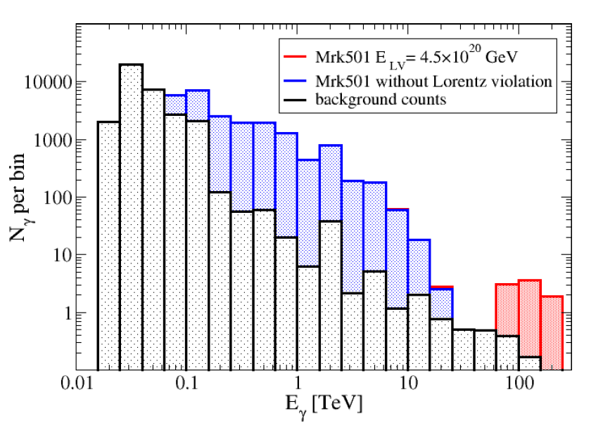
UK contributions to KSPs
Lorentz Invariance Violation 2
M.Fairburn, J.Ellis, (KCL), J.Hinton, R.White (ex-Leicester).
HE γ rays interact with the EBL
(for E_{γ} > 1 TeV) and the CMB
(for E_{γ} > 100 TeV).
Expect universe to be opaque at the highest energies.
But if Lorentz invariance is violated, kinematics of pair production change.
Opacity decreases again at HE.
50 hour observation of Mrk501:
Depending on assumptions made about source spectrum, allows limits M₁ ~ M_{Pl}, M₂ ~ 5 × 10¹¹ GeV.
6

Slide 7
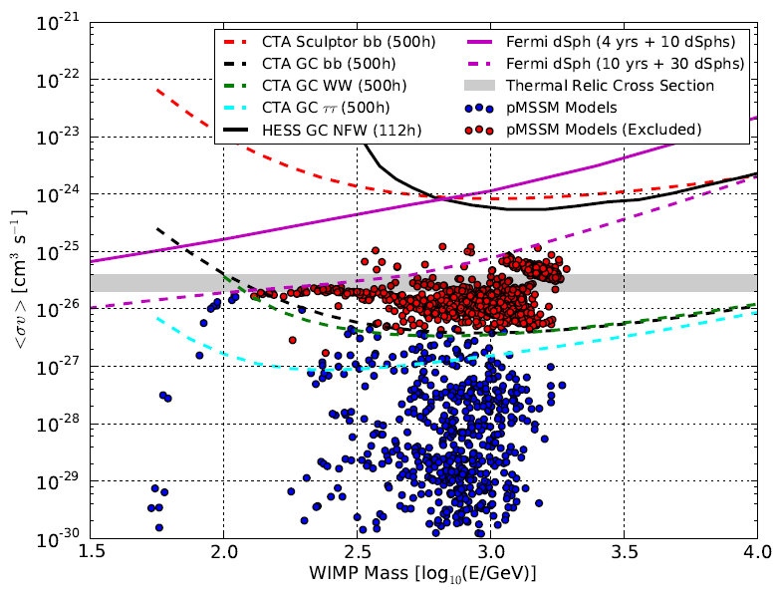
UK contributions to KSPs
Dark Matter Search
M.Fornasa (Nottingham), M.Wilkinson (Leicester), M.Daniel (Liverpool).
Look for evidence of DM through annihilation to photons.
Signal depends on square of DM density, BG on co-located astrophysical sources.
Galactic Centre large signal and BG, Dwarf Galaxies smaller signal but less BG.
GC observations (500 hours) with CTA rule out 50% of WIMPs in pMSSM at 95% CL.
Sensitivity of CTA for GC and Sculptor compared with pMSSM models.
Wood et al, arXiv:13050302
7

Slide 8
UK contributions to KSPs
Transients
P.O’Brien (Leicester), M.Daniel (Liverpool), J.Osborne (Leicester), C.Mundell (Bath).
Follow-up of:
  Gamma-ray bursts.
  Galactic transients.
  High-energy neutrino transients.
  Gravitational waves.
  Optical and radio transients.
VHE transients, discovered via real-time analysis (RTA) during scheduled CTA observations.
VHE transient survey, utilizing divergent pointing observations.
Galaxy Clusters
M.Fornasa (Nottingham), M.Wilkinson (Leicester), M.Daniel (Liverpool), A.Edge (Durham).
Evidence of CRs (electrons and protons) accelerated by e.g. AGN.
Diffuse emission, study of IGMF.
8

Slide 9
UK interest in CTA physics
UK scientists will gain access to CTA data and observing time through CTA-UK in-kind contributions to the observatory.
Interest expressed by many in UK:
Tony Bell (Oxford). CTA will be the ideal instrument to settle the question of the origin of Galactic cosmic rays …first telescope to image gamma-rays produced by cosmic rays with energies above a PeV.
Subir Sarkar (Oxford). The search for DM annihilation in the Galaxy will be extended by CTA to much heavier particles than has been possible so far in γ-ray astronomy.
Martin Hardcastle (Hertfordshire). CTA's combination of sensitivity and resolution will allow us to detect…structures [in radio loud active galaxies] in inverse-Compton emission at TeV energies and, crucially, to spatially separate them from emission from the active nucleus itself.
Brian Reville (QUB). Directly probe the physics at the knee.
Alastair Edge (Durham). AGN.
Will Potter (Oxford). Black hole jets.
Dimitris Emmanoulopoulos (Southampton). LIV.
9

Slide 10
UK interest in CTA physics
Malcolm Fairbairn (KCL). Extreme AP environments in which TeV photons created and radiation fields they travel through.
Anne Green (Nottingham), Mark Wilkinson (Leicester) DM.
Richard Wilson (CfAI). Instrumentation development (turbulence profiling and optical wave-front sensing) for the ELT using CTA.
10

Slide 11
CTA data rights
Science data is either Open Time or Core Programme (some Directors Discretionary Time foreseen).
Relative fractions:
  Expected to evolve from mostly CP to mostly OT over about 10…15 years.
  Expected to be 50:50 CP:OT over this period.
CTAC members come from a CTAO nation contributing to the construction/operation of CTA, and are individually contributors to CTA.
CTAC members have access to all Core Programme data (i.e. all Key Science Projects).
From draft Data Rights Policy (3/14):
  CTA data proprietary to the PI successfully proposing to an AO for 1 year
  Access to the high-level science data in the CTA archive is fully open to the world.
  PI may get data from entire FOV or just the target region (TBD).
  Data from DDT or unanticipated Targets of Opportunity may be proprietary for up to 6 months.
  Data taken during the construction phase will not be open, but will belong to the in-kind contributors.
11

Slide 12
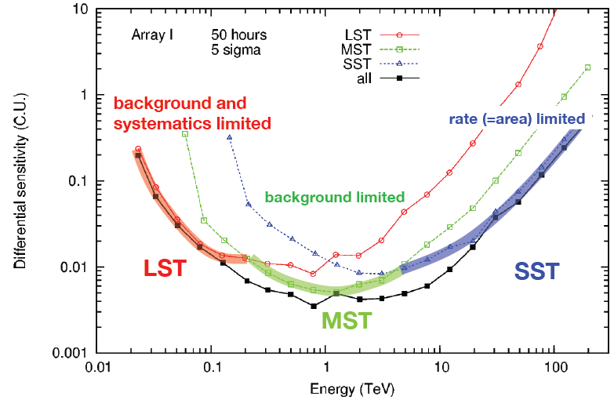
SST contribution
CTA sensitivity above a few TeV dominated by SSTs.
Differential sensitivity (C.U.)
12

Slide 13
SST contribution
Highest energy angular resolution provided by SSTs.
Highest energy resolution in SST energy range.
ΔE/E
S. Funk et al. (2013) Aph. 43, 348.
13

Slide 14
Non-UK GCT contribution
Telescope structure:
14

Slide 15
Non-UK GCT contribution – camera
For pre-production
phase anticipate obtaining funding for one camera
in Holland,
one in
Germany,
one in UK
with some support from Australian and Japanese
groups.
15

Slide 16
Non-UK contributions to the GCT
Netherlands €645k awarded for pre-production phase. Applying for production phase funding now. Hope for ~ €2.5M.
France, discussions regarding pre-production and production phases going on now; aim is to get funding for telescope structures of ~ €4M.
Germany, Max Planck plus BMBF funding, €1M for GCT pre-production, further ~ €3M for production phase.
Japan, ~ €1M secured so far.
Australia, funding received for SiPMs for pre-production phase, total contribution about €0.5M.
Hoped for UK production contribution ~ €5M.
Total anticipated funding about €15M.
Allows construction of ~ 35 GCTs with cameras.
France, Germany and Japan also contributing significantly to CTA in other areas.
16

Slide 17
CTA-UK management and interfaces with GCT and CTA
CTA-UK organogram:
CTA-UK meets three times a month with other GCT partners.
GCT management meets monthly.
Further telephone conference slot kept free for UK-specific meetings if needed.
17

Slide 18
GCT management
GCT organogram.
Interface to CTA is through Project Committee.
Monthly meetings attended by:
  Tim Greenshaw.
  Helene Sol.
  Delphine Dumas.
UK representatives
on CB are Chadwick,
Cotter, Greenshaw
and Osborne.
18

Slide 19
UK data centre
Not part of this proposal.
TDR suggests 4 data centres, with bulk data processing as IKC to CTA.
UK benefit could come from additional national resource, profiting from data centre expertise in software and analysis.
19

Slide 20
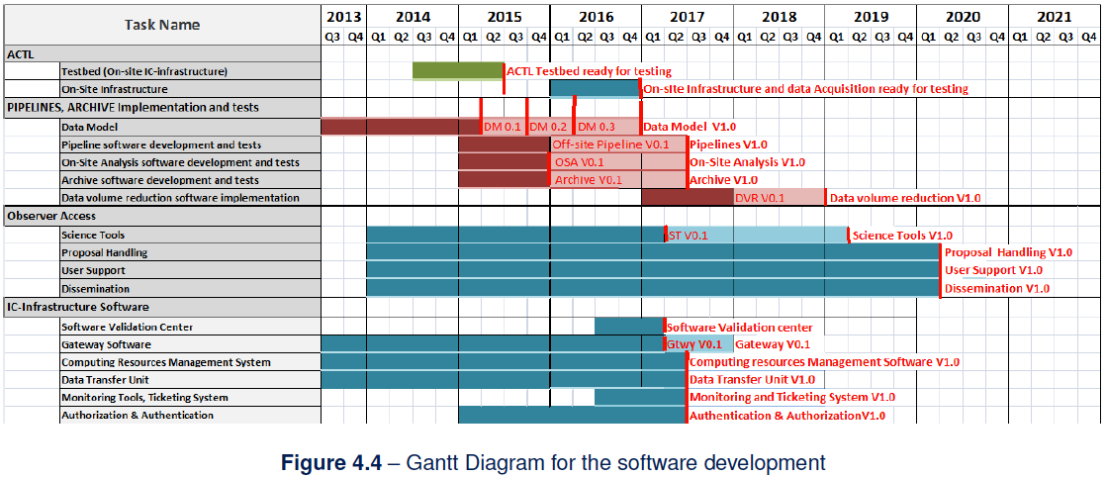

Proposed data pipeline activities and CTA schedule
Proposed WP 4.2 activities.
20

Slide 21
Strategy for physics exploitation
Several strands being pursued.
One is UK involvement in CTA science working groups, leading e.g. to UK input to KSPs.
Involves people on this proposal but also wider CTA-UK community.
KSPs led by Subir Sarkar.
Second is to inform broader community in UK about opportunities offered by CTA, e.g. through IoP meeting “The Violent Universe”, proposed RAS meeting on CTA science and CTA science meeting in Liverpool in conjunction with the CTA consortium meeting in September 2015.
21

Slide 22
Strategy for physics exploitation
Alignment of R&D/
pre-production
Third is involvement in CTA DATA project.
Provide UK expertise to CTA development of pipeline and calibration model.
Ensures UK access to data analysis software during development phase.
Areas of interest include sophisticated image analysis (e.g. optimising incorporation of precise timing information) and real time analysis (c.f. transients KSP).
For camera:
Prototyping phase involves design, construction and testing of MAPM- and SiPM-based prototype cameras, CHEC-M and CHEC-S.
Pre-production phase, design and construction of camera for installation on GCT on southern site.
Require improved trigger performance (TARGET ASIC), best possible SiPMs…
Successful demonstration of telescope and camera on site required before can move to production phase.
22

Slide 23
Management and effect of delays
The CTA strategy for dealing with delays in one of telescope types is:
Prepare the site infrastructure for all telescope types (including those that are delayed), e.g. pour foundations, build roads, lay power cables to… minimizes heavy traffic at later stage.
Proceed with construction and commissioning of available telescopes.
This limits the array sensitivity in the affected energy range.
The delayed telescopes are then installed as they become available.
Installation can proceed during the day without severely curtailing night-time operation of the existing telescopes.
Delays to the UK camera development in the pre-production phase would lead to delays in the installation of the GCTs.
The resulting reduction in the area covered by CTA would cause a loss of high energy sensitivity.
UK scientists may not risk losing first CTA data.
23

Slide 24
Ability of GCT collaborators to cover UK funding deficit
It is foreseen that the UK-designed camera will be constructed with contributions from Dutch (e.g. DAQ system, camera assembly), German (TARGET modules, camera assembly), Japanese and Australian (SiPMs) and US groups (Backplane).
We benefit from this e.g. through the development of the Backplane in the US and the DAQ boards in Holland.
The UK contribution includes the overall design, the mechanical structure, the peripherals and their control, the camera server and control software, first camera testing and development of test procedures.
Even assuming the availability of funding, our collaborators are not in a position to replace UK expertise in a significant proportion of these areas on the timescale required.
The UK facilities have been built up over the period of the last grant, using mainly STFC, Leverhulme and university support (e.g. Leicester and Durham test facilities) and involve significant expertise (e.g. Oxford FPGA engineering effort).
It would take a similar amount of time to establish these facilities elsewhere and would be difficult to find equally skilled technical support.
24

Slide 25
Ability of GCT/CTA collaborators to cover
UK funding deficit
The impact on CTA of a loss of funding in the DATA studies would be the loss of the expertise of UK physicists who have been involved in data analysis for IACTs, Fermi and other experiments…
…but also of expertise in the development of data products for satellite experiments (Swift, XMM-Newton Survey Science Centre).
The (near) full time effort on data pipeline development will be a noticeable loss.
The impact on the UK would be the delay in preparations for UK analysis of (early) CTA data.
Loss of the drives studies may mean the GCT is more expensive than necessary; this study will not be taken up elsewhere.
The loss of structure studies will mean any problems in the camera support will first be found when the camera is installed on the telescope.
The hardware for the mirror development has been purchased through a capital funding bid, so these studies will go ahead, but loss of optical engineer Schmoll would make translating the results of the mirror development to the telescope performance difficult.
25

Slide 26
Risk register
26

Slide 27
Risk register
27

Slide 28
Risk register
28

Slide 29
Risk register
29

Slide 30
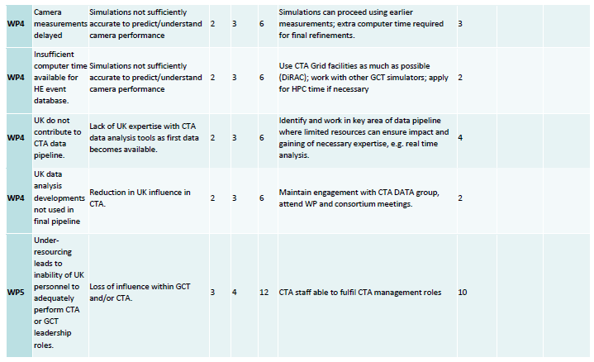
Risk register
30

Slide 31
Risk register
Risks we consider to be significant are:
  New TARGET ASICS don’t meet specifications and a new run is needed, UK contribution £15k.
  Backplane requires modification, UK contribution £23k.
  Damage to sensor/components during assembly, integration and testing; establish GCT spares fund, UK contribution £15k.
Total £53k.
31

Slide 32
Consequences of not supporting project management
Moving into pre-production and production phases requires proper quality management.
Must document receipt of sensors and other components from industry and other GCT institutes, their testing and calibration and incorporation into camera(s) – part of CTA quality control procedures.
Must also document camera installation, operation and maintenance procedures.
Requires dedicated effort: we estimate 0.5 FTE needed for above plus some management of CTA-UK.
Experience from previous grant was that producing documentation required by CTA used a significant amount of technical staff time.
One of factors that led to delay in production and testing of the CHEC cameras.
Remaining 0.5 FTEs of Project Manager would be in-kind contribution to CTA.
Suggestion is PM would have similar roles in UK and in Project Office, e.g. design and management of DBs documenting telescope production.
32

Slide 33
CTA project status
Schedule shown above.
Southern site
ready for telescopes in mid 2016.
Some milestones:
GmbH formed Aug. 2014.
SST TDR Review Nov. 2014.
CDR Jun. 2015.
Southern site signature Jul. 2015.

Slide 34
Camera specifications and their verification
Developed by CTA through extensive programme of MC simulations.
Verification of camera performance described in Design Verification Document.
34

Slide 35
Glyndwr Innovations
Projects of relevance, mirror segment prototypes construction for ELT.
Studies of large (1 m and above) scale, light-weight carbon-fibre mirrors for an industrial application.
Optical test facilities, including the design and commissioning of optical test systems for a wide range of products.
Support systems for large optics of sizes up to 4 m in diameter.
High precision actuation (to 100 nm) of optical components weighing up to 200 kg.
Caroline Gray (engineer at Glyndwr Innovations working on GCT Project) has previous experience of hot slumping.
Starting from a base set of process parameters she believes will be close to those required.
Commercial review being undertaken by Glyndwr University.
Not yet formally completed, but Glyndwr Innovations given go ahead to sign contract for mirror study.
Work starting.
35

Slide 36
Southern site
Mid 2016 telescope installation achievable at Paranal, some delay if Aar chosen (elections in Namibia)?
Site survey following
decision.
Design of infrastructure
for southern site progressing.
Layout for roads:
Road alignment to suit
interface with apron around
each telescope, roads series of straights between telescopes.
Primary road through centre
of array revised. Minor
revisions to secondary roads.
First designs available for lightning protection, power and data networks, buildings on site…
KEY:
Perimeter fence
Access road
Power, data (& if reqd. drainage & lighting) networks follow roads
Primary road
Secondary road
Construction road
Ops/Techl/Residence (diagramatic)
Water treatment + back-up power (diagramatic)
Calibration/measuring equipment (diagramatic)
Site security
36

Slide 37
Impact of optical tolerances on mechanical design
Optical tolerances calculated using Zemax, verified using MathCad and Robast in-house routines.
The following deviations affect PSF less than 10% (after refocussing).
Allowable mirror panel misalignments:
All deviations simulated using MC to ensure that overall effects tolerable.
Mechanical design based on these parameters.
Element decentre | M1 | ± 2 mm
 | M2 | ± 2 mm
Element tilt | M1 | ± 1’
 | M2 | ± 3’
 | Focal plane | ± 5’
Error | Surface | Tolerance
Distance deviation | M1 to M2 | +/- 5 mm
 | M2 to camera | (+/- 5 mm)
Surface irregularity | M1 | 20 µm rms
 | M2 | 50 µm rms
Surface roughness | M1 | 1 µm rms
 | M2 | 1 µm rms
Radius deviation | M1 | +/- 10 mm
 | M2 | +/- 3 mm
 | camera | +/- 3 mm
Element decentre | M1 | +/- 5 mm
 | M2 | +/- 5 mm
 | camera | +/- 5 mm
Element tilt | M1 | +/- 0.14˚
 | M2 | +/- 0.14˚
 | camera | +/- 0.14˚
37

Slide 38
Study of mechanical design
Extensive FEA carried out on structure (two analyses).
E.g. decentering between camera, M1 and M2 die to gravity:
Within tolerances for optical performance (± 5 mm).
Wind induced decentering for
36 km/h wind smaller than effect of gravity.
Combined gravity/wind induced decentering at 20° elevation as function of wind direction:
Within tolerances.
38

Slide 39
Study of mechanical design
Actuators will be used to align mirrors and to focus the telescope.
Specifications chosen in accordance with the alignment tolerances.
Alignment procedure developed.
Take image, move test panel, take new image.
Subtract to identify image elements due to test panel.
Correctly align test panel.
Move in to second panel
Iterate if necessary.
Tested successfully on ¹/₁₀ scale model on optical bench.
FEA used to study response to high wind speeds.
Maximum wind speed at which telescope steered gust of 83.5 km/h.
Largest absolute deformation 13 mm.
Maximum wind speed in parked position is gust of 200 km/h.
Largest absolute deformation 19 mm.
39

Slide 40
Study of mechanical design
Wind-induced stresses always below allowable values for steel/aluminium.
Advisable to reinforce counterweight support and perhaps tower based to provide larger safety factor.
40

Slide 41
Study of mechanical design
FEA used to determine normal oscillation modes of structure.
First mode is due to rotations about vertical axis with superimposed translation along elevation axis.
Frequency is 2.8 Hz when pointing to horizon, higher otherwise.
Above CTA specification of 2.5 Hz (designed to prevent wind-induced oscillations).
FEA also used to investigate response of structure to seismic activity expected in Paranal (worst case).
Spectrum of vertical and horizontal accelerations applied:
Accel (g)
Time (s)
41

Slide 42
Study of mechanical design
Combining earthquake with
120 km/h wind leads to some local stresses where there is little safety factor.
These areas (counterweight support, tower base – steel, two secondary mirror support ribs – Al) will be reinforced in the next design iteration.
42

Slide 43
Descoping
Priority for CTA-UK is to ensure access to CTA data for UK scientists.
Requires UK in-kind contribution to CTA commensurate with GDP (exact conditions not yet defined – scale of proposed total contribution 2…3% of CTA construction costs).
Camera development and construction is the element that provides route to this scale of contribution, so is highest priority for CTA-UK.
Second priority is contribution to CTA DATA project, as this will aid in particular early UK physics studies.
Remaining parts of programme are drive and structure studies and mirror development.
Hardware for mirror studies purchased through capital bid.
Contract with Glyndwr Innovations signed and work starting.
Drive studies would probably reduce telescope costs, but current drives will do the required job.
43

Slide 44
Reduction to 80%
Must save ~ £400k.
Achieve through:
Removing costs of mirror hardware (capital bid), DAQ boards (capital bid), SiPMs (get from Adelaide).
Liverpool support for Daniel for additional 10 months, Durham for Brown 2 months.
Removing structure and drives studies*.
Removing mirror effort bar Schmoll*.
Removing Rose**.
Re-using chiller and PSU**.
Item | Saving (£) | Comments
Remove WP1 consumables & equipment | 24588 | Funded through capital bid
Do not purchase DAQ boards | 14400 | Purchased by Amsterdam University
Do not purchase SiPMs | 91140 | Purchased by University of Adelaide
Reduce support for Daniel by 10 months | 61926 | Will be supported by University of Liverpool
Reduce support for Brown by 2 months | 10263 | Will be supported by University of Durham
Remove WP2 | 39191 | No work on structure and drives; GCT cost probably increased
Remove all WP1 effort etc. except Schmoll | 77204 | Technical risks to mirrors increased
Remove Rose from project | 44586 | Lose manpower in trigger, sensor testing, physics analysis; increases risk
Reduce Rosen to 75% | 23923 | Impacts on UK DATA contribution
Do not purchase chiller | 4880 | Lack of chiller for Lab tests once shipped to telescope; introduces delays
Do not purchase PSU | 1840 | Lack of PSU for Lab tests once shipped to telescope; introduces delays
Total saving | 393941

Slide 45
Reduction to 60%
Must save ~ £790k.
Fund SiPMs and DAQ through capital bid.
10 months Daniel.
Reuse chiller/PSU**.
Remove WP1, 2 and 4**
Reduce Brown to 0.6**.
Remove Rose**.
Remove PM**.
Reduce effort of Cotter, Clark and Greenshaw**.
Remove | Saving (£) | Comments
WP 1, 2 and 4 | 436143 | No work on structure and drives, mirrors funded largely through capital bid, no work on data pipeline
Do not purchase SiPMs | 91140 | No impact, purchased by Adelaide
Do not purchase DAQ boards | 14400 | Funded through capital bid
Do not purchase chiller | 4880 | Lack of chiller for Lab tests once shipped to site
Do not purchase PSU | 1840 | Lack of PSU for Lab tests once shipped to site
Reduce support for Daniel by 10 months | 61926 | University of Liverpool support, no impact
Remove Rose from project | 44586 | Lose manpower in trigger, sensor testing, physics analysis
Reduce support for Brown to 0.6 | 13194 | Increased impact on camera testing
Remove Project Manager | 88251 | No UK in-kind contribution, impact on schedule and/or production of documentation
Reduce effort of Cotter to 20% | 9856 | Loss of oversight of back end electronics development and of UK data analysis expertise.
Reduce effort of Clark by 50% | 6290 | Loss of camera testing effort.
Reduce effort of Greenshaw to 10% | 21834 | Impact on project oversight and schedule.
Total | 794340

Slide 46
Reduction to 40%
In this situation we are unable to support many of the electronic and mechanical staff key to design and construction of the camera.
We would seek to complete:
  Testing of CHEC-M (adding Backplane, testing in Leicester, testing on telescope in Meudon).
  Construction and testing of CHEC-S (mounting of SiPMs, FE electronics and TARGET modules, DAQ boards and Backplane, testing in Lab and on telescope).
We would then pass on these results to our GCT and CTA collaborators.
We would not be in a position to construct a camera for the pre-production GCTs and hence to prepare for, or make the first part of, a UK in-kind contribution to CTA.
46

