Slide 1
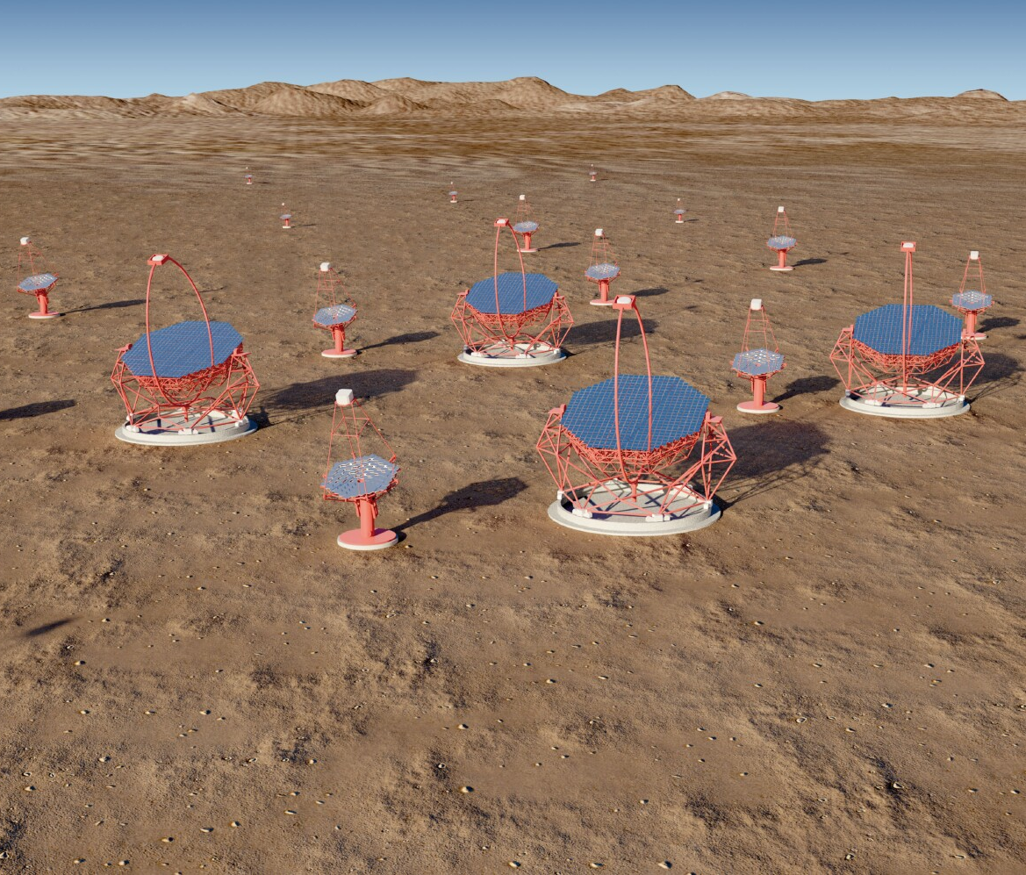
UK participation in CTA
Overview of progress since January 2017 for:
  CTA Consortium (CTAC)
  CTA Observatory (CTAO)
  The Gamma-ray Cherenkov Telescope (GCT)
  Compact High-Energy Camera (CHEC)
Next steps for CTA-UK
Notes:
The Cherenkov Telescope Array (CTA) is the next generation observatory for ground-based gamma-ray astronomy. Current instruments (HESS, MAGIC and VERITAS) have made huge progress in the observation of cosmic sources of photons in the ~ 50 GeV to ~ 50 TeV energy range using Imaging Atmospheric Cherenkov Telescopes (IACTs). CTA will extend the range of these observations at both low and high energies, will improve their sensitivity by a factor of about 10 and will increase the precision of photon energy and direction measurements. This talk presents briefly the designs of the 23 m, 12 m and 4 m diameter IACTs that CTA will use to achieve this performance, before discussing the impact the array will have on studies of Fundamental and Astroparticle Physics. Topics covered include: searches for Dark Matter (DM) and axion-like particles (ALPs); studies of possible violation of Lorentz invariance; and studies of the sources and acceleration mechanisms of high energy cosmic rays.
Remember the Ellis/White paper.
Include EBL studies.

Slide 2
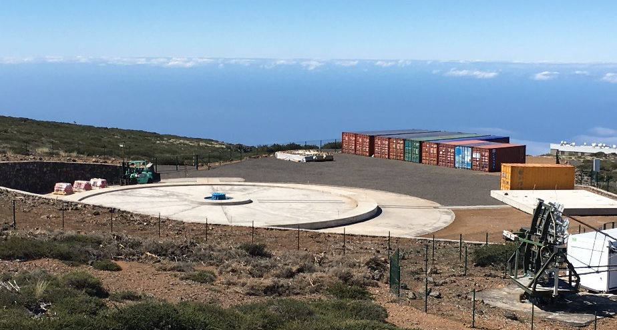
Status of CTA
Progress with La Palma site:
With Paranal site
Progress of prototypes:
Started procedure to change ESFRI status from “project” to “landmark” (implies have moved to implementation/
construction or operation phases).
2

Slide 3
Status of CTA
Most recent CTAC meeting in Rio de Janeiro, 15th to 19th May 2017.
MoU for construction, commissioning and operation of CTA discussed.
Two membership classes:
Category 1)
  Contribute in a commensurate fashion to CTAC duties.
  Invest in the long-term one half or more of research time in CTAC.
  Have well defined contribution (hardware, software, analysis, infrastructure, management).
  Can opt-in to all CTAC publications.
Category 2)
  Do not satisfy above requirements, but bring identifiable benefit to CTAC.
  Can be invited to participate in individual CTAC publications.
Cat 1) members have free access to all CTAC data, software, tools, documents under control of CTAC.
Finalise at next CTAC meeting in November on La Palma.
3

Slide 4
CTAO progress
In Kind Contribution process.
Start from European Spallation Source example:
  Need to allow for many contributors from different shareholders (countries).
  Require coordinating institute for each IKC.
  Council wants relationship between CTAO and coordinating institute to be legally binding.
  Relationship between coordinating institute and other contributors can be MoU based.
For threshold array, allocate following contributions.
  North South
  4 LSTs 15 MSTs
  5 MSTs 50 SSTs
  Software blocks
  Calibration instruments…
Later call(s) for baseline array, after all threshold components allocated:
  North South
  10 MSTs 4 LSTs
  10 MSTs
  20 SSTs
4

Slide 5
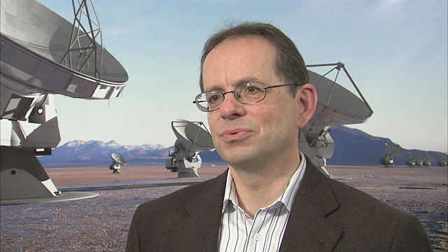
CTAO progress
Move to Bologna complete.
Project Committee meetings now held in Bologna.
New Project Manager hired, Wolfgang Wild:
Full-time from September, some availability before then.
CTAO now has 20 staff.
Meeting with ministries on ERIC organised for September.
Restructured Analysis and Simulations Working Group making rapid progress.
“Boot camp” in Zeuthen (June) attended by several UK personnel.
CTA and related software now running at CHEC institutes.
Meetings organised to present and discuss UK (+ Ireland) analyses.
Next is in Dublin on 28th August.
UK work will be summarised by Garrett.
5

Slide 6
CTAO progress
IKC process – next steps:
  Get Council approval of IKC framework.
  Issue a call for Proposals for Construction (PfCs) according to the catalogue.
Each IKC contributor expected to define a lead institution and some management structure, described in an MoU.
CTAO management receives PfCs and approves, with the support of the In Kind Review Committee, a number of Potential Contributors.
Potential Contributors undergo Preproduction Readiness Review (PPRR) and IKC assessment with the support of the IKRC.
IKC agreement (Allocation Agreement) is worked out; could be common for each contribution, or one for each shareholder involved.
To be approved by Council.
Start pre-production once PPRR passed.
Pre-production Deployment Review.
Commission pre-prod items on site.
Production readiness review.
Complete production and installation.
6

Slide 7
CTA schedule
As presented at July Project Committee meeting:
7

Slide 8
Status of GCT
GCT tests (Paris, March), included tracking of sources.
CHEC-M since operated routinely on telescope by telescope team.
Example of event taken in March.
  Signal amplitude:
  Timing:
  More in Jon’s talk.
8

Slide 9
Status of CHEC
Progress with CHEC-S electronics will be discussed by Jon.
9

Slide 10
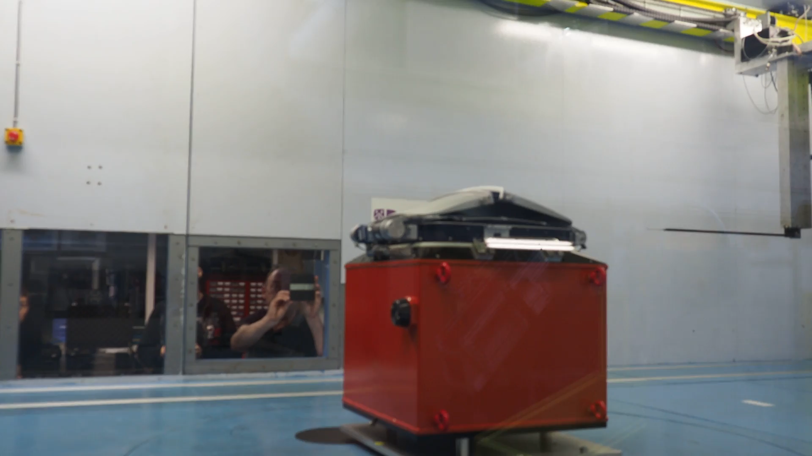
Status of CHEC
Tested doors in Durham wind tunnel.
Wind speeds:
  9 m/s (operating, CTA Req.).
  12.5 m/s (transition, CTA Req.).
  15 m/s (operating, CHEC goal).
  30 m/s (closed only, survival, CTA Req.).
Wind directions:
Opening and closing of doors functioned to 15 m/s.
Here at 90°, 12.5 m/s:
Camera survived maximum wind speed of 30.7 m/s without problems.
90°
45°
0°
-45°
-90°
10

Slide 11
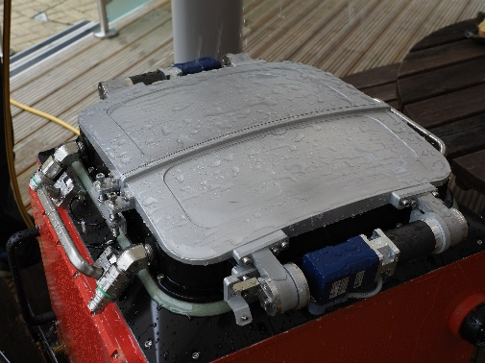
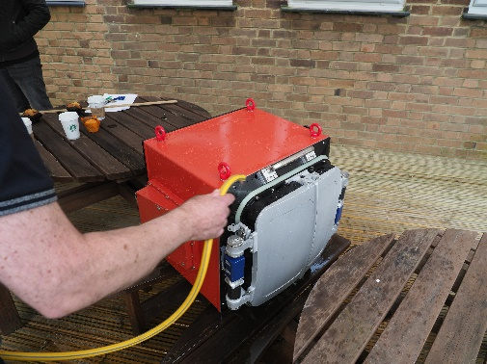
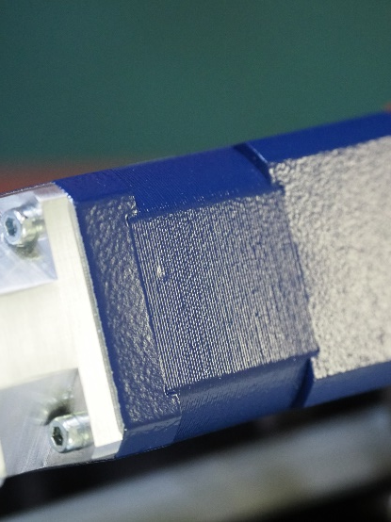
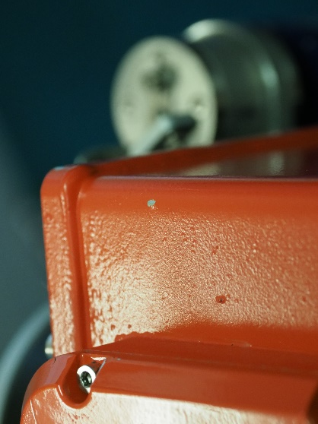
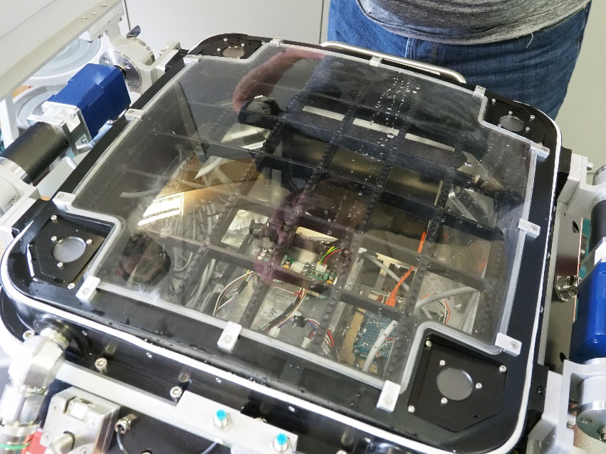
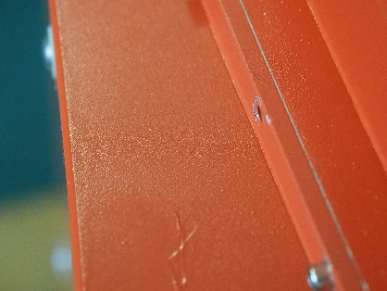
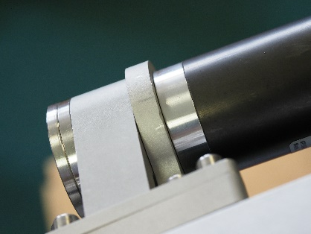
CHEC-S tests
Rain test:
Hail test:
11

Slide 12
Next steps for CTA-UK
Current grant ends June 2018.
Allows completion of PPRR for CHEC.
  CHEC-S is the pre-production camera, with exception of choice of final SiPMs.
Bridging period 2…3 months.
Next grant: request funding for UK contribution required for CHEC to instrument of all GCT and some ASTRI telescopes in threshold arrays (MoUs prepared) and for preparation of physics analysis.
Start end 2018/beginning 2019.
Run for 3 years.
Produce CHEC with partners in Australia, Germany, Japan, Netherlands.
UK will, for all cameras:
  Provide Front End Electronics (TARGET modules, FE buffers).
  Provide Flasher systems.
  Provide doors and door control.
  Provide camera windows.
Assemble 12 or 13 cameras.
Provide UAV-borne calib. light source.
Work on CHEC software.
Contribute to CHEC/CTA pipeline.
Prepare for early data analysis.
Sign CTA MoU.
12

