Slide 1
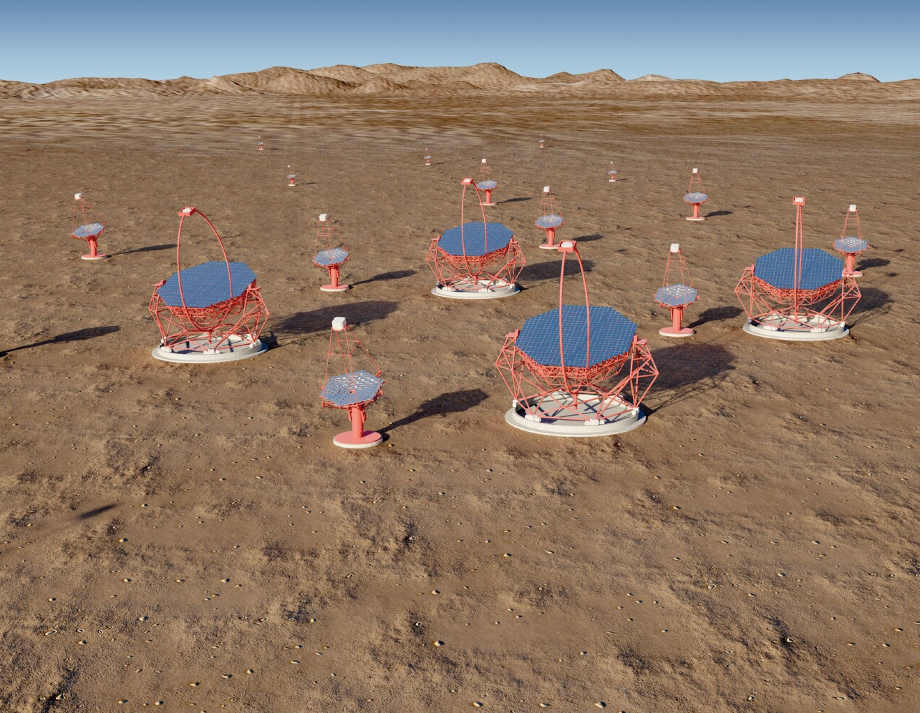
The Gamma-ray Cherenkov Telescope
Pre-history, theory and experiment.
CTA and the SSTs.
GCT optical design.
GCT mechanics.
Camera.
First Cherenkov light.
Some things we have already learnt?
What next?
Summary.

Slide 2
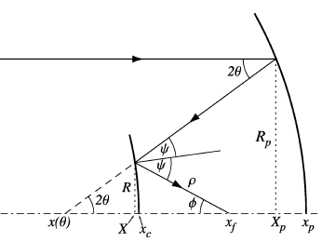
Schwarzschild-Couder telescopes
In 1905, Schwarzschild described a telescope with two concave mirrors and the focal plane between the mirrors.
He showed this suffered no spherical aberration or coma, but significant astigmatism, partly as focal surface assumed flat.
Couder (Paris Observatory) modified this design in 1926, allowing the focal surface to be curved and curing (some of) the astigmatism.
Figured mirrors in 1930s, but telescope never built (because 6 m long for primary diameter D = 0.8 m and focal length F = 2.4 m?).
In 2002, Lynden-Bell described all spherical aberration and coma free dual mirror telescopes, in terms of:
  s × F – mirror separation.
  K × F – secondary to focus.
sF
KF
2

Slide 3
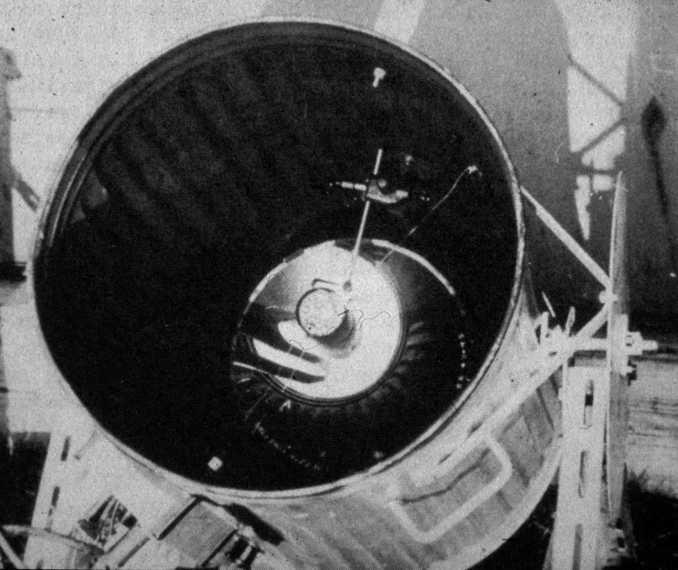
Cherenkov light from air showers
The first detection of Cherenkov light from air showers was made in 1953:
Seen by Galbraith and Jelley using a parabolic mirror viewed by a phototube.
An early “dual mirror” gamma ray telescope, Porter and Jelley, Glencullen (Ireland), 1962.
Gun mount and searchlight mirrors from WWII.
3

Slide 4
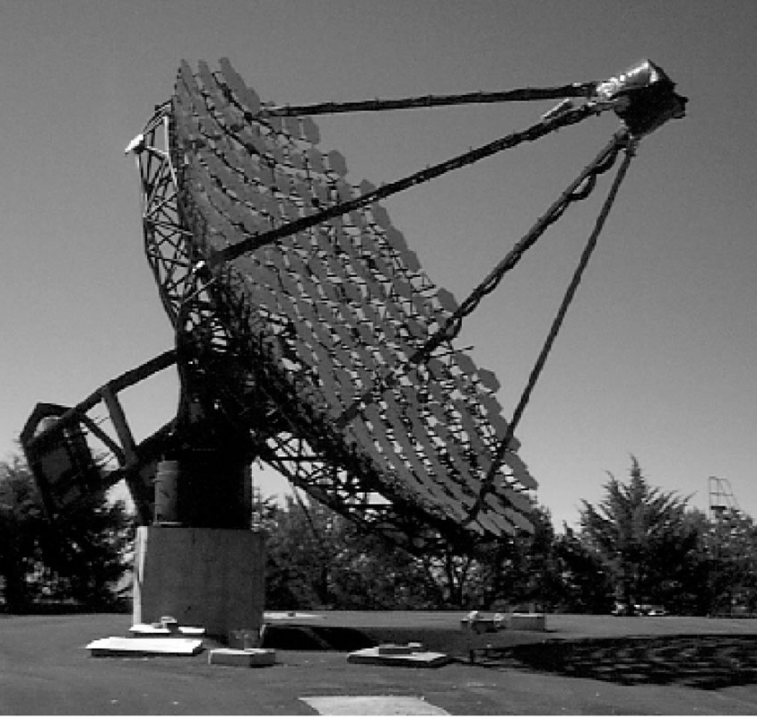
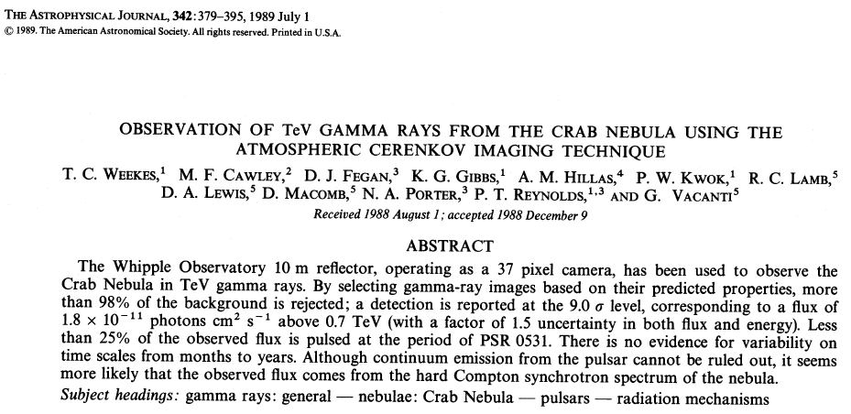
The first TeV source…
Whipple, completed 1968
4

Slide 5
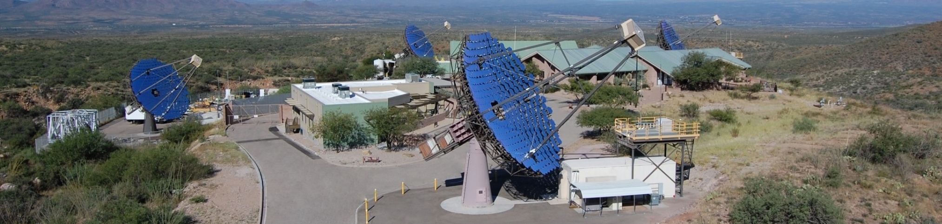
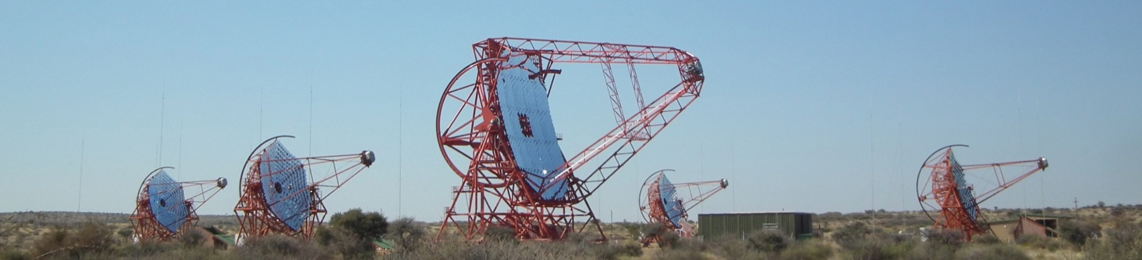
Imaging Atmospheric Cherenkov
Telescope arrays
VERITAS
HESS
5

Slide 6
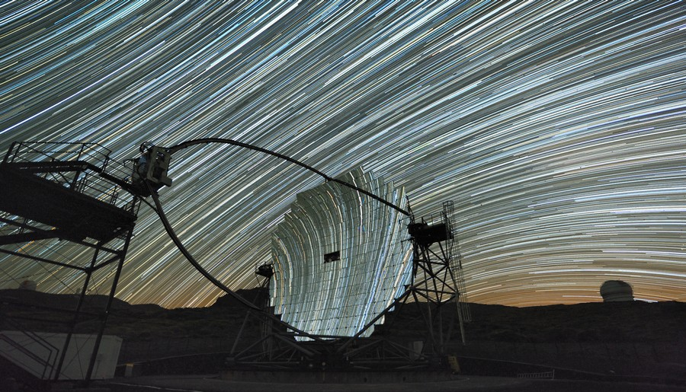
Imaging Atmospheric Cherenkov
Telescope arrays
MAGIC
6

Slide 7
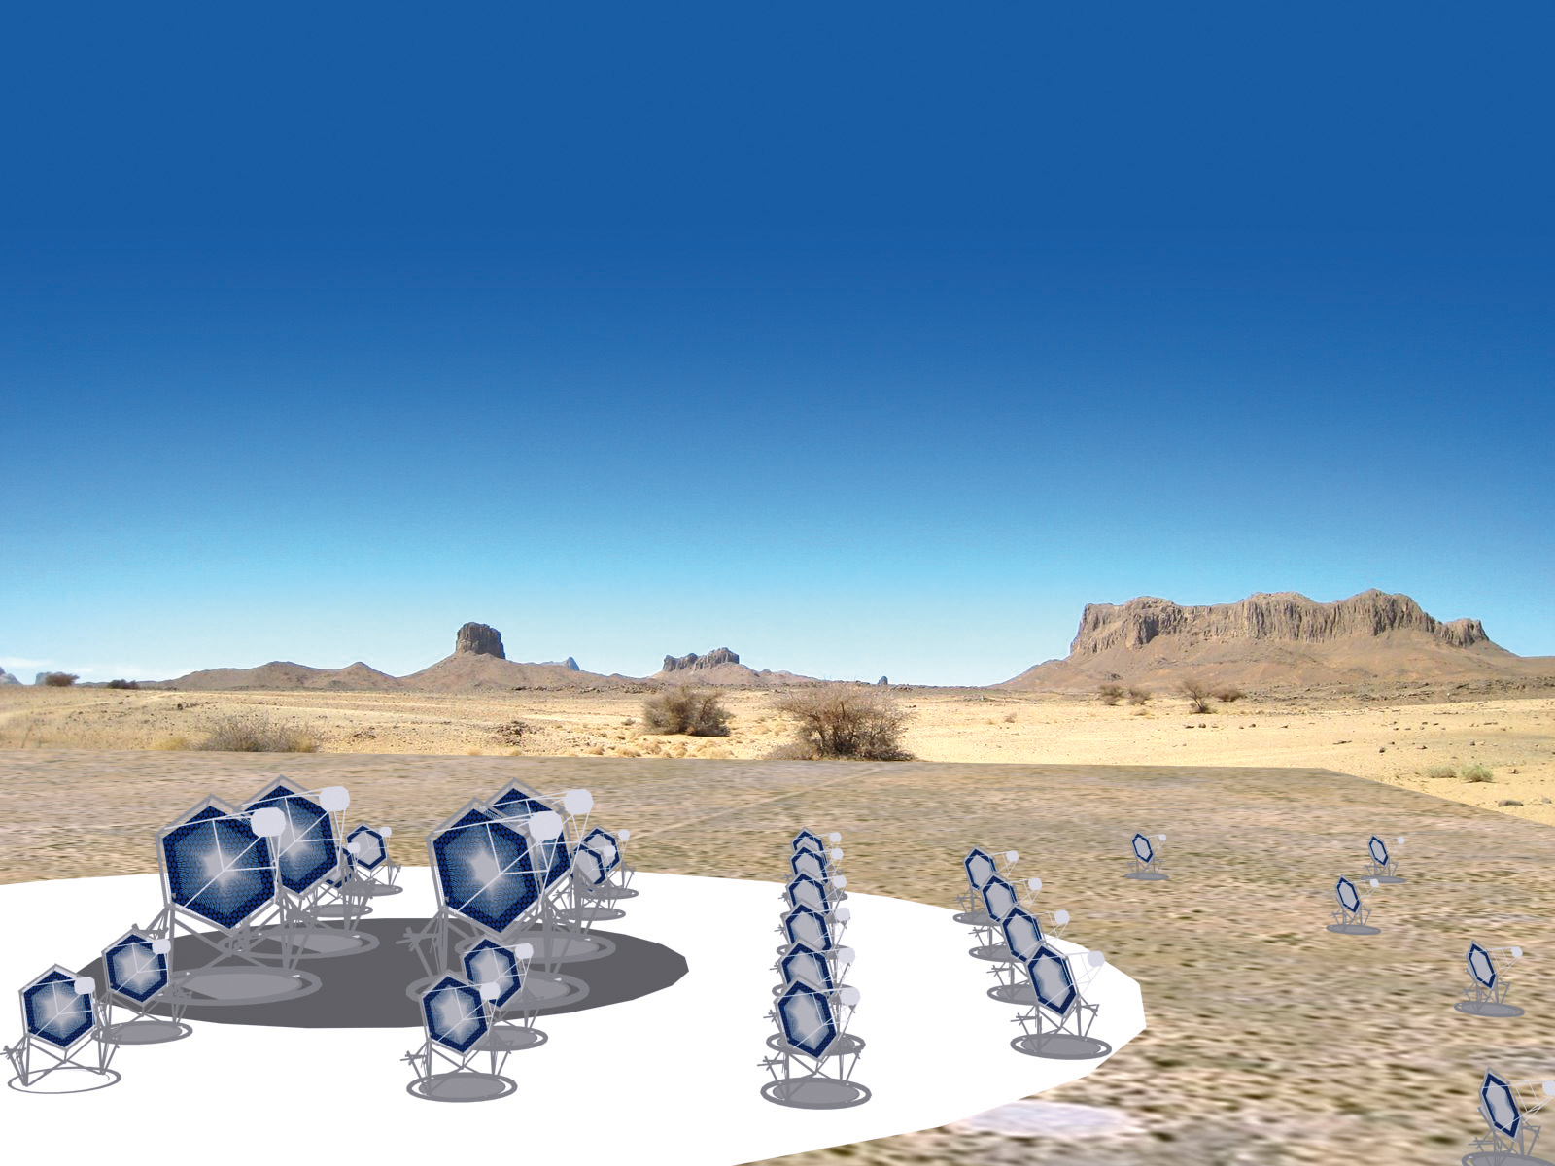
The Cherenkov Telescope Array
Low energy
Four 23 m telescopes
4…5º FoV
~2000 pixels
~ 0.1º
Medium energy
About twenty-five 12 m telescopes
6…8º FoV
~2000 pixels
~ 0.18º
High energy
About seventy 4 m telescopes
8…10º FoV
1000…2000 pixels
~ 0.17º…0.23º

Slide 8
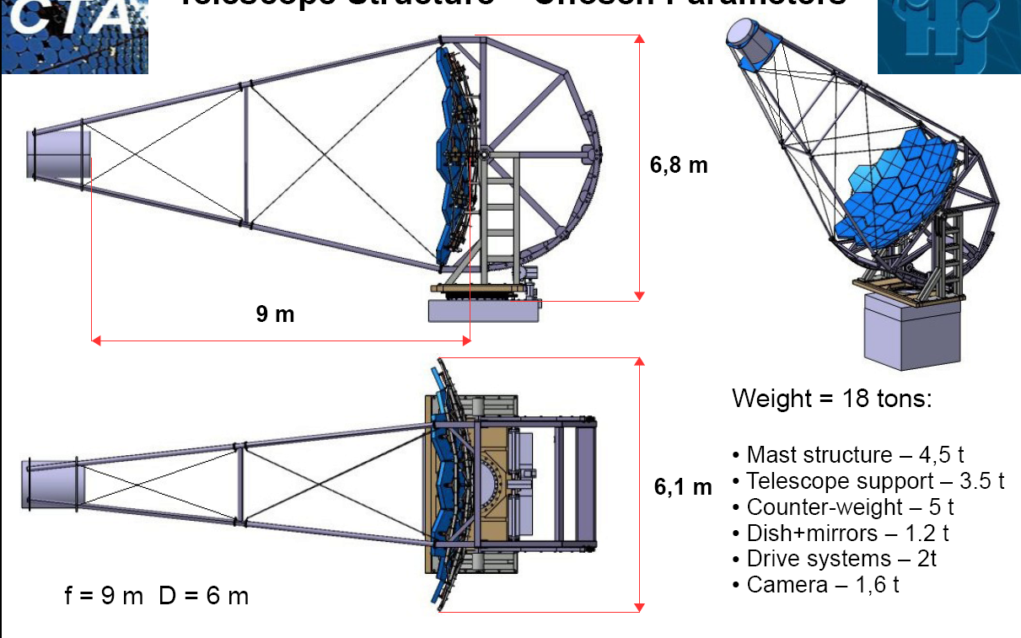
The SSTs – take one
Davies-Cotton 7 m telescope designed for CTA.
This is a viable solution for the SST.
But, the camera:
  Has a diameter of about 1.6 m.
  Weighs about 2 tonnes.
  Is expensive, in no small part because of the price of the PMTs.
The cost of the camera dominates that of the telescope.
Making it cheaper would allow the construction of more telescopes and hence improve CTA performance.
8

Slide 9
The SSTs – take two
Can we use cheaper sensors (e.g. SiPMs) in a compact camera?
Must have F ~ 2 m so ~ 6 × 6 mm² pixels commercially available match required angular resolution of ~ 0.2°.
Need reasonable area, D > 3 m, hence “fast” focal ratio (f = F/D small).
Primary aberrations:
  Spherical ~ 1/f³.
  Coma (1st order) ~ δ/f².
Require sophisticated optics to correct for aberrations at large field angles.
Look at two-mirror telescope designs, proposed by Vassiliev for AGIS.
9

Slide 10
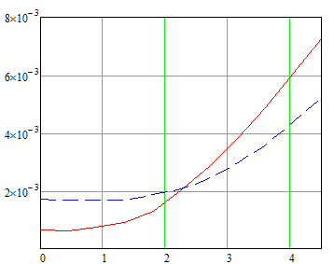
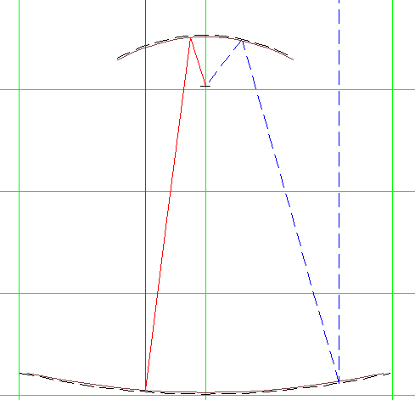
Telescope optics
Scan (s, K) space: “best” telescope has s = 1.56, K = 0.224, F = 2.28 m.
D₁ = 4 m, D₂ = 2 m, f = 0.57.
Focal surface spherical, ρ = 1 m.
Numerical optimisation using ZEMAX.
Sacrifice on-axis PSF for improved performance at large field angles.
D₈₀ (m)
Exact Optics
ZEMAX
0.51 m
3.56 m
δ (°)
10

Slide 11
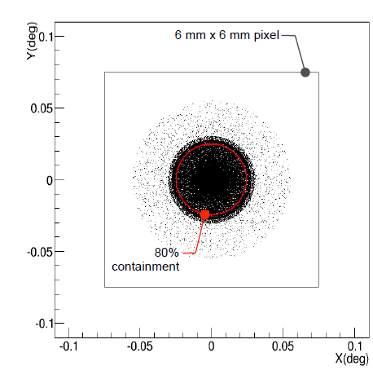
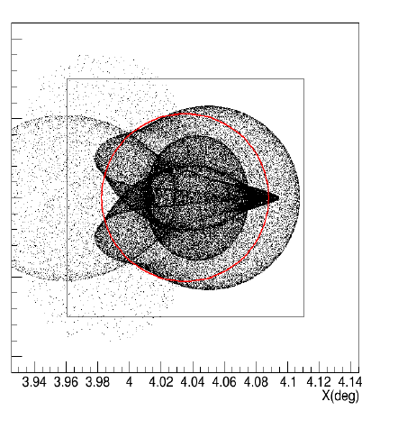
Telescope optics
ZEMAX design:
Images of point source at infinity:
For field angles below about 5, over 80% of the light from a point source at infinity (or at 10 km with refocusing) is contained in a 6 × 6 mm² pixel.
δ = 0°
δ = 4°
11

Slide 12
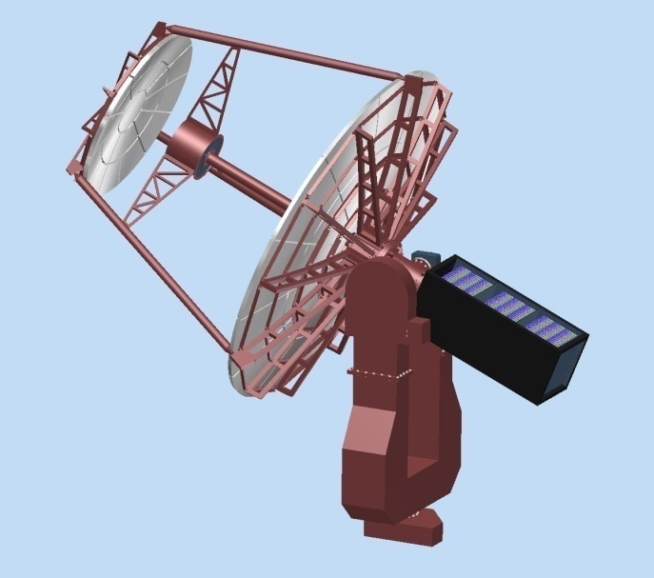
Mechanical design
Durham 2011.
Long fork.
Central tube supports camera.
Tripod supports secondary mirror
Electronics in counterweight.
Aluminium structure.
Paris, 2012.
Short fork.
Primary dish
support
separated from
secondary
support.
Camera
attached to
secondary.
Shaped
counterweight.
Steel structure,
aluminium mirrors.
12

Slide 13
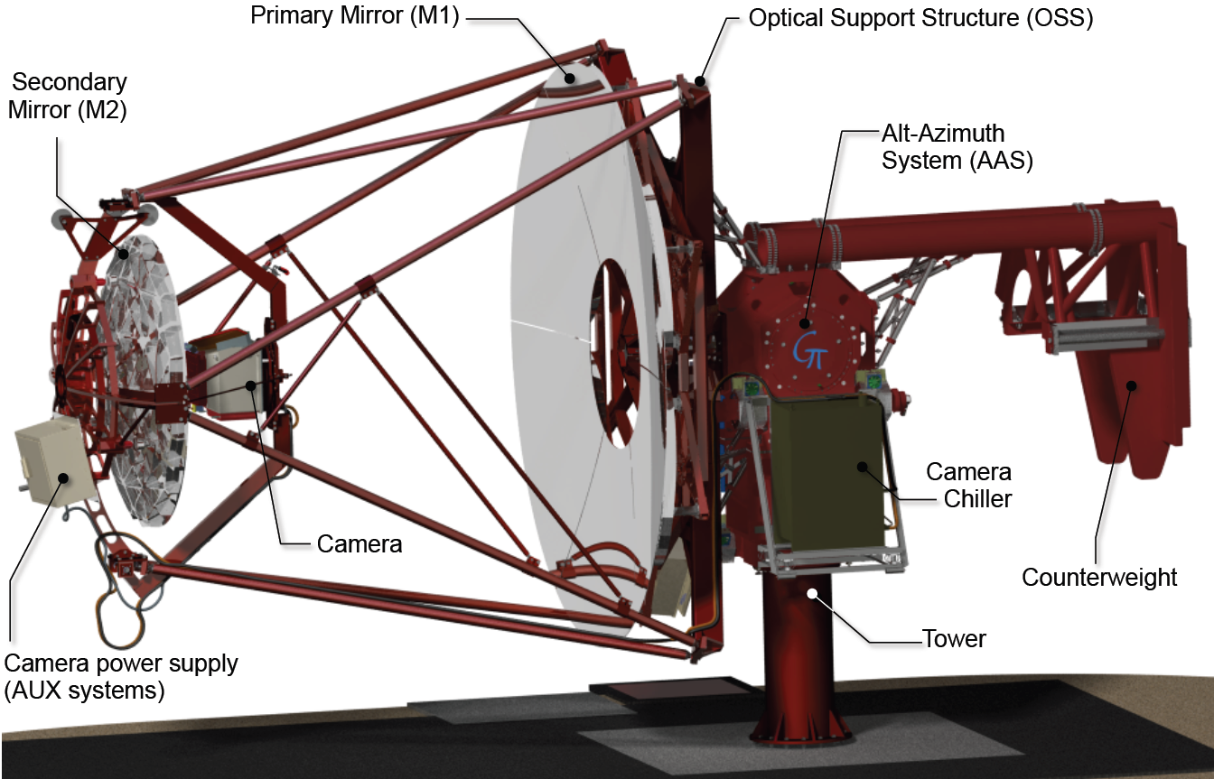
Mechanical design
Paris 2015.
Four masts to
support secondary.
Same motors on both axes.
Primary mirror rotation mechanism to facilitate mirror installation.
Camera removal mechanism.
13

Slide 14
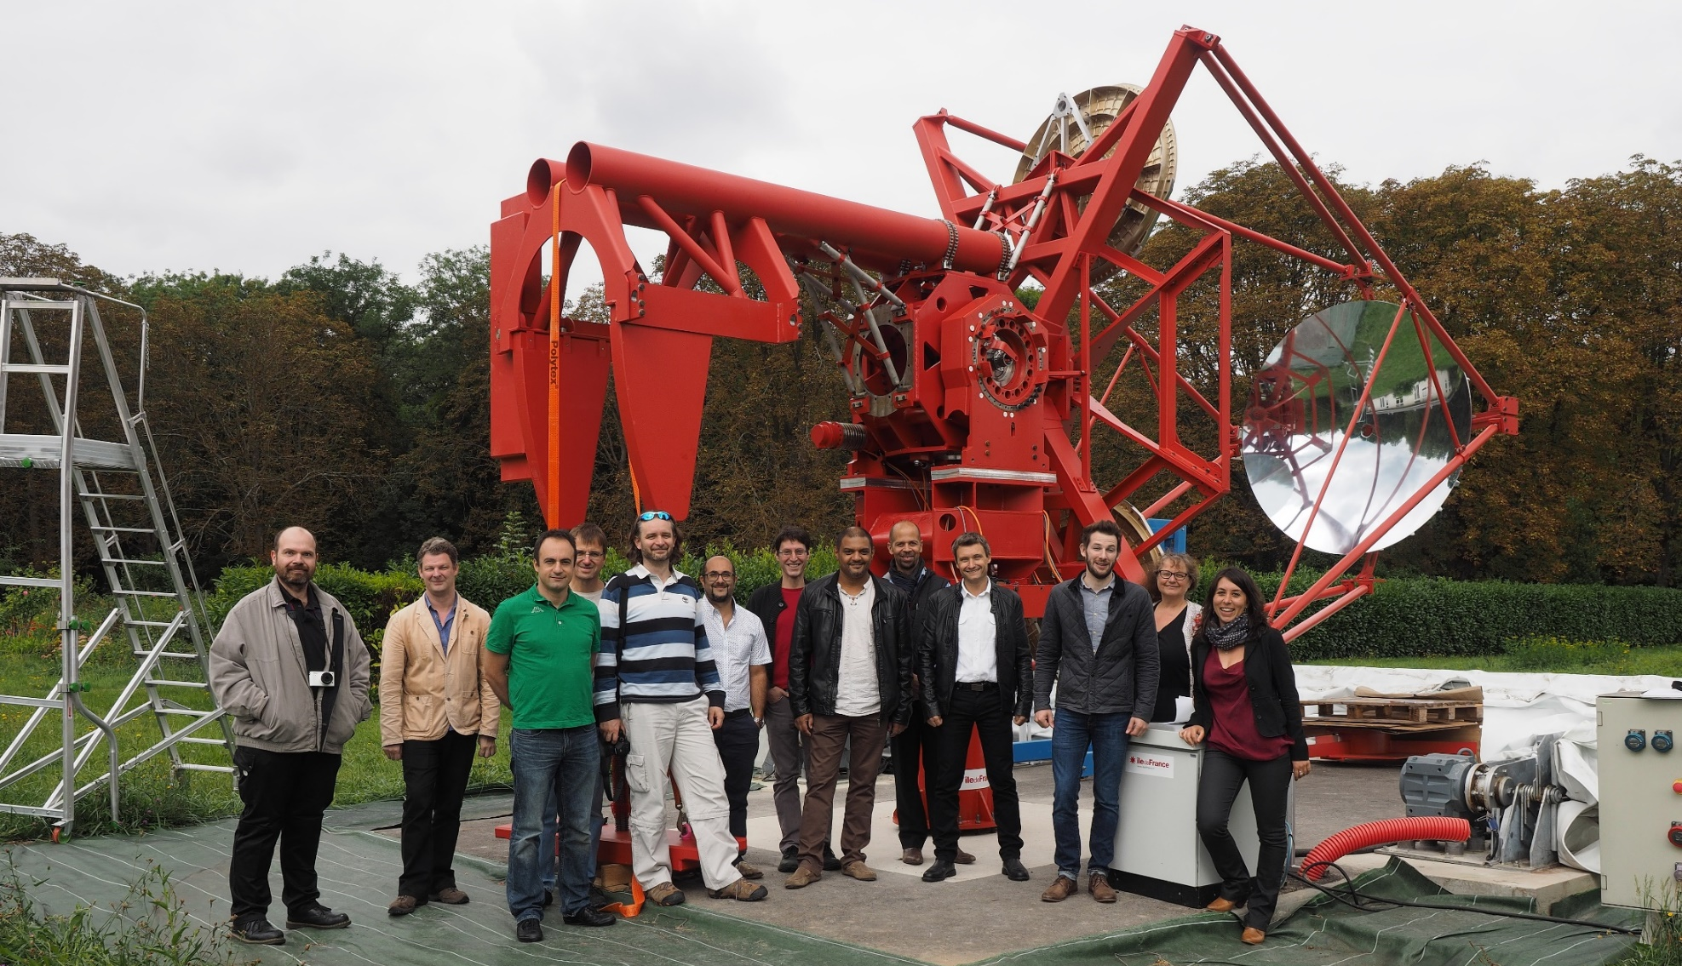
Mechanical structure
Structure assembled in Meudon in April, visited by ESO team in September.
14

Slide 15
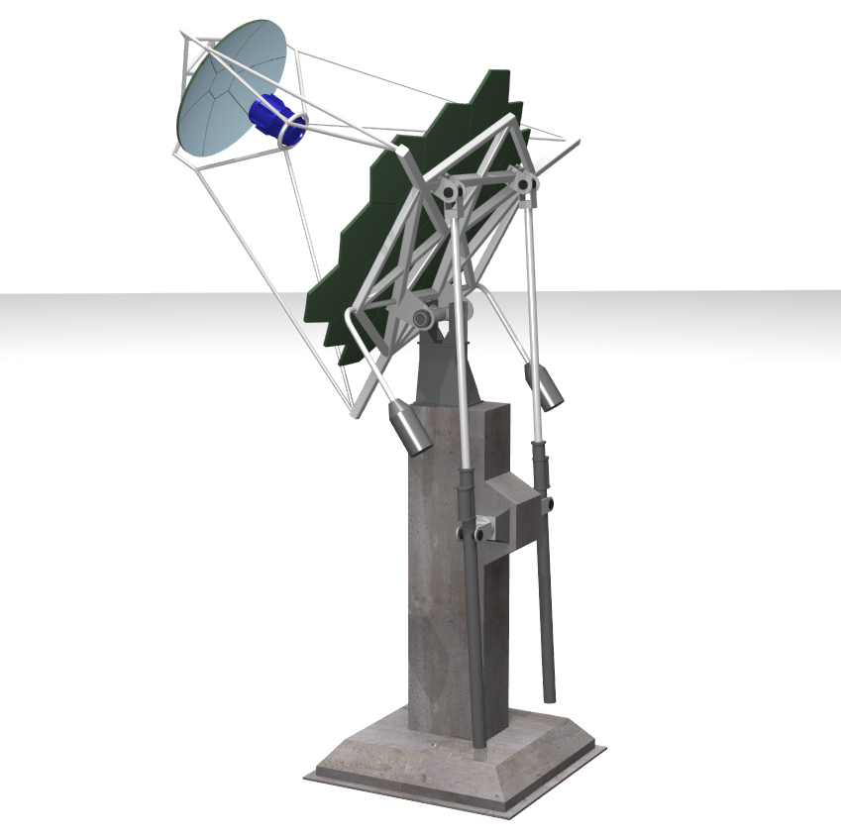
Dual Mirror – alternative Italian design
Primary mirror with sector panels
Secondary mirror
Camera
M1 dish
Mast structure
Elevation universal joint
(Cardan joint)
Counterweight
Worm drive
Concrete pedestal and foundation
15

Slide 16
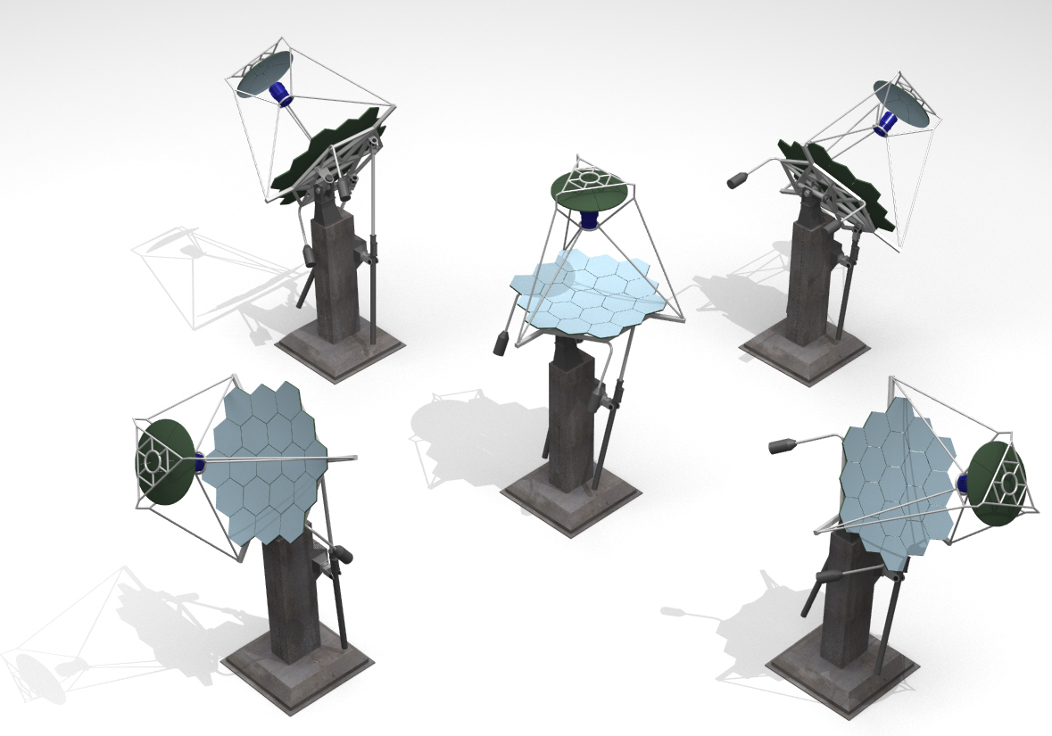
Dual Mirror – alternative Italian design
Illustration of functioning of Cardan joint and worm drives.
Give access to:
  Elevation 30...90°.
  Azimuth
  –180...180°.
Elevation 30°
Azimuth 180°
Elevation 30°
Azimuth –90°
Elevation 90°
Elevation 30°
Azimuth 0°
Elevation 30°
Azimuth 90°
16

Slide 17
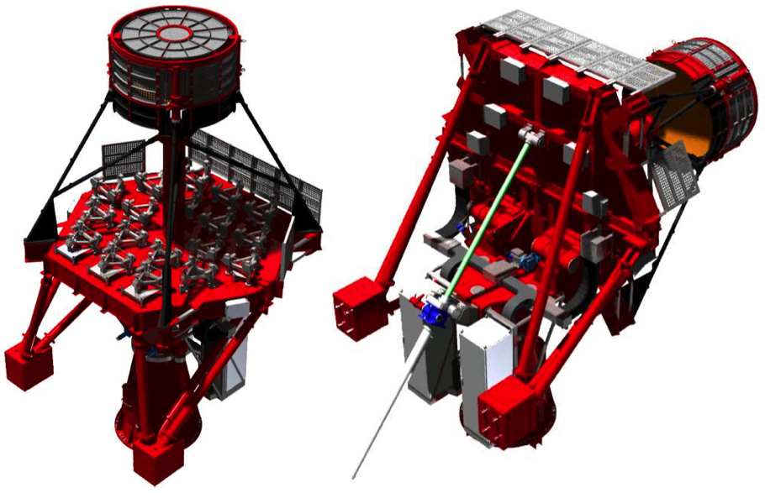
ASTRI – prototype design
M2 Back-Up Structure
M1 electrical boxes
Mast
Counterweight
Snow shields
M2
EL axis
M1 dish
AZ fork
Base
M1 active surface
EL actuator
Electrical cabinets

Slide 18
Camera design
TARGET Module
16 x Preamps
Target Asic
FPGA
UDP Data
64 Pixel Module
16 x Preamps
Target Asic
16 x Preamps
Target Asic
16 x Preamp
TARGET ASIC
Trigger
Backplane Board
Buffering and Serialisation
Backplane
x 32
Amplification and shaping
Digitisation and Trigger
Camera Trigger
64 Pixel Module
Goal – produce low cost camera
with full-waveform readout
Data
DACQ Boards
Timing Board
Peripherals (calibration, lid, etc)
Clock, Timestamps
Safety Boards
18

Slide 19
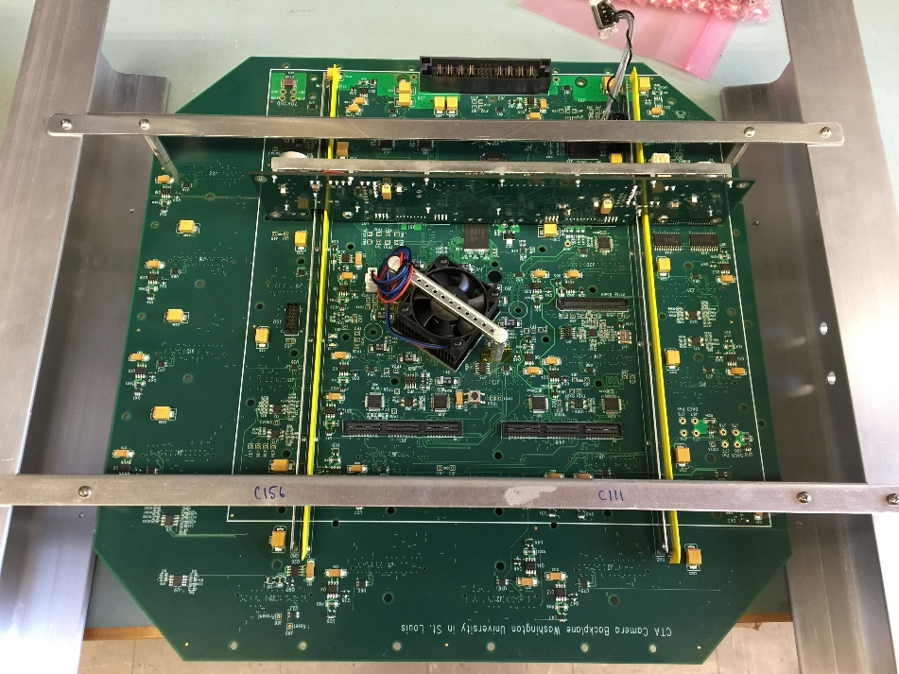
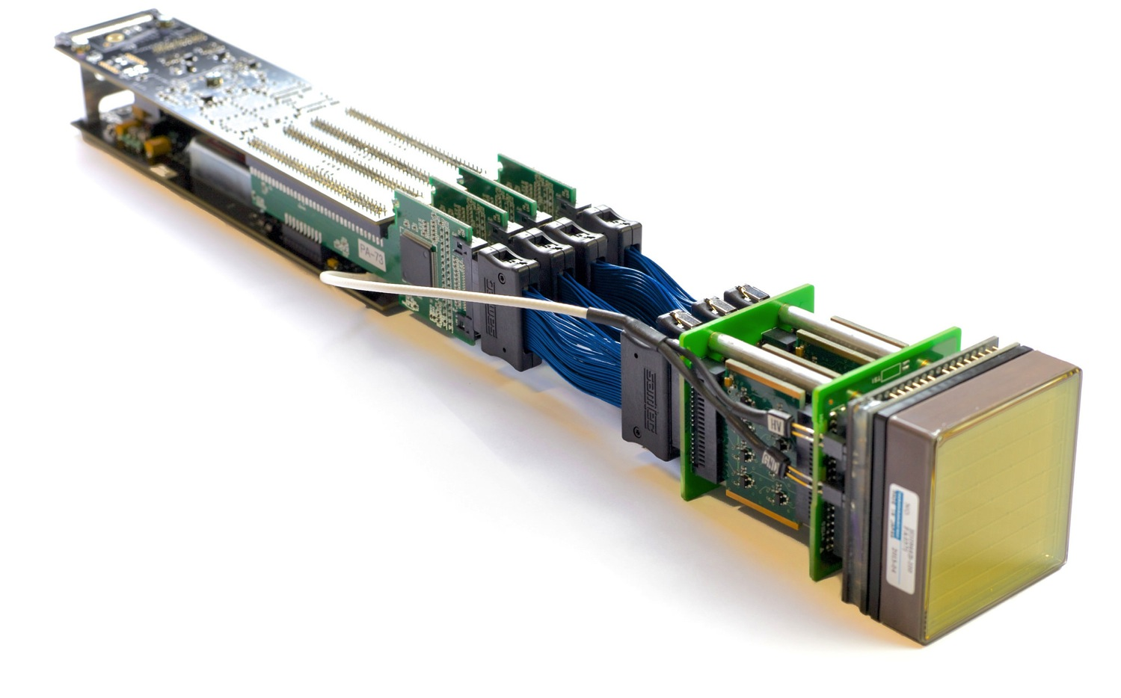
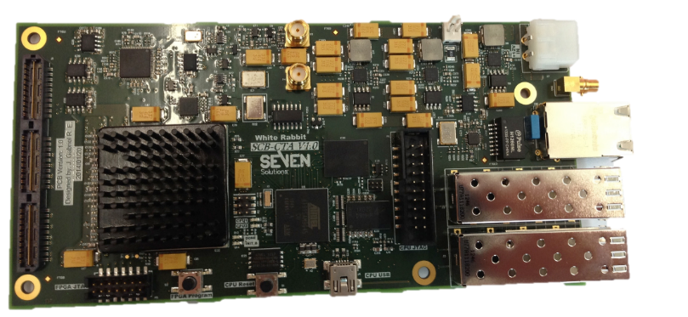
Development of the camera
Leicester 2012, start construction of camera with MAPMs – CHEC-M.
Electronics based around TARGET (Hawaii/SLAC and Erlangen).
DAQ using White Rabbit for timing (Amsterdam).
Backplane, common with SCT (Washington University).
Flashers (Durham) and Peripherals Board (Liverpool) complete camera.
19

Slide 20
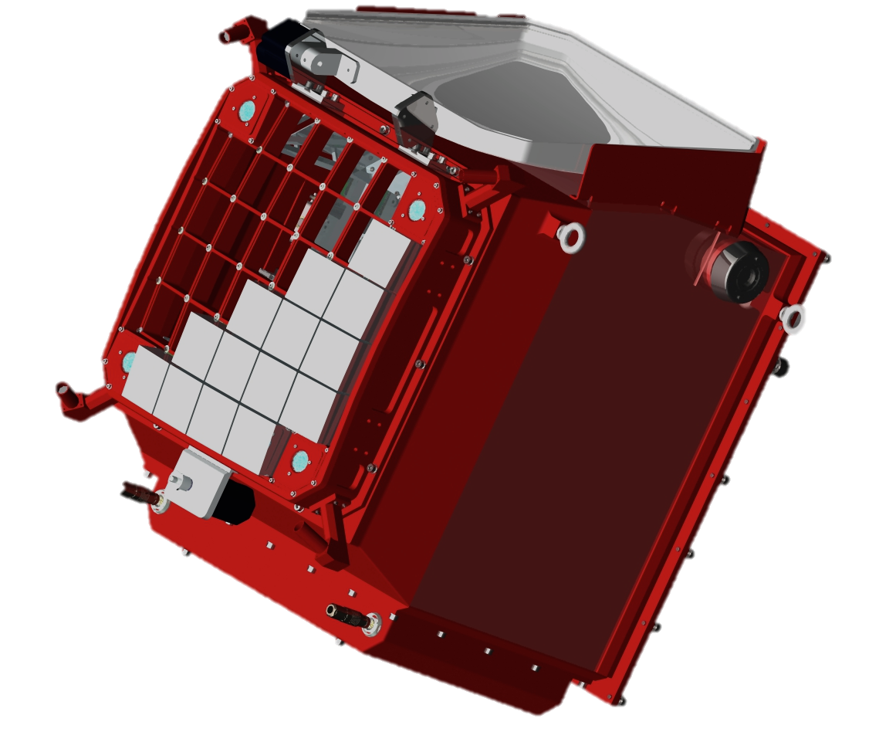
Development of the camera
Leicester 2015, CHEC-M complete.
Pointing LEDs
Lid
Lid motor
Photodetectors and front end electronics
Mounting eyelets
LED Flasher Units
Desiccator
Focal plane plate
Lid Locking Mechanism
Motor Bulk-head Connectors
Thermal Exchange Unit
Enclosure
20

Slide 21
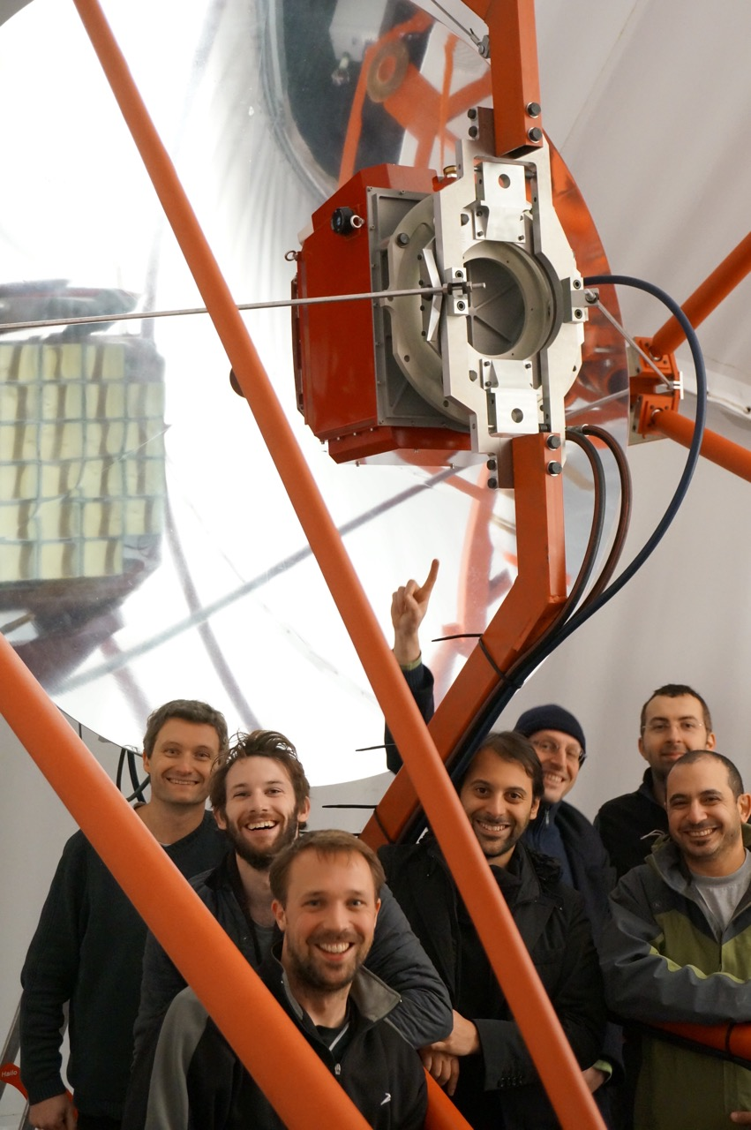
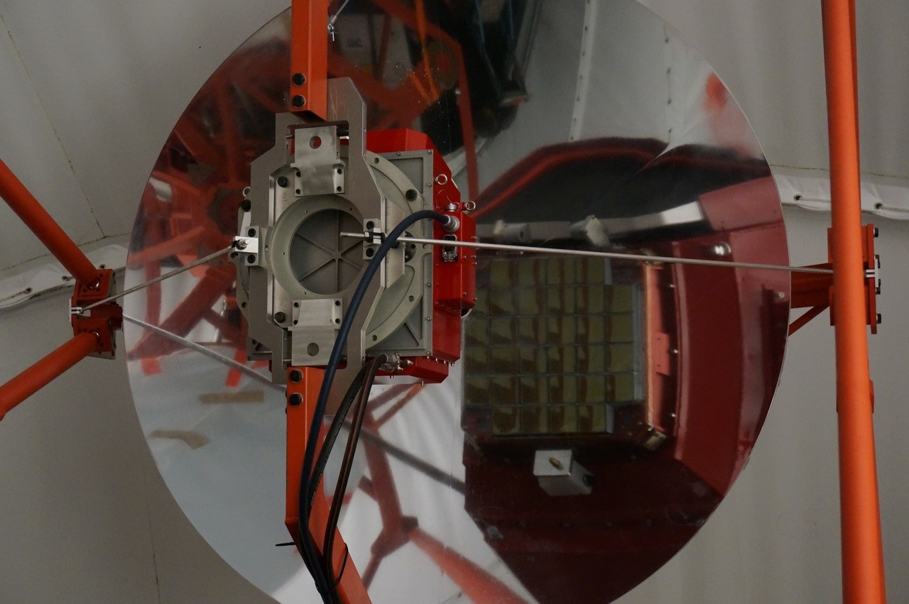
Completing the
GCT prototype
Camera mounted on telescope on Friday 20th November…

Slide 22
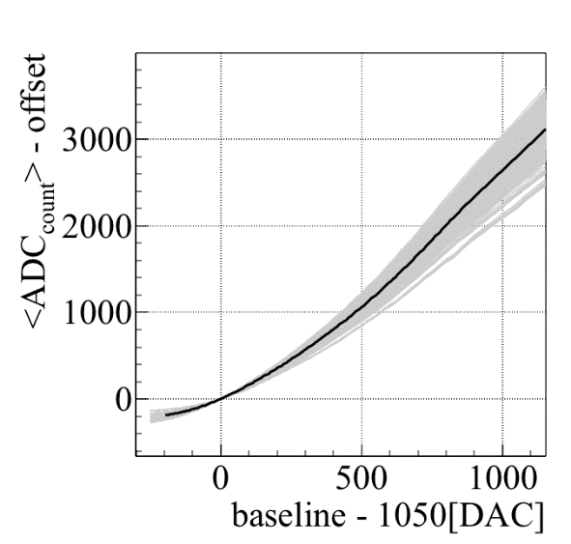
Verify camera operation on telescope
Check that
operation
safe, e.g.
TARGET
module
temperatures.
Check
electronics
performance,
e.g. transfer
functions.
Check that MAPMs functioning as expected – look for single photo-electron peak:
222

Slide 23
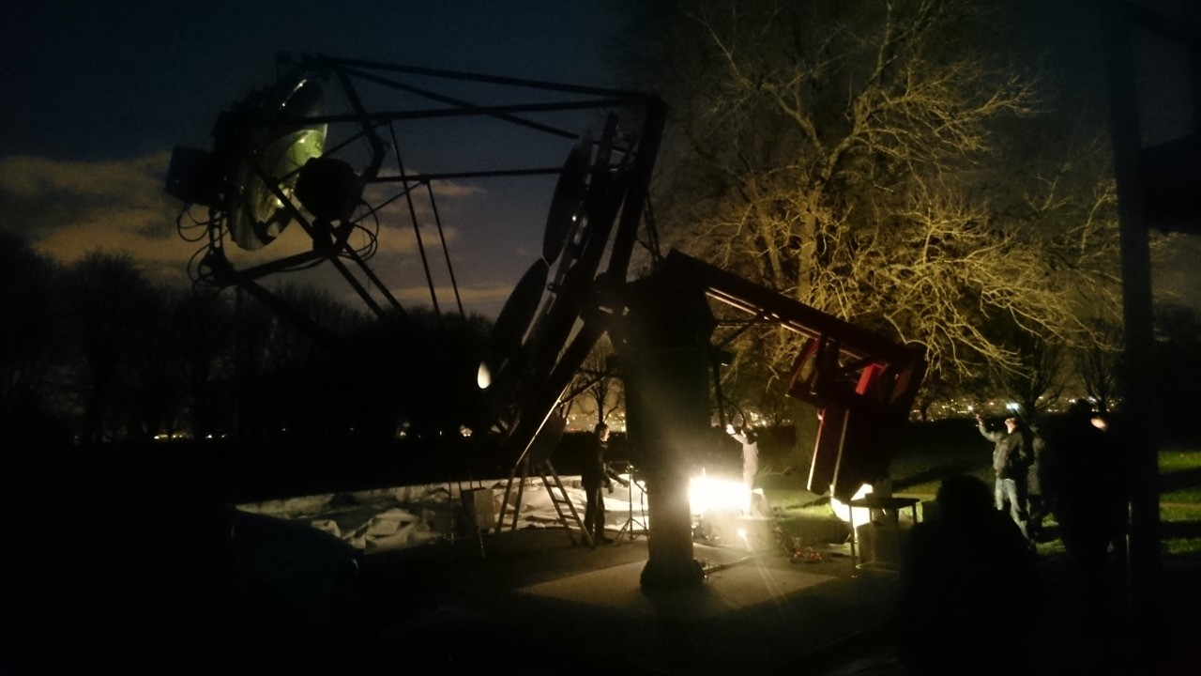
First tests of the GCT prototype on sky
Thursday 26th Nov, night sky background 20 to 100 times higher than CTA sites…

Slide 24
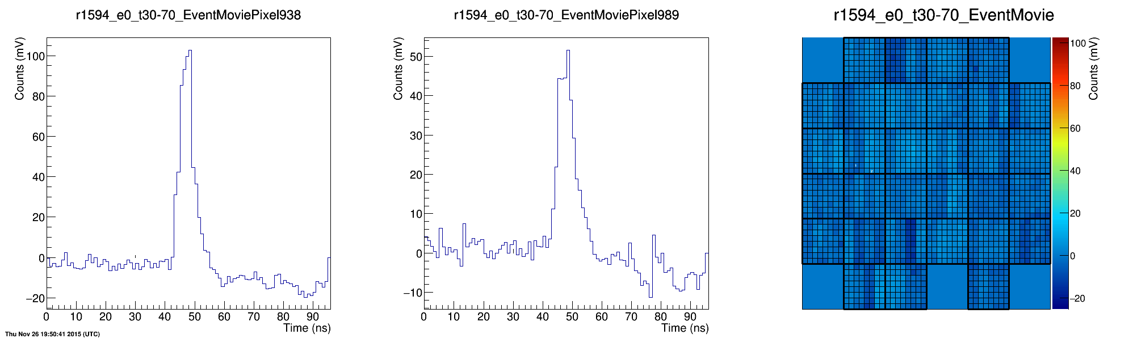
First tests of the GCT prototype on sky
…but successfully observed Cherenkov light from ~ 50 TeV showers.
24

Slide 25
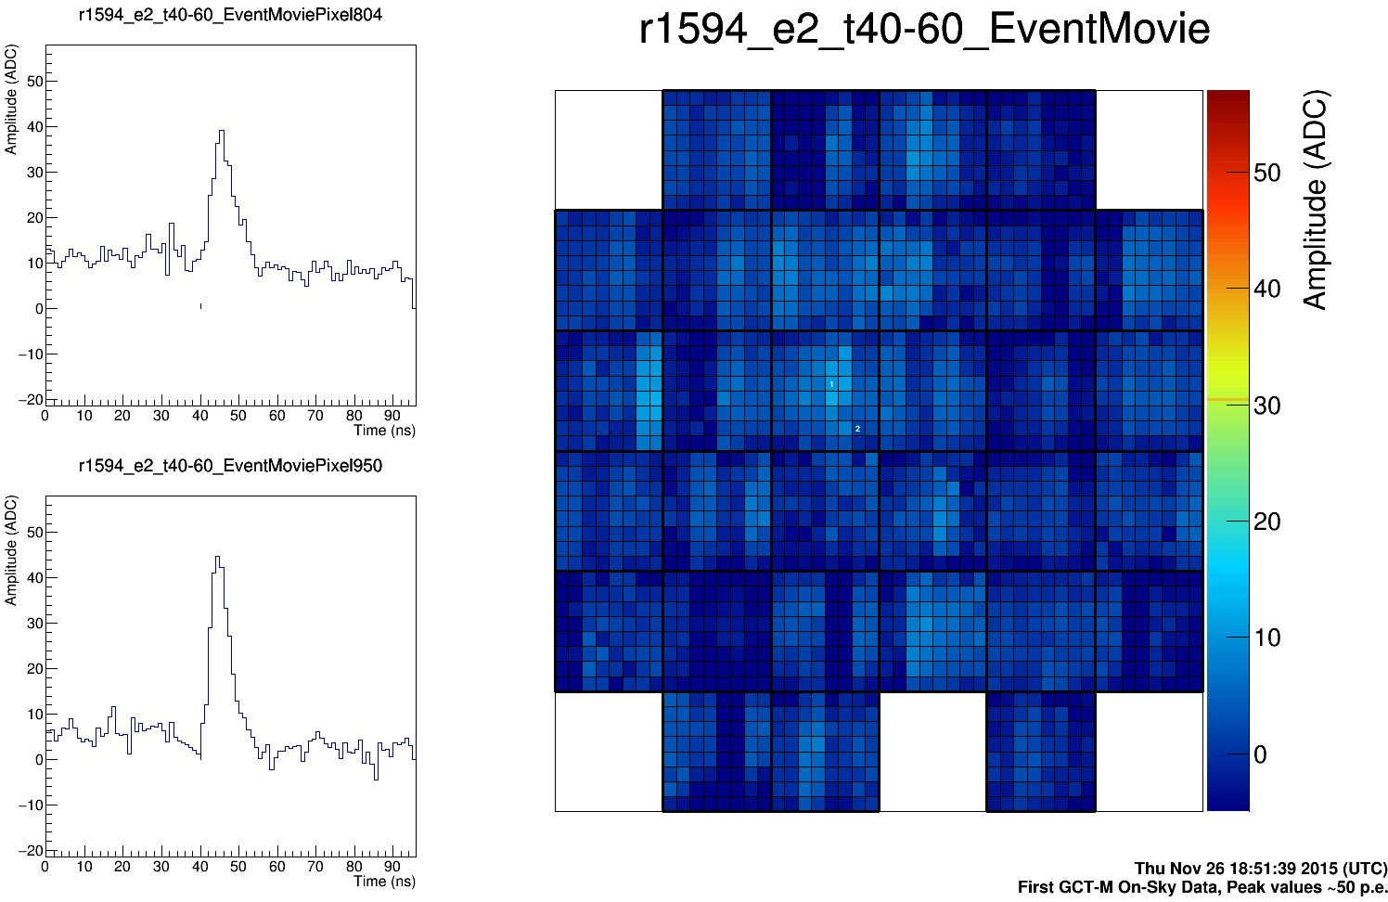
First tests of the GCT prototype on sky
Thursday 26th November.
25

Slide 26
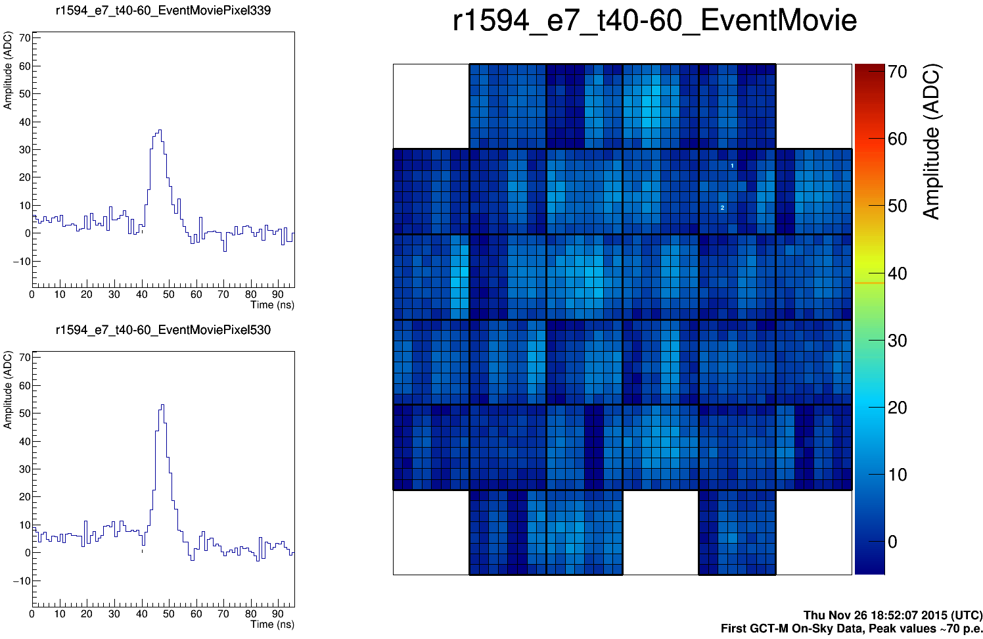
First tests of the GCT prototype on sky
Thursday 26th November.
26

Slide 27
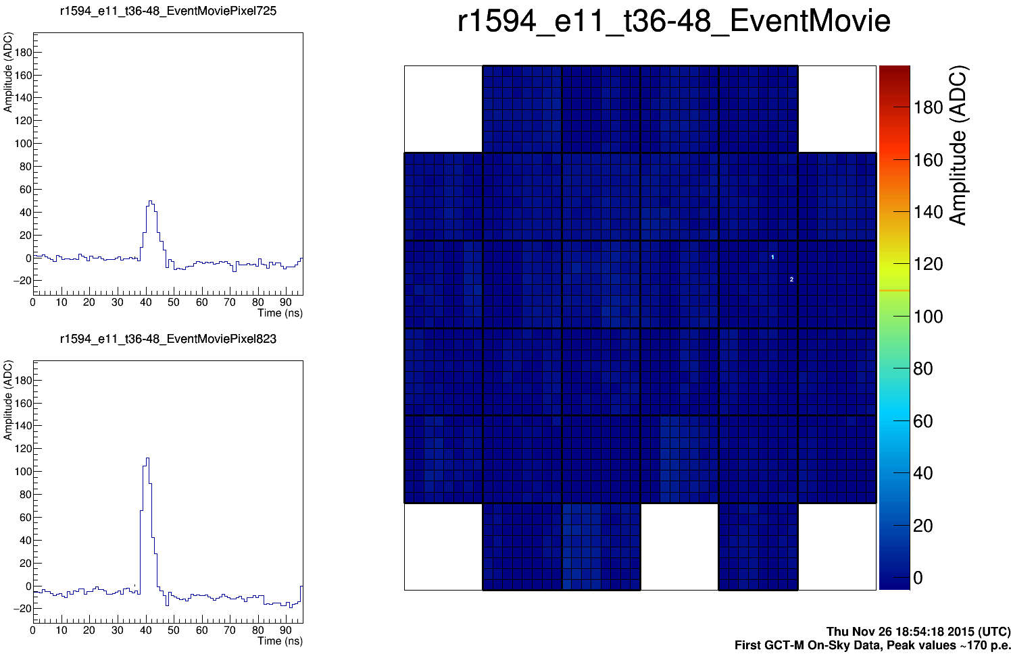
First tests of the GCT prototype on sky
Thursday 26th November.
27

Slide 28
What have we learnt?
All the stuff you have heard in the telescope and camera talks, plus..
Time invested in simplifying installation/maintenance procedures is time well spent – need handles on camera!
Prototype helps identify problems you wouldn’t otherwise spot.
E.g. need for “dummy connectors” to which tubes and cables can be attached when the camera is not on the telescope – prevents things flapping around and keeps them clean.
Prototype aids production and checking documentation.
288

Slide 29
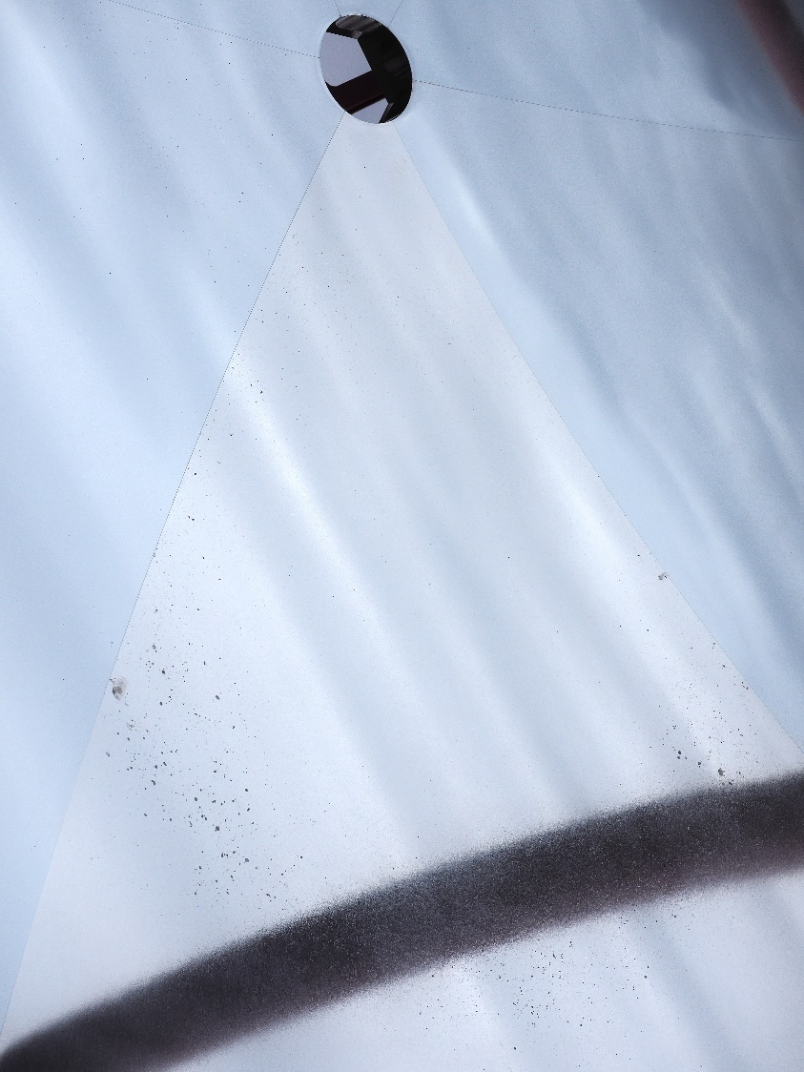
What have we learnt?
We need to work on mirrors and mirror production processes.
Can see by eye that two panels of the secondary are of poor quality (despite nominally all being same).
Try casting aluminium, machining, applying nickel layer, polishing, coating with aluminium and SiO₂.
Nickel layer improves surface quality, but also needed if mirror to be recoated, otherwise old Al coating cannot be stripped off.
Good quality control needed.
Casting should also reduce cost.
(Applies also to structural elements.)
Bad panel in GCT secondary.
299

Slide 30
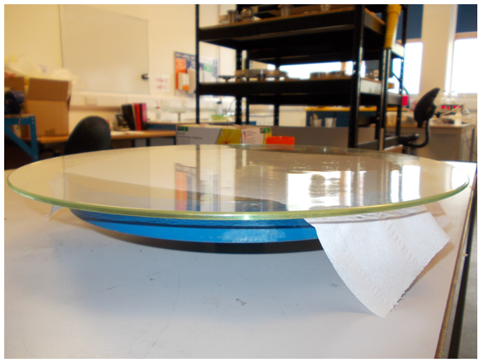
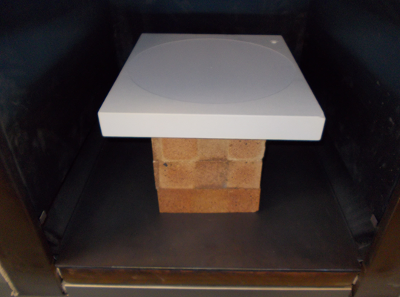
First glass mirror studies
Hot slump glass mirrors using concave mould.
Proof-of-principle studies.
Grind a ceramic mould with radius of curvature of 3 m.
Level mould in oven and slump
4 mm thick glass sheet, 35 cm diameter, using carefully controlled temperature cycle.
30

Slide 31
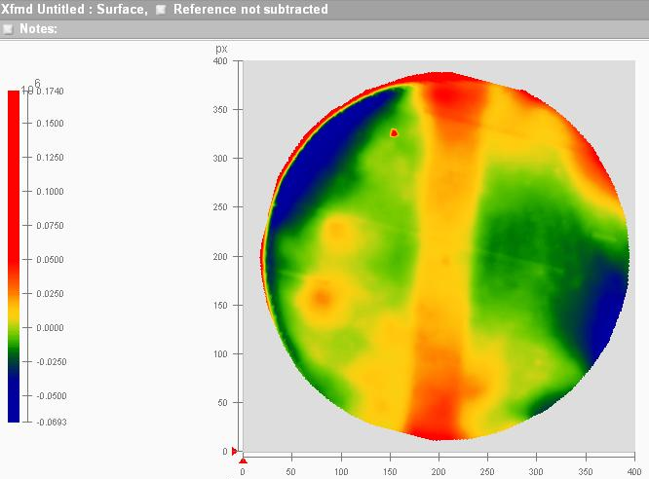
First glass mirror studies
Measure RoC of glass samples and mould.
Mould relaxes slightly after baking.
Part 1, slumped simultaneously with mould baking, during power cut.
Part 2, smaller RoC than mould as expected.
Glass follows shape of mould.
Deviations about ± 25 nm.
Next steps, larger samples, petal shapes, smaller RoC, coating…
31

Slide 32
Further glass mirror studies
Tender put out for GCT mirror panels (thanks to MPI and Andreas Foerster!).
Specifications included table of required mirror surface quality:
Flabeg cannot meet “waviness” criteria: 20 μm (M1) 50 μm (M2).
Need to clarify this: parameters understood? What is the ASTRI experience?
Flabeg suggest using thinner glass is possible approach.
Another reason for working on mirrors is cost…
332

Slide 33
Immediate next steps
GCT
  Complete commissioning and testing of GCT camera and structure.
  Put together Expressions of Interest for Project Office that cover construction of 35 GCTs.
  Design pre-production camera and telescope.
  Review design.
  Get more money!
SST
  Need foundation suitable for all SSTs (for TDR update?).
  Common actuators (ditto?).
CTA
  Site and information on site.
  Agreement on common control systems (e.g. PLCs) would be good (tied with site negotiations?) to reduce amount of effort invested in this area.
33

Slide 34
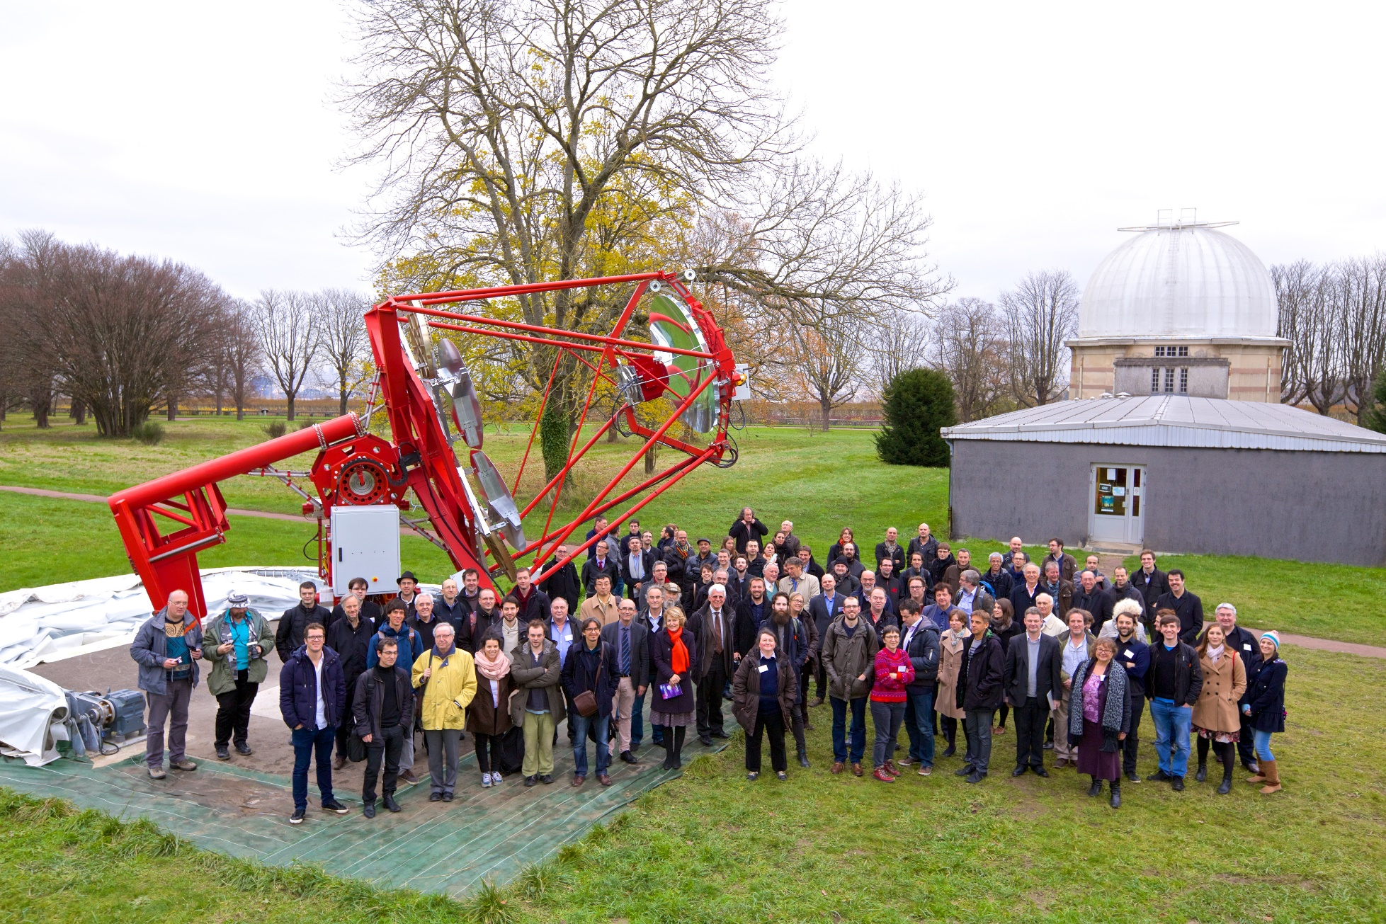
Summary
Thanks
for
coming
to the
party!

