Slide 1
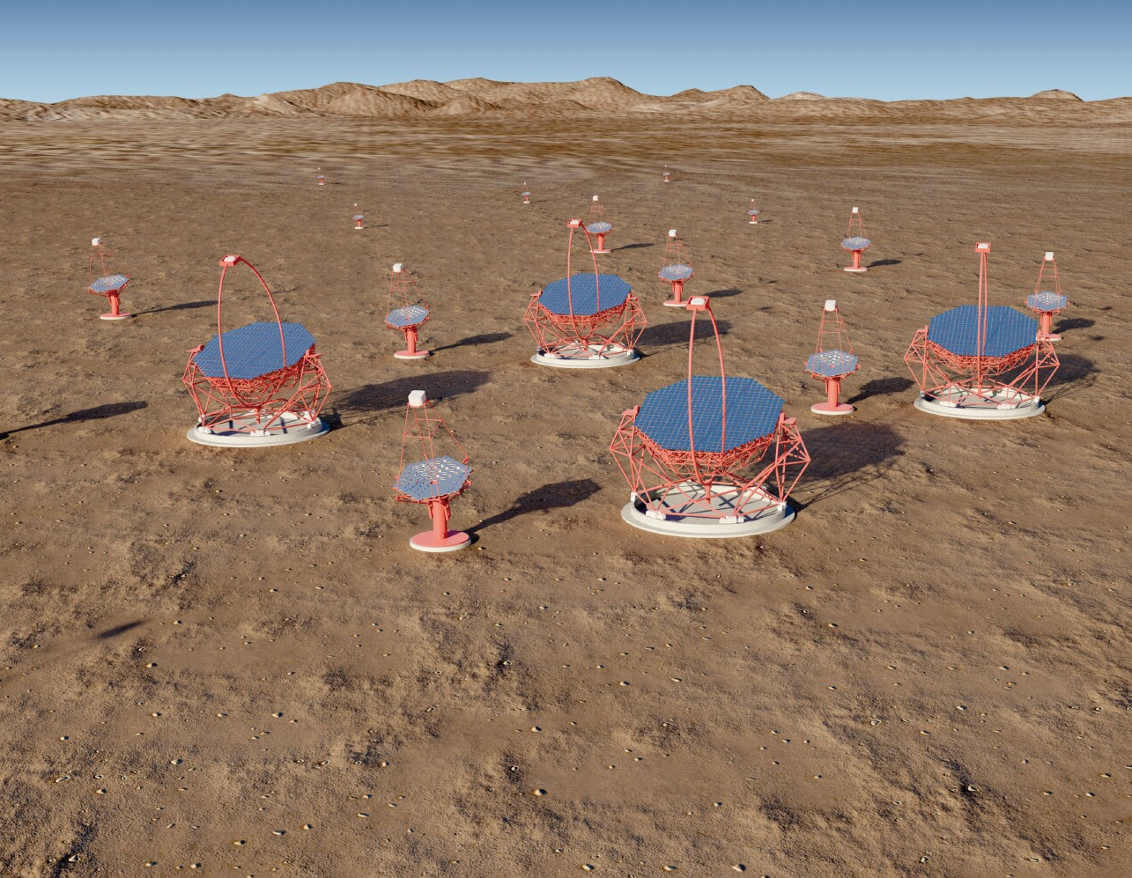
The Gamma-ray Cherenkov Telescope
Detecting HE γ-rays.
The CTA concept.
Schwarzschild-Couder optics – a dual mirror SST design.
Development of the GCT telescope.
Development of the GCT camera.
Installation of camera on telescope.
First tests of complete GCT.
Next steps.

Slide 2
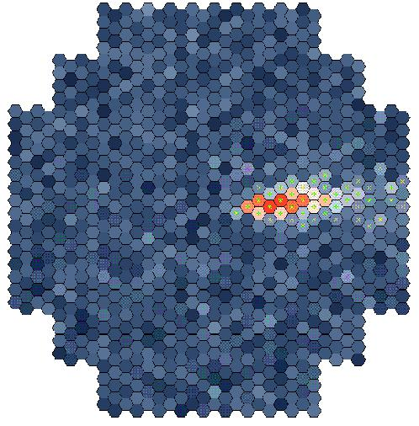
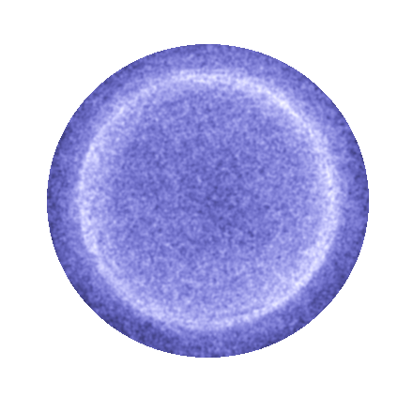
Detecting high energy γ rays
γ
e⁺
e⁻
Cherenkov light
emitted from e⁺e–
shower initiated by
photon.
Flash lasts ~ 10 ns.
Detect with “camera” made of high speed photosensors.
Primary γ ray
~ 10 km
×
~ 100 m
2

Slide 3
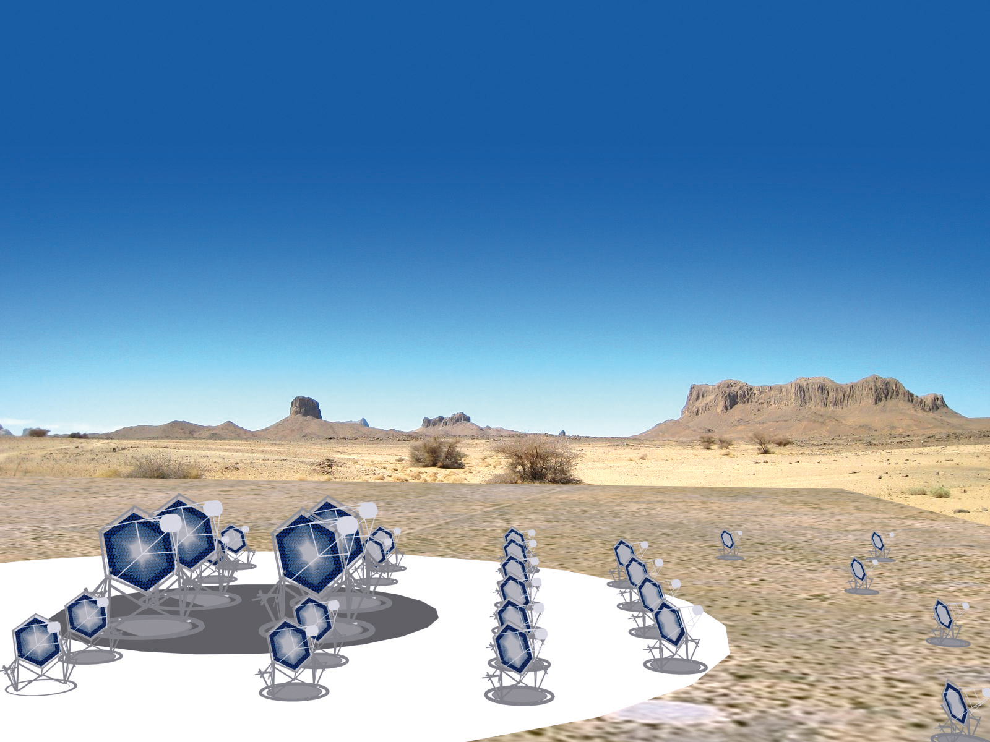
The Cherenkov Telescope Array concept
Low energy
Four 23 m telescopes
4…5º FoV
~2000 pixels
~ 0.1º
Medium energy
About twenty-five 12 m telescopes
6…8º FoV
~2000 pixels
~ 0.18º
High energy
About seventy 4 m telescopes
8…10º FoV
1000…2000 pixels
~ 0.17º…0.23º

Slide 4
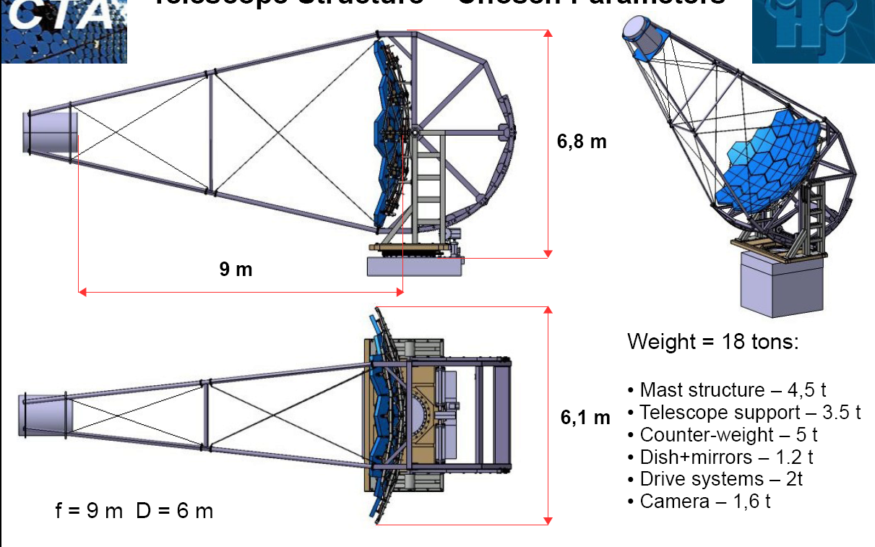
First SST designs
Davies-Cotton 7 m telescope designed for CTA.
This is a viable solution, but…
The camera:
  Has a diameter of about 1.6 m.
  Weighs about 2 tonnes.
  Is expensive, largely because of the price of the photomultiplier tubes.
Making it cheaper would allow the construction of more telescopes and hence improve CTA performance.
One way of doing this is to use a two mirror “Schwarzschild-Couder” optical design (GCT, ASTRI).
Second is Davies-Cotton design with SiPM based camera (SST-1M).
4

Slide 5
Schwarzschild-Couder telescopes
In 1905, Schwarzschild described a telescope with two concave mirrors, between which is the focal plane.
No spherical aberration or coma, but significant astigmatism, partly as focal surface assumed flat.
Schwarzschild better remembered for his 1916 solution to GR equations.
Couder (Paris Observatory) modified design in 1926, curved focal surface, largely curing astigmatism.
Figured mirrors in 1930s, but telescope never built. (Perhaps because 6 m long?)
The SC design languished in the pages of journals until Vassiliev realised it was ideally suited for the small focal
ratio and
large FoV
telescopes
needed γ-ray
astronomy…
…and later
Hinton
decided it
could also
be used for
the SSTs.
Built by ASTRI and GCT groups.
5

Slide 6
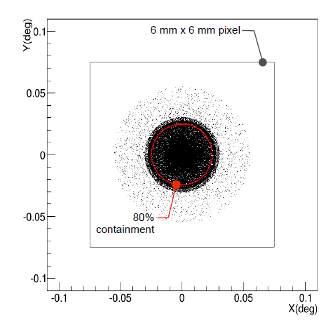
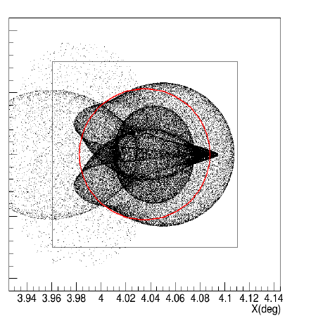
Dual mirror SST – GCT optics
Optical design (Schmoll).
F = 2.28 m, f = 0.57.
Images of point source at infinity:
For field angles below about 5°, over 80% of the light from a point source at infinity (or at 10 km with refocusing) is contained in a 6 × 6 mm² pixel.
δ = 0°
δ = 4°
3.56 m
6

Slide 7
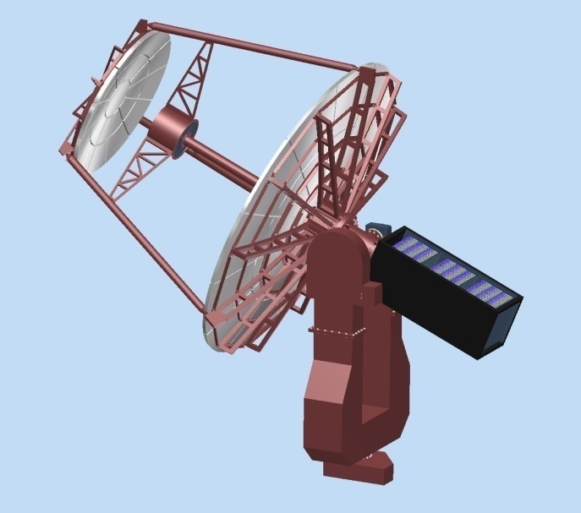
Development of the GCT structure
Durham 2011.
Long fork.
Central tube supports camera.
Tripod supports secondary mirror
Electronics in counterweight.
Aluminium structure.
Paris, 2012.
Short fork.
Primary dish
support
separated from
secondary
support.
Camera
attached to
secondary.
Shaped
counterweight.
Steel structure,
aluminium mirrors.
7

Slide 8
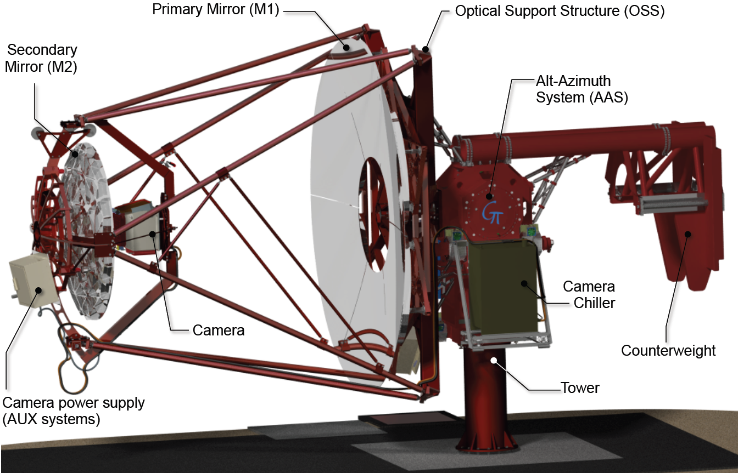
GCT mechanical design
Paris 2015.
Four masts to
support secondary.
Adjustable
counterweight.
Primary mirror rotation mechanism to facilitate mirror installation.
Camera removal mechanism which allows camera installation or removal in 15 minutes.
8

Slide 9
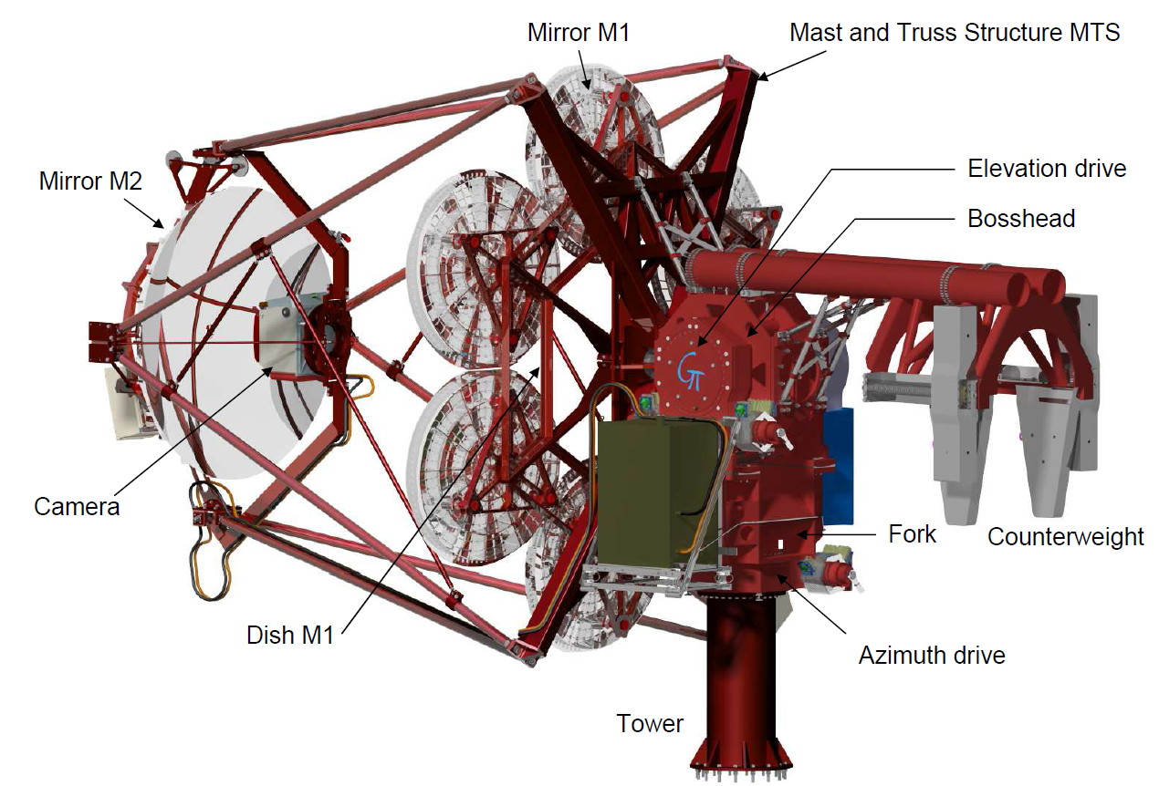
Mechanical design of GCT prototype
Petal shaped primary segments replaced by (approx.) circular segments to reduce costs.
Two primary segments machined polished and coated, remainder are dummy segments.
9

Slide 10
Camera design
TARGET Module
16 x Preamps
Target Asic
FPGA
UDP Data
64 Pixel Module
16 x Preamps
Target Asic
16 x Preamps
Target Asic
16 x Preamp
TARGET ASIC
Trigger
Backplane Board
Buffering and Serialisation
Backplane
x 32
Amplification and shaping
Digitisation and Trigger
Camera Trigger
64 Pixel Module
Goal – produce low cost camera
with full-waveform readout
Data
DACQ Boards
Timing Board
Peripherals (calibration, lid, etc)
Clock, Timestamps
Safety Boards
10

Slide 11
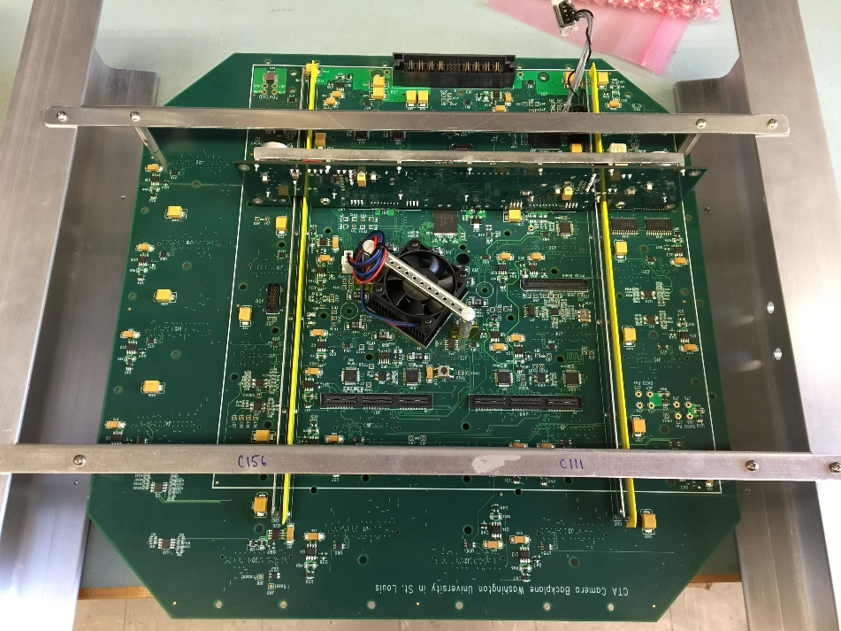
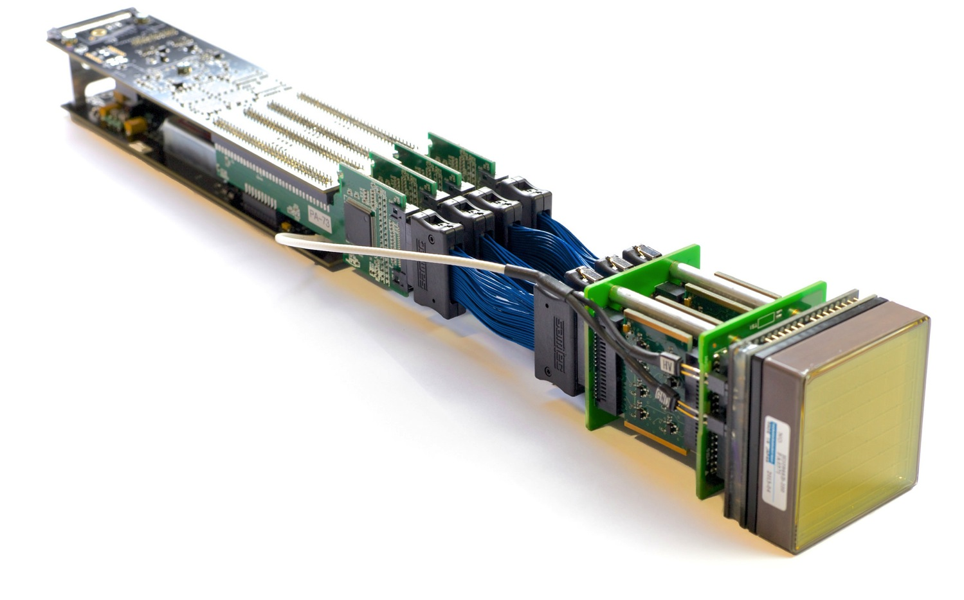
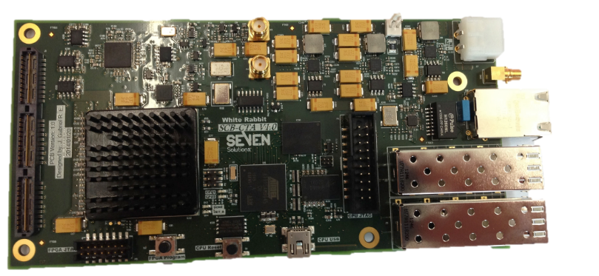
Development of the camera
Leicester 2012, start construction of camera with MAPMs – CHEC-M.
Electronics based around TARGET (Hawaii/SLAC and Erlangen).
DAQ using White Rabbit for timing (Amsterdam).
Backplane, common with SCT (Washington University).
Flashers (Durham) and Peripherals Board (Liverpool) complete camera.
11

Slide 12
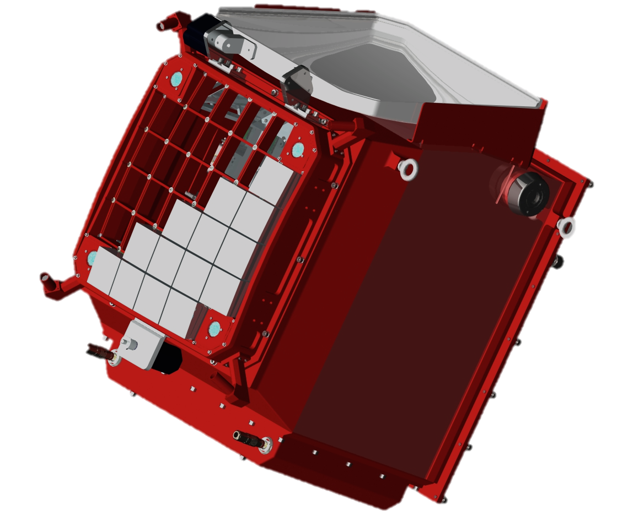
Development of the camera
Leicester 2015, CHEC-M complete.
Pointing LEDs
Lid
Lid motor
Photodetectors and front end electronics
Mounting eyelets
LED Flasher Units
Desiccator
Focal plane plate
Lid Locking Mechanism
Motor Bulk-head Connectors
Thermal Exchange Unit
Enclosure
12

Slide 13
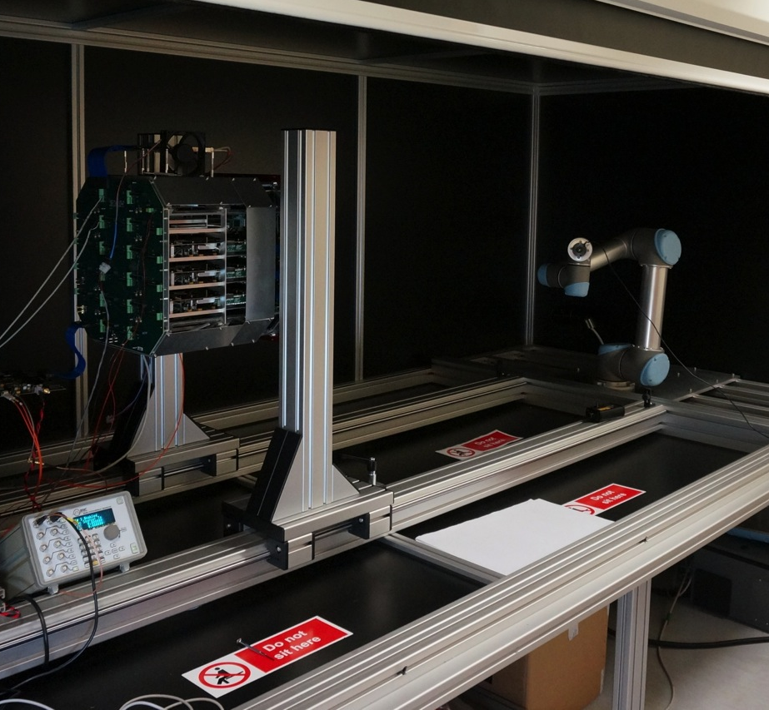
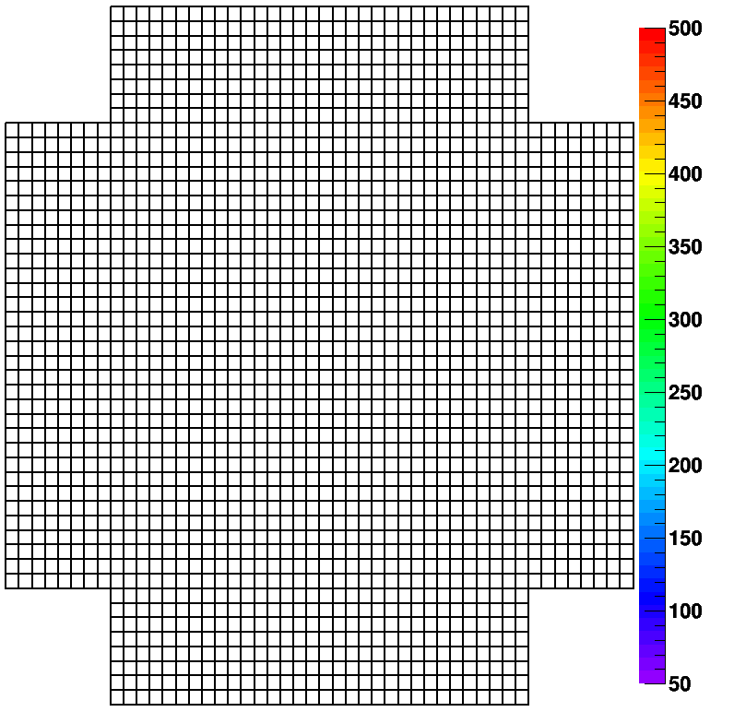
Camera tests
Camera in dark box with laser mounted on robot arm.
Lab. tests results (here with external trigger).
13

Slide 14
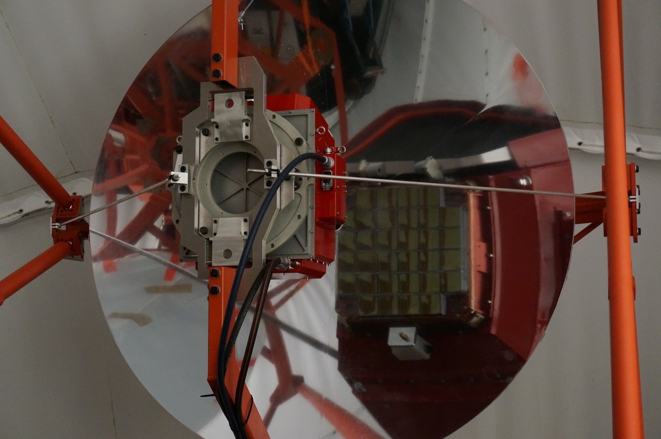
Installation of camera on telescope
Friday 13th November, camera arrives in Paris, performance checks carried out.
Camera mounted on telescope, Friday 20th November…
Check that
monitoring
functions,
e.g. TARGET
module
temperatures…
…and that MAPMs behaving
14

Slide 15
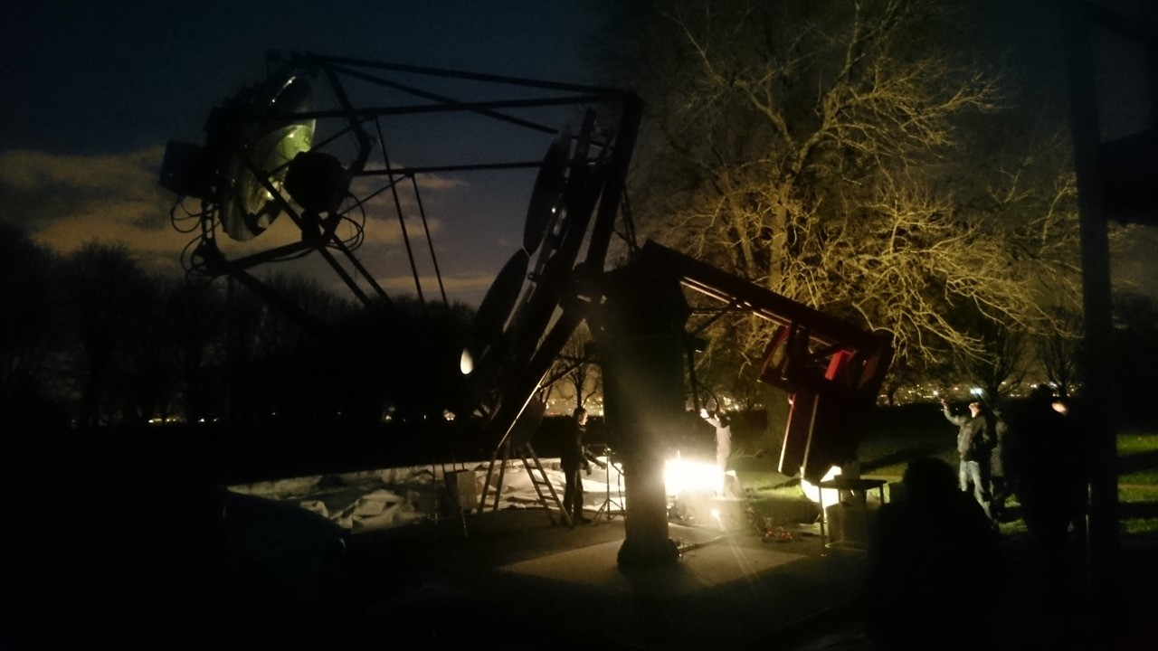
First tests of the GCT prototype on sky
Thursday 26th Nov, night sky background 20 to 100 times higher than CTA sites…

Slide 16
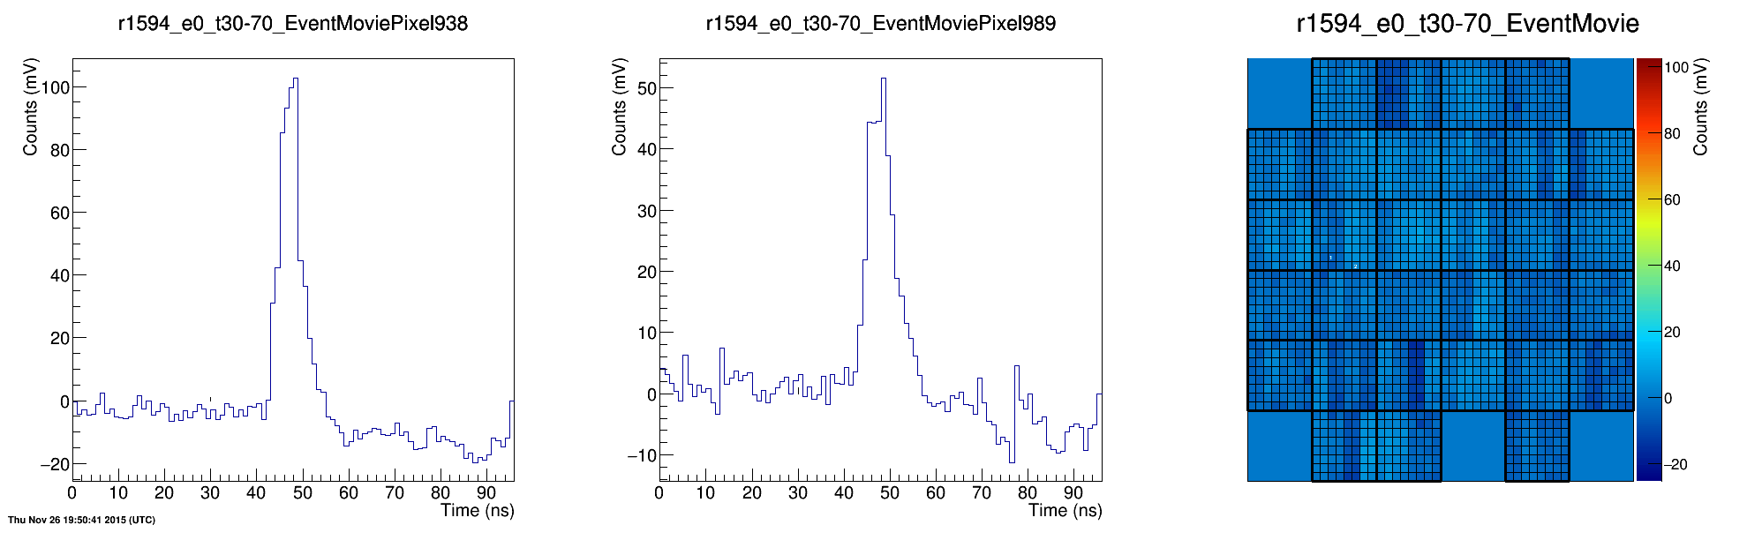
First tests of the GCT prototype on sky
…but successfully observed Cherenkov light from ~ 50 TeV showers.
16

Slide 17
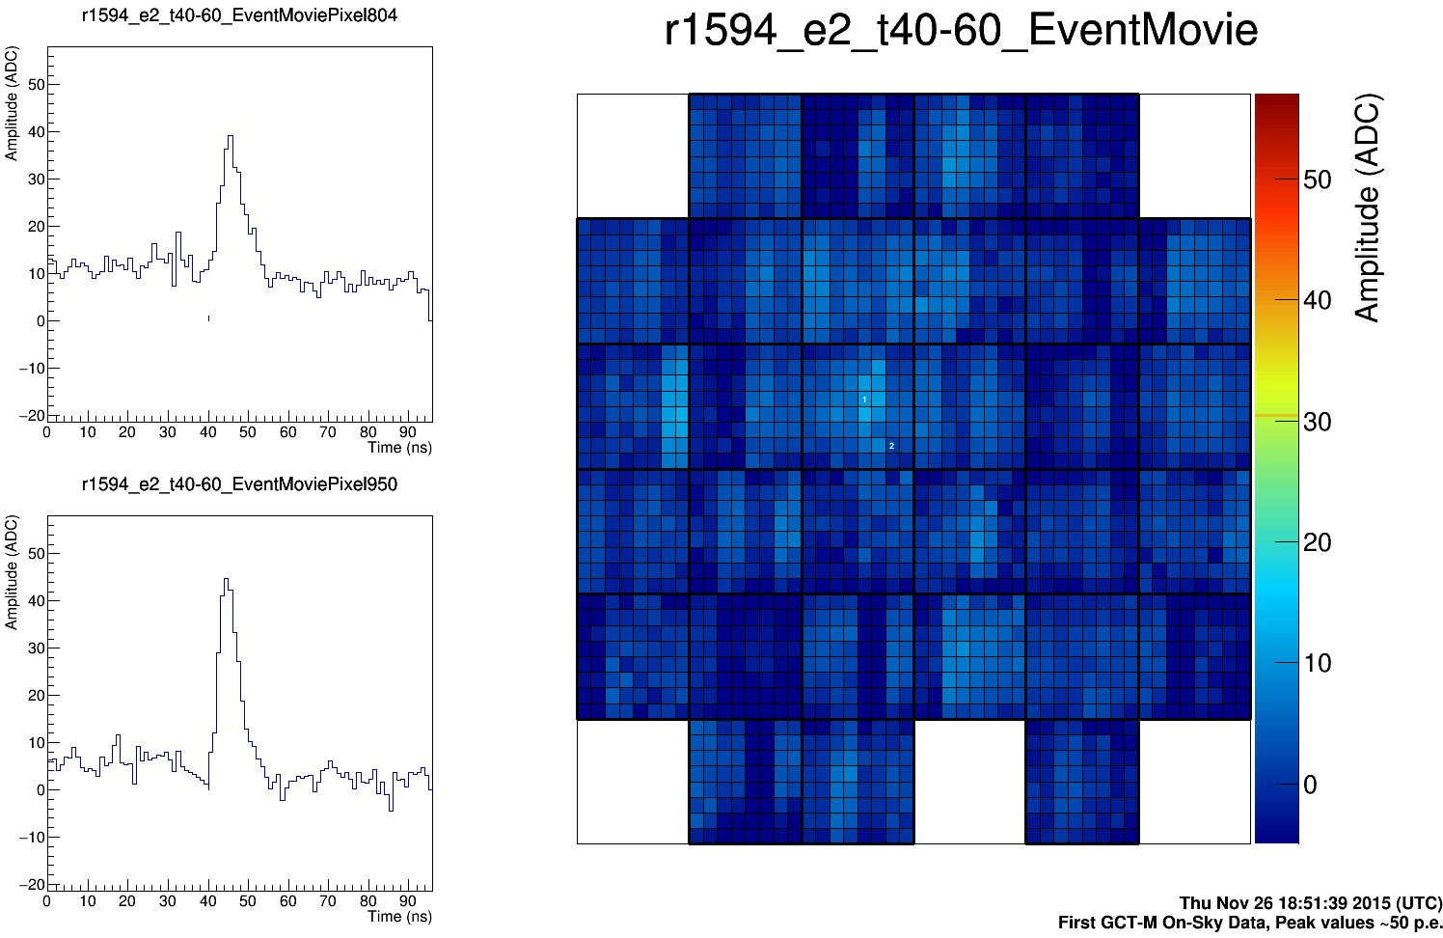
First tests of the GCT prototype on sky
Thursday 26th November.
17

Slide 18
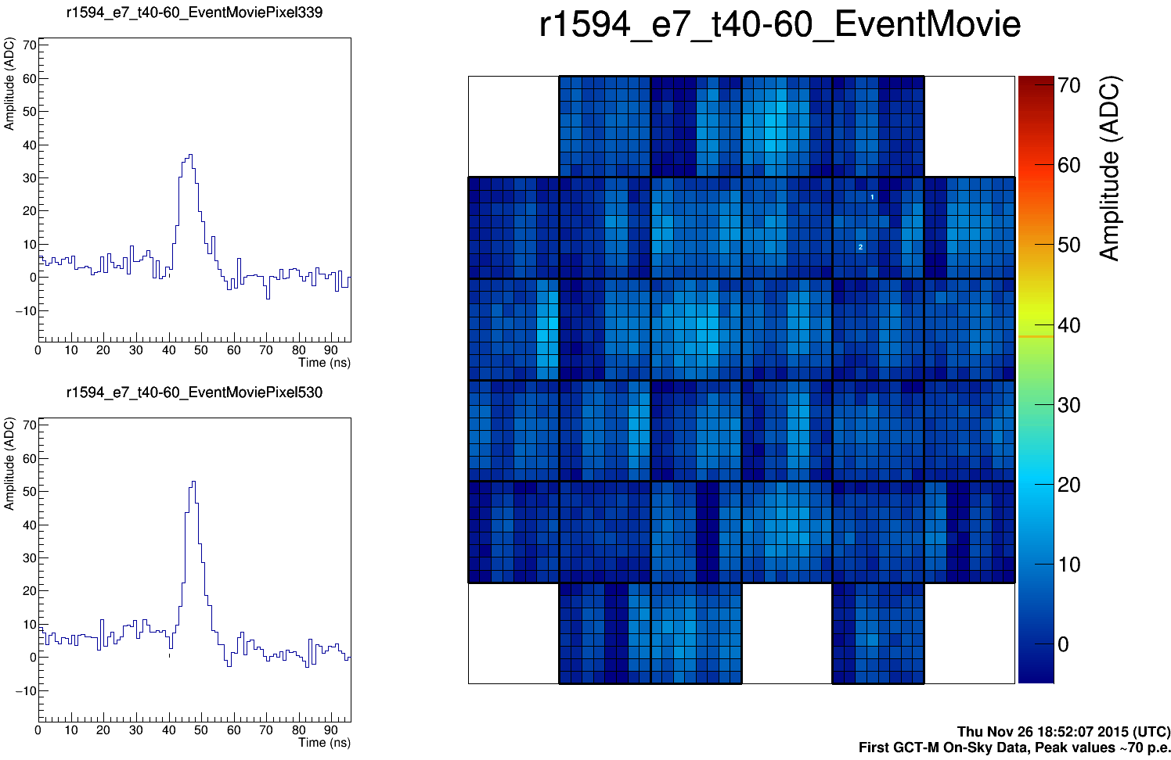
First tests of the GCT prototype on sky
Thursday 26th November.
18

Slide 19
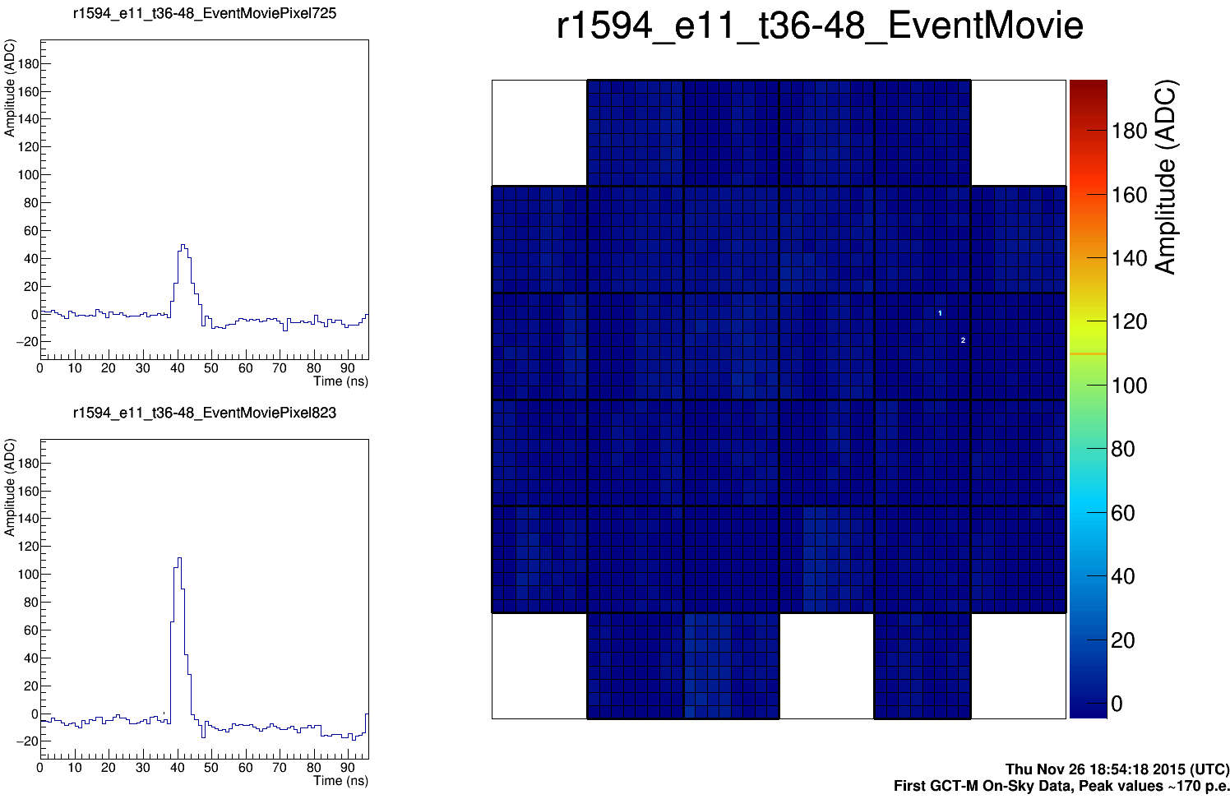
First tests of the GCT prototype on sky
Thursday 26th November.
19

Slide 20
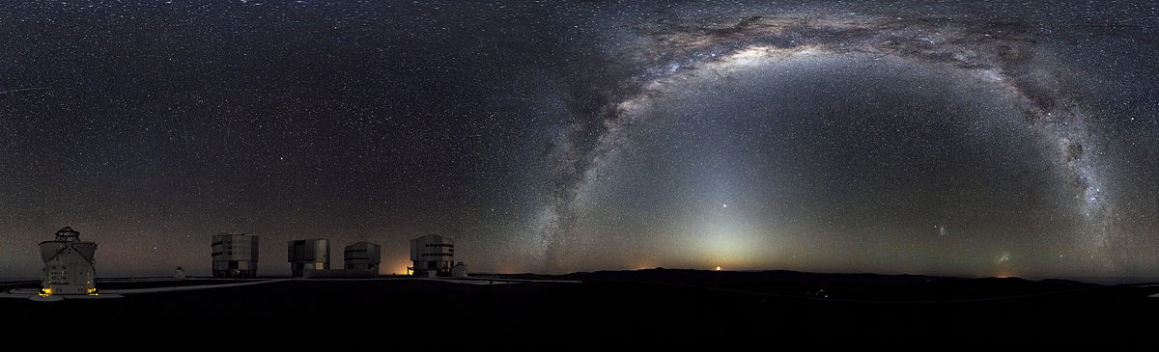
Next steps
Complete commissioning of GCT.
Test structure and MAPM camera.
Complete SiPM-based camera (CHEC-S), test in Lab and on GCT.
Finalise and review pre-production telescope and camera design.
Install three pre-production telescopes on Paranal site, 2016…2017.
Further test and review.
Construct further 32 production GCTs and spares, providing total of 35 GCTs to CTA Observatory.

Slide 21
Many thanks to the GCT team
Name | Institute | Name | Institute | Name | Institute
Abchiche, Abdelkader | DT-INSU | Graham, Jamie | Durham | Ross, Duncan | Leicester
Allan, David | Durham | Greenshaw, Tim | Liverpool | Rowell, Gavin | Adelaide
Amans, Jean-Philippe | GEPI | Hervet, Olivier | LUTH | Sato, Yuta | ISEE
Armstrong, Thomas | Durham | Hidaka, Naoya | ISEE | Sayède, Frédéric | GEPI
Balzer, Arnim | Amsterdam | Hinton, Jim | MPIK | Schmoll, Jürgen | Durham
Berge, David | Amsterdam | Huet, Jean-Michel | GEPI | Schoorlemmer, Harm | MPIK
Boisson, Catherine | LUTH | Jegouzo, Isabelle | GEPI | Servillat, Mathieu | LUTH
Bousquet, Jean-Jacques | GEPI | Jogler, Tobias | Erlangen | Sol, Helene | LUTH
Brown, Anthony | Durham | Kawashima, Takanori | ISEE | Stamatescu, Victor | Adelaide
Bryan, Mark | Amsterdam | Kraus, Manuel | Erlangen | Stephan, Maurice | Amsterdam
Buchholtz, Gilles | DT-INSU | Lapington, Jon | Leicester | Stuik, Remko | Leiden
Chadwick, Paula | Durham | Laporte, Philippe | GEPI | Sykes, Jon | Leicester
Costantini, Heide | CPPM | Lefaucheur, Julien | LUTH | Tajima, Hiroyasu | ISEE
Cotter, Garret | Oxford | Markoff, Sera | Amsterdam | Thornhill, Julian | Leicester
Daniel, Michael | Liverpool | Melse, Thierry | GEPI | Tibaldo, Luigi | MPIK
De Franco, Andrea | Oxford | Mohrmann, Lars | Erlangen | Trichard, Cyril | CPPM
De Frondat, Fatima | GEPI | Molyneux, Philippa | Leicester | Vink, Jacco | Amsterdam
Dournaux, Jean-Laurent | GEPI | Nolan, Sam | Durham | Watson, Jason | Oxford
Dumas, Delphine | GEPI | Okumura, Akira | ISEE; MPIK | White, Richard | MPIK
Fasola, Gilles | GEPI | Osborne, Julian | Leicester | Yamane, Nobuhito | ISEE
Funk, Stefan | Erlangen | Parsons, Dan | MPIK | Zech, Andreas | LUTH
Gironnet, Johann | DT-INSU; GEPI | Rosen, Simon | Leicester | Zink, Adrian | Erlangen
(Total of 66 authors, 14 institutes and 7 countries.)
22

